Slide 1
FRAGMENTATION
By Bikal Thapa

Slide 2
Fragmentation
Process of being broken in parts.
Occurs when free memory blocks in a computer’s RAM become scattered.
There are mainly two types of fragmentation they are Internal and External.

Slide 3
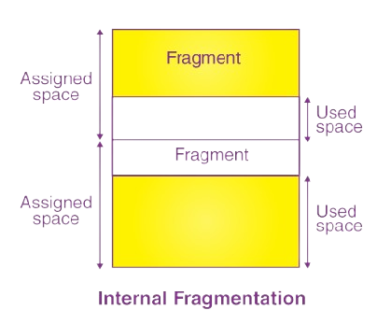
Internal Fragmentation
Occurs when fixed sized memory blocks are allocated.
Unused memory inside allocated blocks is wasted.
For Example : A program needs 100 MB of memory, but the system allocates 128 MB. The remaining 28 MB is not used, leading to internal fragmentation.

Slide 4
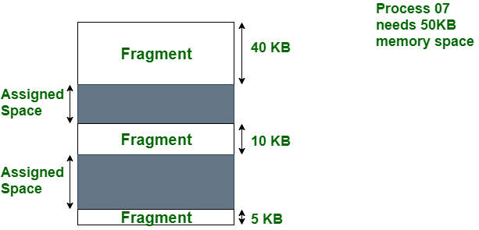
External Fragmentation
It occurs when free memory is separated into small blocks.
Even though total free memory is sufficient, allocation requests for large contiguous block may fail due to fragmentation
Suppose a system has 1 GB of free memory, but it’s spread across 100 small blocks. A process that needs 500 MB of memory may fail to get it because no single block is large enough, even though total free memory is available.

Slide 5
Thank You

