Slide 1
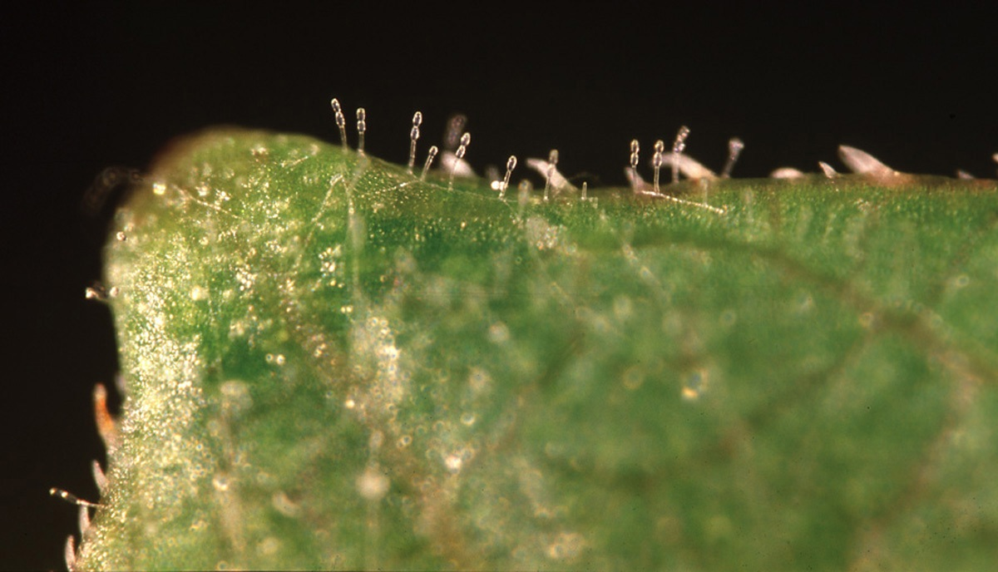
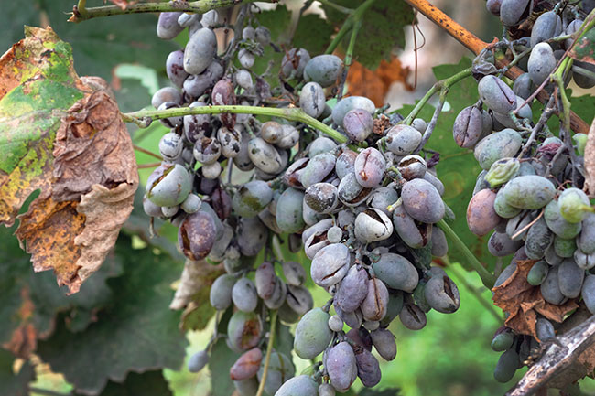
Powdery Mildew of Grapes
Inoculation, Infection, and Pathogen Multiplication Cycle
Caused by *Erysiphe necator*

Slide 2
Introduction
• Major fungal disease of grapevines
• Caused by Erysiphe necator (obligate biotroph)
• Affects leaves, shoots, and berries
• Prefers warm, dry days and humid nights

Slide 3
Overview of Disease Cycle
1. Overwintering
2. Primary Inoculum
3. Inoculation
4. Infection
5. Colonization
6. Sporulation
7. Secondary Spread
8. Overwintering

Slide 4
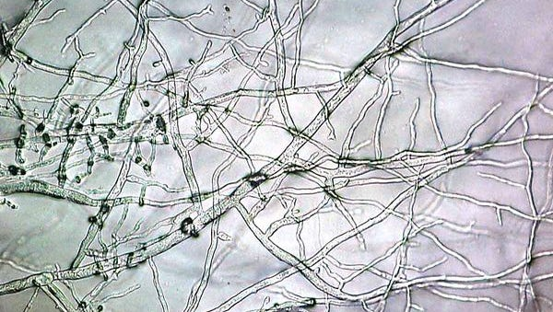
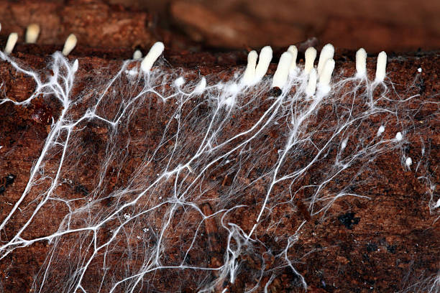
Overwintering (Survival Phase)
• Survives as cleistothecia on bark or fallen leaves
• Mycelium can survive in dormant buds
• Becomes active in spring

Slide 5
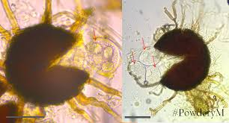
Primary Inoculum Release
• Ascospores released from cleistothecia
• Wet spring conditions trigger release
• Wind-dispersed to young grape tissues

Slide 6
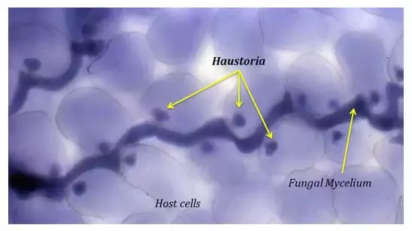
Inoculation
• Spores land on host tissue (leaves, shoots)
• Germinate under high humidity (60–90%)
• Do not require free water

Slide 7
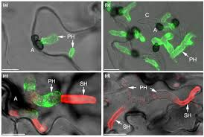
Infection
• Germ tube penetrates epidermal cells
• Forms haustoria for nutrient uptake
• Colonization remains superficial

Slide 8
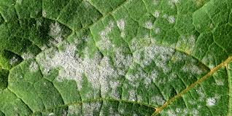
Pathogen Multiplication
• Mycelium spreads across surface
• Produces large numbers of conidia
• Conidia serve as secondary inoculum
• Several infection cycles in one season

Slide 9
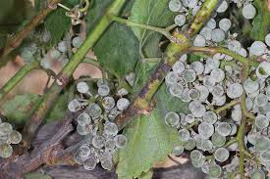
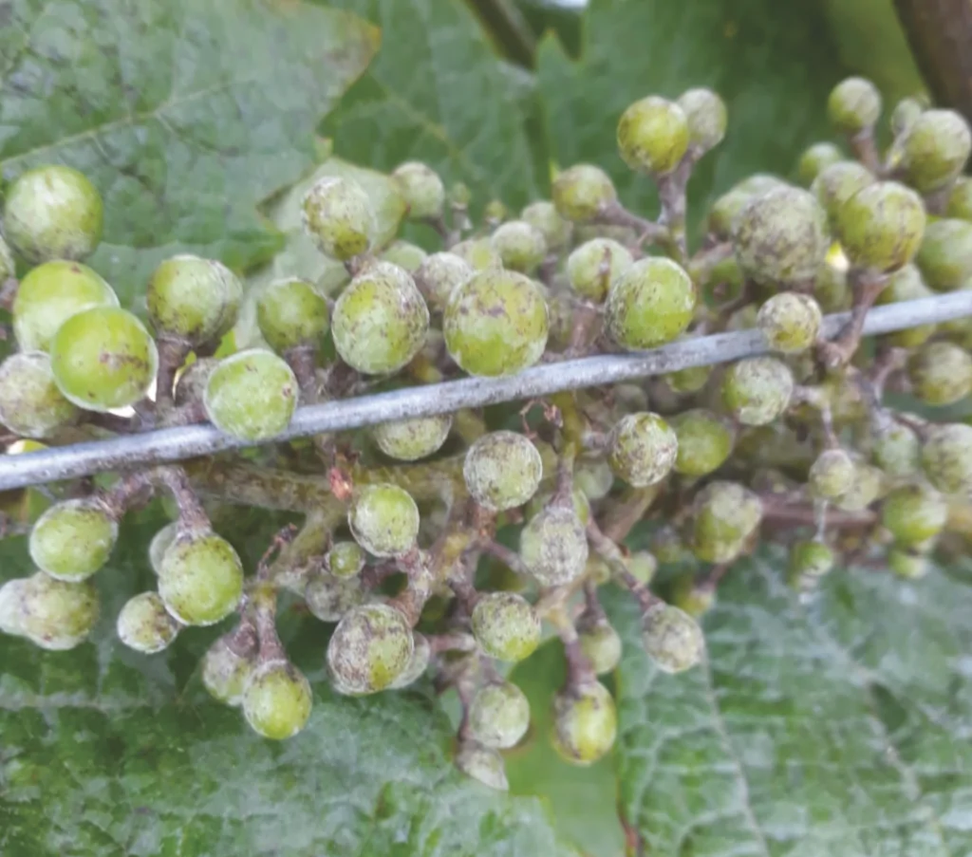
Colonization & Symptom Development
• White powdery growth on leaves, berries
• Leaf curling, shoot stunting, berry scarring
• Reduces photosynthesis and fruit quality

Slide 10
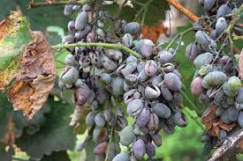
Secondary Spread
• Wind-dispersed conidia infect new tissues
• Multiple cycles during growing season
• Epidemics occur under ideal conditions

Slide 11
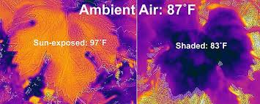
Environmental Conditions
• Optimal temperature: 20–27°C
• High relative humidity
• Dry leaf surfaces (no rain needed)

Slide 12
Summary
• Polycyclic disease with fast spread

Slide 13
References
• Agrios, G.N. (2005). Plant Pathology
• Pearson & Goheen (1988). Compendium of Grape Diseases

