Slide 1
Introduction to Other Plant Pathogens
Understanding major categories of plant pathogens beyond fungi

Slide 2
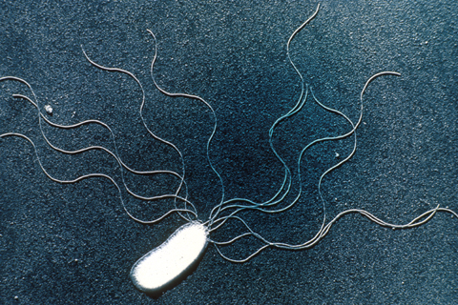
Bacterial Pathogens
• Single-celled prokaryotes causing diseases like wilts, blights, and leaf spots.
• Examples: Xanthomonas, Pseudomonas, Erwinia.

Slide 3
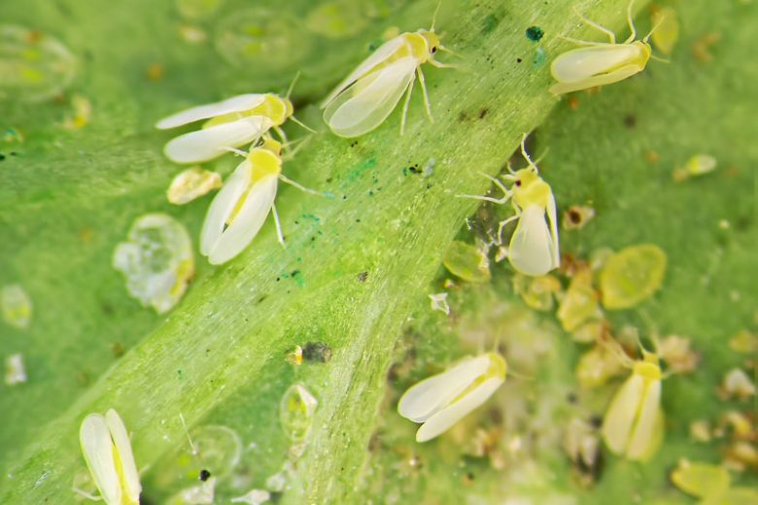
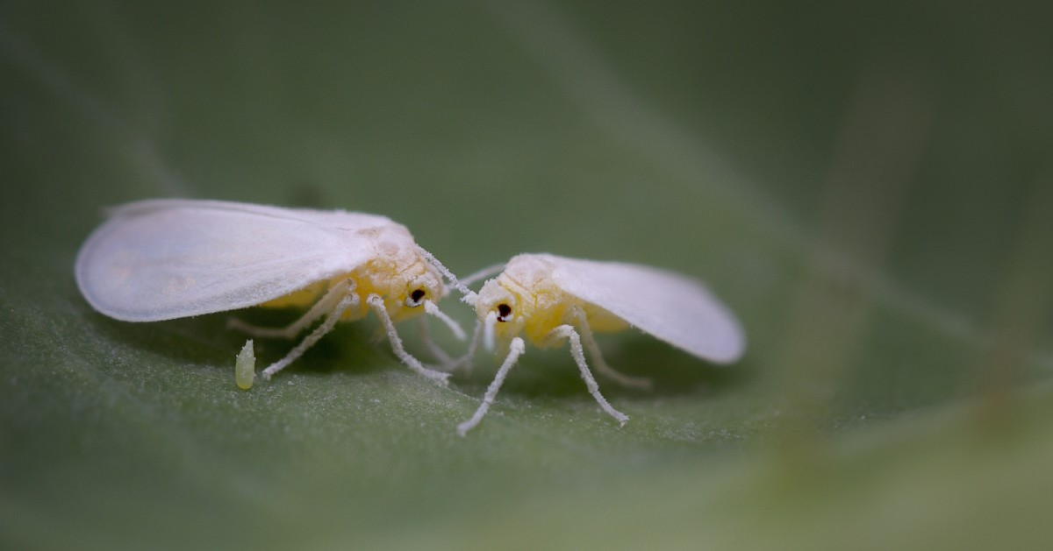
Viral Pathogens
• Cause mosaic, yellowing, and stunting symptoms.
• Spread by insect vectors (aphids, whiteflies).
• Examples: TMV, CMV, Tomato yellow leaf curl virus.

Slide 4
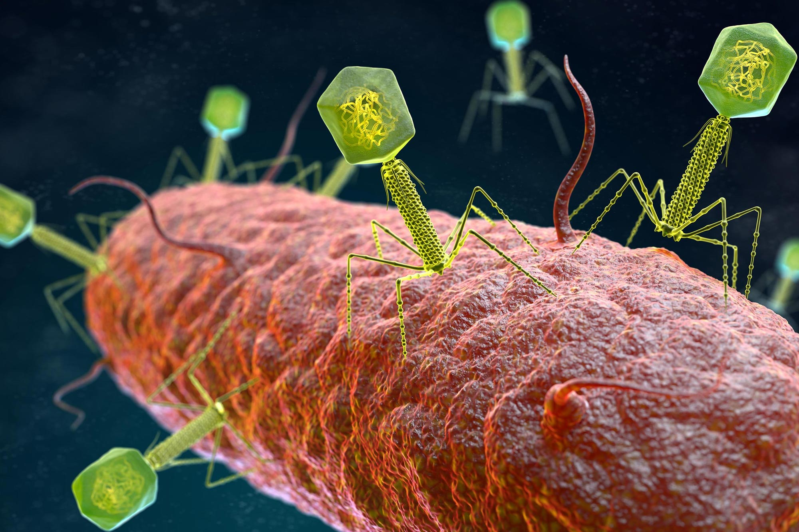

Slide 5
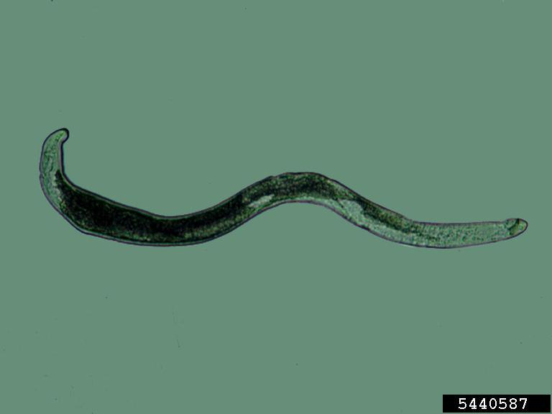
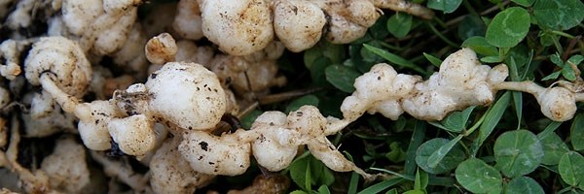
Nematode Pathogens
• Microscopic roundworms attacking roots, stems, and leaves.
• Examples: Root-knot nematode (Meloidogyne spp.), Cyst nematodes.

Slide 6
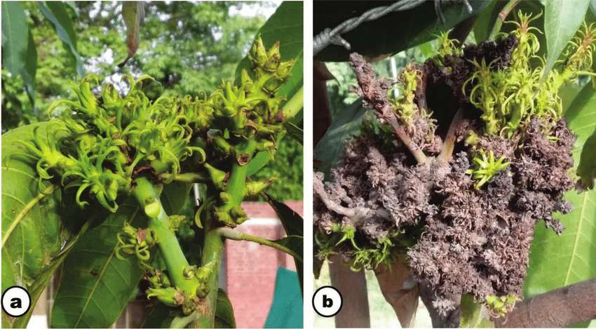
Phytoplasmas and Spiroplasmas
• Cause yellowing, phyllody, and witches' broom symptoms.
• Examples: Aster yellows phytoplasma.

Slide 7
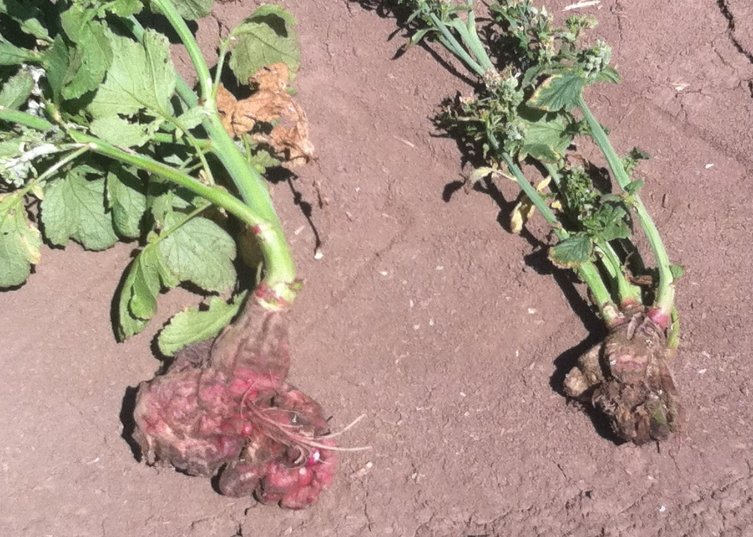
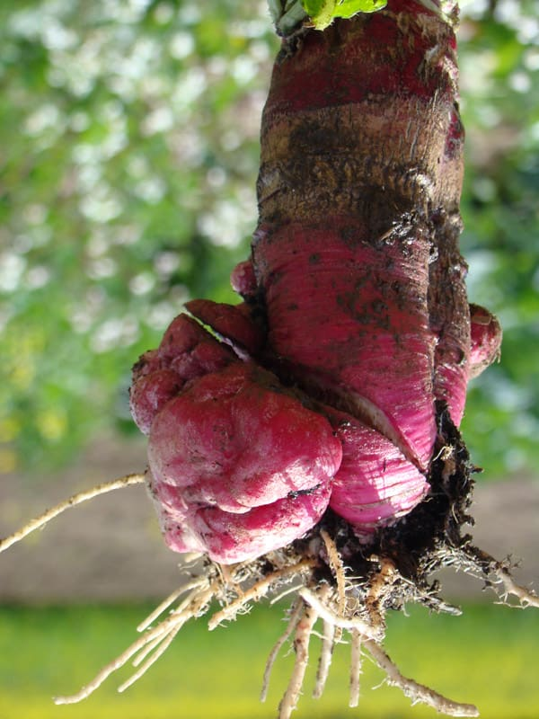
Protozoan and Algal Pathogens
(Plasmodiophora brassicae – clubroot).
Example algal pathogen: Cephaleuros (causes algal leaf spot).

Slide 8
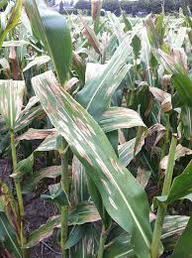
Summary
• Each group has unique biology, symptoms, and management strategies.

