Slide 1
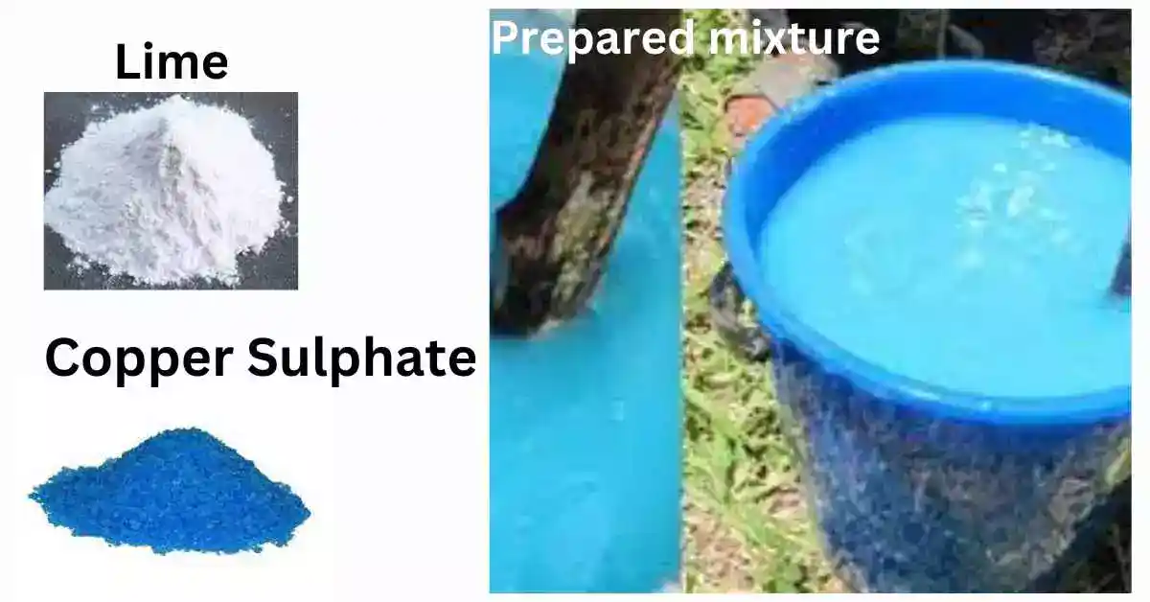

Slide 2

Preparation of Bordeaux Mixture
An effective fungicide made from copper sulfate and lime

Slide 3
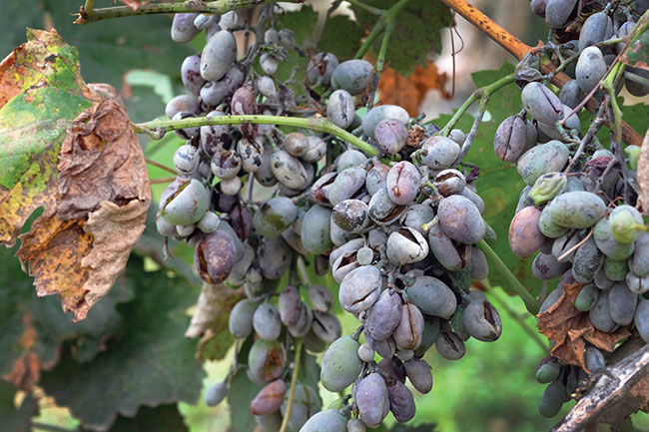
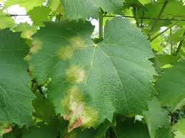
What is Bordeaux Mixture?
• A fungicide made from copper sulfate and lime,
Pierre-Marie-Alexis Millardet, University of Bordeaux.
1882–1885 AD
• Developed in France in the 19th century
• Controls fungal diseases like blights and mildews

Slide 4
Ingredients for Bordeaux Mixture
• Copper Sulfate – 1 kg
• Quicklime – 1 kg
• Water – 100 liters
• For 1% Bordeaux mixture
Materials req: Basket, blue litmus paper, gloves, googles, weighing machine, stirring rod, apron

Slide 5
Equipment Required
• Two plastic or wooden buckets (not metal)
• Wooden stick for stirring
• Muslin cloth or strainer
• pH paper or litmus paper

Slide 6
Step-by-Step Process (1% Bordeaux Mixture)
1. Dissolve 1 kg copper sulfate in 50 liters of water
2. Slake 1 kg lime in 50 liters of water in another container
3. Slowly add copper sulfate solution to lime solution
4. Stir continuously during mixing

Slide 7
Precautions During Mixing
• Never use metal containers
• Always add copper sulfate to lime
• Check pH – should be around 7
• Use immediately after preparation

Slide 8
Lime Test to Ensure Safety
• Dip a clean knife blade or iron nail in the mixture
• Reddish deposit = acidic (add more lime)
• No deposit = safe to spray

Slide 9
Uses of Bordeaux Mixture
• Controls Downy mildew, Blights, Anthracnose
• Effective on grapes, tomatoes, potatoes, mangoes, citrus, lawn

Slide 10
Environmental and Safety Tips
• Wear gloves and protective gear
• Avoid spraying during rain
• Wash hands and tools after use
• Do not store the mixture

Slide 11
Summary
• Bordeaux mixture = CuSO₄ + Lime + Water
• Follow correct sequence and precautions
• Time-tested, effective fungicide
within 24 hours

