Slide 1
Insect Metamorphosis
Understanding Complete, Incomplete, and No Metamorphosis

Slide 2
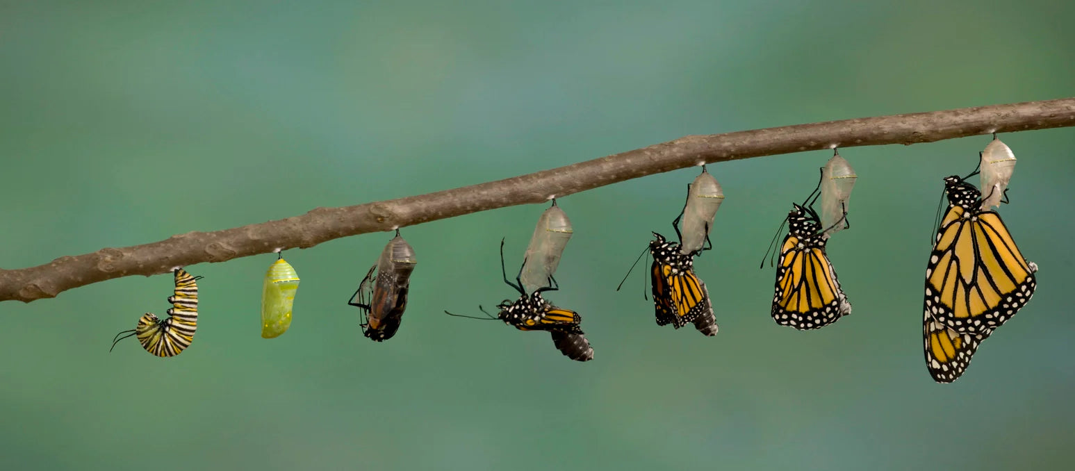
What is Insect Metamorphosis?
Insects undergo a biological transformation from egg to adult.
Three types:

Slide 3
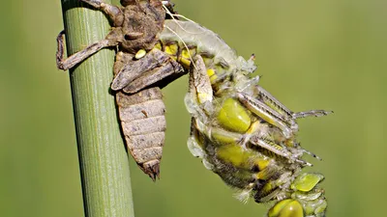
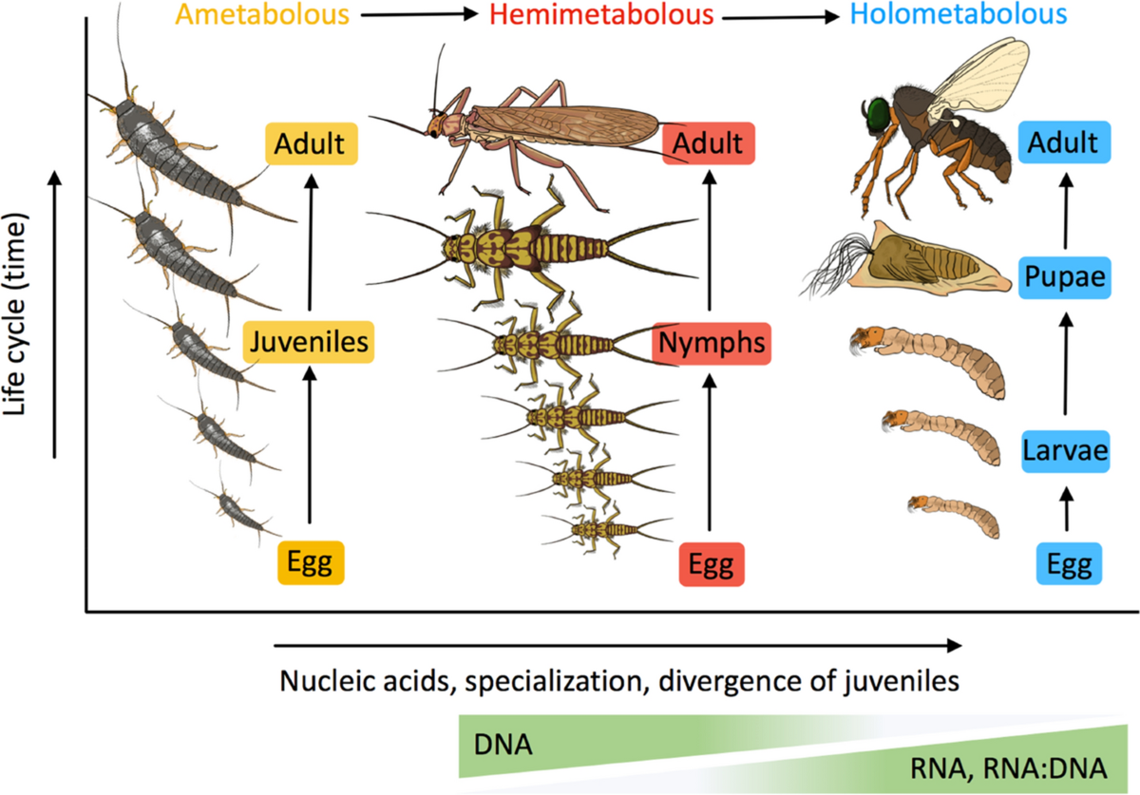

Slide 4
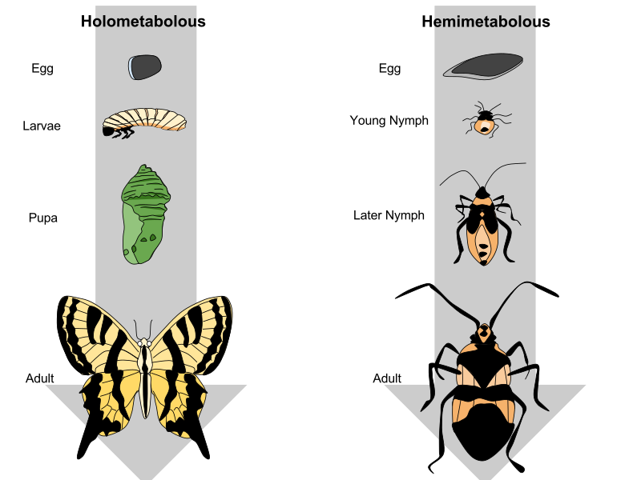

Slide 5
Types of metamorphosis
Complete Metamorphosis(Holometabolism)
-Incomplete Metamorphosis(Hemimetabolism)
-No Metamorphosis(Ametabolism)

Slide 6
Complete Metamorphosis (Holometabolism)
Stages: Egg → Larva → Pupa → Adult
Larva looks and behaves differently than adult
Pupa: Transformative resting stage
Examples: Butterfly, beetles, bees, flies
80–85% of insect species

Slide 7
Incomplete Metamorphosis (Hemimetabolism)
Stages: Egg → Nymph → Adult
Nymphs resemble adults but are smaller and wingless
No pupal stage; transformation is gradual
Examples: Grasshoppers, dragonflies, cockroaches
10–15% of insect species

Slide 8
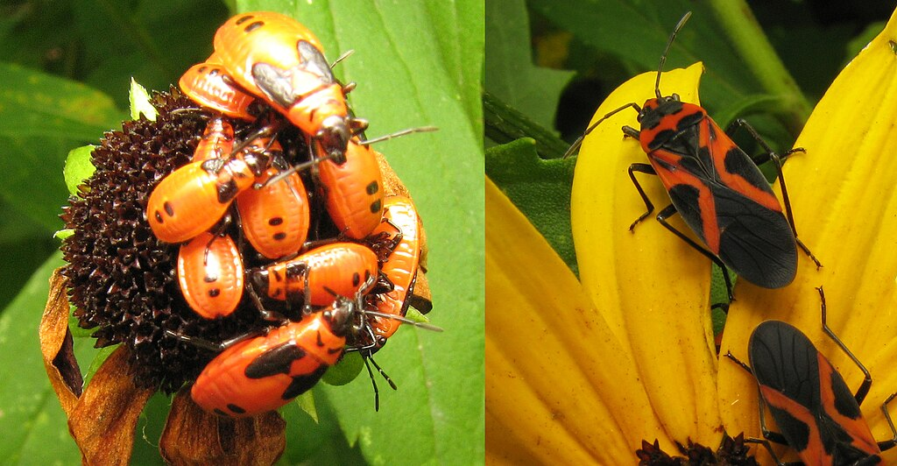

Slide 9
Ametabolism (No Metamorphosis)
Primitive insects with no dramatic transformation
Juveniles look like smaller adults
Grow only through molting
Examples: Silverfish, firebrats, and bristletails.
<1% of insect species

Slide 10
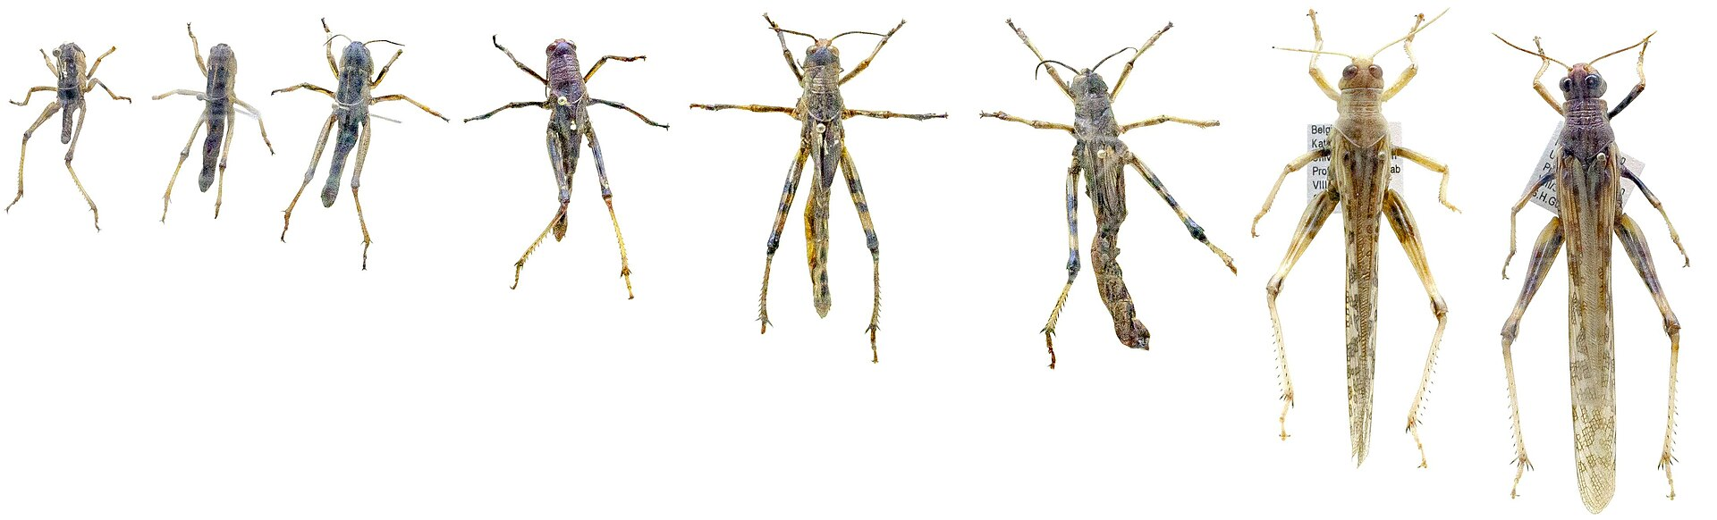

Slide 11
Life Cycle Stages Overview
Common stages:
1. Egg – Laid by adult, hatches into larva/nymph/juvenile
2. Larva or Nymph – Feeding and growth stages
3. Pupa – Transformation (in complete only)
4. Adult – Reproductive stage

Slide 12
Key Differences Between Types
Complete: 4 stages (incl. pupa), drastic change, e.g., butterfly
Incomplete: 3 stages (no pupa), gradual change, e.g., grasshopper
Ametabolism: 2 stages, minimal change, e.g., silverfish

Slide 13
Environmental & Ecological Insights
Development influenced by temperature, humidity, and food
Different diets/habitats between life stages reduce competition
Examples:
- Caterpillar eats leaves; butterfly sips nectar
- Dragonfly nymphs hunt underwater; adults fly and prey

Slide 14
Visual Comparison: Complete vs. Incomplete
Left: Complete – Egg → Larva → Pupa → Adult (Butterfly)
Right: Incomplete – Egg → Nymph → Adult (Grasshopper)

Slide 15
Summary
Metamorphosis is essential to insect development
Types:
- Complete: Drastic change
- Incomplete: Gradual change
- Ametabolism: No change
Understanding metamorphosis is vital for pest control and ecology

Slide 16
Questions?
Thank you!
Let me know if you'd like more details or examples!

