Slide 1
Lesson 2: Plant Disease
Plant Protection: Grade 9
Sub-topic: Meaning of Disease and its Symptoms

Slide 2
Meaning of Plant Disease
Plant disease is defined as dysfunction or abnormal growth in a plant.
It results from a disturbance in the normal life process of the plant.
Types of Plant Disease:
- Biotic: Caused by living organisms (e.g., fungi, bacteria, viruses).
- Abiotic: Caused by non-living factors (e.g., water, temperature, nutrients).

Slide 3
Common Symptoms of Plant Diseases
1. Blights
2. Galls
3. Cankers
4. Leaf Spots
5. Leaf Curl
6. Mildews
7. Rots
8. Rusts
9. Wilts

Slide 4
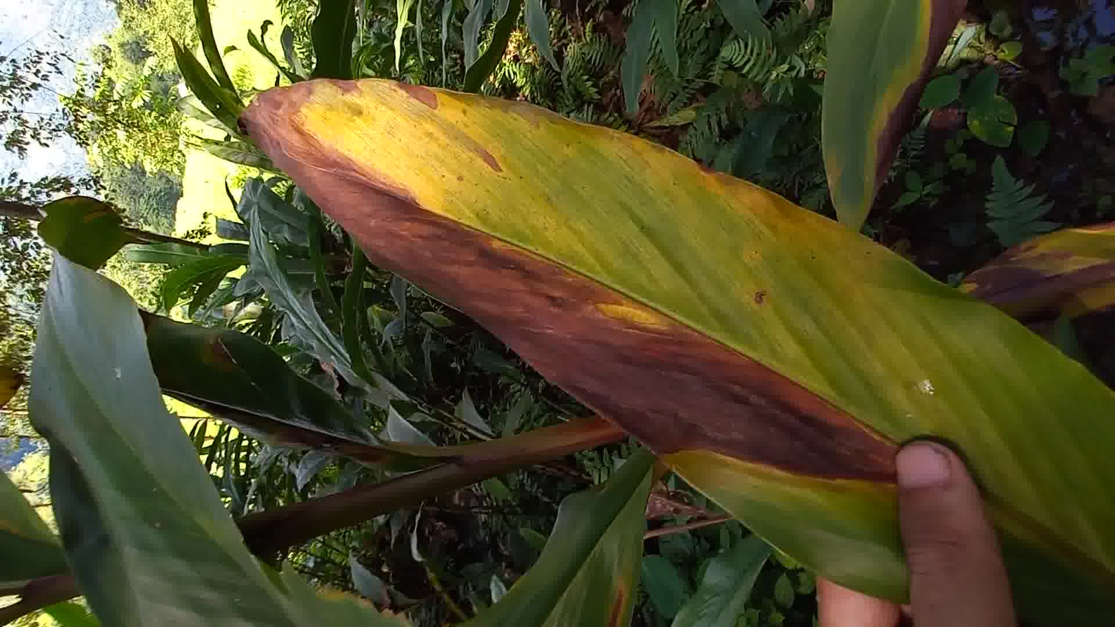
Blights
Sudden wilting, withering, and death of leaves, flowers, stems, and branches.
Caused by fungi (e.g., Botrytis, early and late blight) or bacteria (fire blight).

Slide 5
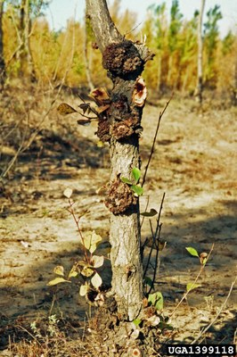
Galls
Swollen or overgrown patches of leaf or stem tissue.
Caused by fungi (leaf gall), bacteria (crown gall), or insects (gall wasps).

Slide 6
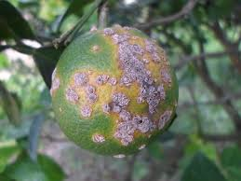
Cankers
Dead, sunken patches on stems and branches that may ooze foul-smelling material.
Caused by fungi (Cytospora canker) or bacteria (fire blight).

Slide 7
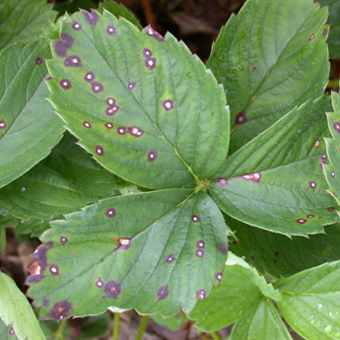
Leaf Spots
Rounded or irregular colored spots on leaves.
Examples include Cercospora leaf spot in chilli and leaf spot in beans.

Slide 8
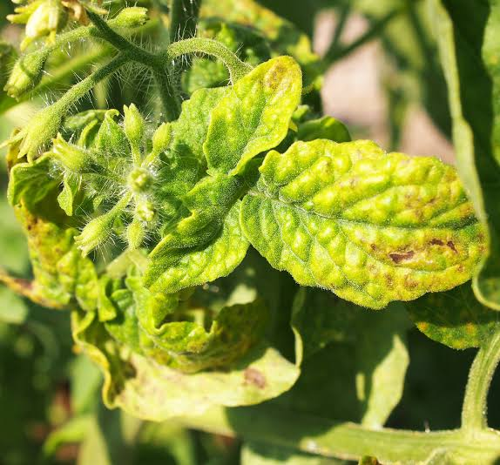
Leaf Curl
Deformed and discolored leaves.
Caused by fungi (e.g., peach leaf curl) or viruses.

Slide 9
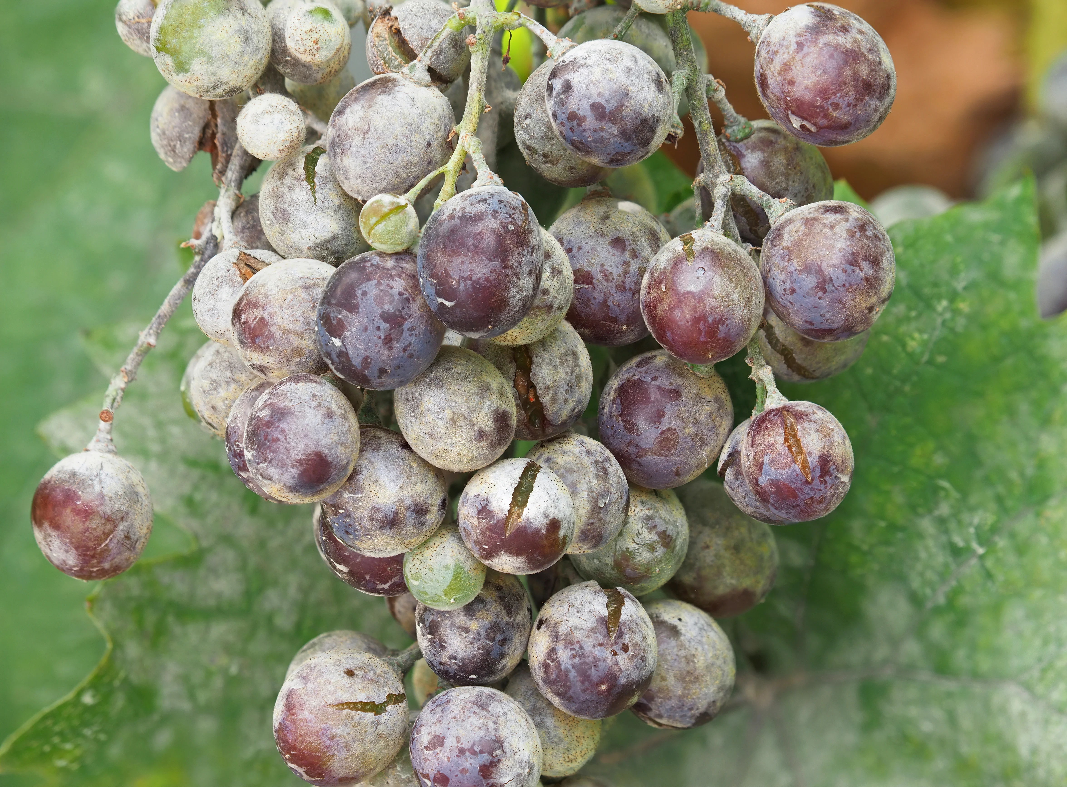
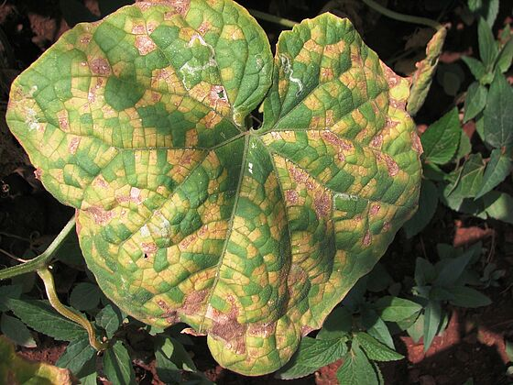
Mildews
Dusty white, gray, or purplish patches on leaves.
Caused by fungal powdery and downy mildews.

Slide 10
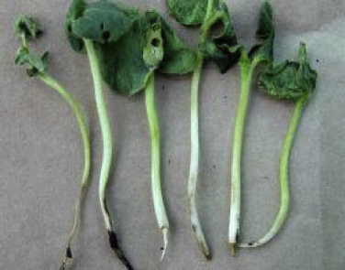
Rots
Soft, discolored, and dying plant tissue.
Affects fruits, stems, flowers, or roots.
Caused by fungi and bacteria.

Slide 11
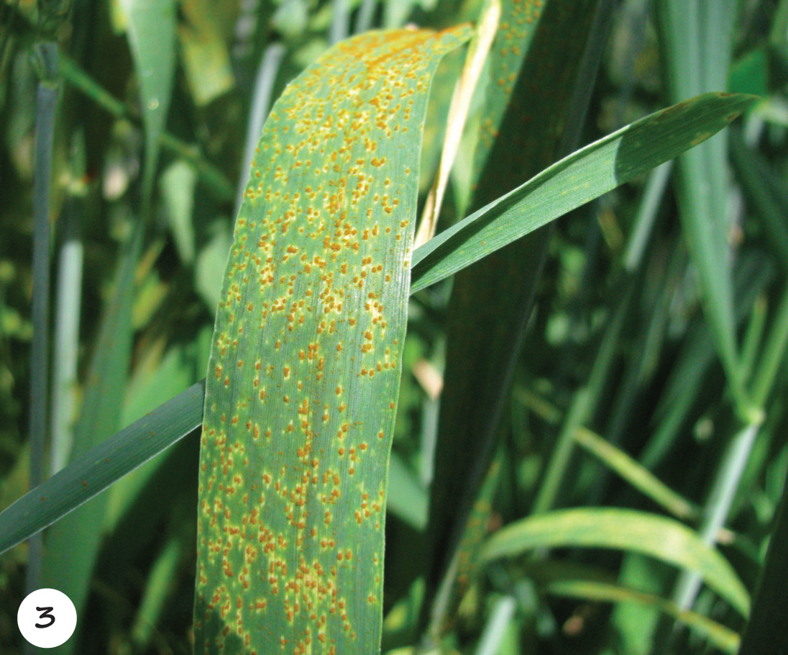
Rusts
Orange or yellow spots, galls, or coatings on leaves, stems, fruits, or flowers.
Caused by fungi.

Slide 12
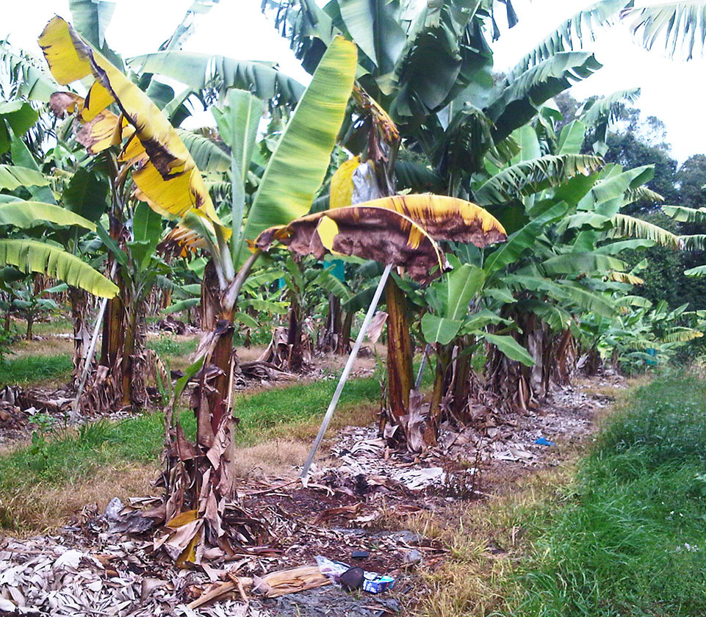
Wilts
Drooping of leaves and stems.
Caused by improper watering or fungi (Fusarium, Verticillium) and bacteria.

