Slide 1
ARTICLE RECOMMENDATION SYSTEM
Submitted by:
Anil Poudel(C0900334)
Anil Shrestha(C0899934)
Aruna Gurung (C0896129)
Bhawana Pathak (C0899371)
Gupta Bhandari(C0899873)
Sabuz Rana(C0899377)
Suresh Mahat(C0900890)

Slide 2
Work distribution
Data Acquisition
Exploratory Data Analysis
Data Visualization
Feature Engineering and Data Pre-processing
System building and Testing

Slide 3
Project goal
This project aims to build a recommendation system for Medium articles using Non-negative Factorization technique.

Slide 4
Data acquisition
Introduction to Dataset
Source: Kaggle
Type of Data: Information about articles published on Medium.
Dataset Size: 1.30 GB

Slide 5
Motivation to choose the dataset
According to some insightful blogging statistics, 77% of internet users regularly read online blog posts and articles. Keeping this stat in mind, we chose this dataset that provides valuable insights on online articles. After the analysis of the dataset we will be able to recommend specific articles to a group of people who are into reading similar type of articles.

Slide 6
Exploring the dataset
The Medium dataset is a valuable resource for people interested in reading articles online.
The dataset has a size of 1.30 GB providing substantial information about article title, publication, published date, number of likes, number of reads, reading time, and so forth.
By exploring this dataset, we will be able to recommend a list of articles to the readers depending on their current read.

Slide 7
Workflow of the project
EDA and Data visualization
Feature Engineering and Data Pre-Processing
Recommending System Building
Testing the system

Slide 8
Exploratory Data analysis
For data analysis, we used Pandas.
Pandas is a fast, powerful, and easy to use open source tool used for data analysis and manipulation.
Why Pandas?
We chose Pandas because of its ability to handle missing values and a variety of data types.
It seamlessly integrates with other libraries (Matplotlib, NumPy, etc) to perform comprehensive data exploration.

Slide 9
Data visualization
Technologies Used:
Matplotlib: It is a python library used for creating various types of visualizations.
Seaborn: It is a python visualization library that provide high-level interface for creating informative statistical graphics. It simplifies complex visualization tasks enabling us to focus on the data’s story.

Slide 10
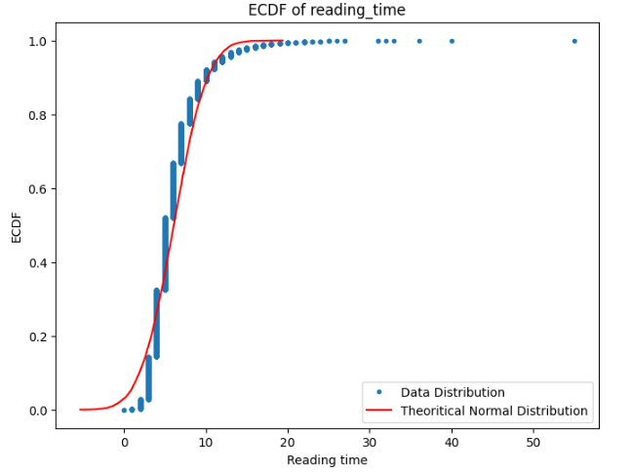
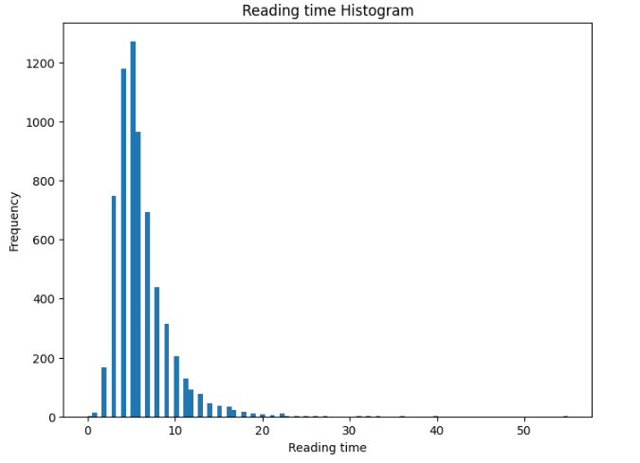

Slide 11
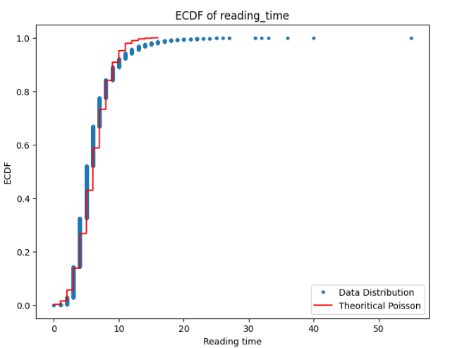

Slide 12
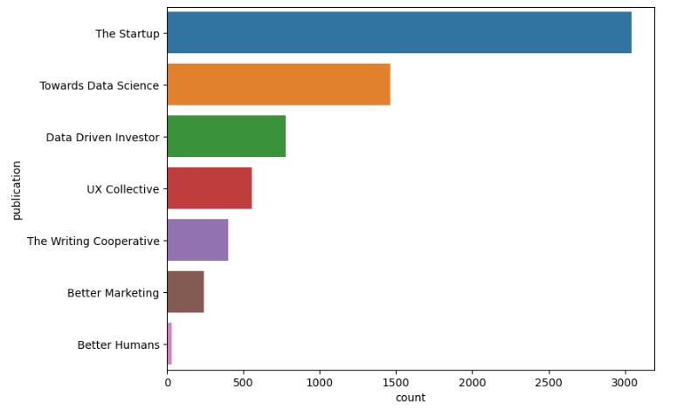
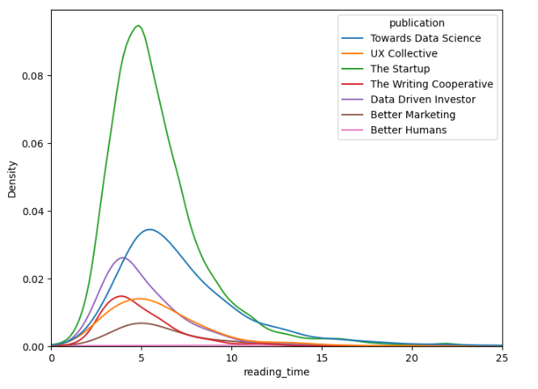

Slide 13
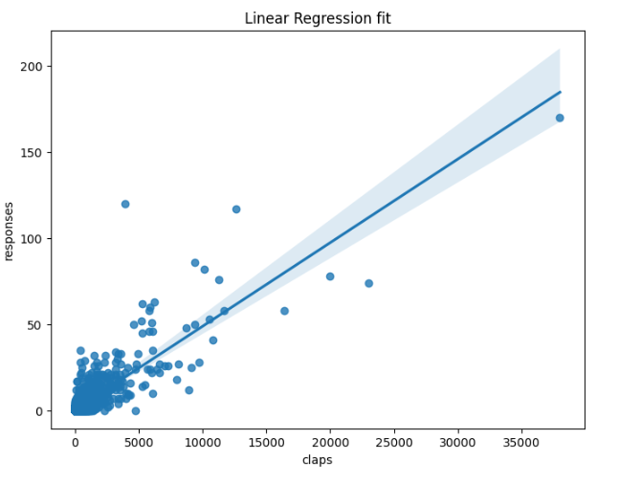
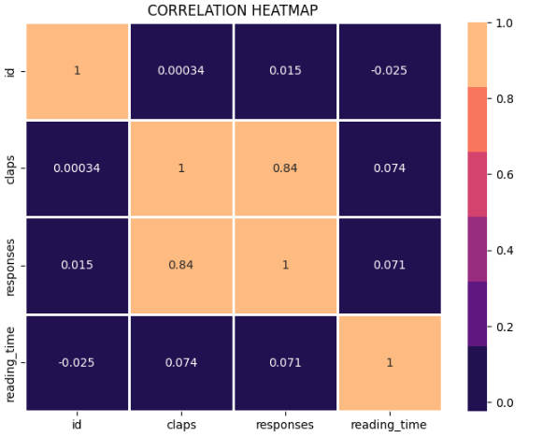

Slide 14
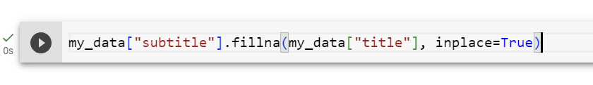
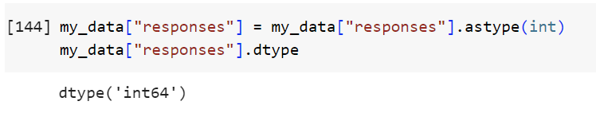

FEATURE ENGINEERING AND DATA-PREPROCESSING
Handled missing data: We used fillna() method to replace the data as per needs.
Handled Incorrect Datatype: Certain fields in our dataset had incorrect data types. We dealt with those fields by changing their data type.
Dropped unwanted columns: Some of the columns were unwanted for our system building. So, we dropped such columns.

Slide 15
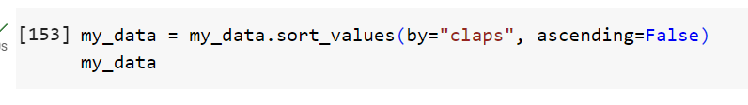
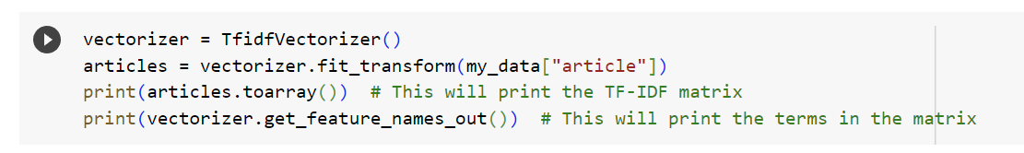
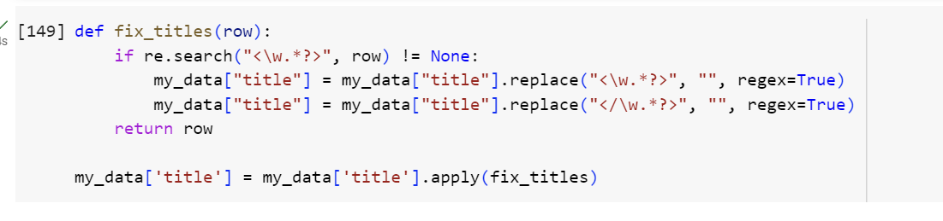
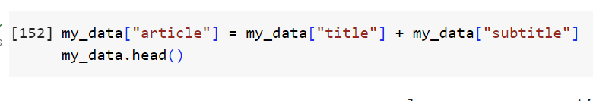
FEATURE ENGINEERING AND DATA-PREPROCESSING
Sorted the data: We sorted data as per our need.
Used TF-IDF Vectorizer to vectorize the textual data: We used TF-IDF Vectorizer to convert a collection of text documents into a matrix of TF-IDF features.
Merged and Fixed columns as per needs: Some of the columns were merged and some were fixed as per needs.

Slide 16
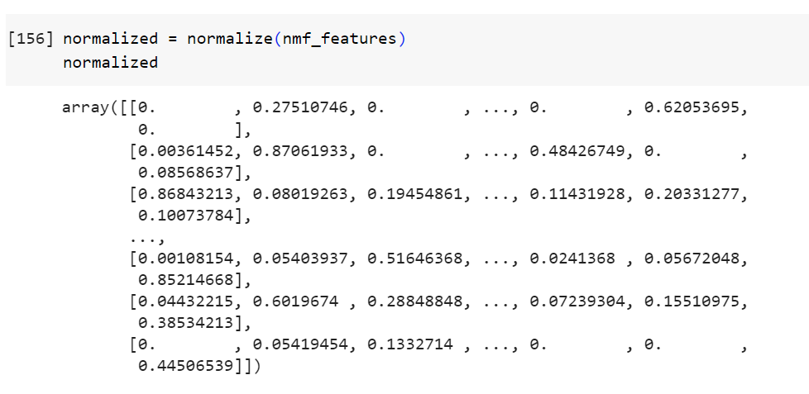
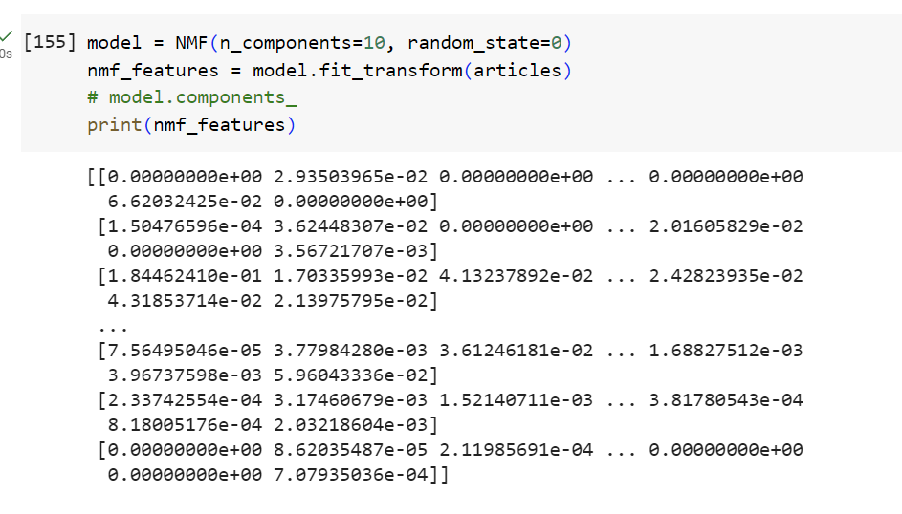
Building a recommending system
Used NMF (Non-Negative Matrix Factorization) with 10 number of components to decompose a given matrix into two lower-dimensional matrices, usually interpreted as representing parts and features of the original data
Normalized the NMF matrices into a unit form

Slide 17
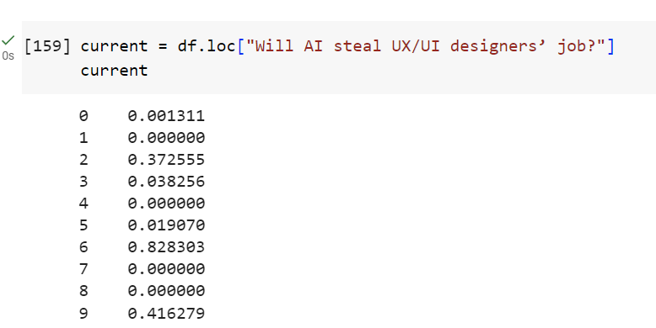
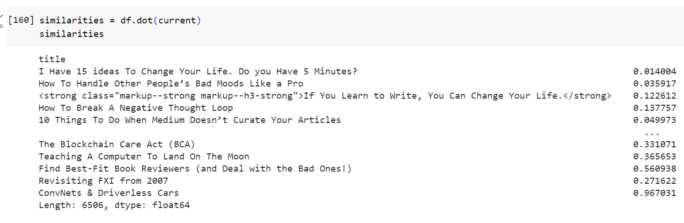
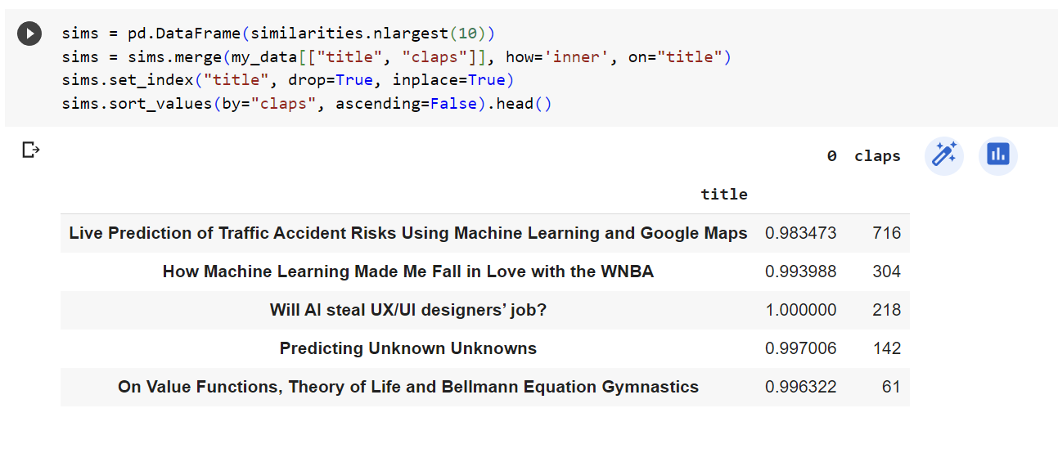
Testing the system
Picked a random article’s title (Will AI steal UX/UI designers’ job?)
Used cosine similarity to find the similarities by performing dot products of the testing vector with all other vectors
Recommended the articles corresponding to top 5 highest dot products

Slide 18
CONCLUSION
In this way, we successfully built a recommendation system for Medium articles by using Non-Negative Matrix Factorization(NMF) technique.

Slide 19
THANK YOU

