Slide 1

Quantum Face Recognition with Multi-Gate Quantum Convolutional Neural Network
B. Tech. Project Mid-Semester Evaluation
Subrata Lodh (2314051) | Yesh Agarwal (2314080)
Supervisor: Dr. Banani Basu
Department of Electronics and Communication Engineering
National Institute of Technology Silchar, Assam (India) - 788010
Notes:
Hybrid quantum-classical face recognition: a 4-qubit filter with 8 trainable quantum parameters.

Slide 2
Introduction & Problem Statement
1 Acquire image
2 Pre-process
3 Extract features
4 Match identity
97.35%
5 – 27
2,304
4
DeepFace accuracy on the LFW benchmark
qubits on commonly accessible IBM devices
qubits if every pixel of a 48×48 image needs its own
qubits for one 2×2 patch, our approach
The challenge
NISQ devices offer only a few tens of reliable qubits, so a whole face cannot be encoded.
The idea
Slide one small trainable 4-qubit circuit over 2×2 patches, like a CNN kernel.
The problem
Recognise faces (ORL, Yale) with a hybrid network that has only 8 trainable quantum parameters.
Notes:
Face recognition pipeline; feature extraction decides accuracy. NISQ hardware has few qubits, so one qubit per pixel (2,304) is impossible; we use 4 qubits per 2x2 patch.

Slide 3




Objectives
1
2
Study quantum ML
Implement the MG-QCNN
Angle encoding, variational circuits, quanvolution
PennyLane + PyTorch, with an analytical model of the filter
3
4
Evaluate on ORL and Yale
Analyse the design
10 random 70:30 splits, 1000 measurement shots
Gates, entanglement, filter size, shot noise, hardware cost
Notes:
Four objectives: study, implement, evaluate, analyse.

Slide 4
Literature Review
Classical face recognition
Variational circuits
Quantum convolution
Gabor + KNN/SVM gave way to deep CNNs
High accuracy, heavy computation
Compute demand outgrows hardware
Rotation angles act as weights
Trained by gradient descent
Barren plateaus favour small, fixed circuits
Henderson: random, fixed filter
Mattern: trainable but random
Oh: fixed, one measured qubit
MG-QCNN: fixed, trainable, all 4 qubits measured
Research gap: small datasets, noise-free simulation and no hardware test in the reference work. We add an independent implementation, an analytical model of the filter and a cost and noise analysis.
Notes:
Three strands; the MG-QCNN combines fixed circuit, trainable rotations, entanglement, all-qubit measurement and a sliding 2x2 filter.

Slide 5
System Architecture
Input
Patches
Quantum filter
Feature maps
FC + softmax
48×48 gray
2×2, stride 2
4 qubits, 8 θ
24×24×4
40 / 15 classes
quantum part
classical part
Quantum filter
same 8 parameters for every patch
4 pixels in → 4 values out
one 2×2 patch = 4 pixels
4 feature maps
24 × 24 = 576 patches × 4 outputs = 2,304 features
Notes:
Image -> 2x2 patches -> one shared 4-qubit filter -> 24x24x4 feature maps -> fully connected layer. Same 8 parameters for every patch.

Slide 6
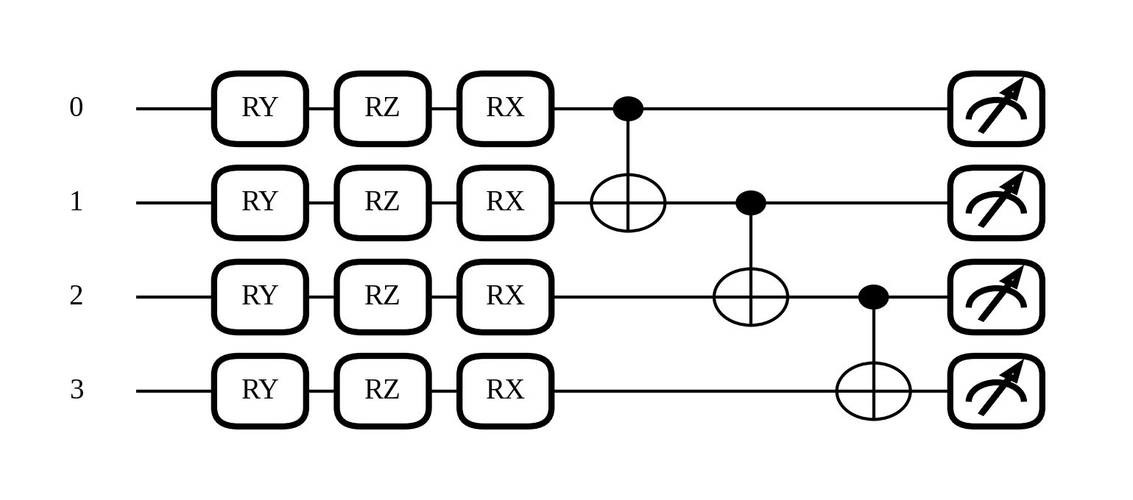
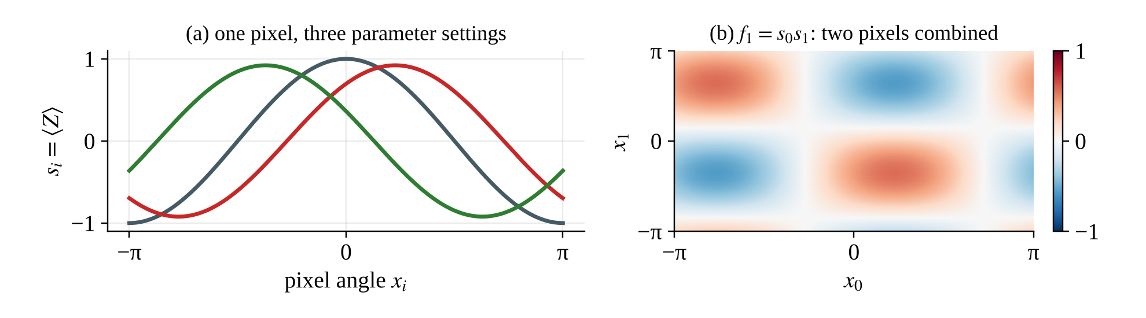
Quantum Filter: Circuit & Closed Form
Closed form
s_{i} = cos θ_{2i+1} cos x_{i}
+ sin θ_{2i+1} sin θ_{2i} sin x_{i}
f_{k} = s₀s₁ ⋯ s_{k}
f₀ sees 1 pixel, f₃ sees all 4 pixels. Checked against the full simulation: error 7×10⁻¹⁶
Encode
Train
Entangle + measure
RY(x) per pixel
RZ, RX: 8 θ
CNOT chain, ⟨Z⟩
Notes:
Encode with RY, train RZ and RX, entangle with a CNOT chain, measure Z. The output has a closed form: f_k is the product of single-qubit terms s_0..s_k, so f_3 depends on all four pixels. Verified numerically to 7e-16.

Slide 7
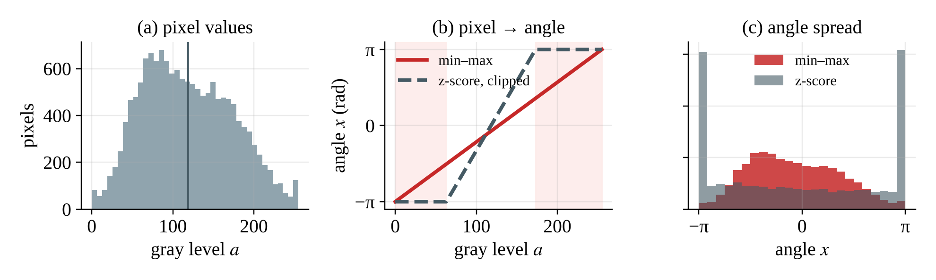
Data & Pre-processing
ORL
400 images · 40 subjects
Yale
165 images · 15 subjects
92×112 px · 10 per subject · split 280 / 120
320×243 px · 11 per subject · split 120 / 45
Grayscale
Resize 48×48
Min–max [−1, 1]
× π
Angle x
Illustrative (synthetic gray levels): clipped z-scores pile about a third of the pixels at ±π; min–max keeps the full angle range.
Notes:
ORL 400 images / 40 subjects; Yale 165 / 15. Grayscale, 48x48, min-max to [-1,1], times pi. The figure is illustrative with synthetic gray levels, showing why clipped z-scores saturate at +-pi.

Slide 8
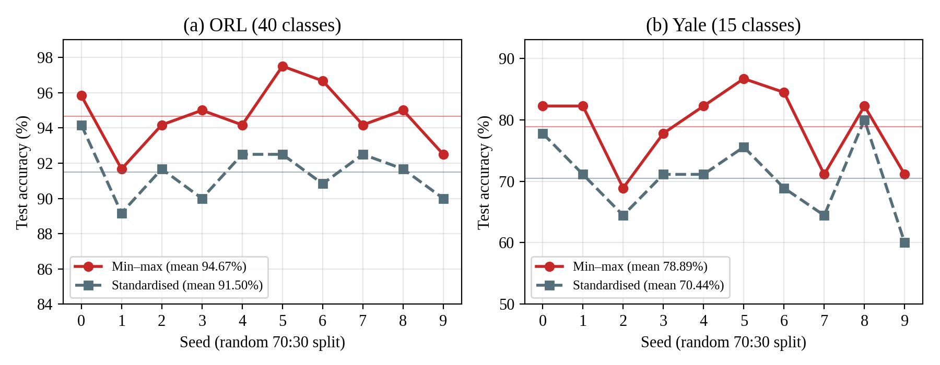
Effect of Pixel Scaling
10 / 10
+3.17 pts
+8.44 pts
seeds won by min–max, both datasets
ORL mean: 94.67 vs 91.50
Yale mean (original set-up): 78.89 vs 70.44
Likely reason (untested): clipped z-scores saturate bright and dark pixels at ±π.
Notes:
Min-max beat Gaussian z-score on all 10 seeds for both datasets. Gain 3.17 points on ORL and 8.44 on the original Yale setup. Explanation (saturation at +-pi) is plausible but untested.

Slide 9
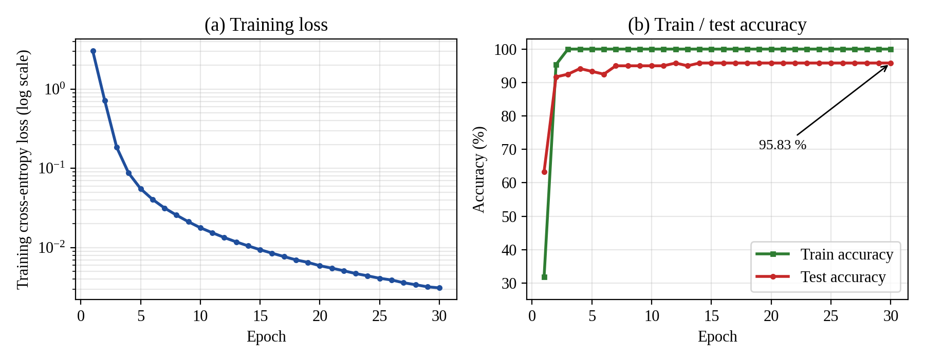
Training Behaviour on ORL
3.03 → 0.0031
100%
95.83%
training loss, epoch 1 to 30
train accuracy from epoch 3
test accuracy from epoch 14 (115 of 120)
Some over-fitting: 4.17-point train–test gap, with 92,200 classical weights on 280 images.
Notes:
Seed 0: loss falls from 3.03 to 0.0031; train accuracy reaches 100% at epoch 3; test accuracy 95.83% from epoch 14 (115 of 120).

Slide 10
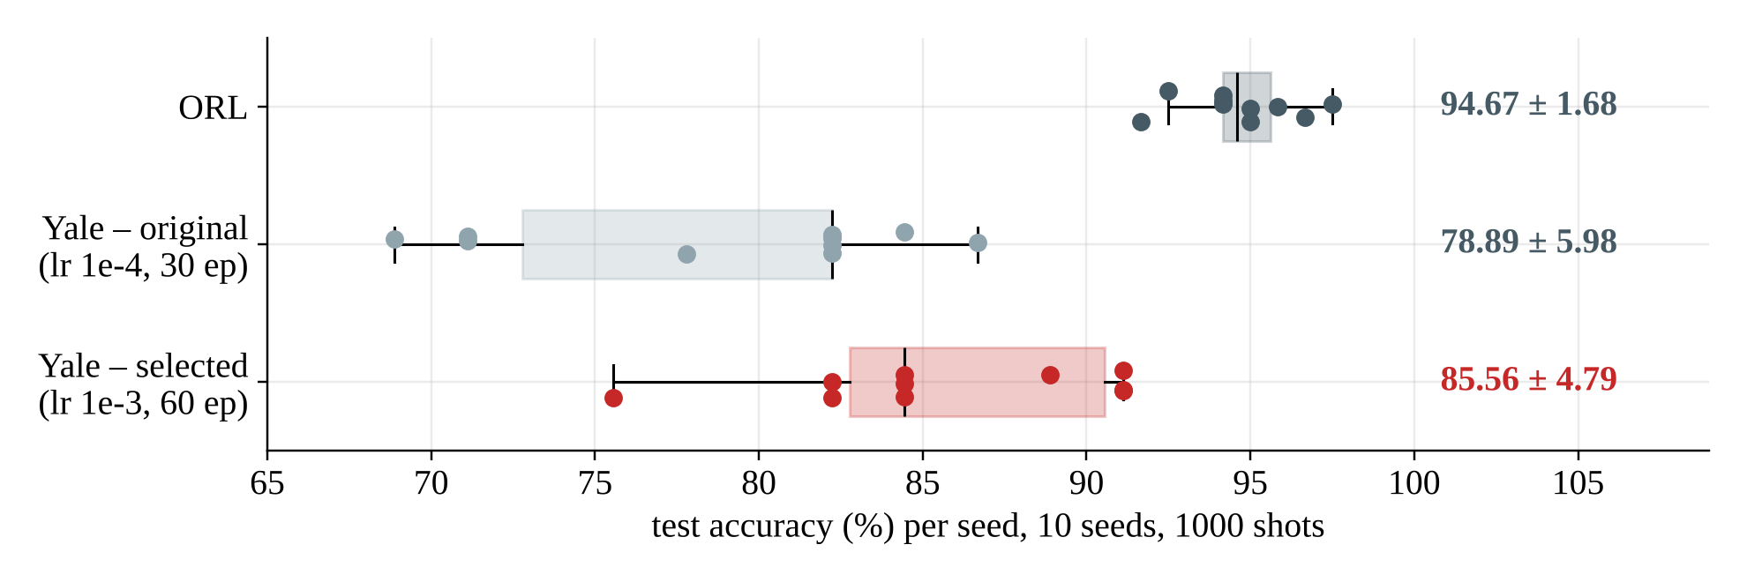
Ten-Seed Evaluation
94.67%
85.56%
+6.7 pts
ORL mean · max 97.50 · std 1.68 · 120 test images
Yale mean · max 91.11 · std 4.79 · 45 test images
Yale after centre crop, lr 1e-3, 60 epochs (from 78.89%)
Why Yale varies more: one test image moves accuracy by 2.22 points (45 images) vs 0.83 on ORL (120).
Notes:
Ten random 70:30 splits, 1000-shot test. ORL 94.667 +- 1.675 (max 97.5). Yale original 78.889, selected 85.556 +- 4.792 (max 91.111). One Yale test image = 2.22 points.

Slide 11
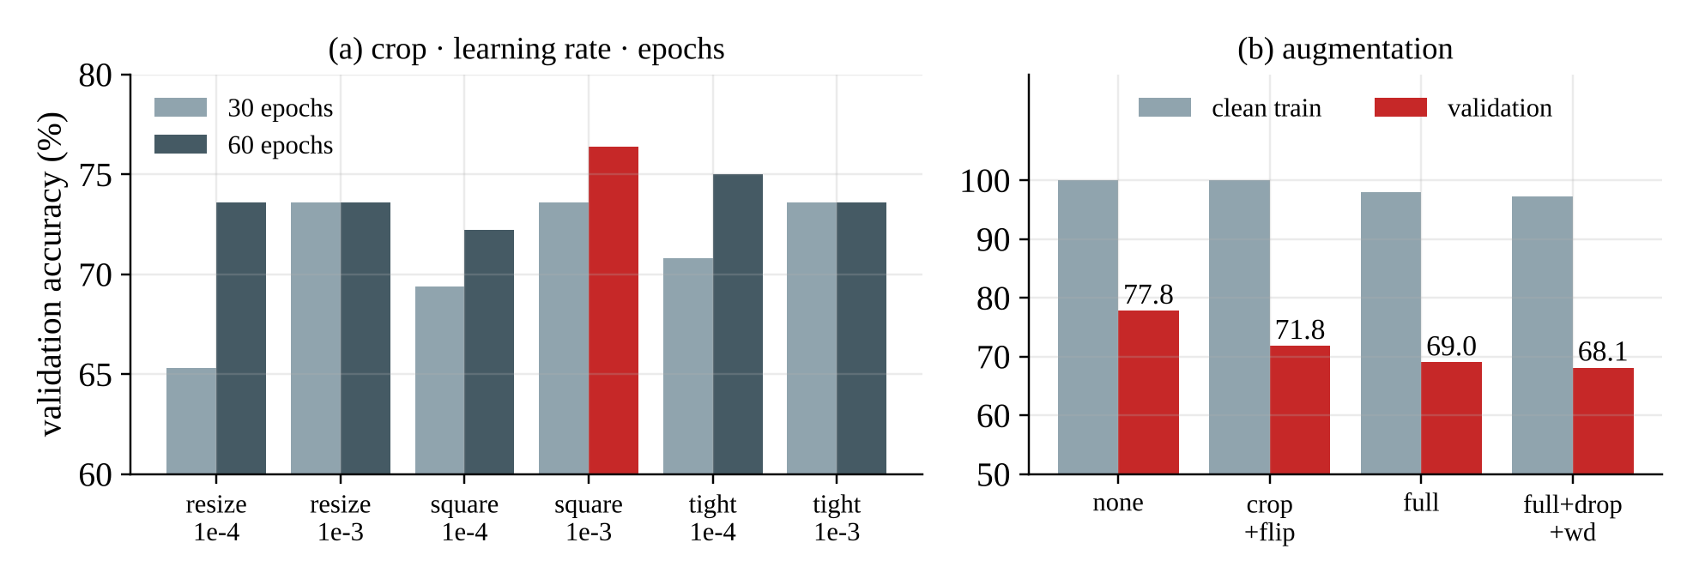
Yale: Tuning and Augmentation
76.4%
77.8 → 68.1%
22 → 29 pts
best validation: square crop, lr 1e-3, 60 epochs
validation accuracy as augmentation increases
train–validation gap grows
Augmentation did not help: the model still fits 120 training images almost perfectly. The cause of the over-fitting is not yet isolated.
Notes:
Validation split 96/24 from the training set, seeds 0-2. Best: square crop, lr 1e-3, 60 epochs (76.4%). Augmentation lowered validation accuracy (77.8 -> 68.1) and widened the train-validation gap (22 -> 29 points).

Slide 12
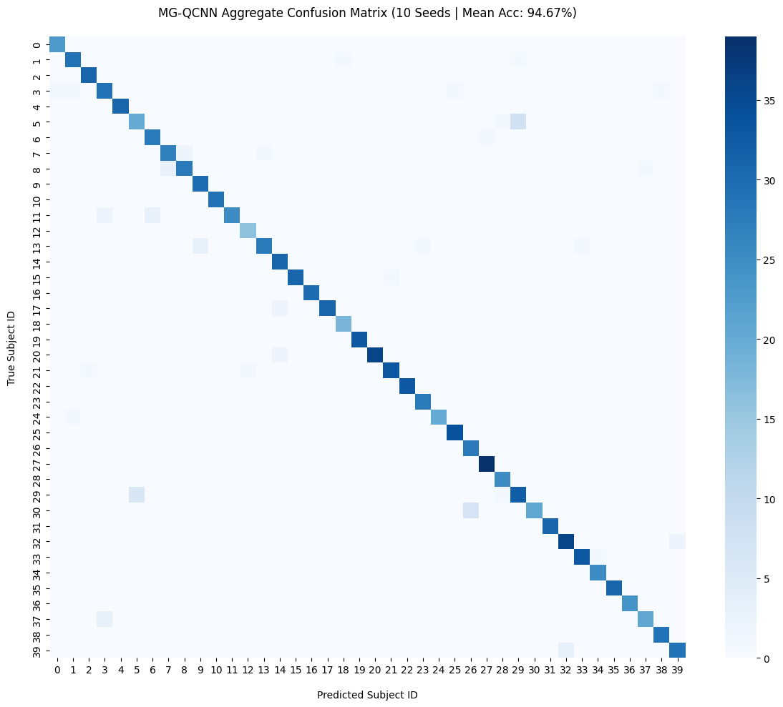
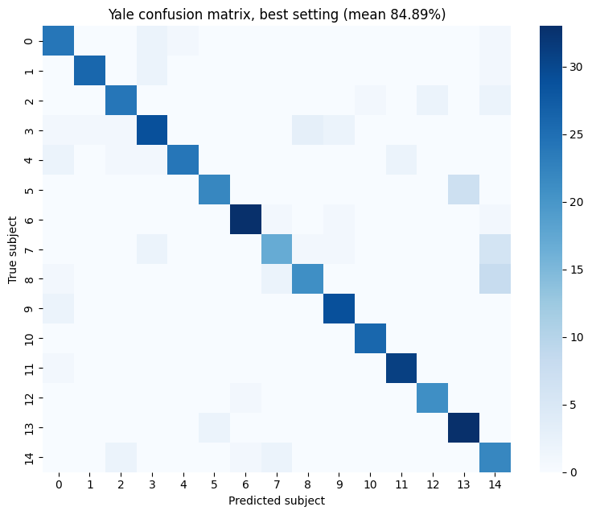
Where the Errors Are
ORL · 94.67% · 1,200 predictions
Yale (tuning run) · 84.89% · 450 predictions
ORL: strong diagonal; errors are scattered single confusions, no subject fails systematically.
Yale: more off-diagonal confusion; subjects 7 and 8 are often read as 14, subject 5 as 13.
Notes:
Pooled over ten seeds: 1,200 ORL and 450 Yale test predictions. Yale matrix is from the earlier square-crop tuning run (84.89%).

Slide 13
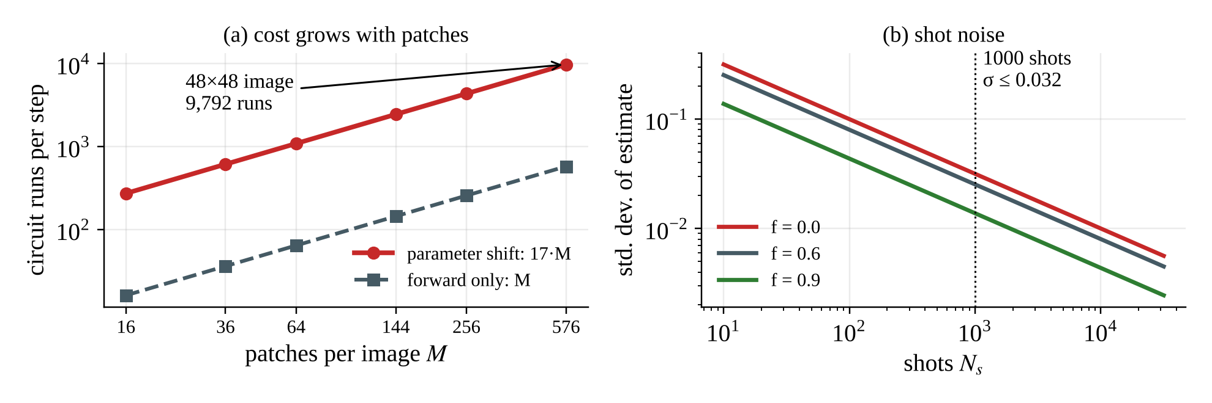
Cost of Training on Hardware
∂f/∂θ = ½ [ f(θ + π/2) − f(θ − π/2) ]
two extra runs per parameter on hardware; simulator backprop gives the same gradient in one pass
17
9,792
8.2×10⁷
2.2×10⁻¹⁵
runs per patch (1 + 2×8)
runs per image per step
runs for one ORL training run
backprop vs shift gradient mismatch
Notes:
Hardware needs the parameter-shift rule: 17 runs per patch, 9,792 per image per step, 8.2e7 for one ORL run. Simulator backpropagation gives the same gradient (mismatch 2.2e-15) in one pass, so it is used for training. Test time uses 1000 shots.

Slide 14



Conclusion, Limitations & Future Scope
Achieved
Limitations
Future scope
MG-QCNN built in PennyLane + PyTorch
Closed-form filter verified
ORL 94.67%, Yale 85.56%
Min–max beats Gaussian on all seeds
Noise-free simulation, not hardware
Yale over-fits: 100% train vs about 85% test
No ablation or noise study yet
Add a feature-extraction stage before the quantum layer to cut the patches needing circuit runs
8 quantum parameters · ORL 94.67% · Yale 85.56%
Fewer patches mean 4× to 16× fewer circuit runs and make real parameter-shift training practical.
Notes:
Achieved: pipeline, closed form verified, ORL 94.67%, Yale 85.56%. Limitations: noise-free simulation, Yale over-fitting, no ablation/noise study yet. Future: feature-extraction stage before the quantum layer so far fewer patches need circuit runs and real parameter-shift training becomes practical.

Slide 15
References
[1] M. Wang, W. Deng, “Deep face recognition: A survey,” Neurocomputing, 2021.
[2] N. C. Thompson et al., “The computational limits of deep learning,” arXiv:2007.05558, 2020.
[3] J. Preskill, “Quantum computing in the NISQ era and beyond,” Quantum, 2018.
[4] Y. Zhu et al., “Quantum face recognition with multigate quantum convolutional neural network,” IEEE Trans. Artif. Intell., 2024.
[5] Y. LeCun et al., “Backpropagation applied to handwritten zip code recognition,” Neural Comput., 1989.
[6] Y. Taigman et al., “DeepFace,” CVPR, 2014.
[7] M. Cerezo et al., “Variational quantum algorithms,” Nat. Rev. Phys., 2021.
[8] J. R. McClean et al., “Barren plateaus in quantum neural network training landscapes,” Nat. Commun., 2018.
[9] Z. Holmes et al., “Connecting ansatz expressibility to gradient magnitudes and barren plateaus,” PRX Quantum, 2022.
[10] I. Cong, S. Choi, M. D. Lukin, “Quantum convolutional neural networks,” Nat. Phys., 2019.
[11] M. Henderson et al., “Quanvolutional neural networks,” Quantum Mach. Intell., 2020.
[12] D. Mattern et al., “Variational quanvolutional neural networks with enhanced image encoding,” arXiv:2106.07327, 2021.
[13] S. Oh, J. Choi, J. Kim, “A tutorial on quantum convolutional neural networks (QCNN),” ICTC, 2020.
[14] S. Y.-C. Chen et al., “Quantum convolutional neural networks for high energy physics data analysis,” Phys. Rev. Res., 2022.
[15] A. Senokosov et al., “Quantum machine learning for image classification,” arXiv:2304.09224, 2023.
[16] T. Hur, L. Kim, D. K. Park, “Quantum convolutional neural network for classical data classification,” Quantum Mach. Intell., 2022.
[17] F. S. Samaria, A. C. Harter, “Parameterisation of a stochastic model for human face identification,” WACV, 1994.
[18] A. S. Georghiades et al., “From few to many,” FG, 2000.
[19] D. P. Kingma, J. Ba, “Adam: A method for stochastic optimization,” ICLR, 2015.
[20] V. Bergholm et al., “PennyLane,” arXiv:1811.04968, 2018.
[21] A. Paszke et al., “PyTorch,” NeurIPS, 2019.
[22] K. Mitarai et al., “Quantum circuit learning,” Phys. Rev. A, 2018.
[23] M. Schuld et al., “Evaluating analytic gradients on quantum hardware,” Phys. Rev. A, 2019.

