Slide 1

Quantum Face Recognition with Multi-Gate Quantum Convolutional Neural Network
B. Tech. Project Mid-Semester Evaluation
Subrata Lodh (2314051) | Yesh Agarwal (2314080)
Supervisor: Dr. Banani Basu
Department of Electronics and Communication Engineering
National Institute of Technology Silchar, Assam (India) - 788010

Slide 2



Introduction & Problem Statement
Why it matters
The catch: qubits
Face recognition is used in banking, security and government services
Why a new approach
Deep CNNs are near-human (DeepFace: 97.35% on LFW) but need ever more compute
Why quantum
Quantum machine learning promises more efficient learning with far fewer trainable resources
Problem statement
Today’s noisy quantum devices offer only 5–27 reliable qubits, but a 48×48 face image has 2,304 pixels. How can faces be recognised with a quantum model that needs only a handful of qubits, and how well does it work?
Notes:
Why: face recognition is everywhere and deep CNNs are costly. Quantum ML is a promising alternative, but today's devices have only a handful of qubits, so a face image cannot be loaded pixel by pixel. Problem: recognise faces with a quantum model that needs very few qubits.

Slide 3


Objectives
1
2
Study quantum ML
Implement the MG-QCNN
Angle encoding, variational circuits, quanvolution
PennyLane + PyTorch, with an analytical model of the filter
3
4
Evaluate on ORL and Yale
Analyse the design
10 random 70:30 splits, 1000 measurement shots
Gates, entanglement, filter size, shot noise, hardware cost
Notes:
Four objectives: study, implement, evaluate, analyse.

Slide 4
Literature Review
Classical face recognition
Variational circuits
Quantum convolution
Gabor + KNN/SVM gave way to deep CNNs
High accuracy, heavy computation
Compute demand outgrows hardware
Rotation angles act as weights
Trained by gradient descent
Barren plateaus favour small, fixed circuits
Henderson: random, fixed filter
Mattern: trainable but random
Oh: fixed, one measured qubit
MG-QCNN: fixed, trainable, all 4 qubits measured
Research gap: small datasets, noise-free simulation and no hardware test in the reference work. We add an independent implementation, an analytical model of the filter and a cost and noise analysis.
Notes:
Three strands; the MG-QCNN combines fixed circuit, trainable rotations, entanglement, all-qubit measurement and a sliding 2x2 filter.

Slide 5
Proposed Methodology: Overview Architecture
1 Pre-process
2 Patch extraction
3 Quantum circuit
4 Measurement
5 Classifier
IN raw image
IN 48×48 angles
IN 4 angles
IN 4-qubit state
IN 24×24×4 = 2,304
OUT 48×48 angles
OUT 576 × 4 values
OUT 4-qubit state
OUT 4 values f₀…f₃
OUT 40 / 15 probabilities
quantum part: 4 qubits, 8 trainable parameters shared by all patches
Tools
Datasets
Evaluation
PennyLane (quantum circuit), PyTorch (training); Kaggle notebooks
ORL: 400 images, 40 subjects · Yale: 165 images, 15 subjects
10 random 70:30 splits, 1000 measurement shots
Next: one slide per component, each with its input and output
Notes:
Five components. Each takes the previous output as input. Quantum part: circuit and measurement with 8 shared parameters. Classical part: pre-processing, patch extraction, classifier.

Slide 6
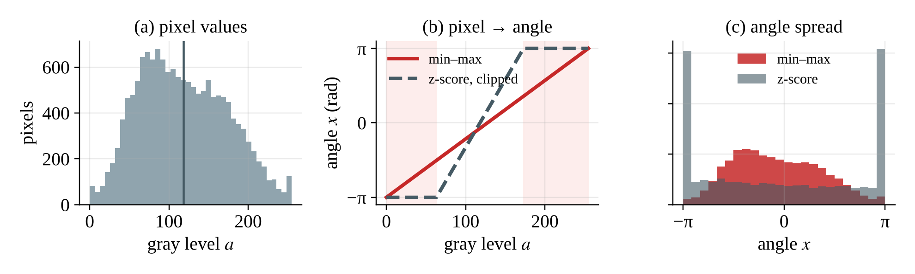
Component 1: Data Pre-processing
INPUT
Pre-process
OUTPUT
Raw gray image
48×48 angle matrix
ORL 92×112 · Yale 320×243
grayscale · resize · scale
each pixel in [−π, π]
94.67%
91.50%
10 / 10
ORL accuracy with min–max scaling
ORL accuracy with Gaussian z-score
seeds won by min–max (+3.17 pts)
Illustrative (synthetic gray levels): clipped z-scores pile about a third of pixels at ±π.
Notes:
Grayscale, resize to 48x48, per-image min-max to [-1,1], times pi. Yale also gets a centre square crop then an 85% centre crop. Min-max beat Gaussian z-score on all 10 ORL seeds (94.67 vs 91.50). Figure is illustrative with synthetic gray levels.

Slide 7
Component 2: Patch Extraction
INPUT
Patch extraction
OUTPUT
48×48 angle matrix
576 patches × 4 values
2,304 values
2×2 window, stride 2
(x₀, x₁, x₂, x₃) each
patch 1 → (x₀, x₁, x₂, x₃)
patch 2 → (x₀, x₁, x₂, x₃)
patch 3 → (x₀, x₁, x₂, x₃)
patch 4 → (x₀, x₁, x₂, x₃)
48×48 image (grid simplified)
⋮ 576 patches in total
24 × 24 = 576 patches. Each patch has 4 pixels, so 4 qubits are enough whatever the image size.
Notes:
A 2x2 window slides with stride 2: 24 x 24 = 576 non-overlapping patches, each flattened row-major into (x0, x1, x2, x3).

Slide 8
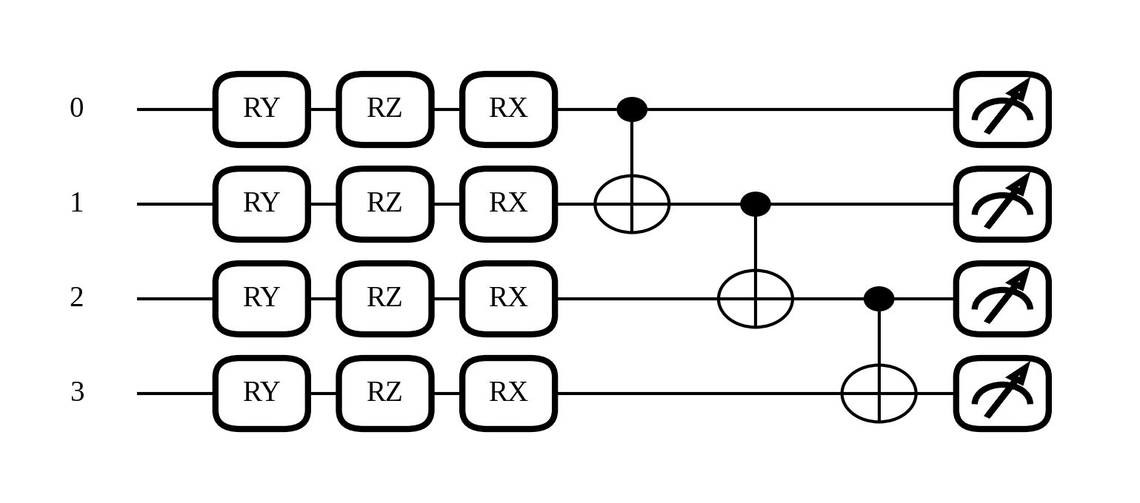
Component 3: Quantum Circuit
INPUT
Quantum circuit
OUTPUT
4 angles x₀…x₃
Entangled 4-qubit state
one patch
4 qubits · 15 gates
depends on all 4 pixels
Encode
Train
Entangle
RY(xᵢ) turns pixel i into a rotation
RZ, RX: 8 parameters θ
CNOT chain 0→1→2→3
Notes:
Encode each pixel as an RY rotation on its own qubit, apply trainable RZ and RX rotations (8 parameters, shared by all patches), then entangle neighbours with a CNOT chain. 15 gates, depth 6, fixed (not random).

Slide 9
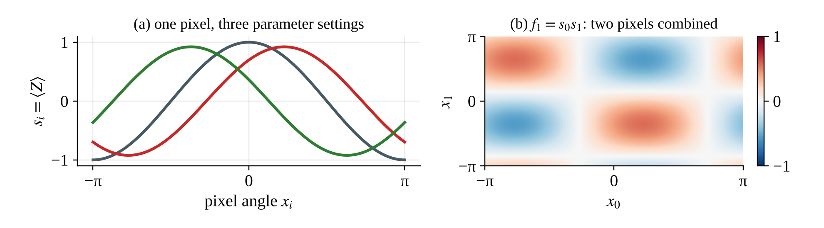
Component 4: Measurement
INPUT
Measurement
OUTPUT
Entangled 4-qubit state
4 values f₀…f₃
from the circuit
Pauli-Z on all 4 qubits
each in [−1, 1]
one qubit: s_{i} = cos θ_{2i+1} cos x_{i} + sin θ_{2i+1} sin θ_{2i} sin x_{i}
with CNOTs: f_{k} = s₀s₁ ⋯ s_{k} f₀ sees 1 pixel, f₃ sees all 4
Verified: closed form matches the full simulation to 7×10⁻¹⁶; 1000 shots add at most 0.032 noise.
Notes:
Measure Pauli-Z on every qubit. Closed form: s_i = cos(th_2i+1) cos(x_i) + sin(th_2i+1) sin(th_2i) sin(x_i); f_k = s_0 ... s_k. Verified against the full simulation to 7e-16. At test time 1000 shots give std <= 0.032.

Slide 10
Component 5: Classifier
INPUT
Classifier
OUTPUT
24×24×4 feature maps
Class probabilities
2,304 values
flatten → FC → softmax
40 (ORL) or 15 (Yale)
Linear layer
2,304
2,304 → 40 (15)
24×24×4
flatten
softmax probabilities
Loss
Optimiser
Trainable
softmax cross-entropy
Adam, learning rate 10⁻³
8 quantum + 92,200 classical (ORL)
Notes:
All 576 patches x 4 values = 2,304 features are flattened into a linear layer with softmax. Trained with cross-entropy and Adam (lr 1e-3). Parameters: 8 quantum + 2,304x40+40 = 92,200 classical on ORL; 8 + 34,575 on Yale.

Slide 11
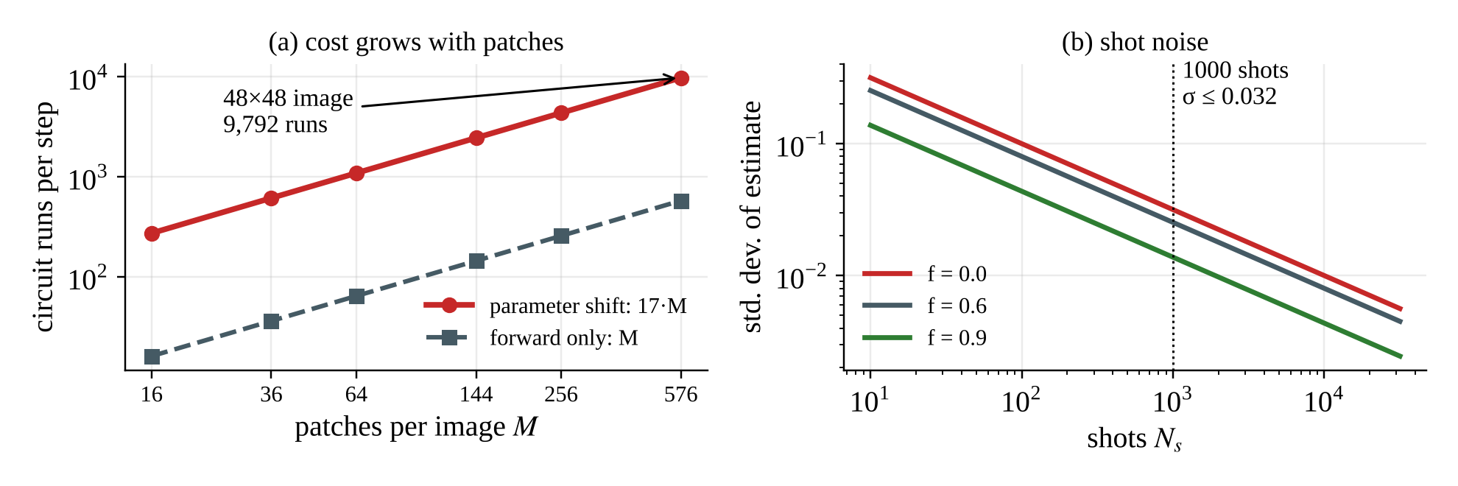
Training the Quantum Parameters
INPUT
Gradient step
OUTPUT
Loss L
Updated parameters
from the predictions
backprop (simulator)
8 θ + classical weights
∂f/∂θ = ½ [ f(θ + π/2) − f(θ − π/2) ]
parameter shift on hardware: two extra runs per parameter; backprop gives the same gradient in one pass
17
9,792
8.2×10⁷
2.2×10⁻¹⁵
runs per patch
runs per image per step
runs, one ORL training
gradient mismatch
Notes:
Hardware needs the parameter-shift rule: 17 runs per patch, 9,792 per image per step, 8.2e7 for one ORL run. Simulator backpropagation gives the same gradient (mismatch 2.2e-15) in one pass, so it is used for training.

Slide 12
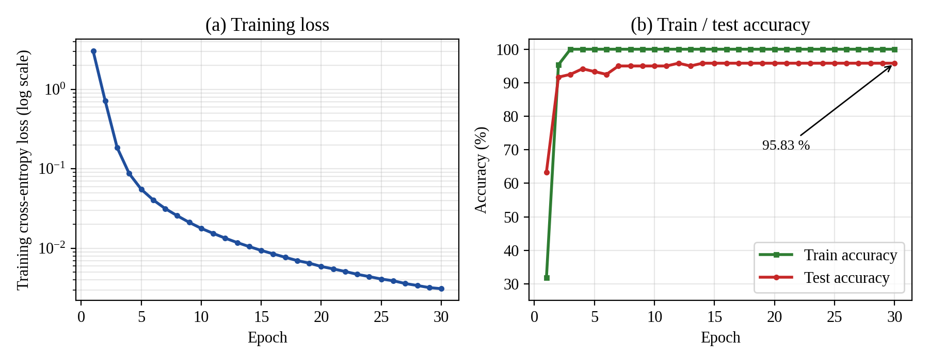
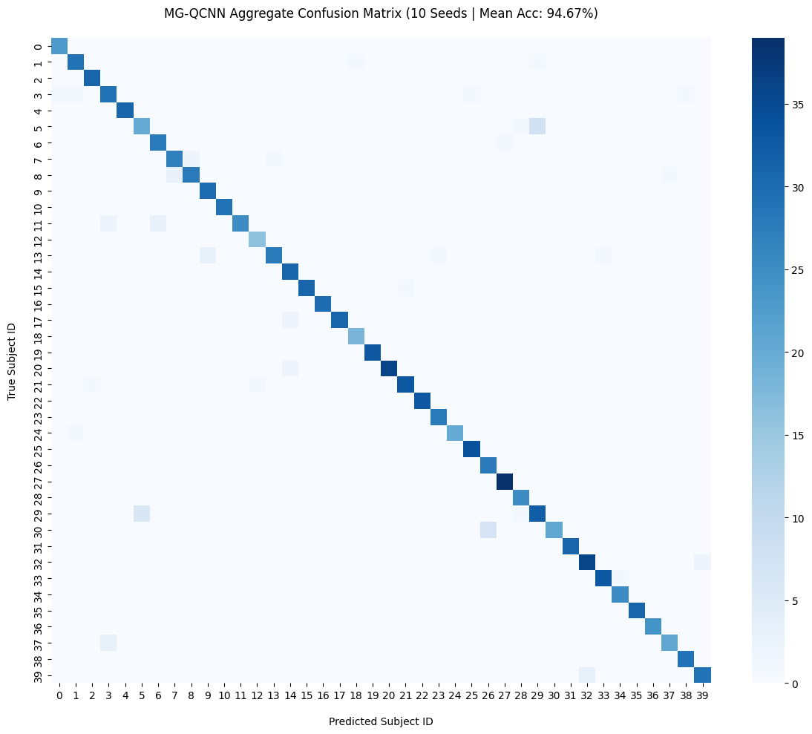
Results & Discussion: ORL
94.67%
100% → 95.83%
mean test accuracy (max 97.50 · std 1.68)
train from epoch 3 · test from epoch 14 (seed 0)
ORL confusion matrix, 10 seeds (1,200 predictions)
Discussion
Learns fast: test accuracy 63% → 92% in epoch 2, above 95% from epoch 7
Min–max scaling beats Gaussian on all 10 seeds (94.67% vs 91.50%)
Errors are scattered single confusions; the 4.17-point train–test gap shows some over-fitting
Notes:
Ten random 70:30 splits, 1000-shot test: mean 94.667, max 97.5, std 1.675. Seed 0: loss 3.03 -> 0.0031, train accuracy 100% from epoch 3, test 95.83% from epoch 14. Min-max beats Gaussian on all 10 seeds (+3.17).

Slide 13
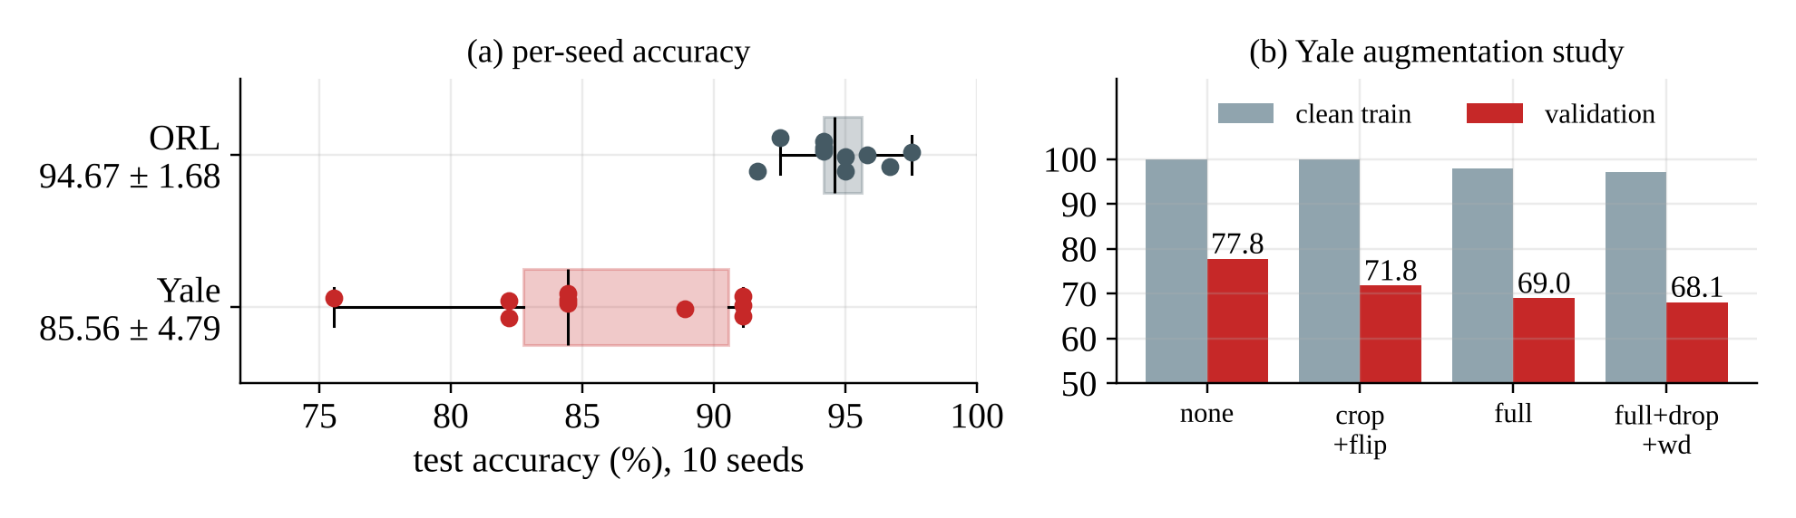
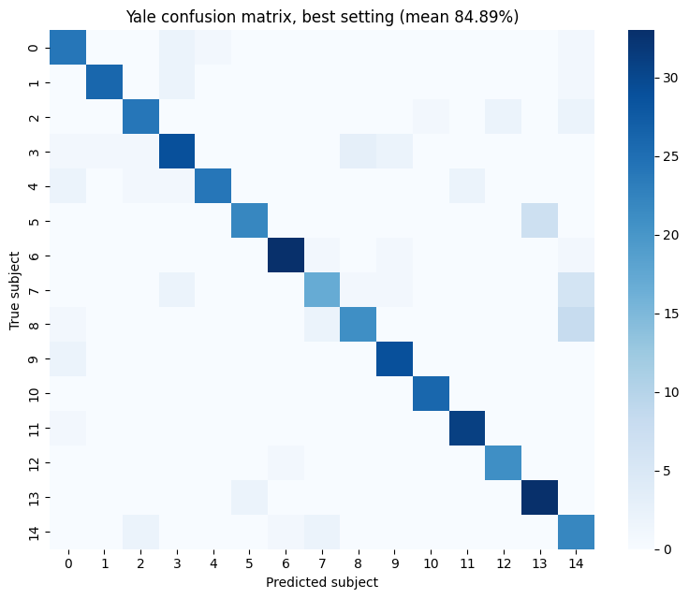
Results & Discussion: Yale
85.56%
22 → 29 pts
mean accuracy · max 91.11 · std 4.79
train–validation gap with augmentation
Over-fits: 100% train accuracy on only 120 images
Augmentation did not help (validation 77.8 → 68.1%)
One test image = 2.22 points, so Yale varies more than ORL
Confusions: subjects 7, 8 read as 14; subject 5 as 13
Yale confusion matrix (tuning run, 450 predictions)
Notes:
Yale (15 subjects, 120 train / 45 test): mean 85.556, max 91.111, std 4.792, using a centre crop (85%), lr 1e-3, 60 epochs selected on a validation split. Augmentation lowered validation accuracy 77.8 -> 68.1 and widened the train-validation gap 22 -> 29 points. One test image = 2.22 points.

Slide 14



Future Work & Conclusion
Achieved
Limitations
Future work
MG-QCNN built in PennyLane + PyTorch
Closed-form filter verified
ORL 94.67%, Yale 85.56%
Min–max beats Gaussian on all ORL seeds
Noise-free simulation, not hardware
Yale over-fits: 100% train vs about 85% test
No ablation or noise study yet
Add a feature-extraction stage before the quantum layer to cut the patches needing circuit runs
8 quantum parameters · ORL 94.67% · Yale 85.56%
Fewer patches mean 4× to 16× fewer circuit runs and make real parameter-shift training practical.
Notes:
Achieved: pipeline, closed form verified, ORL 94.67%, Yale 85.56%. Limitations: noise-free simulation, Yale over-fitting, no ablation/noise study yet. Future: feature-extraction stage before the quantum layer so far fewer patches need circuit runs and real parameter-shift training becomes practical.

Slide 15
References
[1] M. Wang, W. Deng, “Deep face recognition: A survey,” Neurocomputing, 2021.
[2] N. C. Thompson et al., “The computational limits of deep learning,” arXiv:2007.05558, 2020.
[3] J. Preskill, “Quantum computing in the NISQ era and beyond,” Quantum, 2018.
[4] Y. Zhu et al., “Quantum face recognition with multigate quantum convolutional neural network,” IEEE Trans. Artif. Intell., 2024.
[5] Y. LeCun et al., “Backpropagation applied to handwritten zip code recognition,” Neural Comput., 1989.
[6] Y. Taigman et al., “DeepFace,” CVPR, 2014.
[7] M. Cerezo et al., “Variational quantum algorithms,” Nat. Rev. Phys., 2021.
[8] J. R. McClean et al., “Barren plateaus in quantum neural network training landscapes,” Nat. Commun., 2018.
[9] Z. Holmes et al., “Connecting ansatz expressibility to gradient magnitudes and barren plateaus,” PRX Quantum, 2022.
[10] I. Cong, S. Choi, M. D. Lukin, “Quantum convolutional neural networks,” Nat. Phys., 2019.
[11] M. Henderson et al., “Quanvolutional neural networks,” Quantum Mach. Intell., 2020.
[12] D. Mattern et al., “Variational quanvolutional neural networks with enhanced image encoding,” arXiv:2106.07327, 2021.
[13] S. Oh, J. Choi, J. Kim, “A tutorial on quantum convolutional neural networks (QCNN),” ICTC, 2020.
[14] S. Y.-C. Chen et al., “Quantum convolutional neural networks for high energy physics data analysis,” Phys. Rev. Res., 2022.
[15] A. Senokosov et al., “Quantum machine learning for image classification,” arXiv:2304.09224, 2023.
[16] T. Hur, L. Kim, D. K. Park, “Quantum convolutional neural network for classical data classification,” Quantum Mach. Intell., 2022.
[17] F. S. Samaria, A. C. Harter, “Parameterisation of a stochastic model for human face identification,” WACV, 1994.
[18] A. S. Georghiades et al., “From few to many,” FG, 2000.
[19] D. P. Kingma, J. Ba, “Adam: A method for stochastic optimization,” ICLR, 2015.
[20] V. Bergholm et al., “PennyLane,” arXiv:1811.04968, 2018.
[21] A. Paszke et al., “PyTorch,” NeurIPS, 2019.
[22] K. Mitarai et al., “Quantum circuit learning,” Phys. Rev. A, 2018.
[23] M. Schuld et al., “Evaluating analytic gradients on quantum hardware,” Phys. Rev. A, 2019.

