Slide 1

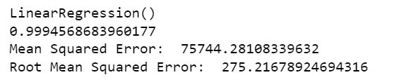
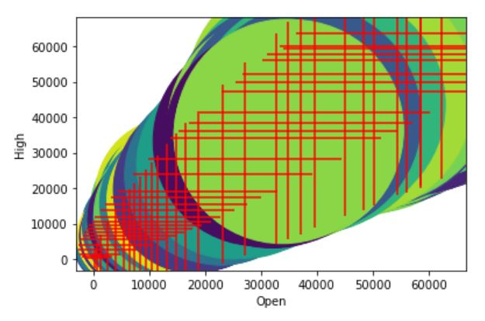
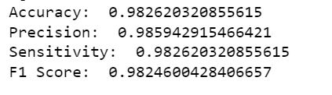
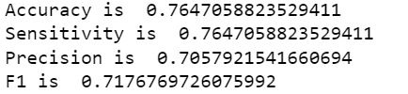
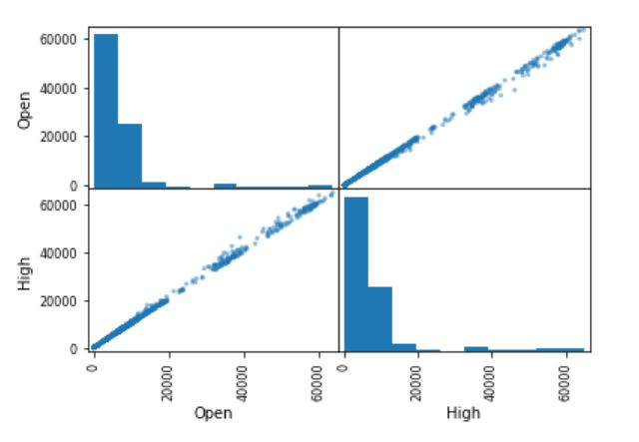
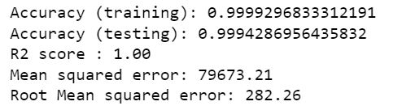
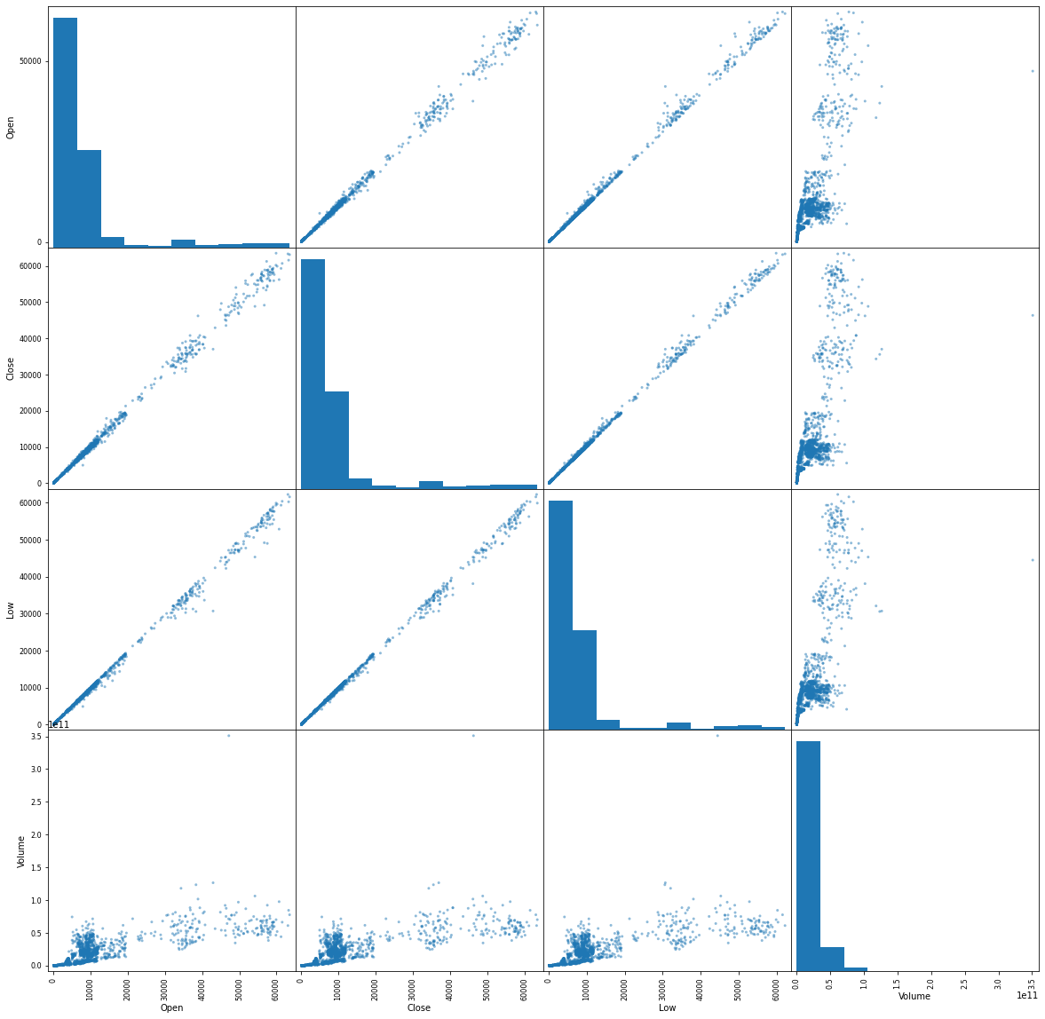

Predicting Bitcoin High Price With Respect To The Opening Price
Bikash Adhikari
School of Computer Science and Information Systems, Northwest Missouri State University
Model Outputs
Interpretation and Conclusion
Dataset Introduction and Goals
Dataset obtained from Kaggle.
2991 Rows and 9 Columns.
Daily Data from 2013 to 2021
Numeric Features include prices opening, closing, low, high, volume and market cap.
Goal: Predicting the bitcoin high price based on the opening price.
Linear Regression
A high R2 value of 0.99 for linear regression suggests an excellent fit and shows strong relationship between opening and high price.
It was suspected that the decision tree was overfitting and while it could have, the metrics for test set are high showing good predictions.
SVM metrics seem to be poor. It could be because the dataset is imbalanced, or the kernel choice was not the best.
To address overfitting of the decision tree metrics Random Forrest with 1000 trees was employed and high metrics yielded suggest it might not be overfitting.
A PCA model can be employed in the future in order to determine if the predictions can be based off a single variable.
Decision Tree Test Data
SVM Test Set
Random Forrest
Models Used
Discussion and Results
Supervised Learning: The dataset was split into 75% training and 25% test set.
Linear Regression Model
Decision Trees
SVM
Random Forrest
Clustering
Neural Nets
Evaluate
Linear Regression Results:
Linear Regression R2 value is 0.99 shows a strong relationship.
Decision Tree
Decision Tree was overfitting on the train set with all metrics exactly equal to 1.0
Overfitting is classic for decision trees.
However, analysis on the test set yields metrics close to 0.98 and interpreted in the conclusion.
SVM
SVM accuracies are in the upper 0.70 and performs lesser than decision trees.
Random Forrest
Metrics are very good with a R2 value of 1.0
Additional Resources
Acknowledgements
Repository
https://www.kaggle.com/datasets/sudalairajkumar/cryptocurrencypricehistory
https://www.kaggle.com/datasets/jessevent/all-crypto-currencies
https://github.com/44-599-machine-learning-S22/project-machine-learning-s22-bikash30851
Kaggle.com
Dr. Charles Hoot
https://github.com/44-599-machine-learning-S22/project-machine-learning-s22-bikash30851

