Slide 1

Frameworks for Designing Interaction
MD. SIPLU SINHA

Slide 2
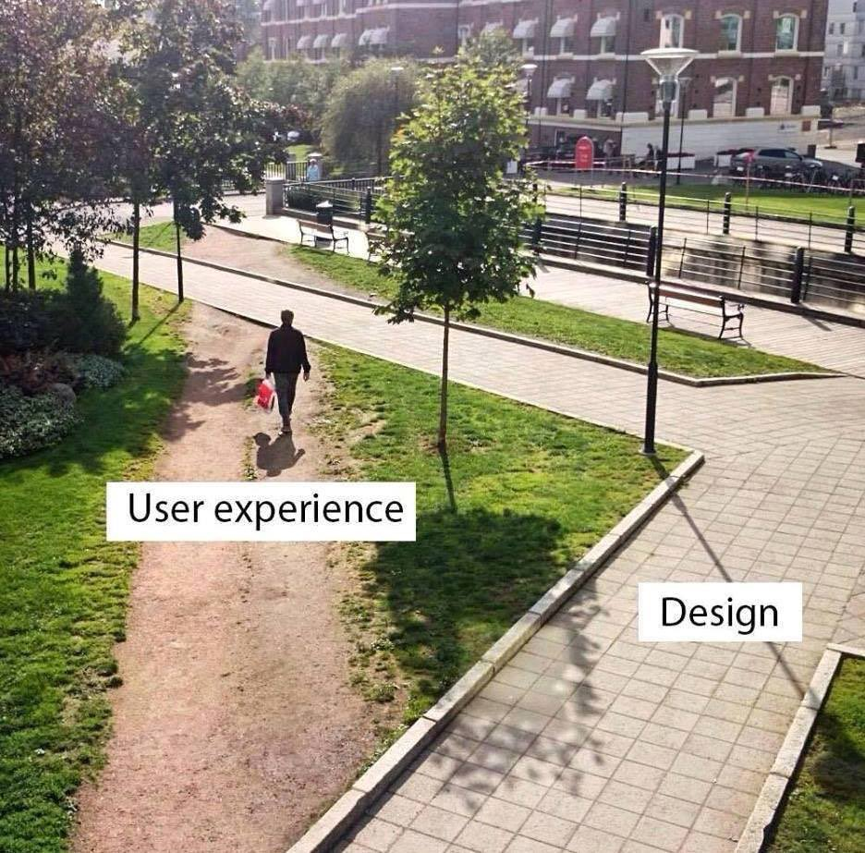
Preamble
When we design a new product,
it’s always essential to understand WHO and HOW people will use it.
Without this understanding,
there is almost no chance of creating a Product people will LOVE.

Slide 3
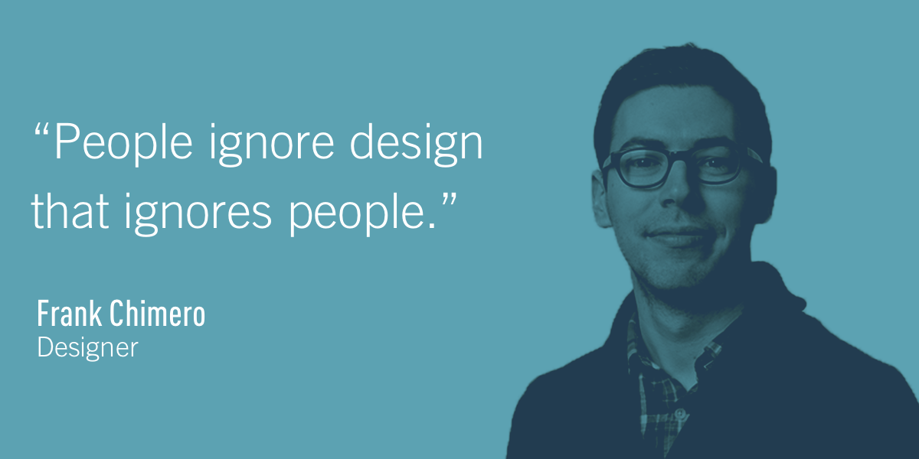
And this quote perfectly summarizes the importance of user-centered design. User-centered design is about gaining a deep understanding of who will be using the product.

Slide 4
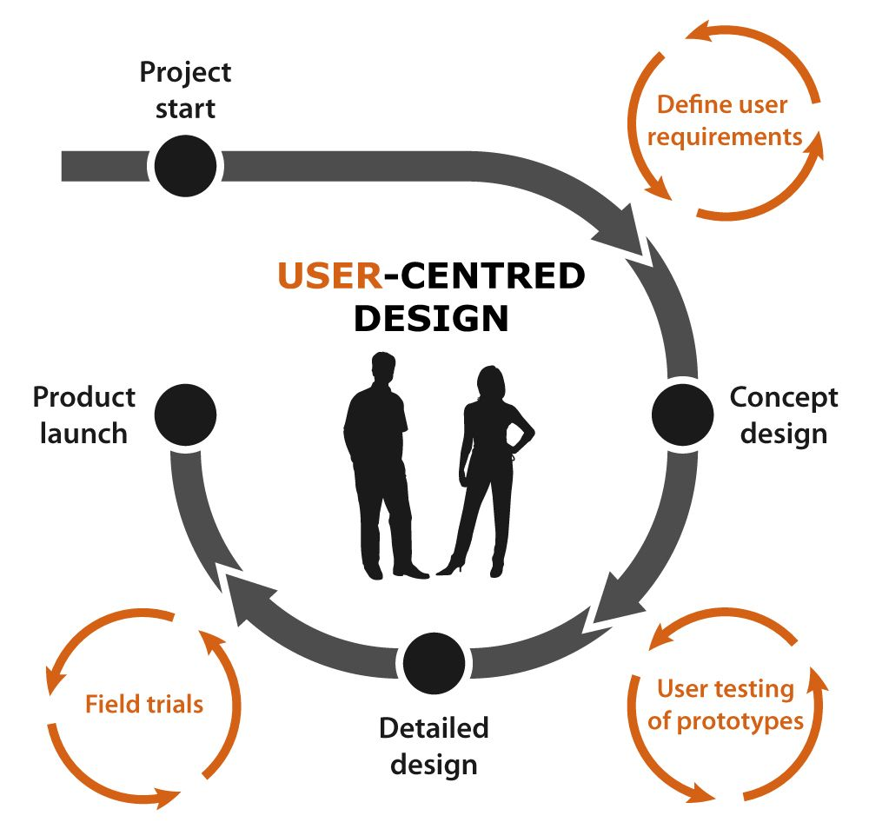
What is User-Centered Design?
User-centered design (UCD) is an iterative design process in which designers focus on the users and their needs in each phase of the design process.
In UCD, design teams involve users throughout the design process via a variety of research and design techniques, to create highly usable and accessible products for them

Slide 5
User-Centered Design Principles
Users are involved in the design process from the very beginning. Critical design decisions are evaluated based on how they work for end-users.
Importance of requirement clarification. The product team always tries to align business requirements with user’s needs.
Introducing user feedback loop in the product life cycle. The product team collects and analyzes feedback from users regularly. This information helps the team to make more user-focused decisions.
Iterative design process. The product team constantly works on improving user experience; it introduces changes gradually as it gains more understanding about their target audience.

Slide 6
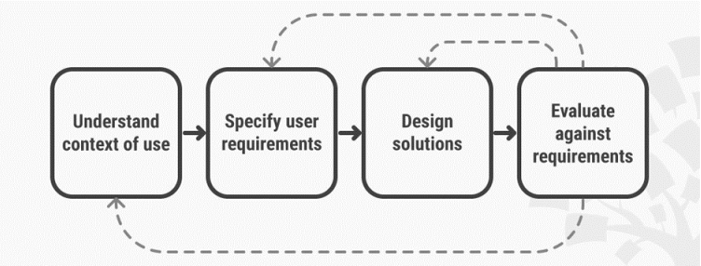
User-Centered Design and Design Process

Slide 7
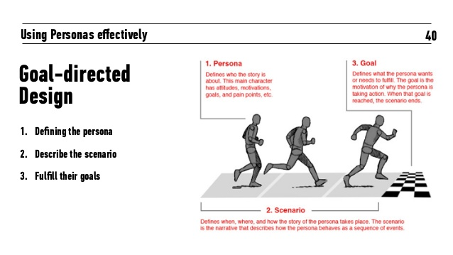
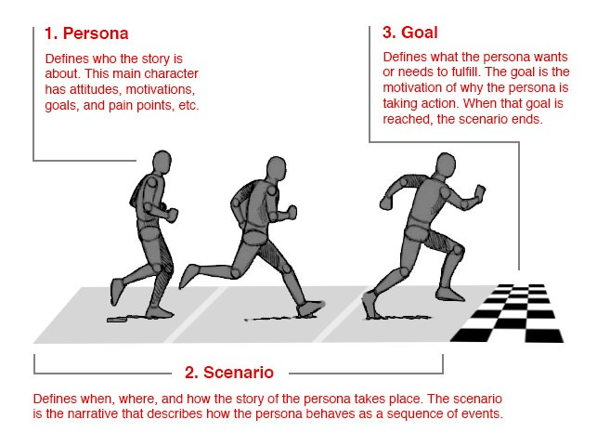

Slide 8
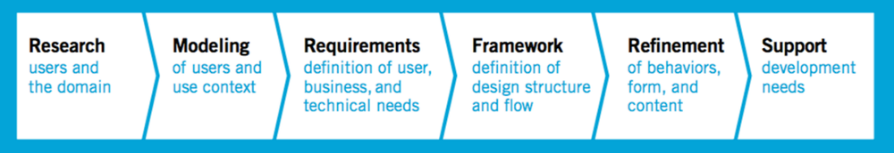
Goal-Directed Design
Goal Oriented Design is a methodology developed by Alan Cooper where a product is designed to accomplish the desire of user but here user is not actual user.
User is archetypical which is called persona and persona describes the goals or necessity of the user.
GDD helps to make improved quality product with less time and less cost along with an effective documentation

Slide 9
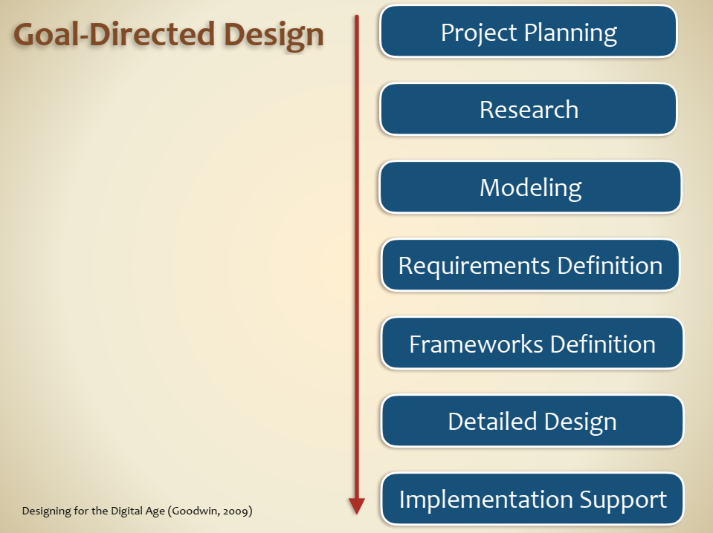

Slide 10
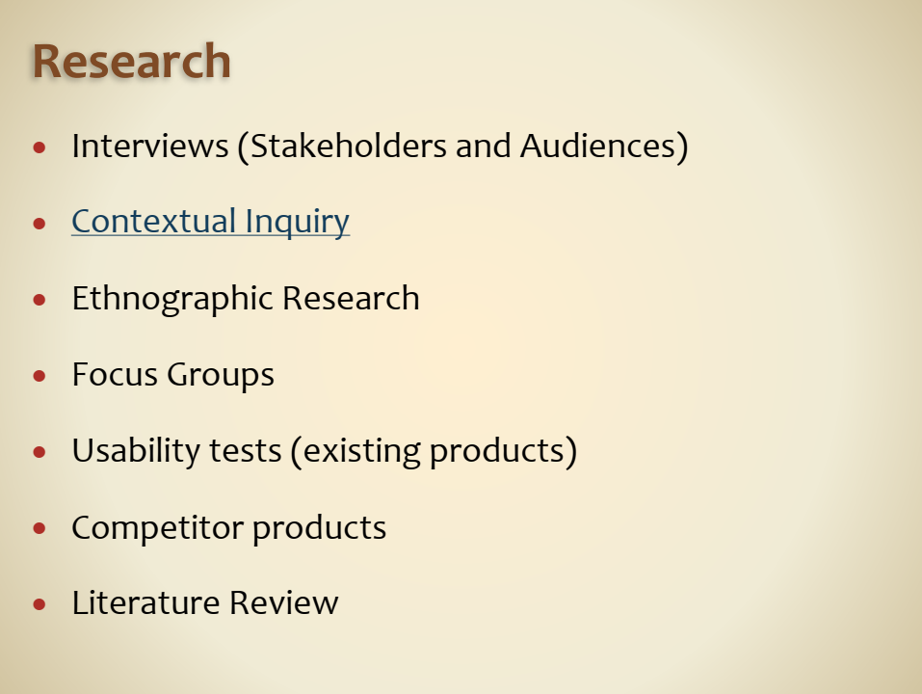
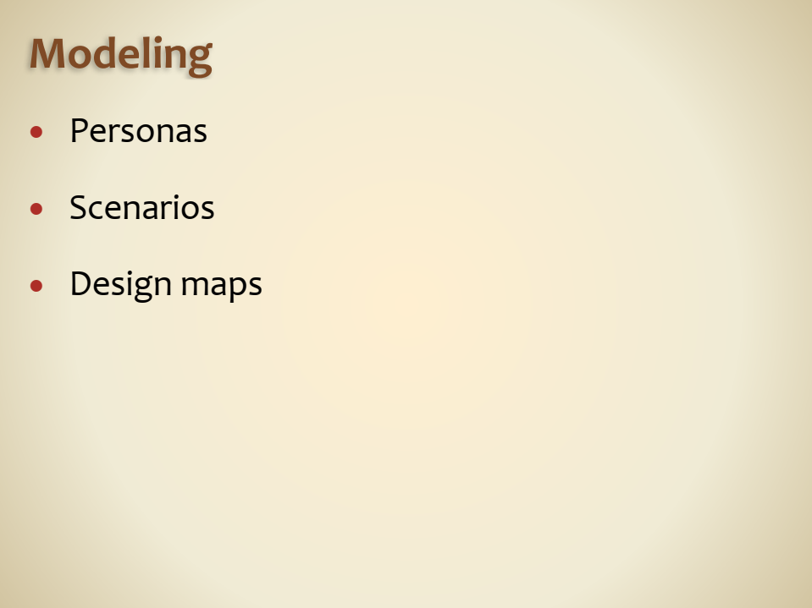

Slide 11
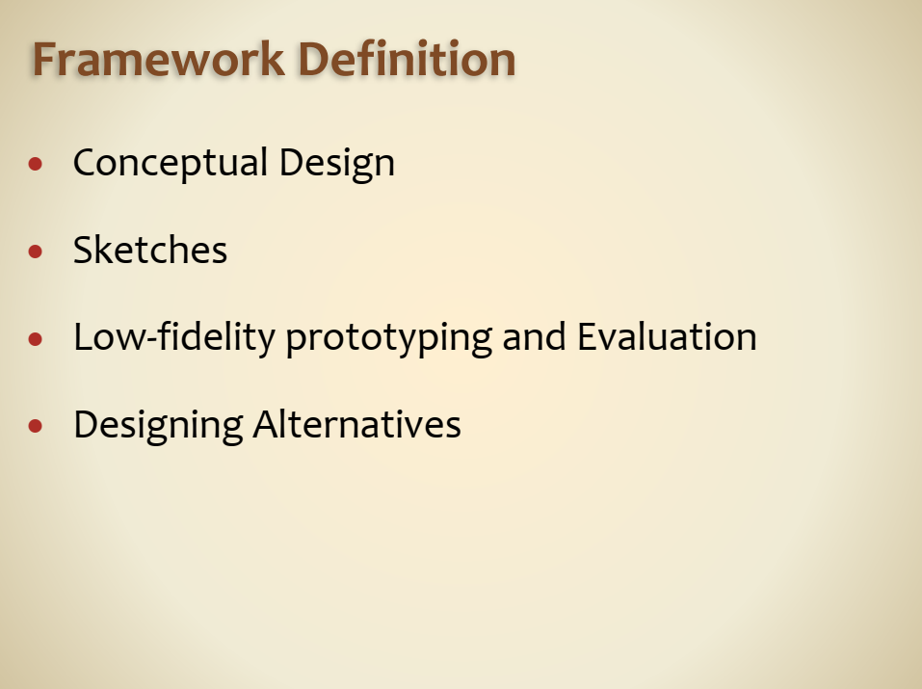
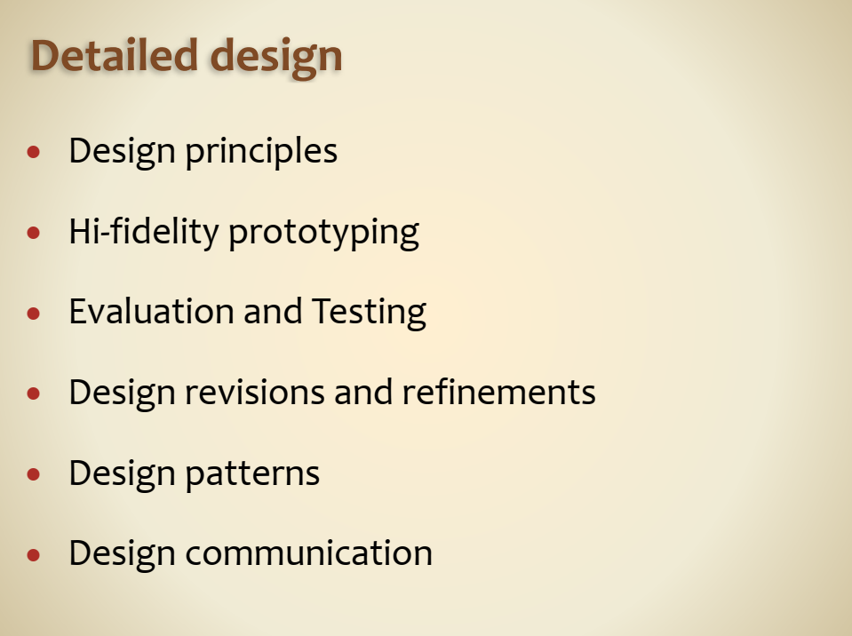

Slide 12
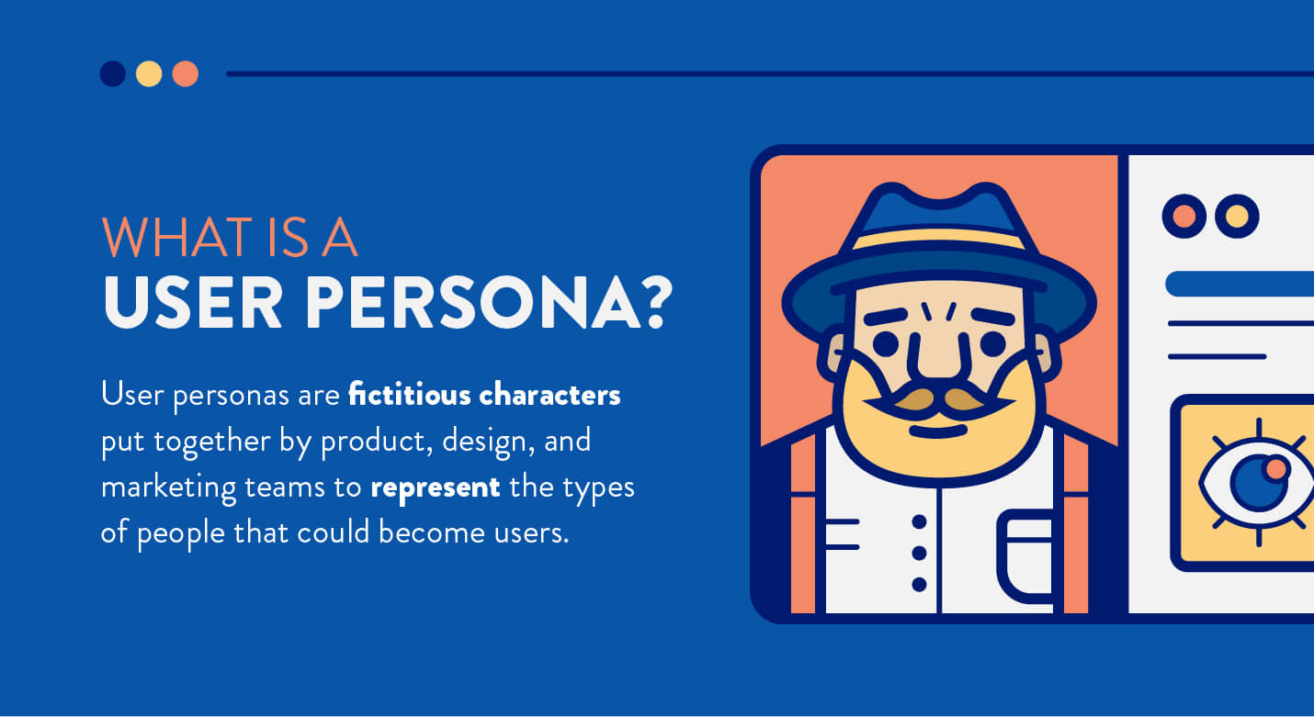

Slide 13
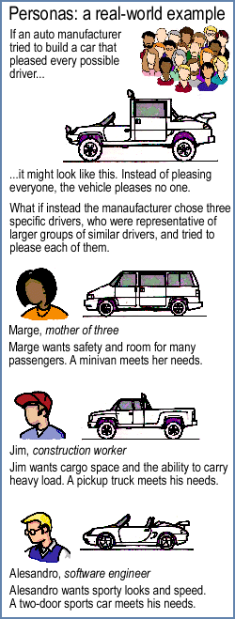
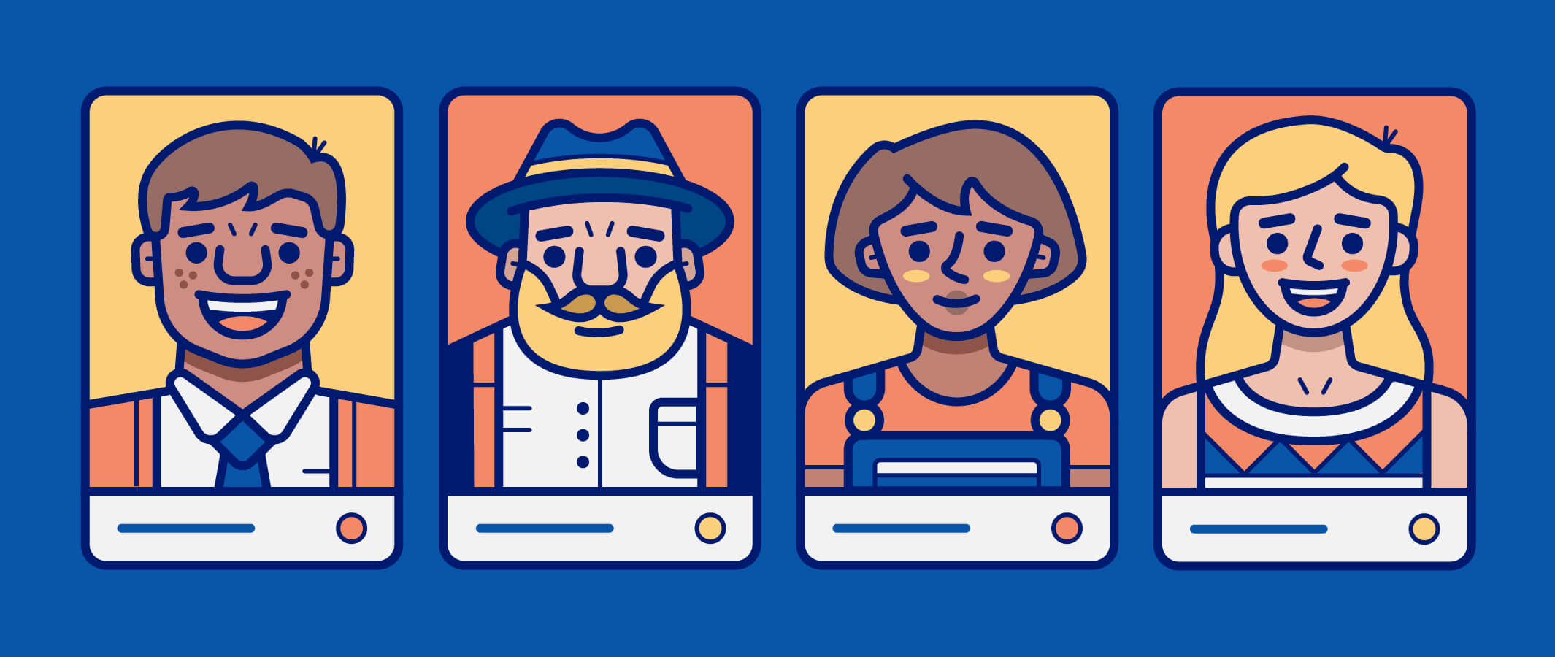

Slide 14
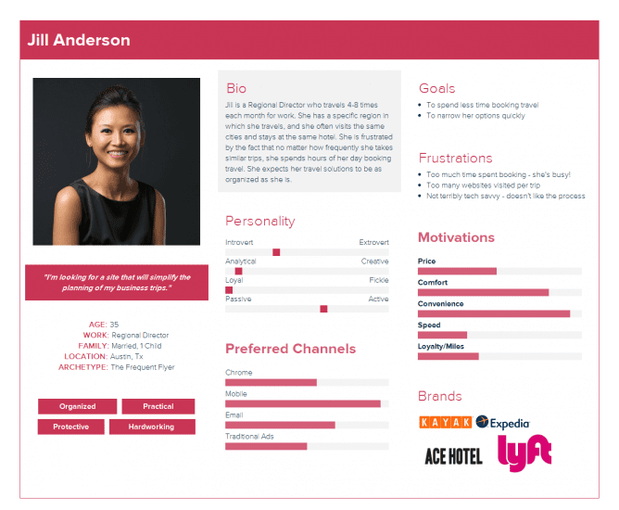
Creating personas
Personas are archetypes of real users.
It is a representation of a particular group of people with similar behavior, needs, goals, skills, attitudes, etc.
Personas make it possible to bring your users to life and help understand their problems better.
This understanding allows designers to make the right decisions about product features, navigation, interactions, visual design, and much more.

Slide 15
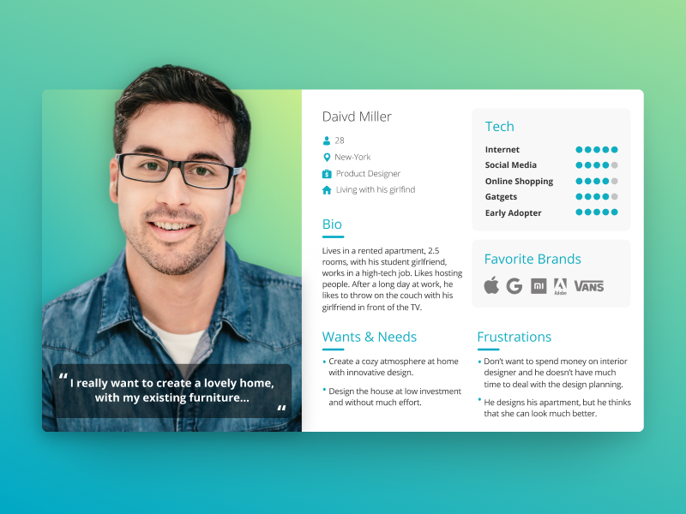

Slide 16

Participatory Design

Slide 17

Participatory Design
An approach to design that invites all stakeholders (e.g. customers, employees, partners, citizens, consumers) into the design process as a means of better understanding, meeting, and sometimes preempting their needs.
Participatory design is an approach to design strategy that brings customers into the heart of the design process. Also known as “co-creation”, “co-design”, or “cooperative design”, it encompasses techniques useful to both initial discovery and subsequent ideation phases of a project, where the end-users of a product, service, or experience take an active role in co-designing solutions for themselves

Slide 18
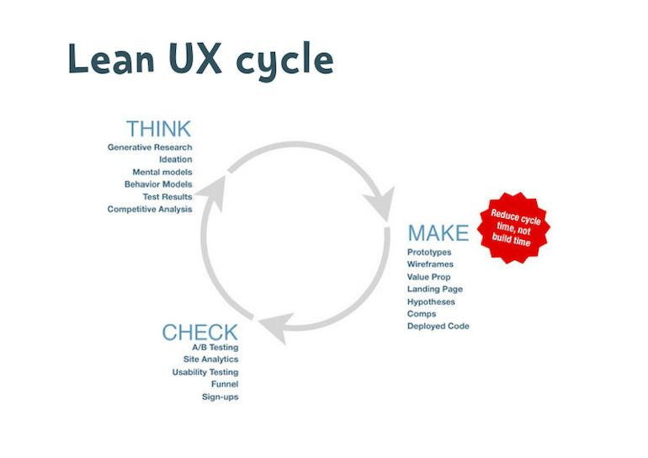
Lean UX:

Slide 19
Lean UX:
Lean UX is an iterative design approach that includes product validation with users which they are going to use. It’s about producing a useable and useful product.
It focuses on better user experience while the design process is running so that early feedback can be used for taking quick decisions.
Lean UX needs are validation of hypothesis and assumption for understanding what we are going to design. Cross-functional team, measurement, and testing taking a different approach to design deliverables.

