Slide 1
EE487 Lesson 31:
Spread Spectrum

Slide 2
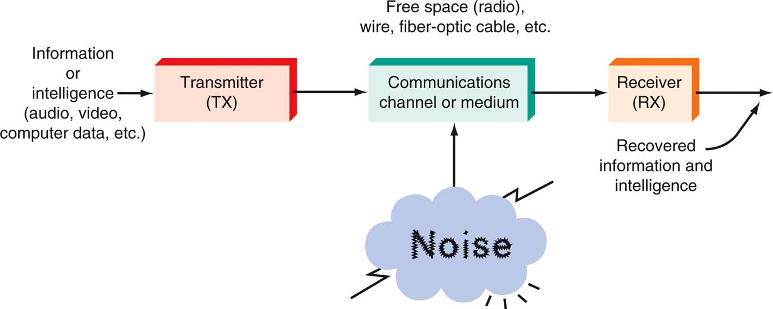
Communication Systems
Figure 1-2: A general model of all communication systems.

Slide 3

Big Picture
System Unit
  Buffer Overflow
Networking Unit
  Data Transmission
  Data Security
Wireless Unit
  Propagation, Measurement, Optimization
  Assuring Availability
  Wireless Attacks

Slide 4
Spread Spectrum
Wideband Modulation
Benefits
  Information Security
  Interference Resistance
  Band Sharing
Frequency Hopping Spread Spectrum (FHSS)
  Data are constant
  Frequencies are randomized
Direct Sequence Spread Spectrum (DSSS)
  Frequency is constant
  Data are randomized

Slide 5


History of spread spectrum
Spread spectrum has its roots in the military’s need for a communication system that is secure and immune to jamming.
Consider how spectrum is typically divided among multiple users.
90.3
WHID
Salisbury
90.5
WKHS
Worton
90.7
WSDL
Ocean City
90.9
WETA
Washington
91.1
WHFC
Bel Air
91.3
WMLU
Farmville
91.5
WBJC
Baltimore
Frequency
(MHz)

Slide 6

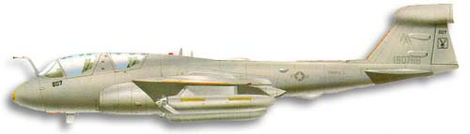
RF Spectrum
This system of frequency division allows multiple stations to share a portion of the RF spectrum without interference.
  e.g., 100 FM radio stations can be assigned to operate in the
  frequency range 88-108 MHz
Main advantage is simplicity.
What are the implications of fixed frequencies for military applications?

Slide 7
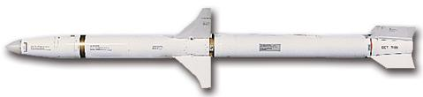
Military RF considerations
High-power, fixed-frequency transmitters make easy targets.
  Easy to jam
  Easy to destroy
AGM-88
High-speed Anti-Radiation (HARM)
missile
Missile seeker head locks on to
RF transmitters
90.9
WETA

Slide 8

Frequency hopping
This dilemma was recognized prior to WWII.
In 1942, Hedy Lamarr and pianist
George Antheil patented a “Secret
Communication System”.
Their scheme was for a
frequency hopping
remote control for
torpedo guidance.
Hedy Lamarr
Actress and co-inventor of frequency hopping spread spectrum
Notes:
http://www.hedylamarr.org/
In 1936 Hedy Lamarr became the first woman to grace the silver screen in a feature film wearing nothing but her birthday suit. Five years later, at a Hollywood dinner party, she engaged in a passionate discussion with an avant-garde composer about protecting U.S. radio-guided torpedoes from enemy interference.
She scrawled her phone number in lipstick on the windshield of his car so they could develop their ideas further.
In 1942, unbeknownst to her adoring public, the unlikely duo secured a patent and gave it to the United States government for a "Secret Communications System" expressly constructed to assist in the defeat of Hitler.
The science presented in this patent serves as the basis for the technology we use today in cell phones, pagers, wireless Internet, defense satellites, and a plethora of other spread-spectrum devices.
In 1933 Hedy achieved international renown when she played the first nude scenes in cinematic history in the Czech film "Ecstasy." The film was banned in many countries around the world, including the United States.
On August 10, 1933, Hedy Kiesler married Austrian industrialist Fritz Mandl, CEO of one of the world's leading arms manufacturers. While her husband forbade her to pursue her acting career, (attempting to buy up all existing copies of "Ecstasy"), this proved to be one of the most valuable relationships to the scientific technology she would develop years later.
From Strapless to Wireless Hedy Lamarr helped to set the groundwork for some of the most revolutionary technology of our time.
Following the outbreak of World War II, Lamarr, a passionate opponent of the Nazis, wanted to contribute more to the allied effort. As Mrs. Fritz Mandl, she had closely observed the planning and discussions that went into attempting to design remote-controlled torpedoes. These never went into production, because the radio-controlled guidance system was too susceptible to disruption. She got the idea of distributing the torpedo guidance signal over several frequencies, thus protecting it from enemy jamming. The only weak point was how to employ the synchronization of the signal's transmitter and receiver.
In 1940, Lamarr met the American avant-garde composer George Antheil of "ballet mécanique" fame. She described her idea to him, and asked him to help her construct a device that would enable this signal to be synchronized. Antheil laid out a system based on 88 frequencies, corresponding to the number of keys on a piano, using perforated paper rolls which would turn in sync with one another, transmitting and receiving ever-changing frequencies, preventing interceptance and jamming.
In December of 1940, the "frequency hopping" device developed by Lamarr and Antheil was submitted to the national inventors council, a semi-military inventors' association. Lamarr and Antheil went on to file for a patent application for the "Secret Communication System," June 10, 1941. The patent was granted by the United States patent office on august 11, 1942.
Lamarr and Antheil immediately placed their patent at the disposal of the US military. Though the us government did not deploy the "secret communication system" during World War II, the US Navy commissioned a project to acoustically detect submarines using sonar buoys remote-controlled from airplanes employing "frequency hopping" in the 1950s.
Twenty years after its conceptualization, during the 1962 Cuban missile crisis, the first instance of large-scale military deployment of Lamarr and Antheil's frequency hopping technology was implemented-- not for the remote-controlled guidance of torpedoes, but to provide secure communications among the ships involved in the naval blockade. The early '60s saw the development of reconnaissance drones based on frequency hopping, which were later deployed in Vietnam. With the emergence of digital technology and the military's release of frequency hopping for public use in the
1980s, Lamarr and Antheil's invention took on new significance. Instead of "frequency hopping," today's term is "spread spectrum" but the basic idea is the same. The FCC recently allotted a special section of the radio spectrum for an experiment using the spread spectrum idea in a test designed to make cell phone calls more secure. A lot of corporate dollars have been invested in this process which has allowed more cell phone users to use the existing frequency spectrum.

Slide 9
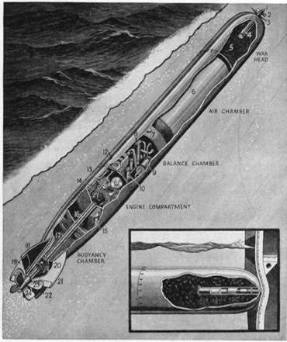
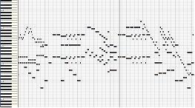
First spread-spectrum patent
By changing the transmitter frequencies in a “random” pattern, the torpedo control signal could not be jammed.
Lamarr proposed using 88
frequencies sequenced
for control.
Frequency switching pattern
Notes:
http://www.hedylamarr.org/
In 1936 Hedy Lamarr became the first woman to grace the silver screen in a feature film wearing nothing but her birthday suit. Five years later, at a Hollywood dinner party, she engaged in a passionate discussion with an avant-garde composer about protecting U.S. radio-guided torpedoes from enemy interference.
She scrawled her phone number in lipstick on the windshield of his car so they could develop their ideas further.
In 1942, unbeknownst to her adoring public, the unlikely duo secured a patent and gave it to the United States government for a "Secret Communications System" expressly constructed to assist in the defeat of Hitler.
The science presented in this patent serves as the basis for the technology we use today in cell phones, pagers, wireless Internet, defense satellites, and a plethora of other spread-spectrum devices.
In 1933 Hedy achieved international renown when she played the first nude scenes in cinematic history in the Czech film "Ecstasy." The film was banned in many countries around the world, including the United States.
On August 10, 1933, Hedy Kiesler married Austrian industrialist Fritz Mandl, CEO of one of the world's leading arms manufacturers. While her husband forbade her to pursue her acting career, (attempting to buy up all existing copies of "Ecstasy"), this proved to be one of the most valuable relationships to the scientific technology she would develop years later.
From Strapless to Wireless Hedy Lamarr helped to set the groundwork for some of the most revolutionary technology of our time.
Following the outbreak of World War II, Lamarr, a passionate opponent of the Nazis, wanted to contribute more to the allied effort. As Mrs. Fritz Mandl, she had closely observed the planning and discussions that went into attempting to design remote-controlled torpedoes. These never went into production, because the radio-controlled guidance system was too susceptible to disruption. She got the idea of distributing the torpedo guidance signal over several frequencies, thus protecting it from enemy jamming. The only weak point was how to employ the synchronization of the signal's transmitter and receiver.
In 1940, Lamarr met the American avant-garde composer George Antheil of "ballet mécanique" fame. She described her idea to him, and asked him to help her construct a device that would enable this signal to be synchronized. Antheil laid out a system based on 88 frequencies, corresponding to the number of keys on a piano, using perforated paper rolls which would turn in sync with one another, transmitting and receiving ever-changing frequencies, preventing interceptance and jamming.
In December of 1940, the "frequency hopping" device developed by Lamarr and Antheil was submitted to the national inventors council, a semi-military inventors' association. Lamarr and Antheil went on to file for a patent application for the "Secret Communication System," June 10, 1941. The patent was granted by the United States patent office on august 11, 1942.
Lamarr and Antheil immediately placed their patent at the disposal of the US military. Though the us government did not deploy the "secret communication system" during World War II, the US Navy commissioned a project to acoustically detect submarines using sonar buoys remote-controlled from airplanes employing "frequency hopping" in the 1950s.
Twenty years after its conceptualization, during the 1962 Cuban missile crisis, the first instance of large-scale military deployment of Lamarr and Antheil's frequency hopping technology was implemented-- not for the remote-controlled guidance of torpedoes, but to provide secure communications among the ships involved in the naval blockade. The early '60s saw the development of reconnaissance drones based on frequency hopping, which were later deployed in Vietnam. With the emergence of digital technology and the military's release of frequency hopping for public use in the
1980s, Lamarr and Antheil's invention took on new significance. Instead of "frequency hopping," today's term is "spread spectrum" but the basic idea is the same. The FCC recently allotted a special section of the radio spectrum for an experiment using the spread spectrum idea in a test designed to make cell phone calls more secure. A lot of corporate dollars have been invested in this process which has allowed more cell phone users to use the existing frequency spectrum.

Slide 10
Frequency hopping spread spectrum
In a frequency hopping spread spectrum system, the carrier frequency is switched in a pseudorandom fashion.
The transmitter and receiver know the pattern and are synchronized.
Time (ms)
Dwell time
225
230
235
240
245
250
255
f (MHz)
Notes:
http://www.hedylamarr.org/
In 1936 Hedy Lamarr became the first woman to grace the silver screen in a feature film wearing nothing but her birthday suit. Five years later, at a Hollywood dinner party, she engaged in a passionate discussion with an avant-garde composer about protecting U.S. radio-guided torpedoes from enemy interference.
She scrawled her phone number in lipstick on the windshield of his car so they could develop their ideas further.
In 1942, unbeknownst to her adoring public, the unlikely duo secured a patent and gave it to the United States government for a "Secret Communications System" expressly constructed to assist in the defeat of Hitler.
The science presented in this patent serves as the basis for the technology we use today in cell phones, pagers, wireless Internet, defense satellites, and a plethora of other spread-spectrum devices.
In 1933 Hedy achieved international renown when she played the first nude scenes in cinematic history in the Czech film "Ecstasy." The film was banned in many countries around the world, including the United States.
On August 10, 1933, Hedy Kiesler married Austrian industrialist Fritz Mandl, CEO of one of the world's leading arms manufacturers. While her husband forbade her to pursue her acting career, (attempting to buy up all existing copies of "Ecstasy"), this proved to be one of the most valuable relationships to the scientific technology she would develop years later.
From Strapless to Wireless Hedy Lamarr helped to set the groundwork for some of the most revolutionary technology of our time.
Following the outbreak of World War II, Lamarr, a passionate opponent of the Nazis, wanted to contribute more to the allied effort. As Mrs. Fritz Mandl, she had closely observed the planning and discussions that went into attempting to design remote-controlled torpedoes. These never went into production, because the radio-controlled guidance system was too susceptible to disruption. She got the idea of distributing the torpedo guidance signal over several frequencies, thus protecting it from enemy jamming. The only weak point was how to employ the synchronization of the signal's transmitter and receiver.
In 1940, Lamarr met the American avant-garde composer George Antheil of "ballet mécanique" fame. She described her idea to him, and asked him to help her construct a device that would enable this signal to be synchronized. Antheil laid out a system based on 88 frequencies, corresponding to the number of keys on a piano, using perforated paper rolls which would turn in sync with one another, transmitting and receiving ever-changing frequencies, preventing interceptance and jamming.
In December of 1940, the "frequency hopping" device developed by Lamarr and Antheil was submitted to the national inventors council, a semi-military inventors' association. Lamarr and Antheil went on to file for a patent application for the "Secret Communication System," June 10, 1941. The patent was granted by the United States patent office on august 11, 1942.
Lamarr and Antheil immediately placed their patent at the disposal of the US military. Though the us government did not deploy the "secret communication system" during World War II, the US Navy commissioned a project to acoustically detect submarines using sonar buoys remote-controlled from airplanes employing "frequency hopping" in the 1950s.
Twenty years after its conceptualization, during the 1962 Cuban missile crisis, the first instance of large-scale military deployment of Lamarr and Antheil's frequency hopping technology was implemented-- not for the remote-controlled guidance of torpedoes, but to provide secure communications among the ships involved in the naval blockade. The early '60s saw the development of reconnaissance drones based on frequency hopping, which were later deployed in Vietnam. With the emergence of digital technology and the military's release of frequency hopping for public use in the
1980s, Lamarr and Antheil's invention took on new significance. Instead of "frequency hopping," today's term is "spread spectrum" but the basic idea is the same. The FCC recently allotted a special section of the radio spectrum for an experiment using the spread spectrum idea in a test designed to make cell phone calls more secure. A lot of corporate dollars have been invested in this process which has allowed more cell phone users to use the existing frequency spectrum.

Slide 11
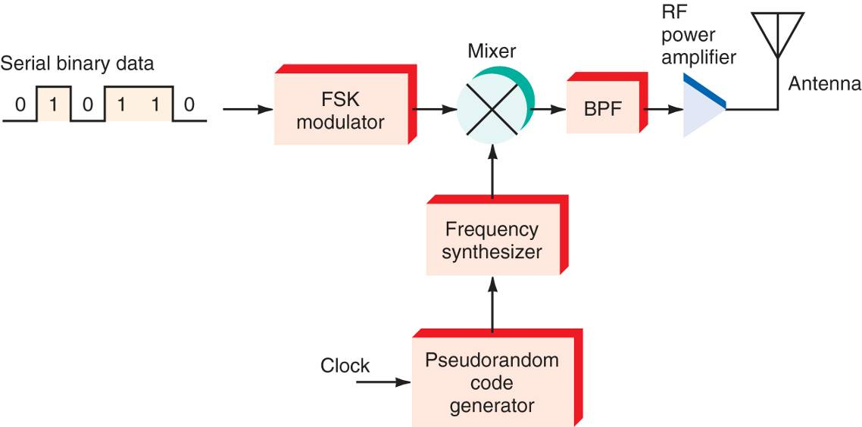
Frequency hopping transmitter
The binary data to be transmitted is applied to a conventional two-tone FSK modulator.
A frequency synthesizer produces a sine wave of a random frequency determined by a pseudorandom code generator.
These two signals are mixed together, filtered and then transmitted.
Notes:
http://www.hedylamarr.org/
In 1936 Hedy Lamarr became the first woman to grace the silver screen in a feature film wearing nothing but her birthday suit. Five years later, at a Hollywood dinner party, she engaged in a passionate discussion with an avant-garde composer about protecting U.S. radio-guided torpedoes from enemy interference.
She scrawled her phone number in lipstick on the windshield of his car so they could develop their ideas further.
In 1942, unbeknownst to her adoring public, the unlikely duo secured a patent and gave it to the United States government for a "Secret Communications System" expressly constructed to assist in the defeat of Hitler.
The science presented in this patent serves as the basis for the technology we use today in cell phones, pagers, wireless Internet, defense satellites, and a plethora of other spread-spectrum devices.
In 1933 Hedy achieved international renown when she played the first nude scenes in cinematic history in the Czech film "Ecstasy." The film was banned in many countries around the world, including the United States.
On August 10, 1933, Hedy Kiesler married Austrian industrialist Fritz Mandl, CEO of one of the world's leading arms manufacturers. While her husband forbade her to pursue her acting career, (attempting to buy up all existing copies of "Ecstasy"), this proved to be one of the most valuable relationships to the scientific technology she would develop years later.
From Strapless to Wireless Hedy Lamarr helped to set the groundwork for some of the most revolutionary technology of our time.
Following the outbreak of World War II, Lamarr, a passionate opponent of the Nazis, wanted to contribute more to the allied effort. As Mrs. Fritz Mandl, she had closely observed the planning and discussions that went into attempting to design remote-controlled torpedoes. These never went into production, because the radio-controlled guidance system was too susceptible to disruption. She got the idea of distributing the torpedo guidance signal over several frequencies, thus protecting it from enemy jamming. The only weak point was how to employ the synchronization of the signal's transmitter and receiver.
In 1940, Lamarr met the American avant-garde composer George Antheil of "ballet mécanique" fame. She described her idea to him, and asked him to help her construct a device that would enable this signal to be synchronized. Antheil laid out a system based on 88 frequencies, corresponding to the number of keys on a piano, using perforated paper rolls which would turn in sync with one another, transmitting and receiving ever-changing frequencies, preventing interceptance and jamming.
In December of 1940, the "frequency hopping" device developed by Lamarr and Antheil was submitted to the national inventors council, a semi-military inventors' association. Lamarr and Antheil went on to file for a patent application for the "Secret Communication System," June 10, 1941. The patent was granted by the United States patent office on august 11, 1942.
Lamarr and Antheil immediately placed their patent at the disposal of the US military. Though the us government did not deploy the "secret communication system" during World War II, the US Navy commissioned a project to acoustically detect submarines using sonar buoys remote-controlled from airplanes employing "frequency hopping" in the 1950s.
Twenty years after its conceptualization, during the 1962 Cuban missile crisis, the first instance of large-scale military deployment of Lamarr and Antheil's frequency hopping technology was implemented-- not for the remote-controlled guidance of torpedoes, but to provide secure communications among the ships involved in the naval blockade. The early '60s saw the development of reconnaissance drones based on frequency hopping, which were later deployed in Vietnam. With the emergence of digital technology and the military's release of frequency hopping for public use in the
1980s, Lamarr and Antheil's invention took on new significance. Instead of "frequency hopping," today's term is "spread spectrum" but the basic idea is the same. The FCC recently allotted a special section of the radio spectrum for an experiment using the spread spectrum idea in a test designed to make cell phone calls more secure. A lot of corporate dollars have been invested in this process which has allowed more cell phone users to use the existing frequency spectrum.

Slide 12
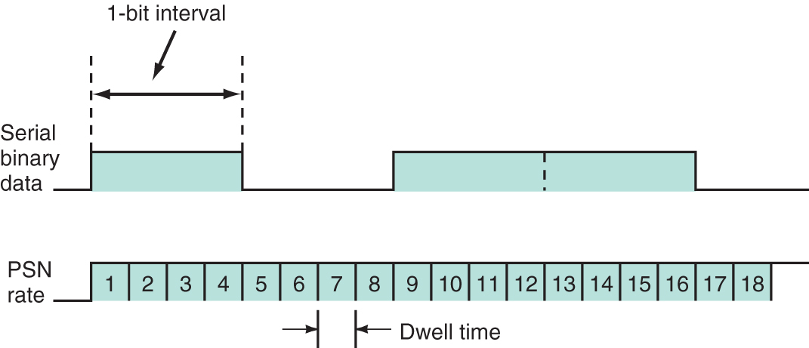
Frequency hopping transmitter
Typically the rate of frequency change is much higher than the data rate.
The illustration below shows that the frequency synthesizer changes 4 times for each data bit.
The time period spent on each frequency is called the dwell time (typically < 10 ms)
Notes:
http://www.hedylamarr.org/
In 1936 Hedy Lamarr became the first woman to grace the silver screen in a feature film wearing nothing but her birthday suit. Five years later, at a Hollywood dinner party, she engaged in a passionate discussion with an avant-garde composer about protecting U.S. radio-guided torpedoes from enemy interference.
She scrawled her phone number in lipstick on the windshield of his car so they could develop their ideas further.
In 1942, unbeknownst to her adoring public, the unlikely duo secured a patent and gave it to the United States government for a "Secret Communications System" expressly constructed to assist in the defeat of Hitler.
The science presented in this patent serves as the basis for the technology we use today in cell phones, pagers, wireless Internet, defense satellites, and a plethora of other spread-spectrum devices.
In 1933 Hedy achieved international renown when she played the first nude scenes in cinematic history in the Czech film "Ecstasy." The film was banned in many countries around the world, including the United States.
On August 10, 1933, Hedy Kiesler married Austrian industrialist Fritz Mandl, CEO of one of the world's leading arms manufacturers. While her husband forbade her to pursue her acting career, (attempting to buy up all existing copies of "Ecstasy"), this proved to be one of the most valuable relationships to the scientific technology she would develop years later.
From Strapless to Wireless Hedy Lamarr helped to set the groundwork for some of the most revolutionary technology of our time.
Following the outbreak of World War II, Lamarr, a passionate opponent of the Nazis, wanted to contribute more to the allied effort. As Mrs. Fritz Mandl, she had closely observed the planning and discussions that went into attempting to design remote-controlled torpedoes. These never went into production, because the radio-controlled guidance system was too susceptible to disruption. She got the idea of distributing the torpedo guidance signal over several frequencies, thus protecting it from enemy jamming. The only weak point was how to employ the synchronization of the signal's transmitter and receiver.
In 1940, Lamarr met the American avant-garde composer George Antheil of "ballet mécanique" fame. She described her idea to him, and asked him to help her construct a device that would enable this signal to be synchronized. Antheil laid out a system based on 88 frequencies, corresponding to the number of keys on a piano, using perforated paper rolls which would turn in sync with one another, transmitting and receiving ever-changing frequencies, preventing interceptance and jamming.
In December of 1940, the "frequency hopping" device developed by Lamarr and Antheil was submitted to the national inventors council, a semi-military inventors' association. Lamarr and Antheil went on to file for a patent application for the "Secret Communication System," June 10, 1941. The patent was granted by the United States patent office on august 11, 1942.
Lamarr and Antheil immediately placed their patent at the disposal of the US military. Though the us government did not deploy the "secret communication system" during World War II, the US Navy commissioned a project to acoustically detect submarines using sonar buoys remote-controlled from airplanes employing "frequency hopping" in the 1950s.
Twenty years after its conceptualization, during the 1962 Cuban missile crisis, the first instance of large-scale military deployment of Lamarr and Antheil's frequency hopping technology was implemented-- not for the remote-controlled guidance of torpedoes, but to provide secure communications among the ships involved in the naval blockade. The early '60s saw the development of reconnaissance drones based on frequency hopping, which were later deployed in Vietnam. With the emergence of digital technology and the military's release of frequency hopping for public use in the
1980s, Lamarr and Antheil's invention took on new significance. Instead of "frequency hopping," today's term is "spread spectrum" but the basic idea is the same. The FCC recently allotted a special section of the radio spectrum for an experiment using the spread spectrum idea in a test designed to make cell phone calls more secure. A lot of corporate dollars have been invested in this process which has allowed more cell phone users to use the existing frequency spectrum.

Slide 13
Frequency hopping spread spectrum
The resulting signal, whose frequency rapidly jumps around, effectively scatters pieces of the signal all over the band.
Someone else monitoring the spectrum would not recognize that a transmission is being made.
225
230
235
240
245
250
255
f (MHz)
Notes:
http://www.hedylamarr.org/
In 1936 Hedy Lamarr became the first woman to grace the silver screen in a feature film wearing nothing but her birthday suit. Five years later, at a Hollywood dinner party, she engaged in a passionate discussion with an avant-garde composer about protecting U.S. radio-guided torpedoes from enemy interference.
She scrawled her phone number in lipstick on the windshield of his car so they could develop their ideas further.
In 1942, unbeknownst to her adoring public, the unlikely duo secured a patent and gave it to the United States government for a "Secret Communications System" expressly constructed to assist in the defeat of Hitler.
The science presented in this patent serves as the basis for the technology we use today in cell phones, pagers, wireless Internet, defense satellites, and a plethora of other spread-spectrum devices.
In 1933 Hedy achieved international renown when she played the first nude scenes in cinematic history in the Czech film "Ecstasy." The film was banned in many countries around the world, including the United States.
On August 10, 1933, Hedy Kiesler married Austrian industrialist Fritz Mandl, CEO of one of the world's leading arms manufacturers. While her husband forbade her to pursue her acting career, (attempting to buy up all existing copies of "Ecstasy"), this proved to be one of the most valuable relationships to the scientific technology she would develop years later.
From Strapless to Wireless Hedy Lamarr helped to set the groundwork for some of the most revolutionary technology of our time.
Following the outbreak of World War II, Lamarr, a passionate opponent of the Nazis, wanted to contribute more to the allied effort. As Mrs. Fritz Mandl, she had closely observed the planning and discussions that went into attempting to design remote-controlled torpedoes. These never went into production, because the radio-controlled guidance system was too susceptible to disruption. She got the idea of distributing the torpedo guidance signal over several frequencies, thus protecting it from enemy jamming. The only weak point was how to employ the synchronization of the signal's transmitter and receiver.
In 1940, Lamarr met the American avant-garde composer George Antheil of "ballet mécanique" fame. She described her idea to him, and asked him to help her construct a device that would enable this signal to be synchronized. Antheil laid out a system based on 88 frequencies, corresponding to the number of keys on a piano, using perforated paper rolls which would turn in sync with one another, transmitting and receiving ever-changing frequencies, preventing interceptance and jamming.
In December of 1940, the "frequency hopping" device developed by Lamarr and Antheil was submitted to the national inventors council, a semi-military inventors' association. Lamarr and Antheil went on to file for a patent application for the "Secret Communication System," June 10, 1941. The patent was granted by the United States patent office on august 11, 1942.
Lamarr and Antheil immediately placed their patent at the disposal of the US military. Though the us government did not deploy the "secret communication system" during World War II, the US Navy commissioned a project to acoustically detect submarines using sonar buoys remote-controlled from airplanes employing "frequency hopping" in the 1950s.
Twenty years after its conceptualization, during the 1962 Cuban missile crisis, the first instance of large-scale military deployment of Lamarr and Antheil's frequency hopping technology was implemented-- not for the remote-controlled guidance of torpedoes, but to provide secure communications among the ships involved in the naval blockade. The early '60s saw the development of reconnaissance drones based on frequency hopping, which were later deployed in Vietnam. With the emergence of digital technology and the military's release of frequency hopping for public use in the
1980s, Lamarr and Antheil's invention took on new significance. Instead of "frequency hopping," today's term is "spread spectrum" but the basic idea is the same. The FCC recently allotted a special section of the radio spectrum for an experiment using the spread spectrum idea in a test designed to make cell phone calls more secure. A lot of corporate dollars have been invested in this process which has allowed more cell phone users to use the existing frequency spectrum.

Slide 14
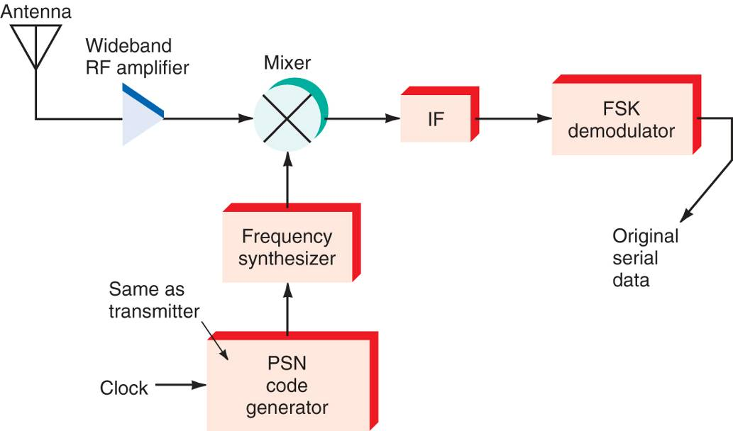
Frequency hopping receiver
The received signal is mixed using a local oscillator driven by the same pseudorandom sequence.
The output produces the original two-tone FSK signal from which the binary data can be extracted.
Timing is extremely critical in frequency hopping systems in order to maintain synchronization.
Notes:
http://www.hedylamarr.org/
In 1936 Hedy Lamarr became the first woman to grace the silver screen in a feature film wearing nothing but her birthday suit. Five years later, at a Hollywood dinner party, she engaged in a passionate discussion with an avant-garde composer about protecting U.S. radio-guided torpedoes from enemy interference.
She scrawled her phone number in lipstick on the windshield of his car so they could develop their ideas further.
In 1942, unbeknownst to her adoring public, the unlikely duo secured a patent and gave it to the United States government for a "Secret Communications System" expressly constructed to assist in the defeat of Hitler.
The science presented in this patent serves as the basis for the technology we use today in cell phones, pagers, wireless Internet, defense satellites, and a plethora of other spread-spectrum devices.
In 1933 Hedy achieved international renown when she played the first nude scenes in cinematic history in the Czech film "Ecstasy." The film was banned in many countries around the world, including the United States.
On August 10, 1933, Hedy Kiesler married Austrian industrialist Fritz Mandl, CEO of one of the world's leading arms manufacturers. While her husband forbade her to pursue her acting career, (attempting to buy up all existing copies of "Ecstasy"), this proved to be one of the most valuable relationships to the scientific technology she would develop years later.
From Strapless to Wireless Hedy Lamarr helped to set the groundwork for some of the most revolutionary technology of our time.
Following the outbreak of World War II, Lamarr, a passionate opponent of the Nazis, wanted to contribute more to the allied effort. As Mrs. Fritz Mandl, she had closely observed the planning and discussions that went into attempting to design remote-controlled torpedoes. These never went into production, because the radio-controlled guidance system was too susceptible to disruption. She got the idea of distributing the torpedo guidance signal over several frequencies, thus protecting it from enemy jamming. The only weak point was how to employ the synchronization of the signal's transmitter and receiver.
In 1940, Lamarr met the American avant-garde composer George Antheil of "ballet mécanique" fame. She described her idea to him, and asked him to help her construct a device that would enable this signal to be synchronized. Antheil laid out a system based on 88 frequencies, corresponding to the number of keys on a piano, using perforated paper rolls which would turn in sync with one another, transmitting and receiving ever-changing frequencies, preventing interceptance and jamming.
In December of 1940, the "frequency hopping" device developed by Lamarr and Antheil was submitted to the national inventors council, a semi-military inventors' association. Lamarr and Antheil went on to file for a patent application for the "Secret Communication System," June 10, 1941. The patent was granted by the United States patent office on august 11, 1942.
Lamarr and Antheil immediately placed their patent at the disposal of the US military. Though the us government did not deploy the "secret communication system" during World War II, the US Navy commissioned a project to acoustically detect submarines using sonar buoys remote-controlled from airplanes employing "frequency hopping" in the 1950s.
Twenty years after its conceptualization, during the 1962 Cuban missile crisis, the first instance of large-scale military deployment of Lamarr and Antheil's frequency hopping technology was implemented-- not for the remote-controlled guidance of torpedoes, but to provide secure communications among the ships involved in the naval blockade. The early '60s saw the development of reconnaissance drones based on frequency hopping, which were later deployed in Vietnam. With the emergence of digital technology and the military's release of frequency hopping for public use in the
1980s, Lamarr and Antheil's invention took on new significance. Instead of "frequency hopping," today's term is "spread spectrum" but the basic idea is the same. The FCC recently allotted a special section of the radio spectrum for an experiment using the spread spectrum idea in a test designed to make cell phone calls more secure. A lot of corporate dollars have been invested in this process which has allowed more cell phone users to use the existing frequency spectrum.

Slide 15
Practical Example: Bluetooth
2.4 GHz – 2.4835 GHz Operating Range
79 Different Radio Channels
Hops 1600 times per second for data/voice links
Hops 3200 times per second for page and inquiry scanning
1 Mbps = R_{b} for Bluetooth Ver 1.1/1.2
3 Mbps = R_{b} for Bluetooth Ver 2.1
Gaussian Frequency Shift Keying (GFSK)

Slide 16
Practical Example: Bluetooth
What is the dwell time for data/voice links? Page and inquiry scanning?
What is the bandwidth of an individual Bluetooth frequency channel?

Slide 17
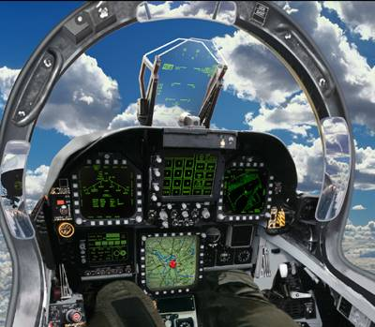
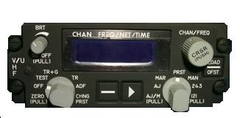
Military spread spectrum examples
HAVEQUICK is a frequency-hopping system used in aircraft radios to provide anti-jamming.
Every radio is synchronized by a timing signal (usually GPS) and steps through a pre-determined set of frequencies which is loaded into the radio daily.
ARC-210 HAVEQUICK
capable radio
Notes:
http://www.hedylamarr.org/
In 1936 Hedy Lamarr became the first woman to grace the silver screen in a feature film wearing nothing but her birthday suit. Five years later, at a Hollywood dinner party, she engaged in a passionate discussion with an avant-garde composer about protecting U.S. radio-guided torpedoes from enemy interference.
She scrawled her phone number in lipstick on the windshield of his car so they could develop their ideas further.
In 1942, unbeknownst to her adoring public, the unlikely duo secured a patent and gave it to the United States government for a "Secret Communications System" expressly constructed to assist in the defeat of Hitler.
The science presented in this patent serves as the basis for the technology we use today in cell phones, pagers, wireless Internet, defense satellites, and a plethora of other spread-spectrum devices.
In 1933 Hedy achieved international renown when she played the first nude scenes in cinematic history in the Czech film "Ecstasy." The film was banned in many countries around the world, including the United States.
On August 10, 1933, Hedy Kiesler married Austrian industrialist Fritz Mandl, CEO of one of the world's leading arms manufacturers. While her husband forbade her to pursue her acting career, (attempting to buy up all existing copies of "Ecstasy"), this proved to be one of the most valuable relationships to the scientific technology she would develop years later.
From Strapless to Wireless Hedy Lamarr helped to set the groundwork for some of the most revolutionary technology of our time.
Following the outbreak of World War II, Lamarr, a passionate opponent of the Nazis, wanted to contribute more to the allied effort. As Mrs. Fritz Mandl, she had closely observed the planning and discussions that went into attempting to design remote-controlled torpedoes. These never went into production, because the radio-controlled guidance system was too susceptible to disruption. She got the idea of distributing the torpedo guidance signal over several frequencies, thus protecting it from enemy jamming. The only weak point was how to employ the synchronization of the signal's transmitter and receiver.
In 1940, Lamarr met the American avant-garde composer George Antheil of "ballet mécanique" fame. She described her idea to him, and asked him to help her construct a device that would enable this signal to be synchronized. Antheil laid out a system based on 88 frequencies, corresponding to the number of keys on a piano, using perforated paper rolls which would turn in sync with one another, transmitting and receiving ever-changing frequencies, preventing interceptance and jamming.
In December of 1940, the "frequency hopping" device developed by Lamarr and Antheil was submitted to the national inventors council, a semi-military inventors' association. Lamarr and Antheil went on to file for a patent application for the "Secret Communication System," June 10, 1941. The patent was granted by the United States patent office on august 11, 1942.
Lamarr and Antheil immediately placed their patent at the disposal of the US military. Though the us government did not deploy the "secret communication system" during World War II, the US Navy commissioned a project to acoustically detect submarines using sonar buoys remote-controlled from airplanes employing "frequency hopping" in the 1950s.
Twenty years after its conceptualization, during the 1962 Cuban missile crisis, the first instance of large-scale military deployment of Lamarr and Antheil's frequency hopping technology was implemented-- not for the remote-controlled guidance of torpedoes, but to provide secure communications among the ships involved in the naval blockade. The early '60s saw the development of reconnaissance drones based on frequency hopping, which were later deployed in Vietnam. With the emergence of digital technology and the military's release of frequency hopping for public use in the
1980s, Lamarr and Antheil's invention took on new significance. Instead of "frequency hopping," today's term is "spread spectrum" but the basic idea is the same. The FCC recently allotted a special section of the radio spectrum for an experiment using the spread spectrum idea in a test designed to make cell phone calls more secure. A lot of corporate dollars have been invested in this process which has allowed more cell phone users to use the existing frequency spectrum.

Slide 18

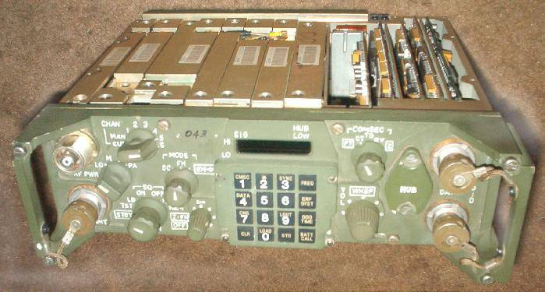
Military spread spectrum examples
SINCGARS is a VHF-FM frequency-hopping system used by the Army, Navy, and USMC.
SINCGARS operates on any or all of the 2,320 frequencies between 30 and 87.975 MHz in 25 kHz increments.
Notes:
http://www.hedylamarr.org/
In 1936 Hedy Lamarr became the first woman to grace the silver screen in a feature film wearing nothing but her birthday suit. Five years later, at a Hollywood dinner party, she engaged in a passionate discussion with an avant-garde composer about protecting U.S. radio-guided torpedoes from enemy interference.
She scrawled her phone number in lipstick on the windshield of his car so they could develop their ideas further.
In 1942, unbeknownst to her adoring public, the unlikely duo secured a patent and gave it to the United States government for a "Secret Communications System" expressly constructed to assist in the defeat of Hitler.
The science presented in this patent serves as the basis for the technology we use today in cell phones, pagers, wireless Internet, defense satellites, and a plethora of other spread-spectrum devices.
In 1933 Hedy achieved international renown when she played the first nude scenes in cinematic history in the Czech film "Ecstasy." The film was banned in many countries around the world, including the United States.
On August 10, 1933, Hedy Kiesler married Austrian industrialist Fritz Mandl, CEO of one of the world's leading arms manufacturers. While her husband forbade her to pursue her acting career, (attempting to buy up all existing copies of "Ecstasy"), this proved to be one of the most valuable relationships to the scientific technology she would develop years later.
From Strapless to Wireless Hedy Lamarr helped to set the groundwork for some of the most revolutionary technology of our time.
Following the outbreak of World War II, Lamarr, a passionate opponent of the Nazis, wanted to contribute more to the allied effort. As Mrs. Fritz Mandl, she had closely observed the planning and discussions that went into attempting to design remote-controlled torpedoes. These never went into production, because the radio-controlled guidance system was too susceptible to disruption. She got the idea of distributing the torpedo guidance signal over several frequencies, thus protecting it from enemy jamming. The only weak point was how to employ the synchronization of the signal's transmitter and receiver.
In 1940, Lamarr met the American avant-garde composer George Antheil of "ballet mécanique" fame. She described her idea to him, and asked him to help her construct a device that would enable this signal to be synchronized. Antheil laid out a system based on 88 frequencies, corresponding to the number of keys on a piano, using perforated paper rolls which would turn in sync with one another, transmitting and receiving ever-changing frequencies, preventing interceptance and jamming.
In December of 1940, the "frequency hopping" device developed by Lamarr and Antheil was submitted to the national inventors council, a semi-military inventors' association. Lamarr and Antheil went on to file for a patent application for the "Secret Communication System," June 10, 1941. The patent was granted by the United States patent office on august 11, 1942.
Lamarr and Antheil immediately placed their patent at the disposal of the US military. Though the us government did not deploy the "secret communication system" during World War II, the US Navy commissioned a project to acoustically detect submarines using sonar buoys remote-controlled from airplanes employing "frequency hopping" in the 1950s.
Twenty years after its conceptualization, during the 1962 Cuban missile crisis, the first instance of large-scale military deployment of Lamarr and Antheil's frequency hopping technology was implemented-- not for the remote-controlled guidance of torpedoes, but to provide secure communications among the ships involved in the naval blockade. The early '60s saw the development of reconnaissance drones based on frequency hopping, which were later deployed in Vietnam. With the emergence of digital technology and the military's release of frequency hopping for public use in the
1980s, Lamarr and Antheil's invention took on new significance. Instead of "frequency hopping," today's term is "spread spectrum" but the basic idea is the same. The FCC recently allotted a special section of the radio spectrum for an experiment using the spread spectrum idea in a test designed to make cell phone calls more secure. A lot of corporate dollars have been invested in this process which has allowed more cell phone users to use the existing frequency spectrum.

Slide 19
Spread Spectrum
Wideband Modulation
Benefits
  Information Security
  Interference Resistance
  Band Sharing
Frequency Hopping Spread Spectrum (FHSS)
  Data are constant
  Frequencies are randomized
Direct Sequence Spread Spectrum (DSSS)
  Frequency is constant
  Data are randomized

Slide 20
Pseudorandom sequences
The spread of the “random” sequence of frequencies is determined by a pseudonoise (PN) sequence generator.
A PN generator outputs a stream of bits (1s and 0s) that appears random (has no apparent pattern).
PN sequence generators are easy to construct using simple logic components:
  XOR gates, and
  a shift register, made up of flip flops
A PN sequence is not truly random (hence, “pseudo”), but is periodic and repeats at a fixed interval.
Notes:
http://www.hedylamarr.org/
In 1936 Hedy Lamarr became the first woman to grace the silver screen in a feature film wearing nothing but her birthday suit. Five years later, at a Hollywood dinner party, she engaged in a passionate discussion with an avant-garde composer about protecting U.S. radio-guided torpedoes from enemy interference.
She scrawled her phone number in lipstick on the windshield of his car so they could develop their ideas further.
In 1942, unbeknownst to her adoring public, the unlikely duo secured a patent and gave it to the United States government for a "Secret Communications System" expressly constructed to assist in the defeat of Hitler.
The science presented in this patent serves as the basis for the technology we use today in cell phones, pagers, wireless Internet, defense satellites, and a plethora of other spread-spectrum devices.
In 1933 Hedy achieved international renown when she played the first nude scenes in cinematic history in the Czech film "Ecstasy." The film was banned in many countries around the world, including the United States.
On August 10, 1933, Hedy Kiesler married Austrian industrialist Fritz Mandl, CEO of one of the world's leading arms manufacturers. While her husband forbade her to pursue her acting career, (attempting to buy up all existing copies of "Ecstasy"), this proved to be one of the most valuable relationships to the scientific technology she would develop years later.
From Strapless to Wireless Hedy Lamarr helped to set the groundwork for some of the most revolutionary technology of our time.
Following the outbreak of World War II, Lamarr, a passionate opponent of the Nazis, wanted to contribute more to the allied effort. As Mrs. Fritz Mandl, she had closely observed the planning and discussions that went into attempting to design remote-controlled torpedoes. These never went into production, because the radio-controlled guidance system was too susceptible to disruption. She got the idea of distributing the torpedo guidance signal over several frequencies, thus protecting it from enemy jamming. The only weak point was how to employ the synchronization of the signal's transmitter and receiver.
In 1940, Lamarr met the American avant-garde composer George Antheil of "ballet mécanique" fame. She described her idea to him, and asked him to help her construct a device that would enable this signal to be synchronized. Antheil laid out a system based on 88 frequencies, corresponding to the number of keys on a piano, using perforated paper rolls which would turn in sync with one another, transmitting and receiving ever-changing frequencies, preventing interceptance and jamming.
In December of 1940, the "frequency hopping" device developed by Lamarr and Antheil was submitted to the national inventors council, a semi-military inventors' association. Lamarr and Antheil went on to file for a patent application for the "Secret Communication System," June 10, 1941. The patent was granted by the United States patent office on august 11, 1942.
Lamarr and Antheil immediately placed their patent at the disposal of the US military. Though the us government did not deploy the "secret communication system" during World War II, the US Navy commissioned a project to acoustically detect submarines using sonar buoys remote-controlled from airplanes employing "frequency hopping" in the 1950s.
Twenty years after its conceptualization, during the 1962 Cuban missile crisis, the first instance of large-scale military deployment of Lamarr and Antheil's frequency hopping technology was implemented-- not for the remote-controlled guidance of torpedoes, but to provide secure communications among the ships involved in the naval blockade. The early '60s saw the development of reconnaissance drones based on frequency hopping, which were later deployed in Vietnam. With the emergence of digital technology and the military's release of frequency hopping for public use in the
1980s, Lamarr and Antheil's invention took on new significance. Instead of "frequency hopping," today's term is "spread spectrum" but the basic idea is the same. The FCC recently allotted a special section of the radio spectrum for an experiment using the spread spectrum idea in a test designed to make cell phone calls more secure. A lot of corporate dollars have been invested in this process which has allowed more cell phone users to use the existing frequency spectrum.

Slide 21
PN sequence generator
The PN sequence length is the number of iterations (the number of 1s and 0s) before the sequence repeats.
The sequence length is determined by the:
  number of flip flops, n, in the shift register
  selection of feedback taps that are applied to one or more XOR gates.
The sequence length can have a maximum value of:
A PN sequence that has this length is said to be a maximal length sequence.
number of flip flops
Notes:
http://www.hedylamarr.org/
In 1936 Hedy Lamarr became the first woman to grace the silver screen in a feature film wearing nothing but her birthday suit. Five years later, at a Hollywood dinner party, she engaged in a passionate discussion with an avant-garde composer about protecting U.S. radio-guided torpedoes from enemy interference.
She scrawled her phone number in lipstick on the windshield of his car so they could develop their ideas further.
In 1942, unbeknownst to her adoring public, the unlikely duo secured a patent and gave it to the United States government for a "Secret Communications System" expressly constructed to assist in the defeat of Hitler.
The science presented in this patent serves as the basis for the technology we use today in cell phones, pagers, wireless Internet, defense satellites, and a plethora of other spread-spectrum devices.
In 1933 Hedy achieved international renown when she played the first nude scenes in cinematic history in the Czech film "Ecstasy." The film was banned in many countries around the world, including the United States.
On August 10, 1933, Hedy Kiesler married Austrian industrialist Fritz Mandl, CEO of one of the world's leading arms manufacturers. While her husband forbade her to pursue her acting career, (attempting to buy up all existing copies of "Ecstasy"), this proved to be one of the most valuable relationships to the scientific technology she would develop years later.
From Strapless to Wireless Hedy Lamarr helped to set the groundwork for some of the most revolutionary technology of our time.
Following the outbreak of World War II, Lamarr, a passionate opponent of the Nazis, wanted to contribute more to the allied effort. As Mrs. Fritz Mandl, she had closely observed the planning and discussions that went into attempting to design remote-controlled torpedoes. These never went into production, because the radio-controlled guidance system was too susceptible to disruption. She got the idea of distributing the torpedo guidance signal over several frequencies, thus protecting it from enemy jamming. The only weak point was how to employ the synchronization of the signal's transmitter and receiver.
In 1940, Lamarr met the American avant-garde composer George Antheil of "ballet mécanique" fame. She described her idea to him, and asked him to help her construct a device that would enable this signal to be synchronized. Antheil laid out a system based on 88 frequencies, corresponding to the number of keys on a piano, using perforated paper rolls which would turn in sync with one another, transmitting and receiving ever-changing frequencies, preventing interceptance and jamming.
In December of 1940, the "frequency hopping" device developed by Lamarr and Antheil was submitted to the national inventors council, a semi-military inventors' association. Lamarr and Antheil went on to file for a patent application for the "Secret Communication System," June 10, 1941. The patent was granted by the United States patent office on august 11, 1942.
Lamarr and Antheil immediately placed their patent at the disposal of the US military. Though the us government did not deploy the "secret communication system" during World War II, the US Navy commissioned a project to acoustically detect submarines using sonar buoys remote-controlled from airplanes employing "frequency hopping" in the 1950s.
Twenty years after its conceptualization, during the 1962 Cuban missile crisis, the first instance of large-scale military deployment of Lamarr and Antheil's frequency hopping technology was implemented-- not for the remote-controlled guidance of torpedoes, but to provide secure communications among the ships involved in the naval blockade. The early '60s saw the development of reconnaissance drones based on frequency hopping, which were later deployed in Vietnam. With the emergence of digital technology and the military's release of frequency hopping for public use in the
1980s, Lamarr and Antheil's invention took on new significance. Instead of "frequency hopping," today's term is "spread spectrum" but the basic idea is the same. The FCC recently allotted a special section of the radio spectrum for an experiment using the spread spectrum idea in a test designed to make cell phone calls more secure. A lot of corporate dollars have been invested in this process which has allowed more cell phone users to use the existing frequency spectrum.

Slide 22
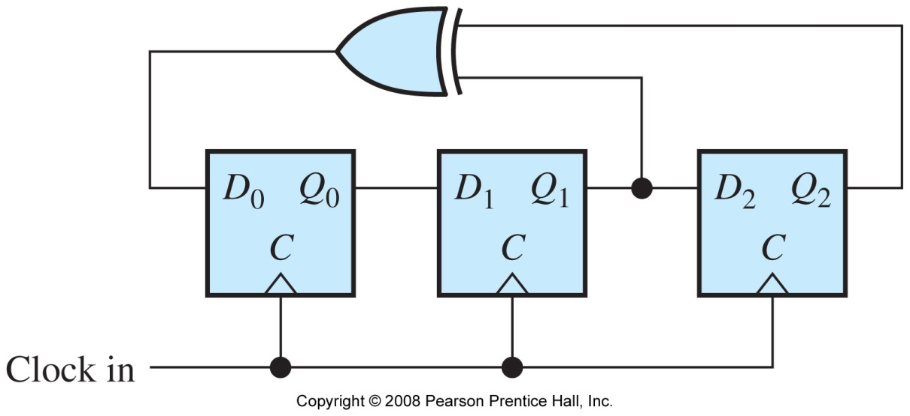
PN sequence generator
For the PN sequence generator below, the number of flip flops, n, is 3.
This generator will generate a maximal length sequence, and the length is determined by:
maximum length = 2^{n} – 1 = 2³ –1 = 7
Notes:
http://www.hedylamarr.org/
In 1936 Hedy Lamarr became the first woman to grace the silver screen in a feature film wearing nothing but her birthday suit. Five years later, at a Hollywood dinner party, she engaged in a passionate discussion with an avant-garde composer about protecting U.S. radio-guided torpedoes from enemy interference.
She scrawled her phone number in lipstick on the windshield of his car so they could develop their ideas further.
In 1942, unbeknownst to her adoring public, the unlikely duo secured a patent and gave it to the United States government for a "Secret Communications System" expressly constructed to assist in the defeat of Hitler.
The science presented in this patent serves as the basis for the technology we use today in cell phones, pagers, wireless Internet, defense satellites, and a plethora of other spread-spectrum devices.
In 1933 Hedy achieved international renown when she played the first nude scenes in cinematic history in the Czech film "Ecstasy." The film was banned in many countries around the world, including the United States.
On August 10, 1933, Hedy Kiesler married Austrian industrialist Fritz Mandl, CEO of one of the world's leading arms manufacturers. While her husband forbade her to pursue her acting career, (attempting to buy up all existing copies of "Ecstasy"), this proved to be one of the most valuable relationships to the scientific technology she would develop years later.
From Strapless to Wireless Hedy Lamarr helped to set the groundwork for some of the most revolutionary technology of our time.
Following the outbreak of World War II, Lamarr, a passionate opponent of the Nazis, wanted to contribute more to the allied effort. As Mrs. Fritz Mandl, she had closely observed the planning and discussions that went into attempting to design remote-controlled torpedoes. These never went into production, because the radio-controlled guidance system was too susceptible to disruption. She got the idea of distributing the torpedo guidance signal over several frequencies, thus protecting it from enemy jamming. The only weak point was how to employ the synchronization of the signal's transmitter and receiver.
In 1940, Lamarr met the American avant-garde composer George Antheil of "ballet mécanique" fame. She described her idea to him, and asked him to help her construct a device that would enable this signal to be synchronized. Antheil laid out a system based on 88 frequencies, corresponding to the number of keys on a piano, using perforated paper rolls which would turn in sync with one another, transmitting and receiving ever-changing frequencies, preventing interceptance and jamming.
In December of 1940, the "frequency hopping" device developed by Lamarr and Antheil was submitted to the national inventors council, a semi-military inventors' association. Lamarr and Antheil went on to file for a patent application for the "Secret Communication System," June 10, 1941. The patent was granted by the United States patent office on august 11, 1942.
Lamarr and Antheil immediately placed their patent at the disposal of the US military. Though the us government did not deploy the "secret communication system" during World War II, the US Navy commissioned a project to acoustically detect submarines using sonar buoys remote-controlled from airplanes employing "frequency hopping" in the 1950s.
Twenty years after its conceptualization, during the 1962 Cuban missile crisis, the first instance of large-scale military deployment of Lamarr and Antheil's frequency hopping technology was implemented-- not for the remote-controlled guidance of torpedoes, but to provide secure communications among the ships involved in the naval blockade. The early '60s saw the development of reconnaissance drones based on frequency hopping, which were later deployed in Vietnam. With the emergence of digital technology and the military's release of frequency hopping for public use in the
1980s, Lamarr and Antheil's invention took on new significance. Instead of "frequency hopping," today's term is "spread spectrum" but the basic idea is the same. The FCC recently allotted a special section of the radio spectrum for an experiment using the spread spectrum idea in a test designed to make cell phone calls more secure. A lot of corporate dollars have been invested in this process which has allowed more cell phone users to use the existing frequency spectrum.

Slide 23
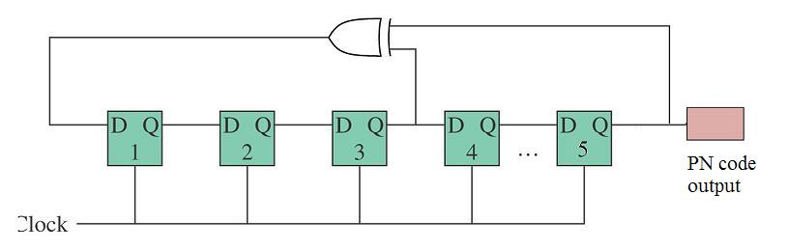
Example Problem 1
Assuming the circuit below is a maximal length PN sequence generator, how many outputs (1s and 0s) would it produce before the sequence repeats?

Slide 24
Example Problem 1
Assuming the circuit below is a maximal length PN sequence generator, how many outputs (1s and 0s) would it produce before the sequence repeats?
maximum length = 2^{n} – 1 = 2⁵ –1 = 31

Slide 25

Evaluating a PN sequence
Given initial flip flop values (seed value), we can determine successive states. Consider the 3-stage generator from earlier:
XOR function using Q₁ and Q₂ contents sets up the value of D₀
initial values (given)
CLK | D₀ | Q₀ | Q₁ | Q₂
1 | 1 | 0 | 0 | 1
2 | 0 | 1 | 0 | 0
3 | 1 | 0 | 1 | 0
4 | 1 | 1 | 0 | 1
5 | 1 | 1 | 1 | 0
6 | 0 | 1 | 1 | 1
7 | 0 | 0 | 1 | 1
1 | 1 | 0 | 0 | 1
2 | 0 | 1 | 0 | 0
Every clock cycle,
bits shift right
Notes:
http://www.hedylamarr.org/
In 1936 Hedy Lamarr became the first woman to grace the silver screen in a feature film wearing nothing but her birthday suit. Five years later, at a Hollywood dinner party, she engaged in a passionate discussion with an avant-garde composer about protecting U.S. radio-guided torpedoes from enemy interference.
She scrawled her phone number in lipstick on the windshield of his car so they could develop their ideas further.
In 1942, unbeknownst to her adoring public, the unlikely duo secured a patent and gave it to the United States government for a "Secret Communications System" expressly constructed to assist in the defeat of Hitler.
The science presented in this patent serves as the basis for the technology we use today in cell phones, pagers, wireless Internet, defense satellites, and a plethora of other spread-spectrum devices.
In 1933 Hedy achieved international renown when she played the first nude scenes in cinematic history in the Czech film "Ecstasy." The film was banned in many countries around the world, including the United States.
On August 10, 1933, Hedy Kiesler married Austrian industrialist Fritz Mandl, CEO of one of the world's leading arms manufacturers. While her husband forbade her to pursue her acting career, (attempting to buy up all existing copies of "Ecstasy"), this proved to be one of the most valuable relationships to the scientific technology she would develop years later.
From Strapless to Wireless Hedy Lamarr helped to set the groundwork for some of the most revolutionary technology of our time.
Following the outbreak of World War II, Lamarr, a passionate opponent of the Nazis, wanted to contribute more to the allied effort. As Mrs. Fritz Mandl, she had closely observed the planning and discussions that went into attempting to design remote-controlled torpedoes. These never went into production, because the radio-controlled guidance system was too susceptible to disruption. She got the idea of distributing the torpedo guidance signal over several frequencies, thus protecting it from enemy jamming. The only weak point was how to employ the synchronization of the signal's transmitter and receiver.
In 1940, Lamarr met the American avant-garde composer George Antheil of "ballet mécanique" fame. She described her idea to him, and asked him to help her construct a device that would enable this signal to be synchronized. Antheil laid out a system based on 88 frequencies, corresponding to the number of keys on a piano, using perforated paper rolls which would turn in sync with one another, transmitting and receiving ever-changing frequencies, preventing interceptance and jamming.
In December of 1940, the "frequency hopping" device developed by Lamarr and Antheil was submitted to the national inventors council, a semi-military inventors' association. Lamarr and Antheil went on to file for a patent application for the "Secret Communication System," June 10, 1941. The patent was granted by the United States patent office on august 11, 1942.
Lamarr and Antheil immediately placed their patent at the disposal of the US military. Though the us government did not deploy the "secret communication system" during World War II, the US Navy commissioned a project to acoustically detect submarines using sonar buoys remote-controlled from airplanes employing "frequency hopping" in the 1950s.
Twenty years after its conceptualization, during the 1962 Cuban missile crisis, the first instance of large-scale military deployment of Lamarr and Antheil's frequency hopping technology was implemented-- not for the remote-controlled guidance of torpedoes, but to provide secure communications among the ships involved in the naval blockade. The early '60s saw the development of reconnaissance drones based on frequency hopping, which were later deployed in Vietnam. With the emergence of digital technology and the military's release of frequency hopping for public use in the
1980s, Lamarr and Antheil's invention took on new significance. Instead of "frequency hopping," today's term is "spread spectrum" but the basic idea is the same. The FCC recently allotted a special section of the radio spectrum for an experiment using the spread spectrum idea in a test designed to make cell phone calls more secure. A lot of corporate dollars have been invested in this process which has allowed more cell phone users to use the existing frequency spectrum.

Slide 26
Evaluating a PN sequence
We will consider the output of the PN sequence generator to be simply the contents of the last flip flop, in this case Q₂. (Note that we could let any Q be “the output”.)
CLK | D₀ | Q₀ | Q₁ | Q₂
1 | 1 | 0 | 0 | 1
2 | 0 | 1 | 0 | 0
3 | 1 | 0 | 1 | 0
4 | 1 | 1 | 0 | 1
5 | 1 | 1 | 1 | 0
6 |  | 1 | 1 | 1
7
1 | 1 | 0 | 0 | 1
2 | 0 | 1 | 0 | 0
time
PN sequence output: 1 0 0 1 0 1 1 1 0 0 1 0 1 1 . . .
Sequence length is 7
Notes:
http://www.hedylamarr.org/
In 1936 Hedy Lamarr became the first woman to grace the silver screen in a feature film wearing nothing but her birthday suit. Five years later, at a Hollywood dinner party, she engaged in a passionate discussion with an avant-garde composer about protecting U.S. radio-guided torpedoes from enemy interference.
She scrawled her phone number in lipstick on the windshield of his car so they could develop their ideas further.
In 1942, unbeknownst to her adoring public, the unlikely duo secured a patent and gave it to the United States government for a "Secret Communications System" expressly constructed to assist in the defeat of Hitler.
The science presented in this patent serves as the basis for the technology we use today in cell phones, pagers, wireless Internet, defense satellites, and a plethora of other spread-spectrum devices.
In 1933 Hedy achieved international renown when she played the first nude scenes in cinematic history in the Czech film "Ecstasy." The film was banned in many countries around the world, including the United States.
On August 10, 1933, Hedy Kiesler married Austrian industrialist Fritz Mandl, CEO of one of the world's leading arms manufacturers. While her husband forbade her to pursue her acting career, (attempting to buy up all existing copies of "Ecstasy"), this proved to be one of the most valuable relationships to the scientific technology she would develop years later.
From Strapless to Wireless Hedy Lamarr helped to set the groundwork for some of the most revolutionary technology of our time.
Following the outbreak of World War II, Lamarr, a passionate opponent of the Nazis, wanted to contribute more to the allied effort. As Mrs. Fritz Mandl, she had closely observed the planning and discussions that went into attempting to design remote-controlled torpedoes. These never went into production, because the radio-controlled guidance system was too susceptible to disruption. She got the idea of distributing the torpedo guidance signal over several frequencies, thus protecting it from enemy jamming. The only weak point was how to employ the synchronization of the signal's transmitter and receiver.
In 1940, Lamarr met the American avant-garde composer George Antheil of "ballet mécanique" fame. She described her idea to him, and asked him to help her construct a device that would enable this signal to be synchronized. Antheil laid out a system based on 88 frequencies, corresponding to the number of keys on a piano, using perforated paper rolls which would turn in sync with one another, transmitting and receiving ever-changing frequencies, preventing interceptance and jamming.
In December of 1940, the "frequency hopping" device developed by Lamarr and Antheil was submitted to the national inventors council, a semi-military inventors' association. Lamarr and Antheil went on to file for a patent application for the "Secret Communication System," June 10, 1941. The patent was granted by the United States patent office on august 11, 1942.
Lamarr and Antheil immediately placed their patent at the disposal of the US military. Though the us government did not deploy the "secret communication system" during World War II, the US Navy commissioned a project to acoustically detect submarines using sonar buoys remote-controlled from airplanes employing "frequency hopping" in the 1950s.
Twenty years after its conceptualization, during the 1962 Cuban missile crisis, the first instance of large-scale military deployment of Lamarr and Antheil's frequency hopping technology was implemented-- not for the remote-controlled guidance of torpedoes, but to provide secure communications among the ships involved in the naval blockade. The early '60s saw the development of reconnaissance drones based on frequency hopping, which were later deployed in Vietnam. With the emergence of digital technology and the military's release of frequency hopping for public use in the
1980s, Lamarr and Antheil's invention took on new significance. Instead of "frequency hopping," today's term is "spread spectrum" but the basic idea is the same. The FCC recently allotted a special section of the radio spectrum for an experiment using the spread spectrum idea in a test designed to make cell phone calls more secure. A lot of corporate dollars have been invested in this process which has allowed more cell phone users to use the existing frequency spectrum.

Slide 27
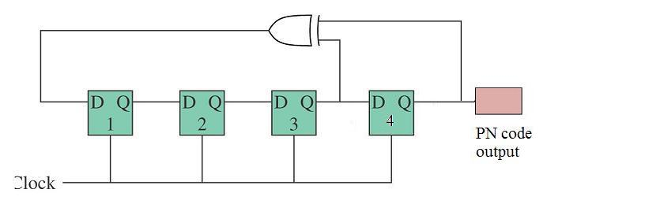
Example Problem 2
A PN sequence generator with 4 flip flops is depicted below. This generator will generate a maximal length sequence. How long is the sequence length? If the initial states of the flip flops are 0, 0, 0, and 1, determine the sequence.

Slide 28
Example Problem 2  solution
given initial states
CLK | D₁ | Q₁ | Q_{\2} | Q₃ | Q₄
1 | 1 | 0 | 0 | 0 | 1
2 | 0 | 1 | 0 | 0 | 0
3 | 0 | 0 | 1 | 0 | 0
4 | 1 | 0 | 0 | 1 | 0
5 | 1 | 1 | 0 | 0 | 1
6 | 0 | 1 | 1 | 0 | 0
7 | 1 | 0 | 1 | 1 | 0
8 | 0 | 1 | 0 | 1 | 1
9 | 1 | 0 | 1 | 0 | 1
10 | 1 | 1 | 0 | 1 | 0
11 | 1 | 1 | 1 | 0 | 1
12 | 1 | 1 | 1 | 1 | 0
13 | 0 | 1 | 1 | 1 | 1
14 | 0 | 0 | 1 | 1 | 1
15 | 0 | 0 | 0 | 1 | 1
1 | 1 | 0 | 0 | 0 | 1
2 | 0 | 1 | 0 | 0 | 0
Since it is a maximal length sequence,
the length is given by:
length = 2^{n} – 1
= 2⁴ – 1
= 15
repeats

Slide 29
PN sequence generator
In reality, the PN sequence generators used in practice contain numerous shift registers to achieve very long sequences.
Number of flip flops (n) | Sequence Length | XOR inputs from shift register stages
3 | 7 | 2, 3
4 | 15 | 3, 4
7 | 127 | 6, 7
8 | 255 | 4, 5, 6, 8
10 | 1,023 | 7, 10
16 | 65,535 | 4, 13, 15, 16
32 | 4,294,967,295 | 10, 30, 31, 32
Notes:
http://www.hedylamarr.org/
In 1936 Hedy Lamarr became the first woman to grace the silver screen in a feature film wearing nothing but her birthday suit. Five years later, at a Hollywood dinner party, she engaged in a passionate discussion with an avant-garde composer about protecting U.S. radio-guided torpedoes from enemy interference.
She scrawled her phone number in lipstick on the windshield of his car so they could develop their ideas further.
In 1942, unbeknownst to her adoring public, the unlikely duo secured a patent and gave it to the United States government for a "Secret Communications System" expressly constructed to assist in the defeat of Hitler.
The science presented in this patent serves as the basis for the technology we use today in cell phones, pagers, wireless Internet, defense satellites, and a plethora of other spread-spectrum devices.
In 1933 Hedy achieved international renown when she played the first nude scenes in cinematic history in the Czech film "Ecstasy." The film was banned in many countries around the world, including the United States.
On August 10, 1933, Hedy Kiesler married Austrian industrialist Fritz Mandl, CEO of one of the world's leading arms manufacturers. While her husband forbade her to pursue her acting career, (attempting to buy up all existing copies of "Ecstasy"), this proved to be one of the most valuable relationships to the scientific technology she would develop years later.
From Strapless to Wireless Hedy Lamarr helped to set the groundwork for some of the most revolutionary technology of our time.
Following the outbreak of World War II, Lamarr, a passionate opponent of the Nazis, wanted to contribute more to the allied effort. As Mrs. Fritz Mandl, she had closely observed the planning and discussions that went into attempting to design remote-controlled torpedoes. These never went into production, because the radio-controlled guidance system was too susceptible to disruption. She got the idea of distributing the torpedo guidance signal over several frequencies, thus protecting it from enemy jamming. The only weak point was how to employ the synchronization of the signal's transmitter and receiver.
In 1940, Lamarr met the American avant-garde composer George Antheil of "ballet mécanique" fame. She described her idea to him, and asked him to help her construct a device that would enable this signal to be synchronized. Antheil laid out a system based on 88 frequencies, corresponding to the number of keys on a piano, using perforated paper rolls which would turn in sync with one another, transmitting and receiving ever-changing frequencies, preventing interceptance and jamming.
In December of 1940, the "frequency hopping" device developed by Lamarr and Antheil was submitted to the national inventors council, a semi-military inventors' association. Lamarr and Antheil went on to file for a patent application for the "Secret Communication System," June 10, 1941. The patent was granted by the United States patent office on august 11, 1942.
Lamarr and Antheil immediately placed their patent at the disposal of the US military. Though the us government did not deploy the "secret communication system" during World War II, the US Navy commissioned a project to acoustically detect submarines using sonar buoys remote-controlled from airplanes employing "frequency hopping" in the 1950s.
Twenty years after its conceptualization, during the 1962 Cuban missile crisis, the first instance of large-scale military deployment of Lamarr and Antheil's frequency hopping technology was implemented-- not for the remote-controlled guidance of torpedoes, but to provide secure communications among the ships involved in the naval blockade. The early '60s saw the development of reconnaissance drones based on frequency hopping, which were later deployed in Vietnam. With the emergence of digital technology and the military's release of frequency hopping for public use in the
1980s, Lamarr and Antheil's invention took on new significance. Instead of "frequency hopping," today's term is "spread spectrum" but the basic idea is the same. The FCC recently allotted a special section of the radio spectrum for an experiment using the spread spectrum idea in a test designed to make cell phone calls more secure. A lot of corporate dollars have been invested in this process which has allowed more cell phone users to use the existing frequency spectrum.

Slide 30
Spread Spectrum
Wideband Modulation
Benefits
  Information Security
  Interference Resistance
  Band Sharing
Frequency Hopping Spread Spectrum (FHSS)
  Data are constant
  Frequencies are randomized
Direct Sequence Spread Spectrum (DSSS)
  Frequency is constant
  Data are randomized

Slide 31
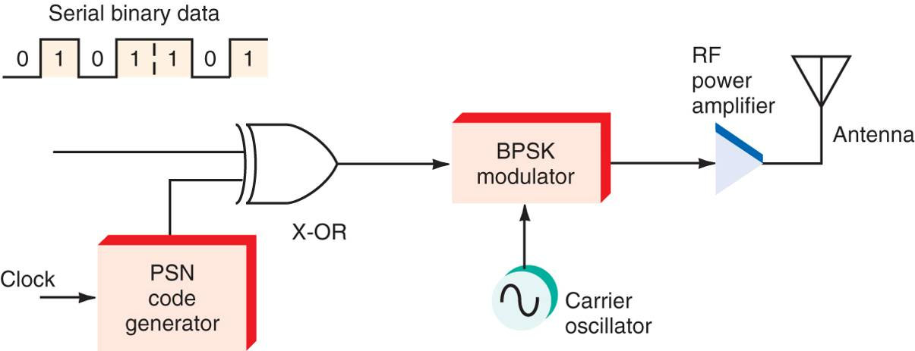
Direct Sequence Spread Spectrum
Another method of realizing spread spectrum is called direct sequence spread spectrum (DSSS).
In a DSSS system the message bit stream is modified by a higher rate pseudonoise (PN) sequence (called a chip sequence).
Notes:
http://www.hedylamarr.org/
In 1936 Hedy Lamarr became the first woman to grace the silver screen in a feature film wearing nothing but her birthday suit. Five years later, at a Hollywood dinner party, she engaged in a passionate discussion with an avant-garde composer about protecting U.S. radio-guided torpedoes from enemy interference.
She scrawled her phone number in lipstick on the windshield of his car so they could develop their ideas further.
In 1942, unbeknownst to her adoring public, the unlikely duo secured a patent and gave it to the United States government for a "Secret Communications System" expressly constructed to assist in the defeat of Hitler.
The science presented in this patent serves as the basis for the technology we use today in cell phones, pagers, wireless Internet, defense satellites, and a plethora of other spread-spectrum devices.
In 1933 Hedy achieved international renown when she played the first nude scenes in cinematic history in the Czech film "Ecstasy." The film was banned in many countries around the world, including the United States.
On August 10, 1933, Hedy Kiesler married Austrian industrialist Fritz Mandl, CEO of one of the world's leading arms manufacturers. While her husband forbade her to pursue her acting career, (attempting to buy up all existing copies of "Ecstasy"), this proved to be one of the most valuable relationships to the scientific technology she would develop years later.
From Strapless to Wireless Hedy Lamarr helped to set the groundwork for some of the most revolutionary technology of our time.
Following the outbreak of World War II, Lamarr, a passionate opponent of the Nazis, wanted to contribute more to the allied effort. As Mrs. Fritz Mandl, she had closely observed the planning and discussions that went into attempting to design remote-controlled torpedoes. These never went into production, because the radio-controlled guidance system was too susceptible to disruption. She got the idea of distributing the torpedo guidance signal over several frequencies, thus protecting it from enemy jamming. The only weak point was how to employ the synchronization of the signal's transmitter and receiver.
In 1940, Lamarr met the American avant-garde composer George Antheil of "ballet mécanique" fame. She described her idea to him, and asked him to help her construct a device that would enable this signal to be synchronized. Antheil laid out a system based on 88 frequencies, corresponding to the number of keys on a piano, using perforated paper rolls which would turn in sync with one another, transmitting and receiving ever-changing frequencies, preventing interceptance and jamming.
In December of 1940, the "frequency hopping" device developed by Lamarr and Antheil was submitted to the national inventors council, a semi-military inventors' association. Lamarr and Antheil went on to file for a patent application for the "Secret Communication System," June 10, 1941. The patent was granted by the United States patent office on august 11, 1942.
Lamarr and Antheil immediately placed their patent at the disposal of the US military. Though the us government did not deploy the "secret communication system" during World War II, the US Navy commissioned a project to acoustically detect submarines using sonar buoys remote-controlled from airplanes employing "frequency hopping" in the 1950s.
Twenty years after its conceptualization, during the 1962 Cuban missile crisis, the first instance of large-scale military deployment of Lamarr and Antheil's frequency hopping technology was implemented-- not for the remote-controlled guidance of torpedoes, but to provide secure communications among the ships involved in the naval blockade. The early '60s saw the development of reconnaissance drones based on frequency hopping, which were later deployed in Vietnam. With the emergence of digital technology and the military's release of frequency hopping for public use in the
1980s, Lamarr and Antheil's invention took on new significance. Instead of "frequency hopping," today's term is "spread spectrum" but the basic idea is the same. The FCC recently allotted a special section of the radio spectrum for an experiment using the spread spectrum idea in a test designed to make cell phone calls more secure. A lot of corporate dollars have been invested in this process which has allowed more cell phone users to use the existing frequency spectrum.

Slide 32
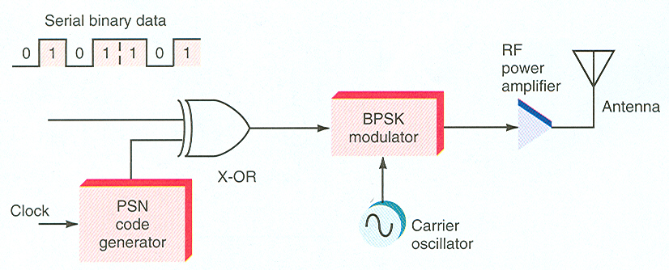
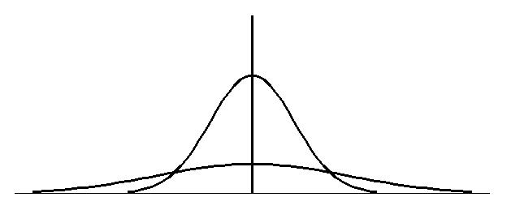
Direct Sequence Spread Spectrum –
DSSS
In direct-sequence spread spectrum (DSSS), the serial binary data is XORed with a pseudo-random binary code which has a bit rate faster than the binary data rate, and the result is used to phase-modulate a carrier.
  chipping rate – bit rate of the pseudorandom code
  the faster you change the phase of a carrier, the more BW the signal takes up – looks like noise
UNMODULATED
CARRIER
SLOW SPEED PSK
HIGH SPEED PSK
many clock (chipping rate)
pulses in one data bit time

Slide 33
DSSS
1
1
0
1
data
time of one data bit
carrier modulated by the data
Pseudo Random
Sequence
“chip”
data ⊕ PRS
XOR ↑
carrier modulated by the data ⊕ PRS
power
UNMODULATED
CARRIER
SLOW SPEED PSK
HIGH SPEED PSK
frequency

Slide 34
Direct Sequence Spread Spectrum
(cont’d)
Observations
  A signal that would normally occupy a few kHz BW is spread out 10 to 10,000 times its BW.
  The fast phase modulation spreads the energy of the signal over a wide BW – appears as noise in a conventional receiver.
  Also called CDMA – Code Division Multiple Access
    used in satellites – many signals can use the same transponder
    used in cell phones – many users in same BW

Slide 35
Direct Sequence Spread Spectrum
Receiver
  Receiver must know the pseudorandom sequence of the transmitter and have a synchronizing circuit to get in step with this pseudorandom digital signal.
  The receiver using an identically programmed PN sequence compares incoming signals and picks out the one with the highest correlation.
  Other signals using different PN sequences appear as noise to the receiver and it doesn’t recognize them.

Slide 36
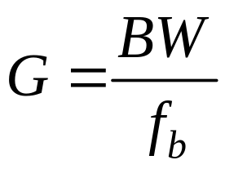
Processing gain
The measure of the spreading is called the processing gain, G, which is the ratio of the DSSS bandwidth, BW, divided by the data rate, f_{b} .
The higher the processing gain, the greater the DSSS signal’s ability to fight interference.
Notes:
http://www.hedylamarr.org/
In 1936 Hedy Lamarr became the first woman to grace the silver screen in a feature film wearing nothing but her birthday suit. Five years later, at a Hollywood dinner party, she engaged in a passionate discussion with an avant-garde composer about protecting U.S. radio-guided torpedoes from enemy interference.
She scrawled her phone number in lipstick on the windshield of his car so they could develop their ideas further.
In 1942, unbeknownst to her adoring public, the unlikely duo secured a patent and gave it to the United States government for a "Secret Communications System" expressly constructed to assist in the defeat of Hitler.
The science presented in this patent serves as the basis for the technology we use today in cell phones, pagers, wireless Internet, defense satellites, and a plethora of other spread-spectrum devices.
In 1933 Hedy achieved international renown when she played the first nude scenes in cinematic history in the Czech film "Ecstasy." The film was banned in many countries around the world, including the United States.
On August 10, 1933, Hedy Kiesler married Austrian industrialist Fritz Mandl, CEO of one of the world's leading arms manufacturers. While her husband forbade her to pursue her acting career, (attempting to buy up all existing copies of "Ecstasy"), this proved to be one of the most valuable relationships to the scientific technology she would develop years later.
From Strapless to Wireless Hedy Lamarr helped to set the groundwork for some of the most revolutionary technology of our time.
Following the outbreak of World War II, Lamarr, a passionate opponent of the Nazis, wanted to contribute more to the allied effort. As Mrs. Fritz Mandl, she had closely observed the planning and discussions that went into attempting to design remote-controlled torpedoes. These never went into production, because the radio-controlled guidance system was too susceptible to disruption. She got the idea of distributing the torpedo guidance signal over several frequencies, thus protecting it from enemy jamming. The only weak point was how to employ the synchronization of the signal's transmitter and receiver.
In 1940, Lamarr met the American avant-garde composer George Antheil of "ballet mécanique" fame. She described her idea to him, and asked him to help her construct a device that would enable this signal to be synchronized. Antheil laid out a system based on 88 frequencies, corresponding to the number of keys on a piano, using perforated paper rolls which would turn in sync with one another, transmitting and receiving ever-changing frequencies, preventing interceptance and jamming.
In December of 1940, the "frequency hopping" device developed by Lamarr and Antheil was submitted to the national inventors council, a semi-military inventors' association. Lamarr and Antheil went on to file for a patent application for the "Secret Communication System," June 10, 1941. The patent was granted by the United States patent office on august 11, 1942.
Lamarr and Antheil immediately placed their patent at the disposal of the US military. Though the us government did not deploy the "secret communication system" during World War II, the US Navy commissioned a project to acoustically detect submarines using sonar buoys remote-controlled from airplanes employing "frequency hopping" in the 1950s.
Twenty years after its conceptualization, during the 1962 Cuban missile crisis, the first instance of large-scale military deployment of Lamarr and Antheil's frequency hopping technology was implemented-- not for the remote-controlled guidance of torpedoes, but to provide secure communications among the ships involved in the naval blockade. The early '60s saw the development of reconnaissance drones based on frequency hopping, which were later deployed in Vietnam. With the emergence of digital technology and the military's release of frequency hopping for public use in the
1980s, Lamarr and Antheil's invention took on new significance. Instead of "frequency hopping," today's term is "spread spectrum" but the basic idea is the same. The FCC recently allotted a special section of the radio spectrum for an experiment using the spread spectrum idea in a test designed to make cell phone calls more secure. A lot of corporate dollars have been invested in this process which has allowed more cell phone users to use the existing frequency spectrum.

Slide 37
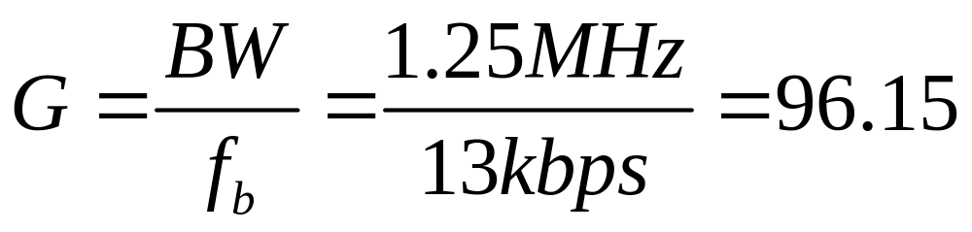
Example
Information signal is 13 kbps, spread over 1.25 MHz of bandwidth (BPSK)
G_{dB}=10Log(96.15)=19.83 dB
The higher the gain, the greater the system’s ability to fight interference

Slide 38
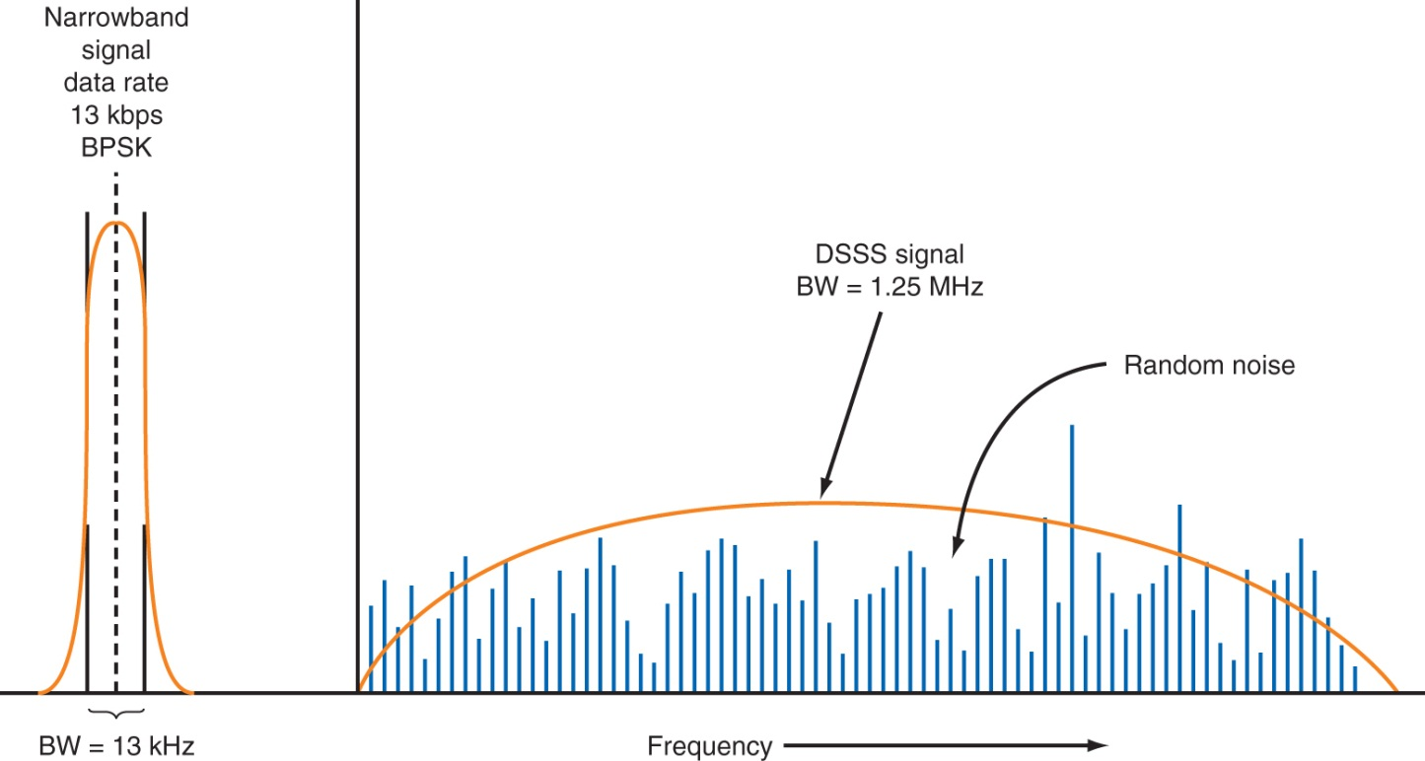
DSSS Signal
The spread signal has the same power as the narrowband signal, but far more sidebands
Amplitudes are very low and just above the random noise level
Transmitter and receiver are using the same PN sequence, so signal will be recognized

Slide 39
Benefits of Spread Spectrum
Spread spectrum is being used in more and more applications in data communications.
Security – need a wide BW receiver and precise knowledge and timing of the pseudorandom sequence
Resistance to jamming and interference – jamming signals are usually restricted to one frequency
Band sharing – many signals can use the same frequency band; but… many spread spectrum signals raise the overall background noise level
Precise timing – can be used in radar where accurate knowledge of transmission time is needed

