Slide 1
Open Access in Research Literature: A Big Data Analysis
June 2020
Dr. Bikash Gyawali
bikashg@live.com

Slide 2
What is Open Access
Open Access (OA) vs non-open access (Subscription) research outputs
Subscription journals
Institutions subscribe (pay fee) to the publishers.
The articles are behind a “paywall”
Authorised user can read/access it but can’t further share/TDM the articles.
Content creators are not content owners!!
Open Access:
Budapest Open Access Initiative (BOAI), 2002

Slide 3
Publishers, Aggregators and more …
Commercial Publishers
Elsevier - https://www.elsevier.com/catalog
Springer - https://www.springer.com/gb
IEEE - https://www.ieee.org/publications/index.html
Institutional Repositories
Open Research Online from The Open University - http://oro.open.ac.uk/
Inria, France - https://hal.inria.fr/

Slide 4
Publishers, Aggregators and more … (contd.)
Aggregators
BASE -- https://www.base-search.net/
CORE – https://core.ac.uk/
Read more at https://scholarlycommunications.jiscinvolve.org/wp/2018/06/01/core-becomes-the-worlds-largest-aggregator/
Scholarly Databases
Microsoft Academic Graph (MAG) -- https://www.microsoft.com/en-us/research/project/microsoft-academic-graph/
Google Scholar -- https://scholar.google.com/

Slide 5
The route to OA
Gold OA:
Authors publish in open access journals.
Author has the copyright.
Pay APC.
Green OA:
Authors copy in repositories.
Copyright of publishers.
Embargo period.
Preprint:
Usually without undergoing peer-review process.
More recent research outputs – no delay in review process.

Slide 6
The route to OA (contd.)
OA Discovery Tools: Return URL to freely accessible full text of documents.
Unpaywall -- https://unpaywall.org/
CORE Discovery -- https://core.ac.uk/services/discovery/
In the news:
MIT ends Elsevier subscription
OA publishing of COVID-19 related articles has spiked

Slide 7
Measuring the OA
Data Extraction: Collecting Papers and Determining their OA status
MAG
CORE Discovery
Data Analysis: Comparison of OA growth
Among countries and across time.
Among universities within countries.

Slide 8
MAG
Big data of scientific publication records
Free to Download and use
Microsoft Azure Platform
Schema: https://docs.microsoft.com/en-us/academic-services/graph/reference-data-schema

Slide 9
PySpark
db_name = "academicgraph"
papers_df = spark.table(db_name + '.papers')
papers_df.count()
papers_df.show(7)
papers_df = papers_df.select('paperid', 'doi', 'year', 'papertitle')
papers_df.show(7, False)
mypapers_df = papers_df.filter('year>2007 and year<2017')
mypapers_df.count()
mypapers_df.show(7, False)
paperaffiliations_df = spark.table(db_name + '.paperauthoraffiliations').select('paperid', 'originalaffiliation')
paperaffiliations_df.show(7, False)
mypaperaffiliations_df = paperaffiliations_df.filter("originalaffiliation = 'Kathmandu University'")
mypaperaffiliations_df.count()
mypaperaffiliations_df.show(7, False)

Slide 10
PySpark (contd …)
Details of papers published from Kathmandu University
mypaper_details = mypapers_df.join(mypaperaffiliations_df, mypapers_df.paperid == mypaperaffiliations_df.paperid)
mypaper_details.select('doi', 'papertitle', 'year','originalaffiliation').show(7, False)
Latitude/Longitude:
Affiliations Table

Slide 11
Data Extraction
8 countries and 400 universities.
Papers published in the period 2007 to 2017.
Country | Count of universities | Count of papers published in 2007-2017
Austria | 9 | 120,273
Brazil | 34 | 600,632
Germany | 34 | 600,797
India | 46 | 260,163
Portugal | 11 | 126,860
Russia | 21 | 94,534
UK | 91 | 1,271,838
USA | 154 | 3,901,539
Total | 400 | 6,976,636

Slide 12
Determining the OA status
CORE Discovery
https://core.ac.uk/services/discovery/
A new service that finds freely accessible copies of research papers.
Using CORE and multiple external services.
SOTA performance in terms of content coverage and precision
https://www.sciencedirect.com/science/article/pii/S2214579618302600
Status – OA vs. Unknown
CORE Discovery returns a link to the full text of article = OA
CORE Discovery can’t find a link (in reality, the article could be OA) = Unknown

Slide 13
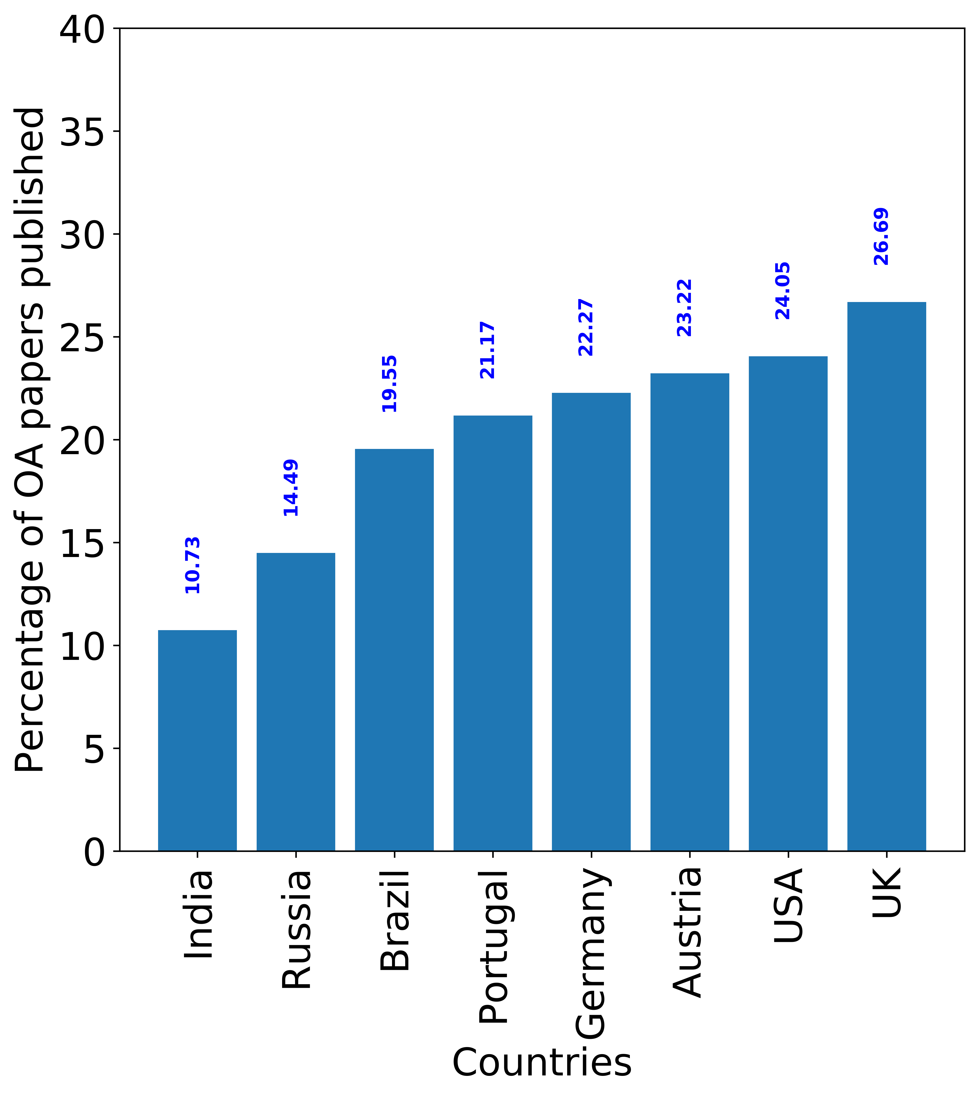
Results 1: Country Level Analysis
% OA papers
OA growth by year
Highest OA output is 26.69% (UK).
Higher than previously reported studies.
Significant rise in OA after 2011.
Peaking around 2016, drop in 2017??
Germany, Portugal – Steady Growth.
Brazil, UK - Steep Growth.

Slide 14
Results 2: University Level Analysis
THE WUR ranks universities by research score.
We used the research score to categorize the universities into “high”, “mid” and “low” tier.
From each tier, we select 5 universities with the median score. In case of Austria and Portugal, 3 universities per tier.
A total of 108 representative universities.

Slide 15
Results: University Level Analysis (Contd … )
Percentage of OA papers published by representative universities.
Notes:
There is no common pattern here.
High and Mid Tier have similar performance – Austria
Mid Tier better performance than High Tier – Germany
Mid Tier poorer than Low Tier – Portugal
UK has the highest accumulative means and India the lowest.

Slide 16
Thank You!
Joint Conference on Digital Libraries (JCDL 2020)
https://2020.jcdl.org/
Open Access 2007 - 2017: Country and University Level Perspective
-- Bikash Gyawali, Nancy Pontika and Petr Knoth
The Open University, UK
http://oro.open.ac.uk/70549/

