Slide 1

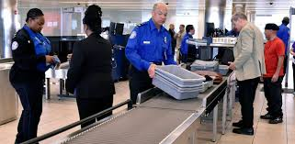
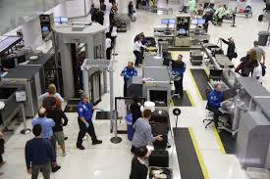
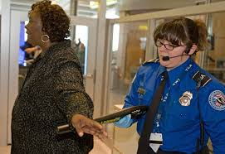

Transportation Security
Administration
Bikram Bhandari
Shikha Chamoli
Renee Eshun
Karishma Saikia

Slide 2


Slide 3
AGENDA
  The Inspiration/Hypothesis
  Data Source
  The Data
  Data Tools, Exploration and Clean up
  Final Visualization
  Demonstration of Web Page/Dashboard
  Conclusion and Analysis

Slide 4
The Inspiration/Hypothesis
Marijuana vs TSA weapons confiscation
How effective is TSA?
Are we safer since 9/11?
This Photo by Unknown Author is licensed under CC BY-NC-ND

Slide 5


DATA SOURCE

Slide 6
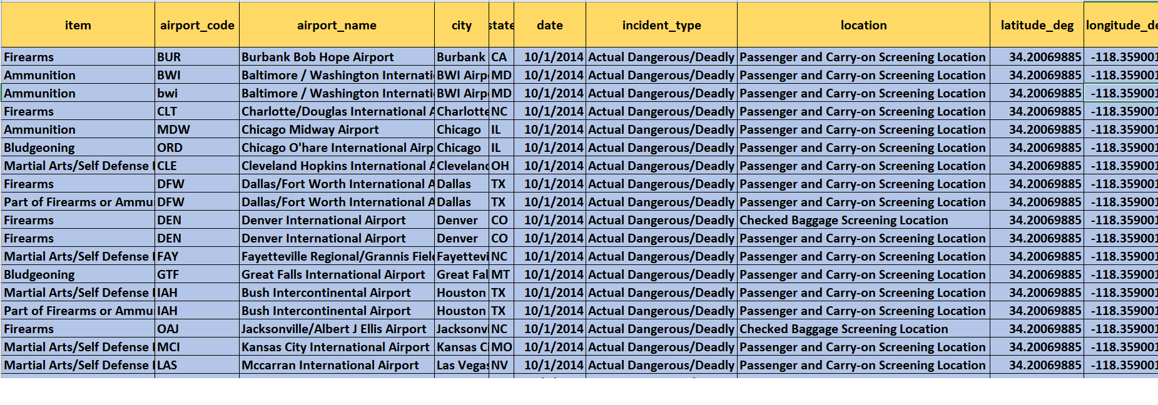
THE DATA

Slide 7
DATA TOOLS, EXPLORATION AND CLEANUP
SQLITE DATABASE
HTML/CSS
JAVA SCRIPT
D3/LEAFLET
PYTHON AND PANDAS

Slide 8
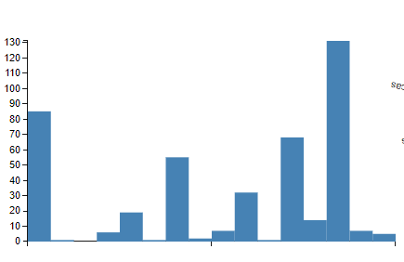
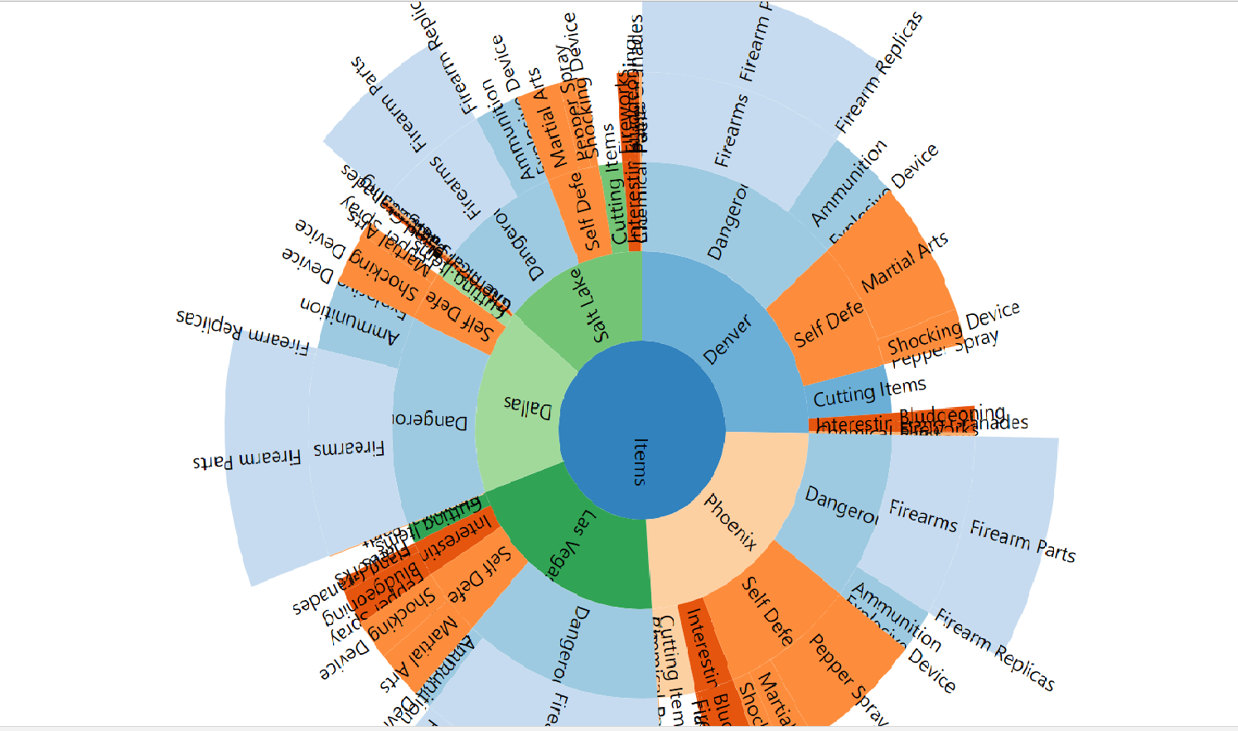
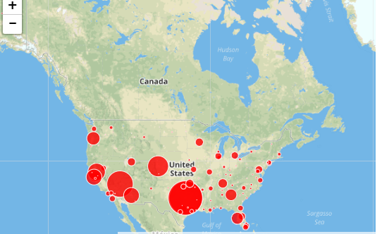
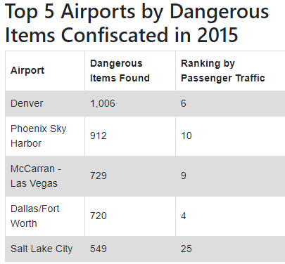
WEB PAGE VISUALIZATION

Slide 9
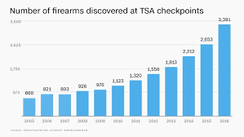
CONCLUSION AND ANALYSIS
The airports with the most dangerous items confiscated are not always the ones with the most passenger traffic.

