Slide 1
Movie Ratings Recommender System using PMRF
Dhruvkumar Patel
Bikramjit Mandal

Slide 2
Recommender system
Enables service providers to predict and address individual personalized needs of the customers.
Helps in finding the most relevant information from among the flood of data.

Slide 3
Expectations
Recommender systems need to be fast and real-time.
Quick predictions considering the temporal variation in user data and behavior.
Pull high volume of crowd and be user cognitive.
Help in predictions even in the case of missing data and discrepancies.
Maintain efficiency on even large scale systems.

Slide 4
Popular Approaches
Collaborative Filtering
Inference is based on the past behavior and data for each of the entities( in our case, users).
Content Based Approach
Inference is performed by creating profiles for the entities- users and items – and relating users to items via profiles.
Hybrid Recommender Systems

Slide 5
Our Approach
Collaborative Filtering
Using Pairwise Markov Random Fields.

Slide 6
Algorithm
Preprocess data in train and test sets.
Compute similarities among users and among items (movies).
For each user, construct separate PMRF graph for unknown items’ ratings.
Run belief propagation algorithm on particular user’s PMRF.
Calculate rating as expectation of marginal probabilities.
Compute Mean Absolute Error, Root Mean Square Error.

Slide 7
Dataset and Preprocessing
MovieLens movie ratings dataset, curated by University of Minnesota group.
100k ratings, by 943 users on more than 1600 movies.
80% data for training
20% data for testing, after at least first 50 ratings by that user has been added to training dataset.

Slide 8
Users and Items similarity
S_{uv}- Similarity between users u and v.
S_{ij} – Similarity between items i and j.
These similarity are computed using Pearson Correlation Coefficient.
These values are used in computing values of Phi- initial evidence of item nodes and Psi- compatibility function between item nodes in PMRF.

Slide 9
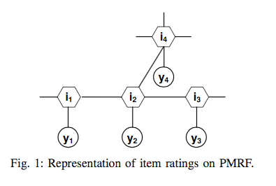
PMRF
Active user z is user for whom ratings are to be predicted.
For each active user z, we create separate graph with unknown items as item nodes.
Item node i - connected in pair with y_{i.}
y_{i} is local evidence node.
Ayday, Zou, Einolghozati , Fekri,A Recommender System Based on Belief Propagation over Pairwise
Markov Random Fields

Slide 10
Belief Propagation
For each active user z, we construct separate graph G consisting item nodes and their local evidences.
y_{i} is determined by average rating by user z and other users who have rated item I, and their similarity with user z.
We set Φ_{i}(r_{iz}) by using local evidence y_{i}.
We similarly set ψ_{ij}(r_{iz},r_{jz}) using simple equation.
We run BP algorithm until messages converge for given active user z.

Slide 11
Rating, MAE, RMSE
Rating is calculated by computing expectation of ratings using marginal probabilities from belief propagation result.
r_{iz} = Σ_{r} r * P(r_{iz} = r)
After computing predicted ratings for all users and unknown items, we compute Mean Absolute Error and Root Mean Square Error as evaluation matrices.

Slide 12
Results
Total ratings- 100k
Number of users- 943
Train set- 80k, Test set- 20k
Number of BP algorithms performed- 252
Mean absolute error MAE- 0.8001
Root mean square error RMSE- 1.0345

Slide 13
Questions?

