Slide 1
ShikshaHub a Web-Based Study Material Sharing Platform
Presented by:
Biken Shrestha

Slide 2


Introduction
Shiksha hub is a web-based platform for sharing study materials like notes , assignments etc. It aims to enhance collaboration between students and teachers by offering a centralized, accessible digital repository.

Slide 3

Problem Statement
Scattered Resources
Duplication of Effort
Limited Accessibility
Lack of Collaboration

Slide 4

Objectives
To create a user-friendly platform for sharing and accessing study materials and facilitate collaboration between students and teachers.
To create open resource so that it will be available at anytime and anywhere.

Slide 5

Technology To be Used
Frontend :
HTML,CSS and Java-script
Backend:
PHP
Database:
MYSQL

Slide 6

Methodology

Slide 7
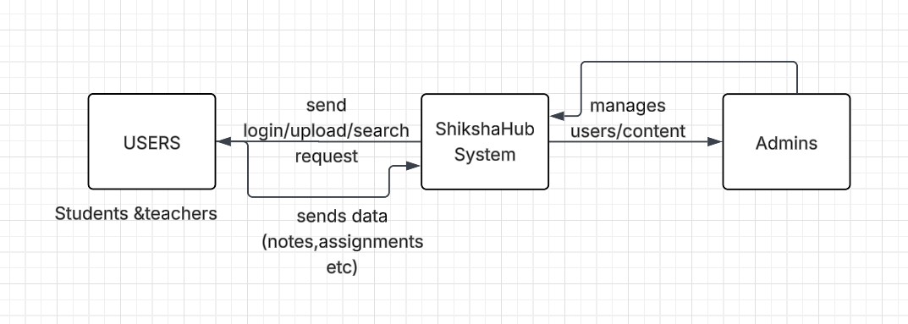
DFD Level 0

Slide 8
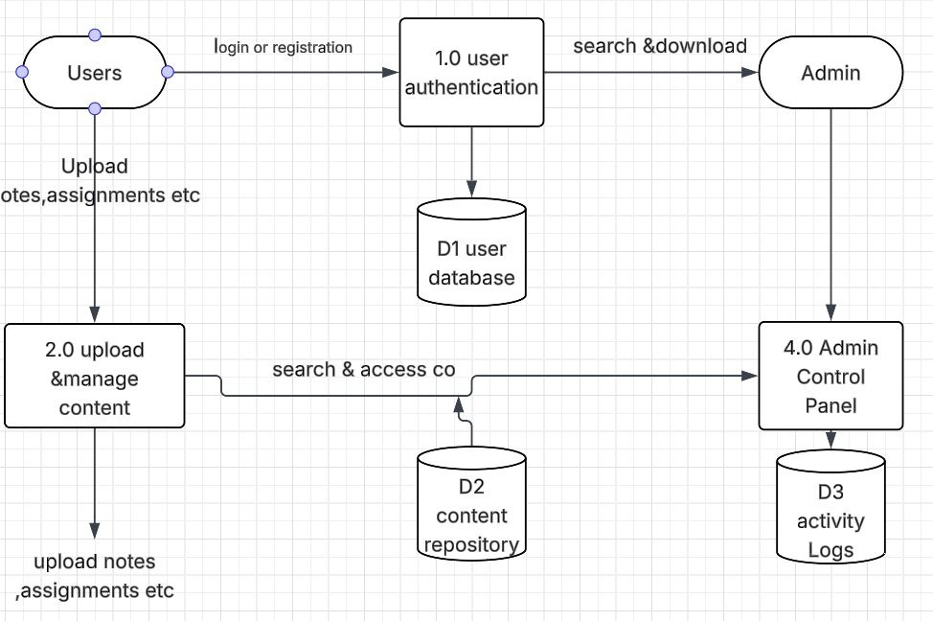
DFD Level 1

Slide 9
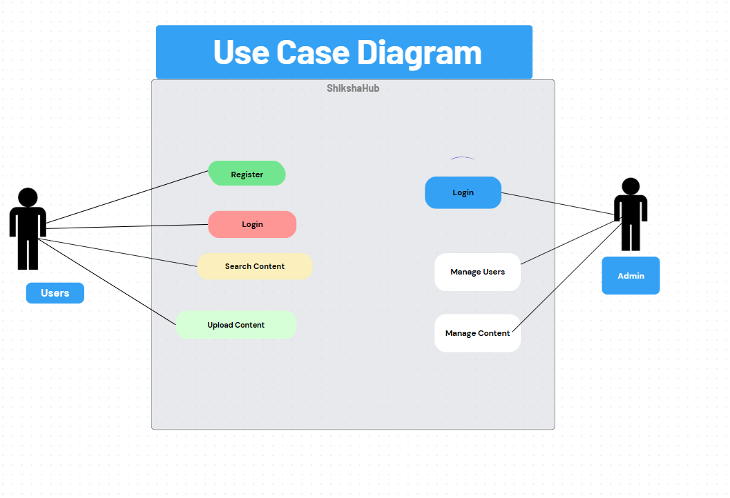
Use case diagram

Slide 10
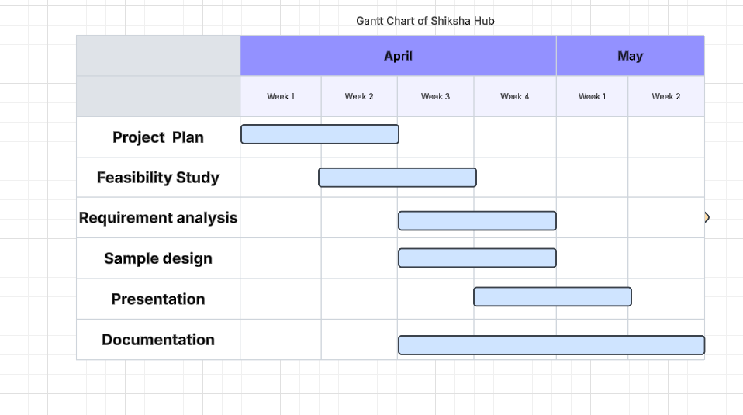
Gantt Chart

Slide 11

Expected Outcome
A fully functional web platform that enables secure sharing, searching, and downloading of academic materials by students and teachers.
A role-based system where administrators manage users and content, ensuring an organized and collaborative learning environment.
Figma

Slide 12

Conclusion
To conclude, ShikshaHub is a user-friendly platform that simplifies the sharing of study materials between students and teachers. It helps create a more organized and collaborative academic environment by centralizing resources and ensuring easy access for all users.

Slide 13


Slide 14
Features

Slide 15
flowchart

