Slide 1
Recursion
Data Structures

Slide 2
What is recursion?
Sometimes, the best way to solve a problem is by solving a smaller version of the exact same problem first
Recursion is a technique that solves a problem by solving a smaller problem of the same type
A recursive definition is one which uses the word or concept being defined in the definition itself

Slide 3
Recursive Definitions
Consider the following list of numbers:
24, 88, 40, 37
Such a list can be defined as
  A LIST is a: number
  or a: number comma LIST
That is, a LIST is defined to be a single number, or a number followed by a comma followed by a LIST
The concept of a LIST is used to define itself

Slide 4
Recursive Definitions
The recursive part of the LIST definition is used several times, terminating with the non-recursive part:
number comma LIST
24 , 88, 40, 37
number comma LIST
88 , 40, 37
number comma LIST
40 , 37
number
37

Slide 5
Infinite Recursion
All recursive definitions have to have a non-recursive part
If they didn't, there would be no way to terminate the recursive path
Such a definition would cause infinite recursion
This problem is similar to an infinite loop, but the non-terminating "loop" is part of the definition itself
The non-recursive part is often called the base case

Slide 6
Problems defined recursively
There are many problems whose solution can be defined recursively
Example: n factorial
1 if n = 0
n!= (recursive solution)
(n-1)!*n if n > 0
1 if n = 0
n!= (closed form solution)
1*2*3*…*(n-1)*n if n > 0

Slide 7
Coding the factorial function
Recursive implementation
  int factorial ( int n )
  {
  if ( n == 0 ) /* base case */
  return 1 ;
  else
  return n * factorial ( n – 1 ) ;
  }

Slide 8
Recursive Definitions
5!
5 * 4!
4 * 3!
3 * 2!
2 * 1!
1
120
24
6
2
1

Slide 9
Tail Recursion → Iteration
When recursion involves single call that is at the end ...
It is called tail recursion and its easy to make iterative:
  int factorial ( int n )
  {
  int count, fact = 1;
  for ( count = 2; count <= n; count++ )
  fact = fact * count;
  return fact;
  }

Slide 10
Another example: n choose k (combinations)
Given n things, how many different sets of size k can be chosen?
n n-1 n-1
= + , 1 < k < n (recursive solution)
k k k-1
n n!
= , 1 < k < n (closed-form solution)
k k!(n-k)!
with base cases:
n n
= n (k = 1), = 1 (k = n)
1 n

Slide 11
n choose k (combinations)
int combinations ( int n, int k )
{
if( k == 1 ) /* base case 1 */
return n;
else if ( n == k ) /* base case 2 */
return 1;
else
return(combinations(n-1, k) + combinations(n-1, k-1));
}

Slide 12
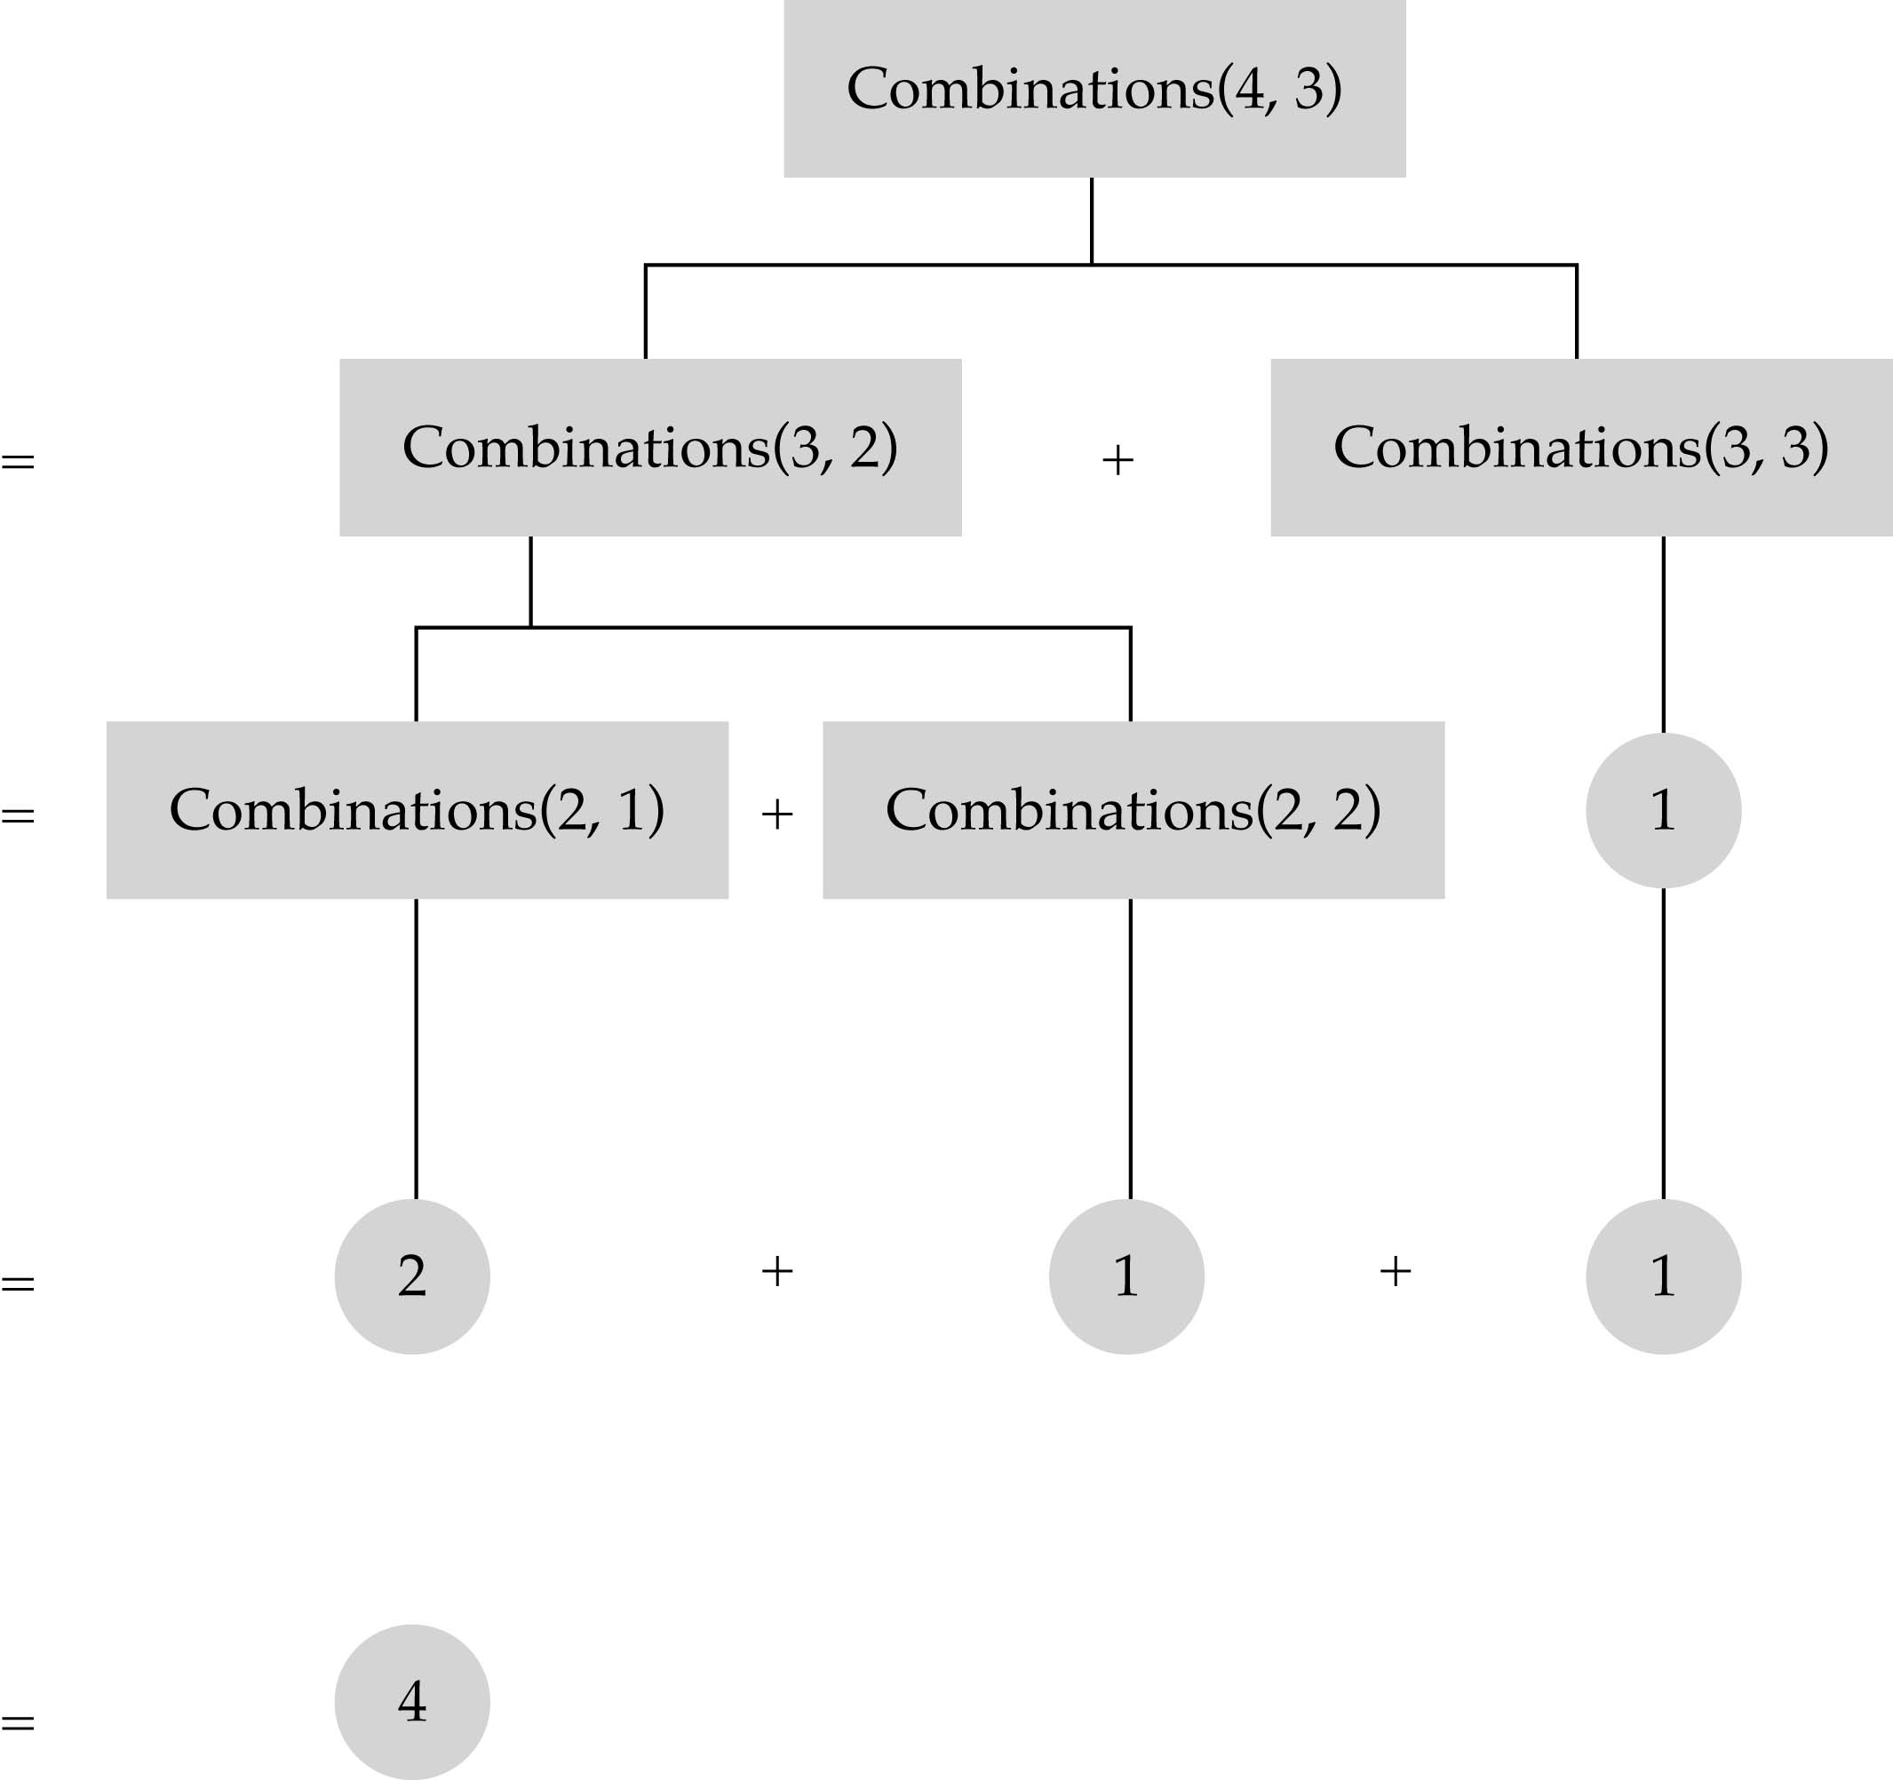

Slide 13
Recursion vs. iteration
Iteration can be used in place of recursion
  An iterative algorithm uses a looping construct
  A recursive algorithm uses a branching structure
Recursive solutions are often less efficient, in terms of both time and space, than iterative solutions
Recursion can simplify the solution of a problem, often resulting in shorter, more easily understood source code

Slide 14
How do I write a recursive function?
Determine the size factor
Determine the base case(s)
  (the one for which you know the answer)
Determine the general case(s)
  (the one where the problem is expressed as a smaller version of itself)
Verify the algorithm
  (use the "Three-Question-Method")

Slide 15
Three-Question Verification Method
The Base-Case Question:
Is there a nonrecursive way out of the function, and does the routine work correctly for this "base" case?
The Smaller-Caller Question:
Does each recursive call to the function involve a smaller case of the original problem, leading inescapably to the base case?
The General-Case Question:
Assuming that the recursive call(s) work correctly, does the whole function work correctly?

Slide 16
Binary search
Non-recursive implementation
int binSearch ( int info[ ], int n, int item )
{
int bottom, mid, top;
bottom = 0; /* initialize bounds to encompass entire list */
top = n - 1;
while( (bottom <= top) ) { /* check terminating condition */
mid = (bottom + top) / 2 ;
if ( item == info [ mid ] )
return mid;
else if ( item < info [ mid ] )
top = mid – 1 ; /* reduce to the bottom half of the list */
else
bottom = mid + 1 ; /* reduce to the top half of the list */
}
return -1 ;
}

Slide 17
Recursive binary search (cont’d)
What is the size factor?
  The number of elements in (info[bottom] ... info[top])
What is the base case(s)?
  (1) If bottom > top, return false
  (2) If item==info[mid], return true
What is the general case?
  if item < info[mid] search the bottom half
  if item > info[mid], search the top half

Slide 18
Recursive binary search (cont’d)
int recBinary ( int info[ ], int item, int bottom, int top)
{
if ( bottom <= top) {
mid = (bottom + top) / 2 ;
if ( item == info [ mid ] ) /* base case */
return mid;
else if ( item < info [ mid ] ) /* search the bottom half */
return recBinary ( info, item, bottom, mid - 1 );
else /* search the top half */
return recBinary ( info, item, mid + 1, top);
}
return -1; /* base case */
}

Slide 19
How is recursion implemented?
What happens when a function gets called?
  int a(int w)
  {
  return w+w;
  }
  int b(int x)
  {
  int z,y=2;
  ……………… /* other statements */
  z = a(x) + y;
  return z;
  }

Slide 20
What happens when a function is called? (cont.)
An activation record is stored into a stack (run-time stack)
  The computer has to stop executing function b and starts executing function a
  Since it needs to come back to function b later, it needs to store everything about function b that is going to need (x, y, z, and the place to start executing upon return)
  Then, x from a is bounded to w from b
  Control is transferred to function a

Slide 21
What happens when a function is called? (cont.)
After function a is executed, the activation record is popped out of the run-time stack
All the old values of the parameters and variables in function b are restored and the return value of function a replaces a(x) in the assignment statement

Slide 22
What happens when a recursive function is called?
Except the fact that the calling and called functions have the same name, there is really no difference between recursive and nonrecursive calls
      int f(int x) f(3)=?
      {
      int y;
      if(x==0)
      return 1;
      else {
      y = 2 * f(x-1);
      return y+1;
      }
      }

Slide 23
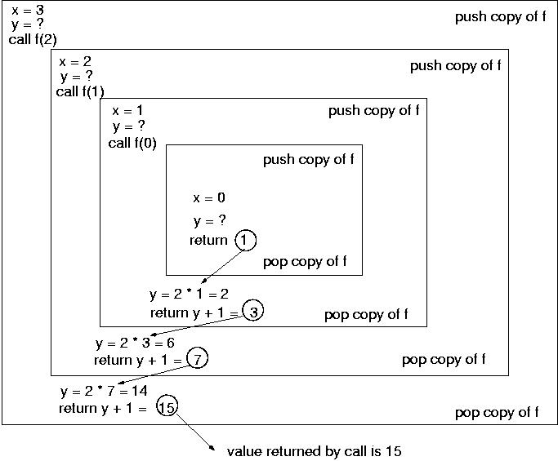
2*f(2)
2*f(1)
2*f(0)
=f(0)
=f(1)
=f(2)
=f(3)

Slide 24
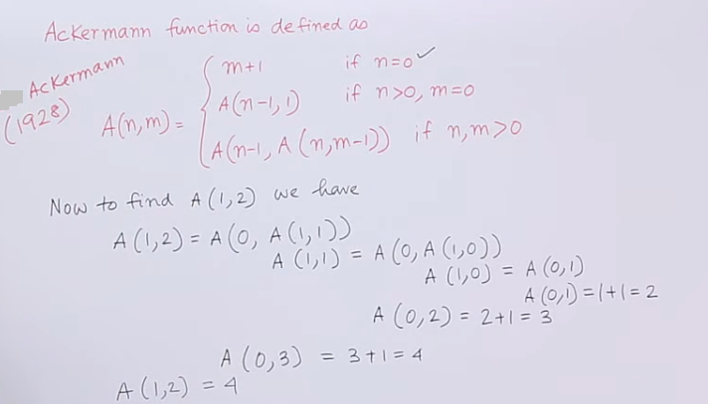
Nested Recursion

Slide 25
Recursive Definitions: Power
x⁰ = 1
x^{n} = x × x^{n-1}
double power (double x, int n)
{
if (n <= 0) /* base case */
return 1;
else
return x * power(x, n-1);
}

Slide 26
Recursive Definitions: Greatest Common Divisor
Definition of gcd(m, n), for integers m > n > 0:
gcd(m, n) = n, if n divides m evenly
gcd(m, n) = gcd(n, m % n), otherwise
int gcd (int m, int n)
{
if (m < n)
return gcd(n, m);
else if (m % n == 0)
return n;
else
return gcd(n, m % n);
}

Slide 27
Indirect Recursion
A function invoking itself is considered to be direct recursion
A function could invoke another function, which invokes another, etc., until eventually the original function is invoked again
For example, function m1 could invoke m2, which invokes m3, which in turn invokes m1 again
This is called indirect recursion, and requires all the same care as direct recursion
It is often more difficult to trace and debug

Slide 28
Indirect Recursion
m1
m2
m3
m1
m2
m3
m1
m2
m3

Slide 29
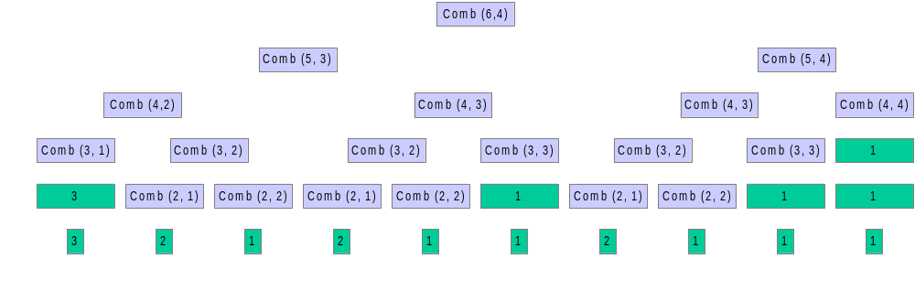
Recursion can be very inefficient is some cases
15

Slide 30
Recursive Definitions: Fibonacci Series
Definition of fib_{i}, for integer i > 0:
fib₁ = 1
fib₂ = 1
Fib_{n} = fib_{n-1} + fib_{n-2}, for n > 2
public static int fib (int n)
{
if (n <= 2)
return 1;
else
return fib(n-1) + fib(n-2);
}
This is straightforward, but an inefficient recursion ...

Slide 31
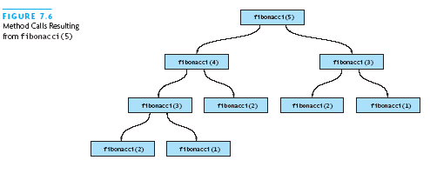
Efficiency of Recursion: Inefficient Fibonacci
# calls apparently
O(2^{n}) – big!

Slide 32
Efficient Fibonacci
Strategy: keep track of:
  Current Fibonacci number
  Previous Fibonacci number
  # left to compute

Slide 33
Efficient Fibonacci: Code
int fibStart ( int n )
{
return fibo ( 1, 0, n );
}
int fibo ( int curr, int prev, int n )
{
if (n <= 1)
return curr;
else
return fibo ( curr + prev, curr, n – 1 );
}

Slide 34
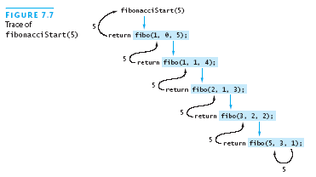
Efficient Fibonacci: A Trace
Performance is O(n)

Slide 35
Deciding whether to use a recursive solution
When the depth of recursive calls is relatively "shallow"
The recursive version does about the same amount of work as the nonrecursive version
The recursive version is shorter and simpler than the nonrecursive solution

Slide 36
Recursion: Design and Implementation
“The Rules”
  Identify one or more base (simple) cases that can be solved without recursion
    In your code, handle these first!!!
  Determine what recursive call(s) are needed for which subproblems
  Also, how to use results to solve the larger problem
  Hint: At this step, don’t think about how recursive calls process smaller inputs! Just assume they work!

Slide 37
Exercise: Find Max and Min
Given a list of elements, find both the maximum element and the minimum element
Obvious solution:
  Consider first element to be max
  Consider first element to be min
  Scan linearly from 2nd to last, and update if something larger then max or if something smaller than min
Class exercise:
  Write a recursive function that solves this using divide and conquer.
    Prototype: void maxmin (list, first, last, max, min);
    Base case(s)? Subproblems? How to combine results?

