Slide 1

Employee Management System
This presentation explores the details of a recent project, including its objectives, tools used, workflow, output, and conclusion.
Name : B. Vishnu Vardhan
Registration Number : 22JK1A0528
Guide name : CH Usha

Slide 2
Table of Contents
Introduction
Tools Used
Project Workflow
Project Output
An Employee Management System is a software solution designed to streamline and automate HR processes
HR Management Systems
A project workflow outlines the structured process of completing tasks, starting with planning and requirements.
The expected output of an Employee Management System is efficient management and centralized access to employee data.
Payroll Software.
Attendance and Time Tracking Tools

Slide 3
Abstract
1
Project Context
2
Project Objectives
3
Project Methodology
An Employee Management System is a tool that simplifies and automates HR tasks like managing employee data, payroll, attendance, and performance reviews.
1.Streamline HR Processes
The project methodology for an Employee Management System follows an agile approach, emphasizing iterative development, continuous feedback, and adaptive planning to meet dynamic organizational needs.
2.Centralized Employee Data
3.Improve Decision-Making
4.Enhance Employee Productivity
Key Results
The key results of an Employee Management System are improved efficiency, accurate employee data management, streamlined HR processes, and enhanced decision-making capabilities.

Slide 4

Project Workflow
1
Phase 1: Project Planning
Defining project scope, setting milestones, allocating resources, and establishing timelines for efficient development and successful implementation.
2
Phase 2: Development & Implementation
Designing a user-friendly interface, integrating databases for employee data storage, automating HR processes, and ensuring secure access and scalability.
3
Phase 3: Testing & Evaluation
Validating functionality, security, and performance through unit tests, integration tests, and user acceptance testing to meet organizational needs and ensure the system is free from critical issues.

Slide 5
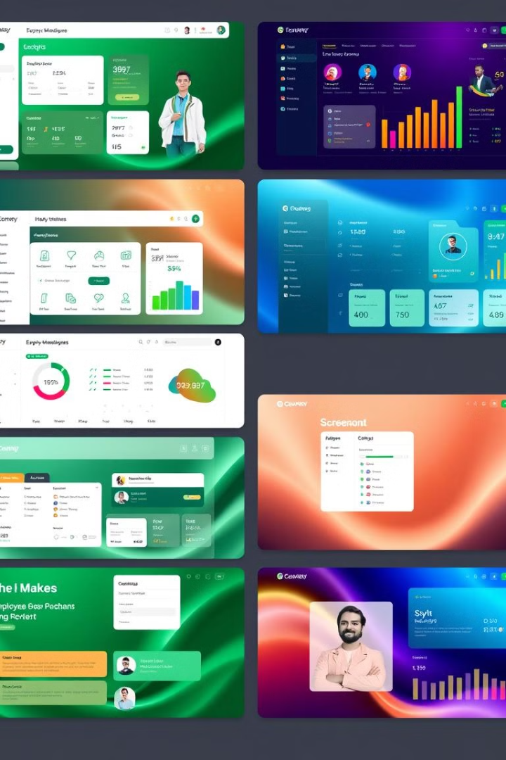
Project Output
The output of an Employee Management System includes streamlined HR processes such as automated payroll, attendance tracking, and performance evaluations. It provides real-time access to centralized employee data, enhancing decision-making and efficiency.

Slide 6



Conclusion
Summary
1
Streamlined HR tasks, centralized employee data, improved decision-making, enhanced productivity, and compliance with regulations.
Lessons Learned
2
workforce performance, attendance trends, and overall organizational efficiency, enabling data-driven decision-making and improved HR management.
Future Directions
3
include integrating AI and machine learning for predictive analytics, automation of HR tasks, and enhancing employee engagement through personalized experiences.

Slide 7

Thank You
Thank you for your time and attention. We hope this presentation has provided a comprehensive overview of the project and its key takeaways. We are open to any questions or feedback you may have.

