Slide 1
Siliguri Institute of Technology
Topic:
Online Quiz Portal
Team Leader: Bikki Prasad
Team Member: Priyanshu kumar choubey ;
Alok kumar ; Sachin Kumar;
Abhishek raj; Pranjal kumar;
Chandni kumari; Gaurav kumar;
Shuvam mishra; Rishu kumar ;
Priyanshu Choudhary

Slide 2
Introduction
This project is about online quiz for the learners. It saves time as it allows large number of client to check their ability and get confident enough for their journey of learning at the same time and display the result just after the test is completed. In this online quiz system, teachers and institute have the privilege to create, modify and delete the test papers and it’s particular questions.

Slide 3
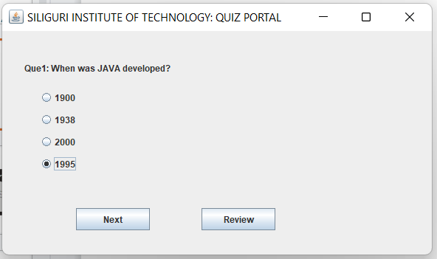
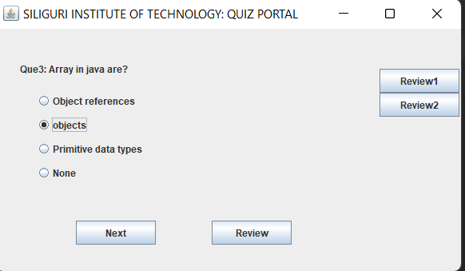
User Interface
Review section
On pressing the Review button, user
can access it again from review section before submitting the Quiz.
On clicking Next button, the current answer is saved and we move to next question.

Slide 4
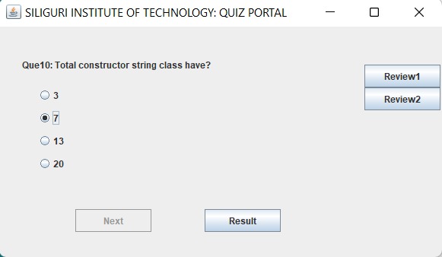
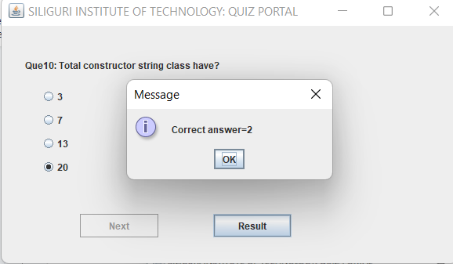
On clicking Result button, A dialogue box appears showing number of correct answers.
On reaching the last question, Result button appears.

Slide 5
SCOPE
Implimented as an Application or a Website.
Question scanner feature can be added to modify quiz questions as per needs.
we can add face tracker to eliminate any malpractice during quiz.

Slide 6
CONCLUSION
In this phase we understand the the Software Requirement documents,we used several libraries and created a online quiz portal for the learners to check their progress easily. In this project, there are given 10 questions to play. User can bookmark any question for the reconsideration while going to result. We are using here java array to store the questions, options and answers not database. You can use collection framework or database in place of array.
ENTER TITLE
Click here to add content of the text，and briefly explain your point of view.Click here to add content of the text，

