Slide 1
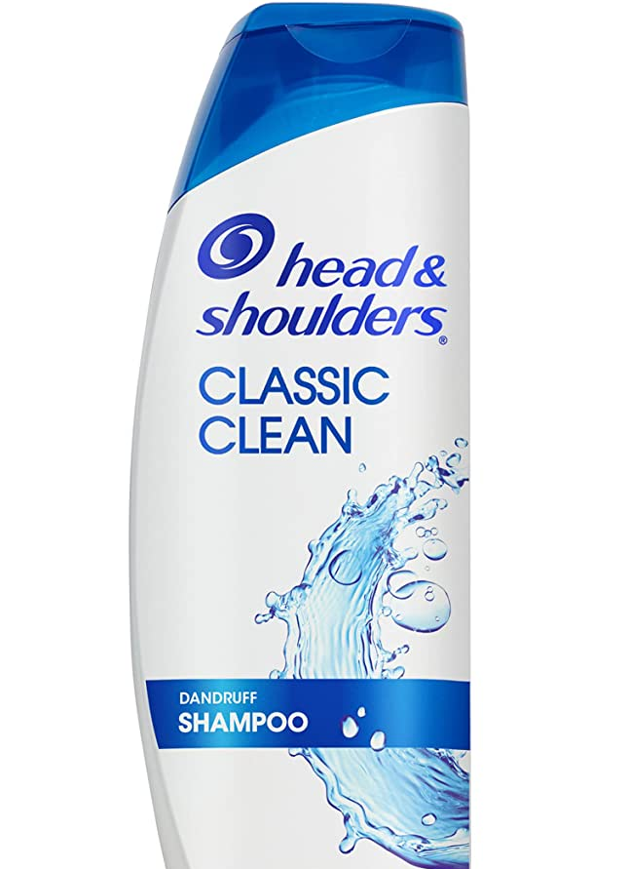

Head and shoulders CLASSIC CLEAN
Brand : Head and shoulders
Item form: liquid
Hair type: Dandruf
Scent: classic clean
Age Range:Adult
Material type : Alcohol free

