Slide 1
Diabetic Retinopathy (DR)
Symptoms, Causes, Risks, Treatment and Prevention

Slide 2
Contents
Introduction
Causes
Risk Factors and Complications
Grade-wise Symptoms , Treatment and Sample Images
Prevention
Conclusion

Slide 3
Introduction
Diabetic retinopathy is a complication of diabetes that damages the blood vessels in the retina, the light-sensitive tissue at the back of the eye
It can develop in anyone with type 1 or type 2 diabetes
Risk increases the longer a person has diabetes and when blood sugar is poorly managed
Early stages may cause no symptoms, but it can lead to blindness if untreated
Two forms: nonproliferative (NPDR) and proliferative (PDR)

Slide 4
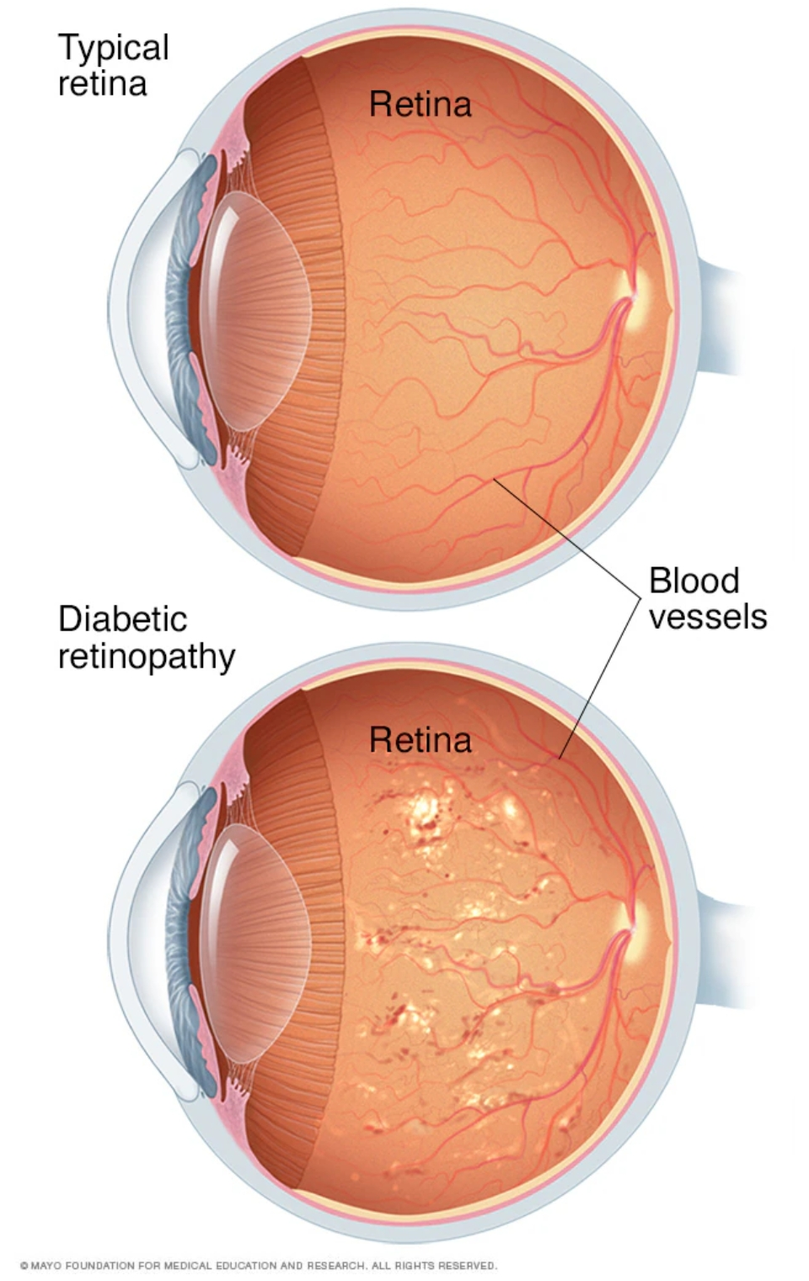
Causes
Prolonged high blood sugar damages the tiny blood vessels that nourish the retina and cuts off its blood supply
NPDR: vessel walls weaken and form small bulges that leak fluid and blood; no new vessels grow
Macular edema: fluid build-up in the center of the retina (macula), possible at any stage
PDR: closed-off vessels trigger growth of abnormal new vessels that leak or bleed easily

Slide 5
Risk Factors and Complications
Risk factors
Complications
Long duration of diabetes
Poorly managed blood sugar
High blood pressure
High cholesterol
Pregnancy
Tobacco use
Black, Latino or Native American ethnicity
Vitreous hemorrhage: bleeding into the eye, causing floaters or blocked vision
Retinal detachment: scar tissue pulls the retina away
Glaucoma: new vessels block fluid outflow and raise eye pressure
Macular edema
Blindness

Slide 6
DR Grading Used in the Datasets
Grade | Class | Messidor-1 label
0 | No DR | No DR
1 | Mild | Mild
2 | Moderate | Moderate + Severe
3 | Severe | Proliferative
4 | Proliferative DR | - (not present)

Slide 7
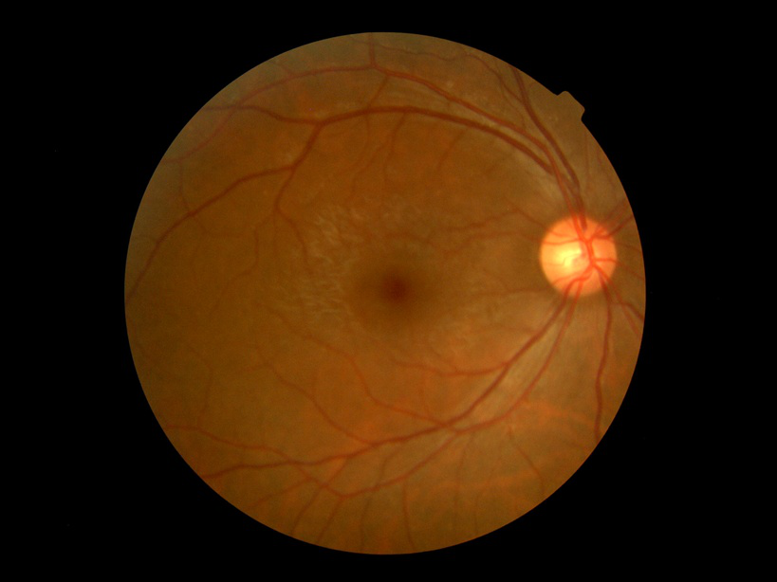
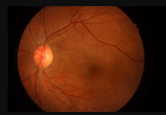
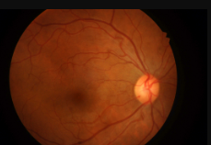
Grade 0: No DR
Symptoms
Treatment
No symptoms
Vision is normal
No visible retinal changes on examination
No eye treatment needed
Dilated eye exam every year
Keep blood sugar, blood pressure and cholesterol in target range
Fig: Sample images of Grade0

Slide 8
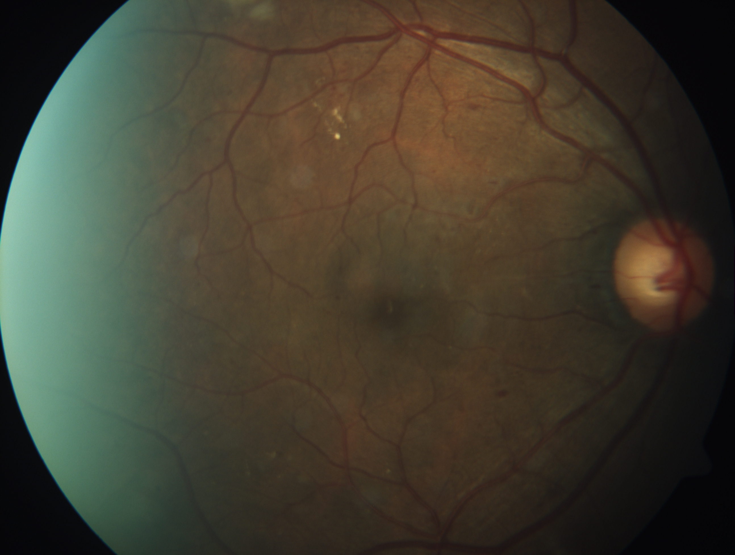
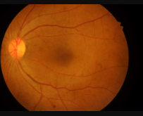
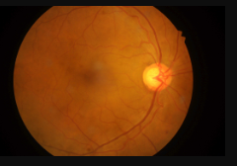
Grade 1: Mild DR
Symptoms
Treatment
Usually no symptoms
Vision is usually normal
Found only on a dilated eye exam or retinal imaging
No eye treatment in most cases
Follow-up eye exam every 6 to 12 months
Strict control of blood sugar, blood pressure and cholesterol
Fig: Sample mages of Grade1

Slide 9
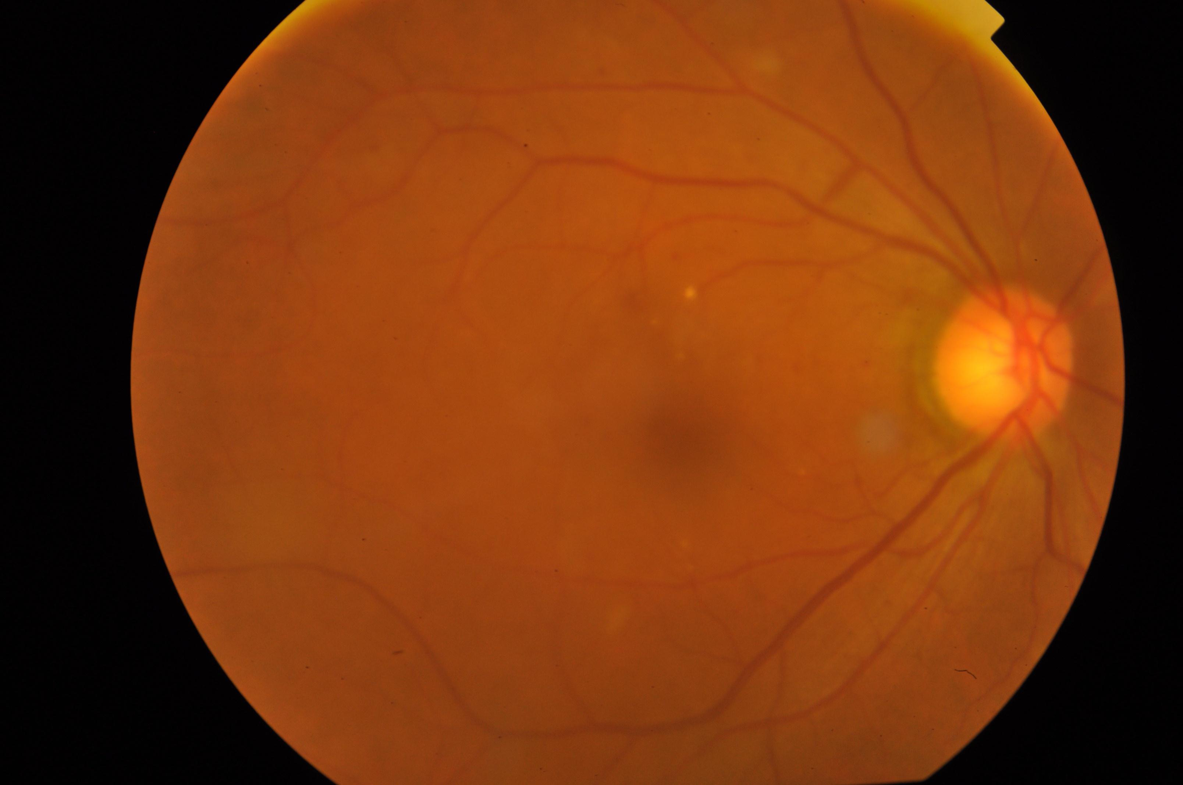
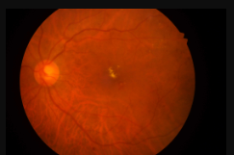
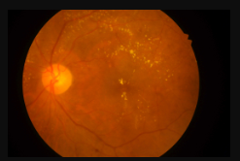
Grade 2: Moderate DR
Symptoms
Treatment
Often none or mild
Slightly blurred vision or a few floaters
Blurred central vision if macular edema is present
Follow-up eye exam every 3 to 6 months
Anti-VEGF injections or focal laser if macular edema affects vision
Systemic control of sugar, pressure and cholesterol
Fig: Sample mages of Grade2

Slide 10
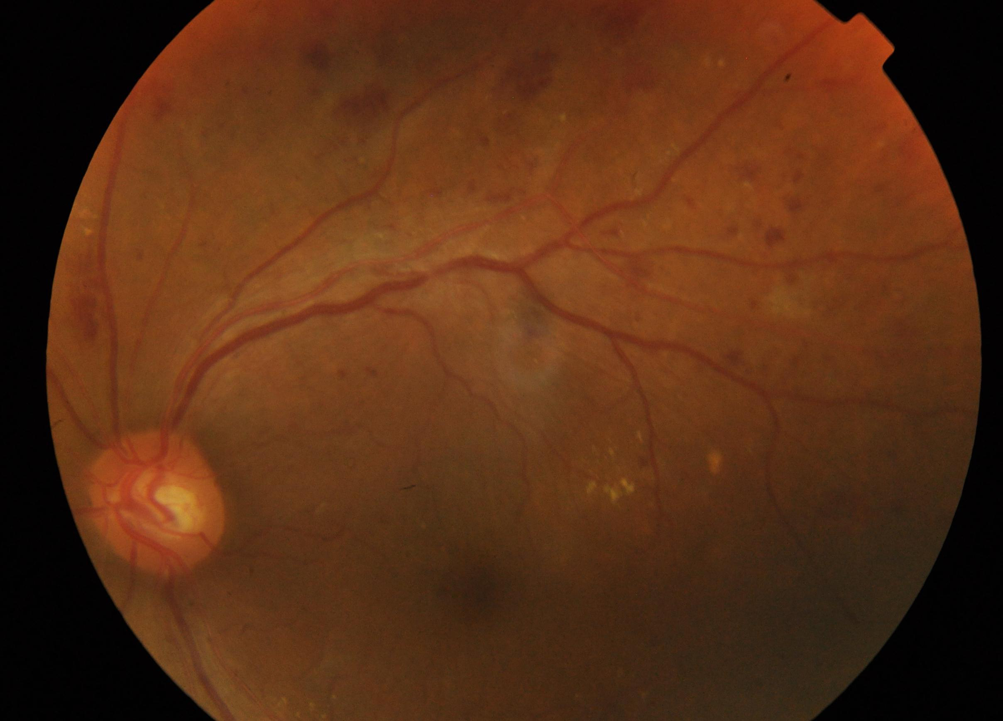
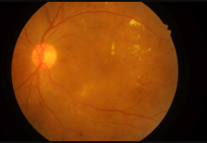
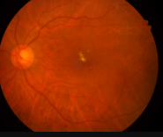
Grade 3: Severe DR
Symptoms
Treatment
Blurred or fluctuating vision
Floaters and dark spots
Dark or empty areas in vision
Poor night vision
Close follow-up every 2 to 4 months
Panretinal (scatter) laser or anti-VEGF may be considered to prevent progression to PDR
Treat macular edema if present, Systemic control
Fig: Sample mages of Grade3

Slide 11
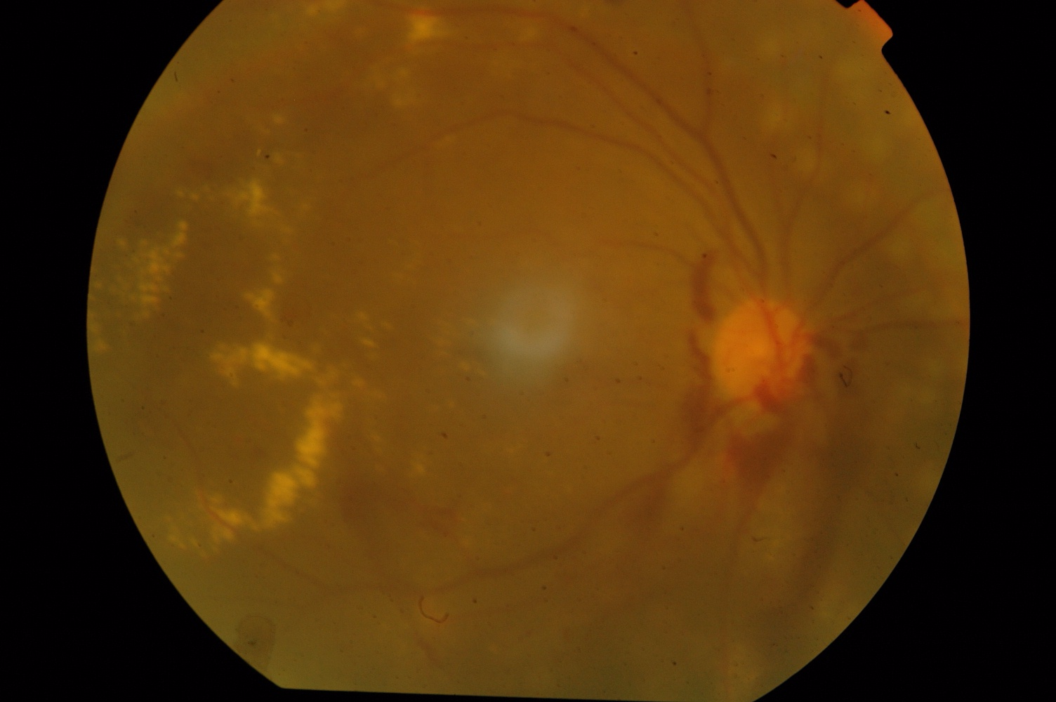
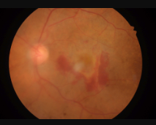
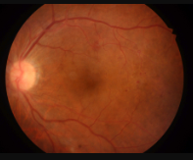
Grade 4: Proliferative DR
Symptoms
Treatment
Sudden floaters or dark spots
Flashes of light
Missing areas of vision
Sudden or severe vision loss from bleeding or retinal detachment
Urgent specialist care
Panretinal laser and/or anti-VEGF injections
Vitrectomy for non-clearing vitreous hemorrhage or retinal detachment
Treat macular edema and glaucoma if present
Fig: Sample images of Grade4

Slide 12
Prevention
Manage diabetes: healthy eating, regular activity (at least 150 minutes of moderate aerobic activity weekly), medicines or insulin as directed
Monitor blood sugar and ask about the HbA1c test and your target
Control blood pressure and cholesterol
Stop smoking and other tobacco use
Yearly dilated eye exam, even if vision seems fine
Report sudden vision changes immediately

Slide 13
Conclusion
DR is a common, often silent, sight-threatening complication of diabetes.Early detection through regular dilated eye exams is essential. Treatments (anti-VEGF, laser, surgery) can slow progression and preserve visionGood control of blood sugar, blood pressure and cholesterol is the best prevention.

