Slide 1

Cybersecurity Awareness and Digital Safety Practices Among Adolescents Aged 16–20 in Dhangadhi, Nepal
National Academy of Science and Technology
SUBMITTED BY
Dhangadhi, Kailali, Nepal | 2026
Bikram Chapagain | Kaustubh Pant | Maniram Chaudhary | Sandarv Lamichhane
SUBMITTED TO
Department of Research and HRD
Mid-Defense Presentation

Slide 2
ABSTRACT
372
6
41
16–20
Valid Responses
Colleges Surveyed
Questionnaire Items
Age Range (Years)
91.6% recognized the importance of strong passwords; 75.7% aware of public Wi-Fi risks
Only 44.3% felt confident spotting suspicious messages; 53.5% used Two-Factor Authentication (2FA)
86.3% claimed to use strong passwords; 78.7% reported not sharing OTP or sensitive info
Only 37.6% used antivirus software or a VPN; 50.7% regularly updated their software
47.8% admitted to ignoring cybersecurity risks despite awareness — critical knowledge-practice gap
85.1% agreed cybersecurity awareness is important; 49.5% personally affected by cyber incidents

Slide 3
TABLE OF CONTENTS
01
Introduction
Background, Literature Review, Objectives, Hypothesis & Conceptual Framework
02
Methodology
Research Design, Study Area, Data Collection, Analysis Techniques
03
Results & Findings
Demographics, Cybersecurity Awareness, Digital Safety Practices
04
Application of Findings
Educational Institutions, Community Programs, Policymakers
05
Progress & Budget
Milestone Tracking & Budget Utilization
06
Challenges & Mitigations
Key Challenges Faced and How They Were Addressed
07
Conclusion
Key Takeaways, Recommendations & Future Research

Slide 4
CHAPTER 1 · INTRODUCTION
Background
Study at a Glance
Internet and smartphones are integral to adolescents' daily lives in Nepal
📍 Location
🏫 Institutions
Dhangadhi, Kailali, Nepal
6 colleges surveyed
Cybersecurity threats: phishing, scams, malware, identity theft, privacy breaches
Dhangadhi students depend on digital platforms but awareness hasn't kept pace
👥 Participants
📋 Design
372 valid respondents (16–20 yrs)
Descriptive research, Cochran's formula
Study targets Grade 11 & 12 students across 6 institutions in Dhangadhi
🔬 Method
📊 Analysis
Structured 41-item Likert Scale questionnaire
Descriptive stats, cross-tabulation, Likert scale

Slide 5
OBJECTIVES & HYPOTHESES
General Objective: To assess cybersecurity awareness and digital safety practices among adolescents aged 16–20 in Dhangadhi, Nepal.
Specific Objectives
Hypotheses
1
Measure the level of cybersecurity awareness among adolescents aged 16–20
H1
Adolescents with higher digital literacy demonstrate greater awareness of cybersecurity threats.
2
Identify common cybersecurity threats encountered on digital platforms
3
Examine the relationship between digital literacy and cybersecurity awareness
H2
Adolescents with greater cybersecurity awareness are more likely to adopt safe digital practices.
4
Analyze digital safety practices adopted to prevent or respond to threats
H3
Adolescents who spend more time online are more likely to be exposed to cybersecurity risks.
5
Provide recommendations for improving cybersecurity education

Slide 6
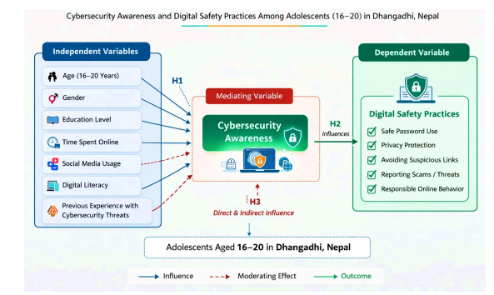
CONCEPTUAL FRAMEWORK

Slide 7
CHAPTER 2 · METHODOLOGY
Research Design
Sample Size
Descriptive design — no variable manipulation; objective assessment of current state of knowledge, attitudes & behaviors.
Target: 384 (Cochran's formula, 95% CI, 5% margin). Collected: 395. Valid after cleaning: 372 (96.9% of target).
Study Area
Sampling Strategy
6 colleges in Dhangadhi, Kailali: NAST, AVN, Alliance International, Navajeevan, Panchodaya, Kailali Model College.
Convenience Sampling (accessibility) + Purposive Sampling (only 16–20 age range included).
Data Collection
Data Entry
41-item structured questionnaire (Sections A–H); physical visits with researchers present to clarify terms.
Paper responses manually entered into Google Forms; double-checked against originals for accuracy.
Analysis Techniques
Data Management
Descriptive stats · Cross-tabulation · Likert scale analysis (% Agree/Strongly Agree) · Thematic/pattern analysis (in progress).
Password-protected files; personally identifiable info removed; physical questionnaires stored securely.

Slide 8
DATA COLLECTION — STUDY AREA
Table 2.1: Data Collections Modules
S.No. | College | Collected | Valid | Percentage
1. | NAST Secondary School | 80 | 76 | 20.4%
2. | Aishwarya Vidya Niketan (AVN) | 75 | 71 | 19.1%
3. | Alliance International Model School | 73 | 70 | 18.8%
4. | Navajeevan College of Nursing and Health Science | 60 | 57 | 15.3%
5. | Panchodaya Higher Secondary School | 60 | 57 | 15.3%
6. | Kailali Model College (KMC) | 47 | 41 | 11.0%
Total |  | 395 | 372 | 100%
Questionnaire Sections (41 items total):

Slide 9
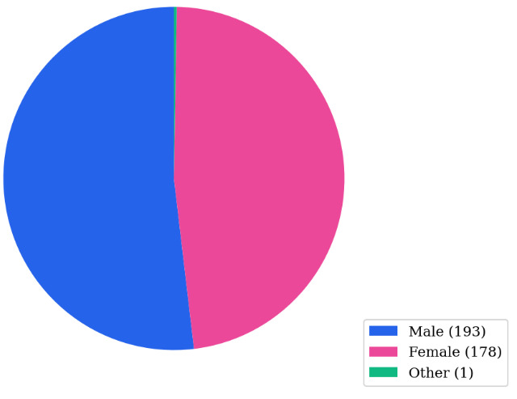
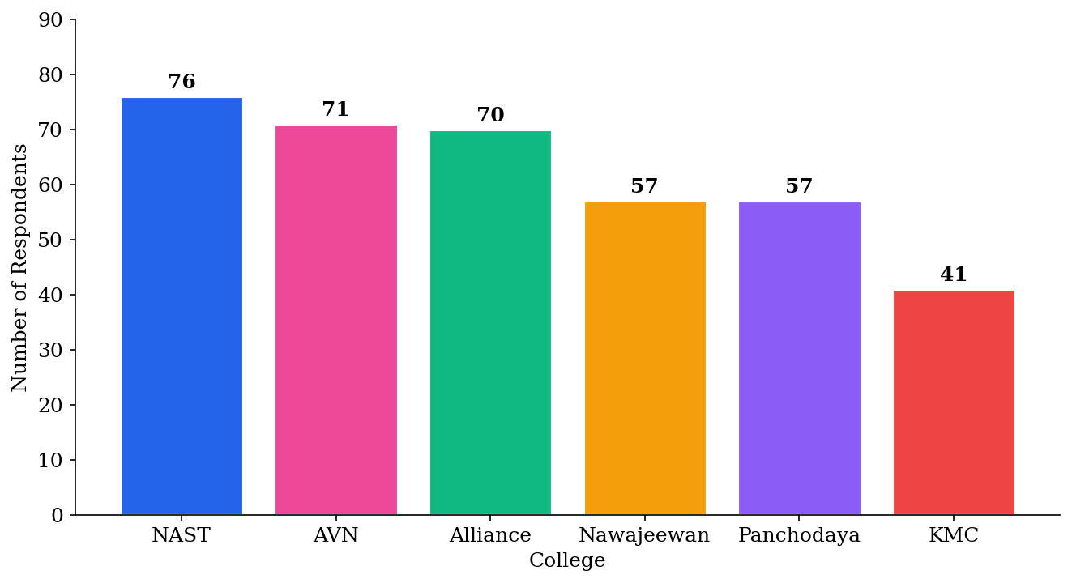
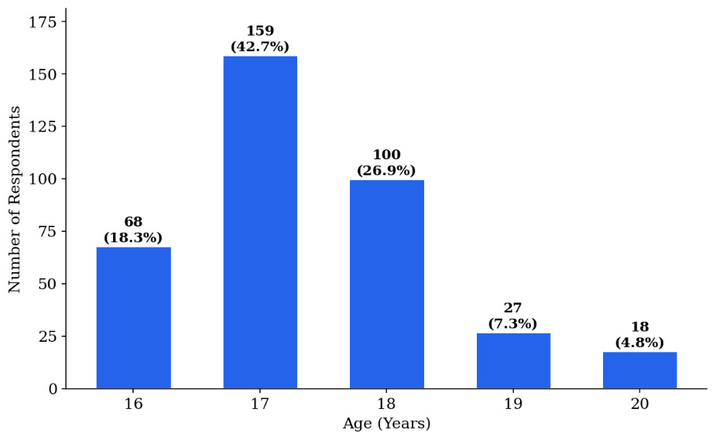
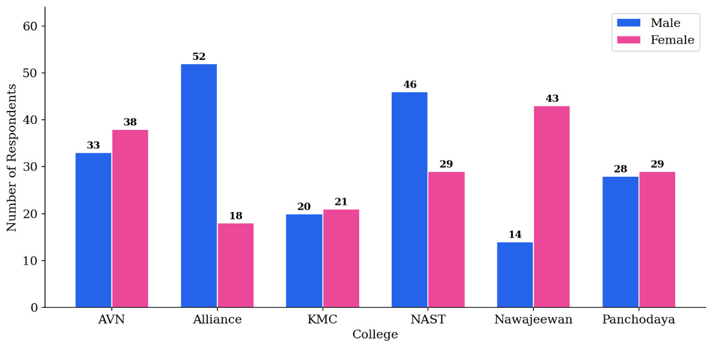
CHAPTER 3 · RESULTS — DEMOGRAPHIC PROFILE
Fig 3.1 · Gender Distribution (N=372)
Fig 3.2 · College-wise Distribution (N=372)
Fig 3.3 · Age Distribution (N=372)
Fig 3.4 · Gender by College (N=372)

Slide 10
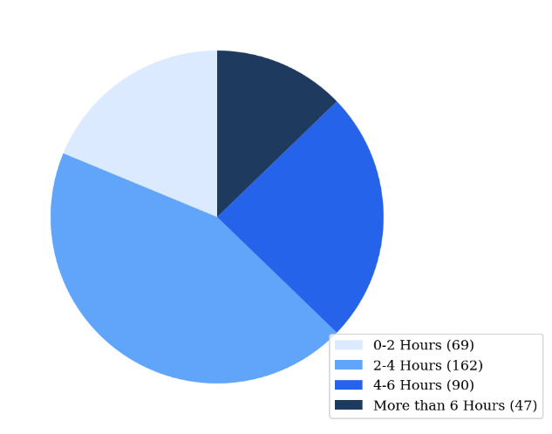
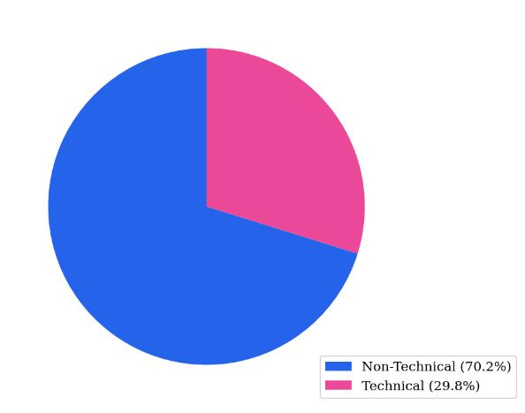
INTERNET USAGE & ACADEMIC BACKGROUND
Fig 3.5 · Daily Internet Usage (N=372)
Fig 3.6 · Technical vs Non-Technical (N=369)
43.5%
12.6%
70.2%
29.8%
use internet 2–4 hrs/day (most common)
use internet 6+ hrs/day (heavy users)
from non-technical backgrounds
from technical (Computer Science) backgrounds

Slide 11
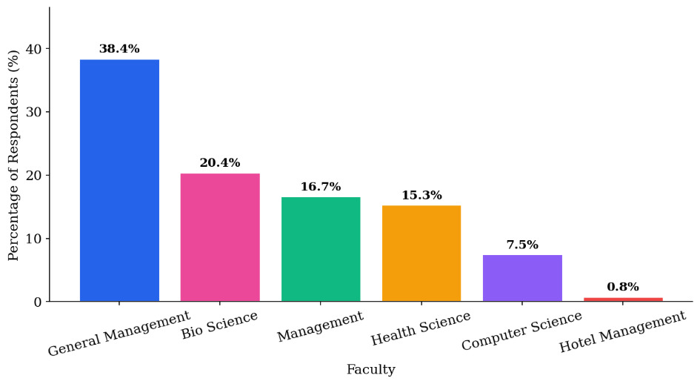
FACULTY-WISE DISTRIBUTION
Fig 3.7 · Faculty-wise Distribution of Respondents (N=372)

Slide 12
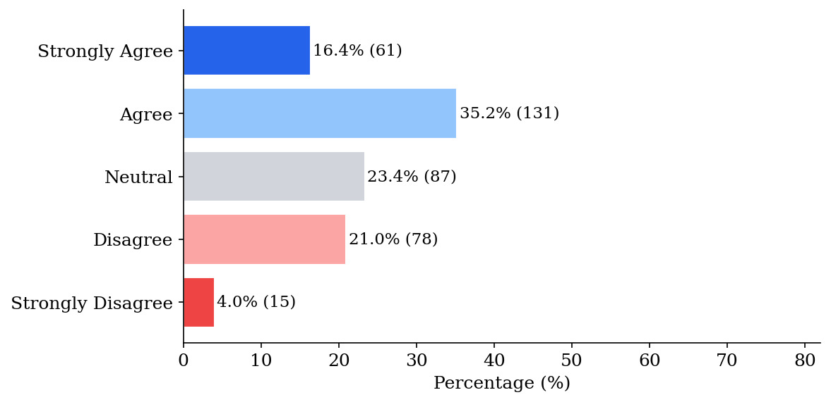
CYBERSECURITY AWARENESS AMONG ADOLESCENTS
Fig 3.8 · Cybersecurity Awareness Likert Distribution (N=372)
91.6%
75.7%
Know strong passwords are important
Aware of public Wi-Fi risks
73.8%
70.1%
Understand unknown link risks
General cyber threat awareness
53.5%
44.3%
Fig 3.9 · Awareness of Suspicious Messages (N=372)
Knowledge & use of 2FA
Can spot suspicious messages
Key Gap: Only 44.3% felt confident spotting suspicious messages — a critical vulnerability point.

Slide 13
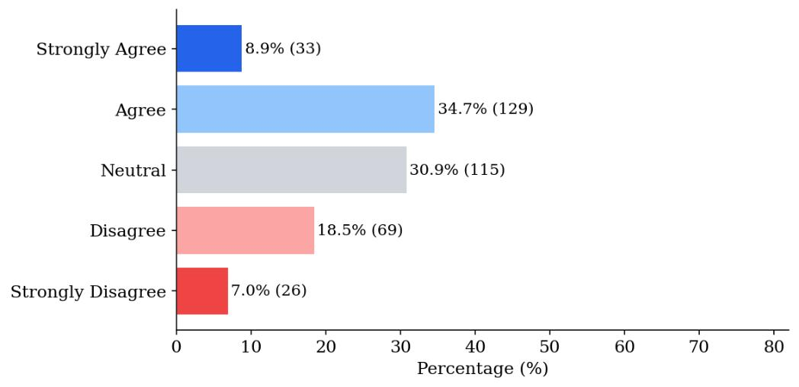
AWARENESS OF PUBLIC WI-FI RISK
Fig 3.10 · Awareness of Public Wi-Fi Risk (N=372)
74.5%
12.4%
13.2%
Strongly Agree + Agree
Neutral
Disagree / Strongly Disagree

Slide 14
DIGITAL SAFETY PRACTICES
Positive Practices
Unsafe / Risky Practices
86.3%
Use strong passwords
62.4%
Do NOT use antivirus / VPN
78.7%
Don't share OTP / sensitive info
49.3%
Don't regularly update software
74.4%
Avoid unknown links
47.8%
Ignore known cybersecurity risks
73.1%
Log out from shared devices
26.3%
Reuse same password on multiple platforms
⚠ Critical Knowledge-Practice Gap: Awareness alone does not guarantee safe digital behavior. 47.8% admit to ignoring risks they are fully aware of.

Slide 15
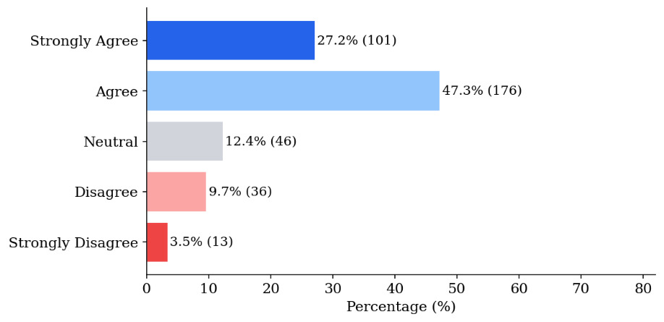
RISKY DIGITAL BEHAVIORS
Fig 3.11 · Risky Digital Behaviors Among Respondents (N=372)

Slide 16
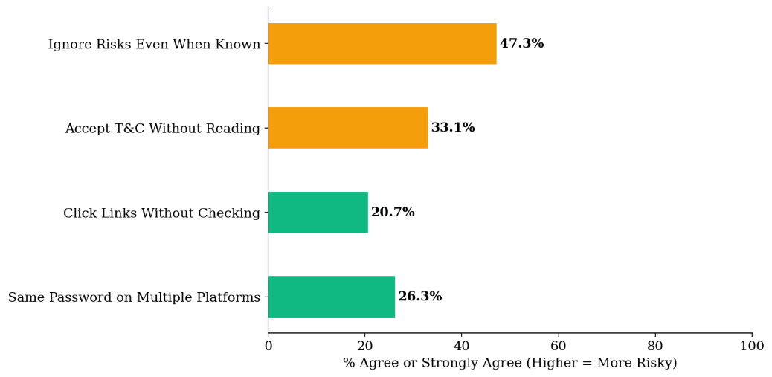
EXPOSURE TO CYBER THREATS & INFLUENCING FACTORS
Key Influencing Factors
Technical Background
Fig 3.12 · Exposure to Cyber Threats (N=372)
Computer Science students showed greater familiarity with 2FA & VPNs vs. non-technical peers.
Internet Usage Time
12.6% using internet 6+ hrs/day reported higher exposure to threats.
Personal Experience
49.5% reported cyber incidents affecting themselves or someone they know.
Community Readiness
85.1% affirm cybersecurity awareness is important — strong foundation for intervention.

Slide 17
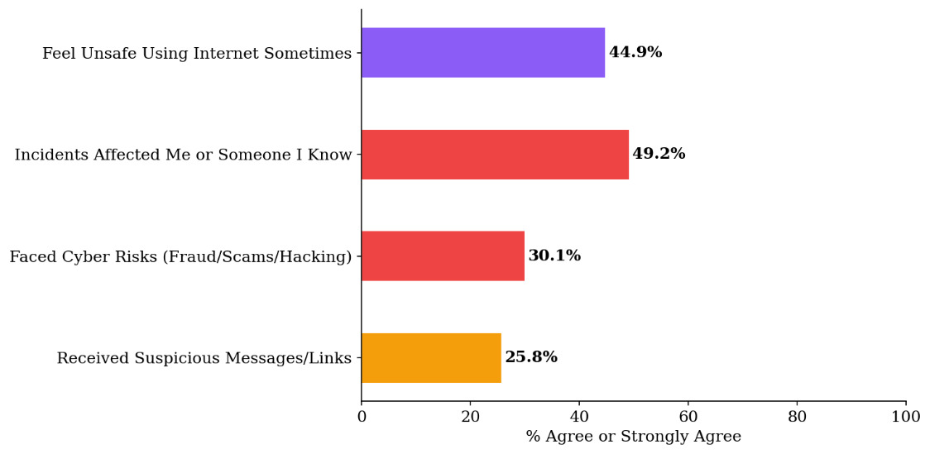
SUMMARY: AWARENESS & SAFETY PRACTICES
Fig 3.13 · Summary Cybersecurity Awareness and Safety Practices (N=372)

Slide 18
CHAPTER 4 · APPLICATION OF RESEARCH FINDINGS
4.1 Educational Institutions
4.2 Community / Classroom Programs
Incorporate cybersecurity as a dedicated topic in CS / IT / digital literacy subjects
Peer-led discussions using this study's data (49.5% affected by cyber incidents)
Develop locally relevant teaching materials: phishing, 2FA, safe passwords, privacy
Hands-on in-class activities: check privacy settings, enable 2FA, identify phishing
Train teachers, especially in non-technical streams (70.2% of respondents)
Students create awareness content: posters, infographics, social media posts
Include cybersecurity orientation for all new students at the start of each academic year
Low-cost, zero-infrastructure — immediately implementable by existing teachers
4.3 Policymakers & Digital Literacy Campaigns
4.4 Public Awareness Initiatives
Policies promoting free and legitimate security tools (antivirus, VPN) — only 37.6% use them
Posters & flyers: 'Do not share your OTP', 'Enable 2FA', 'Avoid unknown links'
Government-backed digital literacy programs targeting semi-urban regions
Social media content (Facebook, TikTok) in Nepali and local languages
Integrate cybersecurity into national curriculum, especially non-technical streams
Short videos: 1 in 2 adolescents ignores risks despite awareness
Ward/municipality-level digital safety initiatives using this study as baseline
Academic network campaigns using peer influence in the 16–20 age group

Slide 19
EVIDENCE-BASED RECOMMENDATIONS
01
Curriculum Integration
Integrate short digital safety modules covering 2FA, phishing recognition, and safe password management into school and college curricula.
02
Peer-Led Sessions
Organize peer-led cybersecurity awareness sessions in colleges, leveraging the 85.1% who already believe cybersecurity awareness is important.
03
Community Workshops
Conduct workshops for parents and youth to address risky behaviors: password reuse, ignoring software updates, and unsafe link clicking.
04
Social Media Campaigns
Share simple, locally relevant content via Facebook and TikTok — widely used by adolescents in Dhangadhi — in Nepali and local languages.
05
Promote Security Tools
Actively promote free and legitimate security tools such as antivirus software and VPN to address the critically low adoption rate of only 37.6%.

Slide 20
CHAPTER 7 · CHALLENGES & MITIGATION MEASURES
1
Obtaining College Permissions
2
Ensuring Honest Responses
Mitigation: Formal permission letters from NAST; personal visits before data collection to build trust with administrators.
Mitigation: Emphasized complete anonymity; no names recorded; no right/wrong answers — encouraged honest reflection.
3
Managing Large Physical Dataset
4
Reaching Diverse Faculties
Mitigation: Divided entry workload by college; double-checked digitized data against originals; rigorous cleaning removed 23 invalid entries.
Mitigation: Pre-coordinated with teachers; used alternative classes when target class unavailable — achieved 70.2%/29.8% non-tech/tech split.
5
Unfamiliar Cybersecurity Terms
6
Data Confidentiality & Privacy
Mitigation: Researchers present throughout to clarify terms (2FA, VPN, phishing) without leading respondents; glossary to be added to final report.
Mitigation: Password-protected digital files; PII removed from analysis dataset; verbal informed consent obtained from all participants.

Slide 21
CONCLUSION
Central Finding: The barrier to digital safety is NOT lack of awareness — it is failure to convert awareness into consistent practice.
Strong Foundation
Knowledge-Practice Gap
91.6% know strong passwords are important; 85.1% affirm cybersecurity awareness matters — population is receptive.
47.8% ignore known risks; only 37.6% use antivirus/VPN; only 53.5% use 2FA — awareness does not drive behavior.
Real-World Impact
Subgroup Differences
49.5% personally affected by cyber incidents — these are not abstract risks but present realities in adolescents' lives.
Technical stream students show greater familiarity with advanced tools; heavy internet users face greater exposure.
Action Required: Design sustained, practical interventions — classroom activities, peer-led sessions, curriculum integration — to close the knowledge-practice gap. Dhangadhi's colleges are well-positioned to act now.

Slide 22
LIMITATIONS & FUTURE RESEARCH
Future Research Directions
Current Limitations
→
Expand Geography
⚠
Thematic/pattern analysis still in progress — deeper qualitative insights pending
Replicate study in other districts of Kailali to test whether findings generalize beyond Dhangadhi.
⚠
Self-reported data carries potential social desirability bias (mitigated by anonymity)
→
Intervention Study
Follow-up survey after a cybersecurity awareness intervention to measure actual behavioral change.
⚠
Convenience + purposive sampling; results specific to Dhangadhi colleges
→
Qualitative Research
In-depth interviews to understand WHY adolescents disengage from safe practices despite awareness.
⚠
Cross-sectional design — does not capture change over time
→
Longitudinal Design
Track how cybersecurity awareness and practices evolve over time with educational interventions.

Slide 23
Thank You
Cybersecurity Awareness and Digital Safety Practices Among Adolescents Aged 16–20 in Dhangadhi, Nepal
Bikram Chapagain | Kaustubh Pant | Maniram Chaudhary | Sandarv Lamichhane
National Academy of Science and Technology, Dhangadhi | 2026

