Slide 1
Tic-Tac-Toe Game
By Ankit Belbase (HCE081BEI007)
Date: 2082/04/16

Slide 2
Introduction
The Tic-Tac-Toe project is a classic implementation of the popular game. It allows Player vs Player and Player vs Computer gameplay. In this project, AI(logics and algorithms) are integrated with different levels of difficulty (Easy, Moderate, Hard).
A colorful Command-line Interface which is a text-based user interface used to interact with software and operating systems by typing commands into a console or terminal. enhances the user experience.
Tic-Tac-Toe is a game consisting of two symbols(X or O) in which we have to place 3 of each symbols in a straight line to win .
This game provides a strategic, engaging game experience and practice with C++.

Slide 3
Objectives
Develop a playable and visually enhanced console Tic-Tac-Toe game.
Allow player to compete against both humans and AI.
Implement an intelligent AI using Minimax algorithm.
Enable persistent score tracking through file handling.
Use the concept of objects and classes.
Use the concept of Inheritance.
Use the standard libraries.

Slide 4
Tools Used
Language: C++
IDE: Visual Studio Code
Libraries:
- iostream: for input/output operations
- fstream: for file handling (saving/loading scores)
- cstdlib : for randomization
- ctime : for time delays
- ANSI escape codes: for colorful command line interface.

Slide 5
System Design
1. Menu Display: Allows mode selection
2. Game Engine: Runs game loop with win/draw detection
3. AI Logic: Implements different levels (Random, Basic Defense, Minimax)
4. Score Manager: Reads/writes from file.
Workflow:
Main Menu
Select Mode
Play Game
Result Save / load Scores

Slide 6
Features
Color-coded terminal display (X=Red, O=Blue, Numbers=Yellow and various text colours)
Supports Player vs Player and Player vs AI
AI with 3 difficulty levels:
- Easy: Random moves
- Moderate: Defensive logic
- Hard: Minimax Algorithm
Persistent Score Saving and Viewing
Menu navigation for seamless user interaction
Features like clearing screen is used for every userinterface shown.

Slide 7
Implementation
1. Game Board: 3x3 char matrix is initialized with 1–9
2. Drawing Board and texts: Colors are applied via ANSI codes
3. Game Logic: Checks for win, draw, or invalid input
4. AI Strategies:
- Easy: Random move selection
- Moderate: Blocks immediate threats
- Hard: Uses full minimax recursive evaluation
5. File I/O: Scores are saved to and loaded from a file (`tictactoe_scores.txt`)

Slide 8
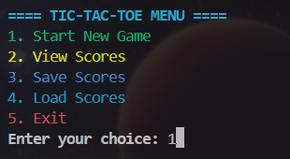
Output / Results
The executable file displays game board after each move with appropriate colouring. This game shows win message, draw alert or failure message with appropriate player score increment.
Output:
- Menu Screen:

Slide 9
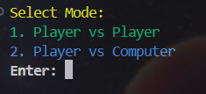
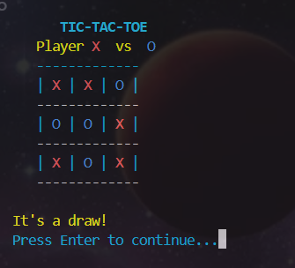
-Mode Selection Screen:
-Player vs Player:

Slide 10
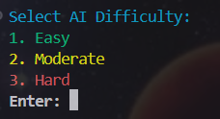
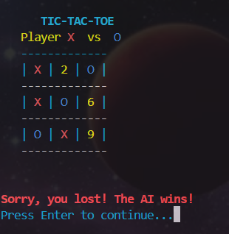
-Player vs AI levels:
-Player vs AI(Hard):

Slide 11

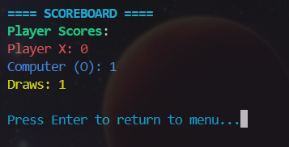
-Saved Scores in .txt file:
-Viewing Scores:

Slide 12
Conclusion
Hence, this project meets all initial goals: AI integration, interactive design, persistent scoring.
Game demonstrates use of key C++ concepts:
- Functions, loops, conditionals
- Arrays, file handling, recursion
- Basic AI logic and user interaction
Hence this game is a fun and educational coding exercise with real engagement value.

