Slide 1
Transaction Processing
Dr. Anindya Halder
Dept of Computer Application,
North-Eastern Hill University, Tura Campus

Slide 2
Transaction Processing
Transaction Concept
Transaction State
Implementation of Atomicity and Durability
Concurrent Executions
Serializability
Recoverability
Implementation of Isolation
Transaction Definition in SQL
Testing for Serializability.

Slide 3
Transaction Concept
A transaction is a unit of program execution that accesses and possibly updates various data items.
A transaction must see a consistent database.
During transaction execution the database may be inconsistent.
When the transaction is committed, the database must be consistent.
Two main issues to deal with:
  Failures of various kinds, such as hardware failures and system crashes
  Concurrent execution of multiple transactions

Slide 4
ACID Properties
To preserve integrity of data, the database system must ensure:
Atomicity. Either all operations of the transaction are properly reflected in the database or none are.
Consistency. Execution of a transaction in isolation preserves the consistency of the database.
Isolation. Although multiple transactions may execute concurrently, each transaction must be unaware of other concurrently executing transactions. Intermediate transaction results must be hidden from other concurrently executed transactions.
  That is, for every pair of transactions T_{i} and T_{j}, it appears to T_{i} that either T_{j}, finished execution before T_{i} started, or T_{j} started execution after T_{i} finished.
Durability. After a transaction completes successfully, the changes it has made to the database persist, even if there are system failures.

Slide 5
Example of Fund Transfer
Transaction to transfer $50 from account A to account B:
  1. read(A)
  2. A := A – 50
  3. write(A)
  4. read(B)
  5. B := B + 50
  6. write(B)
Atomicity requirement — if the transaction fails after step 3 and before step 6, the system should ensure that its updates are not reflected in the database, else an inconsistency will result.
Consistency requirement – the sum of A and B is unchanged by the execution of the transaction.

Slide 6
Example of Fund Transfer (Cont.)
Durability requirement — once the user has been notified that the transaction has completed (i.e., the transfer of the $50 has taken place), the updates to the database by the transaction must persist despite failures.
Isolation requirement — if between steps 3 and 6, another transaction is allowed to access the partially updated database, it will see an inconsistent database
(the sum A + B will be less than it should be).
Can be ensured trivially by running transactions serially, that is one after the other. However, executing multiple transactions concurrently has significant benefits, as we will see.

Slide 7
Transaction State
Active, the initial state; the transaction stays in this state while it is executing
Partially committed, after the final statement has been executed.
Failed, after the discovery that normal execution can no longer proceed.
Aborted, after the transaction has been rolled back and the database restored to its state prior to the start of the transaction. Two options after it has been aborted:
  restart the transaction – only if no internal logical error
  kill the transaction
Committed, after successful completion.

Slide 8

Transaction State (Cont.)

Slide 9
Implementation of Atomicity and Durability
The recovery-management component of a database system implements the support for atomicity and durability.
The shadow-database scheme:
  assume that only one transaction is active at a time.
  a pointer called db_pointer always points to the current consistent copy of the database.
  all updates are made on a shadow copy of the database, and db_pointer is made to point to the updated shadow copy only after the transaction reaches partial commit and all updated pages have been flushed to disk.
  in case transaction fails, old consistent copy pointed to by db_pointer can be used, and the shadow copy can be deleted.

Slide 10
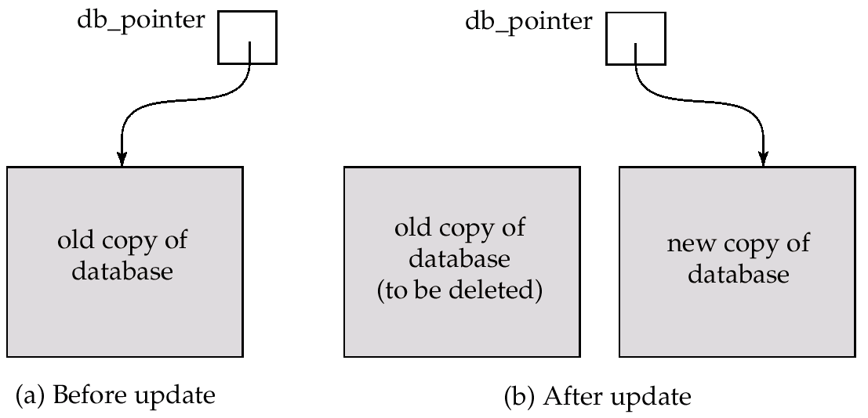
Implementation of Atomicity and Durability (Cont.)
The shadow-database scheme:
Assumes disks to not fail
Useful for text editors, but extremely inefficient for large databases: executing a single transaction requires copying the entire database. Will see better schemes in Chapter 17.

Slide 11
Concurrent Executions
Multiple transactions are allowed to run concurrently in the system. Advantages are:
  increased processor and disk utilization, leading to better transaction throughput: one transaction can be using the CPU while another is reading from or writing to the disk
  reduced average response time for transactions: short transactions need not wait behind long ones.
Concurrency control schemes – mechanisms to achieve isolation, i.e., to control the interaction among the concurrent transactions in order to prevent them from destroying the consistency of the database

Slide 12
Schedules
Schedules – sequences that indicate the chronological order in which instructions of concurrent transactions are executed
  a schedule for a set of transactions must consist of all instructions of those transactions
  must preserve the order in which the instructions appear in each individual transaction.

Slide 13

Example Schedules
Let T₁ transfer $50 from A to B, and T₂ transfer 10% of the balance from A to B. The following is a serial schedule (Schedule 1 in the text), in which T₁ is followed by T₂.
Schedule 1

Slide 14

Example Schedule (Cont.)
Let T₁ and T₂ be the transactions defined previously. The following schedule (Schedule 3 in the text) is not a serial schedule, but it is equivalent to Schedule 1.
Schedule 3
In both Schedule 1 and 3, the sum A + B is preserved.

Slide 15

Example Schedules (Cont.)
The following concurrent schedule (Schedule 4 in the text) does not preserve the value of the the sum A + B.
Schedule 4

Slide 16
Serializability
Basic Assumption – Each transaction preserves database consistency.
Thus serial execution of a set of transactions preserves database consistency.
A (possibly concurrent) schedule is serializable if it is equivalent to a serial schedule. Different forms of schedule equivalence give rise to the notions of:
  1. conflict serializability
  2. view serializability
We ignore operations other than read and write instructions, and we assume that transactions may perform arbitrary computations on data in local buffers in between reads and writes. Our simplified schedules consist of only read and write instructions.

Slide 17
Conflict Serializability
Instructions l_{i} and l_{j} of transactions T_{i} and T_{j} respectively, conflict if and only if there exists some item Q accessed by both l_{i} and l_{j}, and at least one of these instructions wrote Q.
1. l_{i} = read(Q), l_{j} = read(Q). l_{i} and l_{j} don’t conflict.
2. l_{i} = read(Q), l_{j} = write(Q). They conflict.
3. l_{i} = write(Q), l_{j} = read(Q). They conflict
4. l_{i} = write(Q), l_{j} = write(Q). They conflict
Intuitively, a conflict between l_{i} and l_{j} forces a (logical) temporal order between them. If l_{i} and l_{j} are consecutive in a schedule and they do not conflict, their results would remain the same even if they had been interchanged in the schedule.

Slide 18
Conflict Serializability (Cont.)
If a schedule S can be transformed into a schedule S´ by a series of swaps of non-conflicting instructions, we say that S and S´ are conflict equivalent.
We say that a schedule S is conflict serializable if it is conflict equivalent to a serial schedule
Example of a schedule that is NOT conflict serializable:
T₃ T₄
read(Q)
write(Q)
write(Q)
We are unable to swap instructions in the above schedule to obtain either the serial schedule < T₃, T₄ >, or the serial schedule < T₄, T₃ >.

Slide 19

Conflict Serializability (Cont.)
Schedule 3 below can be transformed into Schedule 1, a serial schedule where T₂ follows T₁, by series of swaps of non-conflicting instructions. Therefore Schedule 3 is conflict serializable.

Slide 20
View Serializability
Let S and S´ be two schedules with the same set of transactions. S and S´ are view equivalent if the following three conditions are met:
  1. For each data item Q, if transaction T_{i} reads the initial value of Q in schedule S, then transaction T_{i} must, in schedule S´, also read the initial value of Q.
  2. For each data item Q if transaction T_{i} executes read(Q) in schedule S, and that value was produced by transaction T_{j} (if any), then transaction T_{i} in schedule S´ must also read the value of Q that was produced by transaction T_{j} .
  3. For each data item Q, the transaction (if any) that performs the final write(Q) operation in schedule S must perform the final write(Q) operation in schedule S´.
As can be seen, view equivalence is also based purely on reads
and writes alone.

Slide 21
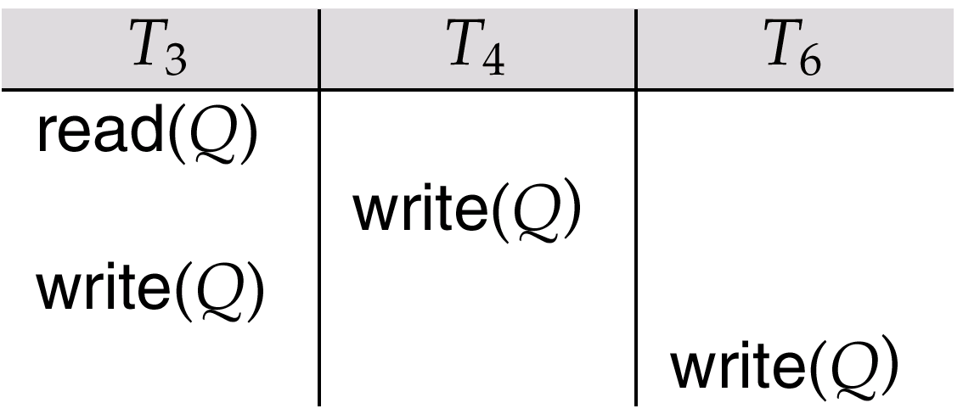
View Serializability (Cont.)
A schedule S is view serializable it is view equivalent to a serial schedule.
Every conflict serializable schedule is also view serializable.
Schedule 9 (from text) — a schedule which is view-serializable but not conflict serializable.
Every view serializable schedule that is not conflict
serializable has blind writes.

Slide 22
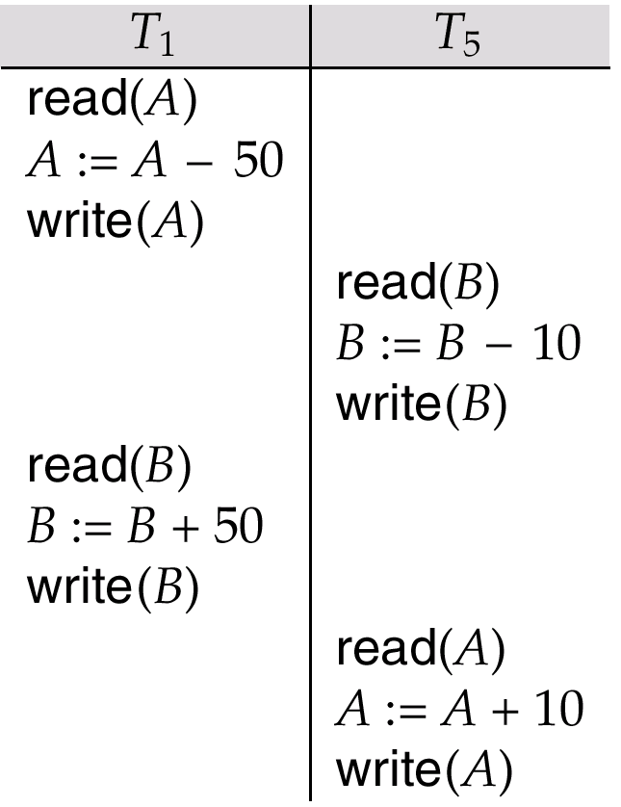
Other Notions of Serializability
Schedule 8 (from text) given below produces same outcome as the serial schedule < T₁, T₅ >, yet is not conflict equivalent or view equivalent to it.
Determining such equivalence requires analysis of operations other than read and write.

Slide 23
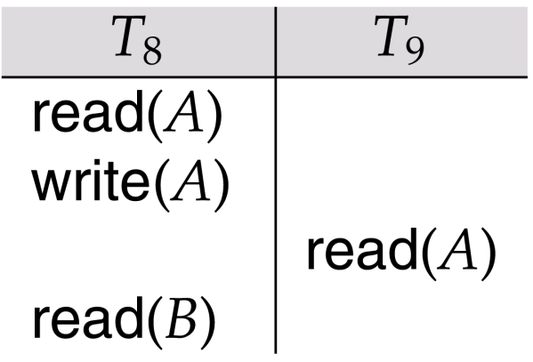
Recoverability
Need to address the effect of transaction failures on concurrently
running transactions.
Recoverable schedule — if a transaction T_{j} reads a data items previously written by a transaction T_{i} , the commit operation of T_{i} appears before the commit operation of T_{j}.
The following schedule is not recoverable if T₉ commits immediately after the read
If T₈ should abort, T₉ would have read (and possibly shown to the user) an inconsistent database state. Hence database must ensure that schedules are recoverable.
commits
commits

Slide 24
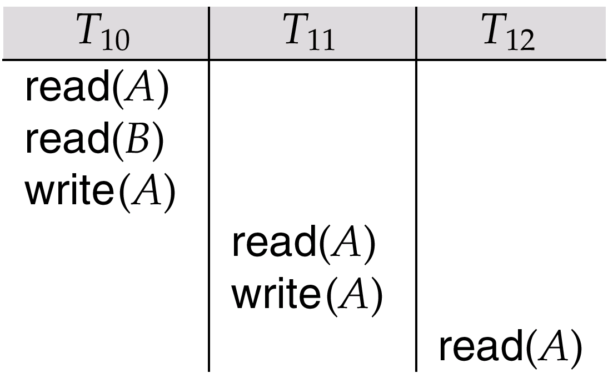
Recoverability (Cont.)
Cascading rollback – a single transaction failure leads to a series of transaction rollbacks. Consider the following schedule where none of the transactions has yet committed (so the schedule is recoverable)
If T₁₀ fails, T₁₁ and T₁₂ must also be rolled back.
Can lead to the undoing of a significant amount of work

Slide 25
Recoverability (Cont.)
Cascadeless schedules — restrict the schedule where cascading rollbacks cannot occur;
- Formally, for each pair of transactions T_{i} and T_{j} such that T_{j} reads a data item previously written by T_{i}, the commit operation of T_{i} appears before the read operation of T_{j}.
Every cascadeless schedule is also recoverable
It is desirable to restrict the schedules to those that are cascadeless

Slide 26
Implementation of Isolation
Schedules must be conflict or view serializable, and recoverable, for the sake of database consistency, and preferably cascadeless.
A policy in which only one transaction can execute at a time generates serial schedules, but provides a poor degree of concurrency..
Concurrency-control schemes tradeoff between the amount of concurrency they allow and the amount of overhead that they incur.
Some schemes allow only conflict-serializable schedules to be generated, while others allow view-serializable schedules that are not conflict-serializable.

Slide 27
Transaction Definition in SQL
Data manipulation language must include a construct for specifying the set of actions that comprise a transaction.
In SQL, a transaction begins implicitly.
A transaction in SQL ends by:
  Commit work commits current transaction and begins a new one.
  Rollback work causes current transaction to abort.
Levels of consistency specified by SQL-92:
  Serializable — default
  Repeatable read
  Read committed
  Read uncommitted

Slide 28
Levels of Consistency in SQL-92
Serializable — default
Repeatable read — only committed records to be read, repeated reads of same record must return same value. However, a transaction may not be serializable – it may find some records inserted by a transaction but not find others.
Read committed — only committed records can be read, but successive reads of record may return different (but committed) values.
Read uncommitted — even uncommitted records may be read.
Lower degrees of consistency useful for gathering approximate
information about the database, e.g., statistics for query optimizer.

Slide 29
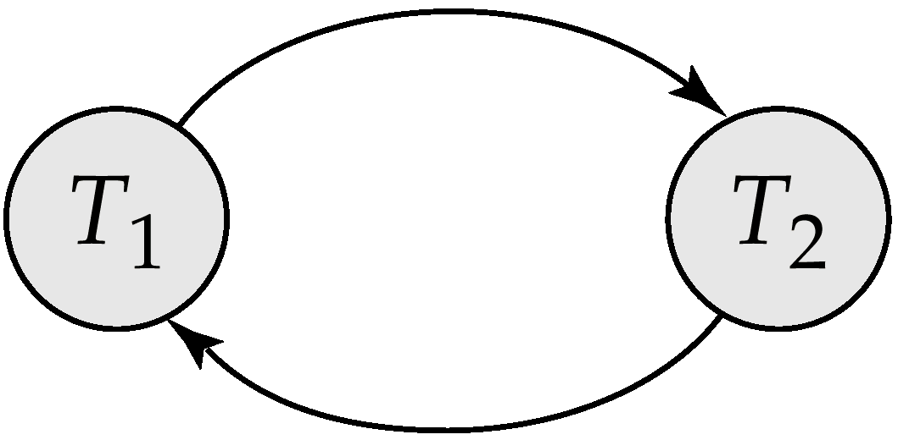
Testing for Serializability
Consider some schedule of a set of transactions T₁, T₂, ..., T_{n}
Precedence graph — a direct graph where the vertices are the transactions (names).
We draw an arc from T_{i} to T_{j} if the two transaction conflict, and T_{i} accessed the data item on which the conflict arose earlier.
This graph consists of a pair G = (V, E), where, V is a set of vertices and E is a set of edges.
The set of vertices consists of all the transactions participating in the schedule.
We may label the arc by the item that was accessed.
Example 1
x
y

Slide 30
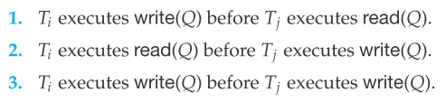
Testing for Serializability contd..
The set of edges consists of all edges Ti → Tj for which one of three conditions holds:
If an edge T i → T j exists in the precedence graph, then, in any serial schedule S’ equivalent to S, Ti must appear before Tj

Slide 31
Testing for Serializability contd..
Example 1
The precedence graph for schedule 4 appears in Figure 14.11. It contains the edge T 1 → T 2 , because T 1 executes read(A) before T 2 executes write(A).
It also contains the edge T 2 → T 1 , because T 2 executes read(B) before T 1 executes write(B)
If the precedence graph for S has a cycle, then schedule S is not conﬂict serializable.
If the graph contains no cycles,
then the schedule S is
conﬂict serializable

Slide 32
Example Schedule (Schedule A)
T₁ T₂ T₃ T₄ T₅
read(X)
read(Y)
read(Z)
read(V)
read(W)
read(W)
read(Y)
write(Y)
write(Z)
read(U)
read(Y)
write(Y)
read(Z)
write(Z)
read(U)
write(U)

Slide 33
Precedence Graph for Schedule A
T₁
T₂
T₄
T₃

Slide 34
Test for Conflict Serializability
A schedule is conflict serializable if and only if its precedence graph is acyclic.
Cycle-detection algorithms exist which take order n² time, where n is the number of vertices in the graph. (Better algorithms take order n + e where e is the number of edges.)
If precedence graph is acyclic, the serializability order can be obtained by a topological sorting of the graph. This is a linear order consistent with the partial order of the graph.
For example, a serializability order for Schedule A would be
T₅ → T₁ → T₃ → T₂ → T₄ .

Slide 35
Test for View Serializability
The precedence graph test for conflict serializability must be modified to apply to a test for view serializability.
The problem of checking if a schedule is view serializable falls in the class of NP-complete problems. Thus existence of an efficient algorithm is unlikely.
However practical algorithms that just check some sufficient conditions for view serializability can still be used.

Slide 36
Concurrency Control vs. Serializability Tests
Testing a schedule for serializability after it has executed is a little too late!
Goal – to develop concurrency control protocols that will assure serializability. They will generally not examine the precedence graph as it is being created; instead a protocol will impose a discipline that avoids nonseralizable schedules.
Will study such protocols in Chapter 16.
Tests for serializability help understand why a concurrency control protocol is correct.

Slide 37
End of Chapter

Slide 38
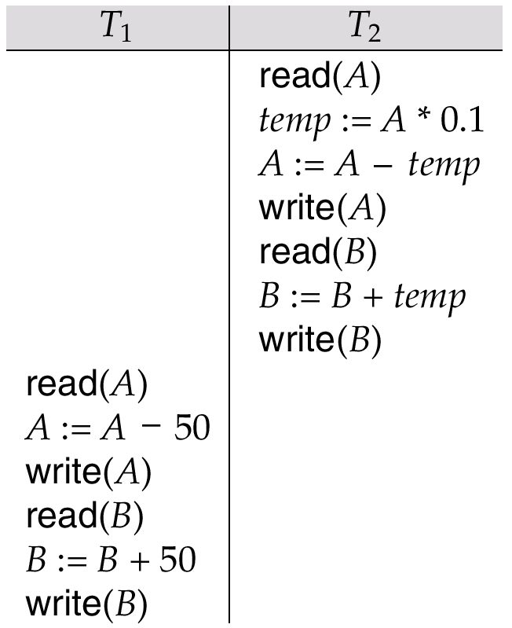
Schedule 2 -- A Serial Schedule in Which
T₂ is Followed by T₁

Slide 39
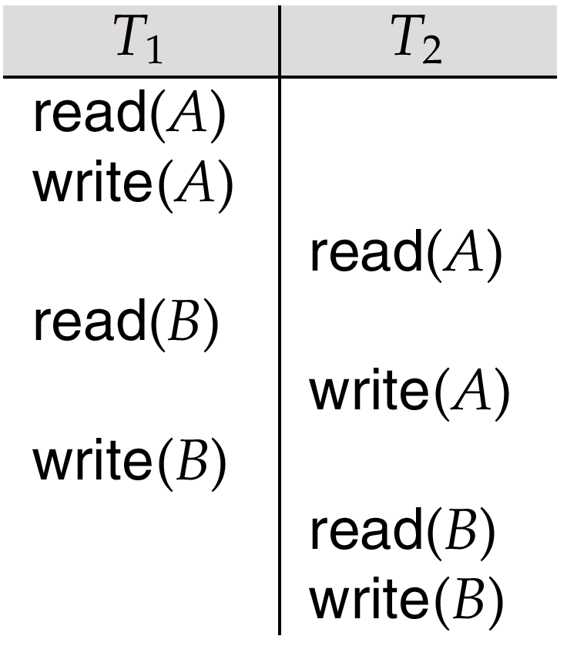
Schedule 5 -- Schedule 3 After Swapping A Pair of Instructions

Slide 40
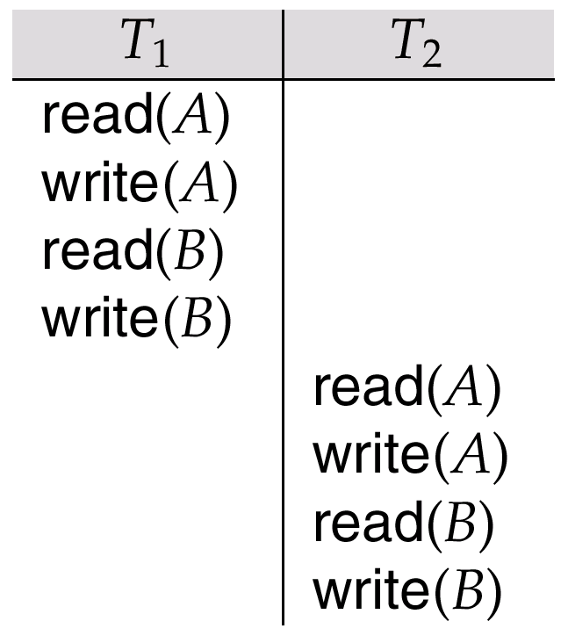
Schedule 6 -- A Serial Schedule That is Equivalent to Schedule 3

Slide 41

Schedule 7

Slide 42
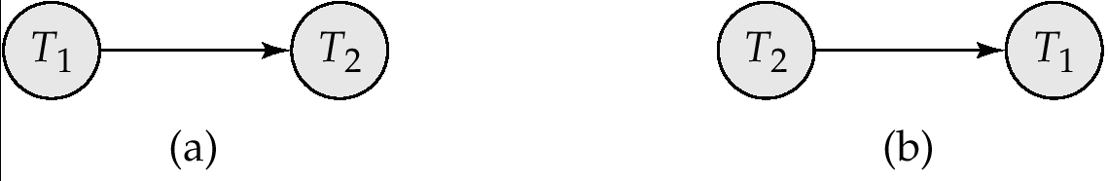
Precedence Graph for
(a) Schedule 1 and (b) Schedule 2

Slide 43
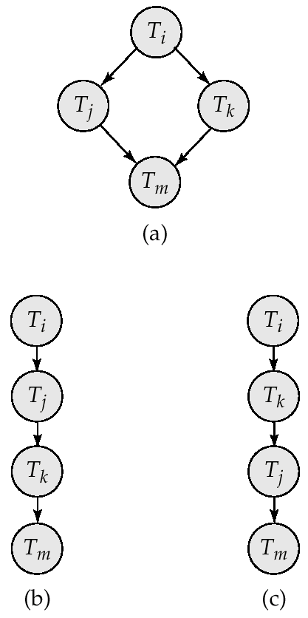
Illustration of Topological Sorting

Slide 44
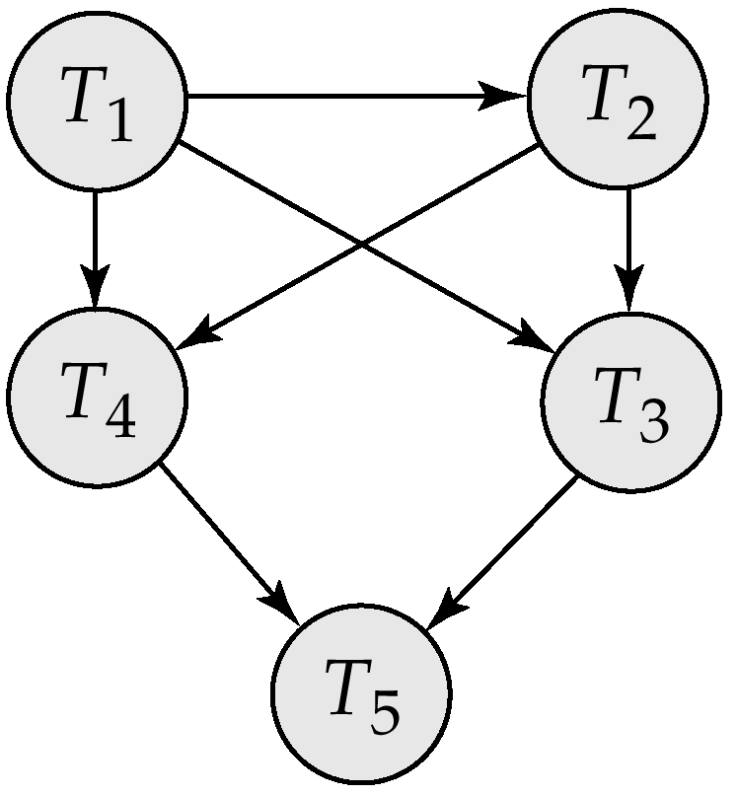
Precedence Graph

Slide 45
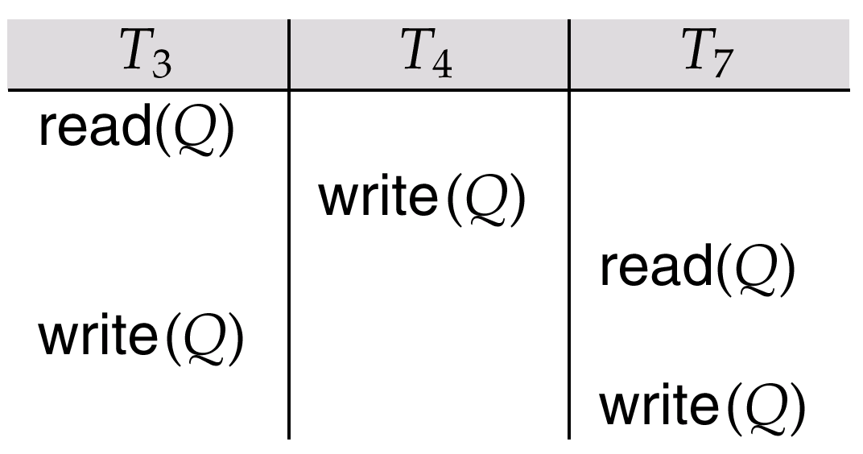
fig. 15.21

