Slide 1
Concurrency Control
Dr. Anindya Halder

Slide 2
Concurrency Control
Introduction
Lock-Based Protocols
Timestamp-Based Protocols
Validation-Based Protocols
Multiple Granularity
Multiversion Schemes
Deadlock Handling
Insert and Delete Operations
Concurrency in Index Structures

Slide 3
Concurrency Control: Introduction
Fundamental properties of a transaction is isolation.
When several transactions execute concurrently in the database, the isolation property may no longer be preserved.
To ensure it, the system must control the interaction among the concurrent transactions;
This control is achieved through one of a variety of mechanisms called concurrency control schemes.
We consider the management of concurrently executing transactions, and we ignore failures.
There are a variety of concurrency-control schemes.

Slide 4
Lock-Based Protocols
One way to ensure isolation is to require that data items be accessed in a mutually exclusive manner.
While one transaction is accessing a data item, no other transaction can modify that data item.
The most common method used to implement this requirement is to allow a transaction to access a data item only if it is currently holding a lock on that item.
A lock is a mechanism to control concurrent access to a data item
Data items can be locked in two modes :
1. exclusive (X) mode. Data item can be both read as well as
written. X-lock is requested using lock-X instruction.
2. shared (S) mode. Data item can only be read. S-lock is
requested using lock-S instruction.
Lock requests are made to concurrency-control manager. Transaction can proceed only after request is granted.

Slide 5

Lock-Based Protocols (Cont.)
Lock-compatibility matrix
A transaction may be granted a lock on an item if the requested lock is compatible with locks already held on the item by other transactions
Any number of transactions can hold shared locks on an item, but if any transaction holds an exclusive on the item no other transaction may hold any lock on the item.
If a lock cannot be granted, the requesting transaction is made to wait till all incompatible locks held by other transactions have been released. The lock is then granted.

Slide 6
Lock-Based Protocols (Cont.)
Example of a transaction performing locking:
T₂: lock-S(A);
read (A);
unlock(A);
lock-S(B);
read (B);
unlock(B);
display(A+B)
Locking as above is not sufficient to guarantee serializability — if A and B get updated in-between the read of A and B, the displayed sum would be wrong.
A locking protocol is a set of rules followed by all transactions while requesting and releasing locks. Locking protocols restrict the set of possible schedules.

Slide 7

Pitfalls of Lock-Based Protocols
Consider the partial schedule
Neither T₃ nor T₄ can make progress — executing lock-S(B) causes T₄ to wait for T₃ to release its lock on B, while executing lock-X(A) causes T₃ to wait for T₄ to release its lock on A.
Such a situation is called a deadlock.
  To handle a deadlock one of T₃ or T₄ must be rolled back
  and its locks released.

Slide 8
Pitfalls of Lock-Based Protocols (Cont.)
The potential for deadlock exists in most locking protocols. Deadlocks are a necessary evil.
Starvation is also possible if concurrency control manager is badly designed. For example:
  A transaction may be waiting for an X-lock on an item, while a sequence of other transactions request and are granted an S-lock on the same item.
  The same transaction is repeatedly rolled back due to deadlocks.
Concurrency control manager can be designed to prevent starvation by the following way. When a transaction T_{i} requests a lock on a data item Q in a particular mode M, the concurrency-control manager grants the lock provided that:
  There is no other transaction holding a lock on Q in a mode that conflicts with M
  There is no other transaction that is waiting for a lock on Q and that made its lock request before T_{i} .
Thus, a lock request will never get blocked by a lock request that is made later.

Slide 9
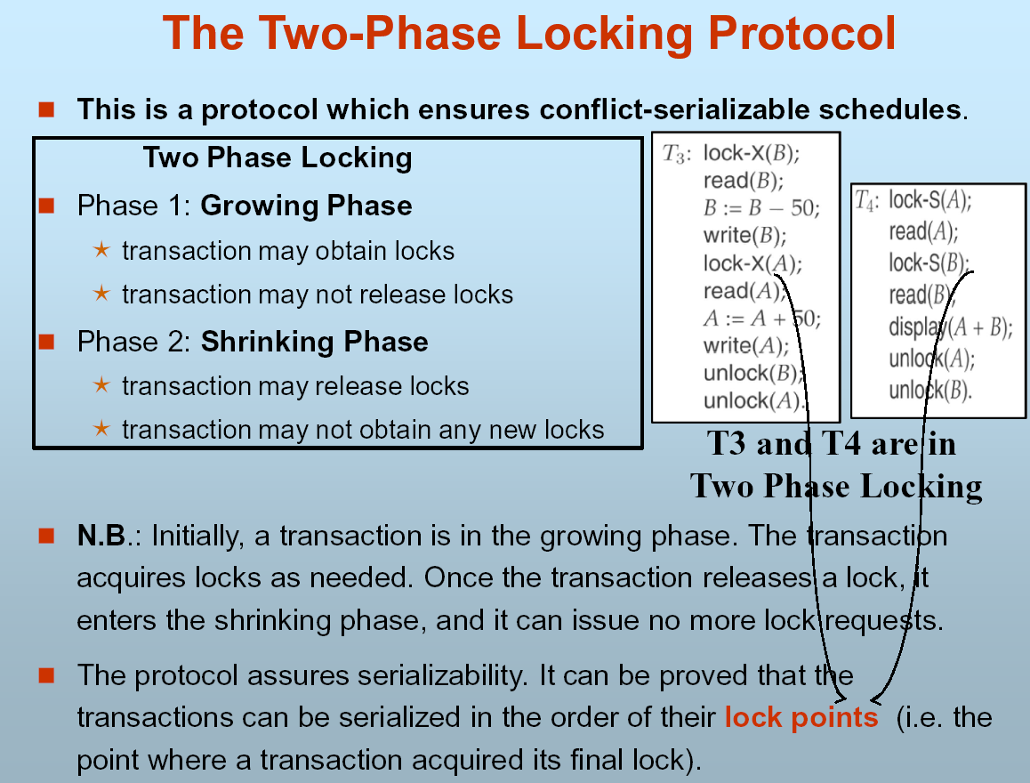

Slide 10
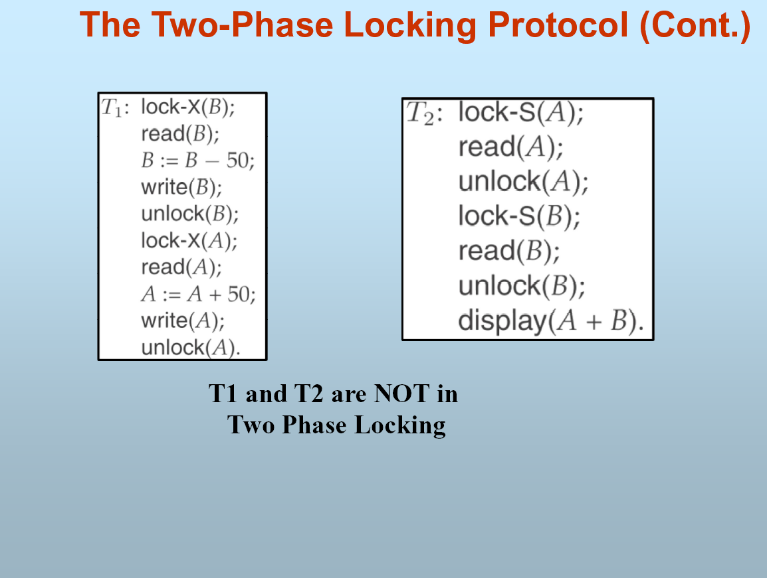

Slide 11
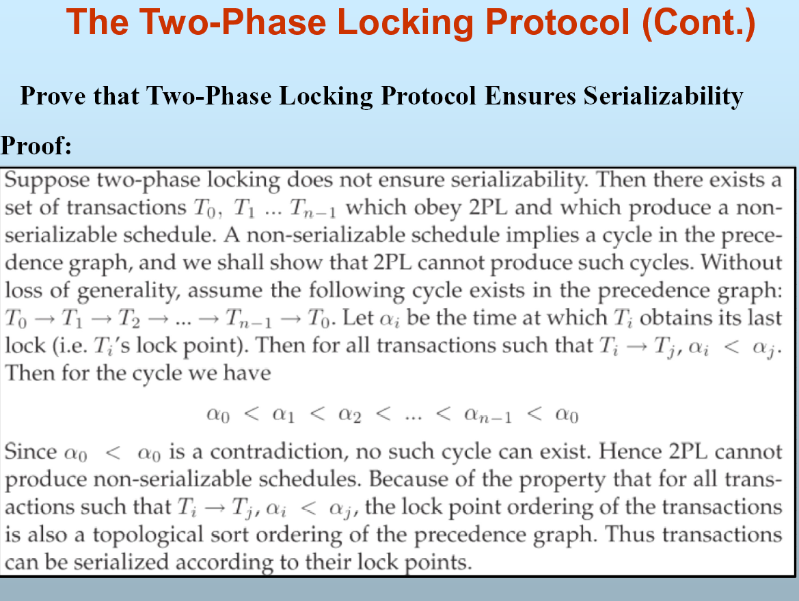

Slide 12
The Two-Phase Locking Protocol (Cont.)
Two-phase locking does not ensure freedom from deadlocks
Cascading roll-back is possible under two-phase locking. To avoid this, follow a modified protocol called strict two-phase locking. Here a transaction must hold all its exclusive locks till it commits/aborts.
Rigorous two-phase locking is even stricter: here all locks are held till commit/abort. In this protocol transactions can be serialized in the order in which they commit.

Slide 13
The Two-Phase Locking Protocol (Cont.)
There can be conflict serializable schedules that cannot be obtained if two-phase locking is used.
However, in the absence of extra information (e.g., ordering of access to data), two-phase locking is needed for conflict serializability in the following sense:
Given a transaction T_{i} that does not follow two-phase locking, we can find a transaction T_{j} that uses two-phase locking, and a schedule for T_{i} and T_{j} that is not conflict serializable.

Slide 14
Lock Conversions
Two-phase locking with lock conversions:
– First Phase:
  can acquire a lock-S on item
  can acquire a lock-X on item
  can convert a lock-S to a lock-X (upgrade)
– Second Phase:
  can release a lock-S
  can release a lock-X
  can convert a lock-X to a lock-S (downgrade)
This protocol assures serializability. But still relies on the programmer to insert the various locking instructions.

Slide 15
Automatic Acquisition of Locks
A transaction T_{i} issues the standard read/write instruction, without explicit locking calls.
The operation read(D) is processed as:
if T_{i} has a lock on D
then
read(D)
else
begin
if necessary wait until no other
transaction has a lock-X on D
grant T_{i} a lock-S on D;
read(D)
end

Slide 16
Automatic Acquisition of Locks (Cont.)
write(D) is processed as:
if T_{i} has a lock-X on D
then
write(D)
else
begin
if necessary wait until no other trans. has any lock on D,
if T_{i} has a lock-S on D
then
upgrade lock on D to lock-X
else
grant T_{i} a lock-X on D
write(D)
end;
All locks are released after commit or abort

Slide 17
Implementation of Locking
A Lock manager can be implemented as a separate process to which transactions send lock and unlock requests
The lock manager replies to a lock request by sending a lock grant messages (or a message asking the transaction to roll back, in case of a deadlock)
The requesting transaction waits until its request is answered
The lock manager maintains a datastructure called a lock table to record granted locks and pending requests
The lock table is usually implemented as an in-memory hash table indexed on the name of the data item being locked

Slide 18

Lock Table
Black rectangles indicate granted locks, white ones indicate waiting requests
Lock table also records the type of lock granted or requested
New request is added to the end of the queue of requests for the data item, and granted if it is compatible with all earlier locks
Unlock requests result in the request being deleted, and later requests are checked to see if they can now be granted
If transaction aborts, all waiting or granted requests of the transaction are deleted
  lock manager may keep a list of locks held by each transaction, to implement this efficiently

Slide 19
Graph-Based Protocols
Graph-based protocols are an alternative to two-phase locking
Impose a partial ordering → on the set D = {d₁, d₂ ,..., d_{h}} of all data items.
  If d_{i} → d_{j} then any transaction accessing both d_{i} and d_{j} must access d_{i} before accessing d_{j}.
  Implies that the set D may now be viewed as a directed acyclic graph, called a database graph.
The tree-protocol is a simple kind of graph protocol.

Slide 20

Tree Protocol
Only exclusive locks are allowed.
The first lock by T_{i} may be on any data item. Subsequently, a data Q can be locked by T_{i} only if the parent of Q is currently locked by T_{i}.
Data items may be unlocked at any time.

Slide 21
Graph-Based Protocols (Cont.)
The tree protocol ensures conflict serializability as well as freedom from deadlock.
Unlocking may occur earlier in the tree-locking protocol than in the two-phase locking protocol.
  shorter waiting times, and increase in concurrency
  protocol is deadlock-free, no rollbacks are required
  the abort of a transaction can still lead to cascading rollbacks.
  (this correction has to be made in the book also.)
However, in the tree-locking protocol, a transaction may have to lock data items that it does not access.
  increased locking overhead, and additional waiting time
  potential decrease in concurrency
Schedules not possible under two-phase locking are possible under tree protocol, and vice versa.

Slide 22
Timestamp-Based Protocols
Each transaction is issued a timestamp when it enters the system. If an old transaction T_{i} has time-stamp TS(T_{i}), a new transaction T_{j} is assigned time-stamp TS(T_{j}) such that TS(T_{i}) <TS(T_{j}).
The protocol manages concurrent execution such that the time-stamps determine the serializability order.
In order to assure such behavior, the protocol maintains for each data Q two timestamp values:
  W-timestamp(Q) is the largest time-stamp of any transaction that executed write(Q) successfully.
  R-timestamp(Q) is the largest time-stamp of any transaction that executed read(Q) successfully.

Slide 23
Timestamp-Based Protocols (Cont.)
The timestamp ordering protocol ensures that any conflicting read and write operations are executed in timestamp order.
Suppose a transaction T_{i} issues a read(Q)
1. If TS(T_{i}) ≤ W-timestamp(Q), then T_{i} needs to read a value of Q
that was already overwritten. Hence, the read operation is
rejected, and T_{i} is rolled back.
2. If TS(T_{i})≥ W-timestamp(Q), then the read operation is
executed, and R-timestamp(Q) is set to the maximum of R-
timestamp(Q) and TS(T_{i}).

Slide 24
Timestamp-Based Protocols (Cont.)
Suppose that transaction T_{i} issues write(Q).
If TS(T_{i}) < R-timestamp(Q), then the value of Q that T_{i} is producing was needed previously, and the system assumed that that value would never be produced. Hence, the write operation is rejected, and T_{i} is rolled back.
If TS(T_{i}) < W-timestamp(Q), then T_{i} is attempting to write an obsolete value of Q. Hence, this write operation is rejected, and T_{i} is rolled back.
Otherwise, the write operation is executed, and W-timestamp(Q) is set to TS(T_{i}).

Slide 25
Example Use of the Protocol
A partial schedule for several data items for transactions with
timestamps 1, 2, 3, 4, 5
T₁
T₂
T₃
T₄
T₅
read(X)
read(Y)
read(Y)
write(Y)
write(Z)
read(Z)
read(X)
abort
read(X)
write(Z)
abort
write(Y)
write(Z)

Slide 26
Correctness of Timestamp-Ordering Protocol
The timestamp-ordering protocol guarantees serializability since all the arcs in the precedence graph are of the form:
Thus, there will be no cycles in the precedence graph
Timestamp protocol ensures freedom from deadlock as no transaction ever waits.
But the schedule may not be cascade-free, and may not even be recoverable.
transaction
with smaller
timestamp
transaction
with larger
timestamp

Slide 27
Recoverability and Cascade Freedom
Problem with timestamp-ordering protocol:
  Suppose T_{i} aborts, but T_{j} has read a data item written by T_{i}
  Then T_{j} must abort; if T_{j} had been allowed to commit earlier, the schedule is not recoverable.
  Further, any transaction that has read a data item written by T_{j} must abort
  This can lead to cascading rollback --- that is, a chain of rollbacks
Solution:
  A transaction is structured such that its writes are all performed at the end of its processing
  All writes of a transaction form an atomic action; no transaction may execute while a transaction is being written
  A transaction that aborts is restarted with a new timestamp

Slide 28
Thomas’ Write Rule
Modified version of the timestamp-ordering protocol in which obsolete write operations may be ignored under certain circumstances.
When T_{i} attempts to write data item Q, if TS(T_{i}) < W-timestamp(Q), then T_{i} is attempting to write an obsolete value of {Q}. Hence, rather than rolling back T_{i} as the timestamp ordering protocol would have done, this {write} operation can be ignored.
Otherwise this protocol is the same as the timestamp ordering protocol.
Thomas' Write Rule allows greater potential concurrency. Unlike previous protocols, it allows some view-serializable schedules that are not conflict-serializable.

Slide 29
Validation-Based Protocol
Execution of transaction T_{i} is done in three phases.
1. Read and execution phase: Transaction T_{i} writes only to
temporary local variables
2. Validation phase: Transaction T_{i} performs a ``validation test''
to determine if local variables can be written without violating
serializability.
3. Write phase: If T_{i} is validated, the updates are applied to the
database; otherwise, T_{i} is rolled back.
The three phases of concurrently executing transactions can be interleaved, but each transaction must go through the three phases in that order.
Also called as optimistic concurrency control since transaction executes fully in the hope that all will go well during validation

Slide 30
Validation-Based Protocol (Cont.)
Each transaction T_{i} has 3 timestamps
Start(T_{i}) : the time when T_{i} started its execution
Validation(T_{i}): the time when T_{i} entered its validation phase
Finish(T_{i}) : the time when T_{i} finished its write phase
Serializability order is determined by timestamp given at validation time, to increase concurrency. Thus TS(T_{i}) is given the value of Validation(T_{i}).
This protocol is useful and gives greater degree of concurrency if probability of conflicts is low. That is because the serializability order is not pre-decided and relatively less transactions will have to be rolled back.

Slide 31
Validation Test for Transaction T_{j}
If for all T_{i} with TS (T_{i}) < TS (T_{j}) either one of the following condition holds:
  finish(T_{i}) < start(T_{j})
  start(T_{j}) < finish(T_{i}) < validation(T_{j}) and the set of data items written by T_{i} does not intersect with the set of data items read by T_{j}.
then validation succeeds and T_{j} can be committed. Otherwise, validation fails and T_{j} is aborted.
Justification: Either first condition is satisfied, and there is no overlapped execution, or second condition is satisfied and
1. the writes of T_{j} do not affect reads of T_{i} since they occur after T_{i}
has finished its reads.
2. the writes of T_{i} do not affect reads of T_{j} since T_{j} does not read
any item written by T_{i}.

Slide 32
Schedule Produced by Validation
Example of schedule produced using validation
T₁₄
T₁₅
read(B)
read(B)
B:- B-50
read(A)
A:- A+50
read(A)
(validate)
display (A+B)
(validate)
write (B)
write (A)

Slide 33
Multiple Granularity
Allow data items to be of various sizes and define a hierarchy of data granularities, where the small granularities are nested within larger ones
Can be represented graphically as a tree (but don't confuse with tree-locking protocol)
When a transaction locks a node in the tree explicitly, it implicitly locks all the node's descendents in the same mode.
Granularity of locking (level in tree where locking is done):
  fine granularity (lower in tree): high concurrency, high locking overhead
  coarse granularity (higher in tree): low locking overhead, low concurrency

Slide 34
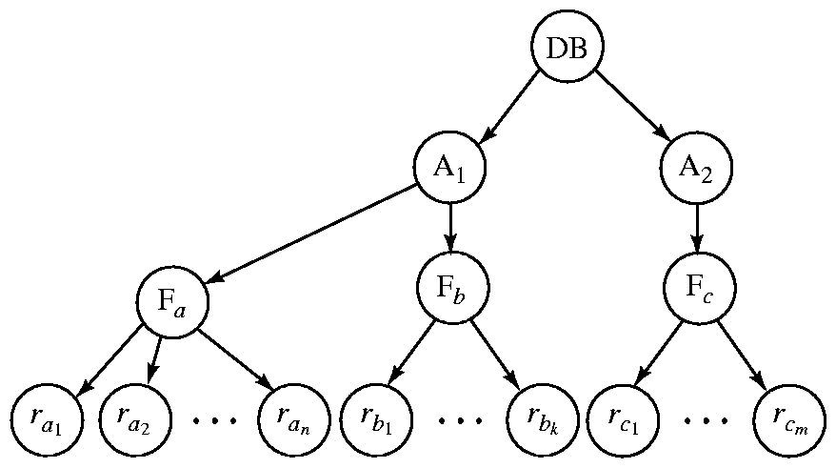
Example of Granularity Hierarchy
The highest level in the example hierarchy is the entire database.
The levels below are of type area, file and record in that order.

Slide 35
Intention Lock Modes
In addition to S and X lock modes, there are three additional lock modes with multiple granularity:
  intention-shared (IS): indicates explicit locking at a lower level of the tree but only with shared locks.
  intention-exclusive (IX): indicates explicit locking at a lower level with exclusive or shared locks
  shared and intention-exclusive (SIX): the subtree rooted by that node is locked explicitly in shared mode and explicit locking is being done at a lower level with exclusive-mode locks.
intention locks allow a higher level node to be locked in S or X mode without having to check all descendent nodes.

Slide 36
Compatibility Matrix with
Intention Lock Modes
The compatibility matrix for all lock modes is:
IS
IX
S
S IX
X
IS
✓
✓
✓
✓
×
IX
✓
✓
×
×
×
S
✓
×
✓
×
×
S IX
✓
×
×
×
×
X
×
×
×
×
×

Slide 37
Multiple Granularity Locking Scheme
Transaction T_{i} can lock a node Q, using the following rules:
1. The lock compatibility matrix must be observed.
2. The root of the tree must be locked first, and may be locked in
any mode.
3. A node Q can be locked by T_{i} in S or IS mode only if the parent
of Q is currently locked by T_{i} in either IX or IS
mode.
4. A node Q can be locked by T_{i} in X, SIX, or IX mode only if the
parent of Q is currently locked by T_{i} in either IX
or SIX mode.
5. T_{i} can lock a node only if it has not previously unlocked any node
(that is, T_{i} is two-phase).
6. T_{i} can unlock a node Q only if none of the children of Q are
currently locked by T_{i}.
Observe that locks are acquired in root-to-leaf order,
whereas they are released in leaf-to-root order.

Slide 38
Multiversion Schemes
Multiversion schemes keep old versions of data item to increase concurrency.
  Multiversion Timestamp Ordering
  Multiversion Two-Phase Locking
Each successful write results in the creation of a new version of the data item written.
Use timestamps to label versions.
When a read(Q) operation is issued, select an appropriate version of Q based on the timestamp of the transaction, and return the value of the selected version.
reads never have to wait as an appropriate version is returned immediately.

Slide 39
Multiversion Timestamp Ordering
Each data item Q has a sequence of versions <Q₁, Q₂,...., Q_{m}>. Each version Q_{k} contains three data fields:
  Content -- the value of version Q_{k}.
  W-timestamp(Q_{k}) -- timestamp of the transaction that created (wrote) version Q_{k}
  R-timestamp(Q_{k}) -- largest timestamp of a transaction that successfully read version Q_{k}
when a transaction T_{i} creates a new version Q_{k} of Q, Q_{k}'s W-timestamp and R-timestamp are initialized to TS(T_{i}).
R-timestamp of Q_{k} is updated whenever a transaction T_{j} reads Q_{k}, and TS(T_{j}) > R-timestamp(Q_{k}).

Slide 40
Multiversion Timestamp Ordering (Cont)
The multiversion timestamp scheme presented next ensures serializability.
Suppose that transaction T_{i} issues a read(Q) or write(Q) operation. Let Q_{k} denote the version of Q whose write timestamp is the largest write timestamp less than or equal to TS(T_{i}).
1. If transaction T_{i} issues a read(Q), then the value returned is the
content of version Q_{k}.
2. If transaction T_{i} issues a write(Q), and if TS(T_{i}) < R-
timestamp(Q_{k}), then transaction T_{i} is rolled
back. Otherwise, if TS(T_{i}) = W-timestamp(Q_{k}), the contents of Q_{k}
are overwritten, otherwise a new version of Q is created.
Reads always succeed; a write by T_{i} is rejected if some other transaction T_{j} that (in the serialization order defined by the timestamp values) should read T_{i}'s write, has already read a version created by a transaction older than T_{i}.

Slide 41
Multiversion Two-Phase Locking
Differentiates between read-only transactions and update transactions
Update transactions acquire read and write locks, and hold all locks up to the end of the transaction. That is, update transactions follow rigorous two-phase locking.
  Each successful write results in the creation of a new version of the data item written.
  each version of a data item has a single timestamp whose value is obtained from a counter ts-counter that is incremented during commit processing.
Read-only transactions are assigned a timestamp by reading the current value of ts-counter before they start execution; they follow the multiversion timestamp-ordering protocol for performing reads.

Slide 42
Multiversion Two-Phase Locking (Cont.)
When an update transaction wants to read a data item, it obtains a shared lock on it, and reads the latest version.
When it wants to write an item, it obtains X lock on; it then creates a new version of the item and sets this version's timestamp to ∞.
When update transaction T_{i} completes, commit processing occurs:
  T_{i} sets timestamp on the versions it has created to ts-counter + 1
  T_{i} increments ts-counter by 1
Read-only transactions that start after T_{i} increments ts-counter will see the values updated by T_{i}.
Read-only transactions that start before T_{i} increments the
ts-counter will see the value before the updates by T_{i}.
Only serializable schedules are produced.

Slide 43
Deadlock Handling
Consider the following two transactions:
T₁: write (A) T₂: write(B)
write(B) write(A)
Schedule with deadlock
T₁
T₂
lock-X on A
write (A)
lock-X on B
write (A)
wait for lock-X on A
wait for lock-X on B

Slide 44
Deadlock Handling
System is deadlocked if there is a set of transactions such that every transaction in the set is waiting for another transaction in the set.
Deadlock prevention protocols ensure that the system will never enter into a deadlock state. Some prevention strategies :
  Require that each transaction locks all its data items before it begins execution (predeclaration).
  Impose partial ordering of all data items and require that a transaction can lock data items only in the order specified by the partial order (graph-based protocol).

Slide 45
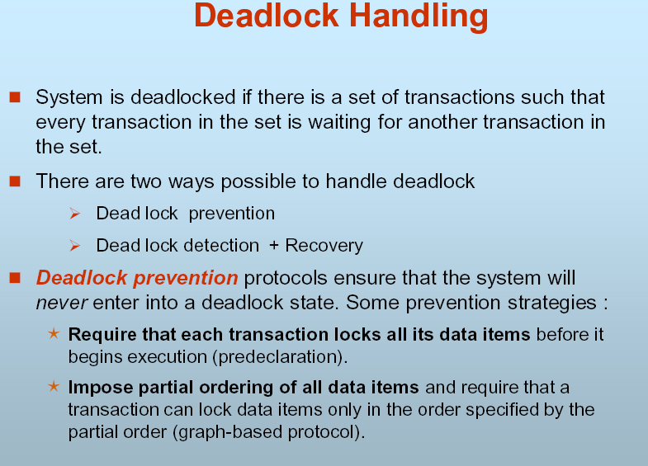

Slide 46
Deadloack Handling Contd..
Limitations of :
  Predeclaration:
    it is often hard to predict, before the transaction begins, what data items need to be locked;
    data-item utilization may be very low, since many of the data items may be locked but unused for a long time.

Slide 47
More Deadlock Prevention Strategies
Following schemes use transaction timestamps for the sake of deadlock prevention alone.
wait-die scheme — non-preemptive
  older transaction may wait for younger one to release data item. Younger transactions never wait for older ones; they are rolled back instead.
  a transaction may die several times before acquiring needed data item
  Example: suppose that transactions T14 , T15 , and T16 have timestamps 5, 10, and 15, respectively. If T14 requests a data item held by T15 , then T14 will wait. If T16 requests a data item held by T15 , then T16 will be rolled back.
wound-wait scheme — preemptive
  older transaction wounds (forces rollback) of younger transaction instead of waiting for it. Younger transactions may wait for older ones.
  may be fewer rollbacks than wait-die scheme.
  Example:with transactions T14 , T15 , and T16 , if T 14 requests a data item held by T 15 , then the data item will be preempted from T15 , and T15 will be rolled back. If T16 requests a data item held by T15 , then T16 will wait

Slide 48
Deadlock prevention (Cont.)
Both in wait-die and in wound-wait schemes, a rolled back transactions is restarted with its original timestamp. Older transactions thus have precedence over newer ones, and starvation is hence avoided.
Limitation: The major problem with both of these schemes is that unnecessary rollbacks may occur.
Timeout-Based Schemes :
  a transaction waits for a lock only for a specified amount of time. After that, the wait times out and the transaction is rolled back.
  thus deadlocks are not possible
  simple to implement; but starvation is possible. Also difficult to determine good value of the timeout interval.

Slide 49
Deadlock Detection
Deadlocks can be described as a wait-for graph, which consists of a pair G = (V,E),
  V is a set of vertices (all the transactions in the system)
  E is a set of edges; each element is an ordered pair T_{i} →T_{j}.
If T_{i} → T_{j} is in E, then there is a directed edge from T_{i} to T_{j}, implying that T_{i} is waiting for T_{j} to release a data item.
When T_{i} requests a data item currently being held by T_{j}, then the edge T_{i} to T_{j} is inserted in the wait-for graph. This edge is removed only when T_{j} is no longer holding a data item needed by T_{i}.
The system is in a deadlock state if and only if the wait-for graph has a cycle. Must invoke a deadlock-detection algorithm periodically to look for cycles.

Slide 50


Deadlock Detection (Cont.)
Wait-for graph without a cycle
Wait-for graph with a cycle

Slide 51
Deadlock Recovery
When deadlock is detected :
  Some transaction will have to rolled back (made a victim) to break deadlock. Select that transaction as victim that will incur minimum cost.
  Rollback -- determine how far to roll back transaction
    Total rollback: Abort the transaction and then restart it.
    More effective to roll back transaction only as far as necessary to break deadlock.
  Starvation happens if same transaction is always chosen as victim. Include the number of rollbacks in the cost factor to avoid starvation

Slide 52
Insert and Delete Operations
If two-phase locking is used :
  A delete operation may be performed only if the transaction deleting the tuple has an exclusive lock on the tuple to be deleted.
  A transaction that inserts a new tuple into the database is given an X-mode lock on the tuple
Insertions and deletions can lead to the phantom phenomenon.
  A transaction that scans a relation (e.g., find all accounts in Perryridge) and a transaction that inserts a tuple in the relation (e.g., insert a new account at Perryridge) may conflict in spite of not accessing any tuple in common.
  If only tuple locks are used, non-serializable schedules can result: the scan transaction may not see the new account, yet may be serialized before the insert transaction.

Slide 53
Insert and Delete Operations (Cont.)
The transaction scanning the relation is reading information that indicates what tuples the relation contains, while a transaction inserting a tuple updates the same information.
  The information should be locked.
One solution:
  Associate a data item with the relation, to represent the information about what tuples the relation contains.
  Transactions scanning the relation acquire a shared lock in the data item,
  Transactions inserting or deleting a tuple acquire an exclusive lock on the data item. (Note: locks on the data item do not conflict with locks on individual tuples.)
Above protocol provides very low concurrency for insertions/deletions.
Index locking protocols provide higher concurrency while
preventing the phantom phenomenon, by requiring locks
on certain index buckets.

Slide 54
Index Locking Protocol
Every relation must have at least one index. Access to a relation must be made only through one of the indices on the relation.
A transaction T_{i} that performs a lookup must lock all the index buckets that it accesses, in S-mode.
A transaction T_{i} may not insert a tuple t_{i} into a relation r without updating all indices to r.
T_{i} must perform a lookup on every index to find all index buckets that could have possibly contained a pointer to tuple t_{i}, had it existed already, and obtain locks in X-mode on all these index buckets. T_{i} must also obtain locks in X-mode on all index buckets that it modifies.
The rules of the two-phase locking protocol must be observed.

Slide 55
Weak Levels of Consistency
Degree-two consistency: differs from two-phase locking in that S-locks may be released at any time, and locks may be acquired at any time
  X-locks must be held till end of transaction
  Serializability is not guaranteed, programmer must ensure that no erroneous database state will occur]
Cursor stability:
  For reads, each tuple is locked, read, and lock is immediately released
  X-locks are held till end of transaction
  Special case of degree-two consistency

Slide 56
Weak Levels of Consistency in SQL
SQL allows non-serializable executions
  Serializable: is the default
  Repeatable read: allows only committed records to be read, and repeating a read should return the same value (so read locks should be retained)
    However, the phantom phenomenon need not be prevented
      T1 may see some records inserted by T2, but may not see others inserted by T2
  Read committed: same as degree two consistency, but most systems implement it as cursor-stability
  Read uncommitted: allows even uncommitted data to be read

Slide 57
Concurrency in Index Structures
Indices are unlike other database items in that their only job is to help in accessing data.
Index-structures are typically accessed very often, much more than other database items.
Treating index-structures like other database items leads to low concurrency. Two-phase locking on an index may result in transactions executing practically one-at-a-time.
It is acceptable to have nonserializable concurrent access to an index as long as the accuracy of the index is maintained.
In particular, the exact values read in an internal node of a
B⁺-tree are irrelevant so long as we land up in the correct leaf node.
There are index concurrency protocols where locks on internal nodes are released early, and not in a two-phase fashion.

Slide 58
Concurrency in Index Structures (Cont.)
Example of index concurrency protocol:
Use crabbing instead of two-phase locking on the nodes of the B⁺-tree, as follows. During search/insertion/deletion:
  First lock the root node in shared mode.
  After locking all required children of a node in shared mode, release the lock on the node.
  During insertion/deletion, upgrade leaf node locks to exclusive mode.
  When splitting or coalescing requires changes to a parent, lock the parent in exclusive mode.
Above protocol can cause excessive deadlocks. Better protocols are available; see Section 16.9 for one such protocol, the B-link tree protocol

Slide 59
End of Chapter

Slide 60

Partial Schedule Under Two-Phase Locking

Slide 61

Incomplete Schedule With a Lock Conversion

Slide 62
Lock Table

Slide 63
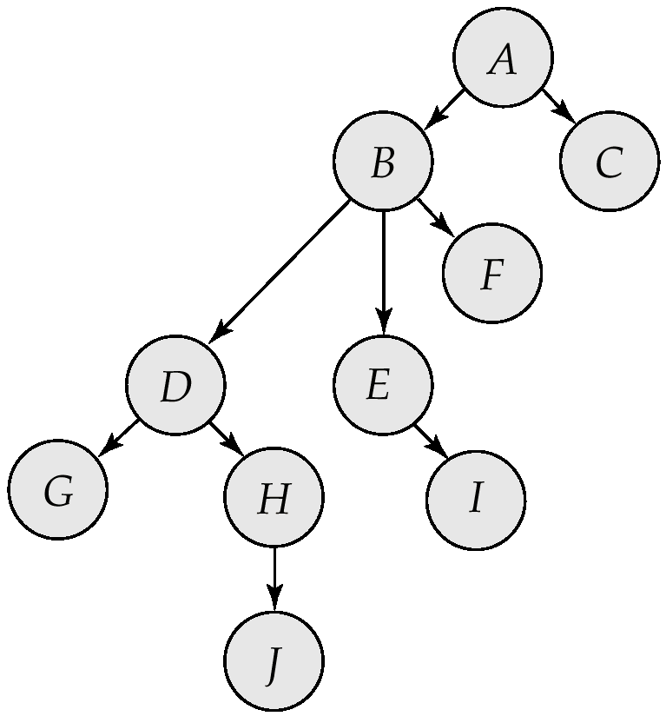
Tree-Structured Database Graph

Slide 64
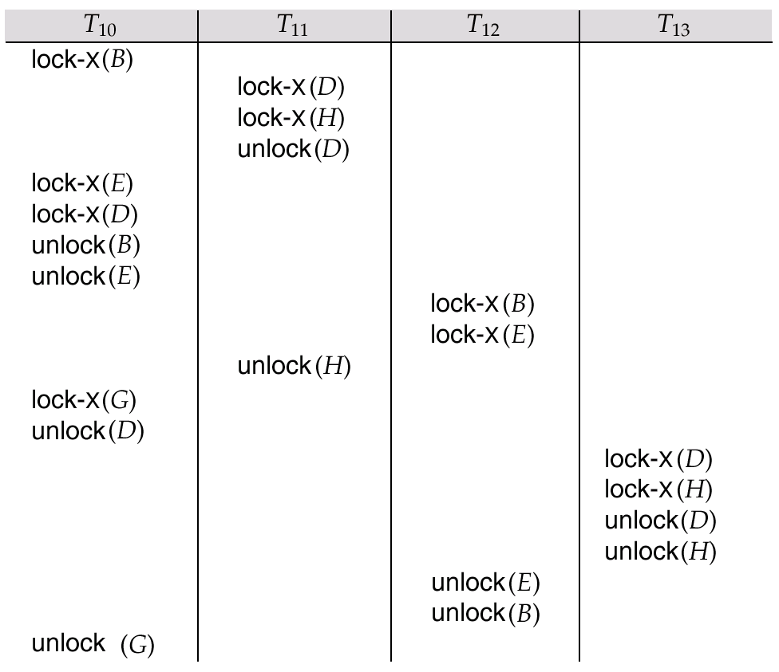
Serializable Schedule Under the Tree Protocol

Slide 65
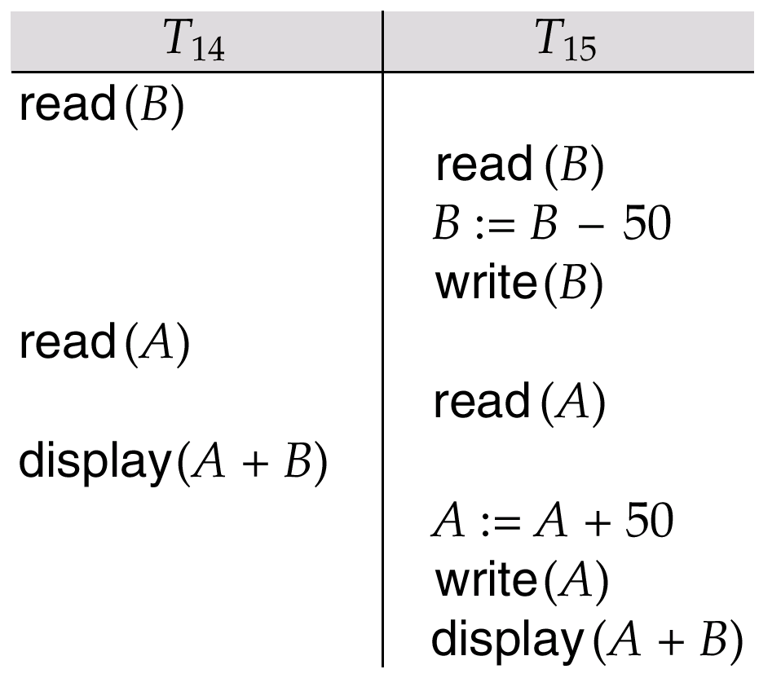
Schedule 3

Slide 66
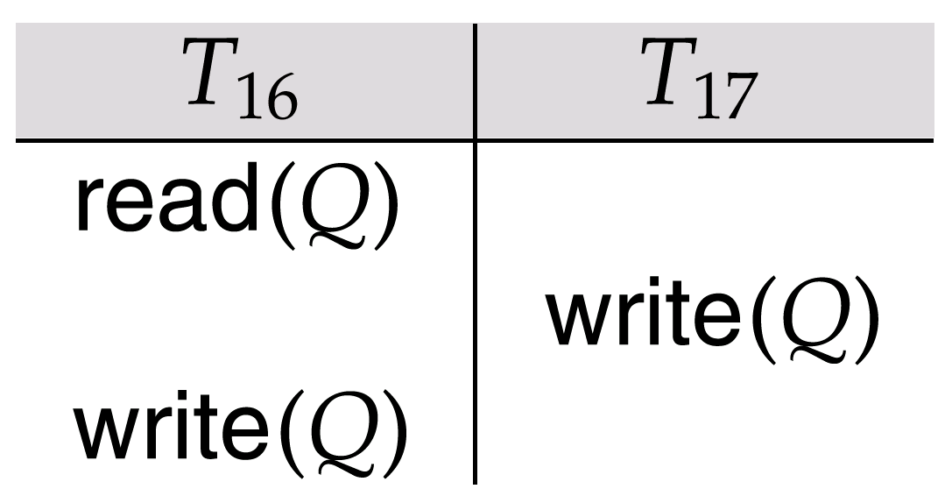
Schedule 4

Slide 67
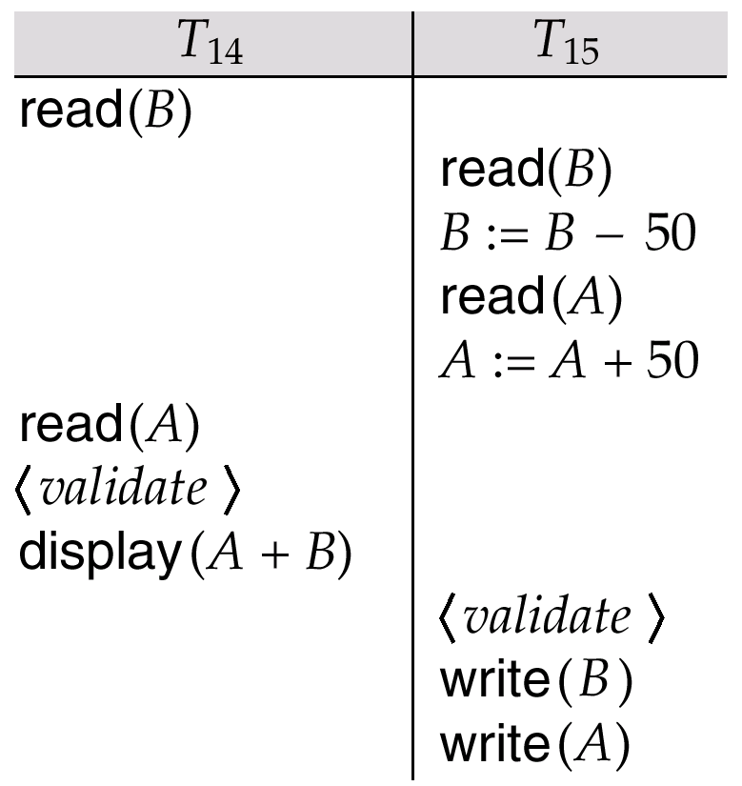
Schedule 5, A Schedule Produced by Using Validation

Slide 68

Granularity Hierarchy

Slide 69
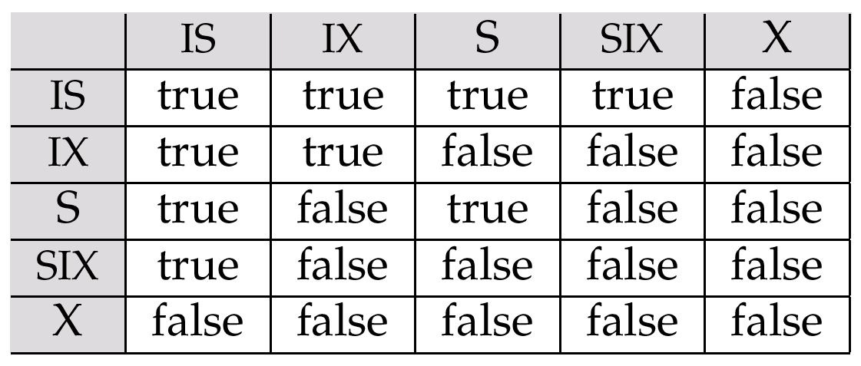
Compatibility Matrix

Slide 70
Wait-for Graph With No Cycle

Slide 71
Wait-for-graph With A Cycle

Slide 72
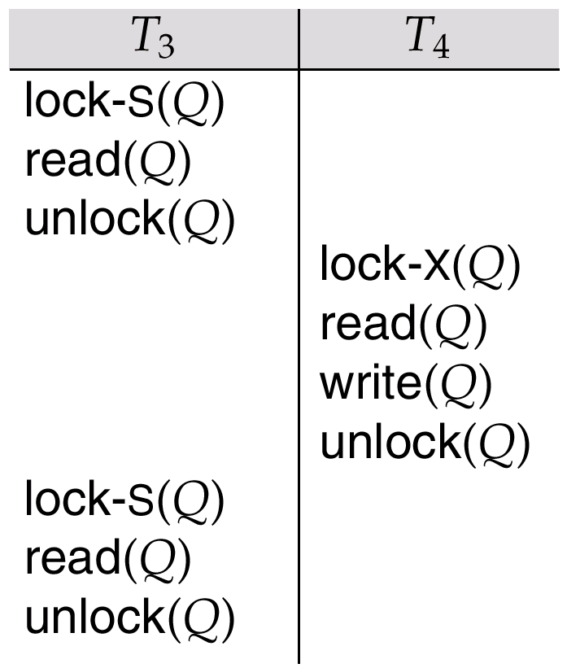
Nonserializable Schedule with Degree-Two Consistency

Slide 73
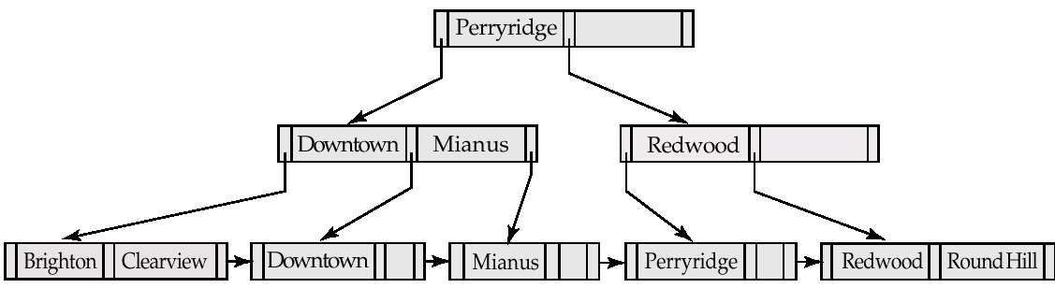
B⁺-Tree For account File with n = 3.

Slide 74
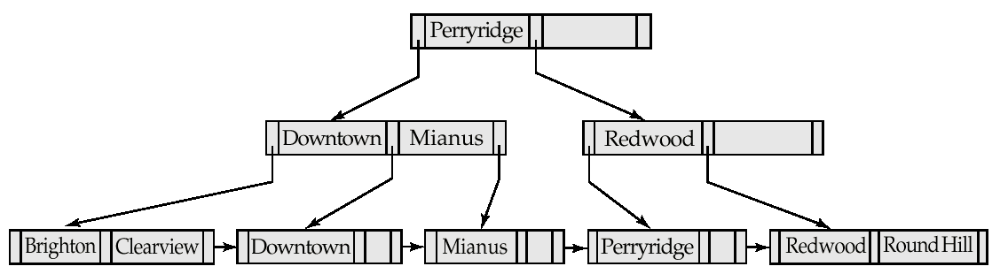
Insertion of “Clearview” Into the B⁺-Tree of Figure 16.21

Slide 75
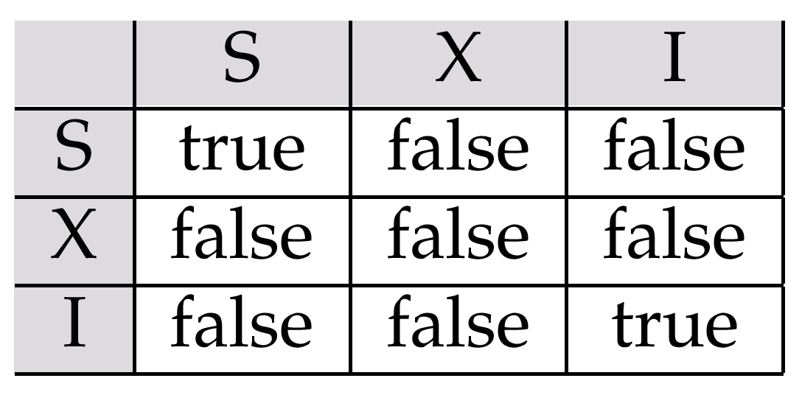
Lock-Compatibility Matrix

