Slide 1
The Application Layer

Slide 2
DNS – The Domain Name System
The mechanism by which Internet software translates names to attributes such as addresses.
To map a name onto an IP address, an application program:
Calls a library procedure called the resolver, passing it the name as a parameter
The resolver sends a UDP packet to a local DNS server
DNS server looks up the name and returns the IP address to the resolver
Resolver returns it to the application
The program can then establish a TCP connection with the destination or send it UDP packets

Slide 3
DNS – The Domain Name System
The DNS name space
Domain Resource records
Name servers

Slide 4
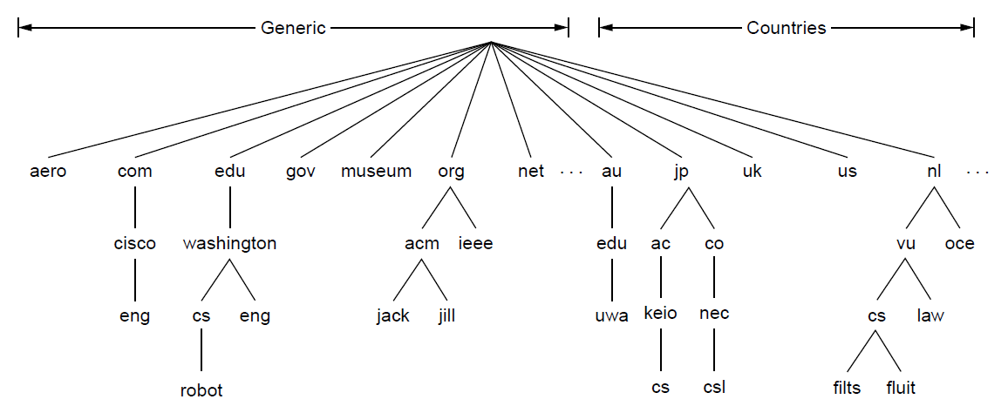
The DNS Name Space
The name space is the structure of the DNS database
-An inverted tree with the root node at the top
Each node has a label
-The root node has a null label, written as “”
A portion of the Internet domain name space.

Slide 5
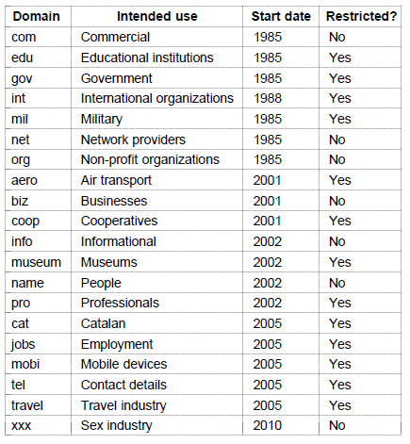
The DNS Name Space
Generic top-level domains

Slide 6
DNS naming
Domain names are case insensitive: edu, Edu, EDU have the same meaning
Each domain name server manages its own name space. It can create subdomain names without asking for permission from upper server. Examples: hcmut.edu.vn and cse.hcmut.edu.vn
A domain name is the sequence of labels from a node to the root, separated by dots (“.”s), read left to right
The name space has a maximum depth of 127 levels
Component name can be up to 63 characters
Domain names are limited to 255 characters in length

Slide 7
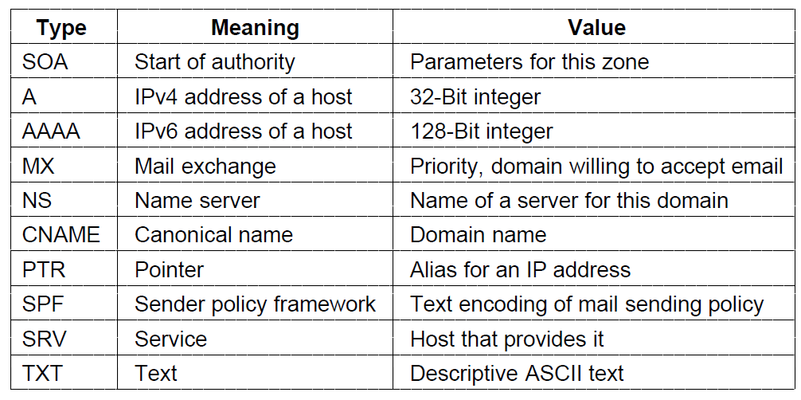
Domain Resource Records
Every domain have a set of resource record. These records are the DNS database. The primary function of DNS is to map domain names onto resource Records. A resource record is a five-tuple.
Domain name Time to live Class Type Value
The principal DNS resource record types

Slide 8
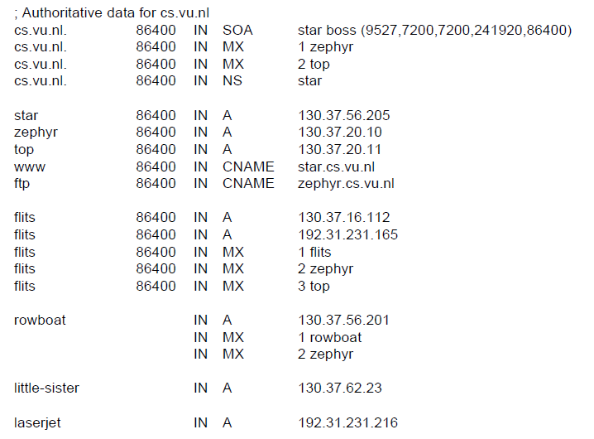
Domain Resource Records
A portion of a possible DNS database for cs.vu.nl.

Slide 9
Name Servers
Name servers store information about the name space in units called “zones”
Usually, more than one name server are authoritative for the same zone
This ensures redundancy and spreads the load
Also, a single name server may be authoritative for many zones

Slide 10
Name Servers and Zones
128.8.10.5 serves data for both nominum.com and isc.org zones
Name Servers
Zones
128.8.10.5
nominum.com
202.12.28.129 serves data for nominum.com zone only
202.12.28.129
isc.org
204.152.187.11 serves data for isc.org zone only
204.152.187.11

Slide 11
Electronic Mail
Format Of Electronic Mail
Architecture and services
The user agent
Message formats
Message transfer
Final delivery

Slide 12
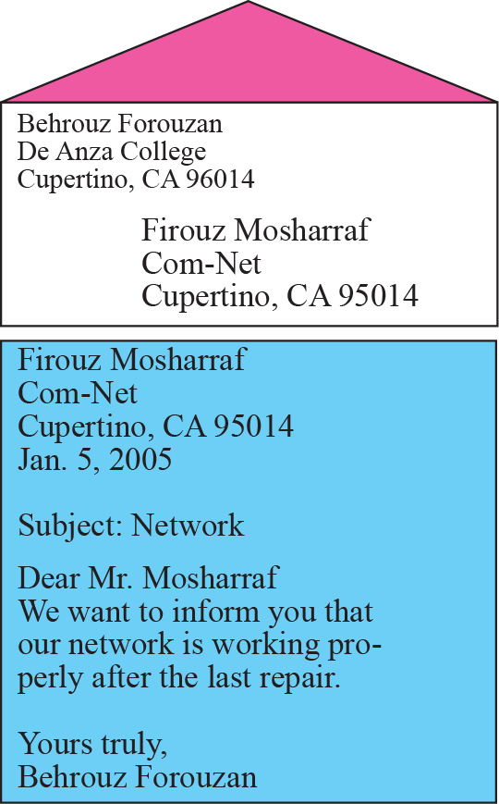
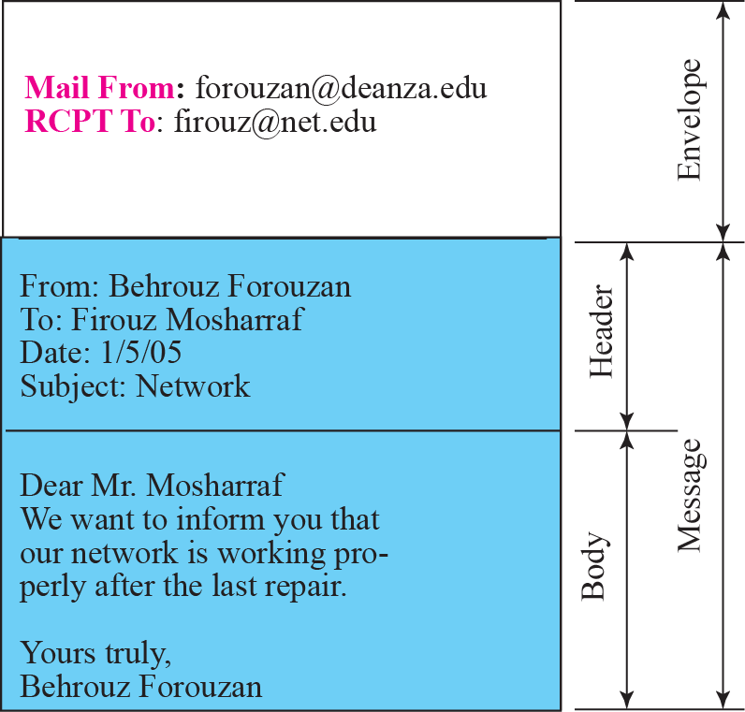
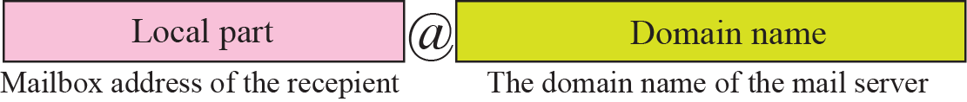
Format of an email
Email Address

Slide 13
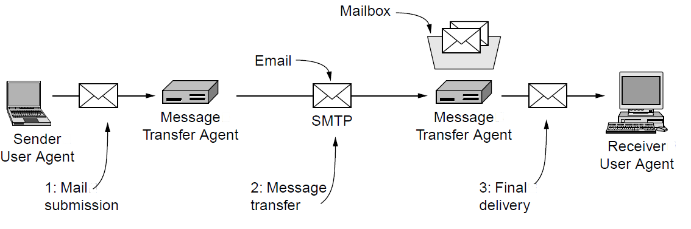
Architecture and Services
Architecture of the email system

Slide 14
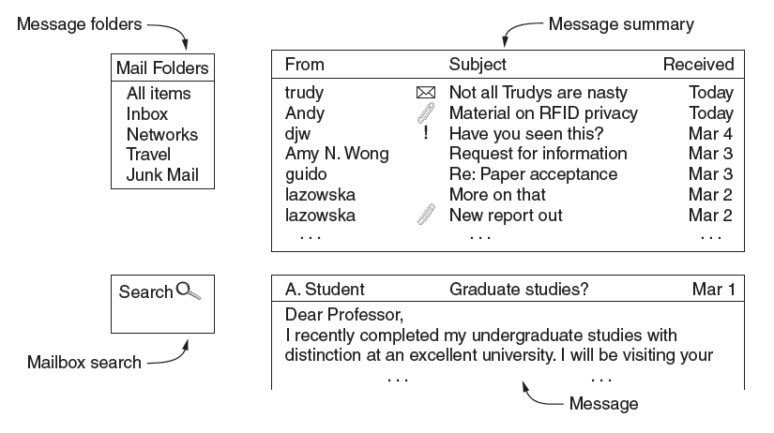
The User Agent
The first component of an electronic mail system is the user agent (UA). It provides service to the user to make the process of sending and receiving a message easier.
Typical elements of the user agent interface

Slide 15
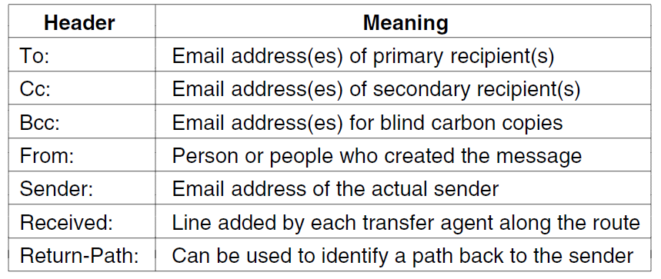
Message Formats
RFC 5322 header fields related to message transport.

Slide 16
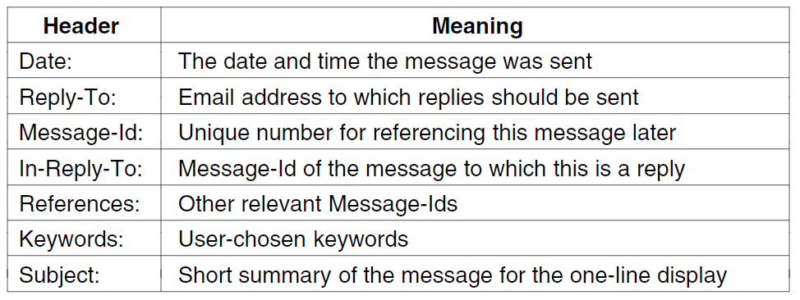
Message Formats
Some fields used in the RFC 5322 message header.

Slide 17
Multipurpose Internet Mail Extensions (MIME)
Electronic mail can send messages only in NVT 7-bit ASCII format. In other words, it has some limitations. Multipurpose Internet Mail Extensions (MIME) is a supplementary protocol that allows non-ASCII data to be sent through e-mail. MIME transforms non-ASCII data at the sender site to NVT ASCII data and delivers it to the client MTA to be sent through the Internet. The message at the receiving site is transformed back to the original data.

Slide 18
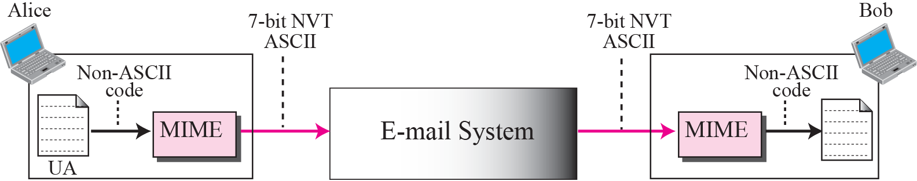
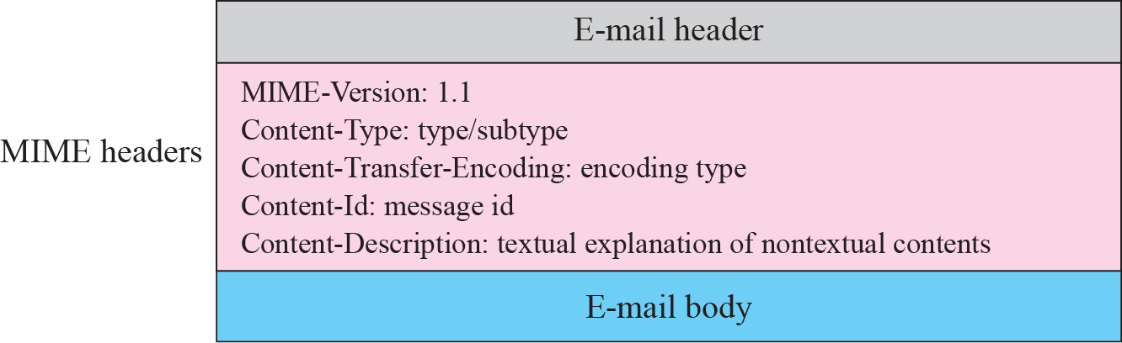

Slide 19
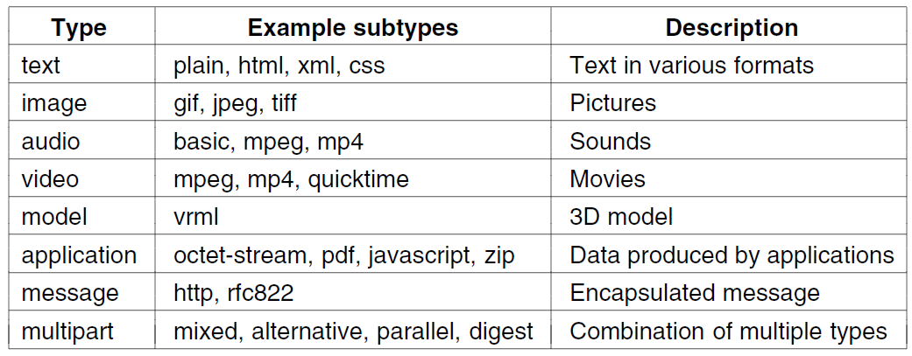
MIME content types and subtypes

Slide 20
MESSAGE TRANSFER AGENT
The actual mail transfer is done through message transfer agents (MTAs). To send mail, a system must have the client MTA, and to receive mail, a system must have a server MTA. The formal protocol that defines the MTA client and server in the Internet is called Simple Mail Transfer Protocol (SMTP).

Slide 21
Simple Mail Transfer Protocol (SMTP)
Simple Mail Transfer Protocol (SMTP) is the standard protocol for sending emails across the Internet.
SMTP uses TCP port 25 or 2525
SMTP is a "push" protocol that does not allow one to "pull" messages from a remote server on demand
That is it sends only
To do a pull (i.e. receive) a mail client must use POP3 or IMAP

Slide 22

Commands of SMTP
HELO : Request to initiate SMTP session
MAIL FROM : Sender’s E-Mail address
RCPT TO : Receiver’s E-Mail address
DATA : Body of message
QUIT : Terminates SMTP connection
RSET : Aborts mail transaction
VRFY : Asks receiver to verify the validity of the mailbox
EXPN : Asks receiver to identify mailing list
HELP : Causes receiver to send help information
NOOP : Forces server to verify the communication with SMTP
receiver

Slide 23
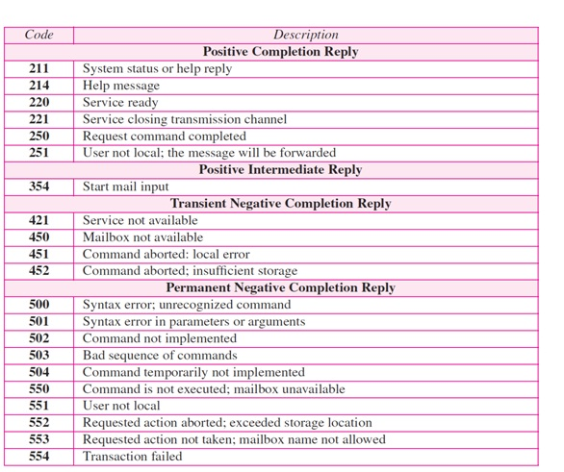
Responses of SMTP

Slide 24
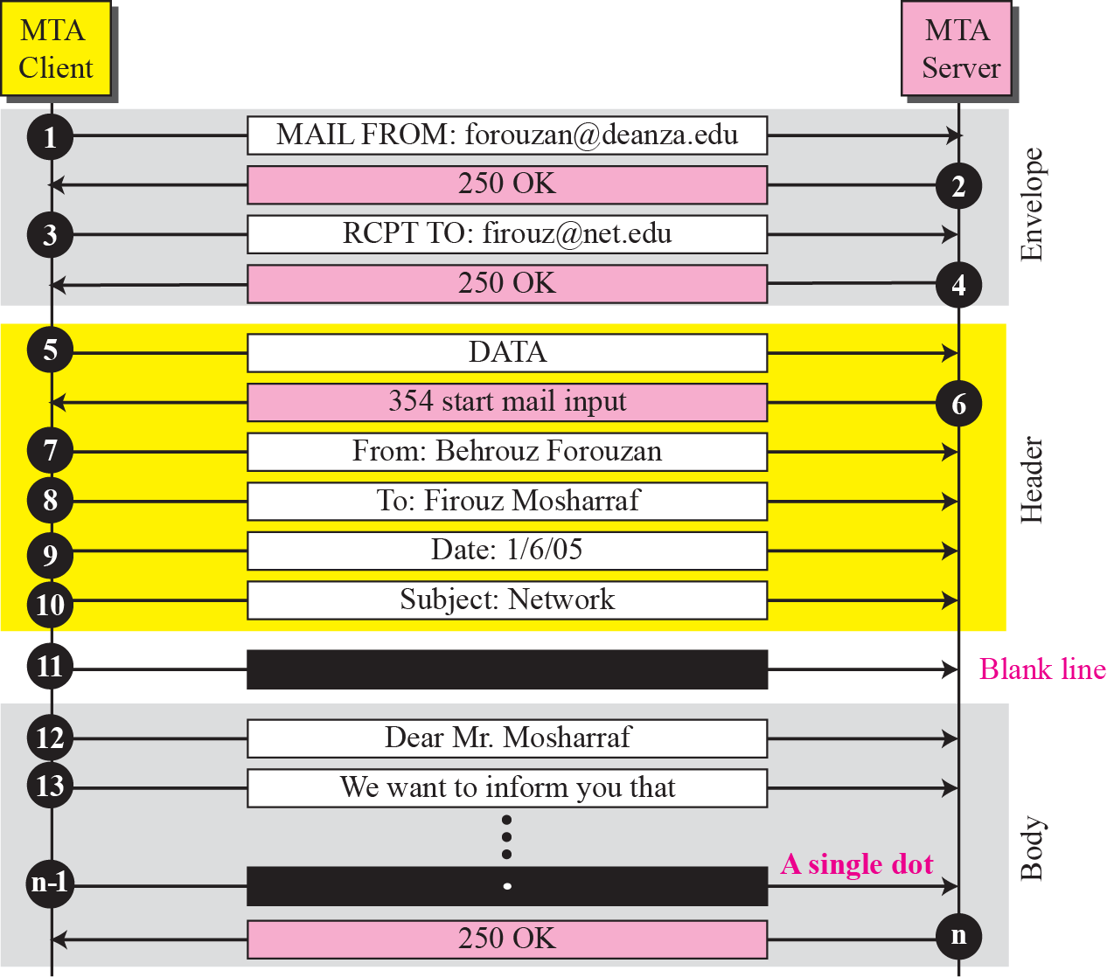
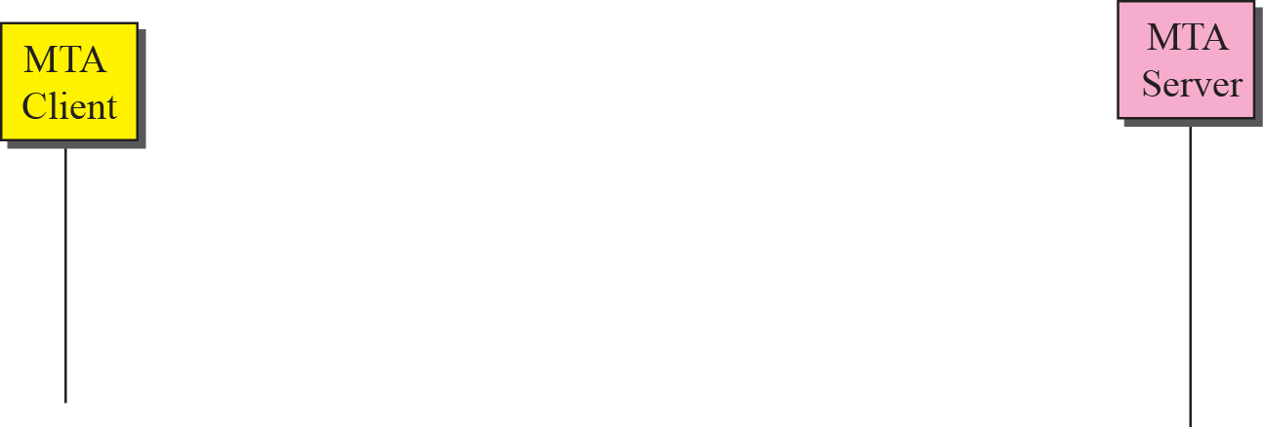
Message transfer

Slide 25
Post Office Protocol
Protocol to transfer e-mail messages from mailbox to local computer.
User invokes a POP3 client, which creates a TCP connection to a POP3 server on the mailbox computer.
POP3 uses Port 110
Computer with permanent mailbox must run 2 servers-
SMTP( Accepts mail sent to user)
POP3 (Allows to extract messages from mailbox).

Slide 26
IMAP4
Internet Message Access Protocol is an alternative to POP3.
User runs a IMAP4 client that contacts the server to retrieve messages.
IMAP4 uses Port 143
IMAP4 allows user to dynamically create, delete or rename mail boxes.

Slide 27
POP3 vs. IMAP
Most e-mail clients support either POP3 or IMAP to retrieve messages
Main differences between IMAP and POP3:
POP3 protocol assumes there is only one client connected to the mailbox
IMAP protocol allows simultaneous access by multiple clients
IMAP is suitable if the mailbox is used by multiple users

Slide 28
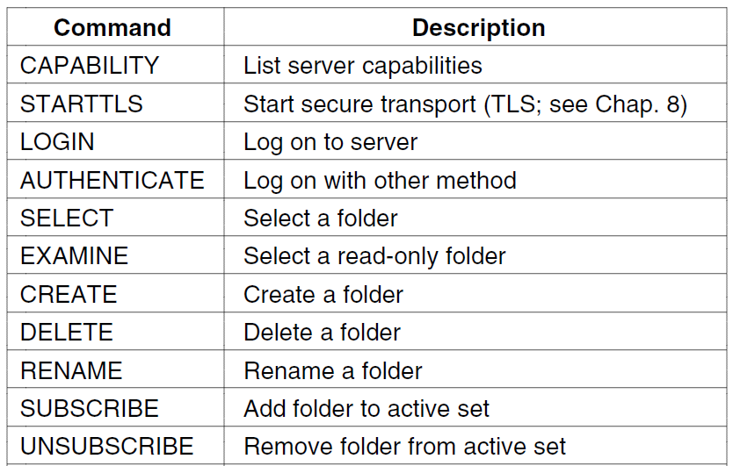
IMAP4 Commands

Slide 29
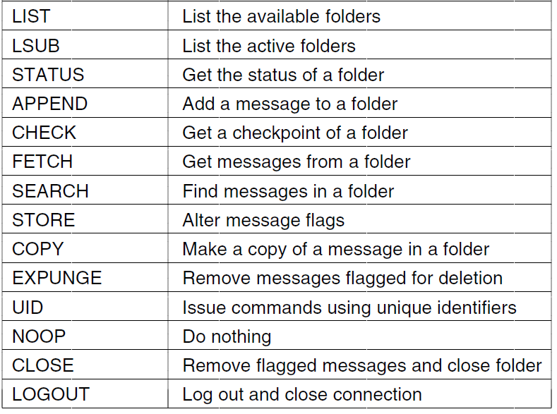
IMAP4 Commands

