Slide 1
BLUETOOTH
Bluetooth is a wireless LAN technology designed to connect devices of different functions such as telephones, notebooks, computers, cameras, printers, and so on. A Bluetooth LAN is an ad hoc network, which means that the network is formed spontaneously.
Bluetooth define two types of networks:
Piconet & Scatternet.

Slide 2
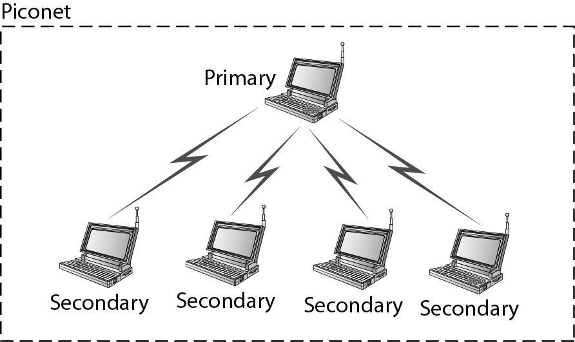
Piconet
A piconet can have up to eight stations, one of which is called primary; the rest are called secondaries.

Slide 3
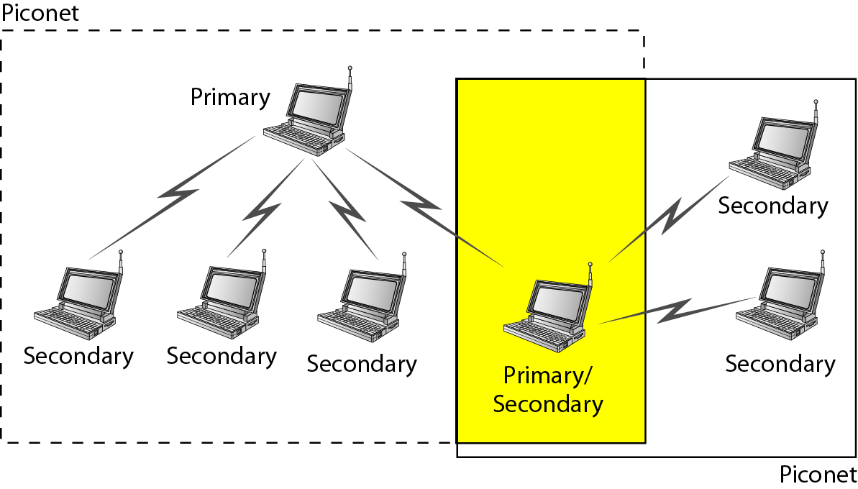
Scatternet
A secondary station in one piconet can be the primary in another piconet. This station can receive the messages from the primary in the first piconet (as a secondary) and , acting as a primary, deliver them to secondaries in the second piconet.

Slide 4
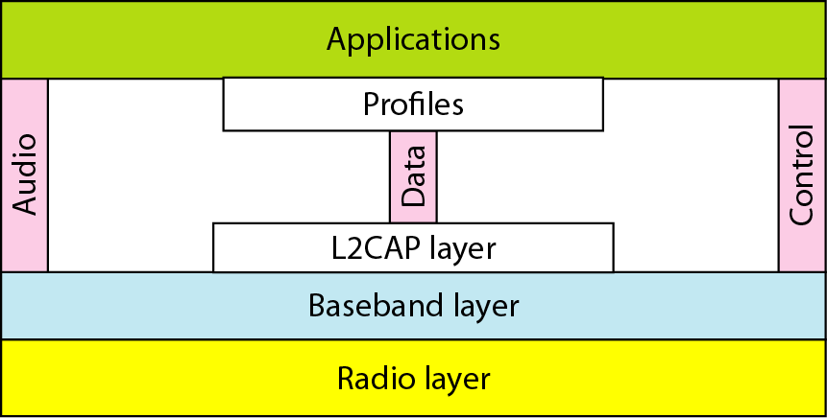
Bluetooth layers

Slide 5
Radio layers
The radio layer is roughly equivalent to the physical layer of the Internet model.
Band: It uses a 2.4 GHz
FHSS: Bluetooth uses FHSS method in the physical layer to avoid the interference form other devices or other networks.
Modulation: Bluetooth uses a sophisticated version of FSK, called GFSK (FSK with Gaussian bandwidth filtering).
Baseband layers
The baseband layer is roughly equivalent to the MAC sub layer in LANs. The access method is TDMA.

Slide 6
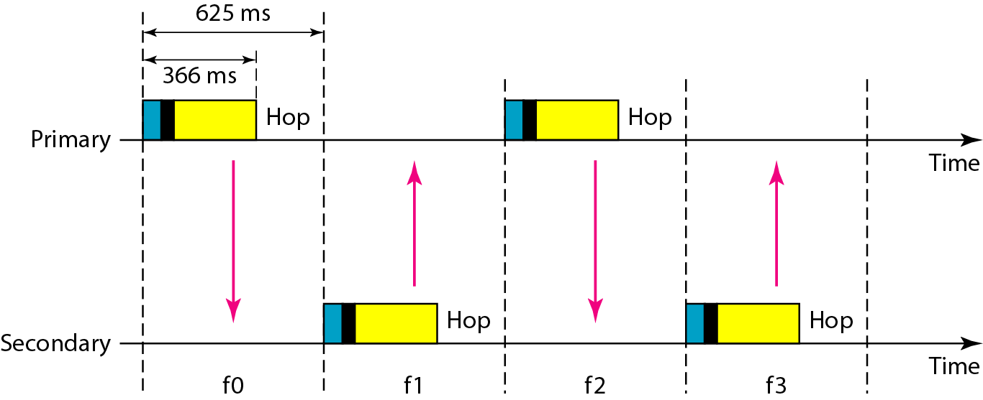
Single-secondary communication

Slide 7
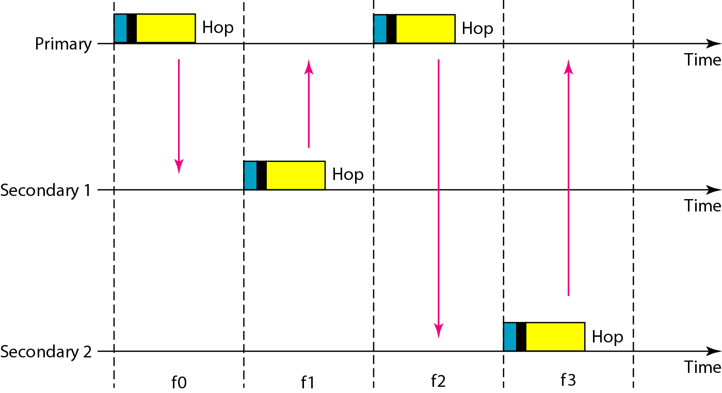
Multiple-secondary communication

Slide 8
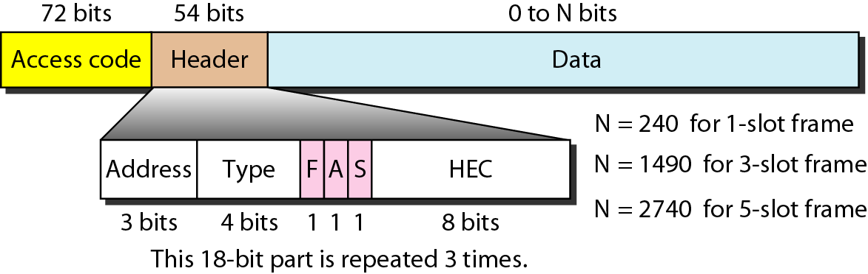
Frame format types

Slide 9
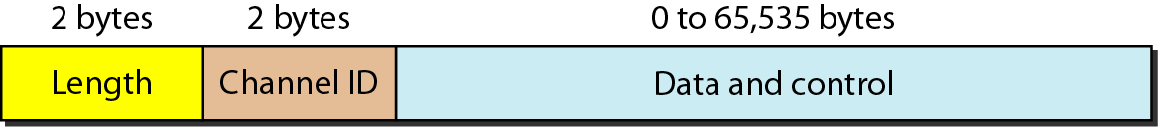
L2CAP (Logical Link Control and Adaptation Protocol
The L2CAP is roughly equivalent to the LLC sub layer in LANs.
The L2CAP has specific duties: multiplexing, segmentation and reassembly , QoS, and group management.
L2CAP data packet format

