Slide 1
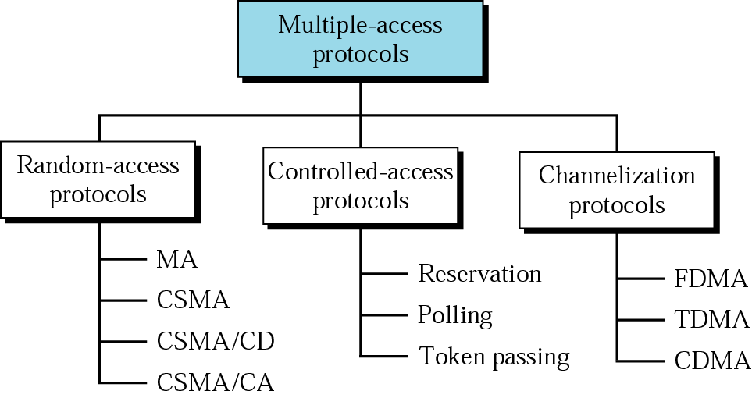
Multiple Access Protocols
ALOHA

Slide 2
CONTROLLED ACCESS
In controlled access, the stations consult one another to find which station has the right to send. A station cannot send unless it has been authorized by other stations.
Reservation Polling Token Passing

Slide 3
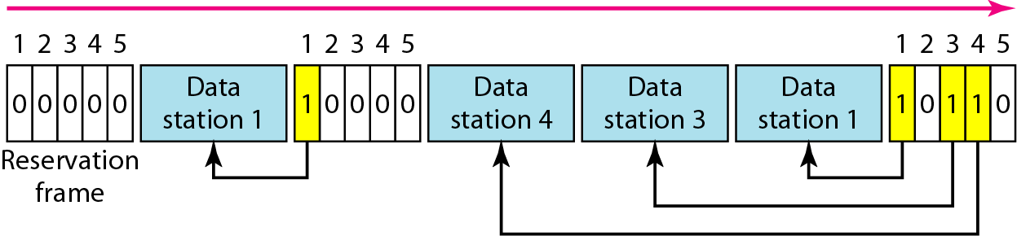
Reservation access method
In the reservation access method, a station needs to make a reservation before sending data. Time is divided into intervals. In each interval, a reservation frame precedes the data frames sent in that interval.

Slide 4
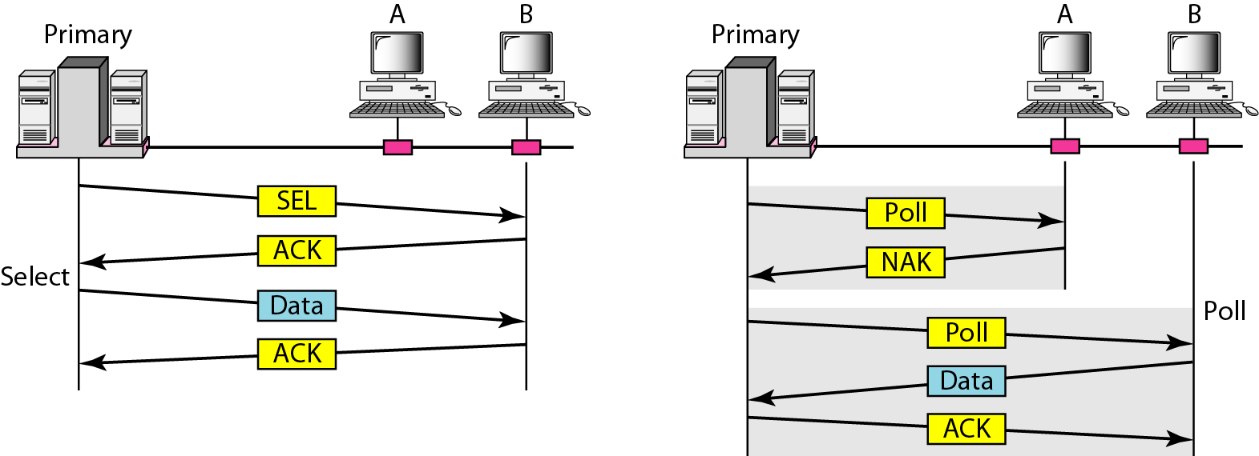
Polling access method
The primary device controls the link, the secondary devices follow its instructions. It is up to the primary device to determine which device is allowed to use the channel at a given time.

Slide 5
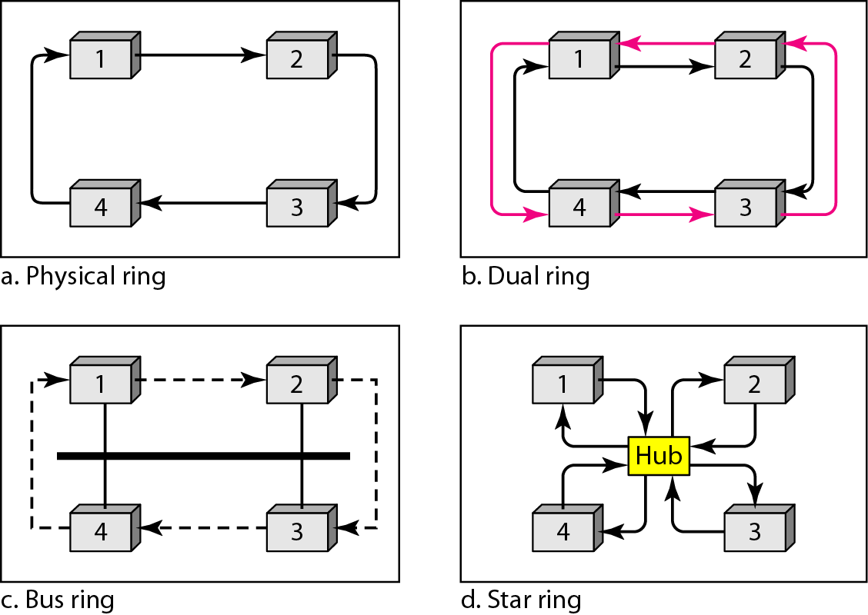
Token Passing access method
In the token-passing method, the stations are organized in a logical ring. In this method, a special packet called token circulates through the ring. The possession of the token gives the station the right to access the channel and send its data.

Slide 6
Multiple Access Protocols
ALOHA

Slide 7
CHANNELIZATION
Channelization is a multiple-access method in which the available bandwidth of a link is shared in time, frequency, or through code, between different stations.
Frequency-Division Multiple Access (FDMA) Time-Division Multiple Access (TDMA)
Code-Division Multiple Access (CDMA)

Slide 8
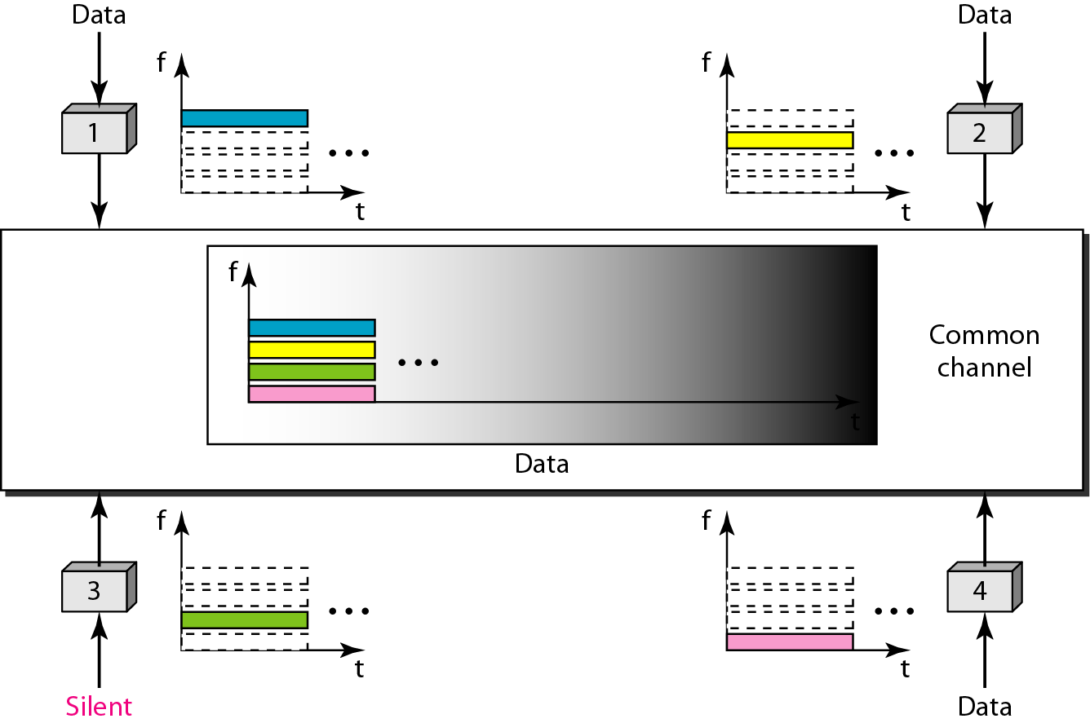
Frequency-division multiple access (FDMA)
In FDMA, the available bandwidth is divided into frequency bands. Each station is allocated a band to send its data.

Slide 9
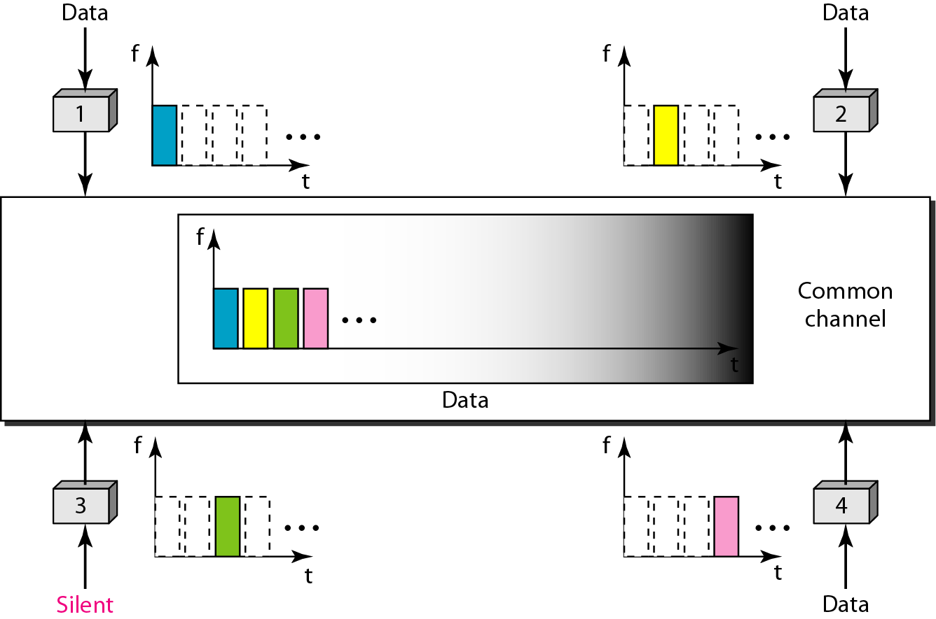
Time-division multiple access (TDMA)
In TDMA, the stations share the bandwidth of the channel in time. Each station is allocated a time slot during which it can send data. Each station transmits its data in is assigned time slot.

Slide 10
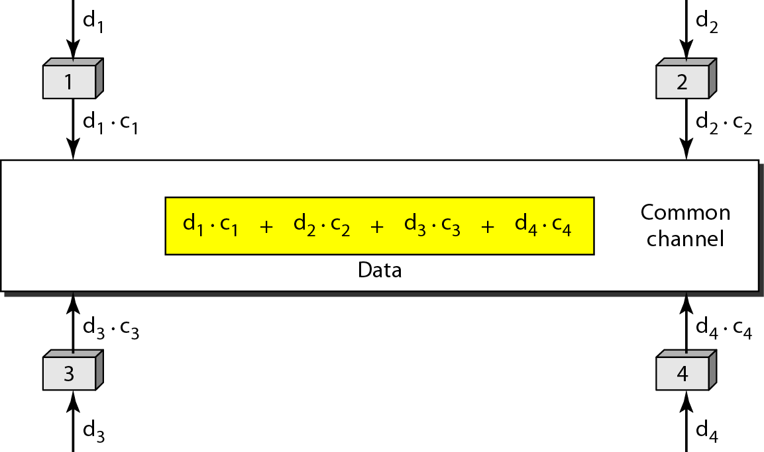
Code-Division Multiple Access (CDMA)
In CDMA, one channel carries all transmissions simultaneously.

Slide 11
Simple idea of communication with CDMA
One channel carries all transmissions simultaneously
Two properties that the assigned cods have:
If we multiply each code by another, we get 0.
If we multiply each code by itself, we get number of channel
Each station wants to receive data from one of other stations multiplies the common data on the channel by the code of the sender

Slide 12
Example
We can say that the data on the channel D = (d1 ⋅ c1 + d2 ⋅ c2 + d3 ⋅ c3 + d4 ⋅ c4). The receiver which wants to get the data sent by station 1 multiplies these data by c1.
When we divide the result by N, we get d1 .

Slide 13
Chip sequences
Sequences have the following properties:
Each sequence is made of N elements, where N is the number of stations
If we multiply a sequence by a number, every element in the sequence is multiplied by that element .
If we multiply two equal sequence, element by element, and add the results, we get inner product = N
If we multiply two different sequence, element by element, and add the results, we get inner product = 0
Adding two sequence means adding the corresponding elements. The result is another sequence

Slide 14
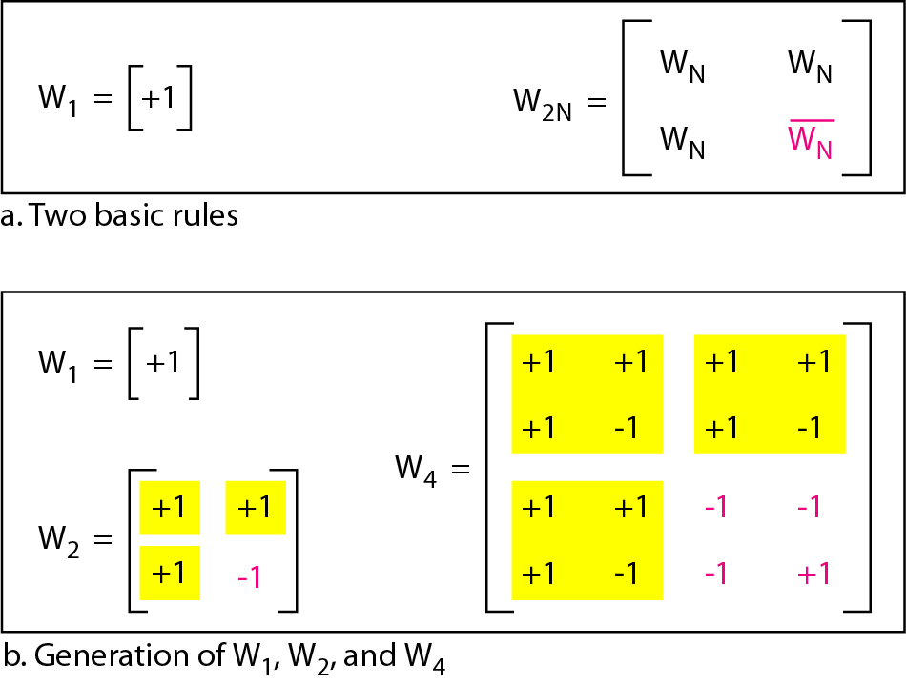
General rule and examples of creating Walsh tables
The number of sequences in a Walsh table needs to be N = 2^{m}.

Slide 15
Data representation in CDMA

Slide 16
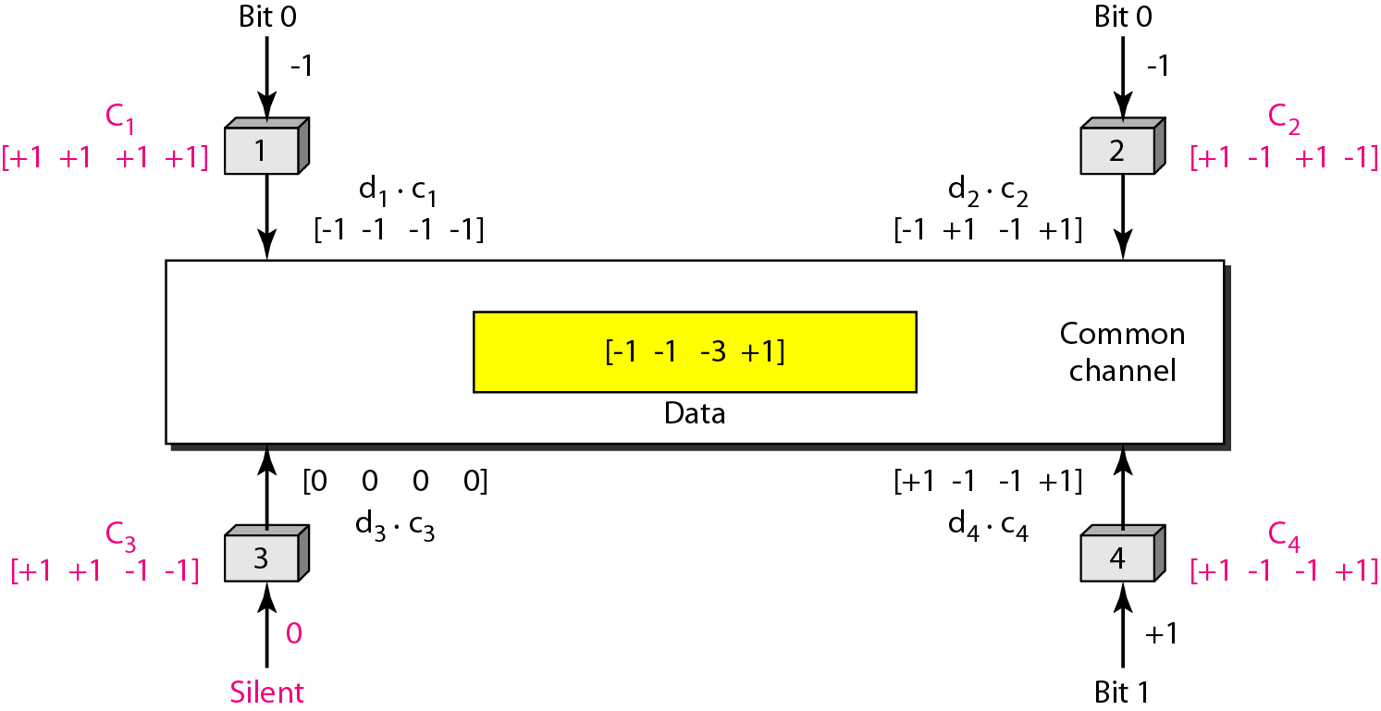
Sharing channel in CDMA

Slide 17
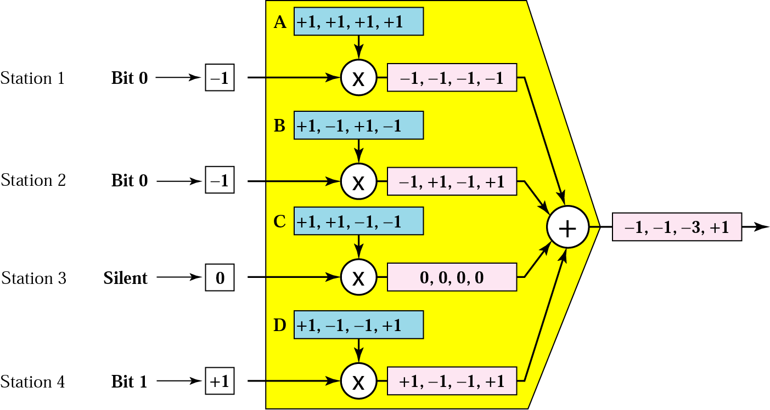
CDMA Multiplexer

Slide 18
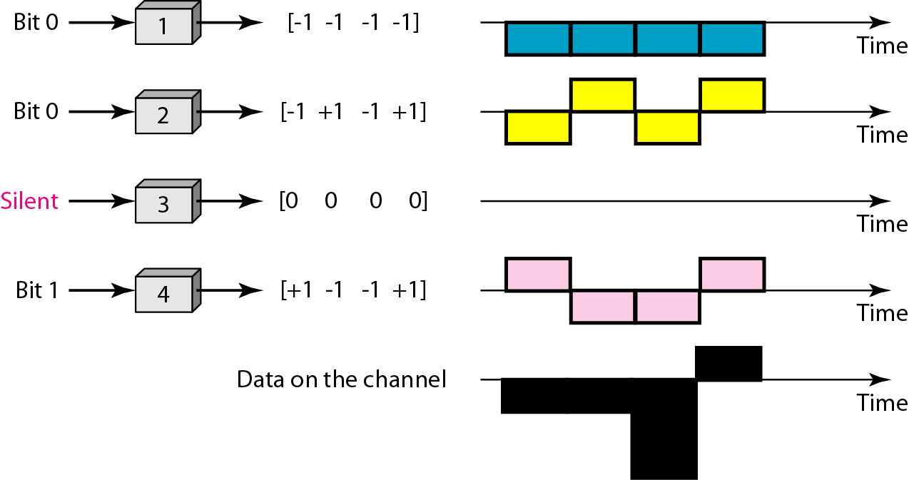
Digital signal created by four stations in CDMA

Slide 19
Decoding of the composite signal for one in CDMA
Any station can detect the data sent for example by station 2 by using the code of station 2 as follow:
[-1 -1 -3 +1] x [ +1 -1 +1 -1] = [ -1 +1 -3 -1]
= -4 /4(no of stations)
= -1
-1 means bit 0

Slide 20
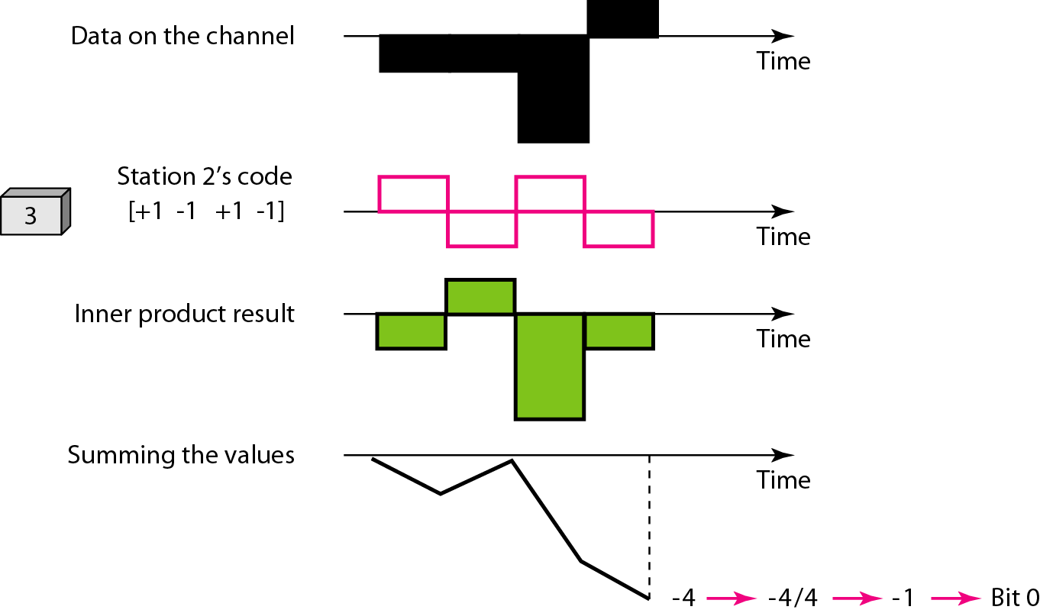
Decoding of the composite signal for one in CDMA

Slide 21
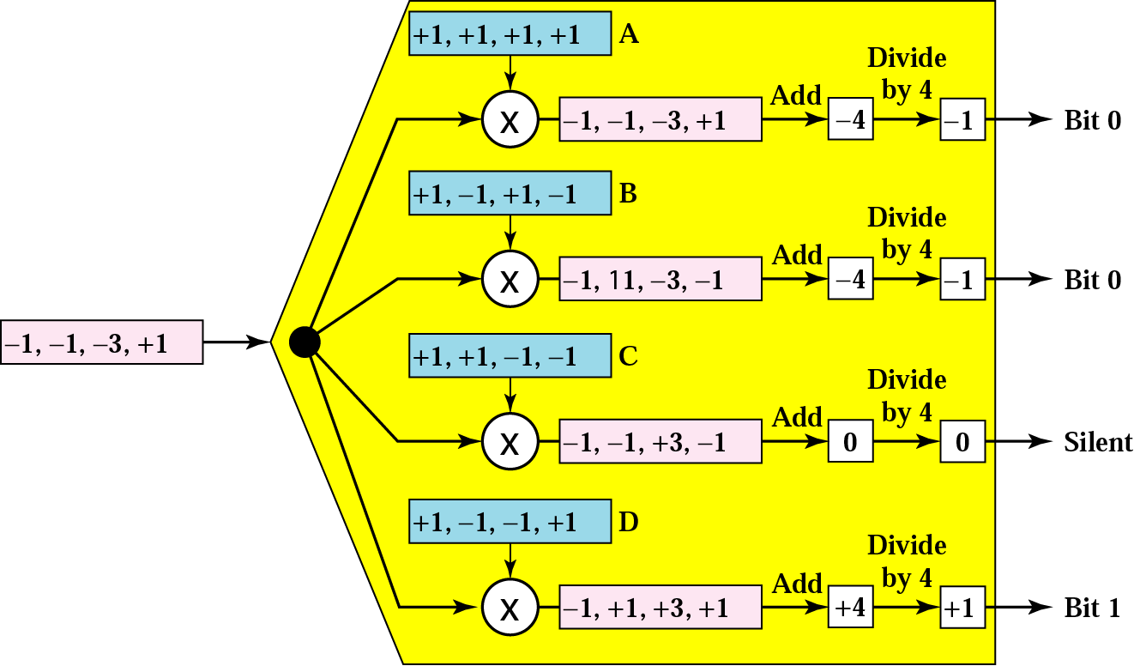
CDMA Demultiplexer

