Slide 1
Wired LANs: Ethernet

Slide 2

IEEE STANDARDS
In 1985, the Computer Society of the IEEE started a project, called Project 802, to set standards to enable intercommunication among equipment from a variety of manufacturers. Project 802 is a way of specifying functions of the physical layer and the data link layer of major LAN protocols.
The relationship of the 802 Standard to the traditional OSI model is shown in Figure below. The IEEE has subdivided the data link layer into two sublayers: logical link control (LLC) and media access control (MAC). IEEE has created several physical layer standards for different LAN protocols.
Figure IEEE standard for LANs

Slide 3

Framing LLC defines a protocol data unit (PDU) that is somewhat similar to that of
HDLC. The header contains a control field like the one in HDLC; this field is used for flow and error control. The two other header fields define the upper-layer protocol
at the source and destination that uses LLC. These fields are called the destination
service access point (DSAP) and the source service access point (SSAP). The other
fields defined in a typical data link control protocol such as HDLC are moved to the
MAC sublayer. In other words, a frame defined in HDLC is divided into a PDU at the
LLC sublayer and a frame at the MAC sublayer.
Figure HDLC frame compared with LLC and MAC frames

Slide 4

STANDARD ETHERNET
The original Ethernet was created in 1976 at Xerox’s Palo Alto Research Center (PARC). Since then, it has gone through four generations. We briefly discuss the Standard (or traditional) Ethernet in this section.
Figure Ethernet evolution through four generations
MAC Sublayer
In Standard Ethernet, the MAC sublayer governs the operation of the access method. It also frames data received from the upper layer and passes them to the physical layer.
Frame Format
The Ethernet frame contains seven fields: preamble, SFD, DA, SA, length or type of
protocol data unit (PDU), upper-layer data, and the CRC. Ethernet does not provide any mechanism for acknowledging received frames, making it what is known as an unreliable medium. Acknowledgments must be implemented at the higher layers.

Slide 5

802.3 MAC frame
Preamble. of alternating Os and 1 s that alerts the receiving system to the coming frame and enables it to synchronize its input timing. The pattern provides only an alert and a timing pulse. The preamble is actually added at the physical layer and is not (formally) part of the frame.
Start frame delimiter (SFD). signals the beginning of the frame. The SFD warns the station or stations that this is the last chance for synchronization. The last 2 bits is 11 and alerts the receiver that the next field is the destination address.
Destination address (DA). The DA field is 6 bytes and contains the physical
address of the destination station or stations to receive the packet.
Source address (SA). contains the physical address of the sender of the packet. Length or type. This field is defined as a type field or length field. The original Ethernet used this field as the type field to define the upper-layer protocol using the MAC frame. The IEEE standard used it as the length field to define the number of bytes in the data field.
Data. This field carries data encapsulated from the upper-layer protocols.
CRC. The last field contains error detection information, in this case a CRC-32

Slide 6

Minimum and maximum lengths
The minimum length restriction is required for the correct operation of CSMA/CD. An Ethernet frame needs to have a minimum length of 512 bits or 64 bytes. Part of this length is the header and the trailer.
The standard defines the maximum length of a frame (without preamble and SFD
field) as 1518 bytes. If we subtract the 18 bytes of header and trailer, the maximum
length of the payload is 1500 bytes.

Slide 7


Addressing
Each station on an Ethernet network (such as a PC, workstation, or printer) has its own
network interface card (NIC). The NIC fits inside the station and provides the station
with a 6-byte physical address. The Ethernet address is 6 bytes (48 bits), normally written in hexadecimal notation, with a colon between the bytes.
Example of an Ethernet address in hexadecimal notation
Unicast, Multicast, and Broadcast Addresses A source address is always a unicast
address--the frame comes from only one station. The destination address, however,
can be unicast, multicast, or broadcast. If the least significant bit of the first byte in a destination address is 0, the address is unicast; otherwise, it is multicast.
Unicast and multicast addresses

Slide 8
The broadcast destination address is a special case of the multicast address in which all bits are 1s.
Example Define the type of the following destination addresses:
a. 4A:30:10:21:10:1A b. 47:20:1B:2E:08:EE c. FF:FF:FF:FF:FF:FF
Solution: To find the type of the address, we need to look at the second hexadecimal digit from the left. If it is even, the address is unicast. If it is odd, the address is multicast. If all digits are F’s, the address is broadcast. Therefore, we have the following:
a. This is a unicast address because A in binary is 1010.
b. This is a multicast address because 7 in binary is 0111.
c. This is a broadcast address because all digits are F’s.

Slide 9


Categories of Standard Ethernet
10Base5 implementation -Thick Ethernet
10Base5 was the first Ethernet specification to use a bus topology with an external transceiver (transmitter/receiver) connected via a tap to a thick coaxial cable. The transceiver is responsible for transmitting, receiving.
The transceiver is connected to the station via a transceiver cable that provides separate paths for sending and receiving. This means that collision can only happen in the coaxial cable.

Slide 10


10Base2 implementation - Thin Ethernet or Cheapernet.
It also uses a bus topology, but the cable is much thinner and more flexible. The cable can be bent to pass very close to the stations. In this case, the transceiver is normally part of the network interface card (NIC), which is installed inside the station. Note that the collision here occurs in the thin coaxial cable. This implementation is more cost effective than 10Base5 because thin coaxial cable is less expensive than thick coaxial. Installation is simpler because the thin coaxial cable is very flexible.
10Base-T implementation - Twisted-Pair Ethernet

Slide 11


Uses a physical star topology. The stations are connected to a hub via two pairs of twisted cable. Note that two pairs of twisted cable create two paths (one for sending and one for receiving) between the station and the hub. Any collision here happens in the hub.
10Base-F implementation - Fiber Ethernet
uses a star topology to connect stations to a hub. The stations are connected to the hub using two fiber-optic cables.
Summary of Standard Ethernet implementations

Slide 12

FAST ETHERNET
Fast Ethernet is backward-compatible with Standard Ethernet, but it can transmit data 10 times faster at a rate of 100 Mbps. The goals of Fast Ethernet can be summarized as follows:
1. Upgrade the data rate to 100 Mbps. 2. Make it compatible with Standard Ethernet.
3. Keep the same 48-bit address. 4. Keep the same frame format.
5. Keep the same minimum and maximum frame lengths.
MAC Sublayer: A main consideration in the evolution of Ethernet from 10 to 100 Mbps was to keep the MAC sublayer untouched. However, a decision was made to drop the bus topologies and keep only the star topology.
Physical Layer: The physical layer in Fast Ethernet is more complicated than the one in Standard Ethernet.
Topology
Fast Ethernet is designed to connect two or more stations together. If there are only two
stations, they can be connected point-to-point. Three or more stations need to be con-
nected in a star topology.

Slide 13


Fast Ethernet implementations

Slide 14
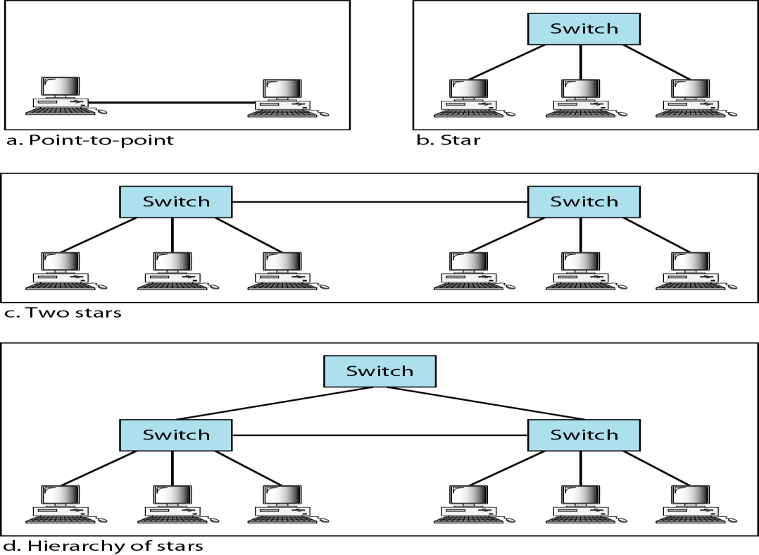
GIGABIT ETHERNET
The need for an even higher data rate resulted in the design of the Gigabit Ethernet protocol (1000 Mbps). The IEEE committee calls the standard 802.3z.
In the full-duplex mode of Gigabit Ethernet, there is no collision; the maximum length of the cable is determined by the signal attenuation in the cable.
Topology
Gigabit Ethernet is designed to connect two or more stations. If there are only two stations, they can be connected point-to-point. Three or more stations need to be connected in a star topology with a hub or a switch at the center. Another possible configuration is to connect several star topologies or let a star topology be part of another as shown in Figure

Slide 15

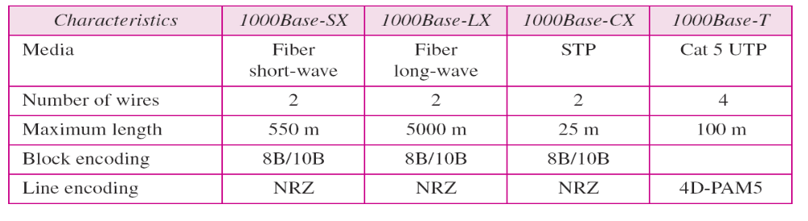
Gigabit Ethernet implementations

Slide 16
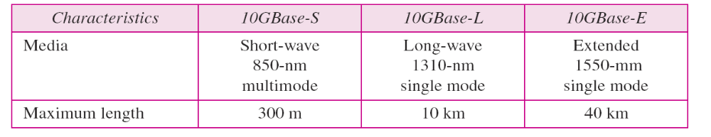
TEN- GIGABIT ETHERNET
MAC Sublayer
Ten-Gigabit Ethernet operates only in full duplex mode which means there is no need for contention; CSMA/CD is not used in Ten-Gigabit Ethernet.
Physical Layer
The physical layer in Ten-Gigabit Ethernet is designed for using fiber-optic cable over long distances. Three implementations are the most common: lOGBase-S, lOGBase-L, and 10GBase-E. Table shows a summary of the Ten-Gigabit Ethernet implementaions.
Summary of Ten-Gigabit Ethernet implementations

Slide 17
802.4 Token Bus
Token bus is a network implementing the token ring protocol over a "virtual ring" on a coaxial cable.
A token is passed around the network nodes and only the node possessing the token may transmit.
If a node doesn't have anything to send, the token is passed on to the next node on the virtual ring.

Slide 18
802.4 Token Bus
Each node must know the address of its neighbour in the ring, so a special protocol is needed to notify the other nodes of connections to, and disconnections from, the ring.

Slide 19
802. 5 Token Ring
Token ring is a local area network protocol which resides at the data link layer (DLL) of the OSI model. It uses a special three-byte frame called a token that travels around the ring. Token ring frames travel completely around the loop.
Initially (in 1985) token ring ran at 4 Mbit/s, but in 1989 IBM introduced the first 16 Mbit/s token ring products and the 802.5 standard was extended to support this.
Token ring LANs normally use differential Manchester encoding of bits on the LAN media.

Slide 20
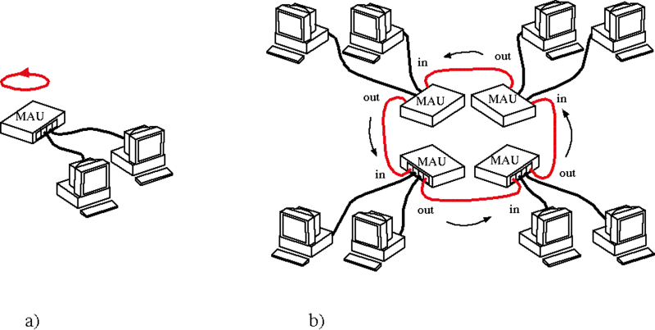
Token Ring

Slide 21
802.6 FDDI
Fiber distributed data interface (FDDI) provides a standard for data transmission in a local area network that can extend in range up to 200 kilometers.
It uses optical fiber. FDDI uses a dual-attached, counter-rotating token ring topology.

Slide 22
FDDI
A FDDI network contains two token rings, one for possible backup in case the primary ring fails. The primary ring offers up to 100 Mbit/s capacity. When a network has no requirement for the secondary ring to do backup, it can also carry data, extending capacity to 200 Mbit/s. The single ring can extend the maximum distance; a dual ring can extend 100 km (62 miles).

Slide 23
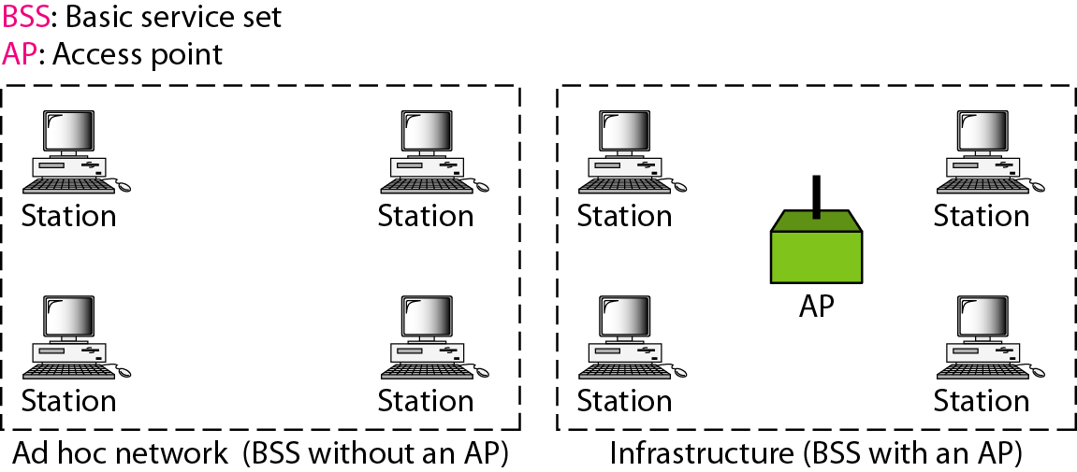
Wireless LAN(IEEE 802.11)
Basic Service Sets
A BSS without an AP is called an ad hoc network;
a BSS with an AP is called an infrastructure network.

Slide 24
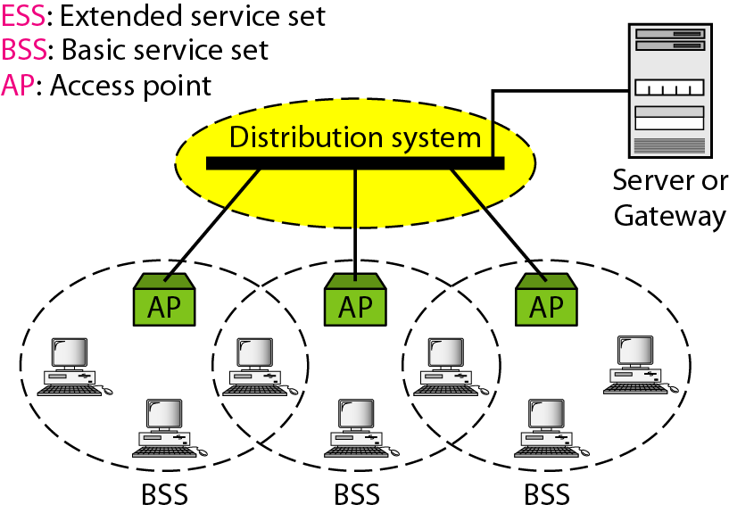
Extended Service Sets

Slide 25
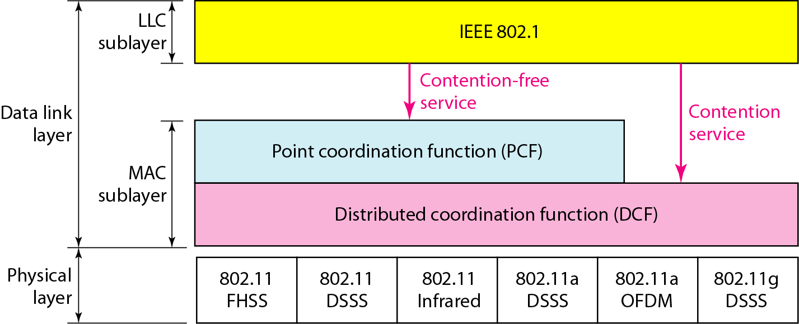
MAC Layers in WiFi

Slide 26

CSMA/CA flowchart

Slide 27
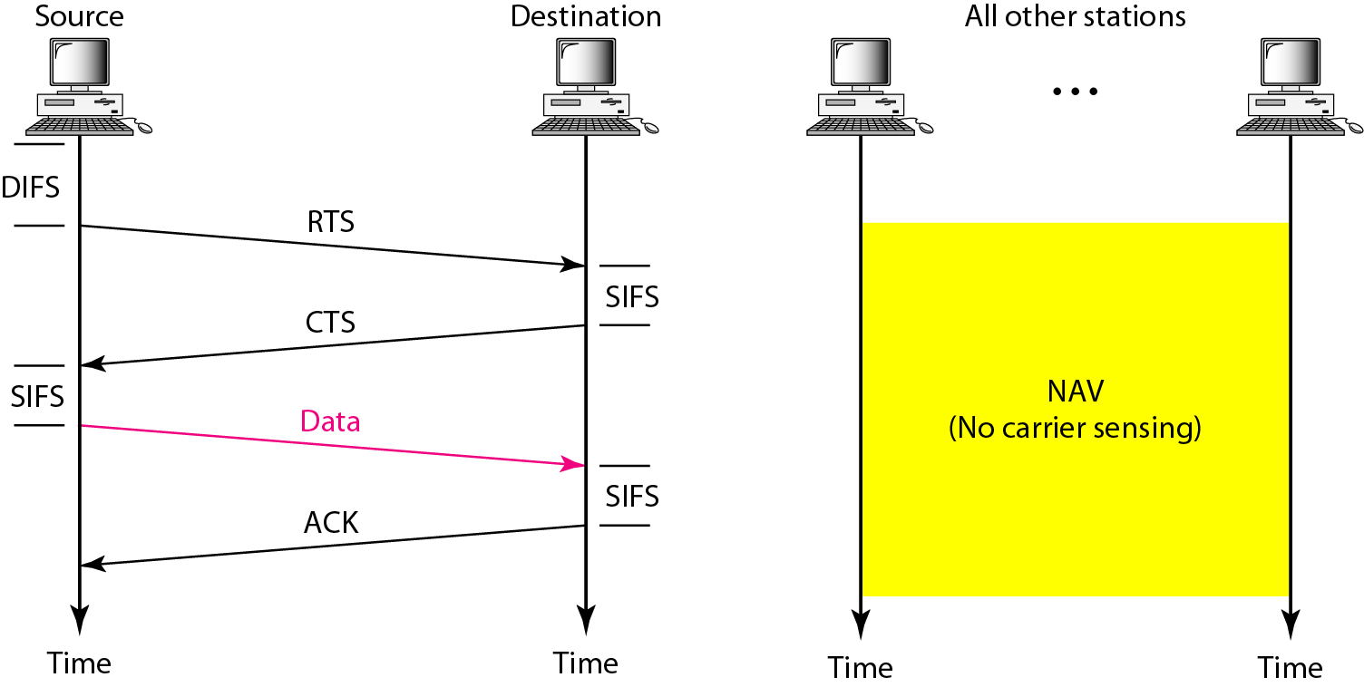
CSMA/CA with NAV

Slide 28
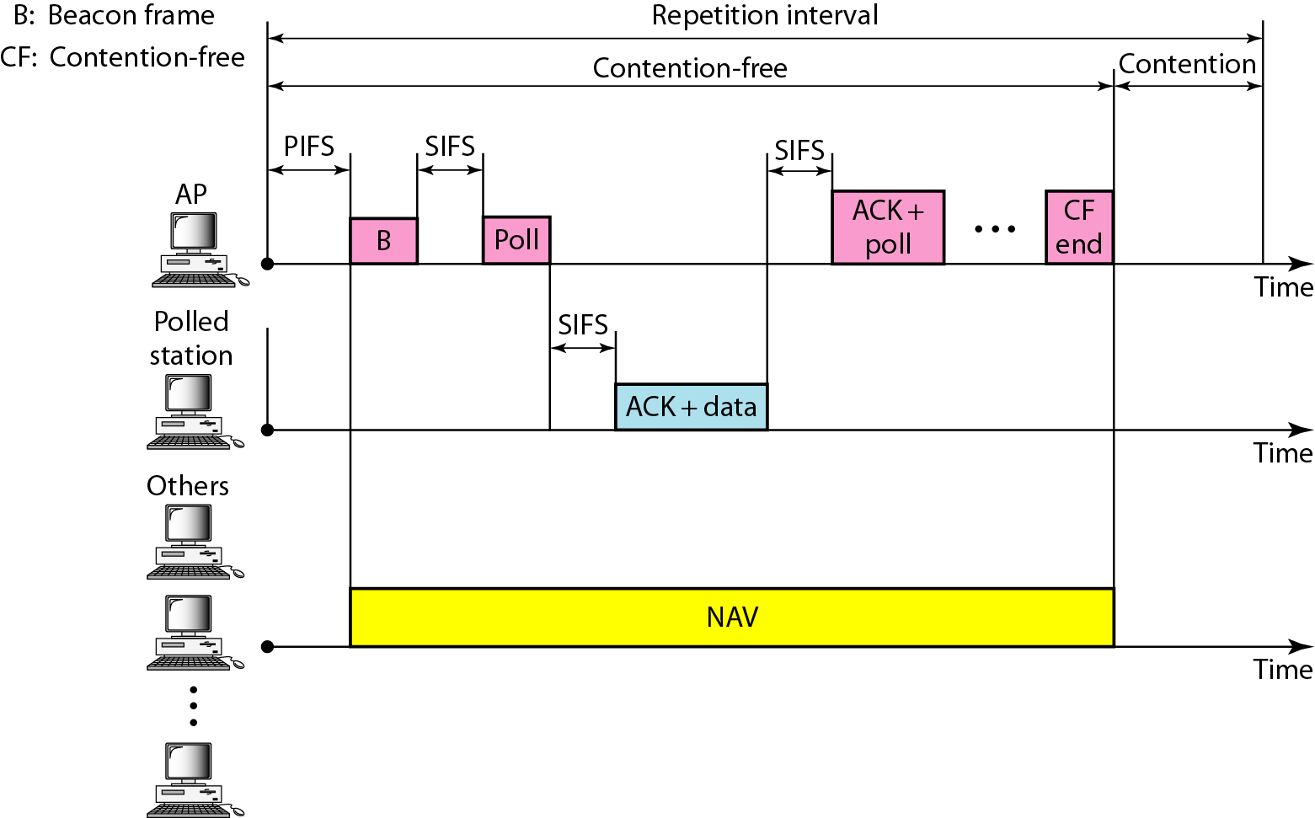
Example of repetition interval

Slide 29

802.11 Frame Format

Slide 30
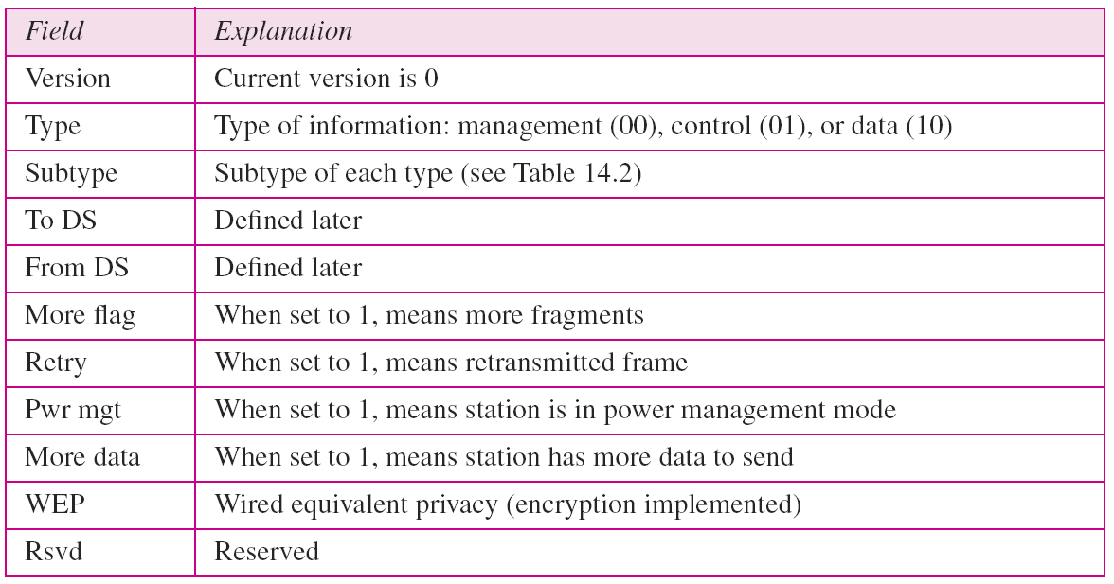
Subfields in FC field

Slide 31
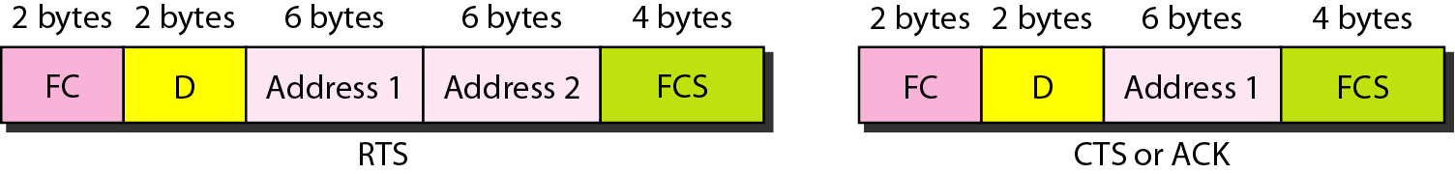
802.11 Control Frames

Slide 32
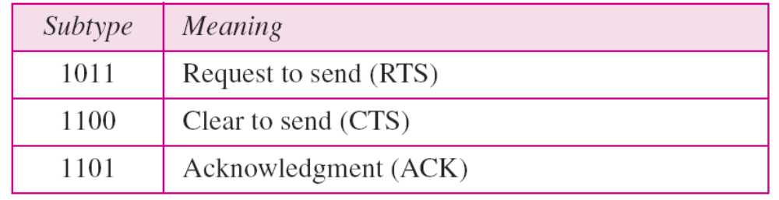
Values of subfields in control frames

Slide 33
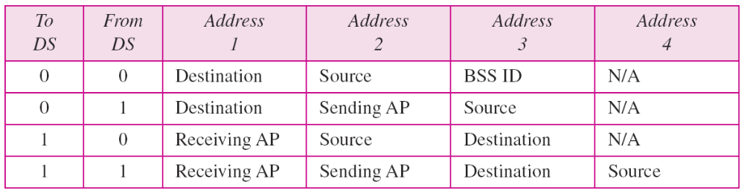
Addresses

Slide 34
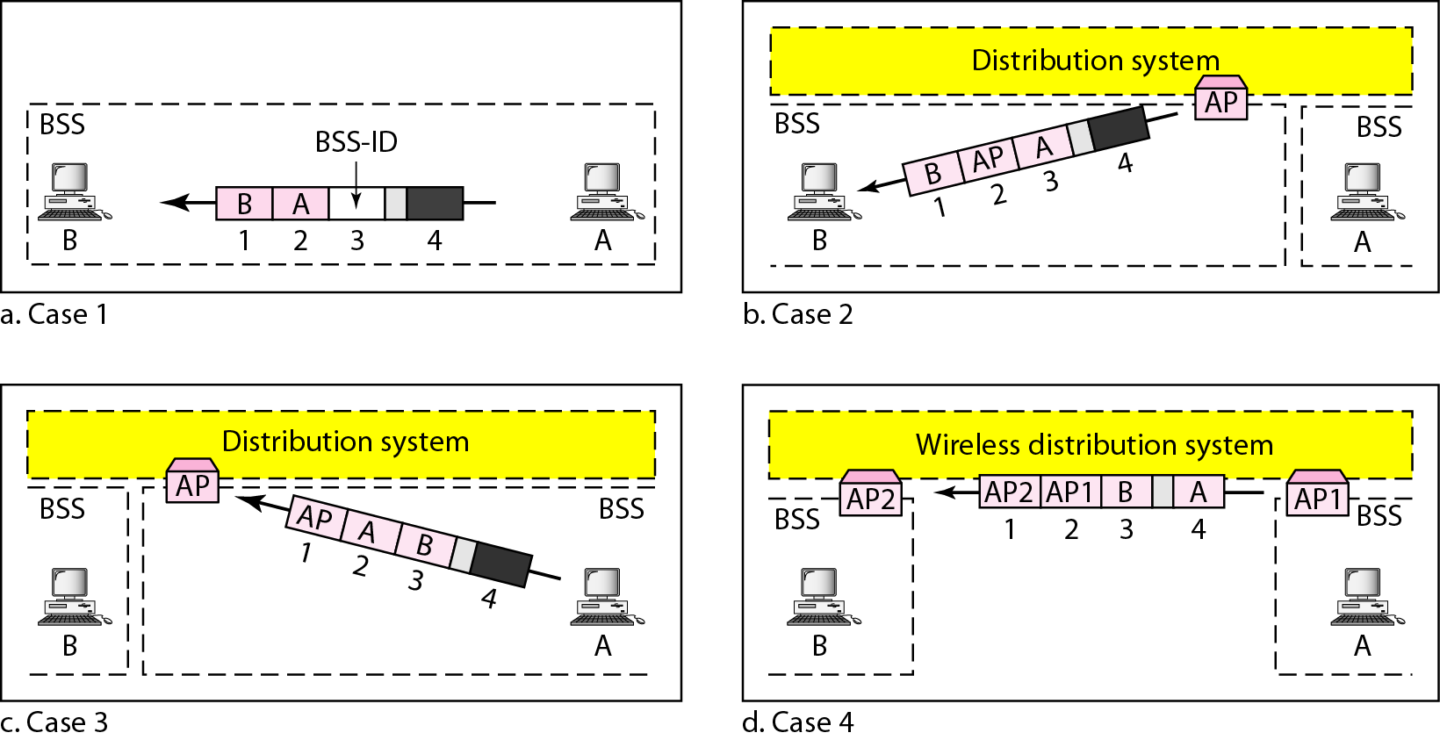
Addressing mechanisms

