Slide 1
Network layer

Slide 2
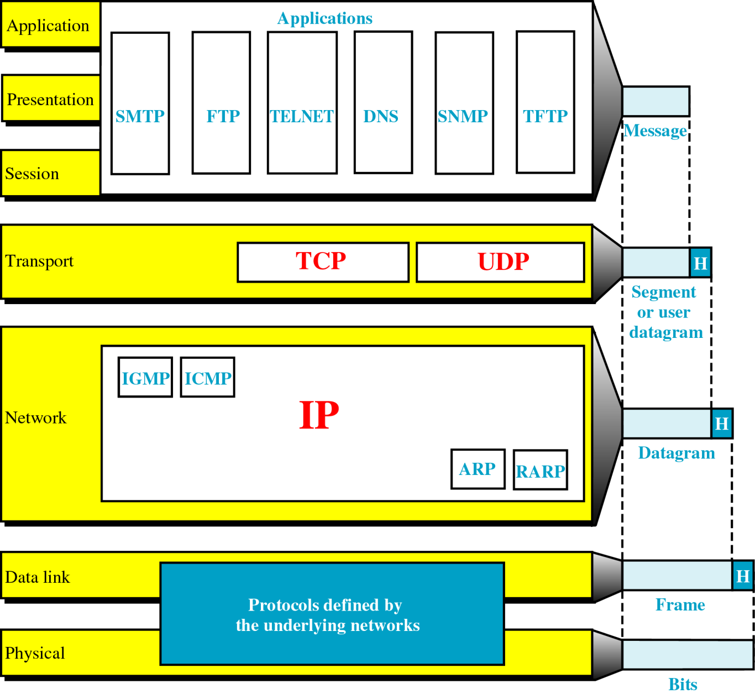
TCP/IP and the OSI Model

Slide 3
IP Addressing
Physical addressing (contained on NICs) that identify individual devices, the Internet requires an address that identifies the connection of a host to its network.
An IP address is a unique identifier for a node or host connection on an IP network.
Each Internet address consists of 4 bytes (32-bits) defining 3 fields: class type, netid and hostid.
These parts are of varying lengths, depending on the class of the address

Slide 4
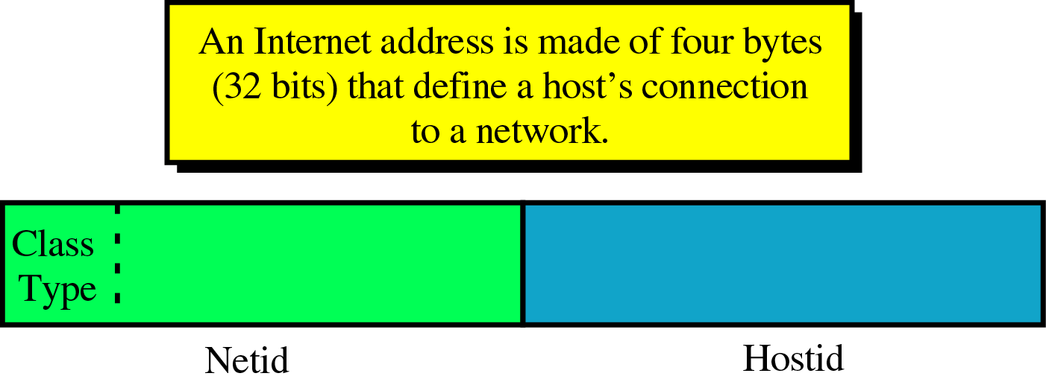
Internet Address

Slide 5
IP classes
A, B,C,D and E
A – C widely used.
D for multicasting (allows copies of a datagram to be passed to select group of hosts rather than to an individual host.)
E for future use.

Slide 6
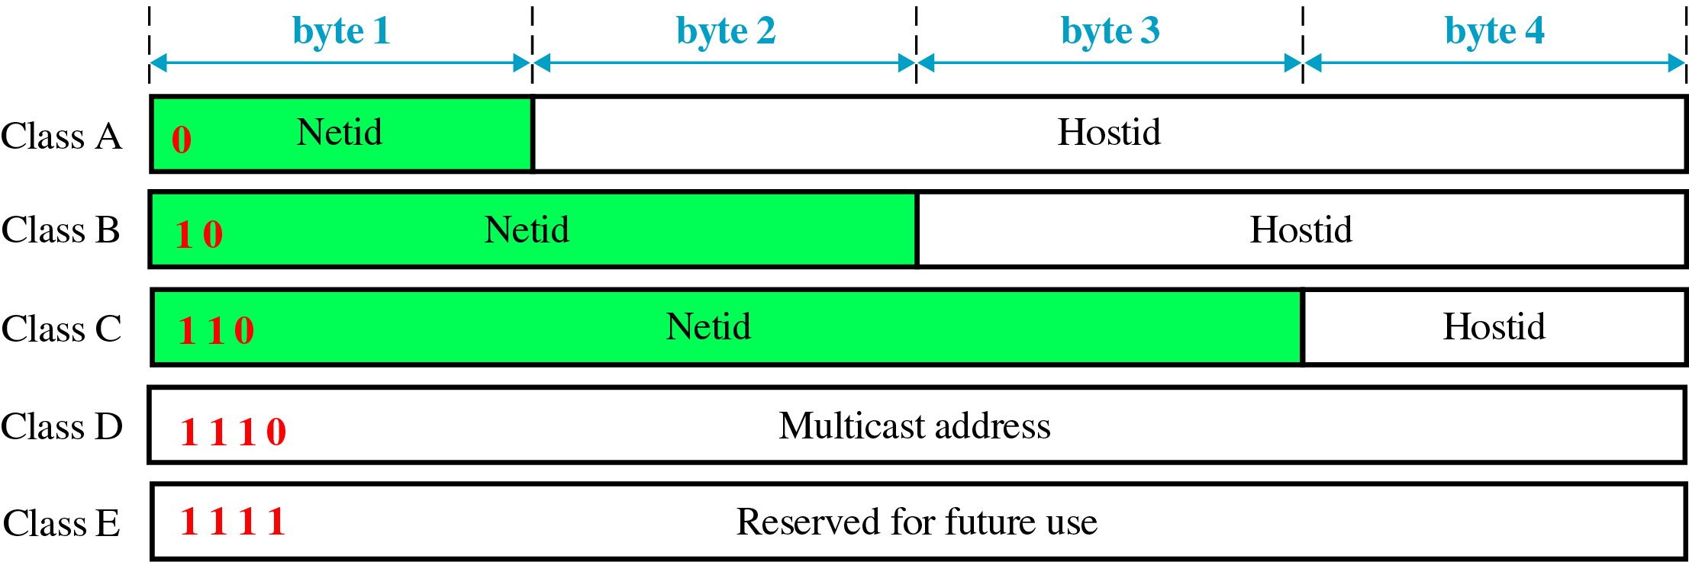
Address Classes

Slide 7
Test question
What is the class of each of the following addresses ?
10011101 10001111 11111100 11001111
11011101 10001111 11111100 11001111

Slide 8
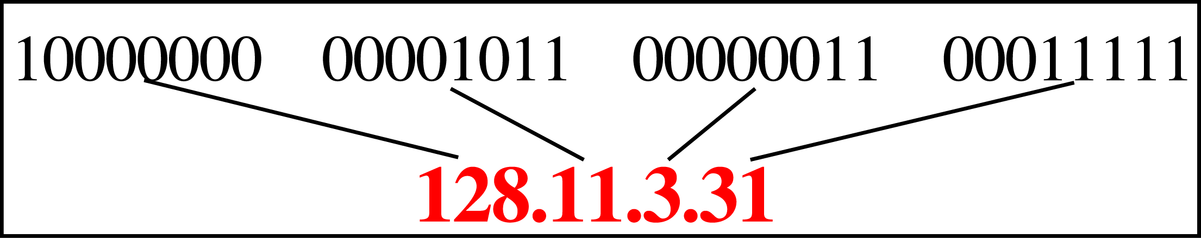
IP Addresses in Decimal Notation

Slide 9
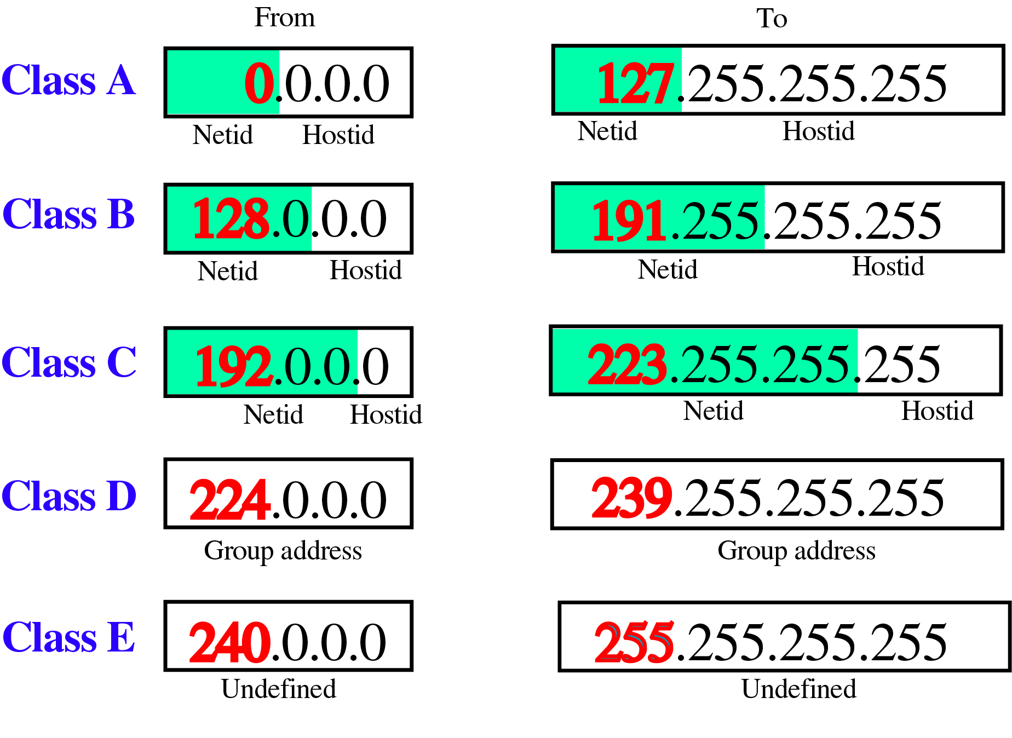
Class Ranges of Internet Addresses

Slide 10
Number of blocks and block size in classful IPv4 addressing
Class A address for large organization. Class B for mid-size organization. And Class C for small organization.

Slide 11
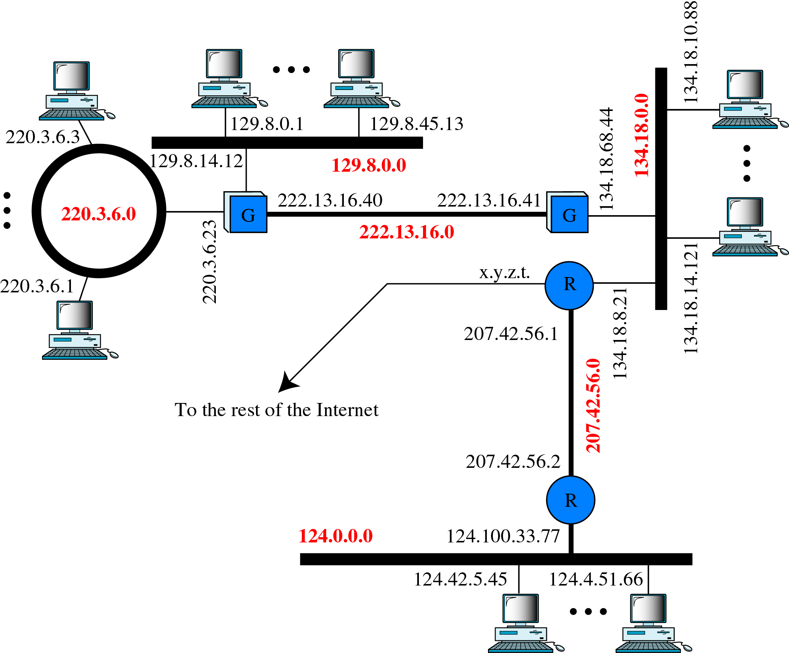
Network and Host Addresses

Slide 12
Flaw in Classful Address
We can see the flaw in this design.
A block in class A address is too large for almost any organization
A block in class B is also very large, probably too large for any of the organizations that received a class B block.
A block in class C is probably too small.
A and B always wasted. But C is always not enough!!!

Slide 13
Subnetting
Basically without subnetting, most of organization is limited to two levels of hierarchy .
In this case, the hosts cannot be organized into groups, and all of the hosts are at the same level.
As a result the organization has one network with many hosts

Slide 14
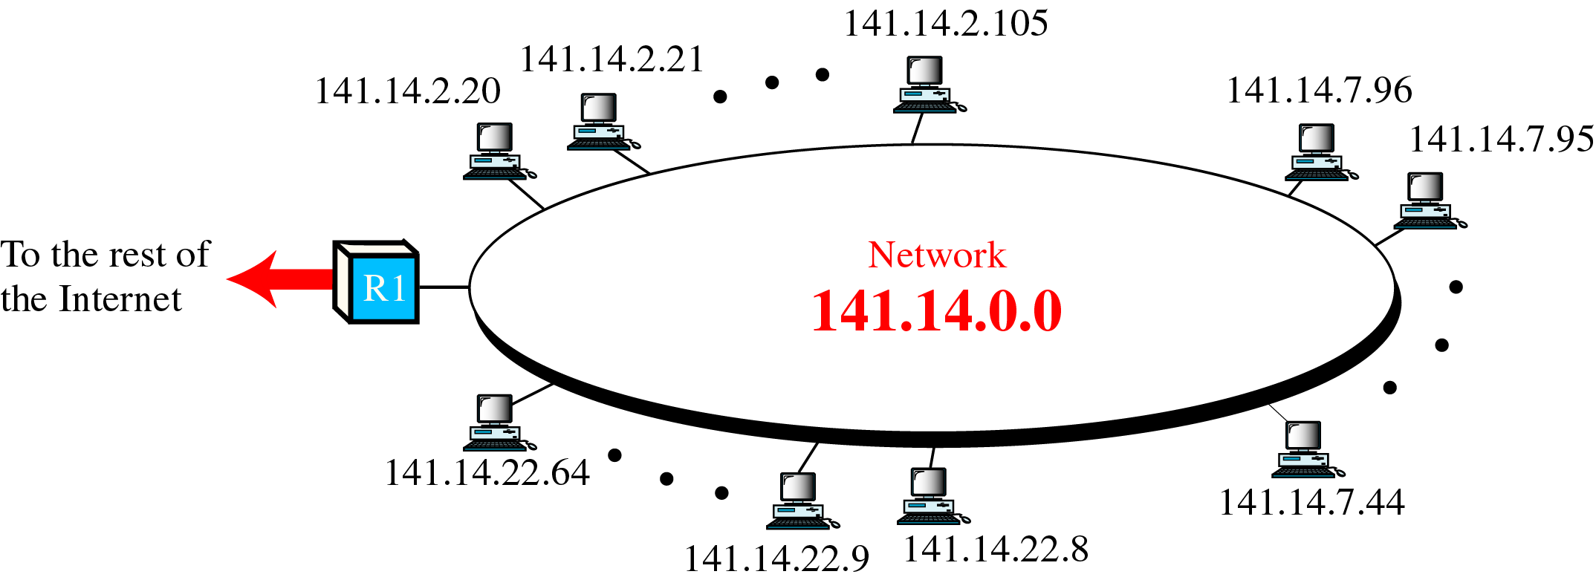
A Network with Two Levels of Hierarchy

Slide 15
To make a network more organize, three levels of hierarchy is implemented.
Subnetting creates an intermediate level of hierarchy in the IP addressing system.
Now we have 3 levels: netid, subnetid, and hostid.

Slide 16
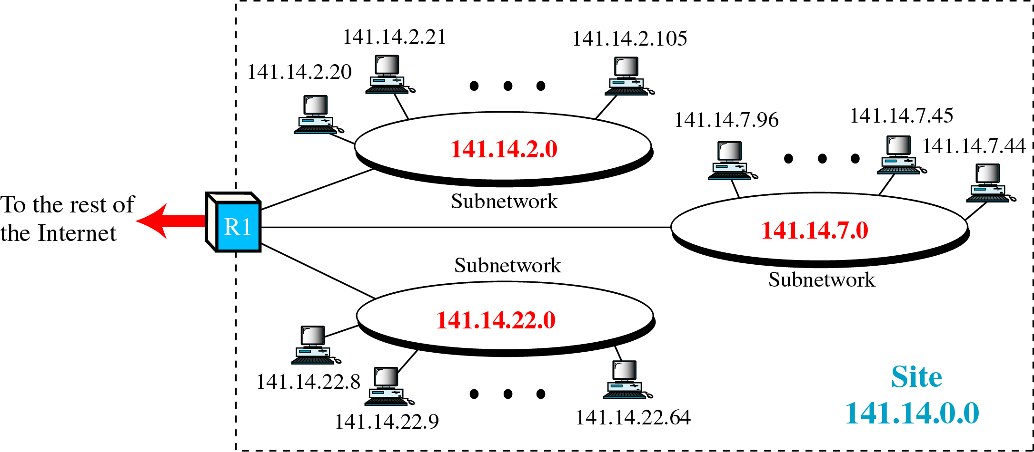
A Network with Three Levels of Hierarchy

Slide 17
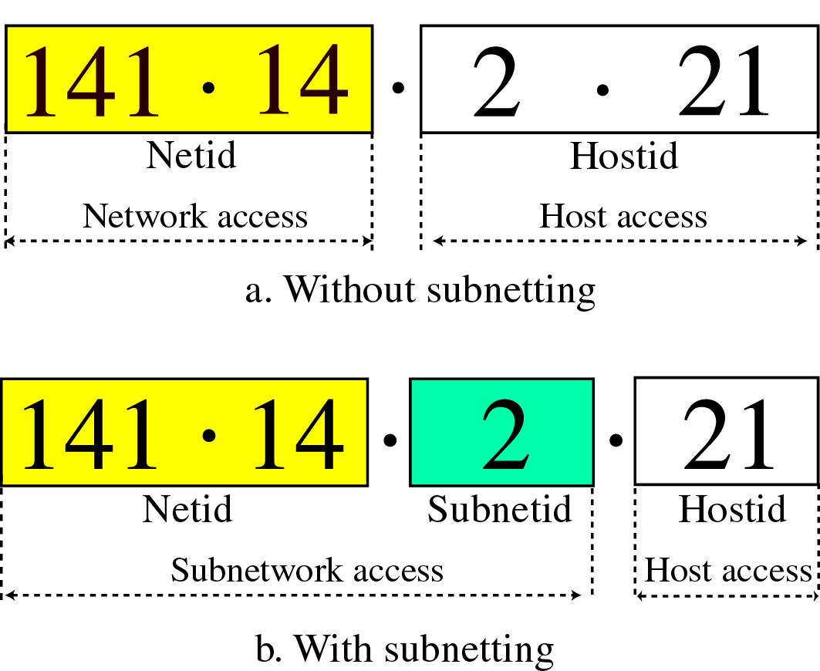
Addresses with and without Subnetting

Slide 18
Masking
A process that extracts the address of the physical network from an IP address.
Masking can be done whether we have subnetting or not.
If we have not subnetted the network, masking extracts the network address from an IP address
If we have subnetted, masking extracts the subnetwork address from an IP address.

Slide 19
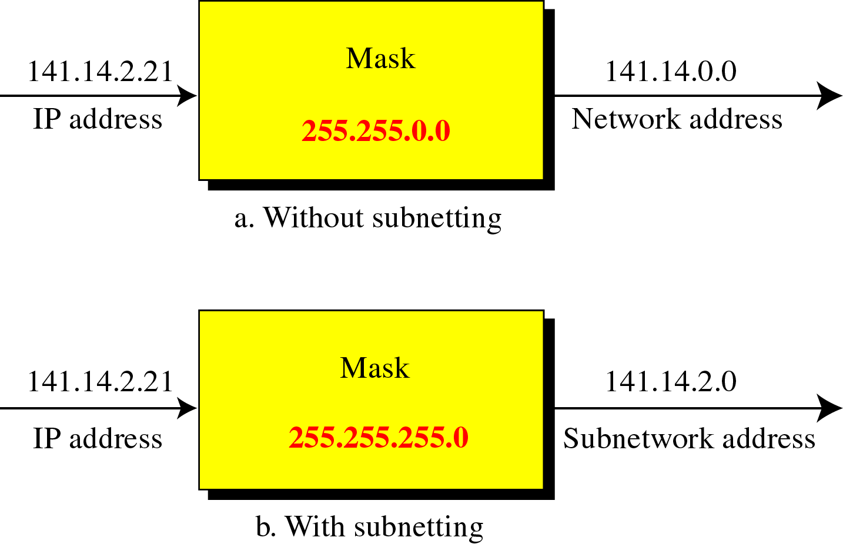
Masking

Slide 20
Mask for unsubnetted networks
Class | Mask | Address (e.g.) | Network Address (e.g)
A | 255.0.0.0 | 15.32.56.7 | 15.0.0.0
B | 255.255.0.0 | 135.67.13.9 | 135.67.0.0
C | 255.255.255.0 | 201.34.12.72 | 201.34.12.0
D | N/A | N/A | N/A
E | N/A | N/A | N/A

Slide 21
Mask for subnetted networks
Class | Mask | Address (e.g.) | Network Address (e.g)
A | 255.255.0.0 | 15.32.56.7 | 15.32.0.0
B | 255.255.255.0 | 135.67.13.9 | 135.67.13.0
C | 255.255.255.192 | 201.34.12.72 | 201.34.12.64
D | N/A | N/A | N/A
E | N/A | N/A | N/A

Slide 22
Network Address Translation (NAT)
A quick solution to the problem of inadequate/shortage of IP address for home/private network.
NAT enables a user to have a large set of addresses internally (local IP address) and one address externally (global IP address)

Slide 23
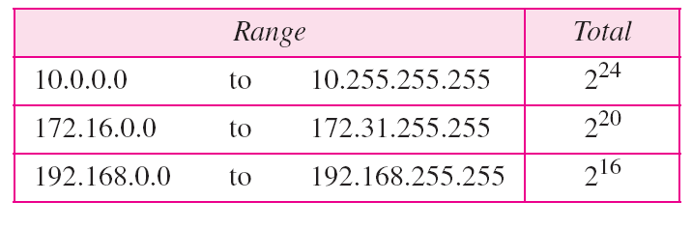
Addresses for private networks

