Slide 1
Subnetting/Supernetting and Classless Addressing

Slide 2
SUBNETTING

Slide 3
Network
Network
Host
Host
172
16
0
0
Network
Network
Subnet
Host
Subnetting is the process of borrowing bits from the HOST bits, in order to divide the larger network into small subnets

Slide 4
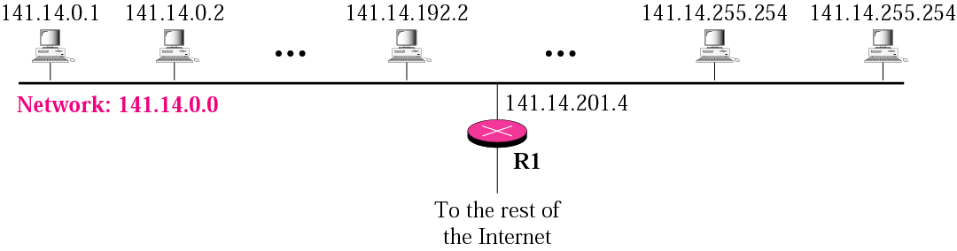
IP addresses are designed with two levels of hierarchy.
A network with two levels of hierarchy (not subnetted)

Slide 5
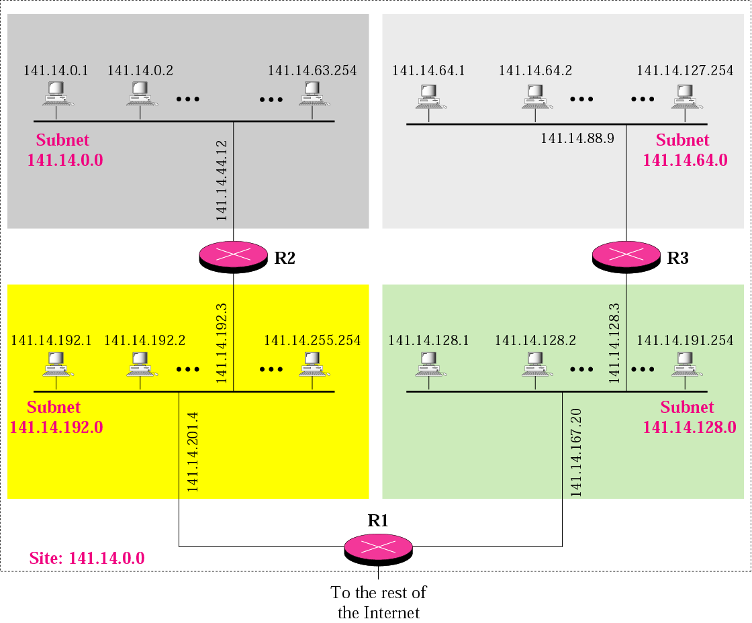
A network with three levels of
hierarchy (subnetted)

Slide 6
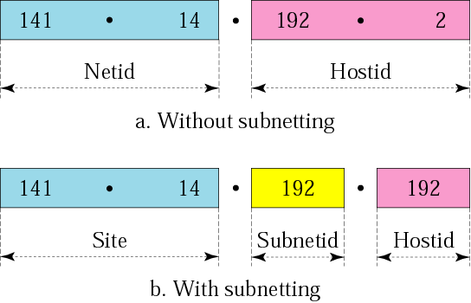
Addresses in a network with and without subnetting

Slide 7
The subnet mask (in binary) has:
all ones in the network and subnet portion of the address
all zeros in the host potion of the address
If you want no subnetting, use these default masks
Class A: 255.0.0.0
Class B: 255.255.0.0
Class C: 255.255.255.0

Slide 8
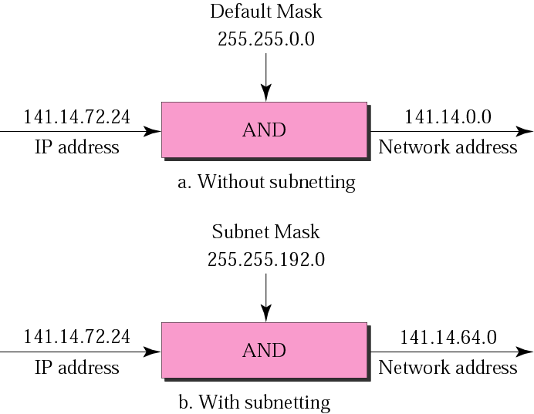
Default mask and subnet mask

Slide 9
Finding the Subnet Address
Given an IP address, we can find the subnet address by applying the mask to the address.
we use binary notation for both the address and the mask and then apply the AND operation to find

Slide 10
Question
What is the subnetwork address if the destination address is 200.45.34.56 and the subnet mask is 255.255.240.0?
Solution
11001000 00101101 00100010 00111000
11111111 11111111 11110000 00000000
11001000 00101101 00100000 00000000
The subnetwork address is 200.45.32.0.

Slide 11
The number of subnets must be a power of 2.

Slide 12
Question
A company is granted the site address 201.70.64.0 (class C). The company needs six subnets. Design the subnets.
Solution
The number of 1s in the default mask is 24 (class C).
The company needs six subnets. This number 6 is not a power of 2. The next number that is a power of 2 is 8 (2³). We need 3 more 1s in the subnet mask. The total number of 1s in the subnet mask is 27 (24 + 3).
The total number of 0s is 5 (32 − 27). The mask is

Slide 13
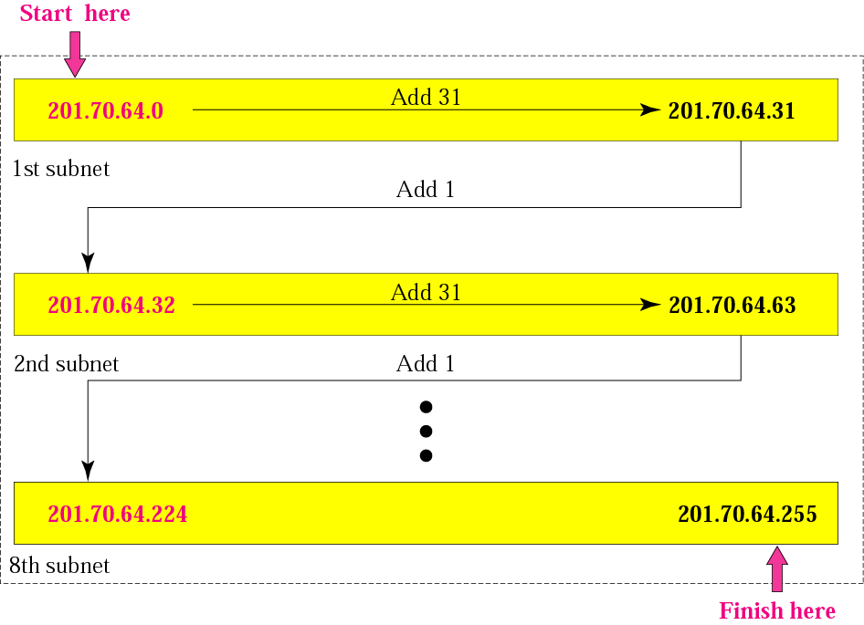
11111111 11111111 11111111 11100000
or
255.255.255.224
The number of subnets is 8.
The number of addresses in each subnet is 2⁵ (5 is the number of 0s) or 32.

Slide 14
SUPERNETTING
In supernetting, we need the first address of the supernet and the supernet mask to define the range of addresses.

Slide 15
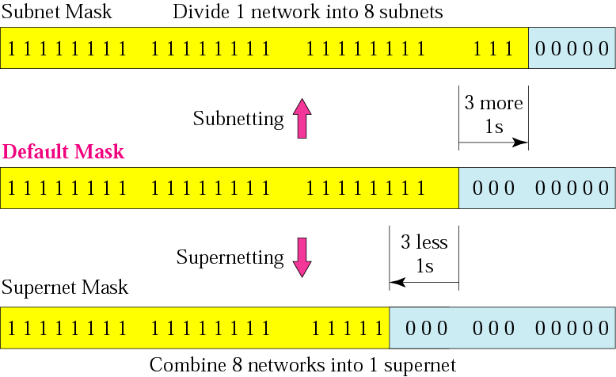
Comparison of subnet, default,
and supernet masks

Slide 16
Example
We need to make a supernetwork out of 16 class C blocks. What is the supernet mask?
Solution
We need 16 blocks. For 16 blocks we need to change four 1s to 0s in the default mask. So the mask is
11111111 11111111 11110000 00000000
or
255.255.240.0

Slide 17

Slash notation
Slash notation is also called CIDR notation.

Slide 18
Example
A small organization is given a block with the beginning address and the prefix length 205.16.37.24/29 (in slash notation). What is the range of the block?
Solution
The beginning address is 205.16.37.24. To find the last address we keep the first 29 bits and change the last 3 bits to 1s.
Beginning:11001111 00010000 00100101 00011000
Ending : 11001111 00010000 00100101 00011111
There are only 8 addresses in this block.

Slide 19
A block in classes A, B, and C can easily be represented in slash notation as A.B.C.D/ n where n is either 8 (class A), 16 (class B), or 24 (class C).

Slide 20
Example 13
What is the network address if one of the addresses is 167.199.170.82/27?
Solution
The prefix length is 27, which means that we must keep the first 27 bits as is and change the remaining bits (5) to 0s. The 5 bits affect only the last byte. The last byte is 01010010. Changing the last 5 bits to 0s, we get 01000000 or 64. The network address is 167.199.170.64/27.

Slide 21
Example 14
An organization is granted the block 130.34.12.64/26. The organization needs to have four subnets. What are the subnet addresses and the range of addresses for each subnet?
Solution
The suffix length is 6. This means the total number of addresses in the block is 64 (2⁶). If we create four subnets, each subnet will have 16 addresses.

Slide 22
Let us first find the subnet prefix (subnet mask). We need four subnets, which means we need to add two more 1s to the site prefix. The subnet prefix is then /28.
Subnet 1: 130.34.12.64/28 to 130.34.12.79/28.
Subnet 2 : 130.34.12.80/28 to 130.34.12.95/28.
Subnet 3: 130.34.12.96/28 to 130.34.12.111/28.
Subnet 4: 130.34.12.112/28 to 130.34.12.127/28.

Slide 23
