Slide 1
Overview of
Data Communications
and
Computer Networks

Slide 2
Data Communication
Data Communication is the exchange of data between two devices via some form of transmission medium such as a wire cable
Characteristics of Data Communication :
The effectiveness of a data communication depends on three Characteristics
1.Delivery
2.Accuracy
3.Timeliness

Slide 3
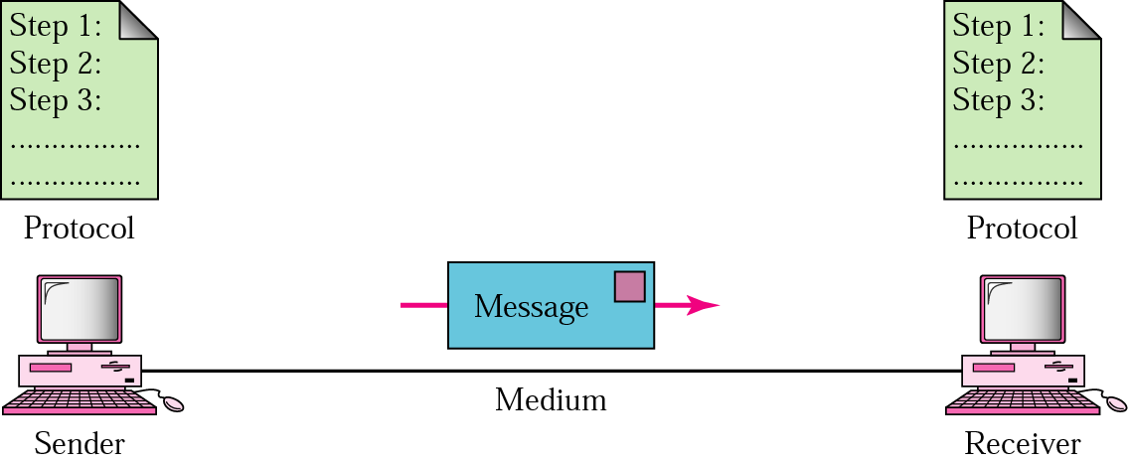
Components of data communication
Five components of data communication

Slide 4
Components of a data communications system
l. Message The message is the information (data) to be communicated.
Popular forms of information include text, numbers, pictures, audio,
and video.
2. Sender The sender is the device that sends the data message.
It can be a computer, workstation, telephone handset, video camera.
3. Receiver The receiver is the device that receives the message.
It can be a computer, workstation, telephone handset, television.
4. Transmission medium The transmission medium is the physical path
by which a message travels from sender to receiver.
Some examples of transmission media include twisted-pair wire,
coaxial cable, fiber-optic cable, and radio waves.
5. Protocol A protocol is a set of rules that govern data communications.
It represents an agreement between the communicating devices.
Without a protocol, two devices may be connected but not
communicating, just as a person speaking French cannot be understood
by a person who speaks only Japanese

Slide 5
Data Flow\Transmission Mode
Communication between two devices can be
- Simplex
half-duplex
full-duplex

Slide 6
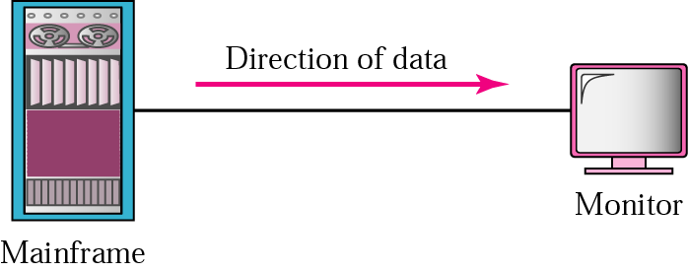
Simplex
In simplex mode, the communication is unidirectional.
Only one of the two devices on a link can transmit; the other can only receive
Keyboards and traditional monitors are examples of simplex devices
key­board can only introduce input; the monitor can only accept output.
The simplex mode can use the entire capacity of the channel to send data in one direction

Slide 7
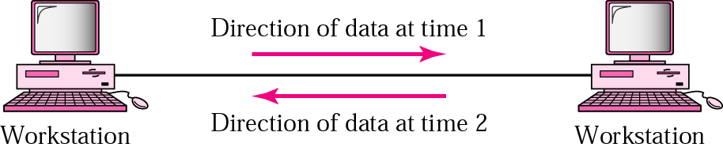
Half-duplex
In half-duplex mode, each station can both transmit and receive, but not at the same time.
When one device is sending, the other can only receive, and vice versa
ln a half-duplex transmission, the entire capacity of a channel is taken over by whichever of the two devices is transmitting at the time.
Walkie-talkies is half-duplex systems

Slide 8
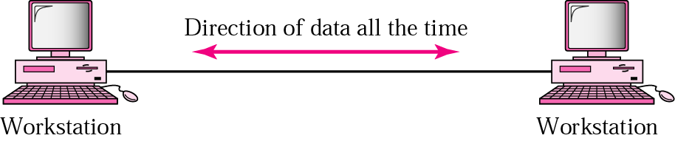
Full-duplex
In full-duplex mode both stations can transmit and receive simultaneously
In full-duplex mode, signals going in one direction share the capacity of the link with signals going in the other direction.
One common example of full-duplex communication is the telephone network. When two people are communicating by a telephone line, both can talk and listen at the same time

Slide 9
Networks
A network is a set of devices (often referred to as nodes) connected by communication links.
A node can be a computer, printer, or any other device capable of sending and/or receiving data generated by other nodes on the network.

Slide 10
Physical Structures
Type of Connection
There are two possible types of connections:
1. Point-to-point Connection and
2. Multipoint Connection.

Slide 11
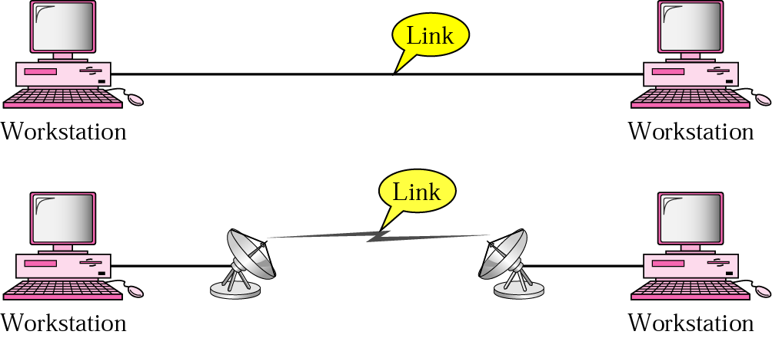
Point-to-Point Connection
A Point-to-Point connection provides a dedicated link between two devices. The entire capacity of the link is reserved for transmission between those two devices.
When we change television channels by infrared remote control, we establish a point-to-point connection between the remote control and the television's control system

Slide 12
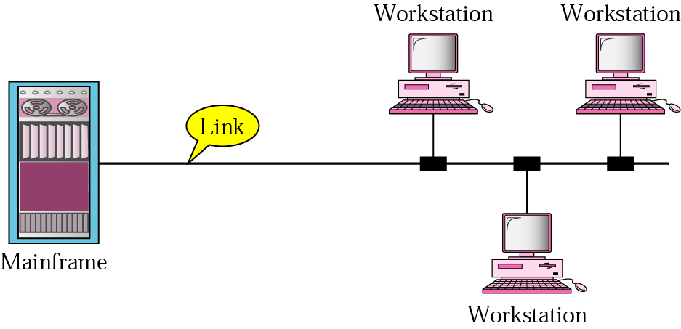
Multipoint Connection
A multipoint connection is one in which more than two specific devices share a single link
The capacity of the channel is shared.

Slide 13
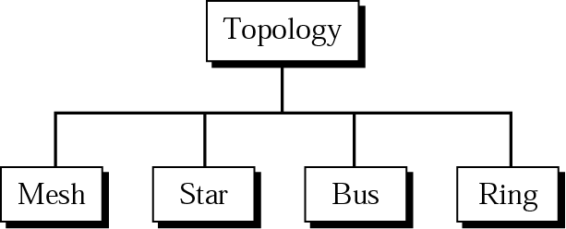
Categories of topology
The term physical topology refers to the way in which a network is laid out physically.
It is the geometric representation of the relationship of all the links and linking devices (usually called nodes) to one another.
There are four basic topologies possible: mesh, star, bus, & ring

Slide 14
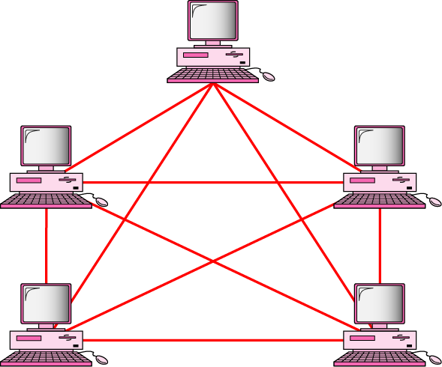
Fully connected mesh topology (for five devices)
In a mesh topology, every device has a dedicated point-to-point link to every other device.
The term dedicated means that the link carries traffic only between the two devices it connects

Slide 15
Advantages and Disadvantages of mesh topology
A mesh offers several advantages over other network topologies.
A mesh topology is robust. If one link becomes unusable, it does not harm the entire system.
There is the advantage of privacy or security. When every message travels along a dedicated line, only the intended recipient sees it.
The main disadvantage of a mesh are related to the amount of cabling and the number of I/O ports required.
Every device must be connected to every other device, installation and reconnection are difficult
One practical example of a mesh topology is the connection of telephone regional offices in which each regional office needs to be connected to every other regional office

Slide 16
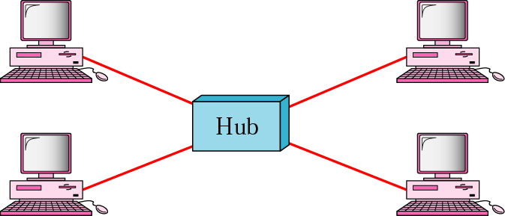
Star topology
In a star topology, each device has a dedicated point-to-point link only to a central controller, usually called a HUB.
The devices are not directly linked to one another.
The controller acts as an exchange, If one device wants to send data to another, it sends the data to the controller, which then relays the data to the other connected device.
In a star, each device needs only one link and one I/O port to connect it to any number of others. This factor also makes it easy to install and reconfigure.
Far less cabling needs.
Robustness
If one link fails, only that link is affected. All other links remain active.
One big disadvantage is the dependency of the whole topology on one single point, the hub. If the hub goes down, the whole system is dead

Slide 17
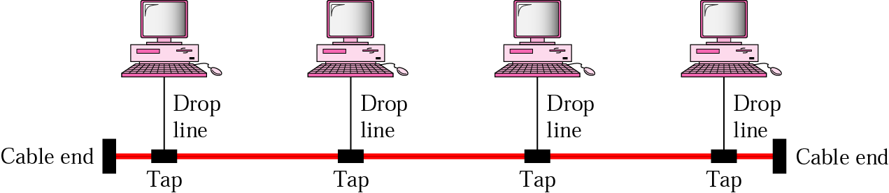
Bus topology
The bus topology is multipoint. One long cable acts as a backbone to link all the devices in a network
Nodes are connected to the bus cable by drop lines and taps.
A drop line is a connection running between the device and the main cable.
A tap is a connector.

Slide 18
Advantages and Disadvantages of Bus topology
Advantages of a bus topology include ease of installation.
Backbone cable can be laid along the most efficient path, then connected to the nodes by drop lines of various lengths. In this way, a bus uses less cabling than mesh
Disadvantages include difficult reconnection and a fault or break in the bus cable stops all transmission

Slide 19
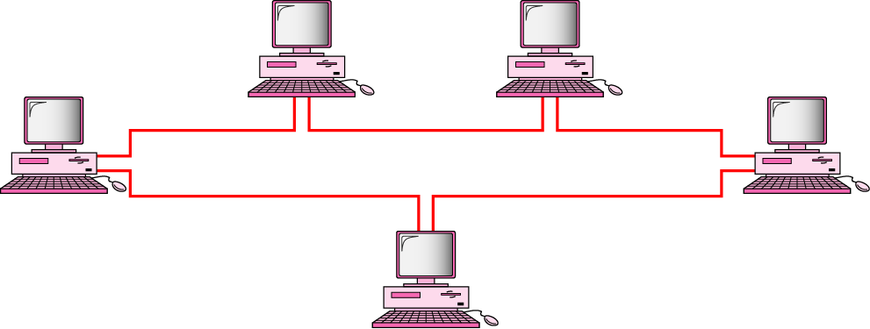
Ring topology
In a ring topology, each device has a dedicated point-to-point
connection with only the two devices on either side of it.
A signal is passed along the ring in one direction, from device to
device, until it reaches its destination.

Slide 20
Advantages and Disadvantages of Ring topology
Advantages :
Easy to install and reconfigure.
To add or delete a device requires changing only two connections.
Disadvantages:
A break in the ring disables the entire network. It can be solved by using a dual ring.

Slide 21
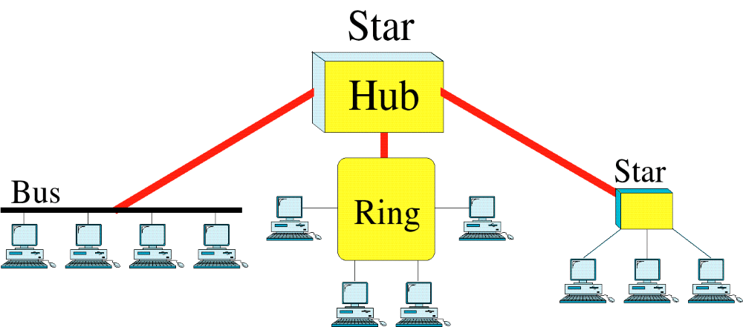
Hybrid Topology
A network can be hybrid. For example, we can have a main star topology with each branch connecting several stations in a bus topology

Slide 22
Categories of Networks
  LAN (Local Area Network)
  WAN (Wide Area Network)
  MAN (Metropolitan Area Network)
  Internet(Interconnection of Networks

Slide 23
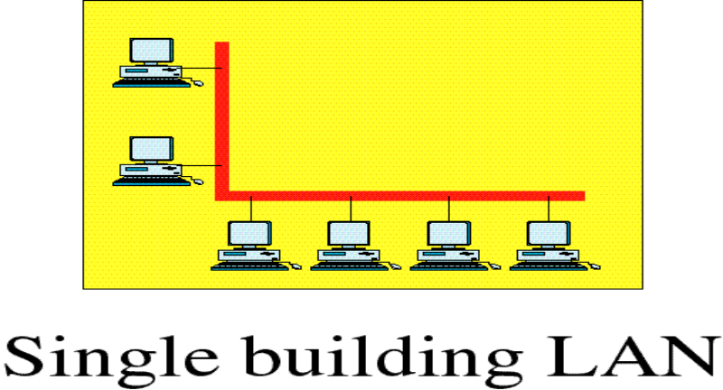
Local Area Network
LANs are privately-owned networks within a single building or campus of up to a few kilometres in size.
  High speed
Connect personal computers and workstations in company offices and factories to share resources (e.g., printers) and exchange information.

Slide 24
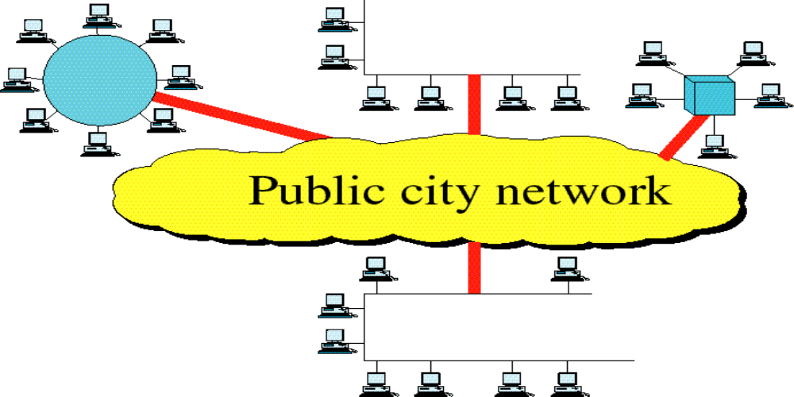
Metropolitan Area Network
A metropolitan area network, or MAN, covers a city.
Private or public network
High speed
Example of a MAN is the cable television network available in many cities

Slide 25
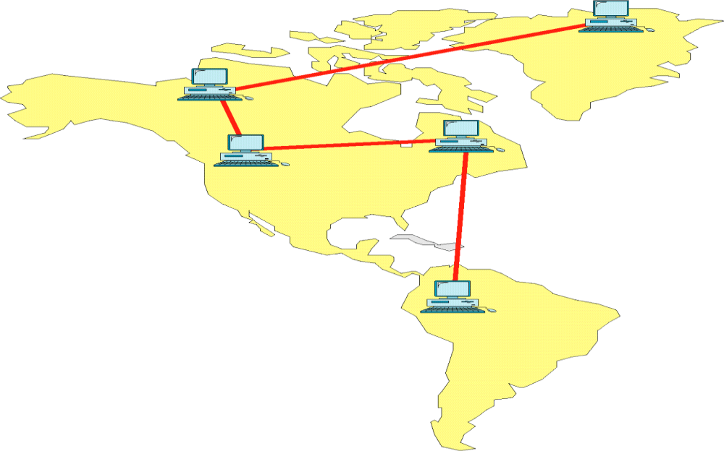
Wide Area Network
WAN spans a large geographical area, often a country or continent.
Slower than a LAN.
Less reliable than a LAN.

Slide 26
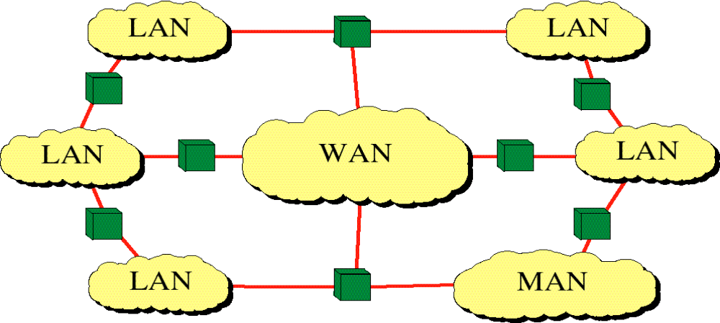
Internetwork
(Internet)
Network of Networks

Slide 27
