Slide 1
Physical Layer
Data and Signals
Notes:
Nidhi Gautam, Lecturer UIAMS, Panajb University, Chandigarh

Slide 2
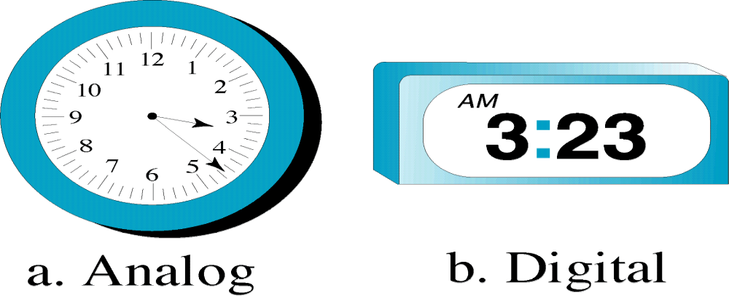
ANALOG AND DIGITAL
Data can be analog or digital. The term analog data refers to information that is continuous; digital data refers to information that has discrete states. Analog data take on continuous values. Digital data take on discrete values.
Notes:
Nidhi Gautam, Lecturer UIAMS, Panajb University, Chandigarh

Slide 3
Signals can be analog or digital.
Analog signals can have an infinite number of values in a range; digital signals can have only a limited
number of values.
Notes:
Nidhi Gautam, Lecturer UIAMS, Panajb University, Chandigarh

Slide 4

Figure 3.1 Comparison of analog and digital signals
Notes:
Nidhi Gautam, Lecturer UIAMS, Panajb University, Chandigarh

Slide 5
In data communications, we commonly use periodic analog signals and nonperiodic digital signals.
Notes:
Nidhi Gautam, Lecturer UIAMS, Panajb University, Chandigarh

Slide 6

A sine wave
Notes:
Nidhi Gautam, Lecturer UIAMS, Panajb University, Chandigarh

Slide 7

Period refers to the amount of time, in seconds, a signal
needs to complete 1 cycle.
Frequency refers to the number of period in 1 s.
  Amplitude: Maximum value (measured in Volts)
Frequency and period are the inverse of each other.
Notes:
Nidhi Gautam, Lecturer UIAMS, Panajb University, Chandigarh

Slide 8

Two signals with the same amplitude, but different frequencies
Notes:
Nidhi Gautam, Lecturer UIAMS, Panajb University, Chandigarh

Slide 9

Two signals with the same frequency, but different amplitudes
Notes:
Nidhi Gautam, Lecturer UIAMS, Panajb University, Chandigarh

Slide 10
Frequency is the rate of change with respect to time.
Change in a short span of time
means high frequency.
Change over a long span of
time means low frequency.
Notes:
Nidhi Gautam, Lecturer UIAMS, Panajb University, Chandigarh

Slide 11

Units of period and frequency
Notes:
Nidhi Gautam, Lecturer UIAMS, Panajb University, Chandigarh

Slide 12
Example
Express a period of 100 ms in microseconds.
Solution
From Table 3.1 we find the equivalents of 1 ms (1 ms is 10⁻³ s) and 1 s (1 s is 10⁶ μs). We make the following substitutions:.

Slide 13

Example
The period of a signal is 100 ms. What is its frequency in kilohertz?
Solution
First we change 100 ms to seconds, and then we calculate the frequency from the period (1 Hz = 10⁻³ kHz).

Slide 14
Phase
Phase describes the position of the waveform relative to time zero.
The phase is measured in degrees or radians (360 degrees is 2π radians)
Notes:
Nidhi Gautam, Lecturer UIAMS, Panajb University, Chandigarh

Slide 15

Three sine waves with the same amplitude and frequency, but different phases
Notes:
Nidhi Gautam, Lecturer UIAMS, Panajb University, Chandigarh

Slide 16

Question
A sine wave is offset 1/6 cycle with respect to time 0. What is its phase in degrees and radians?
Solution
We know that 1 complete cycle is 360°. Therefore, 1/6 cycle is

Slide 17
Question
Find the amplitude, frequency, and period of the following sine waves.
1) s(t)=5 sin (10πt)
2) s(t)= sin (10t)
Solution
1) Amplitude A=5
Frequency= 10π = 2πf, so f=5Hz
Period (T)=1/f =1/5 s
2) A=1
f=10/2π =1.6 Ηz
T= 1/1.6=0.628 s

Slide 18

The time-domain and frequency-domain plots of a sine wave

Slide 19
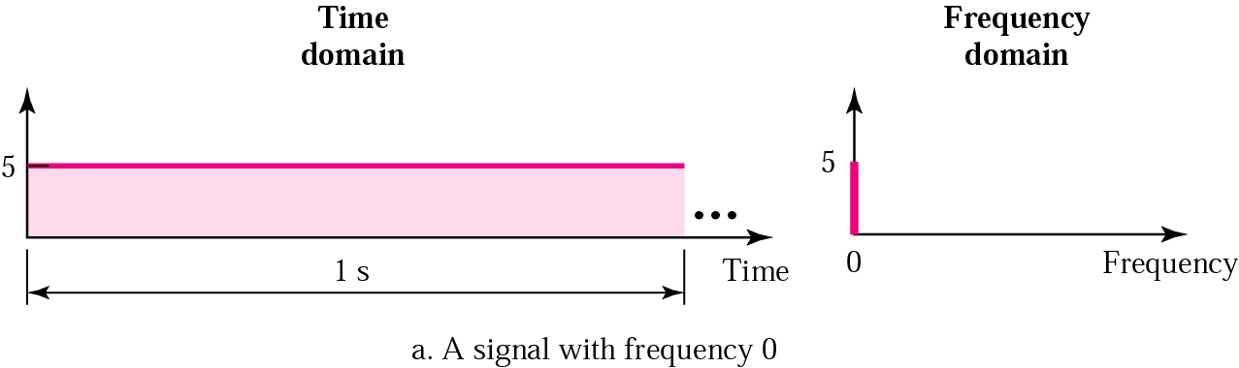
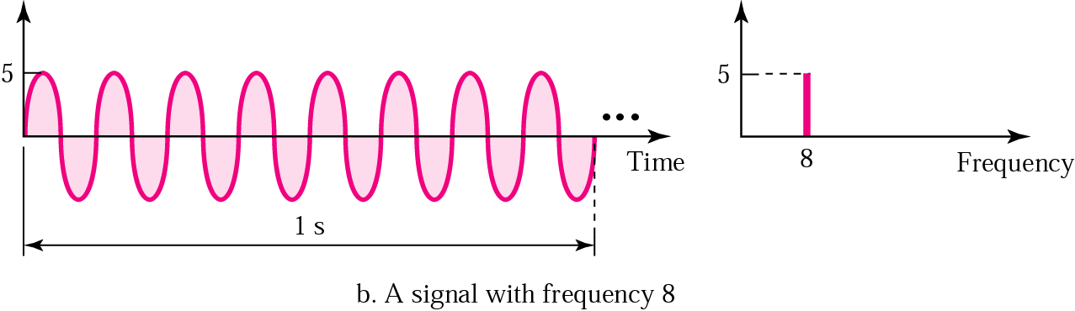
Time and frequency domains

Slide 20

The time domain and frequency domain of three sine waves

Slide 21
A single-frequency sine wave is not useful in data communications; we need to send a composite signal, a signal made of many simple sine waves.
According to Fourier analysis, any composite signal is a combination of simple sine waves with different frequencies, amplitudes, and phases.

Slide 22

A composite periodic signal

Slide 23

Decomposition of a composite periodic signal in the time and
frequency domains

Slide 24
Bandwidth
The bandwidth of a signal is the width of the frequency spectrum.
The bandwidth of a composite signal is the difference between the highest and the lowest frequencies contained in that signal.

Slide 25

The bandwidth of periodic and nonperiodic composite signals
3.<number>

Slide 26
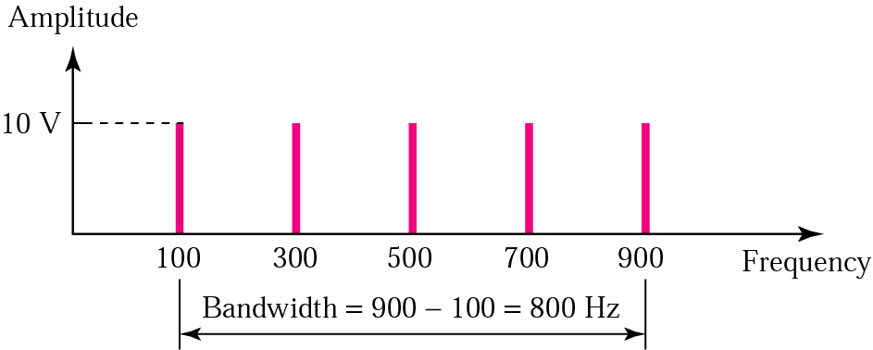
Question
If a periodic signal is decomposed into five sine waves with frequencies of 100, 300, 500, 700, and 900 Hz, what is the bandwidth? Draw the spectrum, assuming all components have a maximum amplitude of 10 V.
Solution

Slide 27
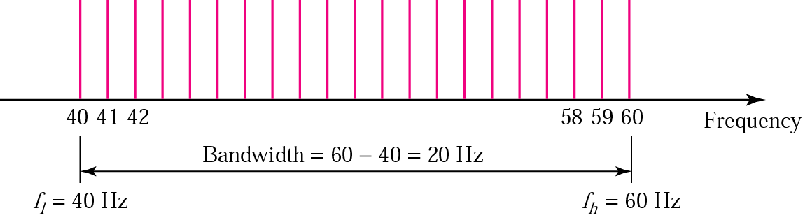
Question
A signal has a bandwidth of 20 Hz. The highest frequency is 60 Hz. What is the lowest frequency? Draw the spectrum if the signal contains all integral frequencies of the same amplitude.
Solution
B = f_{h} - f_{l}
20 = 60 - f_{l}
f_{l} = 60 - 20 = 40 Hz

Slide 28

Question
A nonperiodic composite signal has a bandwidth of 200 kHz, with a middle frequency of 140 kHz and peak amplitude of 20 V. The two extreme frequencies have an amplitude of 0. Draw the frequency domain of the signal.
Solution
The lowest frequency must be at 40 kHz and the highest at 240 kHz.

Slide 29

DIGITAL SIGNALS
In Digital signal, data stored in the form of 0s and 1s. For example, a 1 can be encoded as a positive voltage and a 0 as zero voltage. A digital signal can have more than two levels. In this case, we can send more than 1 bit for each level.

Slide 30
Bit Rate
Bit rate is the number of bits transmitted during one second.
Baud Rate
Baud rate is the number of signal units per second that are required to represent those bits.
baud rate = bit rate / r
where r is no-of-bits represented by each signal element.

Slide 31
Question
A signal carries 4 bits per signal element. If 1000 signal elements are sent per second, find the bit rate and baud rate.
Solution
Baud rate = 1000 baud
Bit rate= 1000x4=4000 bps.

Slide 32
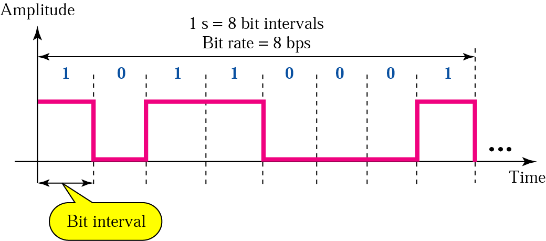
Bit interval
The bit interval is the time required to send one single bit.

Slide 33
Question
A digital signal has a bit rate of 2000 bps. What is the duration of each bit (bit interval) in microsecond?
Solution
The bit interval is the inverse of the bit rate.
Bit interval = 1/ 2000 s = 0.000500 s
= 0.000500 x 10⁶ μs = 500 μs

Slide 34
Question
A digital signal has eight levels. How many bits are needed per level?
Solution
Each signal level is represented by 3 bits.

Slide 35
Question
A digitized voice channel is made by digitizing a 4-kHz bandwidth analog voice signal. We need to sample the signal at twice the highest frequency (two samples per hertz). We assume that each sample requires 8 bits. What is the required bit rate?
Solution
Bit rate=

Slide 36

The time and frequency domains of periodic and nonperiodic
digital signals

Slide 37

TRANSMISSION IMPAIRMENT
Signals travel through transmission media, which are not perfect. The imperfection causes signal impairment. This means that the signal at the beginning of the medium is not the same as the signal at the end of the medium. Three causes of impairment are attenuation, distortion, and noise.

Slide 38

Attenuation means a loss of energy. When a signal, simple or composite, travels through a medium, it loses some of its energy in overcoming the resistance of the medium.
Decibel(dB) measures the relative strengths of two signals or one signal at two different points.
dB=10 log₁₀ p2/p1

Slide 39

Example
Suppose a signal travels through a transmission medium and its power is reduced to one-half. This means that P2 is (1/2)P1. In this case, the attenuation (loss of power) can be calculated as
A loss of 3 dB (–3 dB) is equivalent to losing one-half the power.

Slide 40


Example
A signal travels through an amplifier, and its power is increased 10 times. This means that P₂ = 10P₁ . In this case, the amplification (gain of power) can be calculated as

Slide 41


Example
Changes in the strength of a signal is that decibel numbers can be added (or subtracted) when we are measuring several points (cascading) instead of just two. In Figure, a signal travels from point 1 to point 4. In this case, the decibel value can be calculated as

Slide 42

Distortion means that the signal changes its form or shape.
Distortion can occur in composite signal made of different frequencies.

Slide 43

Noise
Additional signals inserted between transmitter and receiver.
Notes:
Thermal noise
Due to Random motion of electrons in wire which creates an extra signal not originally.
Crosstalk
A signal from one line is picked up by another
Unwanted electrical coupling between the transmission paths
Impulse noise
Irregular pulses or spikes
External electromagnetic disturbance

Slide 44

Measure of Noise
SNR =
SNR (in dB) =10 log₁₀ SNR decibels

Slide 45
Question
The power of a signal is 10 mW and the power of the noise is 1μW; what are the values of SNR and SNR(in dB)?
Solution
SNR = 10 000 μW / 1 μW =10 000
SNR_{dB} = 10 log₁₀ 10 000 = 40

Slide 46
DATA RATE LIMITS
A very important consideration in data communications is how fast we can send data, in bits per second, over a channel. Data rate depends on three factors:
1. The bandwidth available
2. The level of the signals we use
3. The quality of the channel

Slide 47
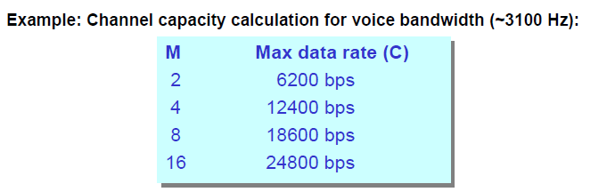
Noiseless Channel : Nyquist Formula for Maximum Data Rate (Capacity) of a Channel
Bit Rate(C) =2B log₂L bits/sec
Where B = bandwidth L = number of discrete signal levels
L

Slide 48
Question
Consider a noiseless channel with a bandwidth of 3000 Hz transmitting a signal with two signal levels. Find out the maximum bit rate.
Solution

Slide 49
Noisy Channel :Shannon Capacity
Determine the theoretical highest data rate for noisy channel
Capacity(c) = B log₂(1 +S/N) bits/sec
Where S/N = Signal-to-noise ratio

Slide 50
Question
The signal-to-noise ratio is often given in decibels. Assume that SNR_{dB} = 36 and the channel bandwidth is 2 MHz. find out the theoretical channel capacity.
Solution

