Slide 1
Encoding
Techniques

Slide 2
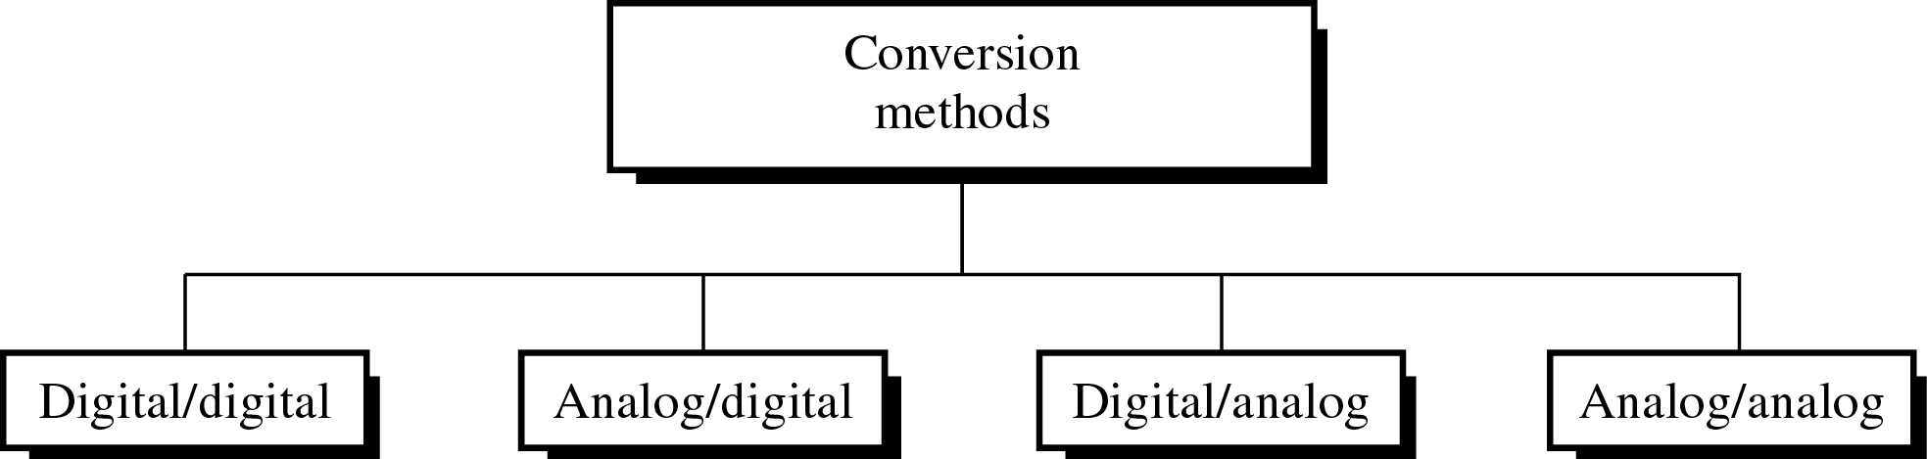
Different Conversion Schemes

Slide 3
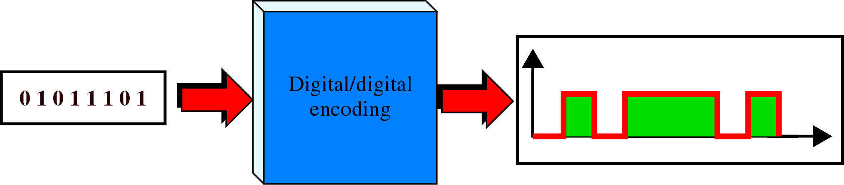
Digital to Digital Encoding

Slide 4
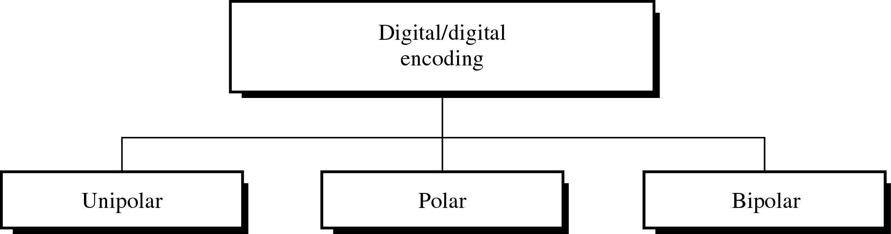
Types of Digital to Digital Encoding

Slide 5
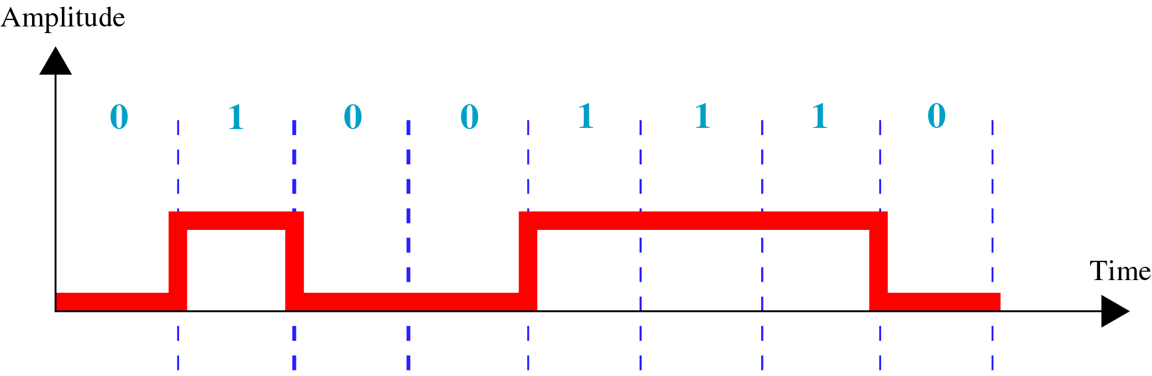
Unipolar Encoding
All the Signal levels are on one side of the time axis, either above or below.
Positive Voltage – bit 1
Zero Voltage – bit 0.

Slide 6
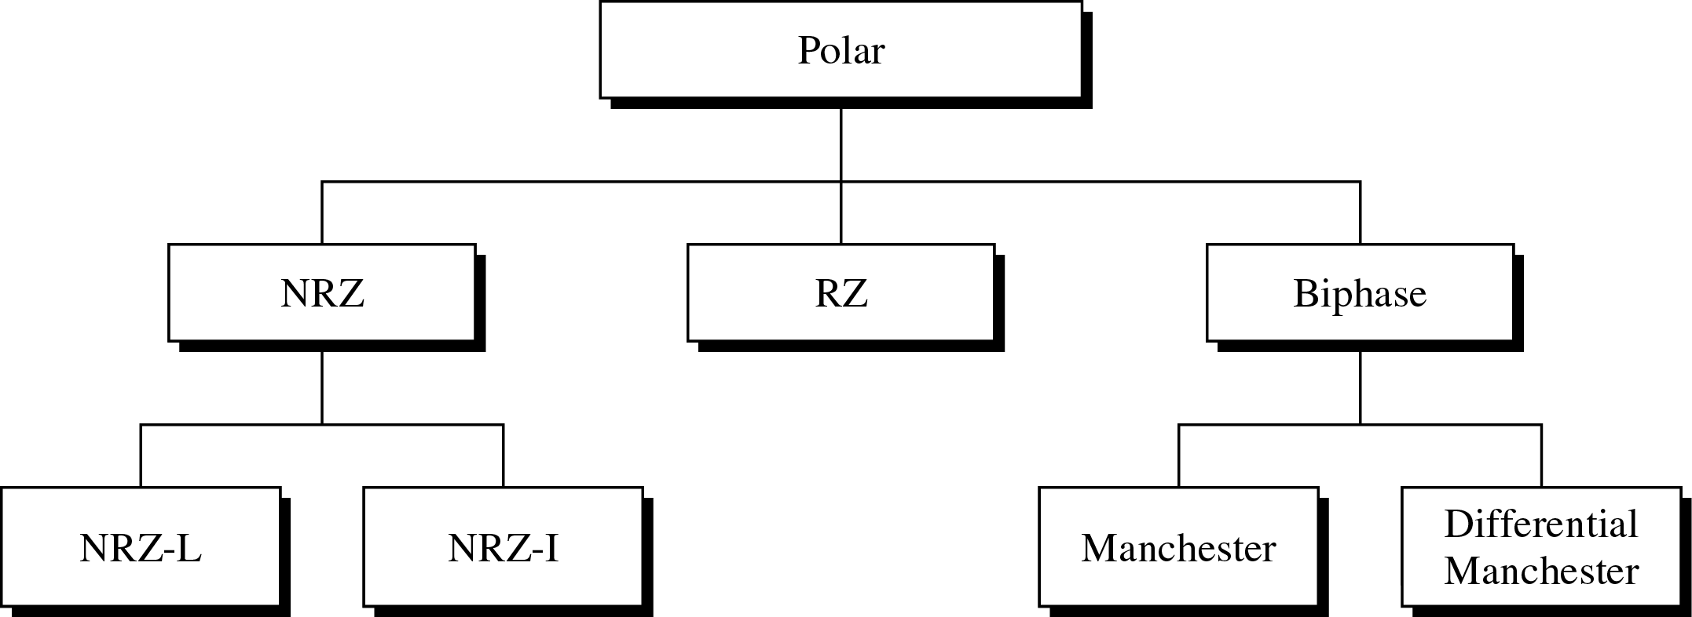
Polar Encoding
Signal levels are on the both sides of the time axis. For Example, the voltage level for 0 can be positive and the voltage level for 1 can be negative.

Slide 7
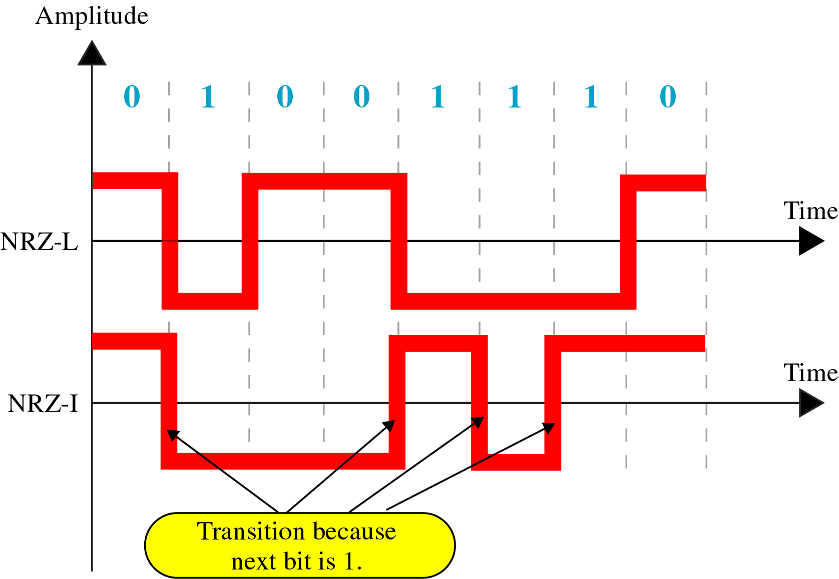
NRZ-L and NRZ-I Encoding
NRZ-L(Non-Return-to-Zero-Level) - The level of the voltage determines the value of the bit.
NRZ-I (NRZ-Invert) – If there is no change, the bit is 0; if there is a change, the bit is 1.

Slide 8
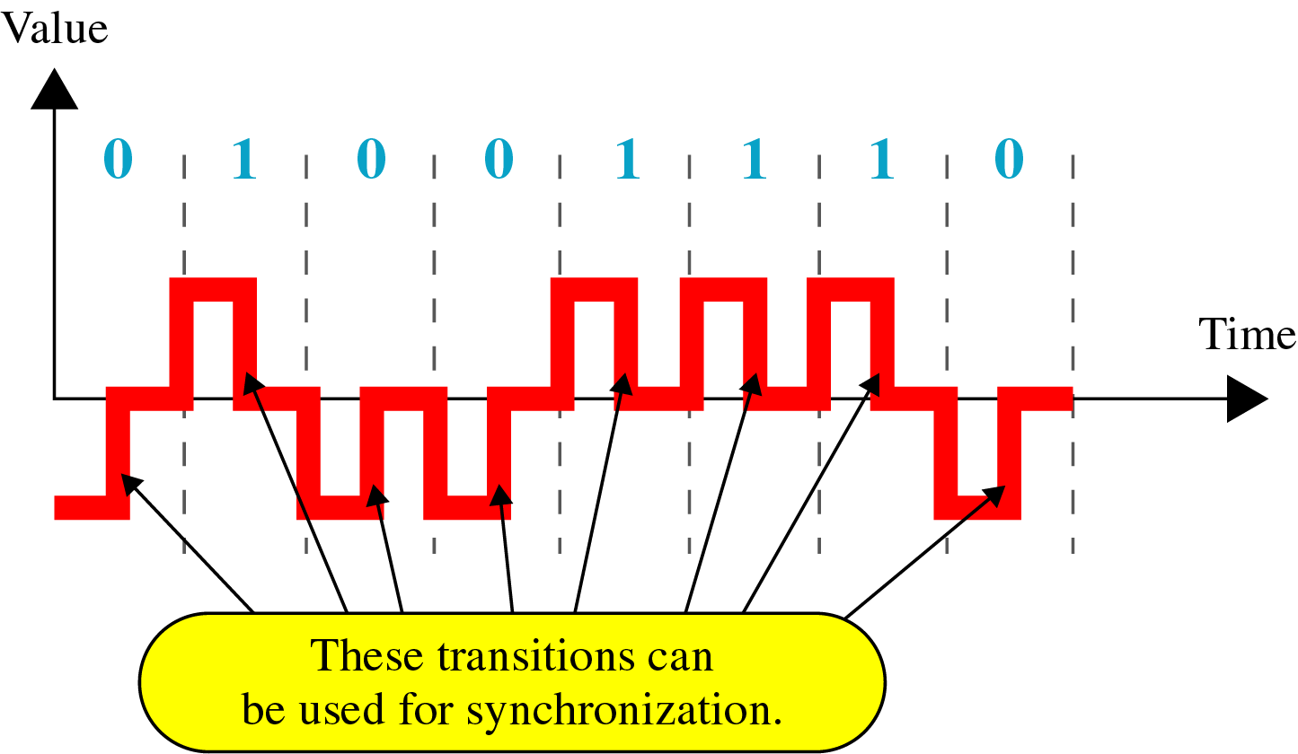
RZ (Return to Zero) Encoding
The main problem with NRZ encoding occurs when the sender and receiver clocks are not synchronized. The receiver does not know when one has ended and the next bit is starting.
In RZ, the signal changes not between bits but during the bit.

Slide 9
Manchester and Differential Manchester Encoding
In Manchester encoding, the duration of the bit is divided into two halves. The voltage remains at one level during the first half and moves to the other level in the second half.
In Differential Manchester encoding, there is always a transition at the middle of the bit, but the bit values are determined at the beginning of the bit. If the next bit is 1, there is a transition; if the next bit is 0, there is none.

Slide 10
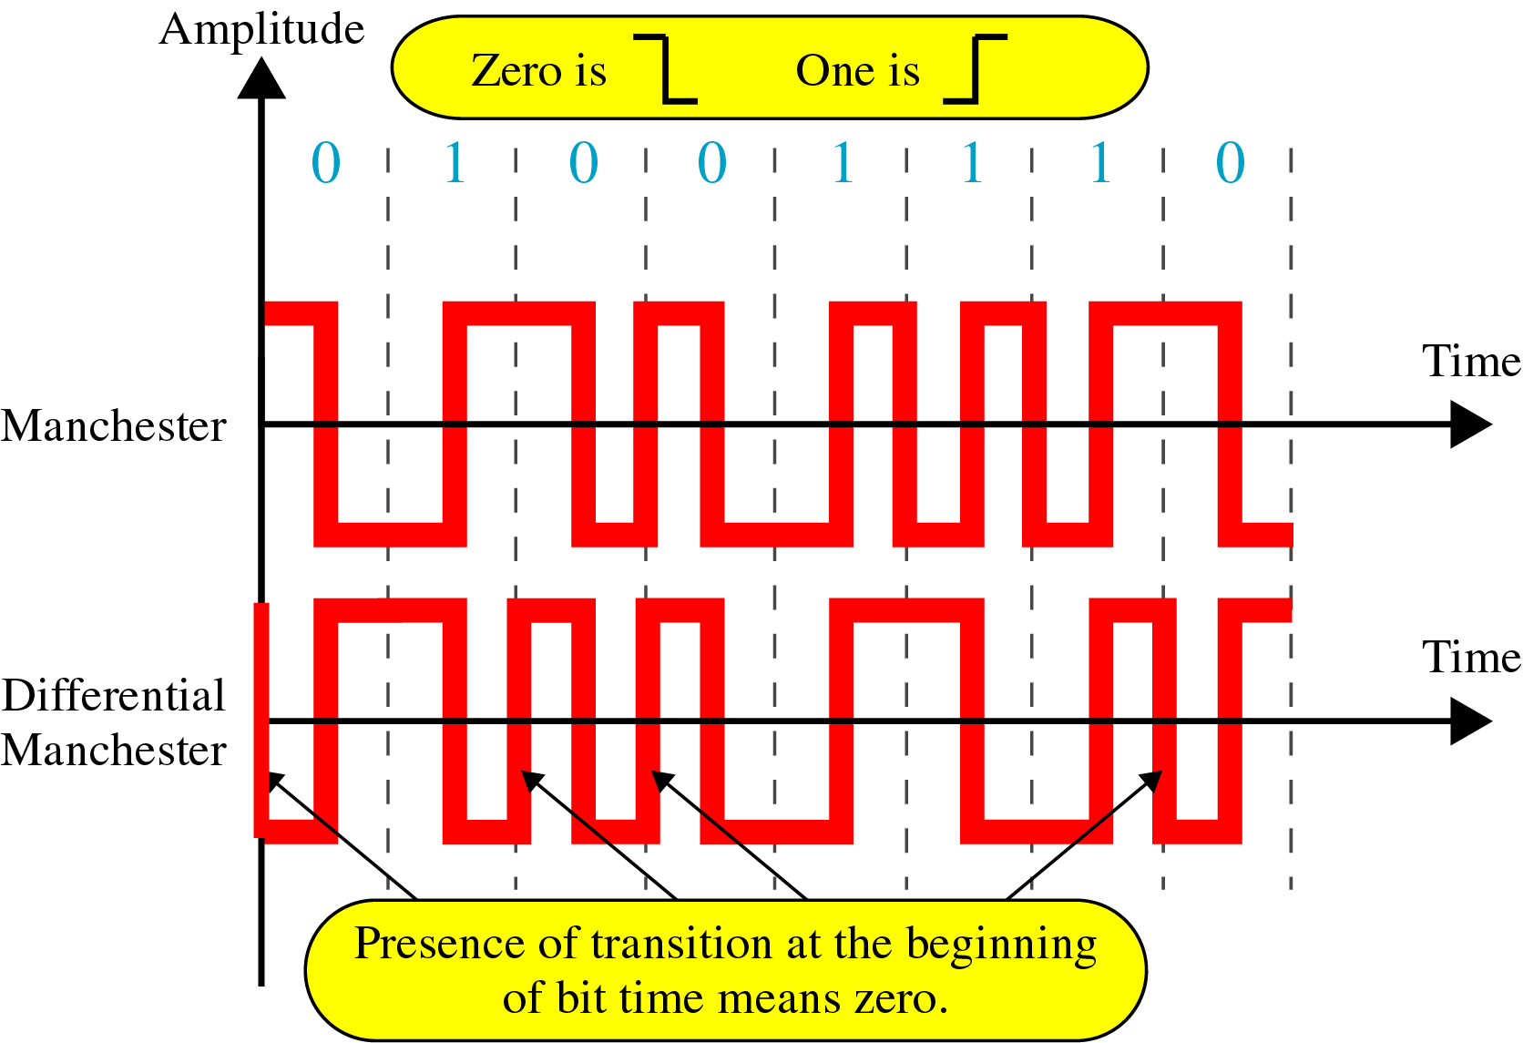

Slide 11
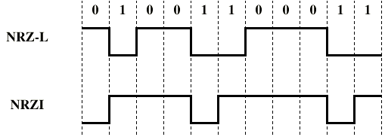
Question Draw the graph of the NRZ-L and NRZ-I of the data stream 01001100011.
Solution:

Slide 12
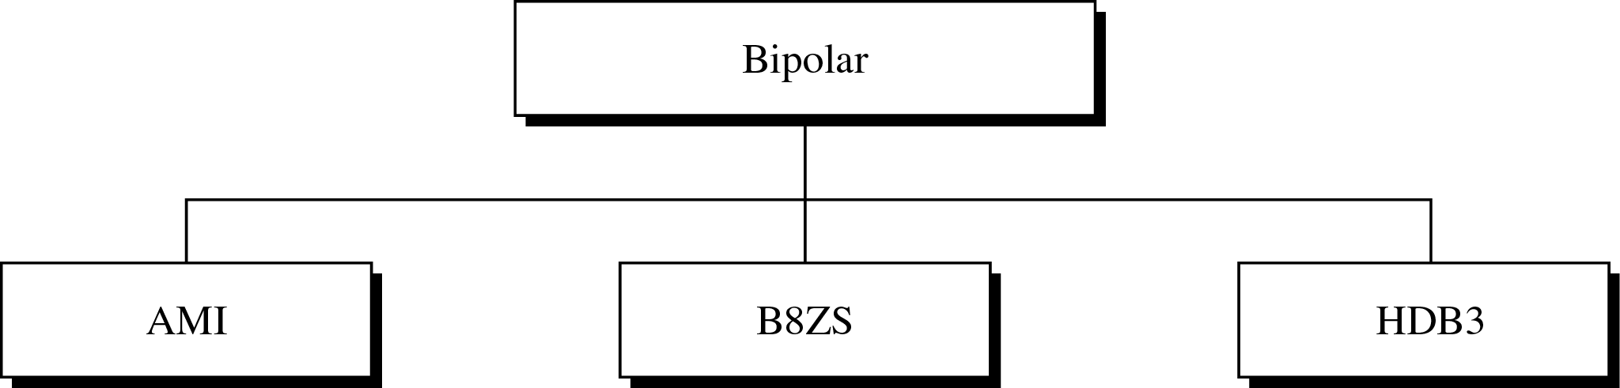
Types of Bipolar Encoding

Slide 13
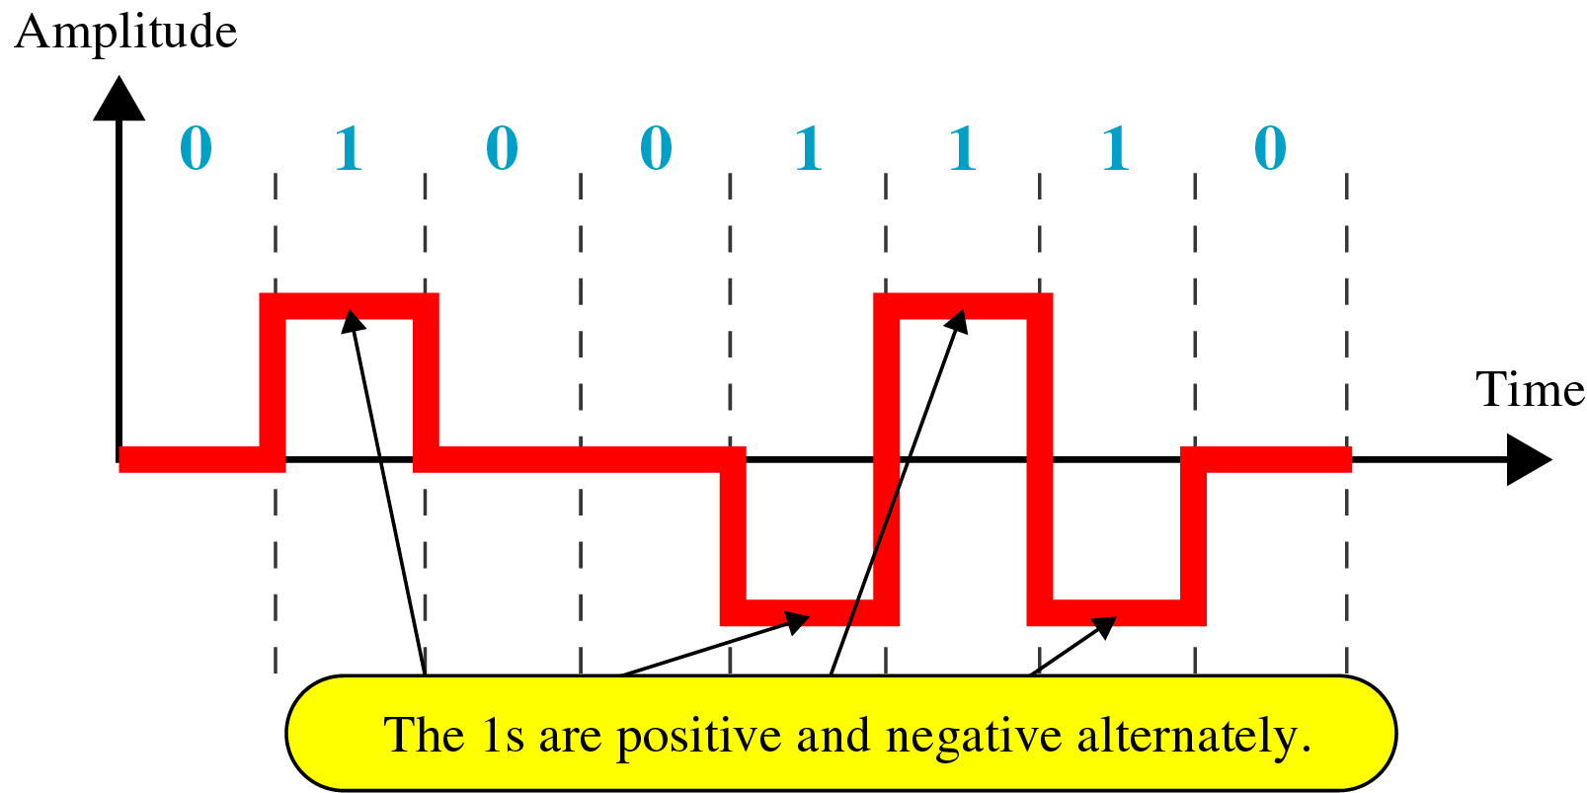
Bipolar (Multilevel Binary )
Use more than two voltage levels
Bipolar-AMI (Alternate Mark Inversion)
Binary 0 represented by zero voltage.
Binary 1 represented by alternating positive and negative voltages.

Slide 14
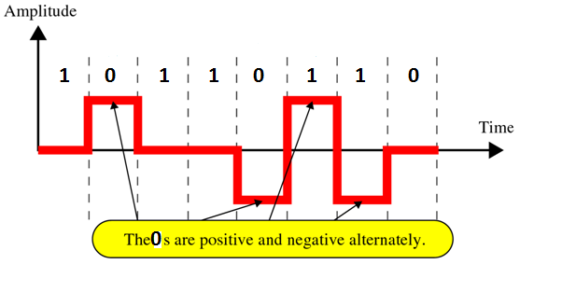
Pseudoternary
Binary 1 represented by zero voltage.
Binary 0 represented by alternating positive and negative voltages.

Slide 15
Scrambling Technique
Used to replace sequences that would produce constant voltage
Avoid long sequences of zero level line signal
Two commonly used techniques are: B8ZS, and HDB3
Used for long distance transmission.

Slide 16
Bipolar With 8 Zeros Substitution (B8ZS)
Based on bipolar-AMI
If octet of all zeros and last voltage pulse preceding was positive, encode as 000+-0-+
If octet of all zeros and last voltage pulse preceding was negative, encode as 000-+0+-
Causes two violations of AMI code.
Receiver detects and interprets as octet of all zeros

Slide 17
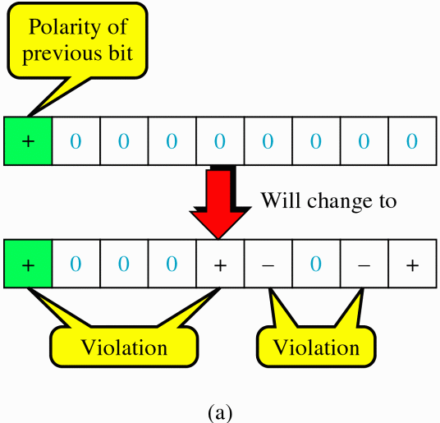

B8ZS

Slide 18
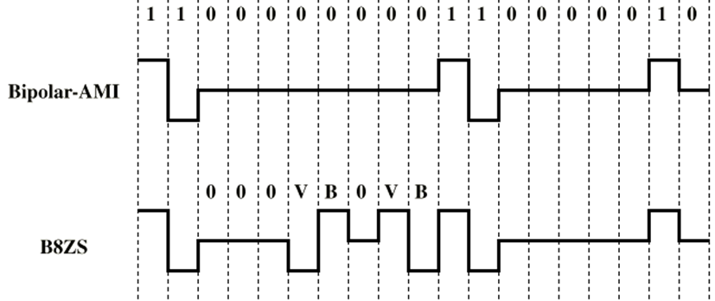
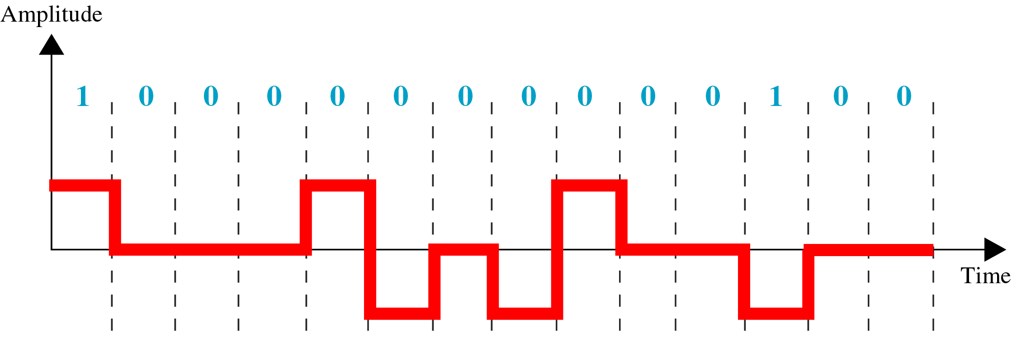
EXAMPLES OF B8ZS

Slide 19
HDB3
High Density Bipolar 3 Zeros
Based on bipolar-AMI
String of four zeros replaced with one or two pulses

Slide 20
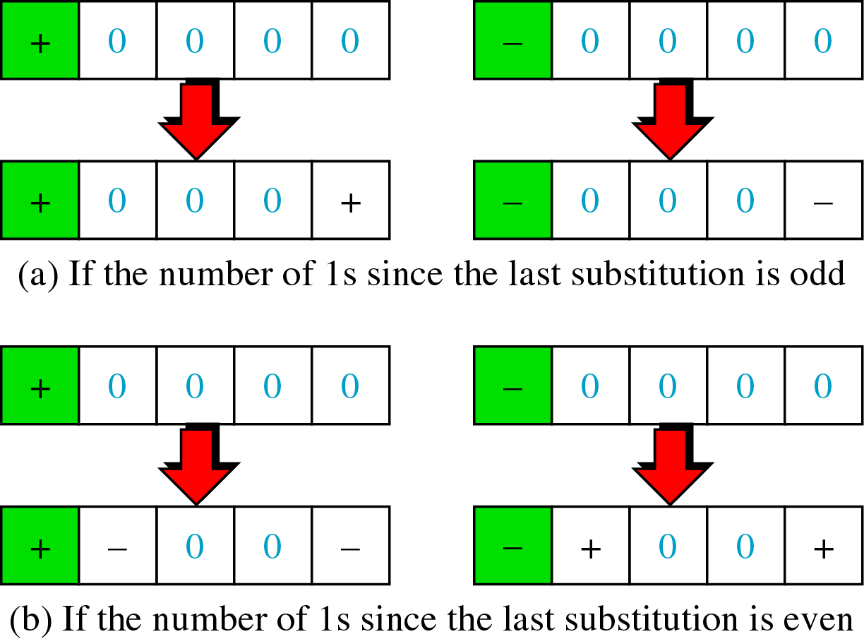
HDB3 Encoding

Slide 21
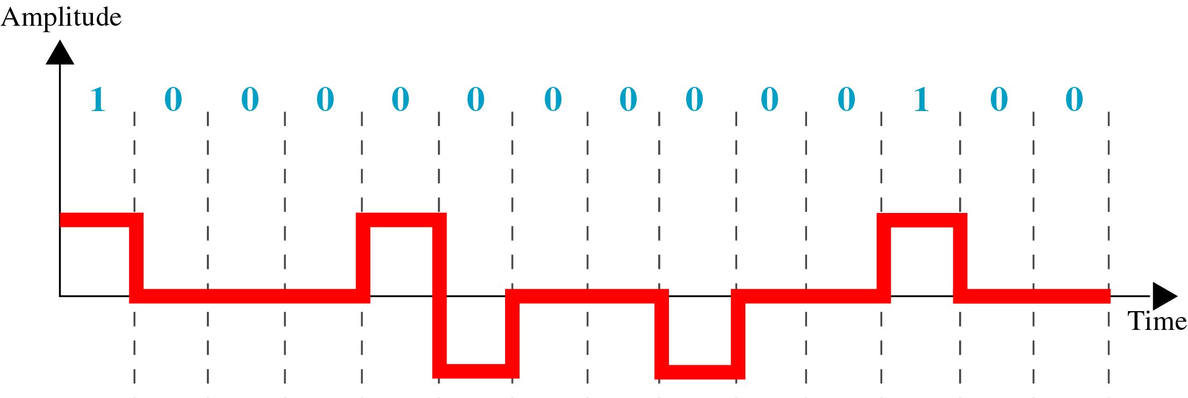
EXAMPLE OF HDB3

Slide 22
Question Draw the graph for the B8ZS and HDB3 of the data stream 11100000000000.

Slide 23
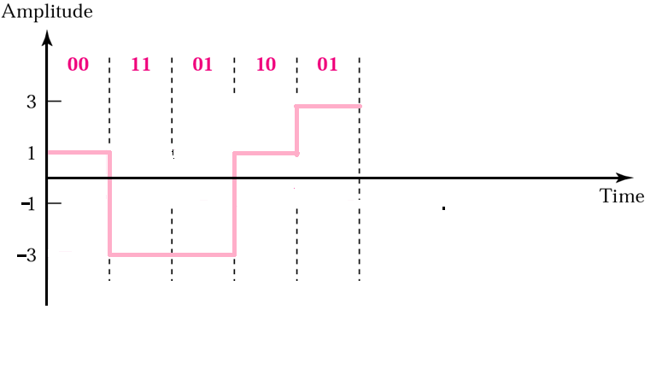
2B1Q
(TWO BINARY, ONE QUATERNARY)
Previous level : +ve
Previous level : -ve
Next bits | Next Level | Next Level
00 | +1 | -1
01 | +3 | -3
10 | -1 | +1
11 | -3 | +3
TRANSITION TABLE

Slide 24
MLT-3
(Multiline Transmission, three level)
It uses three levels (+V, 0, and –V).
Transition rules to move between the levels.
1. If the next bit is 0, there is no transition.
2. If the next bit is 1 and the current level is not 0, the next level is 0.
3. If the next bit is 1 and the current level is 0, the next level is the opposite of the last nonzero level.

Slide 25
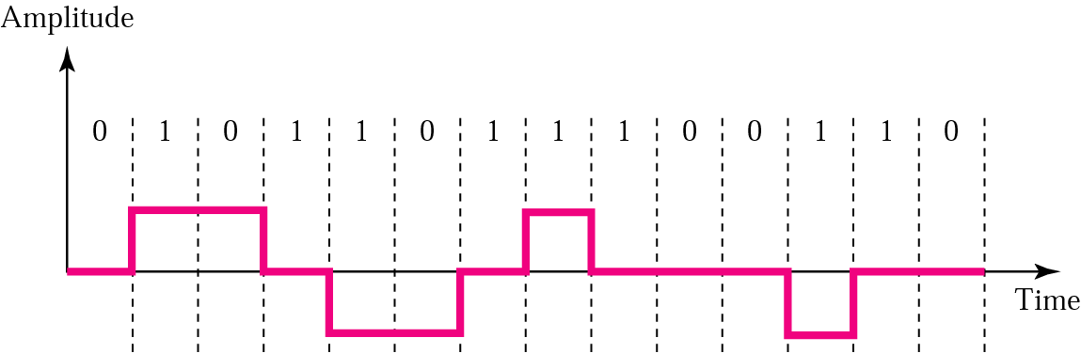
Example of MLT-3
(Multiline Transmission, three level)

Slide 26
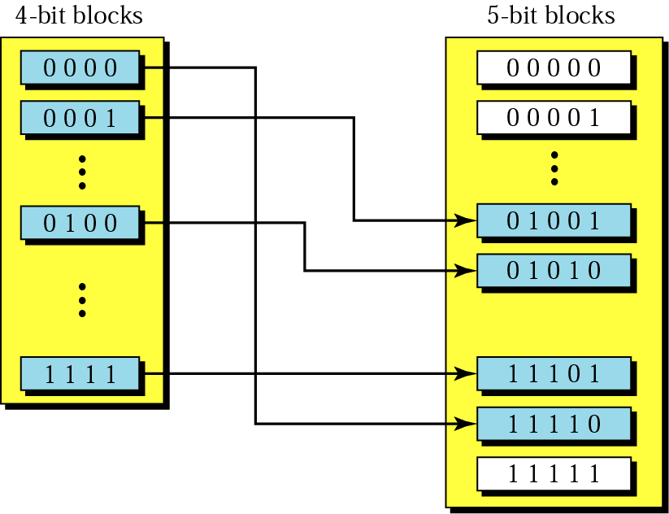
4B/5B Encoding
(Four Binary/Five binary)

Slide 27
4B/5B Encoding continue
(Four Binary/Five binary)
Data | Code | Data | Code
0000 | 11110 | 1000 | 10010
0001 | 01001 | 1001 | 10011
0010 | 10100 | 1010 | 10110
0011 | 10101 | 1011 | 10111
0100 | 01010 | 1100 | 11010
0101 | 01011 | 1101 | 11011
0110 | 01110 | 1110 | 11100
0111 | 01111 | 1111 | 11101

Slide 28
