Slide 1
ANALOG-TO-DIGITAL CONVERSION
A digital signal is superior to an analog signal because it is more robust to noise and can easily be recovered, corrected and amplified.
To convert analog data into a digital signal, there are two basic techniques:
Pulse code modulation (used by telephone systems)
Delta modulation

Slide 2
PCM
PCM consists of three steps to digitize an analog signal:
Sampling
Quantization
Binary encoding

Slide 3
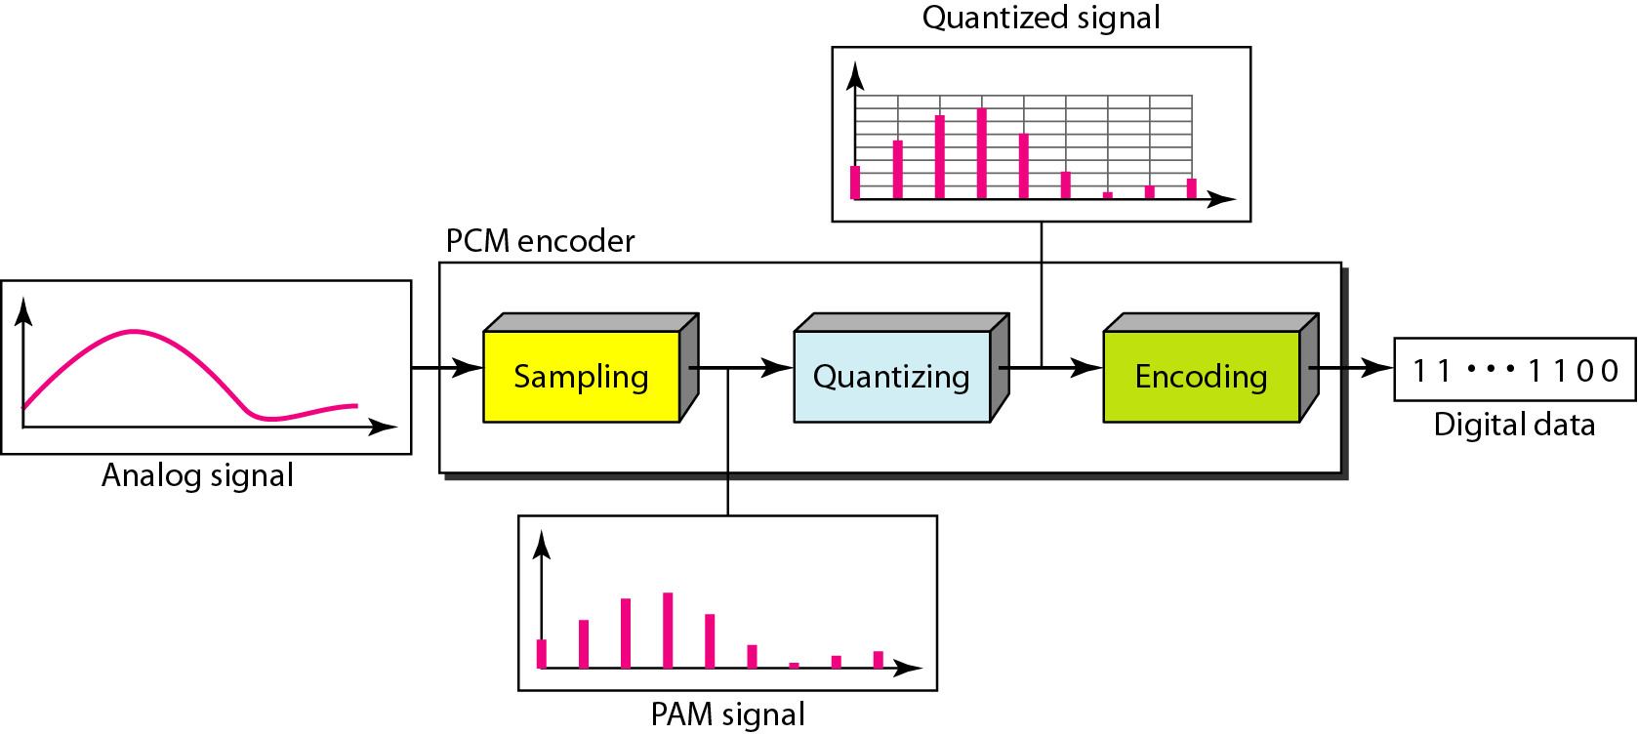
Components of PCM encoder

Slide 4
Sampling
Analog signal is sampled every T_{S} secs.
T_{s} is referred to as the sampling interval.
f_{s} = 1/T_{s} is called the sampling rate or sampling frequency.
The process is referred to as pulse amplitude modulation PAM and the outcome is a signal with analog (non integer) values

Slide 5
PAM(Pulse amplitude modulation)

Slide 6
Quantization
Sampling results in a series of pulses of varying amplitude values ranging between two limits: a min and a max.
The amplitude values are infinite between the two limits.
We need to map the infinite amplitude values onto a finite set of known values.
This is achieved by dividing the distance between min and max into L zones, each of height Δ.
Δ = (max - min)/L

Slide 7
Quantized PAM Signal

Slide 8
Quantizing Using
Sign and Magnitude

Slide 9
PCM

Slide 10
From Analog to PCM

Slide 11
From Analog to PCM

Slide 12
From Analog to PCM

Slide 13
From Analog to PCM

Slide 14
Quantization Error
When a signal is quantized, we introduce an error - the coded signal is an approximation of the actual amplitude value.
The difference between actual and coded value (midpoint) is referred to as the quantization error.
The more zones, the smaller Δ which results in smaller errors.
BUT, the more zones the more bits required to encode the samples -> higher bit rate

Slide 15
Delta Modulation
This scheme sends only the difference between pulses, if the pulse at time t_{n+1} is higher in amplitude value than the pulse at time t_{n}, then a single bit, say a “1”, is used to indicate the positive value.
If the pulse is lower in value, resulting in a negative value, a “0” is used.
This scheme works well for small changes in signal values between samples.
If changes in amplitude are large, this will result in large errors.

Slide 16
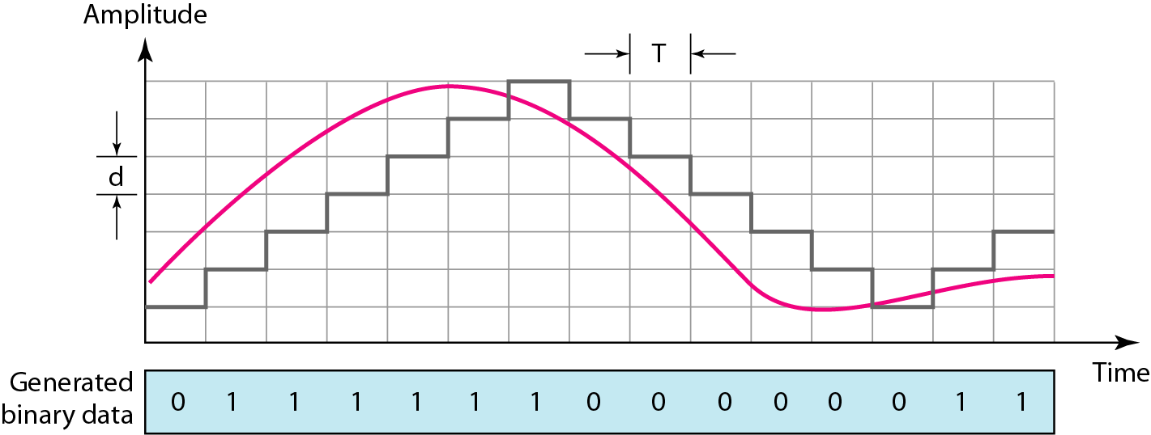
The process of delta modulation

Slide 17
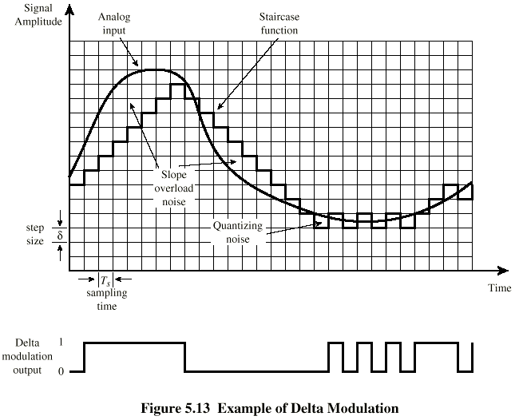
Delta Modulation - example

Slide 18
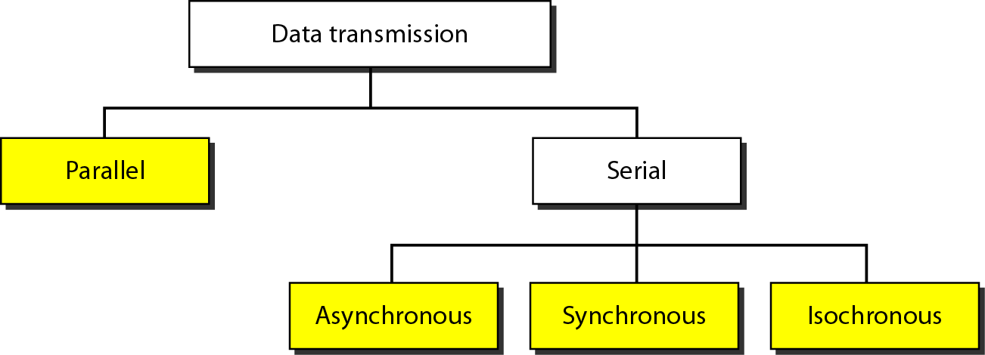
TRANSMISSION MODES
The transmission of binary data across a link can be accomplished in either parallel or serial mode.

Slide 19
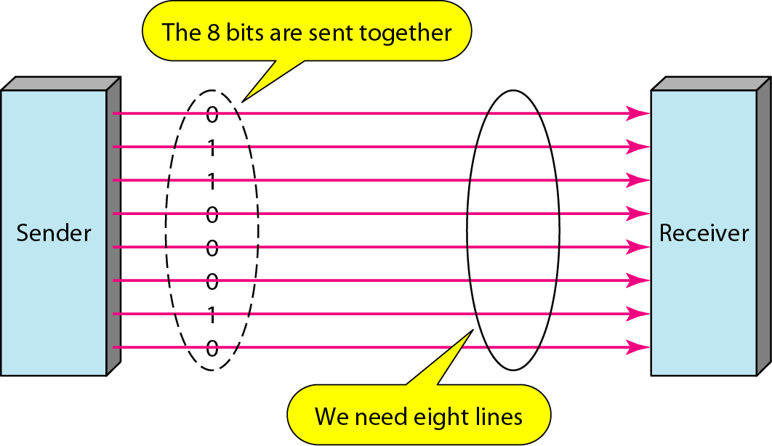
Parallel transmission

Slide 20
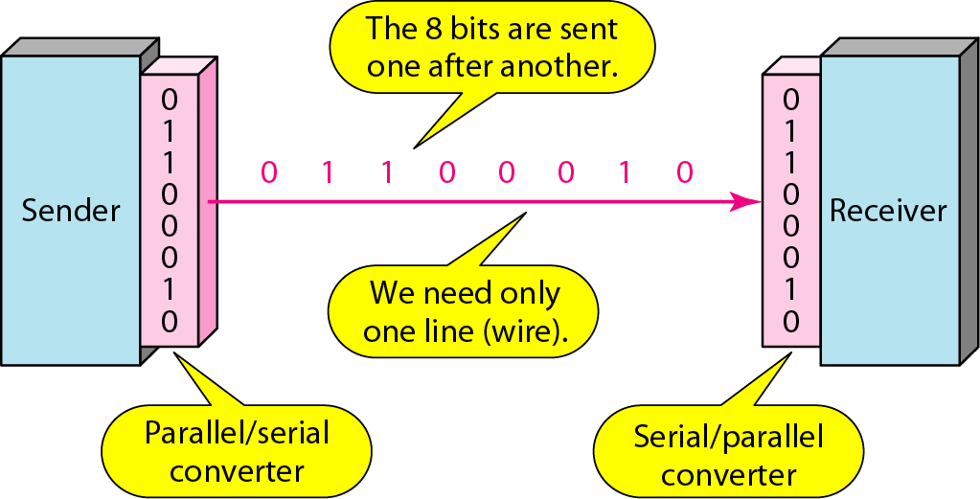
Serial transmission

Slide 21
In asynchronous transmission, we send 1 start bit (0) at the beginning and 1 or more stop bits (1s) at the end of each byte. There may be a gap between each byte.

Slide 22
Asynchronous here means “asynchronous at the byte level,”
but the bits are still synchronized; their durations are the same.

Slide 23
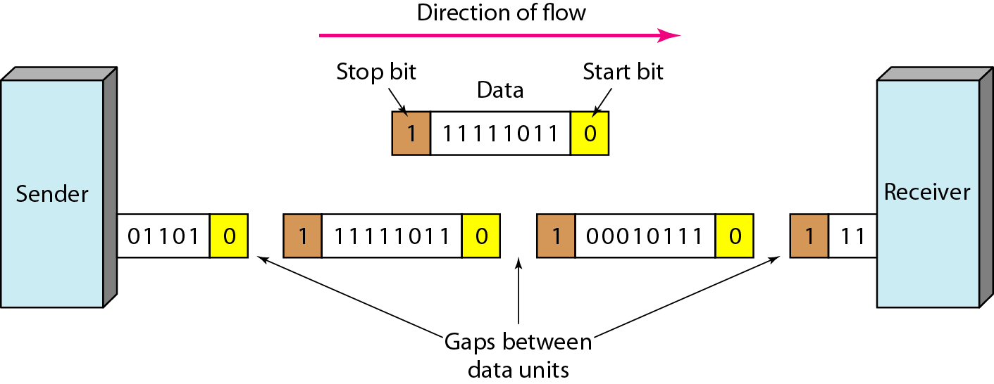
Asynchronous transmission

Slide 24
In synchronous transmission, we send bits one after another without start or stop bits or gaps. It is the responsibility of the receiver to group the bits. The bits are usually sent as bytes and many bytes are grouped in a frame. A frame is identified with a start and an end byte.

Slide 25
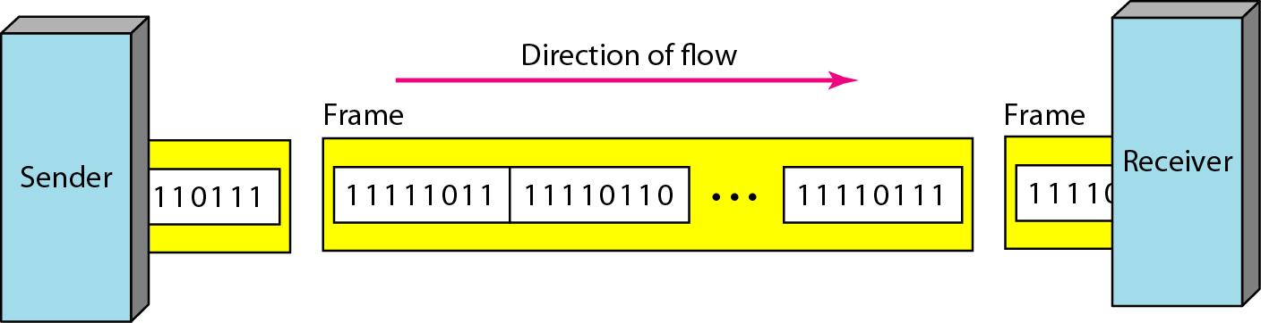
Synchronous transmission

Slide 26
Isochronous
In isochronous transmission we cannot have uneven gaps between frames.
Transmission of bits is fixed with equal gaps.
Example: TV images are broadcast at the rate of 30 images per second , they must be viewed at the same rate.

