Slide 1
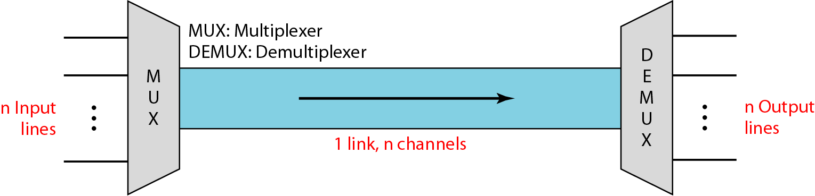
MULTIPLEXING
Whenever the bandwidth of a medium linking two devices is greater than the bandwidth needs of the devices, the link can be shared. Multiplexing is the set of techniques that allows the simultaneous transmission of multiple signals across a single data link.
Dividing a link into channels

Slide 2
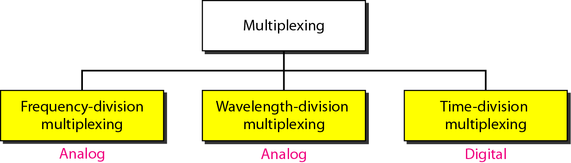
Categories of multiplexing

Slide 3
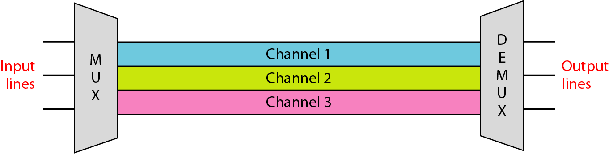
Frequency Division Multiplexing
Assignment of non-overlapping frequency ranges to each “user” or signal on a medium. Thus, all signals are transmitted at the same time, each using different frequencies.
A multiplexor accepts inputs and assigns frequencies to each device.

Slide 4
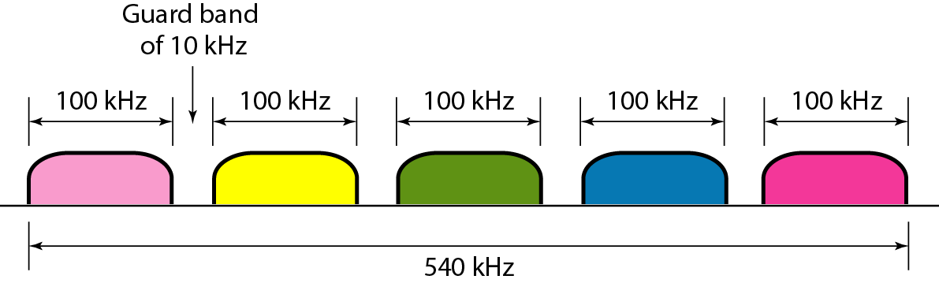
Question
Five channels, each with a 100-kHz bandwidth, are to be multiplexed together. What is the minimum bandwidth of the link if there is a need for a guard band of 10 kHz between the channels to prevent interference?
Solution
For five channels, we need at least four guard bands. This means that the required bandwidth is at least
5 × 100 + 4 × 10 = 540 kHz,

Slide 5
Wavelength Division Multiplexing
Wavelength division multiplexing multiplexes multiple data streams onto a single fiber optic cable.
Different wavelength transmit the multiple signals
Each signal carried on the fiber can be transmitted at a different rate from the other signals

Slide 6
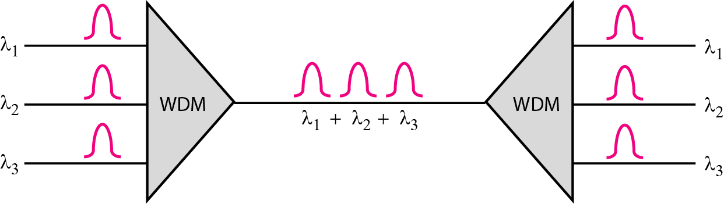
Wavelength-division multiplexing

Slide 7
Time Division Multiplexing
Sharing signal is accomplished by dividing available transmission time on a medium among users
Digital signaling is used.
Time division multiplexing comes in two basic forms:
Synchronous time division multiplexing
Statistical, or asynchronous time division multiplexing

Slide 8
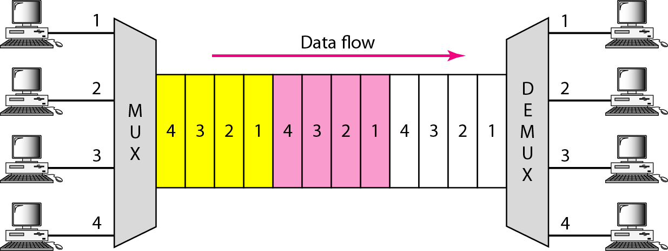
TDM

Slide 9
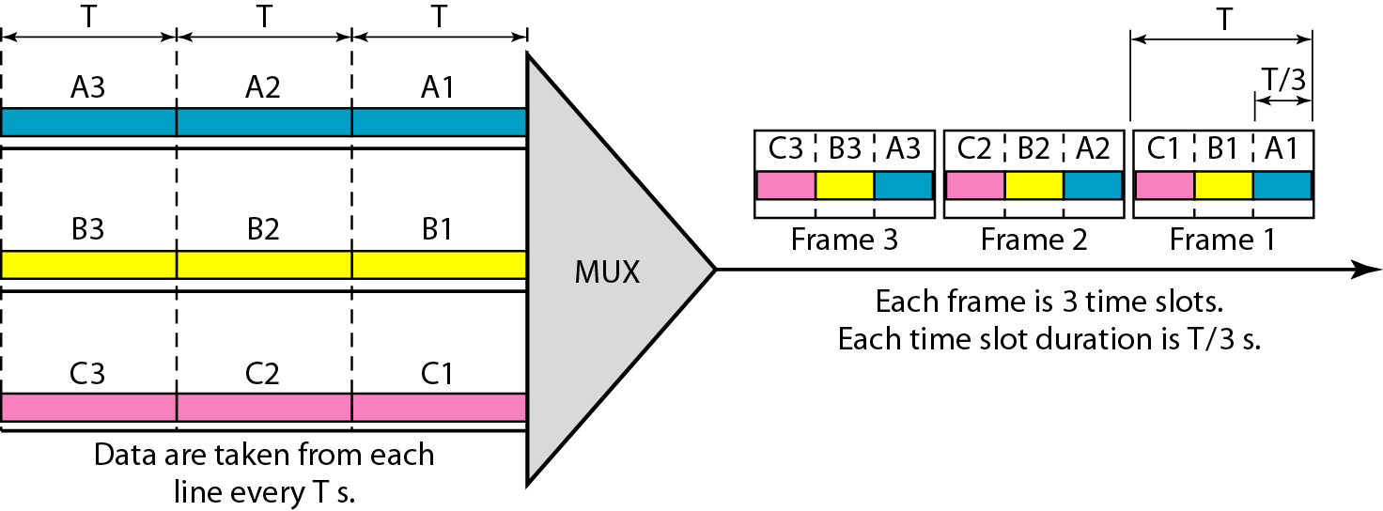
Synchronous time-division multiplexing

Slide 10
Example
In previous slide Figure, the data rate of the each input link is 1 kbps. If 1 bit at a time is multiplexed (a unit is 1 bit), what is the duration of (a) each input slot, (b) each output slot, and (c) each frame?
Solution
a. The data rate of each input connection is 1 kbps. This means that the bit duration is 1/1000 s or 1 ms. The duration of the input time slot is 1 ms (same as bit duration).

Slide 11
Example (continued)
b. The duration of each output time slot is one-third of the input time slot. This means that the duration of the output time slot is 1/3 ms.
c. Each frame carries three output time slots. So the duration of a frame is 3 × 1/3 ms, or 1 ms. The duration of a frame is the same as the duration of an input unit.

Slide 12
Question
Four 1-kbps connections are multiplexed together. A unit is 1 bit. Find (a) the duration of 1 bit before multiplexing, (b) the transmission rate of the link, (c) the duration of a time slot, and (d) the duration of a frame.

Slide 13
Solution
The duration of 1 bit before multiplexing is 1 / 1 kbps, or 0.001 s (1 ms).
b. The rate of the link is 4 times the rate of a connection, or 4 kbps.
c. The duration of each time slot is one-fourth of the duration of each bit before multiplexing, or 1/4 ms or 250 μs.
d. The duration of a frame is always the same as the duration of a unit before multiplexing, or 1 ms. We can also calculate this in another way. Each frame in this case has four time slots. So the duration of a frame is 4 times 250 μs, or 1 ms.

Slide 14
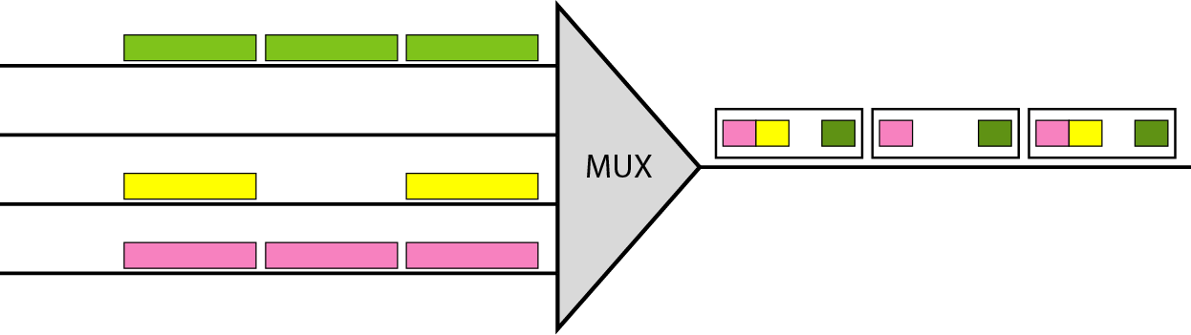
Empty slots

Slide 15
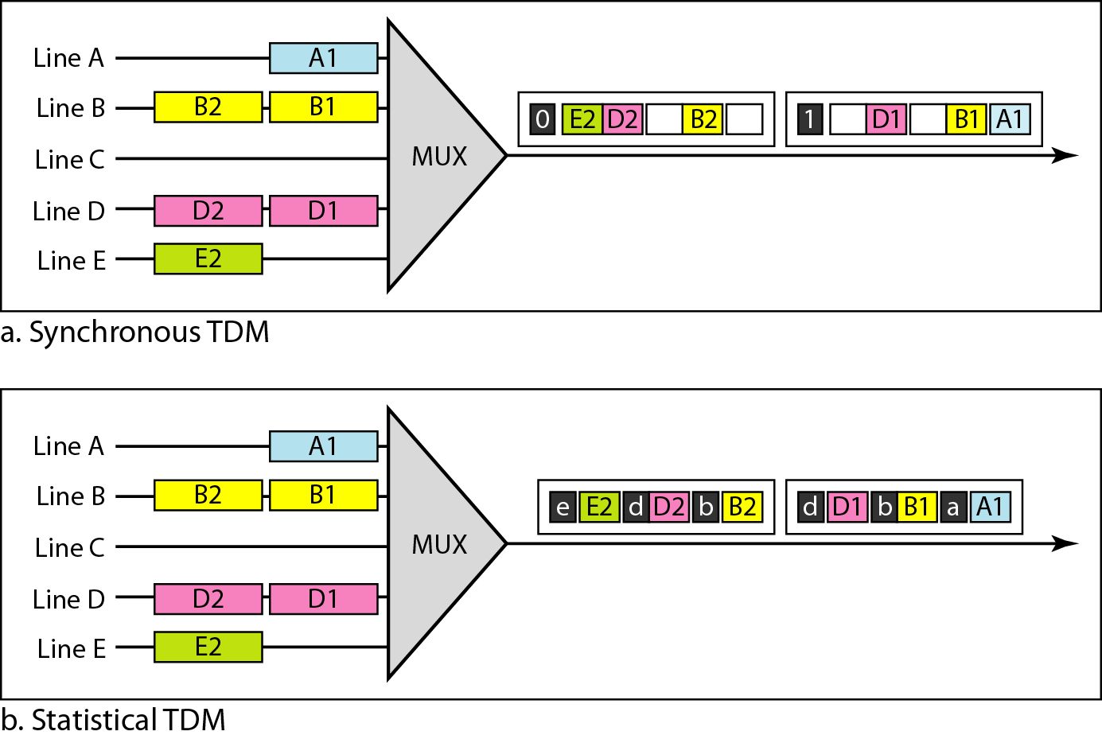
TDM slot comparison

Slide 16
SPREAD SPECTRUM
In spread spectrum (SS), we combine signals from different sources to fit into a larger bandwidth, but our goals are to prevent eavesdropping and jamming. To achieve these goals, spread spectrum techniques add redundancy.

Slide 17
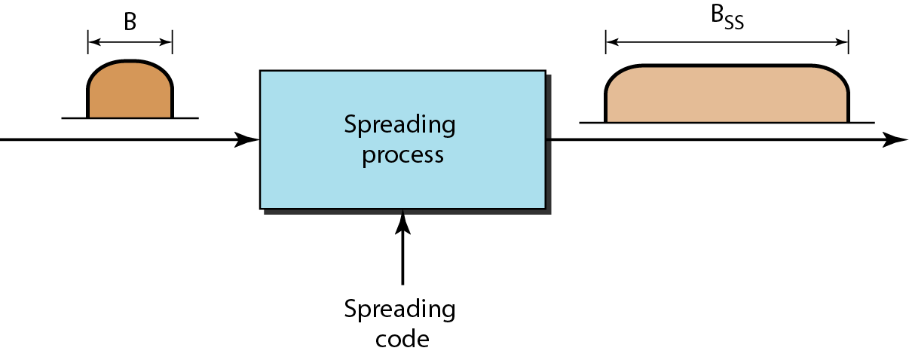
Spread spectrum

Slide 18
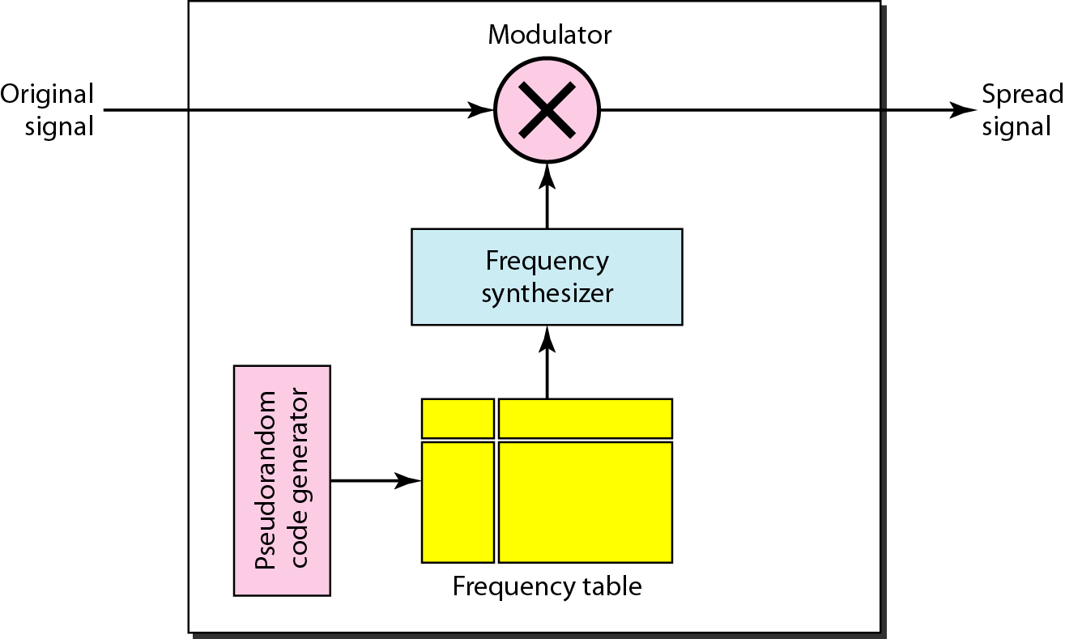
Frequency hopping spread spectrum (FHSS)

Slide 19
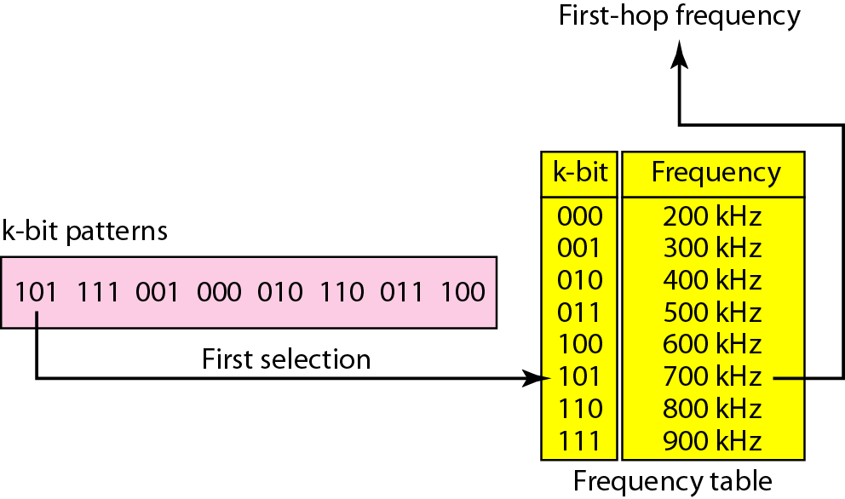
Frequency selection in FHSS

Slide 20
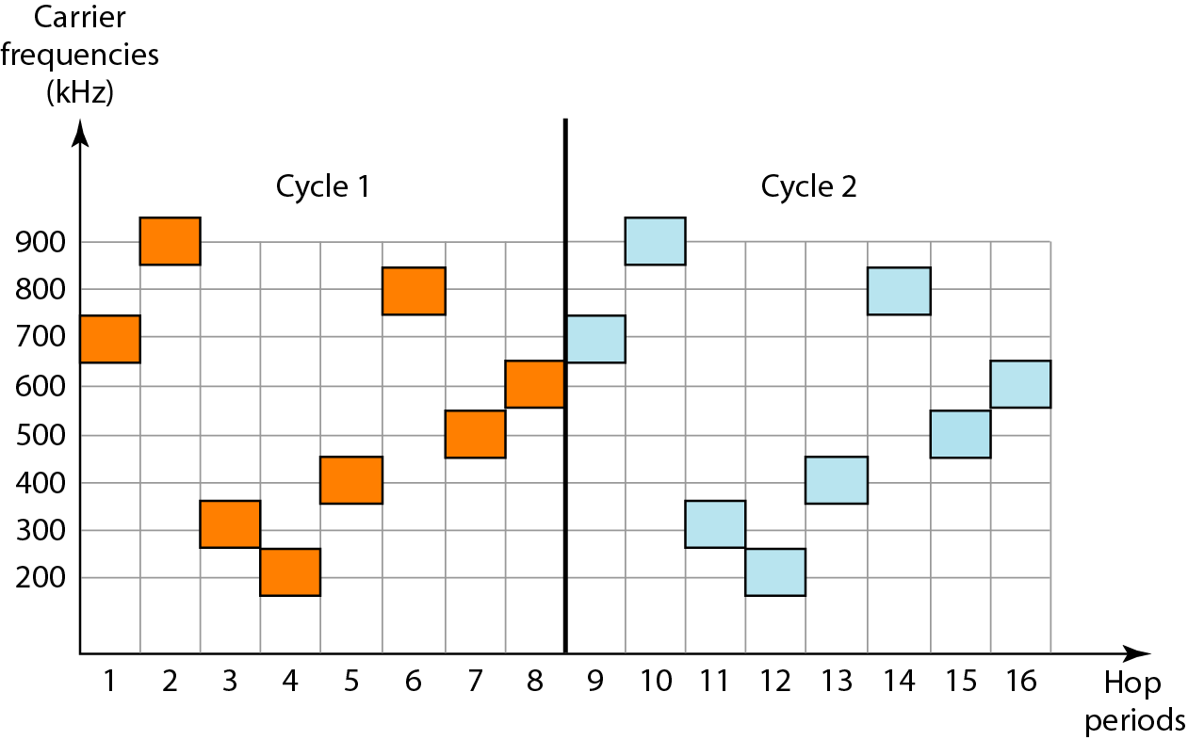
FHSS cycles

Slide 21
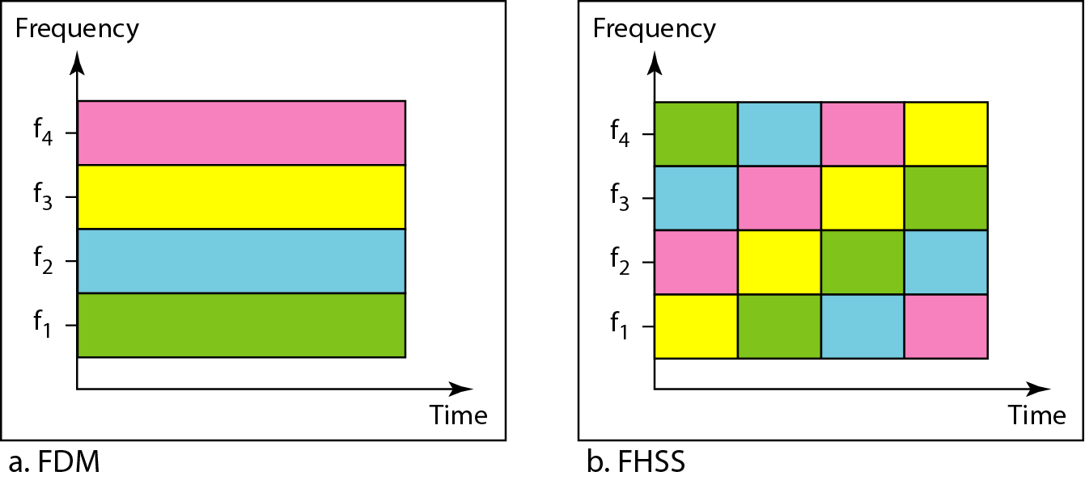
Bandwidth sharing

Slide 22
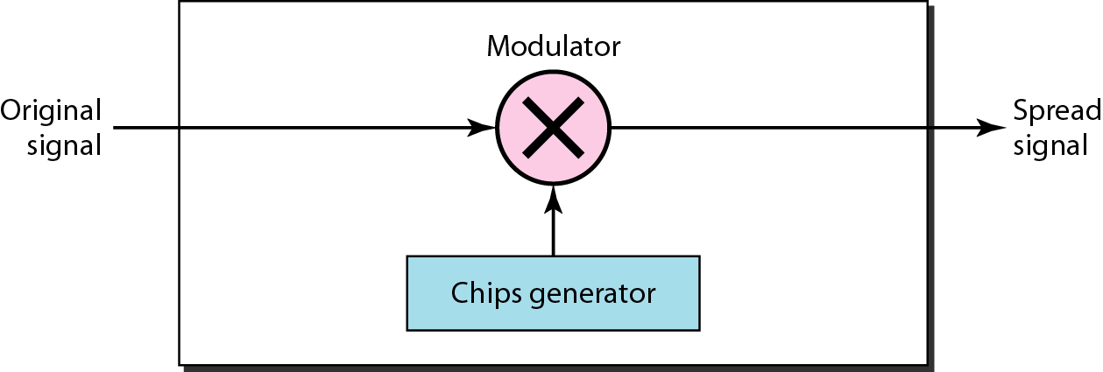
DSSS

Slide 23
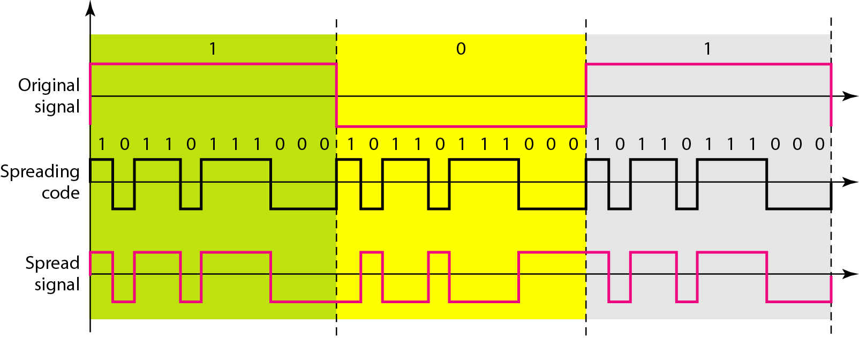
DSSS example

