Slide 1
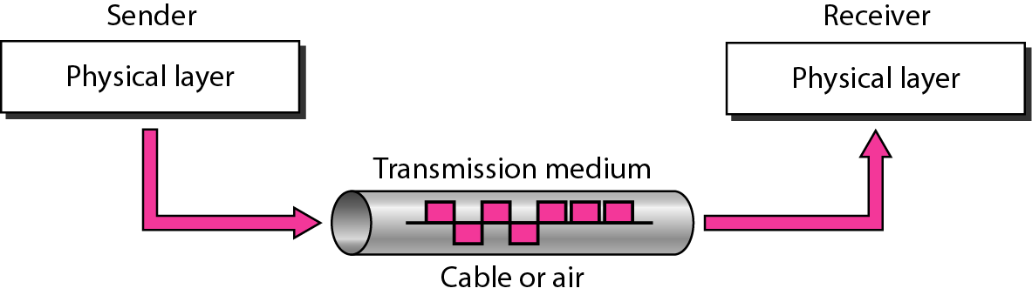
Transmission Media
The transmission medium is the physical path by which a message travels from sender to receiver.
Repeaters or amplifiers may be used to extend the length of the medium.

Slide 2
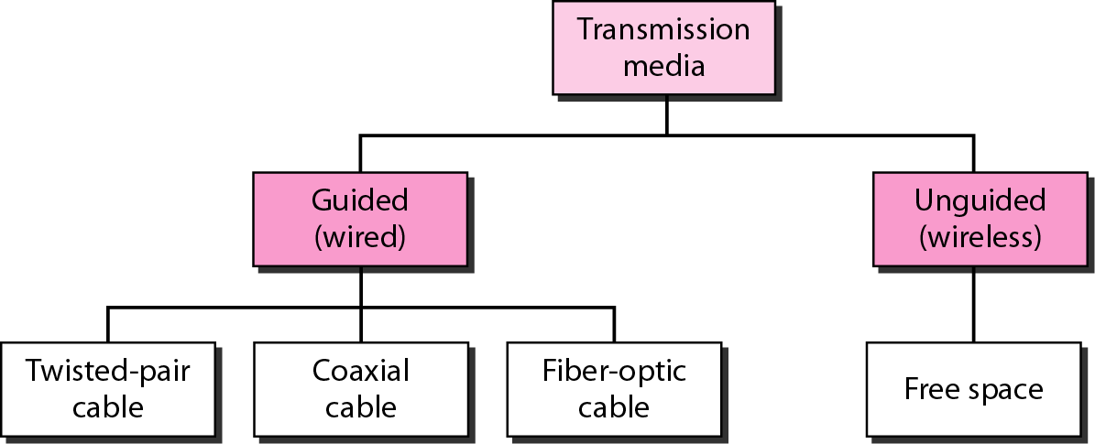
Classes of transmission media

Slide 3
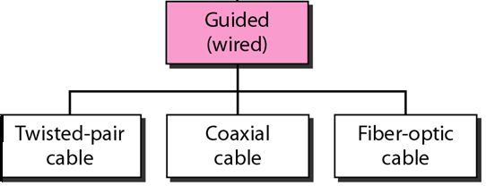
GUIDED MEDIA
Waves are guided along a solid medium, such as twisted pair, coaxial cable or fiber optic.

Slide 4
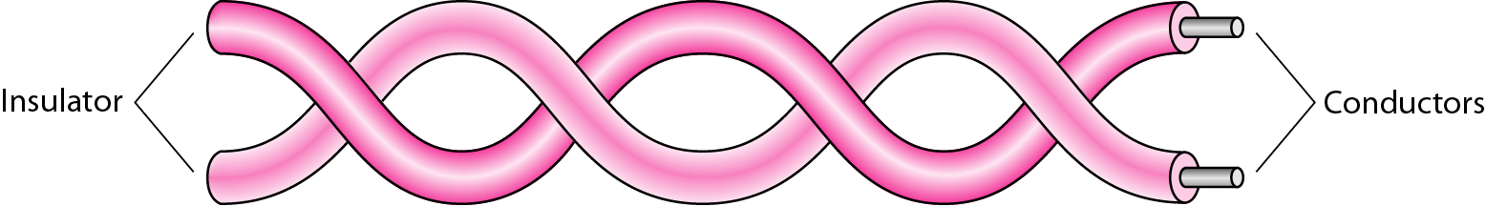
Twisted-pair cable
A twister pair consists of two conductors
(copper), each with its own plastic insulation, twisted together.
It is used to transmit both analog and digital transmission.
It is much less expensive than the other guided transmission media.

Slide 5
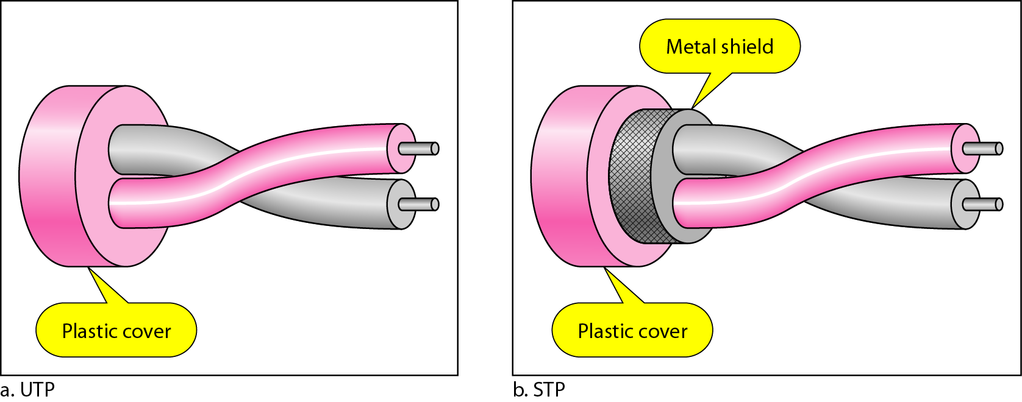
Types of Twisted Pair
STP (shielded twisted pair)
the pair is wrapped with metallic foil to insulate the pair from electromagnetic interference
UTP (unshielded twisted pair)
each wire is insulated with plastic wrap, but the pair is encased in an outer covering

Slide 6
Categories of unshielded twisted-pair cables

Slide 7
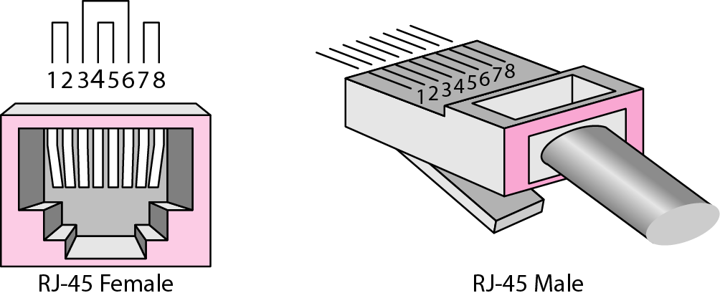
UTP connector
RJ stands for registered jack

Slide 8
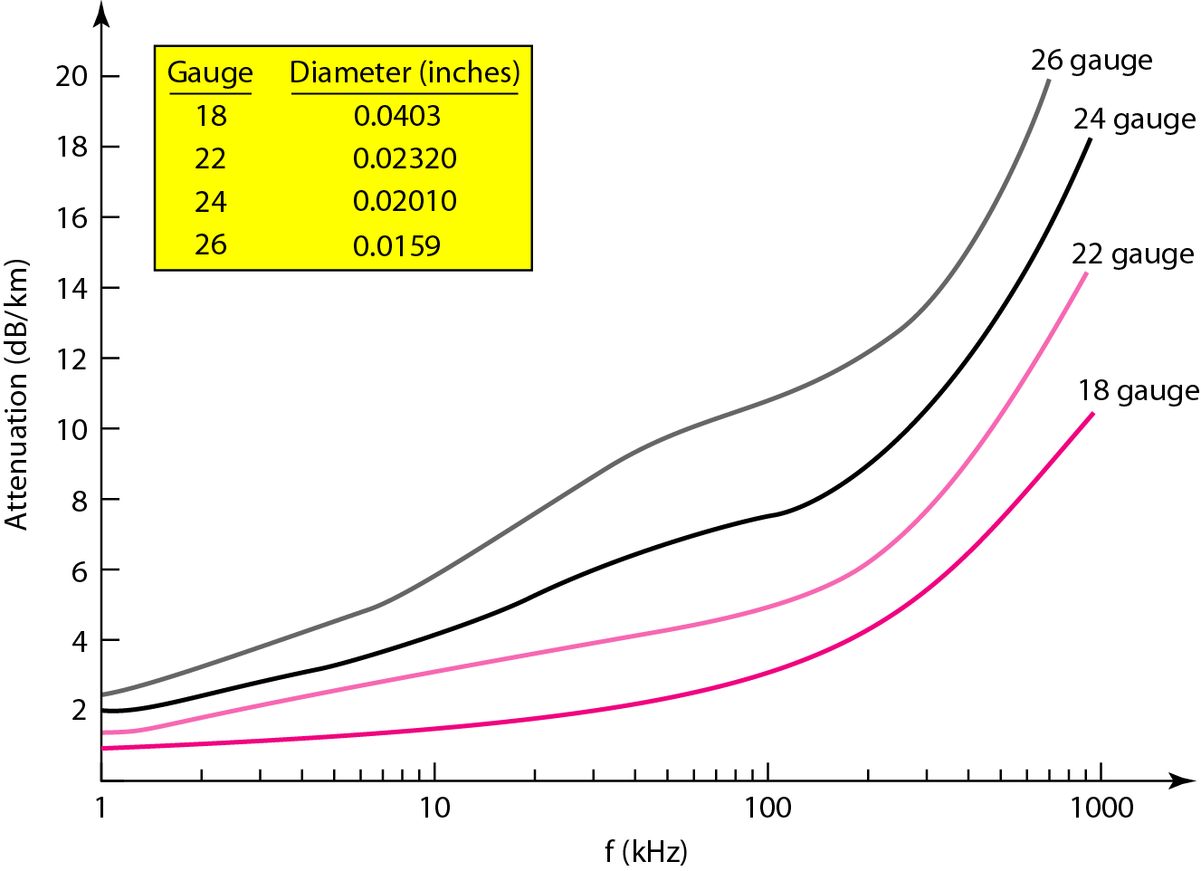
UTP performance

Slide 9
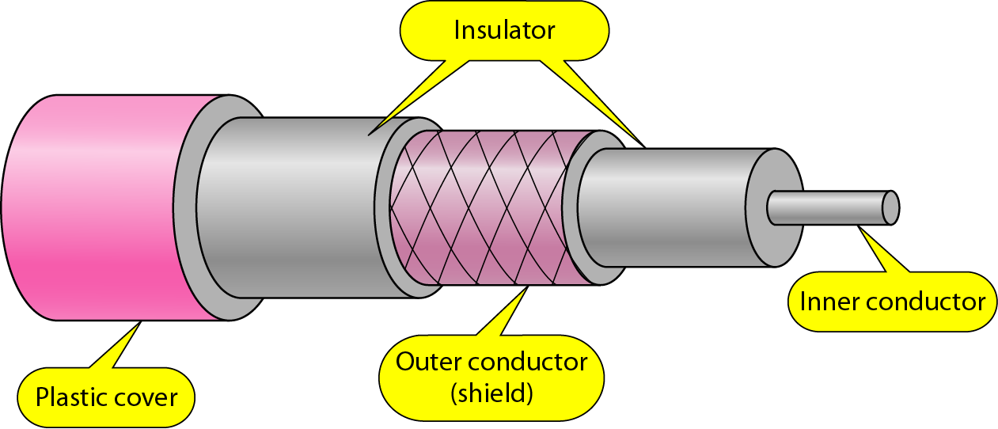
Coaxial Cable
Coaxial Cable has a single copper conductor enclosed in an insulating sheath, the outer metallic wrapping serves as a shield against noise. This outer conductor is also enclosed in an insulating sheath, and the whole cable is protected by a plastic cover.
Carries signals of higher frequency ranges than twisted-pair cable.

Slide 10
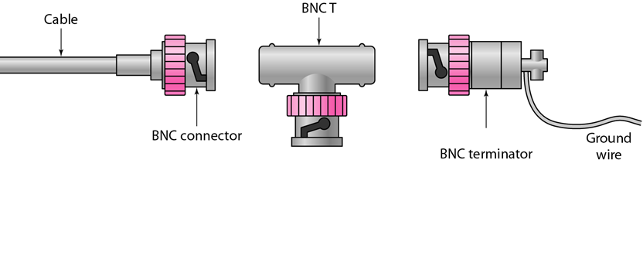
Bayone-Neill-Concelman (BNC) Connectors

Slide 11
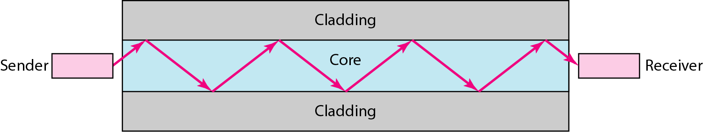
Fiber-Optic Cable
Optical Fiber is made of glass or plastic and transmits signals in the form of light.
Fiber optic cable has the ability to transmit signals over much longer distances than coaxial and twisted pair. It also has the capability to carry information at vastly greater speeds. It is more expensive than other guided media, it is difficult to install.

Slide 12
Angle of Incidence
When light travels into a more dense medium, the angle of incidence is greater than the angle of refraction; and when light travels into a less dense medium, the angle of incidence is less than the angle of refraction.

Slide 13
Critical Angle
When the change in the incident angle results in a refracted angle of 90 degrees, with the refracted beam now lying along the horizontal. The incident angle at this point is known as the critical angle.

Slide 14
Angle of Reflection
When the angle of incidence becomes greater than the critical angle, a new phenomenon occurs called reflection. In this case the angle of incidence is always equal to the angle of reflection.

Slide 15
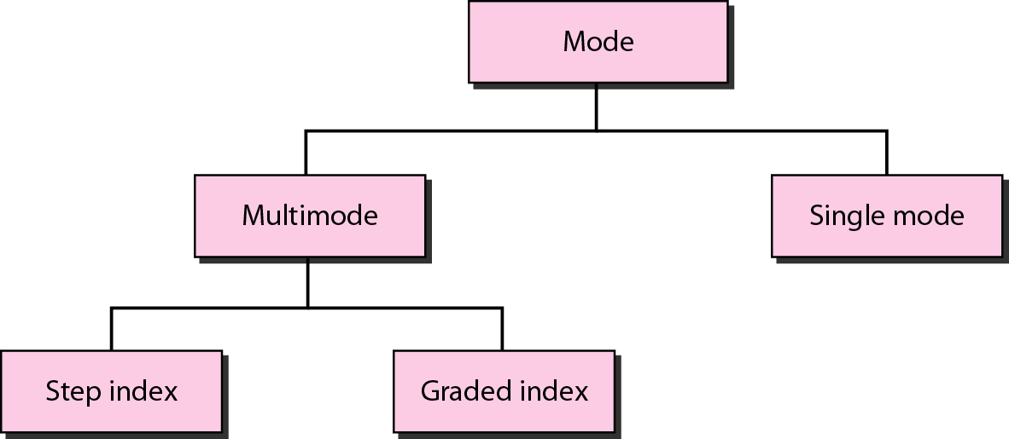
Propagation modes

Slide 16
Multimode Step-Index
Multimode step-index uses multiple beams of light. The density of the core remains constant from the center to the edges. A beam of light moves through the constant density in a straight line until it reaches the interface of the core and the cladding. At the interface there is an abrupt change due to a lower density that alters the angle of the beam's motion.

Slide 17
Multimode Step-Index

Slide 18
Multimode Graded-Index
Multimode graded-index uses fiber with varying densities. Density is highest at the center of the core and decreases gradually to its lowest at the edge. Each density difference causes each beam to refract into a curve. Varying the refraction varies the distance each beam travels in a given period of time, resulting in different beams intersection at regular intervals.

Slide 19
Multimode Graded-Index

Slide 20
Single Mode
Single mode uses step-index fiber and a highly focused source of light that limits beams to a small range of angles, all close to the horizontal. Propagation of different beams is almost identical and delays are negligible.

Slide 21
Single Mode

Slide 22
Fiber types

Slide 23
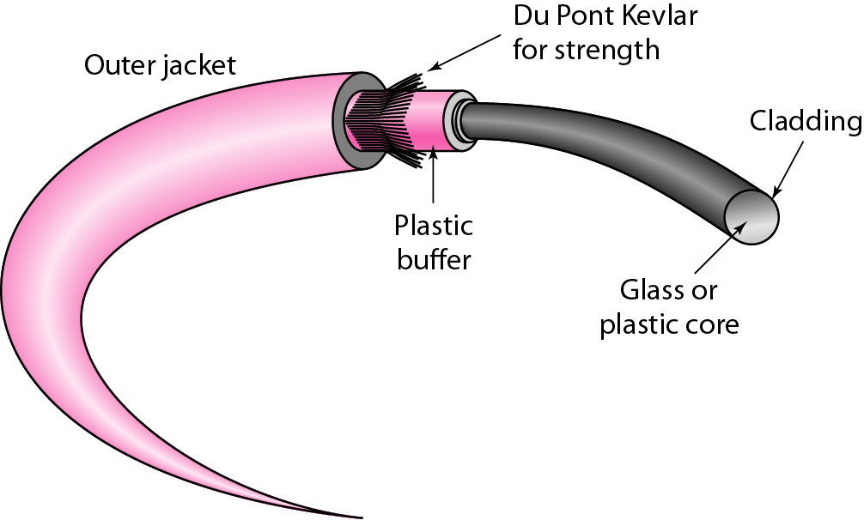
Fiber construction
Notes:
buffer layer that protects it from moisture

Slide 24
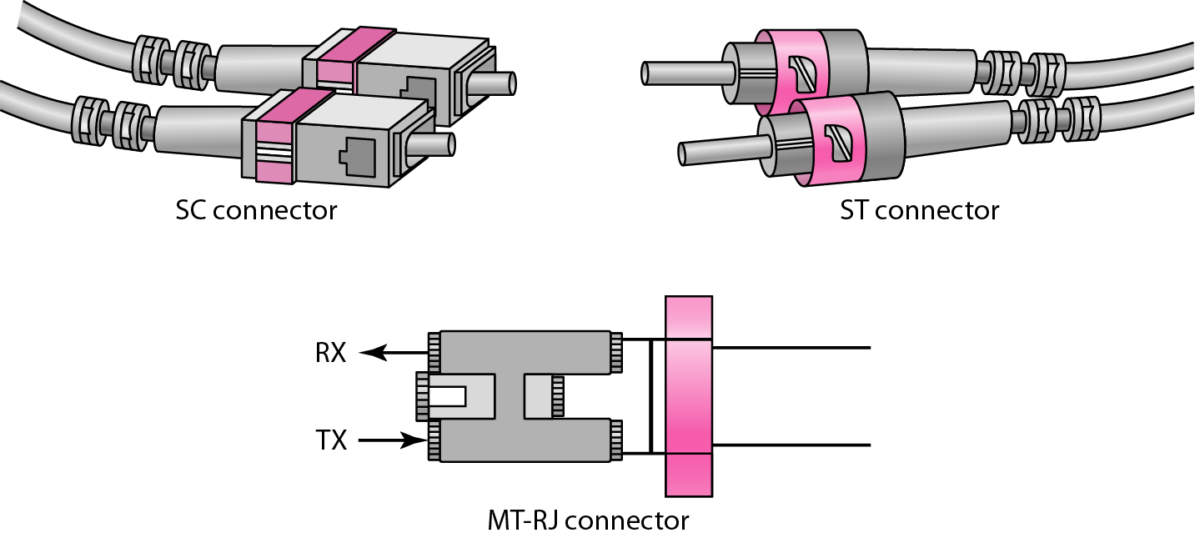
Fiber-optic cable connectors
Subscriber channel is used for cable TV
Straight-tip is used for connecting cable to networking device.

Slide 25
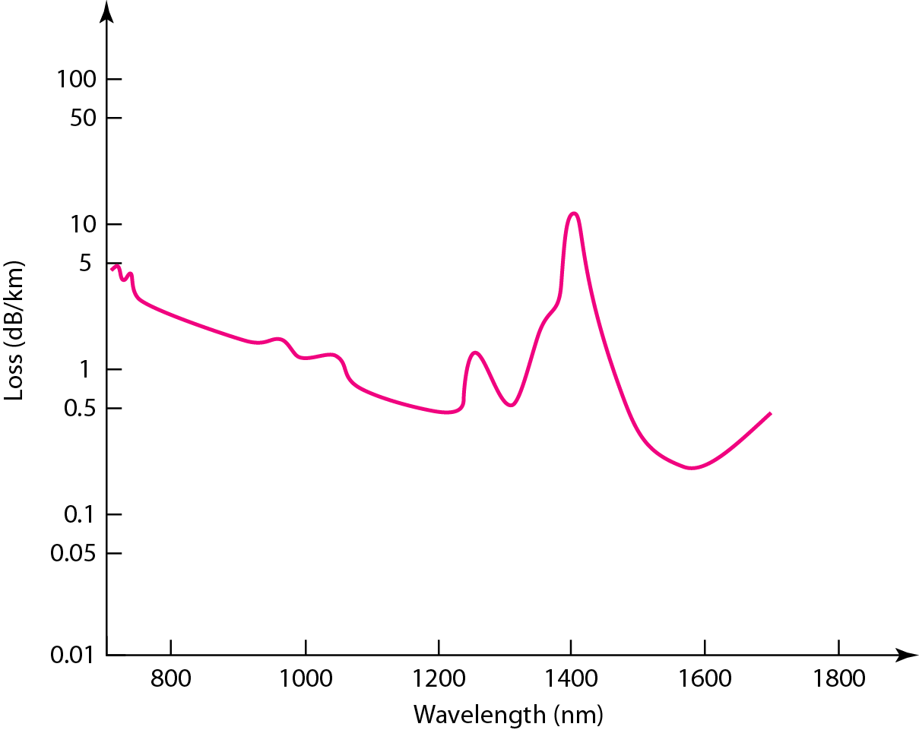
Optical fiber performance

Slide 26
UNGUIDED MEDIA: WIRELESS
Unguided media transport electromagnetic waves without using a physical conductor. This type of communication is often referred to as wireless communication. Signals are normally broadcast through free space and thus are available to anyone who has a device capable of receiving them.

Slide 27
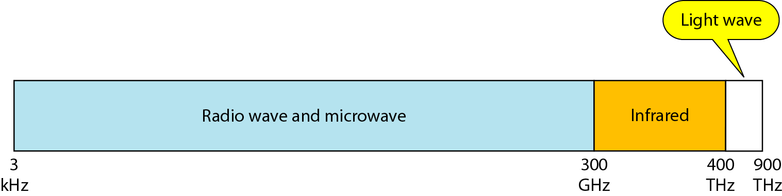
Electromagnetic spectrum for wireless communication

Slide 28
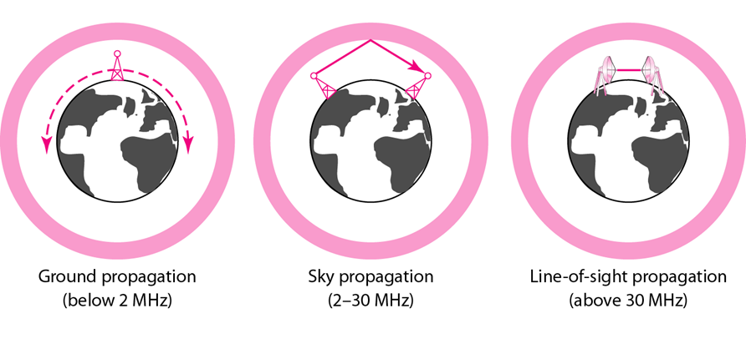
Propagation methods
Unguided signals can travel from the source to destination in several ways:

Slide 29
Propagation methods cont…..
In ground propagation, radio waves travel through the lowest portion of the atmosphere. These low frequency signals emanate in all directions from the transmitting antenna. Distance depends on the amount of power in the signal: The greater the power, the greater the distance.
In Sky propagation, higher frequency radio waves radiate upward into the ionosphere where they are reflected back to earth.
In line-of-sight propagation, very high frequency signals are transmitted in straight lines directly from antenna to antenna. Antennas must be directional, facing each other, and either tall enough or close enough together.

Slide 30
Radio waves and microwaves is divided into eight ranges, called Bands, each regulated by government authorities.

Slide 31
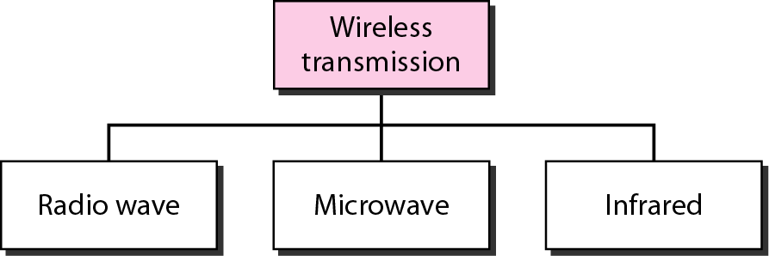
Wireless transmission waves

Slide 32
Radio waves
Electromagnetic waves having frequencies between 3 KHz and 1 GHz are called radio waves.
Radio waves are used for multicast communications, such as radio and television, and paging systems.
They can penetrate through walls.
Highly regulated by authorities.
Use omnidirectional antennas that send out signals in all directions.

Slide 33
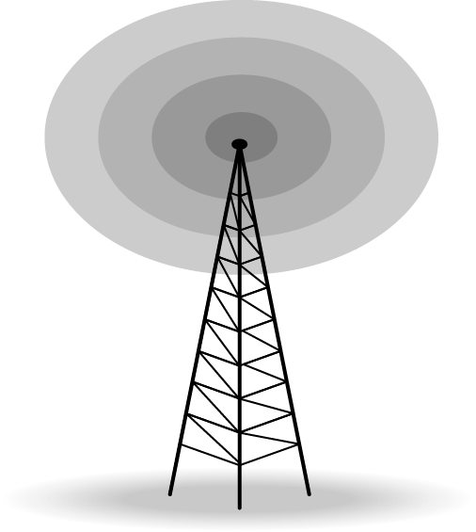
Omnidirectional antenna

Slide 34
Microwaves
Electromagnetic waves having frequencies between 1GHz and 300 GHz are called microwaves.
microwaves are used for unicast communications, such as cellular telephones, satellite networks, and wireless LANs.
Very high-frequency cannot penetrate the walls.
Use of certain portion of band requires permission from authorities.
Need unidirectional antennas that send out signals in one directions.

Slide 35
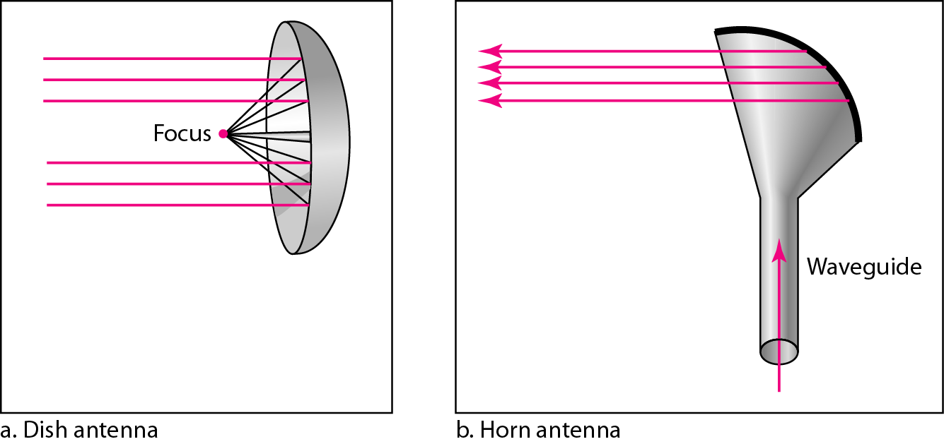
Unidirectional antennas

Slide 36
Infrared
Infrared waves, with frequencies from 300 GHz to 400 THz.
It can be used for short-range communication in a closed area .
Infrared waves, having high-frequency cannot penetrate the walls.
Uses same technology as remotes for T.V.

