Slide 1
DATA LINK LAYER
The data link layer is responsible for moving frames from one hop (node) to the next.
It is also responsible for error control, framing, flow control, addressing, media access control.

Slide 2
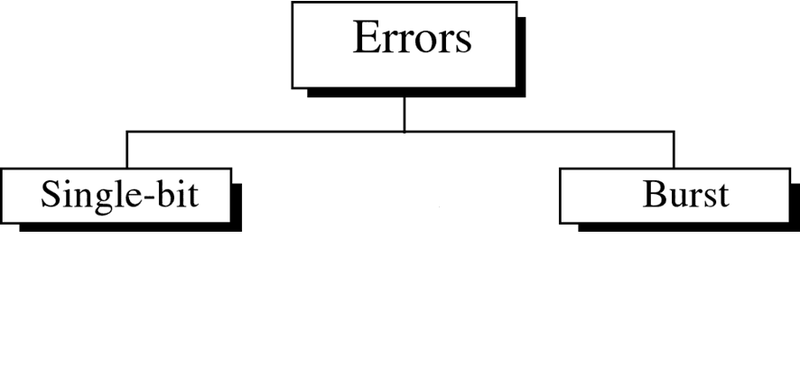
Error Detection and Correction
Data can be corrupted during transmission. Some applications require that errors be detected and corrected.
Types of Errors

Slide 3
Single-bit error
In a single-bit error, only 1 bit in the data unit has changed.

Slide 4
Burst error
A burst error means that 2 or more bits in the data unit have changed.

Slide 5
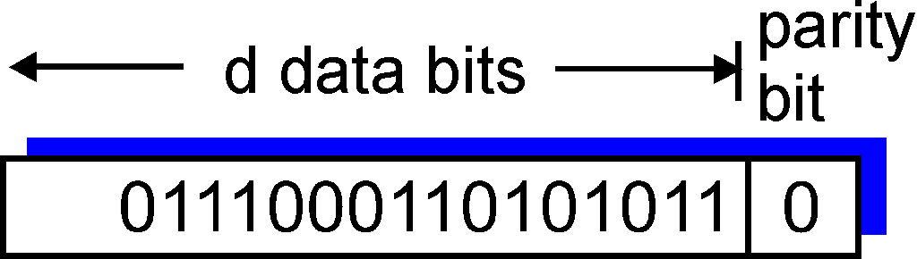
Parity Checking
Single Bit Parity:
Detect single bit errors

Slide 6
Example of Single Parity Code
Dataword (7 bits): (0, 1, 0, 1, 1, 0, 0)
Check Bit: b₈ = (0 + 1 +0 + 1 +1 + 0) mod 2 = 1
Codeword (8 bits): (0, 1, 0, 1, 1, 0, 0, 1)
If single error in bit 3 : (0, 1, 1, 1, 1, 0, 0, 1)
# of 1’s =5, odd
Error detected
If errors in bits 3 and 5: (0, 1, 1, 1, 0, 0, 0, 1)
# of 1’s =4, even
Error not detected

Slide 7
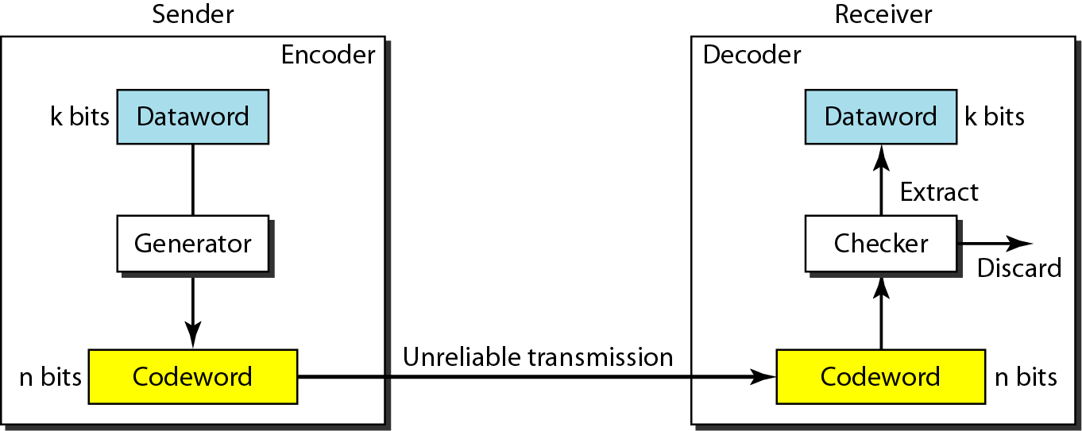
Process of error detection in block coding

Slide 8
Cyclic redundancy checking
Cyclic redundancy checking (CRC) codes provide error detection for large blocks of data.
A group of error control bits is appended to the end of the block of transmitted data.

Slide 9
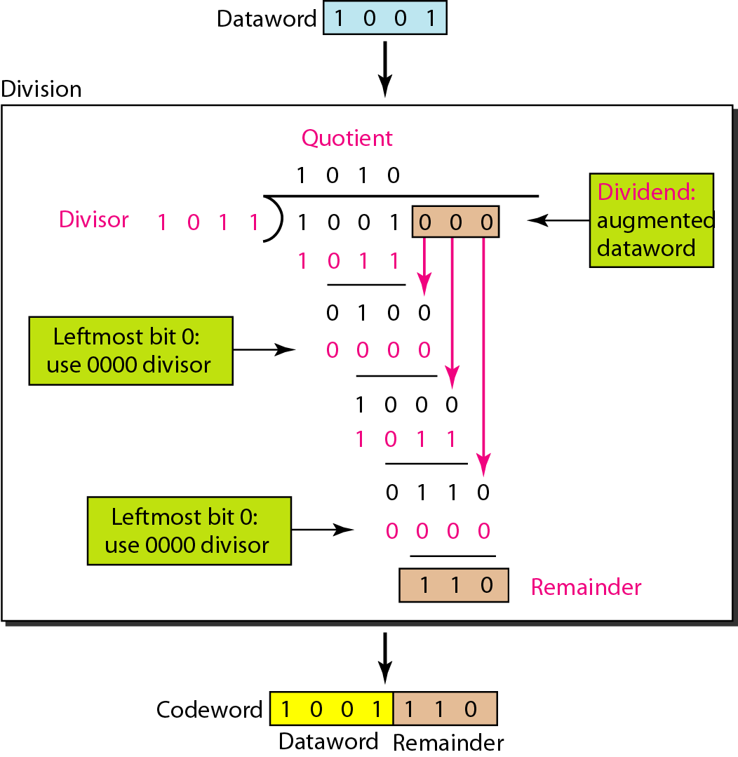
Division in CRC encoder
Subtraction: logical XOR operation

Slide 10
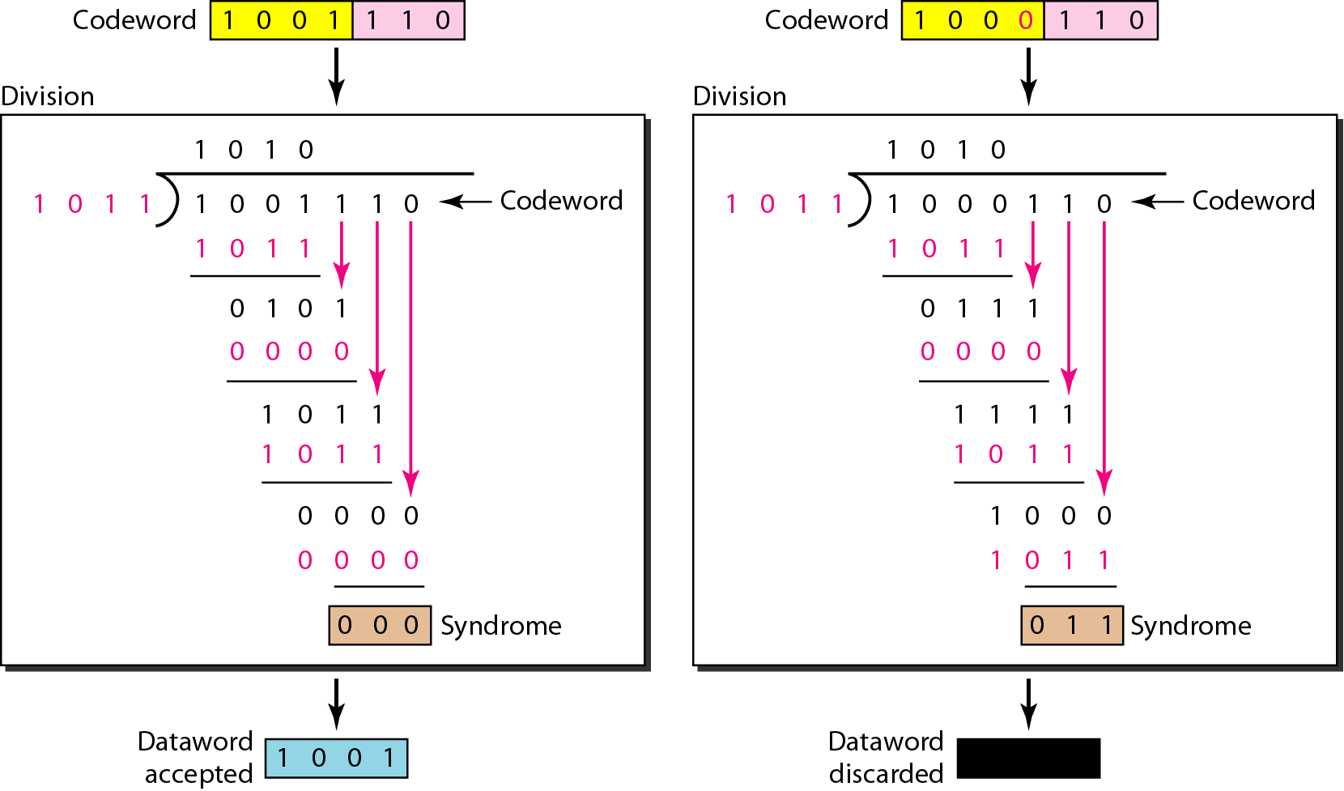
Division in the CRC decoder for two cases

Slide 11
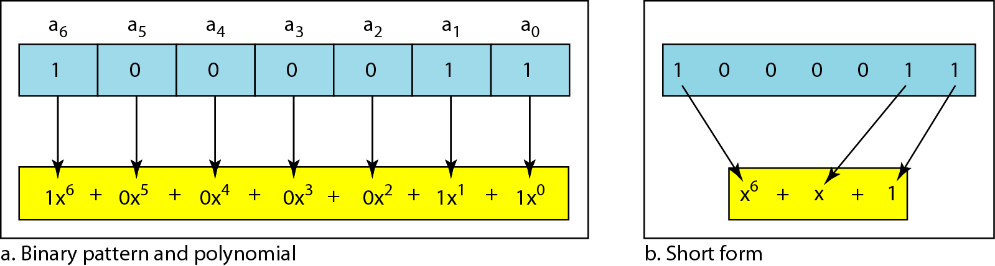
Polynomial to represent a binary word

Slide 12
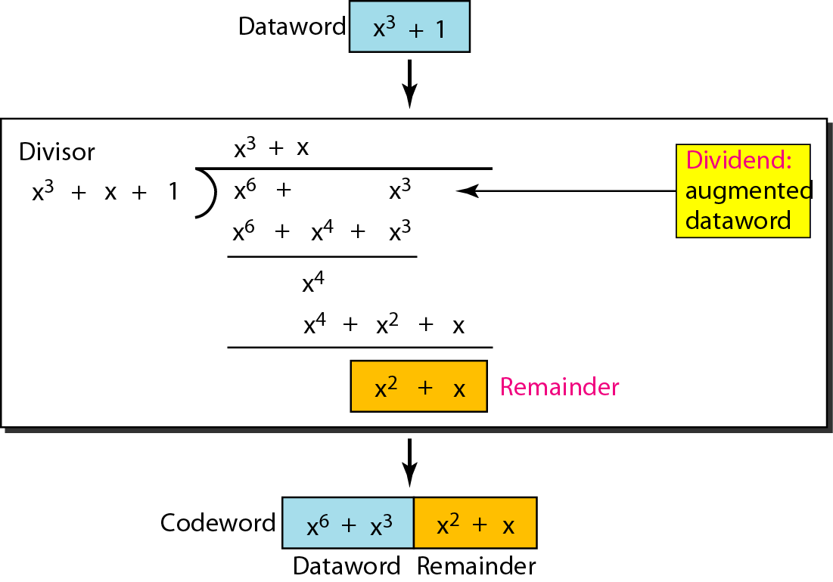
CRC division using polynomials

Slide 13
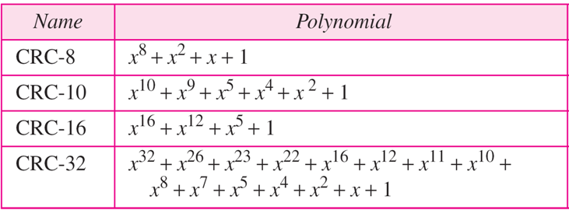
Standard polynomials

Slide 14
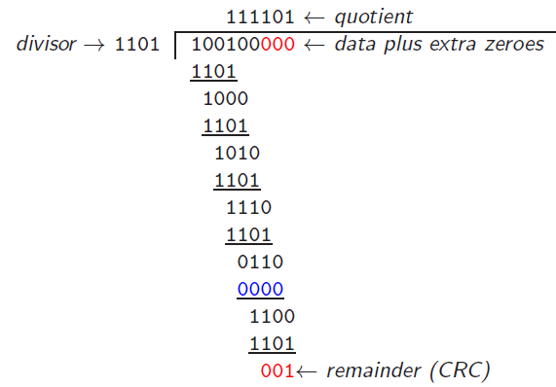
Question
Given the message 100100 and the divisor 1101, Find the CRC.
Solution

