Slide 1
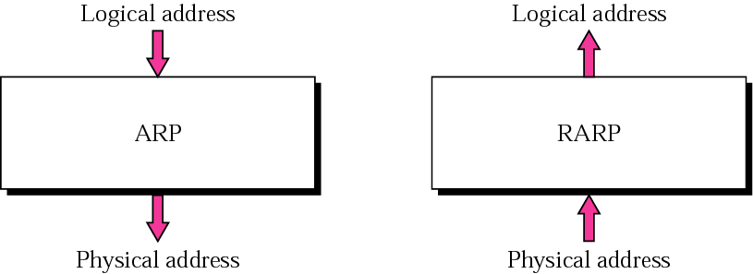
ARP (Address Resolution Protocol) & RARP(Reverse address Resolution Protocol)

Slide 2
ARP
ARP (Address Resolution Protocol)
ARP associates an IP address with its physical address. On a typical physical network, such as a LAN, each device on a link is identified by a physical or station address that is usually imprinted on the NIC.
Logical address to physical address translation can be done dynamically (with ARP).

Slide 3
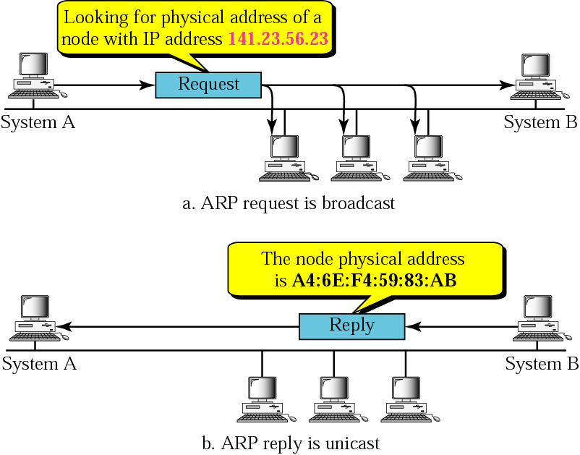
ARP operation

Slide 4
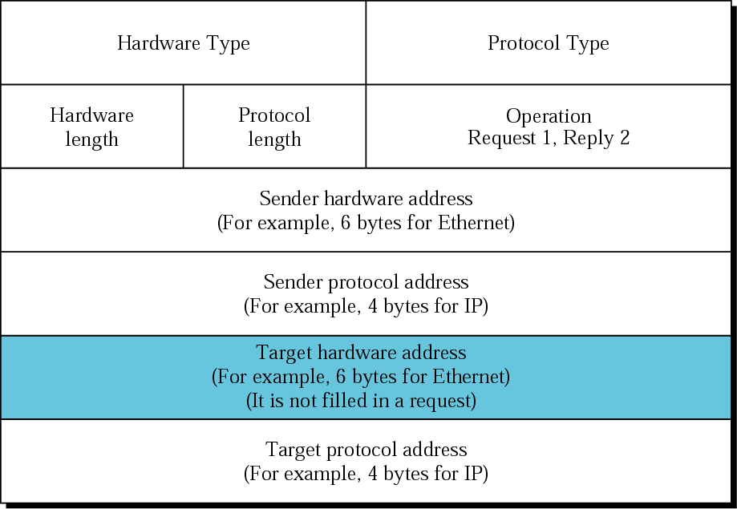
ARP packet
Hardware
Type - Ethernet
is type 1
Protocol Type-
IPv4=x0800
Hardware
Length:length of
Ethernet
Address (6)
Protocol
Length:length of
IPv4 address (4)

Slide 5
RARP
RARP(Reverse address Resolution Protocol)
RARP finds the logical address for a machine that only knows its physical address.
RARP requests are broadcast, RARP replies are unicast.
If a client workstation needs to know its IP address, it probably
also needs to know its subnet mask, router address, DNS address, etc.
So we need something more than RARP. BOOTP, and now DHCP have
replaced RARP.

Slide 6
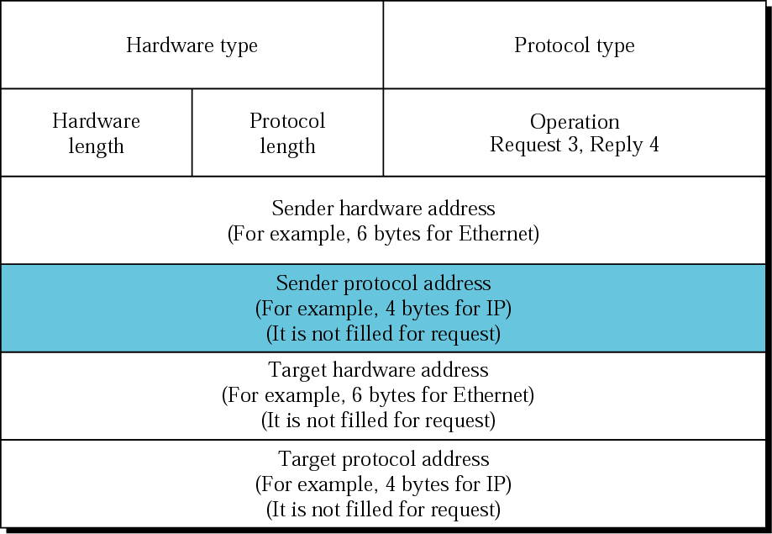
RARP packet

Slide 7
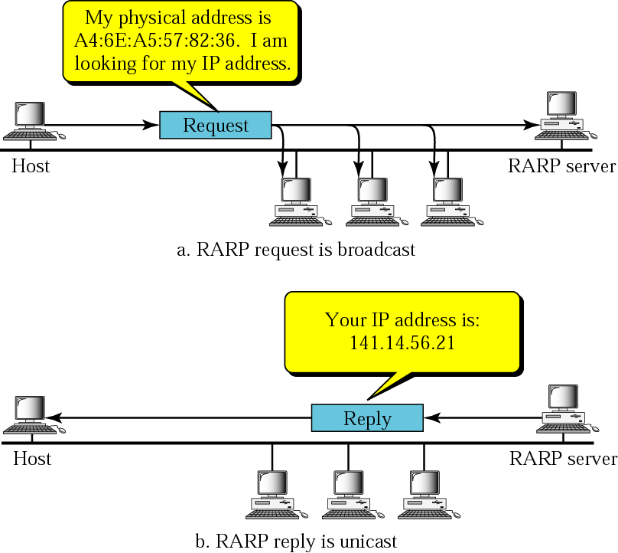
RARP operation

Slide 8
DHCP: Dynamic Host Configuration Protocol
Goal: allow host to dynamically obtain its IP address from network server when it joins network
Allows reuse of addresses (only hold address while connected an “on”
Support for mobile users who want to join network (more shortly)
DHCP overview:
host broadcasts “DHCP discover” msg
DHCP server responds with “DHCP offer” msg
host requests IP address: “DHCP request” msg
DHCP server sends address: “DHCP ack” msg

Slide 9
DHCP client-server scenario
A
223.1.1.1
DHCP
223.1.2.1
server
223.1.1.2
223.1.1.4
223.1.2.9
B
223.1.2.2
E
arriving DHCP
client needs
address in this
network
223.1.1.3
223.1.3.27
223.1.3.1
223.1.3.2

Slide 10
DHCP client-server scenario
DHCP server: 223.1.2.5
arriving
client
DHCP discover
src : 0.0.0.0, 68
dest.: 255.255.255.255,67
yiaddr: 0.0.0.0
transaction ID: 654
DHCP offer
src: 223.1.2.5, 67
dest: 255.255.255.255, 68
yiaddrr: 223.1.2.4
transaction ID: 654
Lifetime: 3600 secs
DHCP request
src: 0.0.0.0, 68
dest:: 255.255.255.255, 67
yiaddrr: 223.1.2.4
transaction ID: 655
Lifetime: 3600 secs
time
DHCP ACK
src: 223.1.2.5, 67
dest: 255.255.255.255, 68
yiaddrr: 223.1.2.4
transaction ID: 655
Lifetime: 3600 secs

Slide 11
NAT: Network Address Translation
rest of
Internet
local network
(e.g., home network)
10.0.0.0/24
10.0.0.1
10.0.0.4
10.0.0.2
138.76.29.7
10.0.0.3
All datagrams leaving local
network have same single source NAT IP address: 138.76.29.7,
different source port numbers
Datagrams with source or
destination in this network
have 10.0.0.0/24 address for
source, destination (as usual)

Slide 12
NAT: Network Address Translation
Motivation: local network uses just one IP address as far as outside word is concerned:
no need to be allocated range of addresses from ISP: - just one IP address is used for all devices
can change addresses of devices in local network without notifying outside world
can change ISP without changing addresses of devices in local network
devices inside local net not explicitly addressable, visible by outside world (a security plus).

Slide 13
NAT: Network Address Translation
Implementation: NAT router must:
outgoing datagrams: replace (source IP address, port #) of every outgoing datagram to (NAT IP address, new port #)
. . . remote clients/servers will respond using (NAT IP address, new port #) as destination addr.
remember (in NAT translation table) every (source IP address, port #) to (NAT IP address, new port #) translation pair
incoming datagrams: replace (NAT IP address, new port #) in dest fields of every incoming datagram with corresponding (source IP address, port #) stored in NAT table

Slide 14
NAT: Network Address Translation
NAT translation table
WAN side addr LAN side addr
1: host 10.0.0.1
sends datagram to
128.119.40, 80
2: NAT router
changes datagram
source addr from
10.0.0.1, 3345 to
138.76.29.7, 5001,
updates table
138.76.29.7, 5001 10.0.0.1, 3345
…… ……
S: 10.0.0.1, 3345
D: 128.119.40.186, 80
10.0.0.1
1
2
S: 138.76.29.7, 5001
D: 128.119.40.186, 80
10.0.0.4
10.0.0.2
138.76.29.7
S: 128.119.40.186, 80
D: 10.0.0.1, 3345
4
S: 128.119.40.186, 80
D: 138.76.29.7, 5001
3
10.0.0.3
4: NAT router
changes datagram
dest addr from
138.76.29.7, 5001 to 10.0.0.1, 3345
3: Reply arrives
dest. address:
138.76.29.7, 5001

Slide 15
NAT: Network Address Translation
16-bit port-number field:
60,000 simultaneous connections with a single LAN-side address!
NAT is controversial:
routers should only process up to layer 3
violates end-to-end argument
NAT possibility must be taken into account by app designers, eg, P2P applications
address shortage should instead be solved by IPv6

Slide 16
ICMP: Internet Control Message Protocol
used by hosts, routers, gateways to communication network-level information
error reporting: unreachable host, network, port, protocol
echo request/reply (used by ping)
network-layer “above” IP:
ICMP msgs carried in IP datagrams
ICMP message: type, code plus first 8 bytes of IP datagram causing error
Type Code description
0 0 echo reply (ping)
3 0 dest. network unreachable
3 1 dest host unreachable
3 2 dest protocol unreachable
3 3 dest port unreachable
3 6 dest network unknown
3 7 dest host unknown
4 0 source quench (congestion
control - not used)
8 0 echo request (ping)
9 0 route advertisement
10 0 router discovery
11 0 TTL expired
12 0 bad IP header

Slide 17
16.1 BOOTP
The Bootstrap Protocol (BOOTP) is a client/server protocol that configures a diskless computer or a computer that is booted for the first time. BOOTP provides the
IP address
net mask
the address of a default router
the address of a name server.
BOOTP is static. When a client workstation asks for the above info,
it is retrieved from a fixed table. Every time the client asks for the info,
it gets the same results.

Slide 18
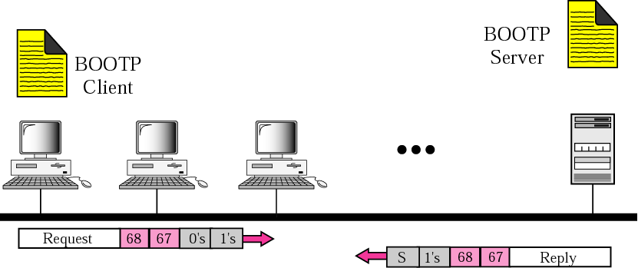
Client and server on the same network
The BOOTP server can be on the same network as the
BOOTP client or on different networks.
BOOTP places its packet inside a UDP packet (note that BOOTP
is an application layer program).

Slide 19
Client and server on the same network
The BOOTP server issues a passive open command on UDP
port number 67 and waits for a client.
A booted client issues an active open command on port
number 68. The message is encapsulated in a UDP user
datagram and then in an IP packet. In the IP packet
the source address is all 0s and the destination address
is all 1s.
Server responds with a UDP datagram source port 67 and
destination port 68. Can also bypass ARP since server
also knows the MAC address of the client.

Slide 20
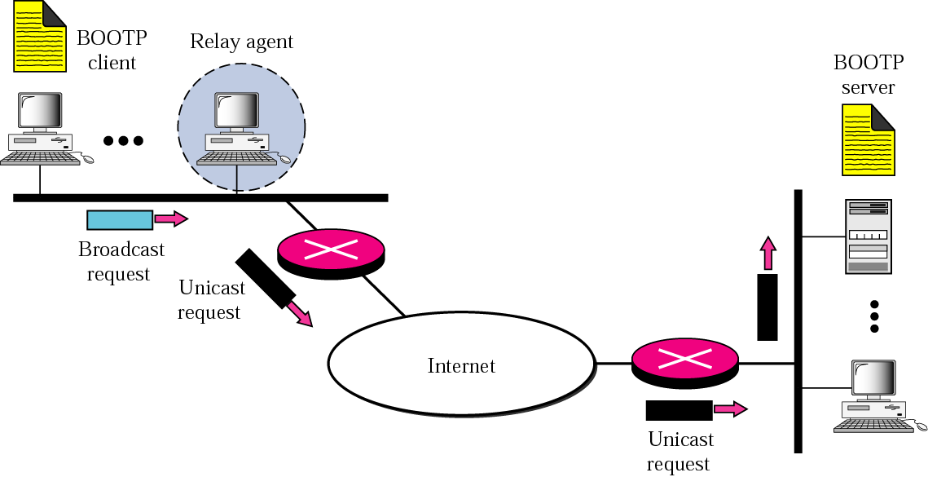
Client and server on two different networks
When client and server are on different networks, we need a
relay agent, because client does not know IP address of
server, and a limited broadcast address gets dumped by the
local router. Relay agent knows the IP addr of the server.

Slide 21
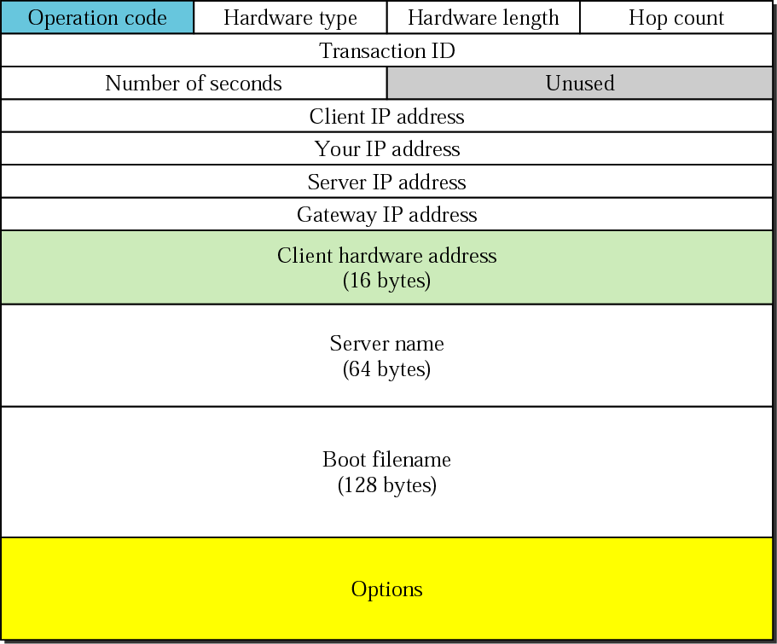
BOOTP packet format
Operation code: request=1,
reply=2
Hardware type: Ethernet=1
Hardware len: Ethernet=6
Transaction ID: identifies the
BOOTP request/reply
Number seconds:how many
seconds elapsed since the
client started to boot.
Client hardware address: can
be supplied by the client but
is usually supplied by the
server.
Server name: optional
Boot filename: optional,
contains the full pathname
of the boot file (contains other
booting information).

