Slide 1
Network Layer

Slide 2
Network Layer Design Issues
Store-and-Forward Packet Switching
Services Provided to the Transport Layer
    Connectionless Service
    Connection-Oriented Service

Slide 3
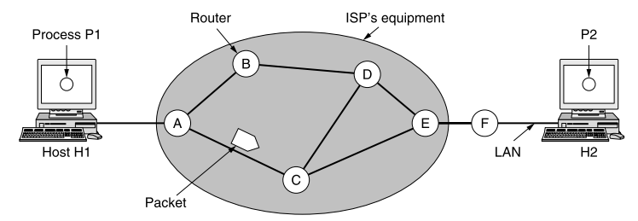
Store-and-forward Packet Switching
fig 5-1
The environment of the network layer protocols.
A host with a packet to send transmits it to the nearest router, either on its own LAN or over a point-to-point link to the ISP. The packet is stored there until it has fully arrived and the link has finished its processing by verifying the checksum. Then it is forwarded to the next router until it reaches the destination host, where it is delivered.

Slide 4
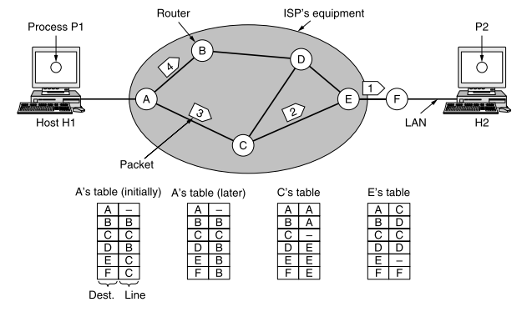
Connectionless Service
In connectionless service, packets are injected into the network individually and routed independently of each other. No advance setup is needed.
Routing within a diagram subnet.

Slide 5
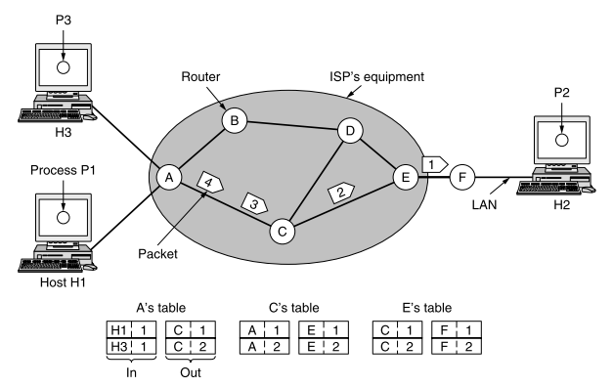
Connection-Oriented Service
In connection-oriented service, a path from the source router to the destination router must be established before any data packets can be sent. This connection is called a VC (virtual circuit) and the network is called a virtual-circuit network
Routing within a virtual-circuit subnet.

Slide 6

Connectionless VS. Connection-Oriented

Slide 7
Routing
Routing is the process of forwarding of a packet in a network so that it reaches
its intended destination. The main goals of routing are:
Correctness: The routing should be done properly and correctly so that the packets may reach their proper destination.
Simplicity: The routing should be done in a simple manner so that the overhead is as low as possible.
Robustness: The algorithms designed for routing should be robust enough to handle hardware and software failures and should be able to cope with changes in the topology and traffic.
Stability: The routing algorithms should be stable under all possible circumstances.
Fairness: Every node connected to the network should get a fair chance of transmitting their packets. This is generally done on a first come first serve basis.
Optimality: The routing algorithms should be optimal in terms of throughput and minimizing mean packet delays.

Slide 8
Classification of Routing Algorithms
Adaptive Routing Algorithm: These algorithms change their routing decisions to reflect changes in the topology and in traffic as well. These get their routing information from adjacent routers or from all routers.
Non-Adaptive Routing Algorithm: These algorithms do not base their routing decisions on measurements and estimates of the current traffic and topology. Instead the route to be taken in going from one node to the other is computed in advance, off-line, and downloaded to the routers when the network is booted. This is also known as static routing.

Slide 9
Routing Algorithms
Shortest Path Routing
Flooding
Distance Vector Routing
Link State Routing
Hierarchical Routing
Broadcast Routing
Multicast Routing
Routing for Mobile Hosts
Routing in Ad Hoc Networks

Slide 10
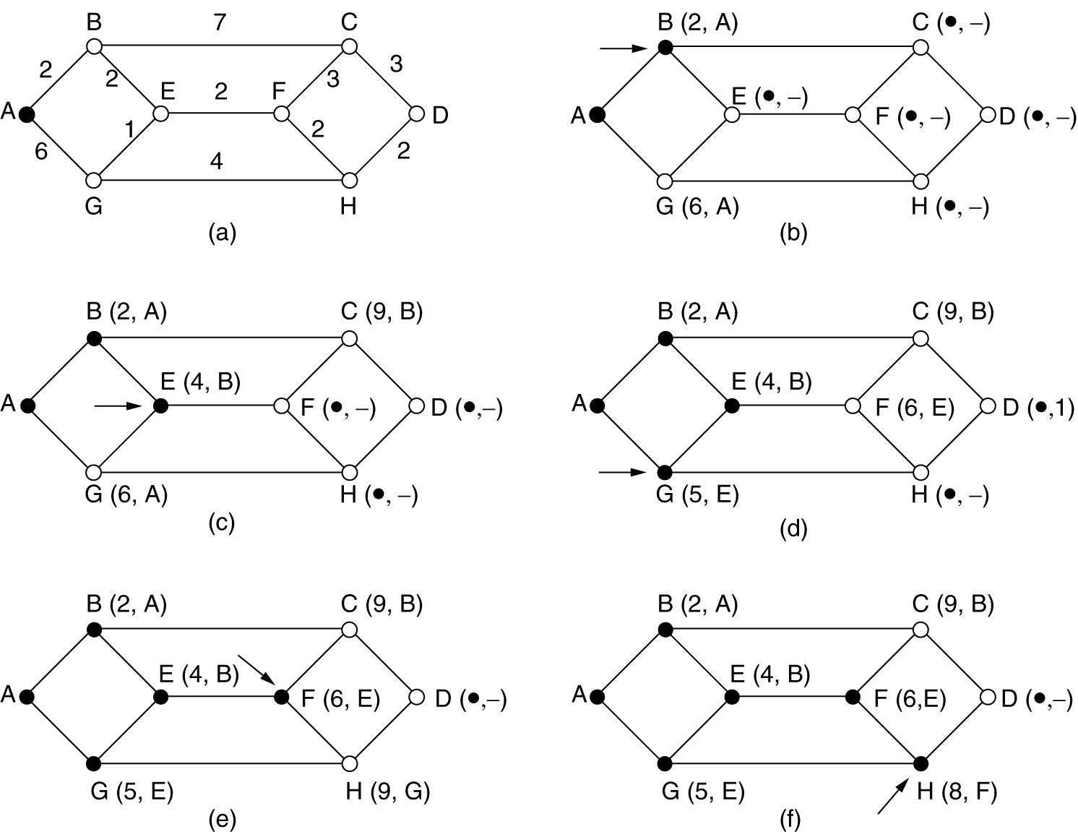
Shortest Path Algorithm
A network is represented as a graph, with its terminals as nodes and the links as edges. A 'length' is associated with each edge, which represents the cost of using the link for transmission. Lower the cost, more suitable is the link. To choose a route between a given pair of routers, the algorithm just finds the shortest path between them on graph.
The first 5 steps used in computing the shortest path from A to D.
The arrows indicate the working node.

Slide 11
Flooding
  Flooding adapts the technique in which every incoming packet is sent on every outgoing line except the one on which it arrived. One problem with this method is that packets may go in a loop. As a result of this a node may receive several copies of a particular packet which is undesirable. Some techniques adapted to overcome these problems are as follows:
    Sequence Numbers: Every packet is given a sequence number. When a node receives the packet it sees its source address and sequence number. If the node finds that it has sent the same packet earlier then it will not transmit the packet and will just discard it.
    Hop Count: Every packet has a hop count associated with it. This is decremented(or incremented) by one by each node which sees it. When the hop count becomes zero(or a maximum possible value) the packet is dropped.
    Spanning Tree: The packet is sent only on those links that lead to the destination by constructing a spanning tree routed at the source. This avoids loops in transmission but is possible only when all the intermediate nodes have knowledge of the network topology.
Flooding is not practical for general kinds of applications. But in cases where high degree of robustness is desired such as in military applications, flooding is of great help.

Slide 12
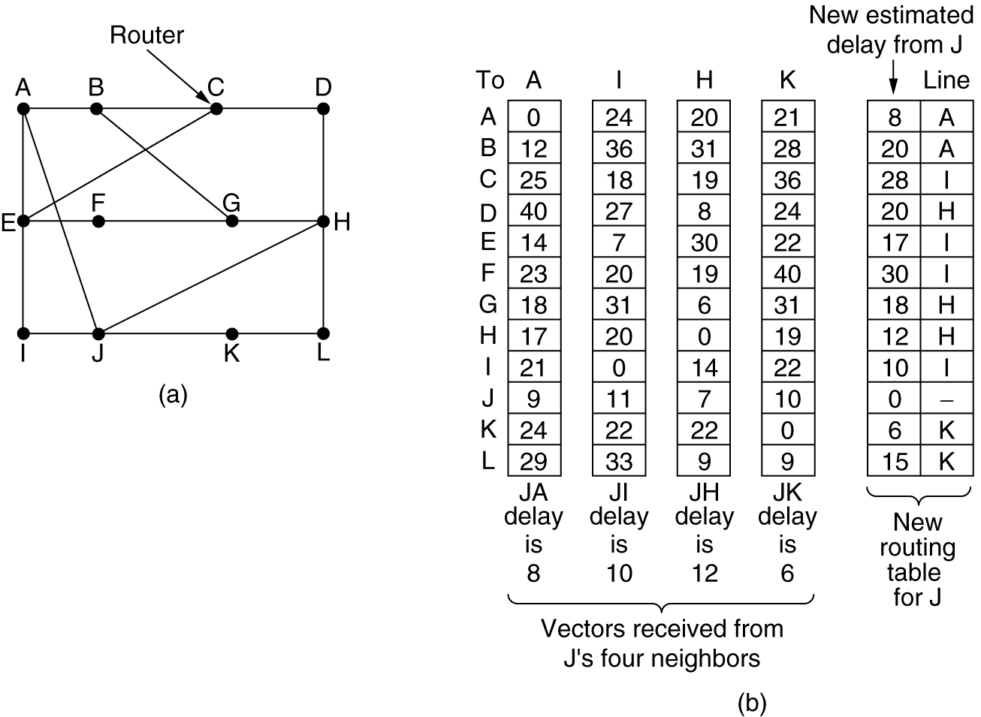
Distance Vector Routing
In distance vector routing, each router maintains a table (i.e. a vector) giving the best known distance to each destination and which line to use to get there. These tables are updated by exchanging information with the neighbors.
(a) A subnet. (b) Input from A, I, H, K, and the new routing table for J.

Slide 13
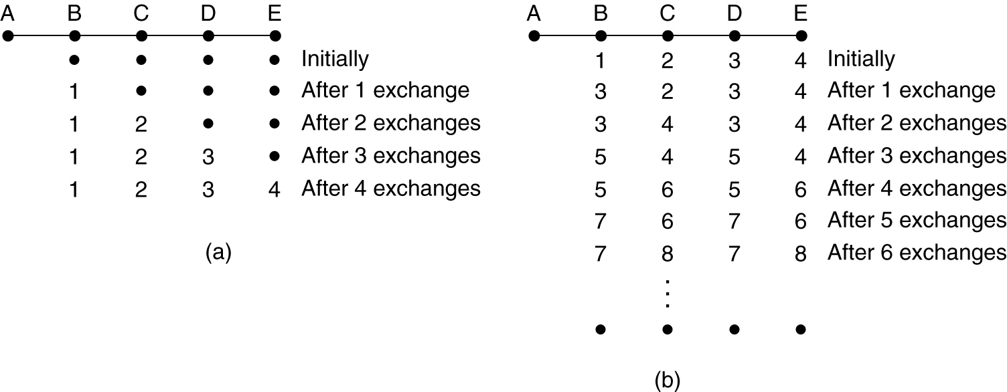
Distance Vector Routing
The count-to-infinity problem.

Slide 14
Link State Routing
Five steps:
  Discover its neighbors, learn their network address.
  Measure the delay (cost) to each of its neighbors.
  Construct a packet containing all this information.
  Send this packet to all other routers.
  Compute the shortest path to every other router.

Slide 15
Link State Routing : Discovering Your Neighbors
Send “HELLO” packet on each point-to-point line. Destination node replies with its address.

Slide 16
Link State Routing : Measuring Line Cost
The link state routing algorithm requires each router to know, or at least have a reasonable estimate, of the delay to each of its neighbors. The most direct way to determine this delay is to send over the line a special ECHO packet that the other side is required to send back immediately. By measuring the round-trip time and dividing it by two, the sending router can get a reasonable estimate of the delay.

Slide 17
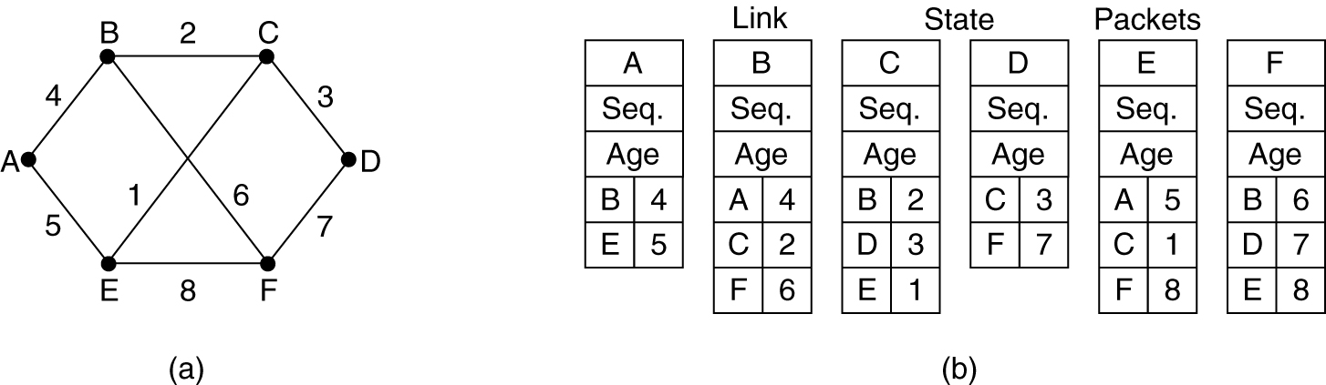
Link State Routing : Building Link State Packets
To build a packet for each router containing all the data. The packet starts with the identity of the sender, followed by a sequence number and age and a list of neighbors. The cost to each neighbor is also given.
(a) A subnet. (b) The link state packets for this subnet.

Slide 18
Link State Routing : Distributing the Link State Packets
Use selective flooding
Each packet contains a sequence number that is incremented for each new packet sent. Routers keep track of all the (source router, sequence) pairs they see. When a new link state packet comes in, it is checked against the list of packets already seen. If it is new, it is forwarded on all lines except the one it arrived on. If it is a duplicate, it is Discarded.

Slide 19
Link State Routing : Computing the New Routes
Dijkstra’s Shortest Path algorithm is used to determine the shortest path to each destination.

Slide 20
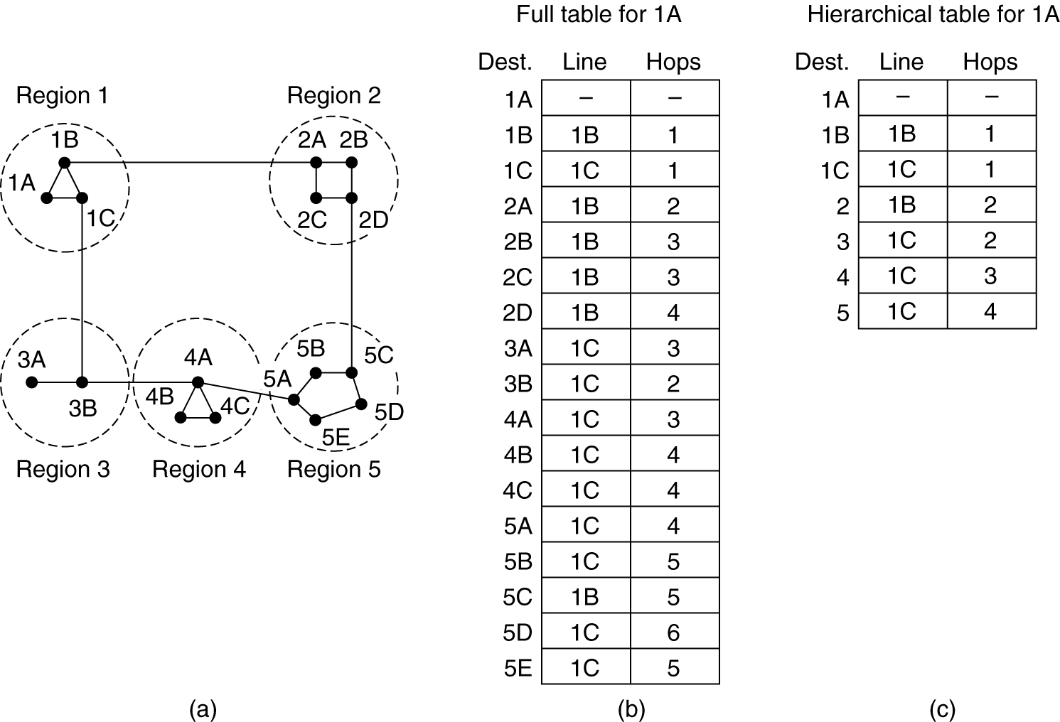
Hierarchical Routing
Networks grow in size, the router routing tables grow proportionally.
More CPU time is needed to scan them and more bandwidth is needed to send status reports about them.
Routers are divided into regions.
Routers know the routes for their own regions only.
Works like telephone routing

Slide 21
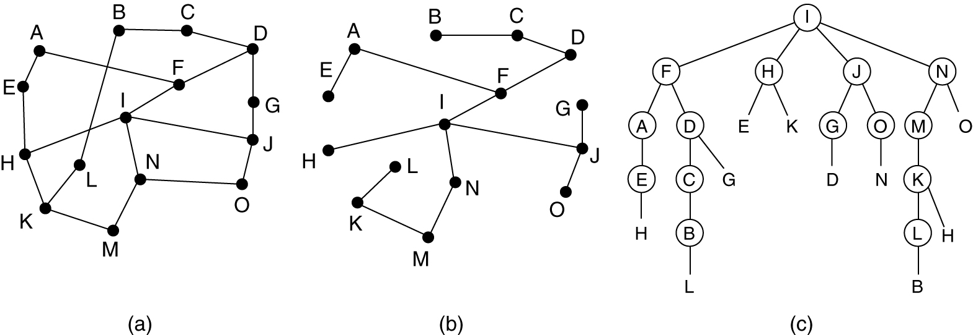
Broadcast Routing
Deliver packets from source to all other nodes.
Flooding: when node receives brdcst pckt, sends copy to all neighbors.
Spanning tree: No redundant packets received by any node.
Reverse Path Forwarding is a technique, in which router knows in advance about its predecessor from where it should receive broadcast. This technique is used to detect and discard duplicates.
(a) A subnet. (b) Sink tree. (c) The tree built by reverse path forwarding.

Slide 22
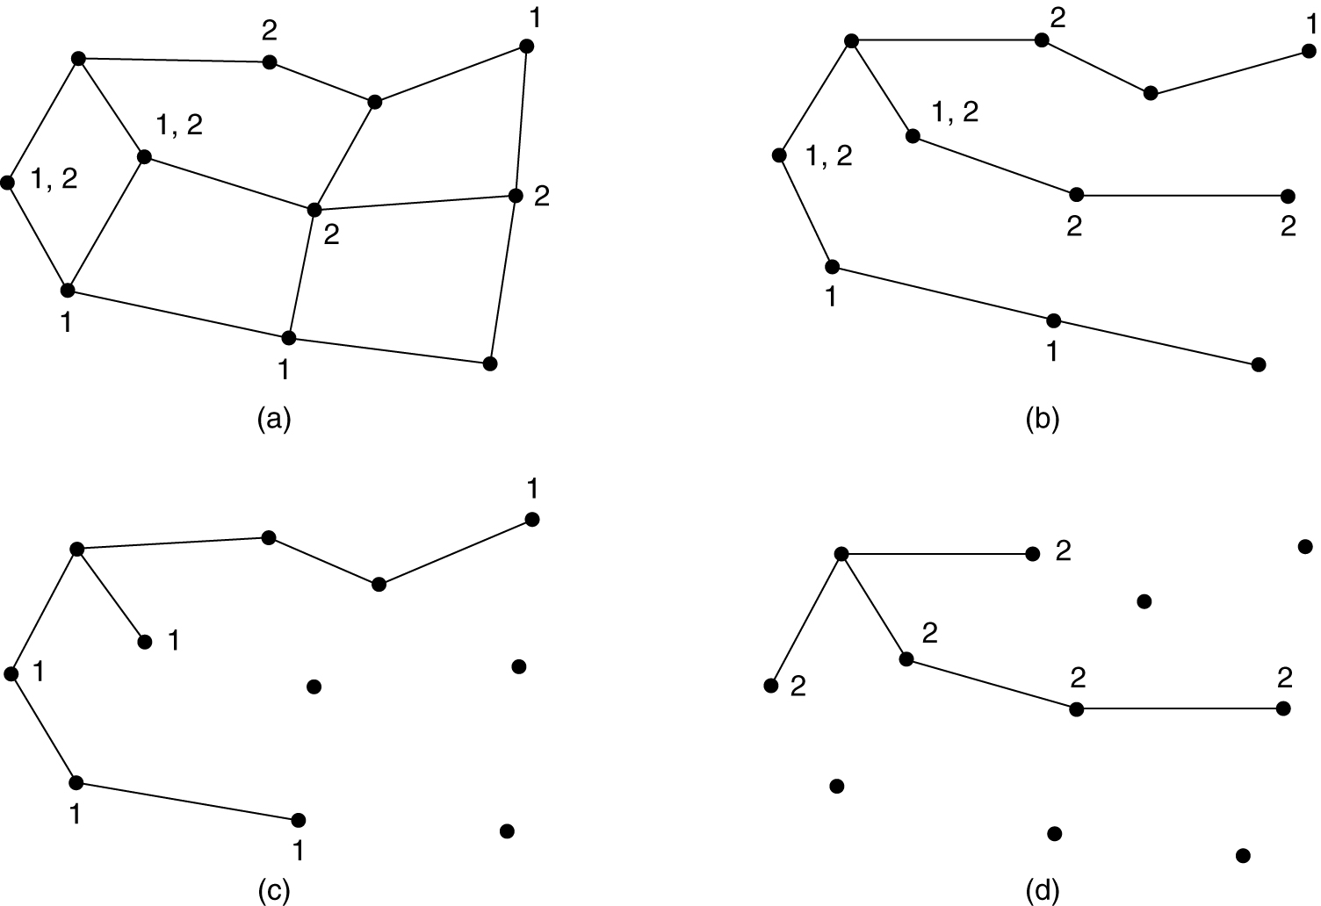
Multicast Routing
Multicast routing is special case of broadcast routing but has significance difference and challenges. In broadcast routing packets are sent to all nodes, even if they do not want it. But in Multicast routing, the data is sent to only nodes which wants to receive the packets.
Router must know that there are nodes who wishes to receive multicast packets (or stream) then only it should forward. Multicast routing works spanning tree protocol to avoid looping.
(a) A network. (b) A spanning tree for the leftmost router.
(c) A multicast tree for group 1. (d) A multicast tree for group 2.

Slide 23
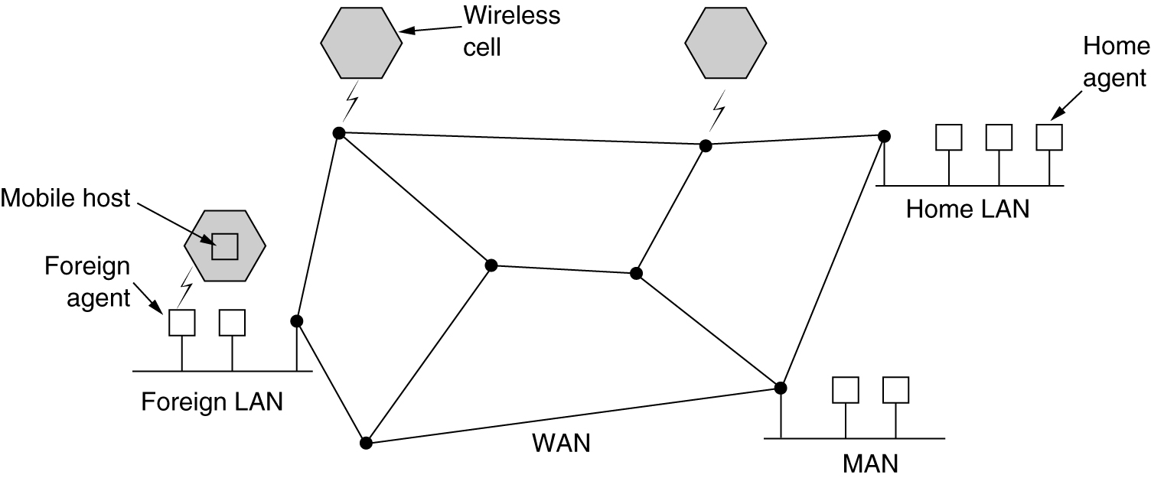
Routing for Mobile Hosts
  All mobile agents are assumed to have a permanent home location
  When a portable computer is attached to a remote network it contacts a process that acts as the foreign agent.
  Each home location has a process that acts as the home agent

Slide 24
Routing for Mobile Hosts
Home
Network
Mobile Node
Home Agent
binding acknowledgment
binding update
care-of-address
Internet
Visited
Network
Correspondent
Node
The mobile node informs the correspondent node of the care-of-address
After which the mobile and the correspondent node can exchange packets directly
The home agent replies with a binding acknowledgment
It constructs a care-of-address and sends a binding update to its home agent
Initially the correspondent node communicates with mobile node via the mobile’s home agent
When a node moves to a visited network

Slide 25
Routing in Ad Hoc Networks
Possibilities when the routers are mobile:
Military vehicles on battlefield.
  No infrastructure.
A fleet of ships at sea.
  All moving all the time
Emergency works at earthquake .
  The infrastructure destroyed.
AODV = Ad Hoc On-demand Distance Vector
Source floods route request in the network.
Reverse paths are formed when a node hears a route request.
Each node forwards the request only once (pure flooding).

Slide 26
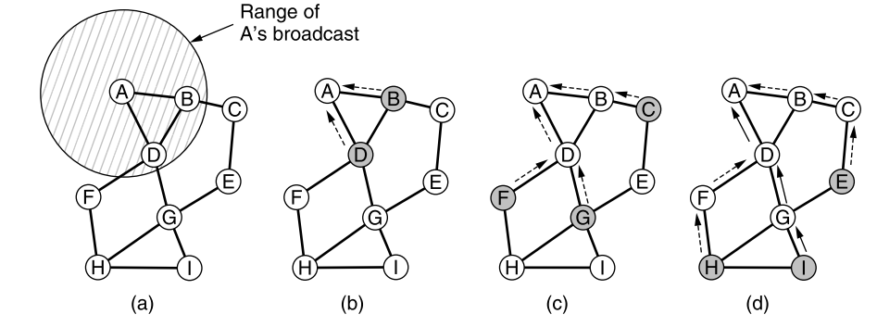
Routing in Ad Hoc Networks : Route Discovery
(a) Range of A's broadcast.
(b) After B and D have received A's broadcast.
(c) After C, F, and G have received A's broadcast.
(d) After E, H, and I have received A's broadcast.
Shaded nodes are new recipients. Arrows show possible reverse route. The solid lines show the discovered routes.

Slide 27
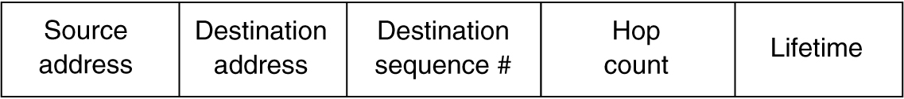
Routing in Ad Hoc Networks : Route Discovery
The basic message set consists of:
  RREQ – Route request
  RREP – Route reply
  RERR – Route error
  HELLO – For link status monitoring
Format of a ROUTE REQUEST packet.
Format of a ROUTE REPLY packet.

Slide 28
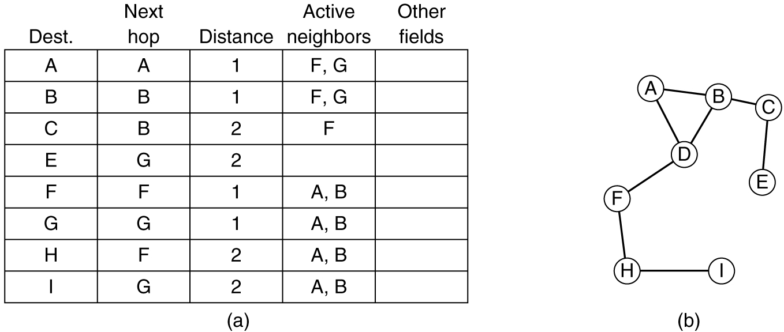
Routing in Ad Hoc Networks : Route Maintenance
(a) D's routing table before G goes down.
(b) The graph after G has gone down.

