Slide 1
Network Security
Network Security are needed to protect data during their transmission.
Goals of Network Security
Confidentiality: only sender, intended receiver should “understand” message contents.
  sender encrypts message
  receiver decrypts message
Authentication: sender, receiver want to confirm identity of each other.

Slide 2
Message Integrity: sender, receiver want to ensure message not altered (in transit, or afterwards) without detection.
Access and Availability: services must be accessible and available to users.
Non-repudiation: A Sender should not be able to falsely deny later that he sent a message.
Network Security is achieved through the use of cryptography. Cryptography can provide confidentiality, integrity, authentication and non-repudiation of message.

Slide 3
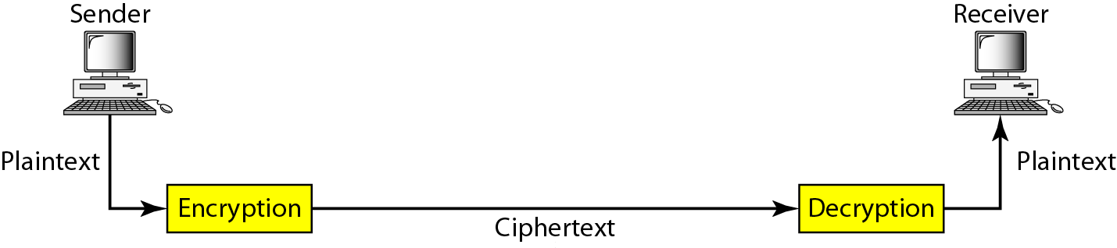
Cryptography
Cryptography, a word with Greek origins means “secret writing”
Cryptography Components
Plaintext: The Original message, before being transformed.
Encryption Algorithm: It transforms the plaintext into ciphertext.

Slide 4
Decryption Algorithm: Transforms the Ciphertext back into Plaintext.
Cipher: A cryptographic algorithm, also called a cipher. It is the mathematical function used for encryption and decryption.
Key: A Key is a number (or a set of numbers) that the cipher, as an algorithm, operates on.

Slide 5



Friends and enemies: Alice, Bob, Trudy
well-known in network security world
Bob, Alice want to communicate “securely”
Trudy (intruder) may intercept, delete, add messages
Alice
Bob
channel
data, control messages
secure
sender
secure
receiver
data
data
Trudy

Slide 6
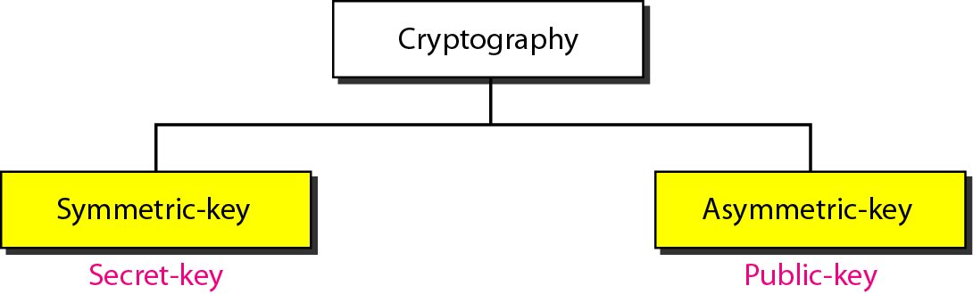
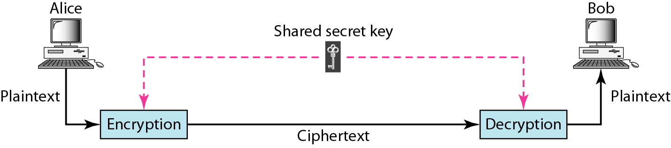
Categories of cryptography
Symmetric-key cryptography :In symmetric-key cryptography, the same key is used by the sender (for encryption) and the receiver (for decryption). The key is shared.

Slide 7
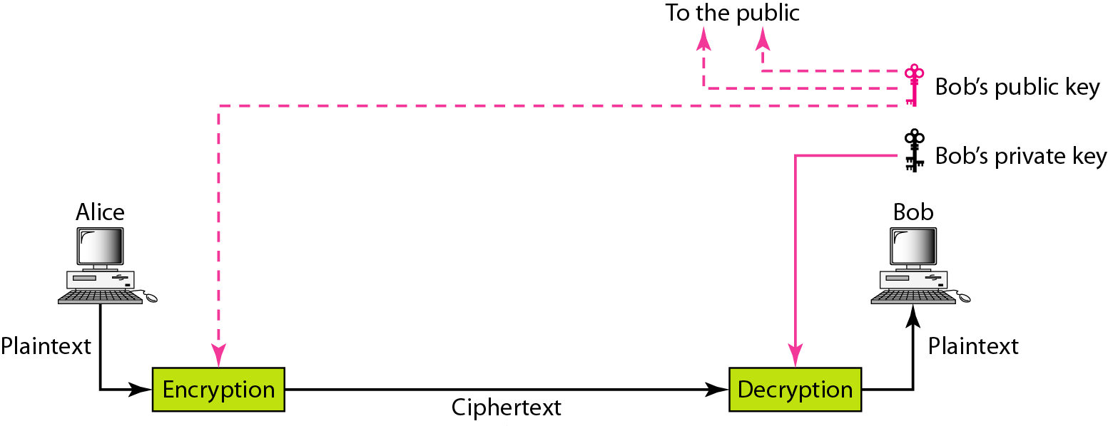
Asymmetric-key cryptography :In asymmetric-key cryptography, there are two keys: a private key and public key. The private key is kept by the receiver (to decrypt the message). The public key (to encrypt the message) is announced to the public.

Slide 8
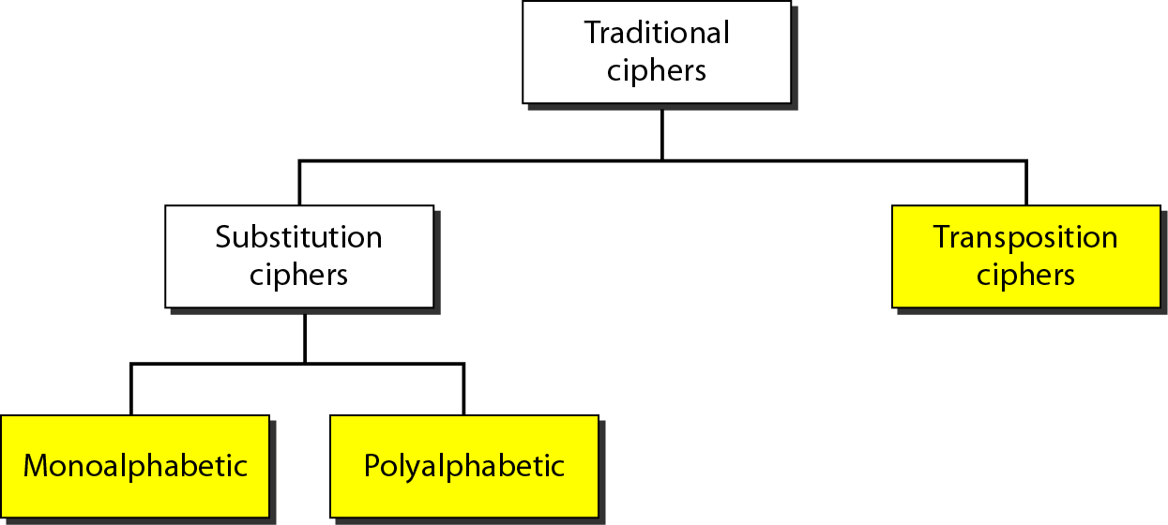
Symmetric key cryptography

Slide 9
Substitution Cipher: substituting one thing for another
  Monoalphabetic cipher: A character in the plaintext is always changed to the same character in the ciphertext regardless of its position in the text.
plaintext: abcdefghijklmnopqrstuvwxyz
ciphertext: mnbvcxzasdfghjklpoiuytrewq
E.g.:
Plaintext: bob. Let us meet at cc
ciphertext: nkn. Gcu vi hccu mu bb
Polyalphabetic cipher: Each occurrence of a character can have a different substitute. The relationship between a character in the plaintext to a character in the ciphertext is one-to-many relationship.
E.g.:
Plaintext: HELLO
ciphertext: ABNZF

Slide 10
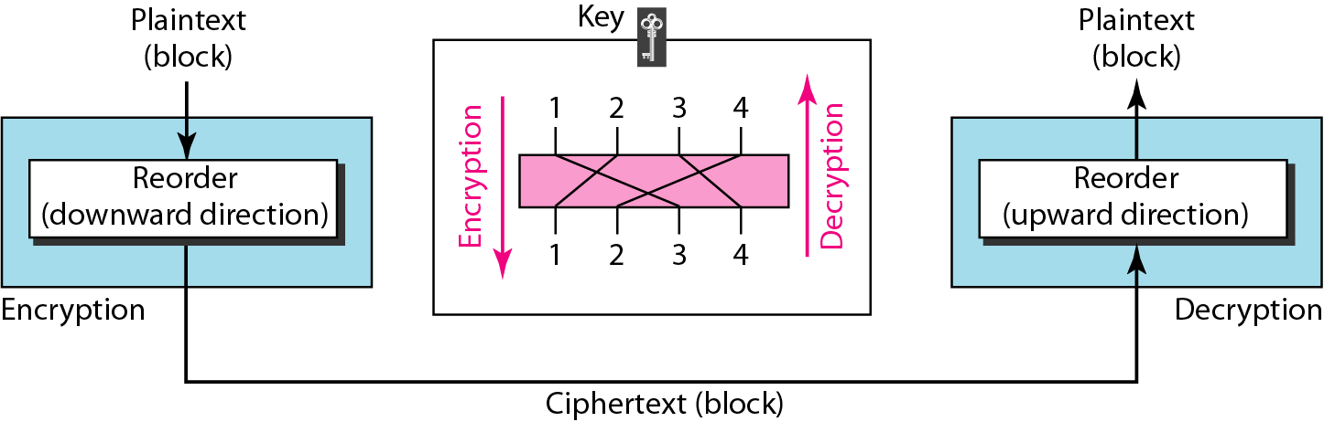
Transposition Cipher: A transposition cipher reorders symbols in a block of symbols. A character in the first position of the plaintext may appear in the tenth position of the ciphertext. A character in the eighth position of the plaintext may appear in the first position of the ciphertext
Example: Encrypt the message “HELLO MY DEAR”
HELL OMYD EARZ
Three Blocks of Ciphertext: ELHL MDOY AZER

Slide 11
Simple Modern Ciphers
XOR Cipher
Rotation Cipher
Substitution Cipher :S-box
Transposition Cipher: P-box

Slide 12
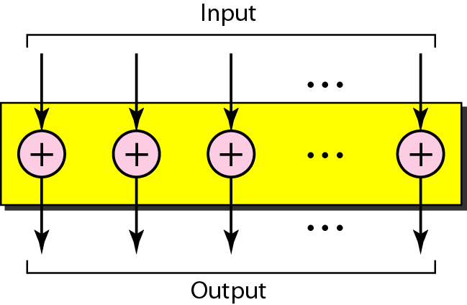
XOR Cipher
XOR Cipher uses the exclusive-or-operation.
XOR operation needs two data inputs plaintext, as the first and a Key as the second.
The size of the key, the plaintext, and the ciphertext are all the same.

Slide 13
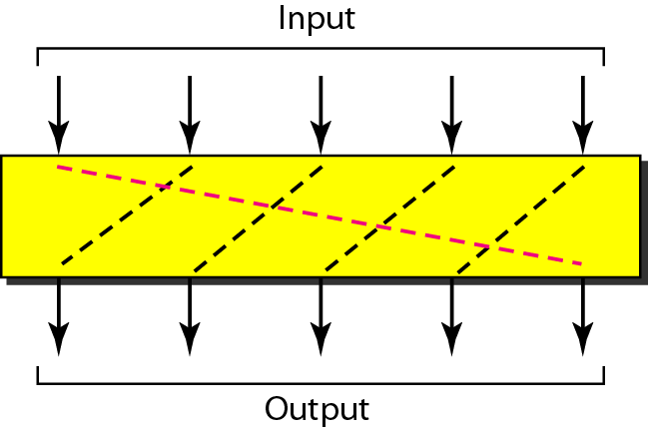
Rotation Cipher
Input bits are rotated to the left or right.
The rotation cipher can be keyed or keyless.
In keyed rotation, the value of the key defines the number of rotations.
In keyless rotation the number of rotations is fixed.
The no. of rotations must be between 1 and N-1.

Slide 14
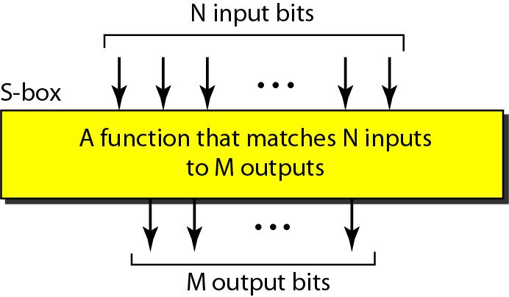
Substitution Cipher :S-box
S-box (substitution box) parallels the traditional substitution cipher for characters.
Input to an S-box is a stream of bits with length N.
Result is another stream of bits with length M.
M and N are not necessarily the same.

Slide 15
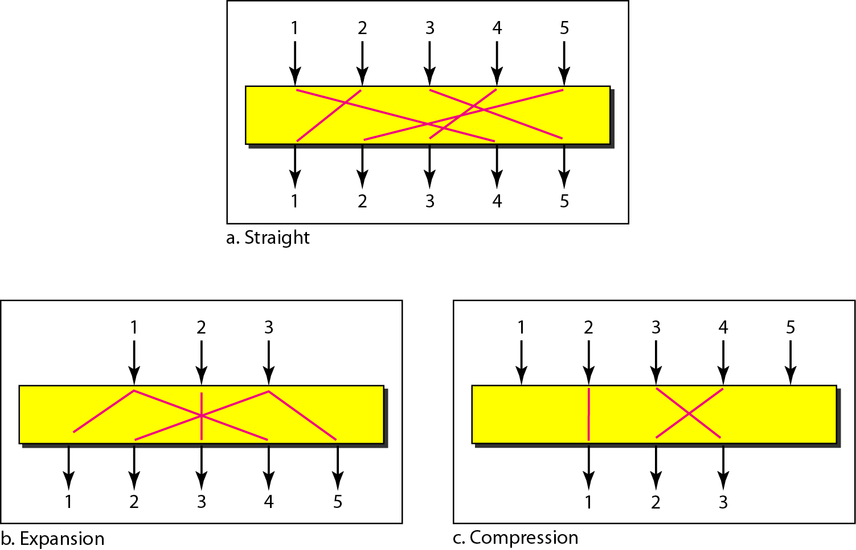
Transposition Cipher: P-box
P-box (permutation box) parallels the traditional transposition cipher for characters.
It performs a transposition at the bit level.
There are three types of permutations in p-box.

Slide 16
Symmetric-key round Ciphers
DES (Data Encryption Standard)
AES (Advanced Encryption Standard)
Block cipher

Slide 17
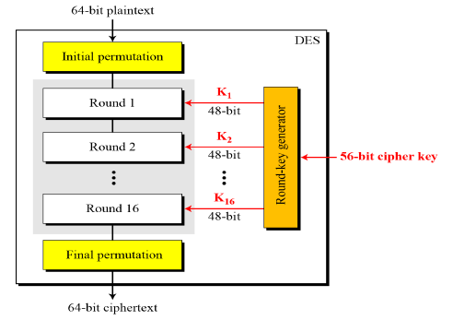
DES (Data Encryption Standard)
DES was designed by IBM.
In January 1977, the U.S. Government adopted a product.
Algorithm encrypt a 64-bit plaintext block using a 56-bit key.

Slide 18
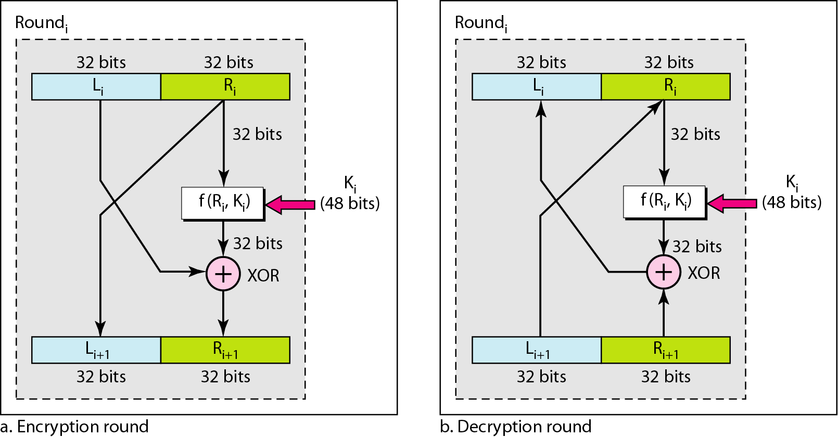
One round in DES ciphers

Slide 19
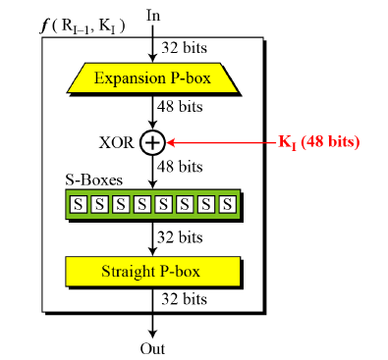
DES function

Slide 20
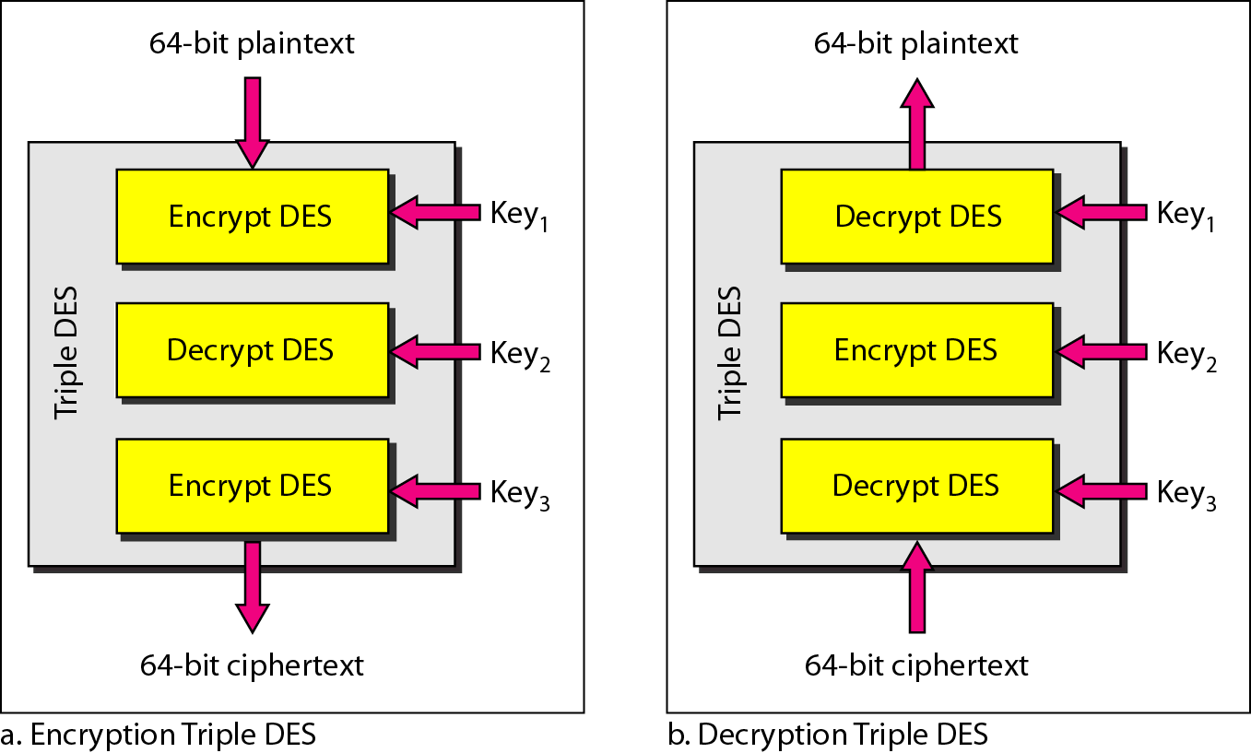
Triple DES

Slide 21
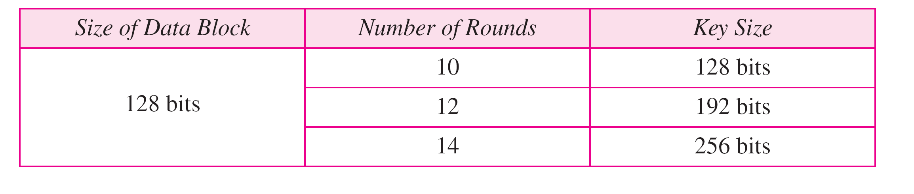
AES (Advanced Encryption Standard)
In Nov. 2001, NIST (National Institute of Standards and Technology), replaced DES by AES.
AES is very complex round cipher.
AES design with three key sizes.
A 128-bit key gives a key space of 2¹²⁸ = 3 × 10³⁸ keys.
Machine with 1 billion parallel processors, each being able to evaluate one key per picoseconds, it would take such a machine about 10¹⁰ years to search the key space by brute force attack.

Slide 22
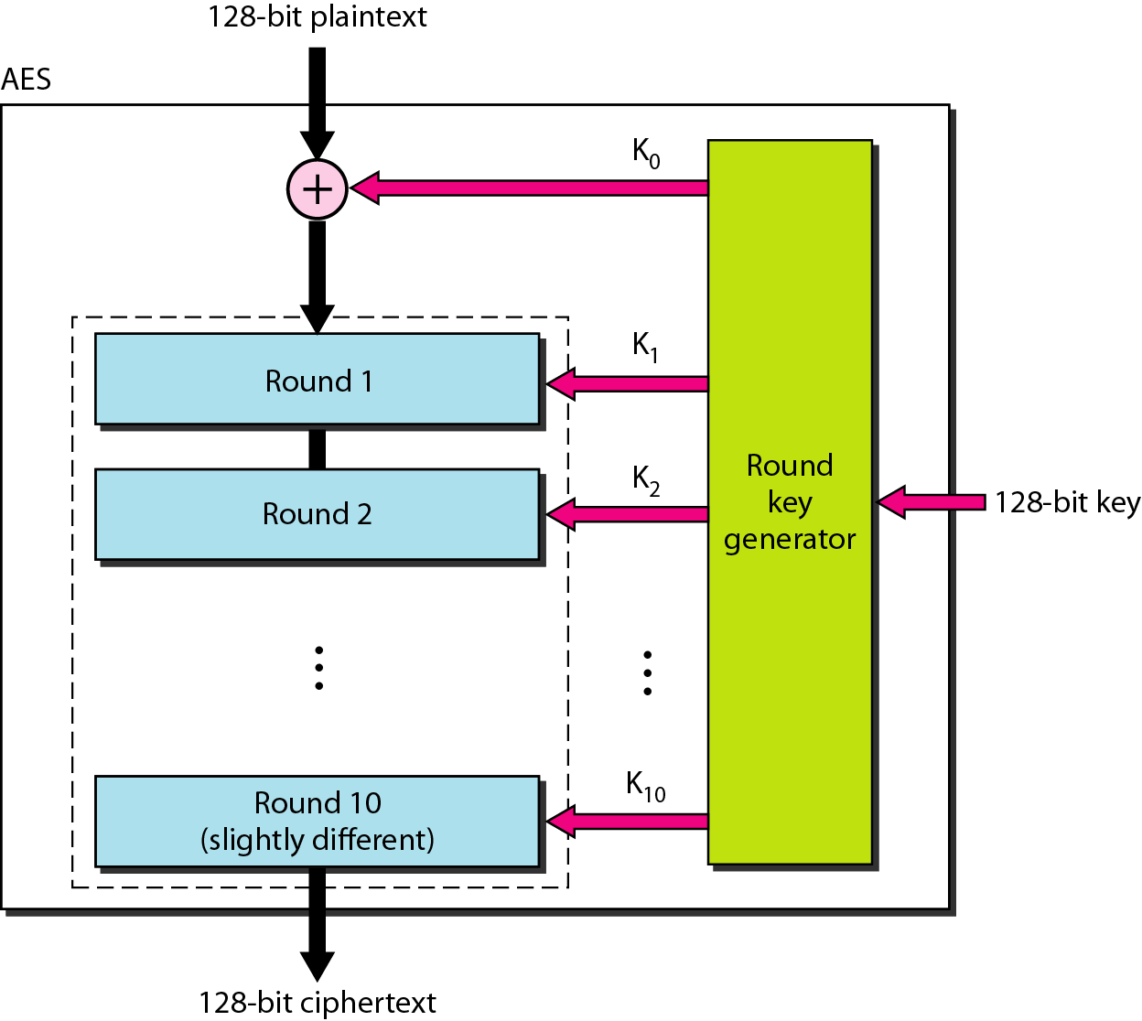
AES

Slide 23
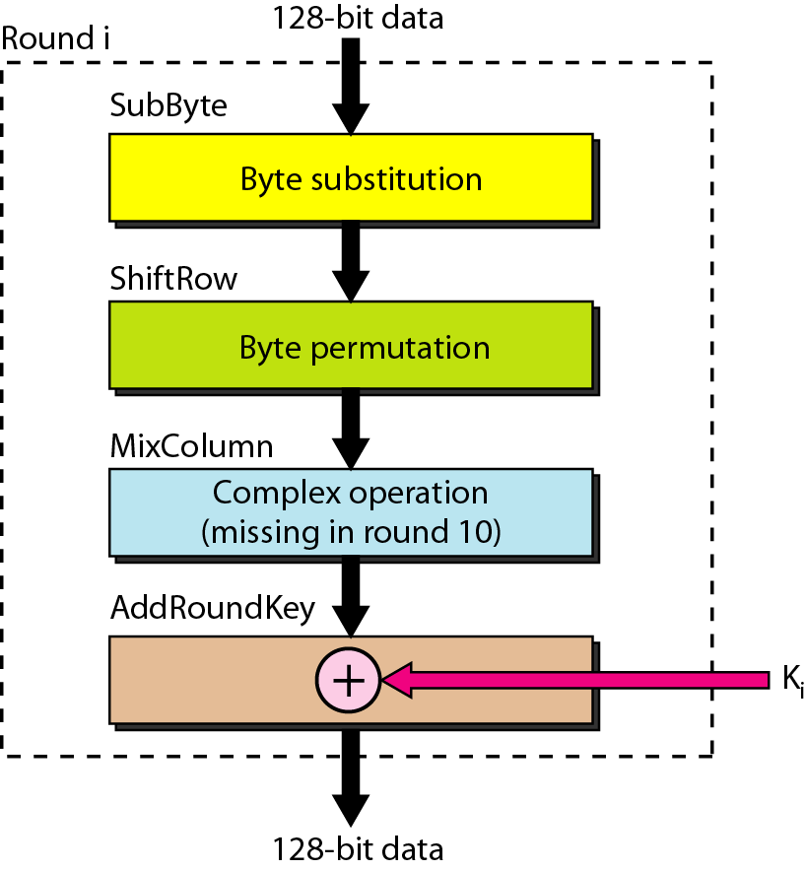
Structure of each round

Slide 24
How to use a block cipher?
Block ciphers encrypt fixed-size blocks
  e.g. DES encrypts 64-bit blocks
We need some way to encrypt a message of arbitrary length
  e.g. a message of 1000 bytes
NIST defines several ways to do it
  called modes of operation

Slide 25
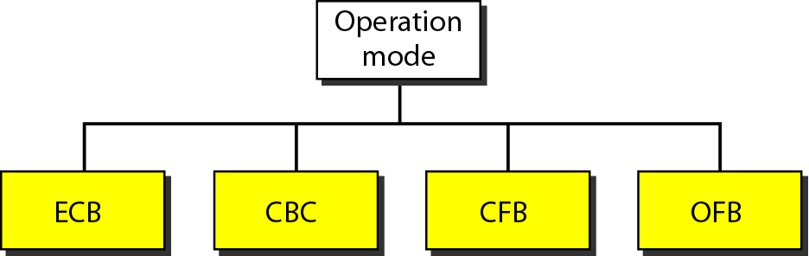
Modes of operation for block ciphers
ECB: Electronic Code Book
CBC: Cipher Block chaining
CFB: Cipher feedback mode
OFB: Output feedback mode

Slide 26
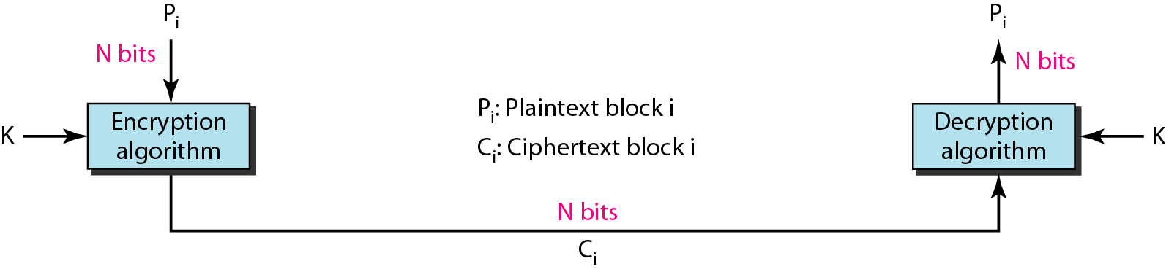
ECB: Electronic Code Book
The plaintext is divided into blocks of N bits.
The ciphertext is made of blocks of N bits and the value of N depends on the type of cipher used.
Blocks are independent of each other.
An error in one block is not propagated to other blocks.

Slide 27
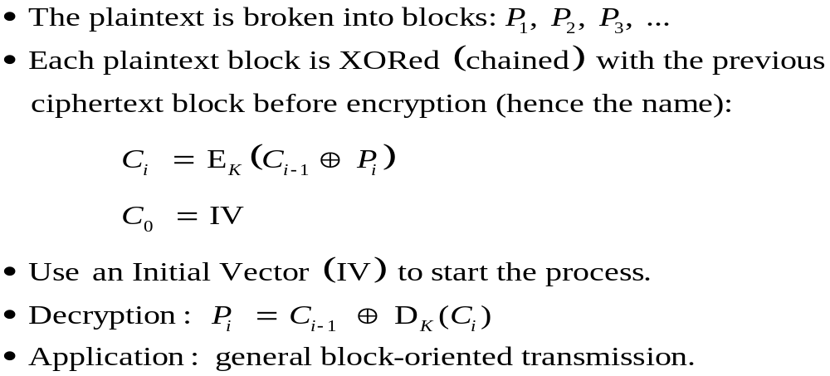
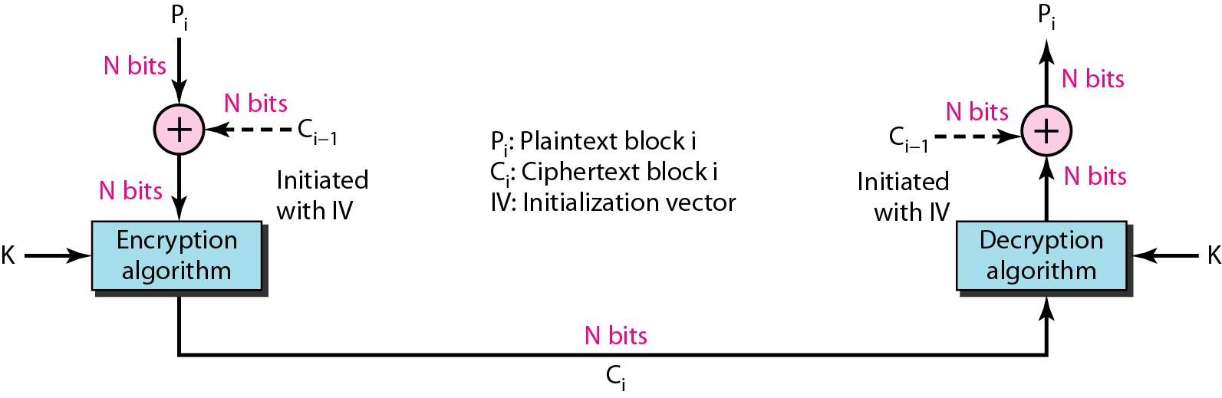
CBC: Cipher Block chaining
Blocks are dependent on previous blocks.
An error in one block is propagated to other blocks.

Slide 28
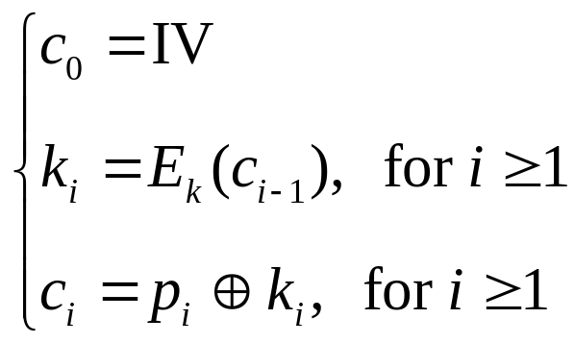
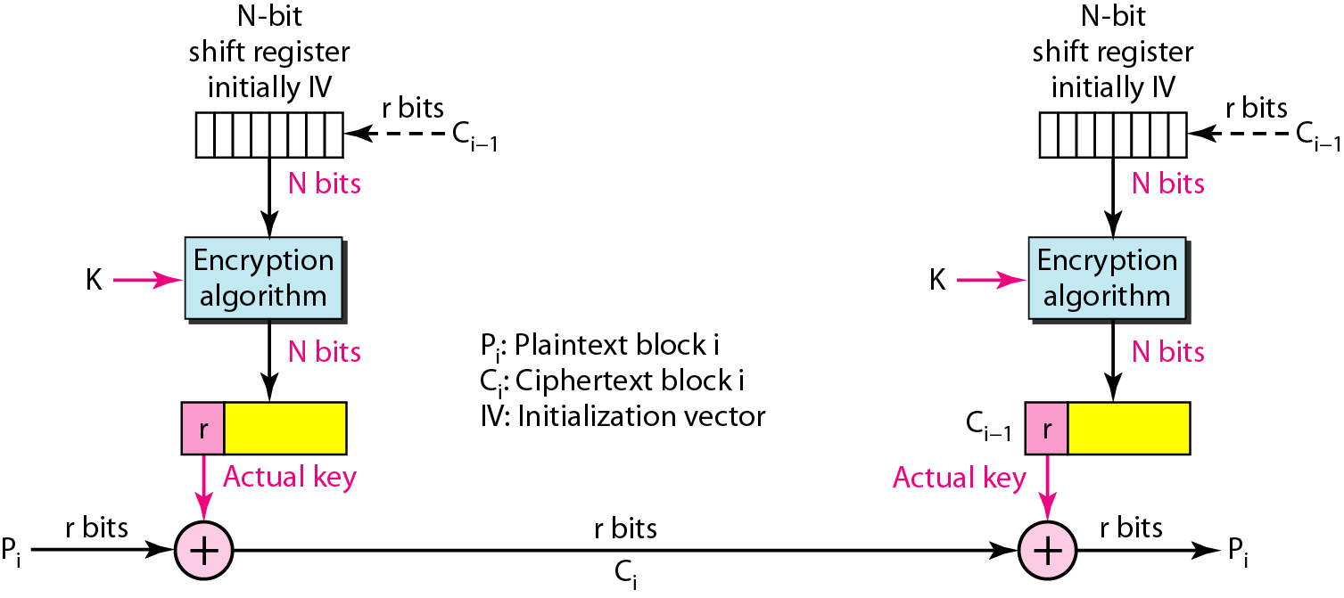
CFB: Cipher feedback mode
Plaintext blocks: p₁, p₂, …
Key: k
Basic idea: construct key stream k₁, k₂, k₃, …
Encryption:

Slide 29
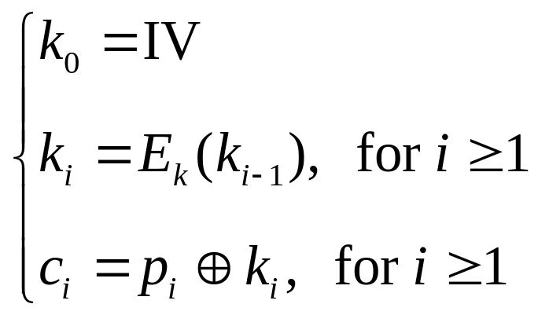
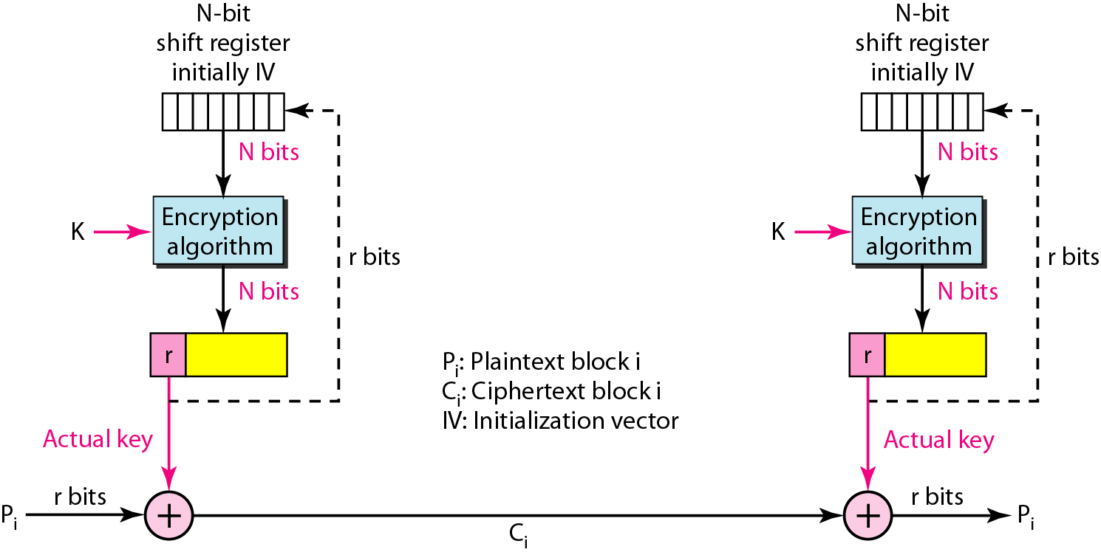
OFB: Output feedback mode
Plaintext blocks: p₁, p₂, …
Key: k
Basic idea: construct key stream k₁, k₂, k₃, …
Encryption:

Slide 30

ASYMMETRIC-KEY CRYPTOGRAPHY
An asymmetric-key (or public-key) cipher uses two keys: one private and one public.
+
Bob’s public
key
K
B
-
Bob’s private
key
K
B
encryption
algorithm
ciphertext
decryption
algorithm
plaintext
message
+
K (m)
-
+
B
m = K (K (m))
B
B

Slide 31
RSA: (Rivest, Shamir, Adelson) algorithm
1. Choose two large prime numbers p, q.
(e.g., 1024 bits each)
2. Compute n = pq, z = (p-1)(q-1)
3. Choose e (with e<n) that has no common factors
with z. (e, z are “relatively prime”).
4. Choose d such that ed-1 is exactly divisible by z.
(in other words: ed mod z = 1 ).
5. Public key is (n,e). Private key is (n,d).
+
-
K
K
B
B

Slide 32
RSA: Encryption, decryption
1. To encrypt bit pattern, m, compute
e
e
c = m mod n
(i.e., remainder when m is divided by n)
2. To decrypt received bit pattern, c, compute
d
d
m = c mod n
(i.e., remainder when c is divided by n)
e
d
m = (m mod n)
mod n
c

Slide 33
RSA example:
Bob chooses p=5, q=7. Then n=35, z=24.
e=5 (so e, z relatively prime).
d=29 (so ed-1 exactly divisible by z.
m
e
e
letter
m
c = m mod n
encrypt:
l
12
248832
17
d
d
c
c
m = c mod n
letter
decrypt:
17
481968572106750915091411825223071697
12
l

Slide 34
RSA: Why is that
e
d
m = (m mod n)
mod n
Useful number theory result: If p,q prime and
n = pq, then:
y
y mod (p-1)(q-1)
x mod n = x mod n
e
d
ed
(m mod n)
mod n = m mod n
ed mod (p-1)(q-1)
= m mod n
(using number theory result above)
1
= m mod n
(since we chose ed to be divisible by
(p-1)(q-1) with remainder 1 )
= m

Slide 35
Digital Signatures
The authenticity of many legal, financial, and other documents is determined by the presence or absence of an authorized handwritten signature.
Sender (Alice) digitally signs document.
Recipient (Bob) can prove to someone that Alice, and no one else (including Bob), must have signed document.

Slide 36
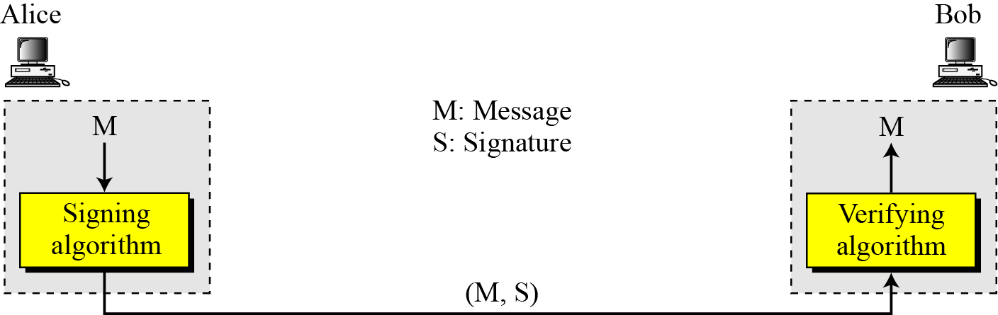
Digital Signatures
The sender uses a signing algorithm to sign the message. The message and the signature are sent to the receiver. The receiver receives the message and the signature and applies the verifying algorithm to the combination. If the result is true, the message is accepted; otherwise, it is rejected.

Slide 37
Digital Signatures
Symmetric-Key Signatures
Public-Key Signatures
Message Digests

Slide 38
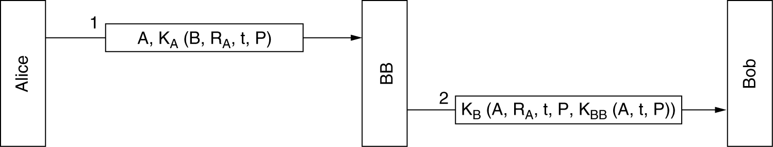
Symmetric-Key Signatures
Digital signatures with Big Brother.
When Alice wants to send a signed plaintext message, P, to Bob, she generates K_{A} (B, R_{A} , t, P), where B is Bob’s identity, R_{A} is a random number chosen by Alice, t is a timestamp to ensure freshness, and K_{A} (B, R_{A} , t, P) is the message encrypted with her key, K_{A} .
BB sees that the message is from Alice, decrypts it, and sends a message to Bob. The message to Bob contains the plaintext of Alice’s message and also the signed message K_{BB} (A, t, P). Bob now carries out Alice’s request.

Slide 39
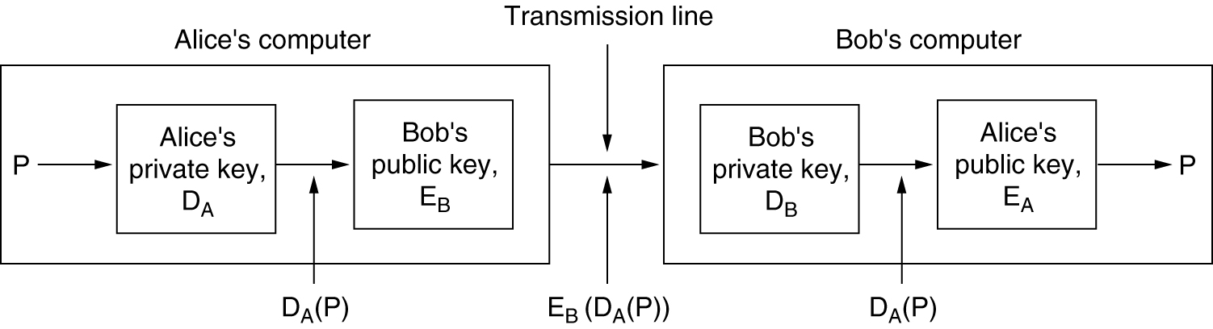
Public-Key Signatures
Digital signatures using public-key cryptography.
Alice can send a signed plaintext message, P, to Bob by transmitting E_{B} (D_{A} (P)). Alice knows her own (private) key, D_{A} , as well as Bob’s public key, E_{B} , so constructing this message is something Alice can do.
When Bob receives the message, he transforms it using his private key, as usual, yielding D_{A} (P). He stores this text in a safe place and then applies E_{A} to get the original plaintext.

Slide 40
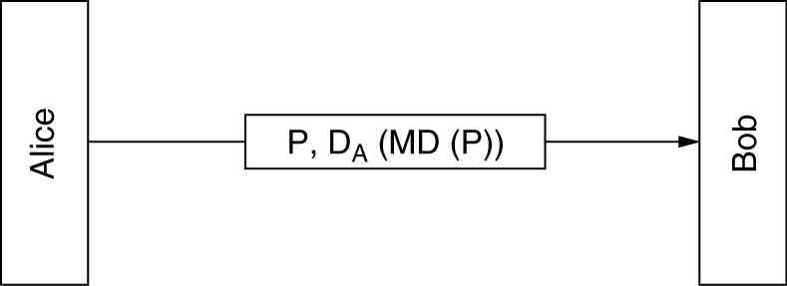
Message Digests
Digital signatures using message digests.
Alice first computes the message digest of her plaintext. She then signs the message digest and sends both the signed digest and the plaintext to Bob. If Trudy replaces P along the way, Bob will see this when he computes MD(P).
1. Given P, it is easy to compute MD(P).
2. Given MD(P), it is effectively impossible to find P.
3. Given P, no one can find P′ such that MD (P′) = MD(P).
4. A change to the input of even 1 bit produces a very different output.

Slide 41

Digital signature = signed message digest
Bob verifies signature and integrity of digitally signed message:
Alice sends digitally signed message:
large
message
m
H: Hash
function
encrypted
msg digest
H(m)
-
K_{B}(H(m))
Alice’s
private
key
digital
signature
(encrypt)
large
message
m
-
Alice’s
public
key
digital
signature
(decrypt)
K
B
+
H: Hash
function
K
encrypted
msg digest
B
+
-
K_{B}(H(m))
H(m)
H(m)
equal
?

Slide 42
Authentication Protocols
Authentication Based on a Shared Secret Key
Establishing a Shared Key: Diffie-Hellman
Authentication Using a Key Distribution Center
Authentication Using Kerberos
Authentication Using Public-Key Cryptography

Slide 43
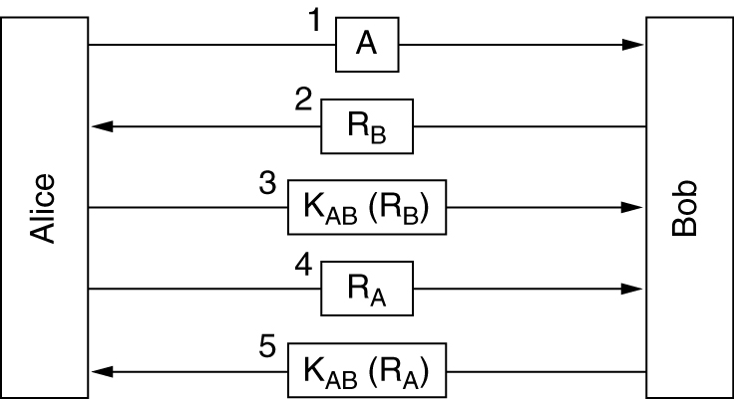
Authentication Based on a Shared Secret Key
Two-way authentication using a challenge-response protocol.

Slide 44
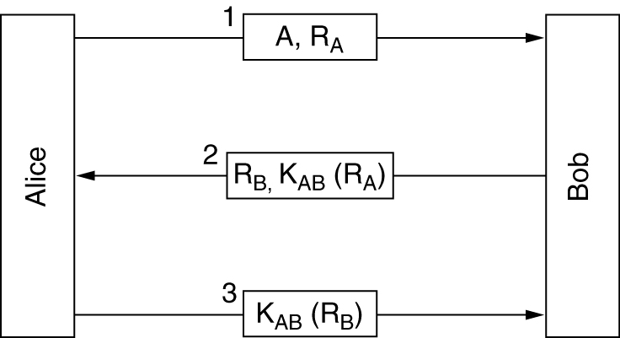
Authentication Based on a Shared Secret Key
A shortened two-way authentication protocol.

Slide 45
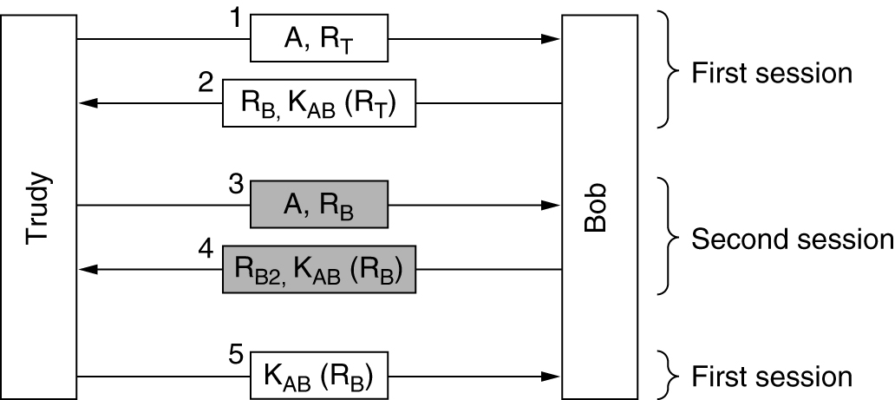
Authentication Based on a Shared Secret Key
The reflection attack.

Slide 46
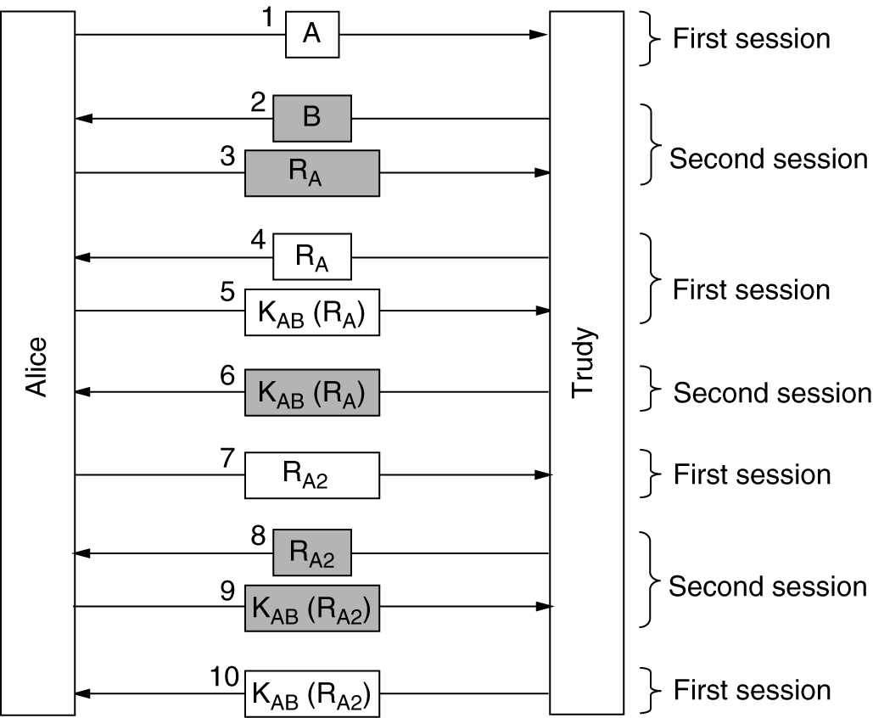
Authentication Based on a Shared Secret Key
A reflection attack on the protocol of Figure.

Slide 47
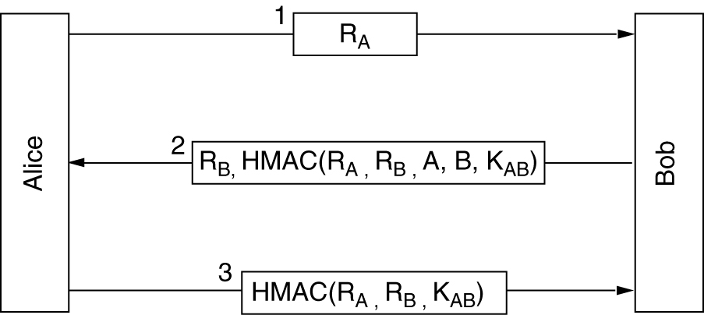
Authentication Based on a Shared Secret Key
Authentication using HMACs.

Slide 48
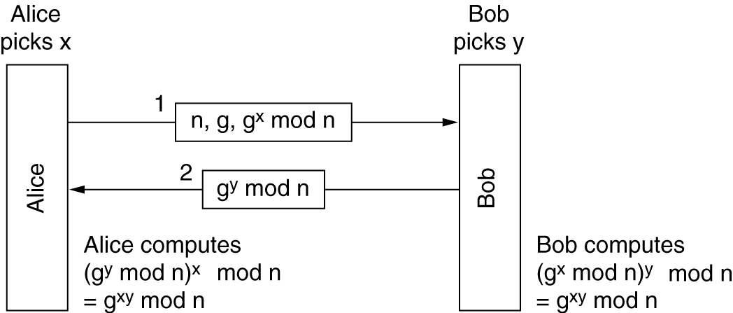
Establishing a Shared Key:
The Diffie-Hellman Key Exchange
The Diffie-Hellman key exchange.

Slide 49
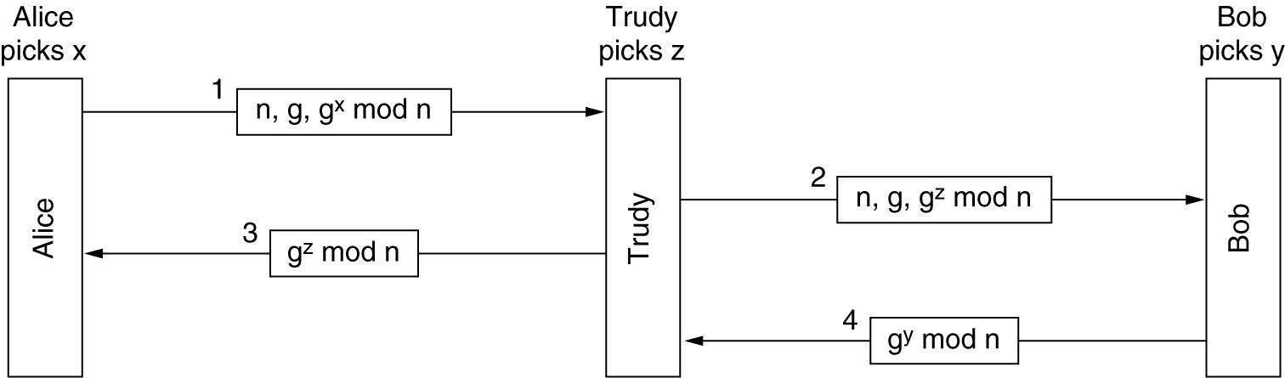
Establishing a Shared Key:
The Diffie-Hellman Key Exchange
The bucket brigade or man-in-the-middle attack.

Slide 50
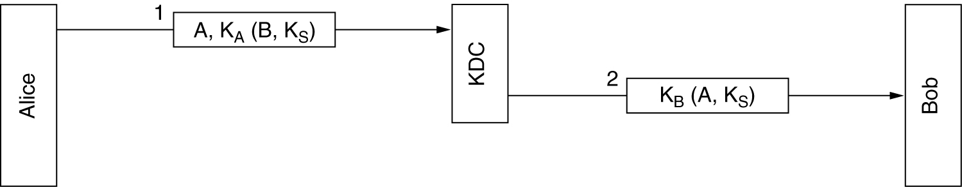
Authentication Using a Key Distribution Center
A first attempt at an authentication protocol using a KDC.

Slide 51
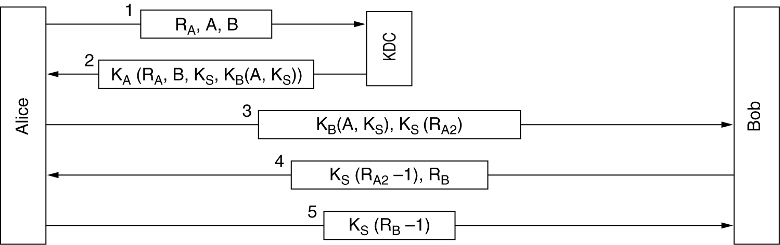
Authentication Using a Key Distribution Center
The Needham-Schroeder authentication protocol.

Slide 52
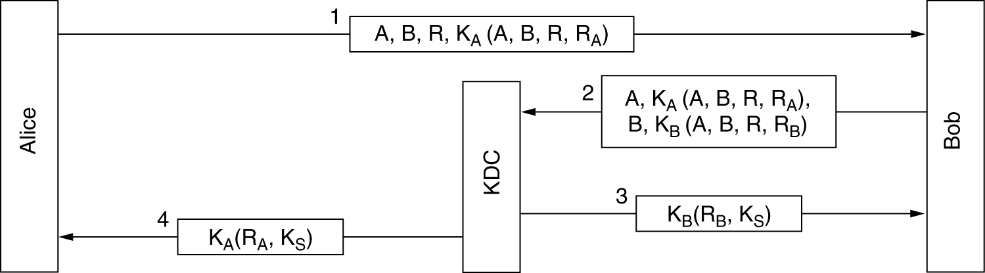
Authentication Using a Key Distribution Center (3)
The Otway-Rees authentication protocol (slightly simplified).

Slide 53
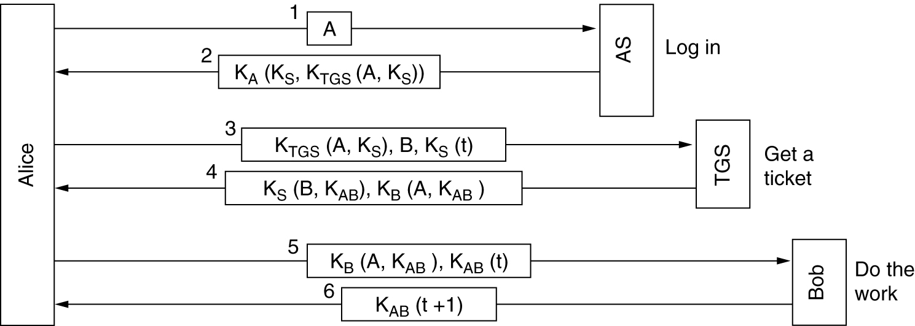
Authentication Using Kerberos
An authentication protocol used in many real systems (including Windows 2000 and later versions) is Kerberos
Kerberos involves three servers in addition to Alice (a client workstation):
1. Authentication Server (AS): Verifies users during login.
2. Ticket-Granting Server (TGS): Issues ‘‘proof of identity tickets.’’
3. Bob the server: Actually does the work Alice wants performed.

Slide 54
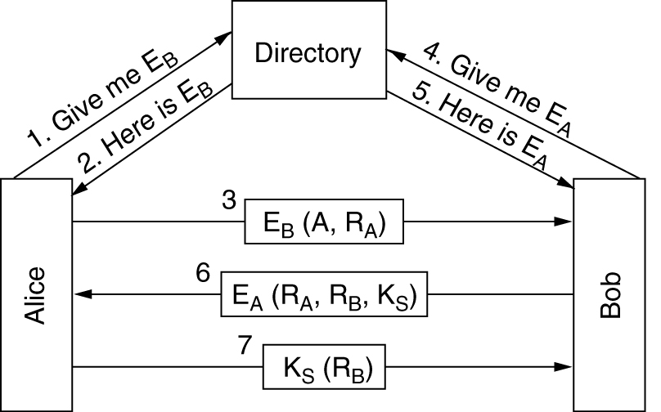
Authentication Using Public-Key Cryptography
Mutual authentication using public-key cryptography.

Slide 55
Communication Security
IPsec
Firewalls
Virtual Private Networks
Wireless Security

Slide 56
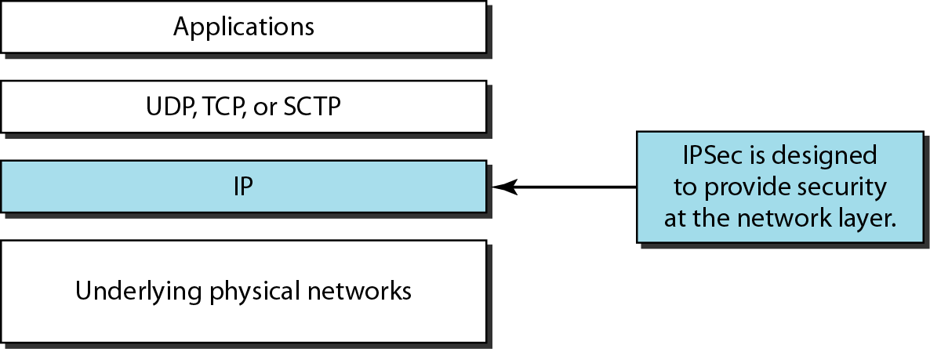
IPSecurity (IPSec)
IPSecurity (IPSec) is a collection of protocols designed by the Internet Engineering Task Force (IETF) to provide security for a packet at the network level.
IPSec helps to create authenticated and confidential packets for the IP layer.

Slide 57
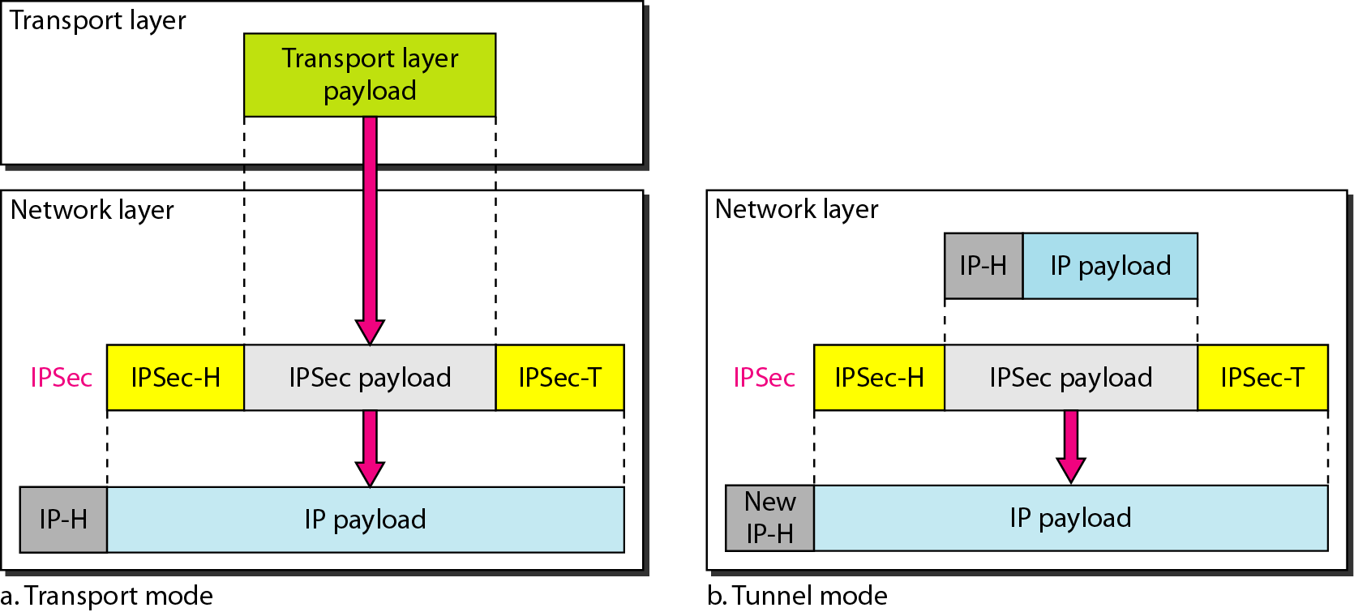
Transport mode and tunnel modes of IPSec protocol

Slide 58
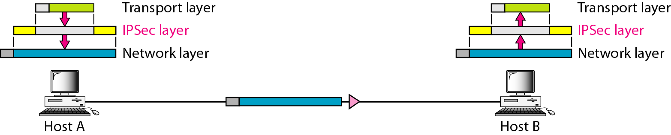
Transport mode in action
IPSec in the transport mode does not protect the IP header; it only protects the information coming from the transport layer.
The transport mode is normally used when we need end-to-end protection of data.

Slide 59
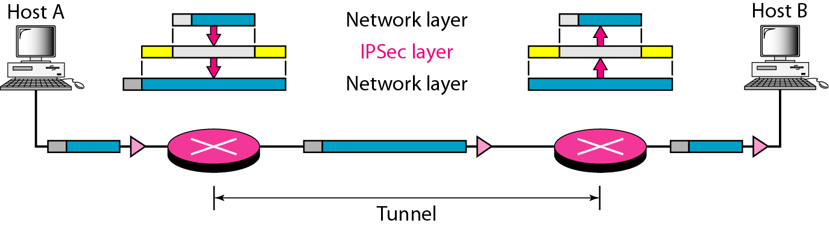
Tunnel mode in action
IPSec in tunnel mode protects the original IP header.
We use the tunnel mode when either the sender or the receiver is not a host.

Slide 60
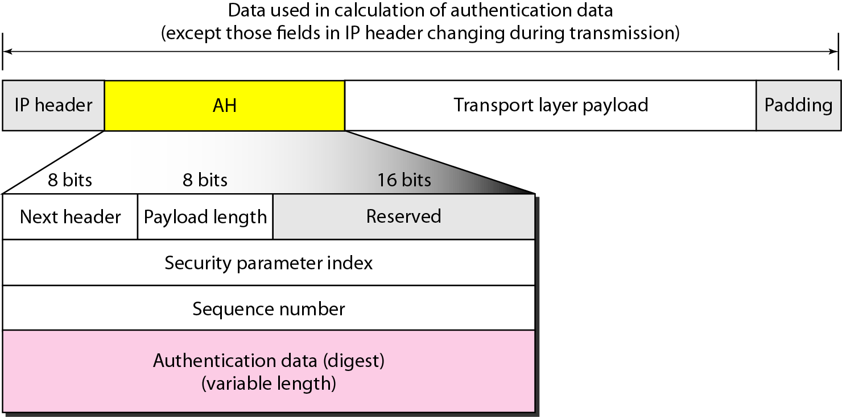
Authentication Header (AH) Protocol in transport mode
The AH Protocol provides source authentication and data integrity, but not privacy.

Slide 61
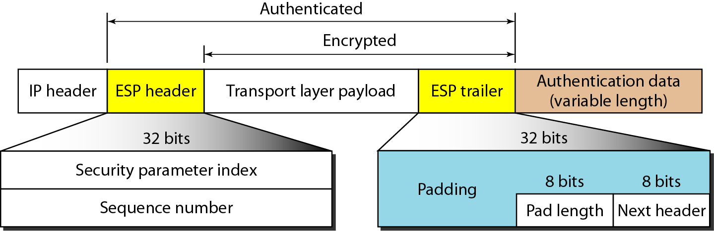
Encapsulating Security Payload (ESP) Protocol in transport mode
ESP provides source authentication, data integrity, and privacy.

Slide 62
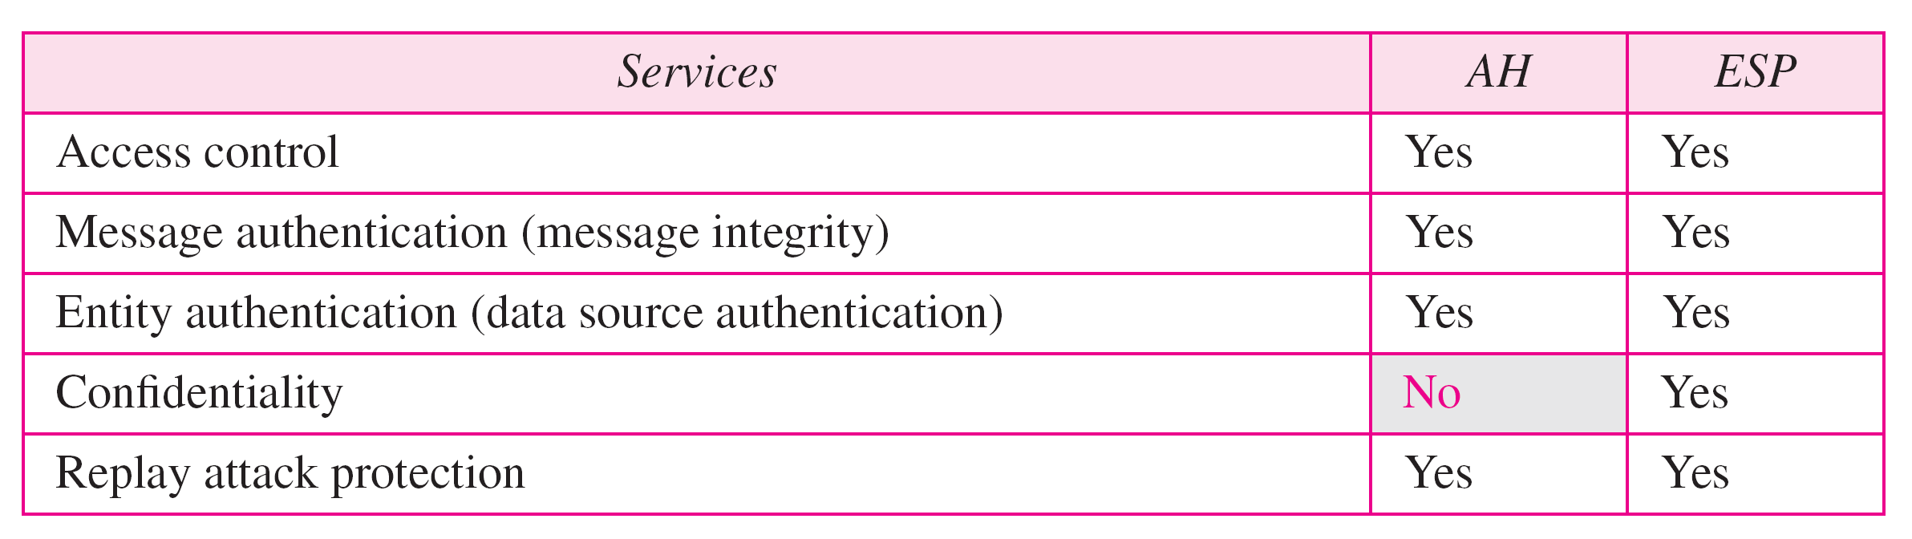
IPSec services

Slide 63
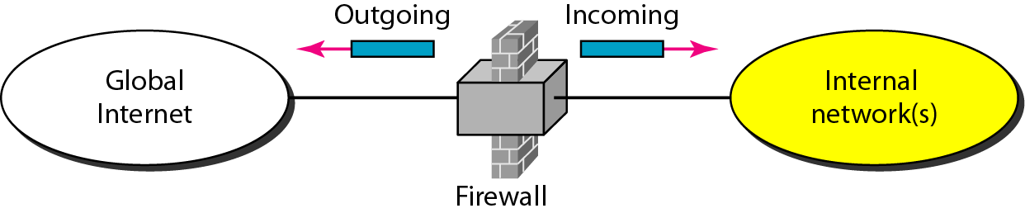
FIREWALLS
All previous security measures cannot from a harmful message to a system. To control access to a system, we need firewalls. A firewall is a device installed between the internal network of an organization and the rest of the Internet. It is designed to forward some packets and filter (not forward) others.

Slide 64
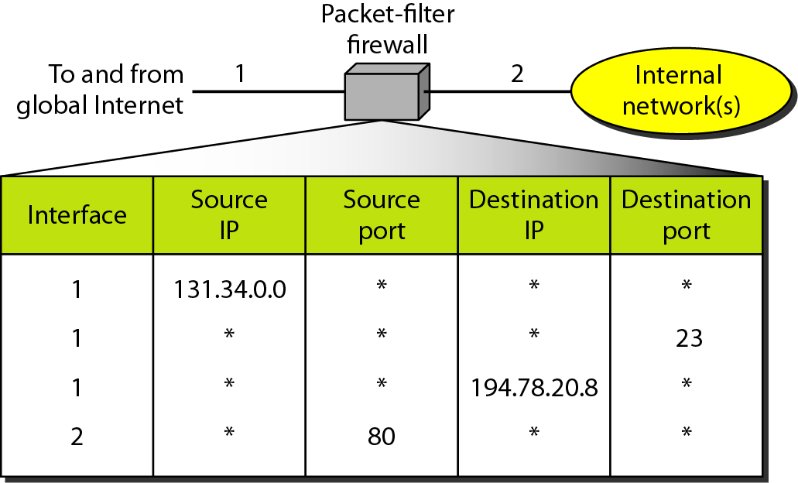
Packet-filter firewall
A packet-filter firewall filters at the network or transport layer.

Slide 65

Proxy firewall
A proxy firewall filters at the application layer.

Slide 66
IEEE 802.11 security
Securing 802.11
  encryption, authentication
  first attempt at 802.11 security: Wired Equivalent Privacy (WEP): a failure
  current attempt: 802.11i

Slide 67
Wired Equivalent Privacy (WEP):
authentication as in protocol ap4.0
  host requests authentication from access point
  access point sends 128 bit nonce
  host encrypts nonce using shared symmetric key
  access point decrypts nonce, authenticates host
no key distribution mechanism
authentication: knowing the shared key is enough

Slide 68
WEP data encryption
Host/AP share 40 bit symmetric key (semi-permanent)
Host appends 24-bit initialization vector (IV) to create 64-bit key
64 bit key used to generate stream of keys, k_{i}^{IV}
k_{i}^{IV} used to encrypt ith byte, d_{i}, in frame:
c_{i} = d_{i} XOR k_{i}^{IV}
IV and encrypted bytes, c_{i} sent in frame

Slide 69

802.11 WEP encryption
Sender-side WEP encryption

Slide 70
Breaking 802.11 WEP encryption
Security hole:
24-bit IV, one IV per frame, -> IV’s eventually reused
IV transmitted in plaintext -> IV reuse detected
Attack:
  Trudy causes Alice to encrypt known plaintext d₁ d₂ d₃ d₄ …
  Trudy sees: c_{i} = d_{i} XOR k_{i}^{IV}
  Trudy knows c_{i} d_{i}, so can compute k_{i}^{IV}
  Trudy knows encrypting key sequence k₁^{IV} k₂^{IV} k₃^{IV} …
  Next time IV is used, Trudy can decrypt!

Slide 71
802.11i: improved security
numerous (stronger) forms of encryption possible
provides key distribution
uses authentication server separate from access point

Slide 72



802.11i: four phases of operation
STA:
client station
AP: access point
AS:
Authentication
server
wired
network
1 Discovery of
security capabilities
2
STA and AS mutually authenticate, together
generate Master Key (MK). AP servers as “pass through”
STA derives
Pairwise Master
Key (PMK)
3
3
AS derives
same PMK,
sends to AP
STA, AP use PMK to derive
Temporal Key (TK) used for message
encryption, integrity
4

Slide 73

Virtual private network
A virtual private network (VPN) provides a secure connection between a sender and a receiver over a public non-secure network such as the Internet. A secure connection is generally associated with private networks. (A private network is a network that is owned, or at least controlled via leased lines, by an organization.)

Slide 74

Addressing in a VPN
Private networks can use IP addresses anywhere in the following ranges:
192.168.0.0 - 192.168.255.255 (65,536 IP addresses)
172.16.0.0 - 172.31.255.255 (1,048,576 IP addresses)
10.0.0.0 - 10.255.255.255 (16,777,216 IP addresses)
VPN technology uses IPSec in the tunnel mode to provide authentication, integrity, and privacy.

Slide 75

One-Time Pads
One-time pad is a system in which a private key generated randomly is used only once to encrypt a message that is then decrypted by the receiver using a matching one-time pad and key.
When a message is to be sent, the sender uses the secret key to encrypt each character, one at a time. If a computer is used, each bit in the character (which is usually 7 bits in length) is exclusively "OR'ed" with the corresponding bit in the secret key.
The use of a one-time pad for encryption and the possibility of getting any possible plaintext from the ciphertext by the use of some other pad.

Slide 76

Quantum Cryptography
Quantum cryptography is based on the fact that light comes in little packets called photons, which have some peculiar properties. Light can be polarized by being passed through a polarizing filter, a fact well known to both sunglasses wearers and photographers. If a beam of light is passed through a polarizing filter, all the photons emerging from it will be polarized in the direction of the filter’s axis.
Alice uses her polarizers to send randomly photons to Bob in one of the four possible polarizations 0,45,90,135 degree.
Bob uses his polarizers to measure each polarization of photons he receives. He can use the( + )basis or the ( ) but not both simultaneously.

Slide 77

Quantum Cryptography
An example of quantum cryptography.

