Slide 1
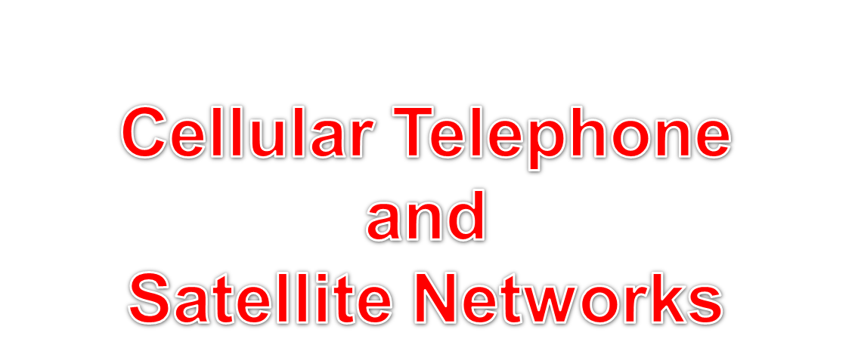

Slide 2
CELLULAR TELEPHONE
Cellular telephone is designed to provide communications between two moving units, called mobile stations (MSs), or between one mobile unit and one stationary unit, often called a land unit.
•Cellular service area divided into cells.
•Each cell contains an antenna and controlled by a BS
•Each BS in turn is controlled by a switching office called a mobile
_{switching Center (MSC)}

Slide 3
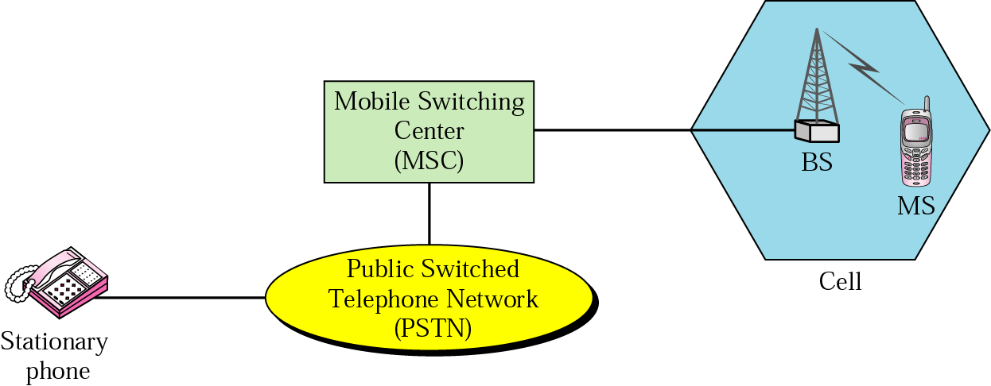
Cellular system

Slide 4
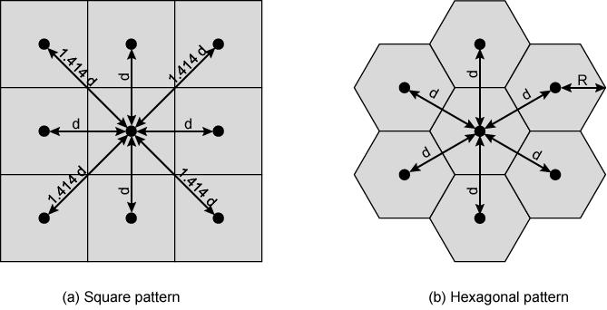
Cellular Geometries

Slide 5
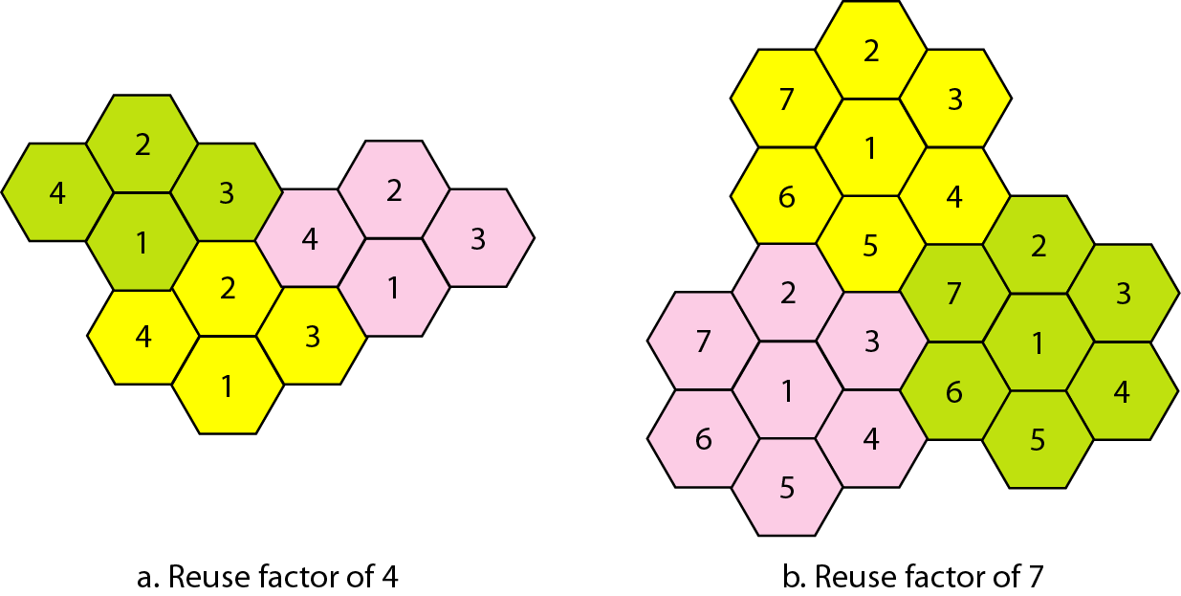
Frequency reuse patterns
Frequency reuse is the process in which the same set of frequencies (channels) can be allocated to more than one cell, provided the cells are separated by sufficient distance.

Slide 6
Transmitting and Receiving
Transmitting involves the following steps:
A caller enters a code of 10 digits (a phone number) and presses the send button.
The mobile station then scans the band, seeking a setup channel with a strong signal, and sends the data (phone number) to the closest base station using that channel.
The base station relays the data to the MSC.
The MSC sends the data on to the telephone central office. If the called party is available, a connection is made and the result is relayed back to the MSC.
The MSC assigns an unused voice channel to the call, and a connection is established and communication can begin.

Slide 7
Transmitting and Receiving
Receiving involves the following steps:
When a mobile phone is called, the telephone central office sends the number to the MSC.
The MSC searches for the location of the mobile station by sending query signals to each cell in a process called paging.
Once the mobile station is found, The MSC transmits a ringing signal and, when the mobile station answers, assigns a voice channel to the call, allowing voice communication to begin.

Slide 8
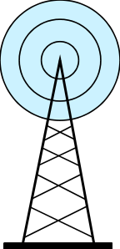

Handoff
When a mobile station moves out of a cell, the base station notices the MS’s signal fading away and requests all the neighbouring BSs to report the strength they are receiving. The BS then transfers ownership to the cell getting the strongest signal and the MSC changes the channel carrying the call. The process is called handoff.

Slide 9
Types of Handoff
Hard Handoff In a hard handoff, a mobile station only communicates with one base station. When the MS moves from one cell to another, communication must first be broken with the previous base station before communication can be established with the new one.
_{Soft Handoff In Soft} handoff, a mobile station can communicate with two base stations at the same time. This means that, during handoff, a mobile station may continue with the new base station before breaking off from the old one.

Slide 10
Other Functions
_{Call blocking}
  During mobile-initiated call stage, if all traffic channels busy, mobile tries again
_{Call termination}
  _{User hangs up}
  Traffic channels at two BSs released
_{Call drop}
  BS cannot maintain required signal strength
  _{Traffic channel dropped}

Slide 11
Cellular Network Generations
  1G: Analog cellular telephone
  2G: Digital cellular telephone
  3G: High-speed digital cellular telephone (including video telephone)
  4G: LTE(Long Term Evolution ): IP-based “anytime, anywhere” voice, data, and multimedia telephone at faster data rates than 3G

Slide 12
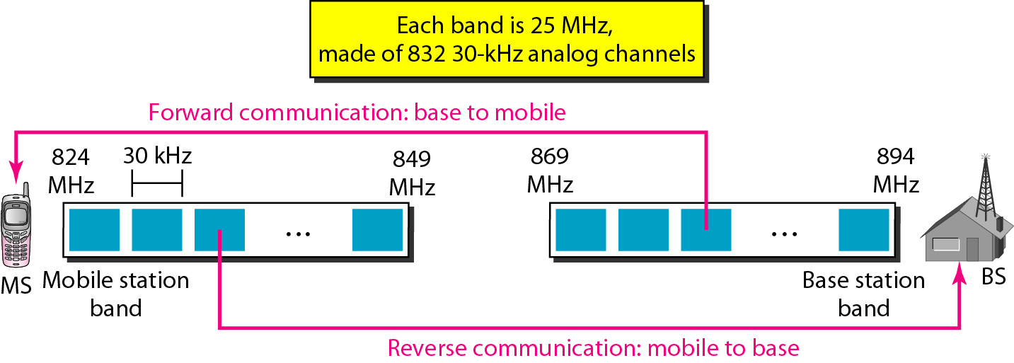
First Generation
First-generation mobile system used in North America, AMPS.
Advanced Mobile Phone System (AMPS) is an analog cellular phone system using FDMA to separate channels in a link. The system uses two separate analog channels, one for forward (base station to mobile station) communication and one for reverse (mobile station to base station) communication. The band between 824 and 849 MHz carries reverse communication; the band between 869 and 894 MHz carries forward communication. AMPS uses FM and FSK for modulation

Slide 13
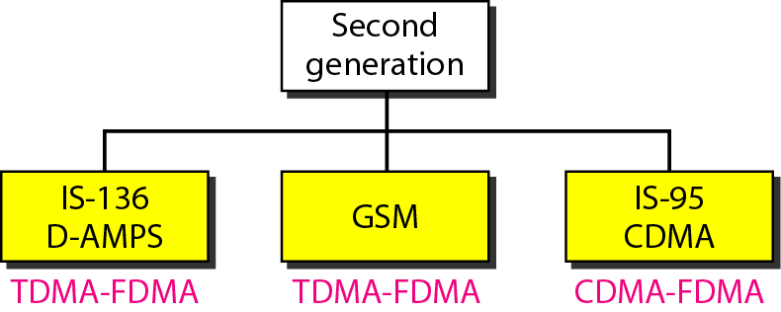
Second Generation

Slide 14
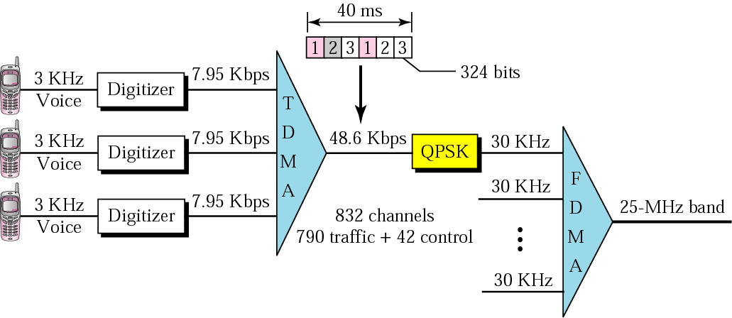
D-AMPS
D-AMPS is a digital version of AMPS and it is backward
compatible with AMPS. It uses the same bands and channels as AMPS. Each voice channel is digitized using a very complex PCM and compression technique. A voice channel is digitized to 7.95 kbps. Three 7.95-kbps digital voice channels are combined using TDMA. The result is 48.6 kbps of digital data. The resulting 48.6 kbps of digital data modulates a carrier using QPSK; the result is a 30-kHz analog signal share a 25-MHz band (FDMA).

Slide 15
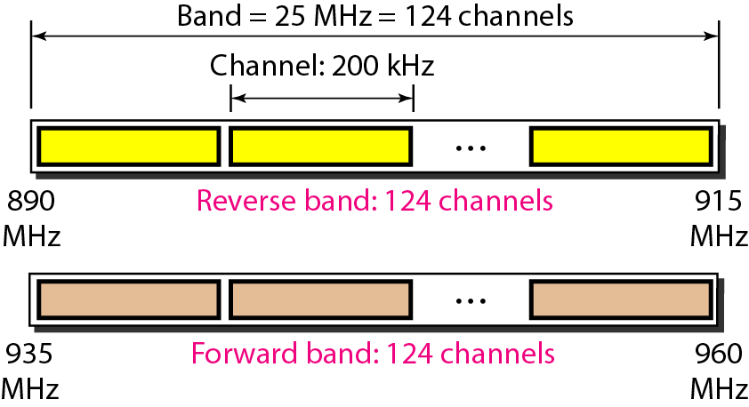
GSM
The Global System for Mobile Communication (GSM) is a European standard that was developed to provide a common second-generation technology for all Europe. The aim was to replace a number of incompatible first-generation technologies. GSM uses two bands for duplex communication. Each band is 25 MHz in width and divided into 124 channels of 200 kHz separated by guard bands.

Slide 16
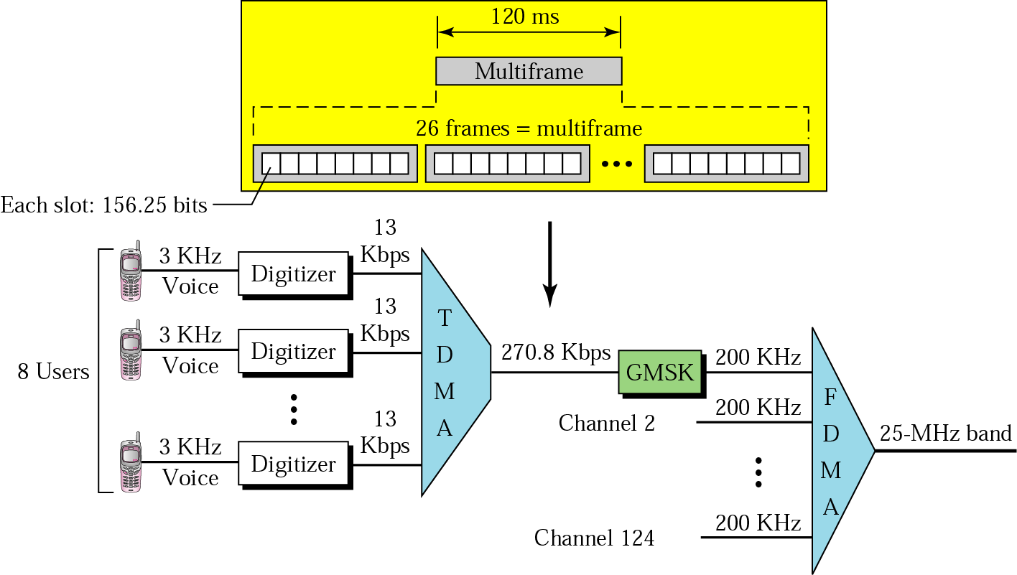
GSM
Each voice channel is digitized and compressed to a 13-kbps digital signal. Eight slots share a frame (TDMA). Twenty-six frames also share a multiframe. Each 270.8-kbps digital channel modulates a carrier using GMSK (FSK); 124 analog channels of 200 kHz are combined using FDMA. The result is a 25-MHz band.

Slide 17
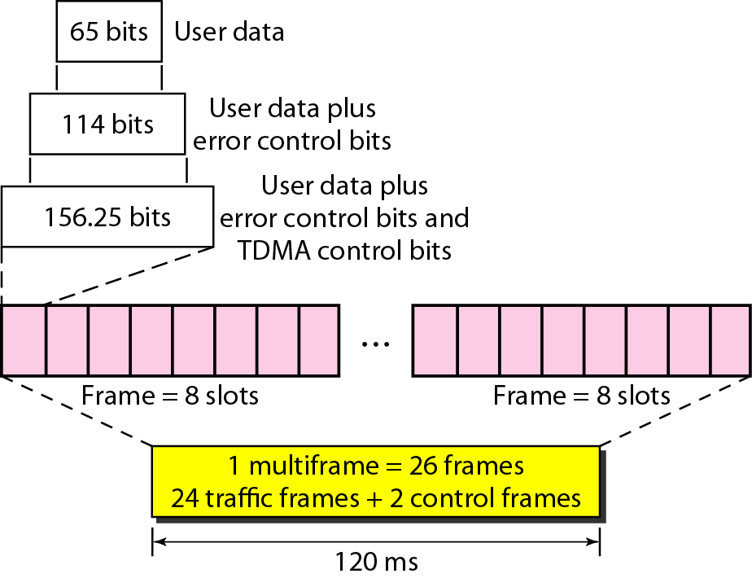
Multiframe components

Slide 18
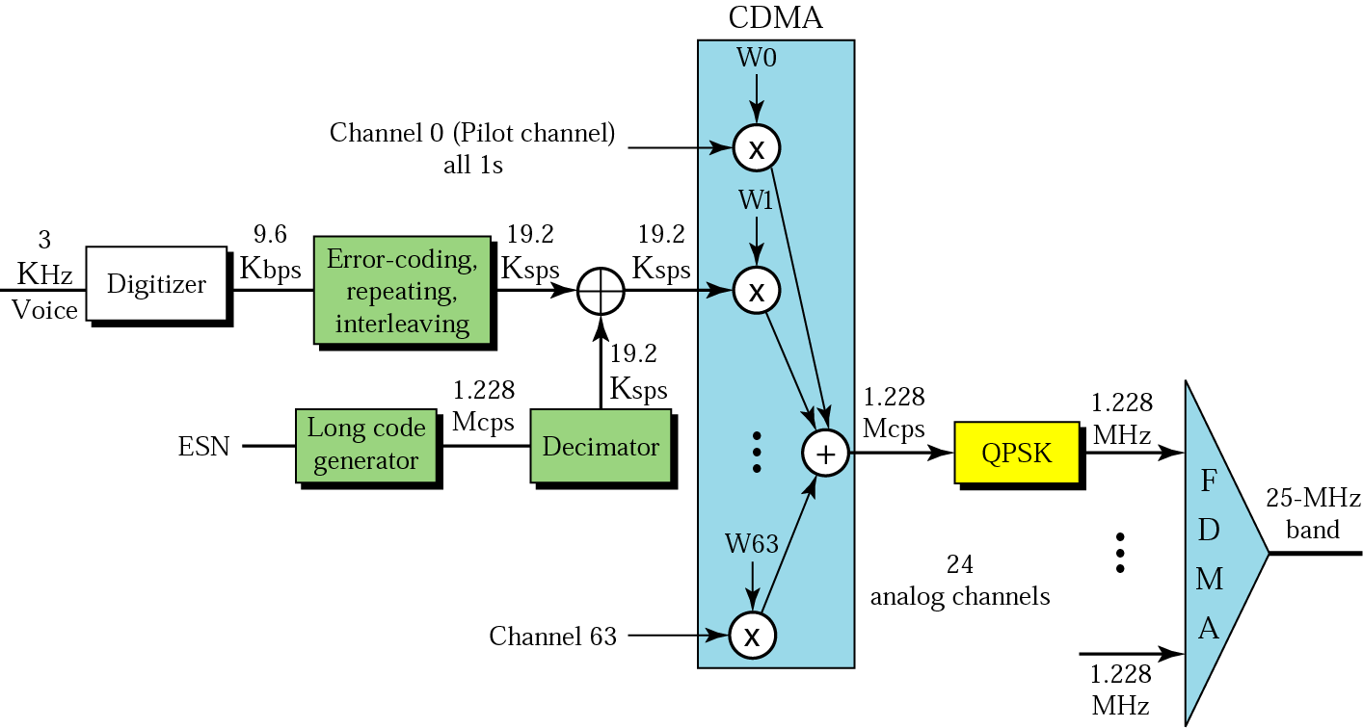
CDMA
Interim Standard-95 (IS-95) CDMA is based on CDMA/DSSS and FDMA medium access control technique.
_{IS-95 forward transmission}

Slide 19
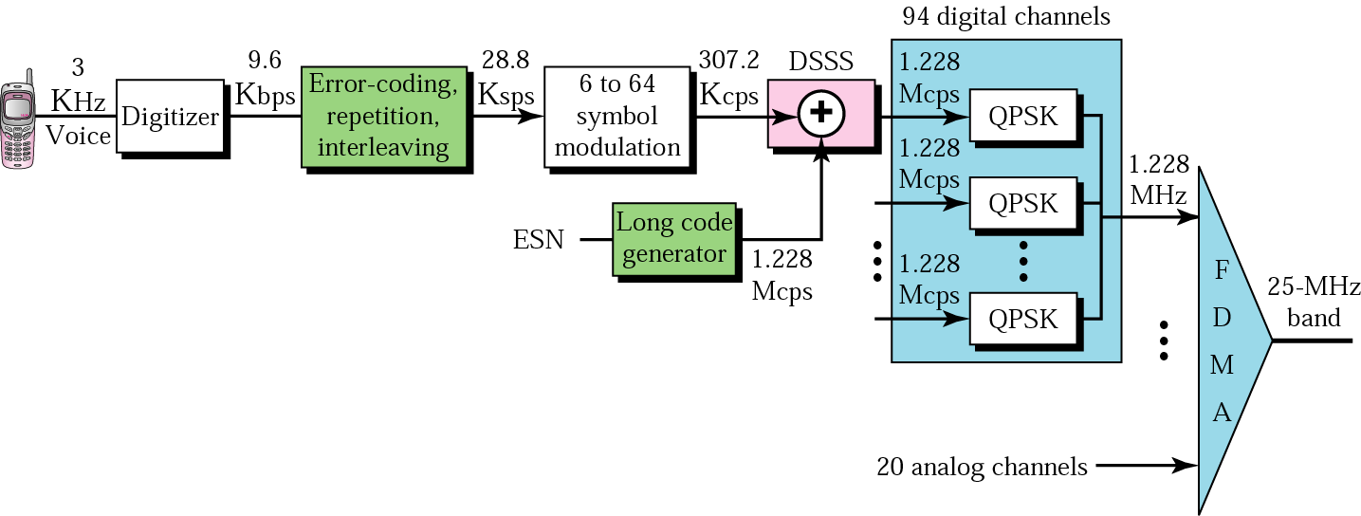
_{IS-95 reverse transmission}

Slide 20
3rd Generation Wireless
Provide high speed wireless for voice, data, video and multimedia
ITU’s view
  voice quality of wired
  144 kbps high-speed roaming / 384 kbps low-speed
  adaptive interface to internet for asymmetric speed
  more efficient use of spectrum (2GHz)
  support wide variety of equipment, services, etc

Slide 21
PCS & PCN
Personal Communications Services (PCS)
  find person easily
  use communication system anywhere with single account
Personal Communications Network (PCN)
  use terminal in wide variety of environments to connect to information services

Slide 22
WAP
Wireless Application Protocol
  universal, open standard - WAP forum
  provide mobile users access to information services, including internet and web
Works with wireless network technologies
Based on existing internet standards such as TCP, IP, HTTP, HTML, XML
Support limited resources in and variety of mobile devices

Slide 23
WAP Specs
Include
  programming model
  Wireless Markup Language (adhering to XML)
  Microbrowser
  Lightweight protocol stack
  Framework for wireless telephony applications

Slide 24
The main goal of third-generation cellular telephony is to provide
universal personal communication.

Slide 25
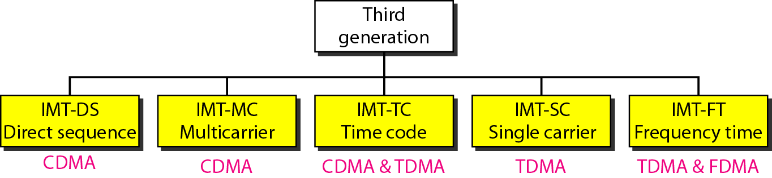
IMT-2000 radio interfaces

Slide 26
SATELLITE NETWORKS
A satellite network is a combination of nodes, some of which are satellites, that provides communication from one point on the Earth to another. A node in the network can be a satellite, an Earth station, or an end-user terminal or telephone.
Topics discussed in this section:
Orbits
Footprint
Three Categories of Satellites
GEO Satellites
MEO Satellites
LEO Satellites

Slide 27
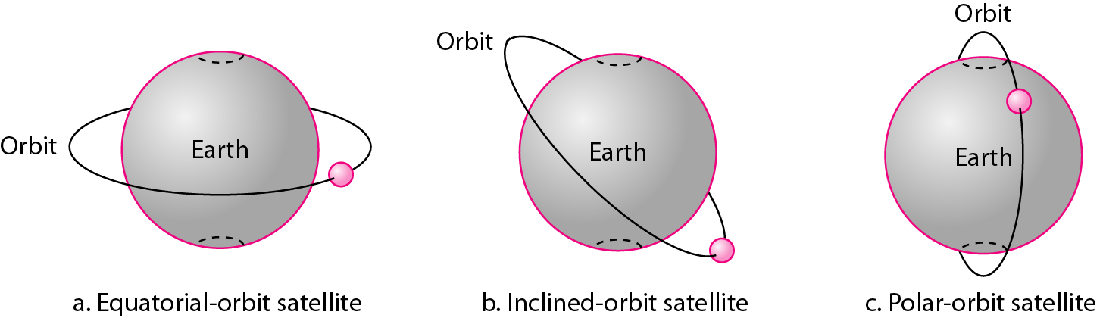
Satellite orbits

Slide 28

Example
What is the period of the Moon, according to Kepler’s law?
Here C is a constant approximately equal to 1/100. The period is in seconds and the distance in kilometers.

Slide 29
Example (continued)
Solution
The Moon is located approximately 384,000 km above the Earth. The radius of the Earth is 6378 km. Applying the formula, we get.

Slide 30
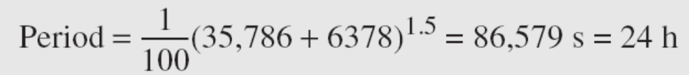
Example
According to Kepler’s law, what is the period of a satellite that is located at an orbit approximately 35,786 km above the Earth?
Solution
Applying the formula, we get

Slide 31
Example (continued)
This means that a satellite located at 35,786 km has a period of 24 h, which is the same as the rotation period of the Earth. A satellite like this is said to be stationary to the Earth. The orbit, as we will see, is called a geosynchronous orbit.

Slide 32
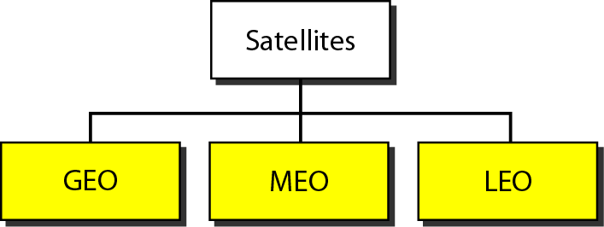
Satellite categories

Slide 33
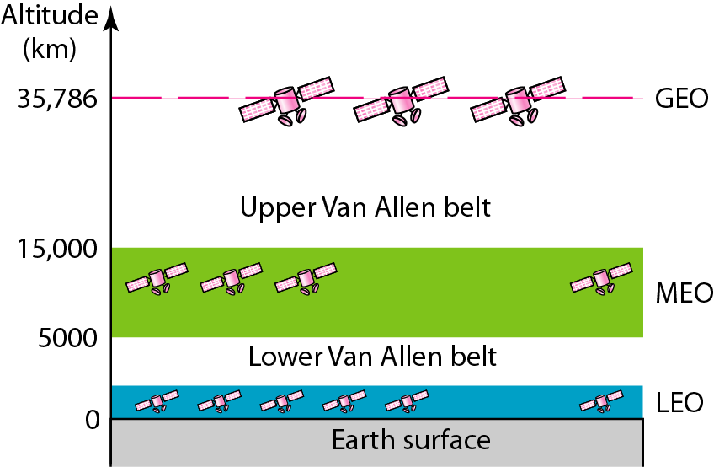
Satellite orbit altitudes

Slide 34
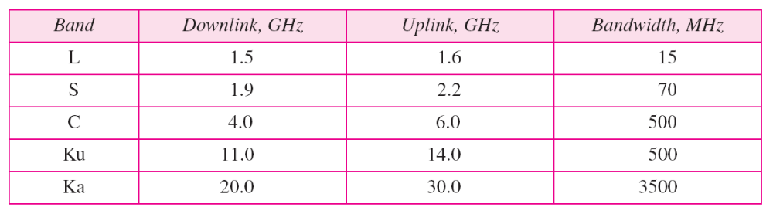
Table Satellite frequency bands

Slide 35
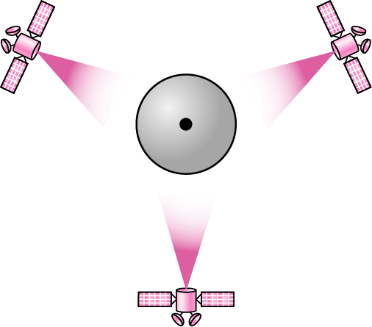
Satellites in geostationary orbit

Slide 36
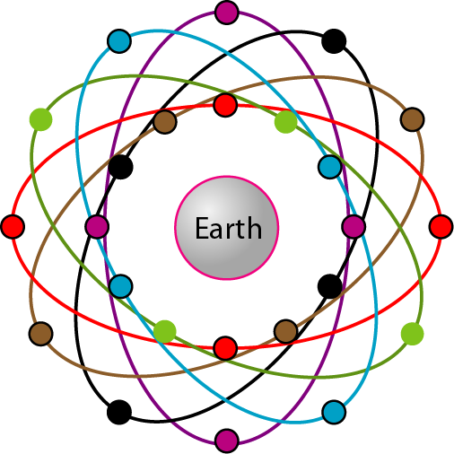
Orbits for global positioning system (GPS) satellites

Slide 37
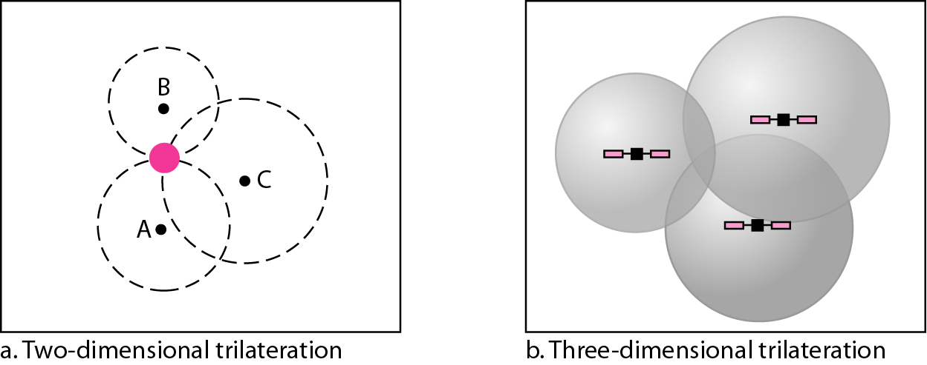
Trilateration

Slide 38
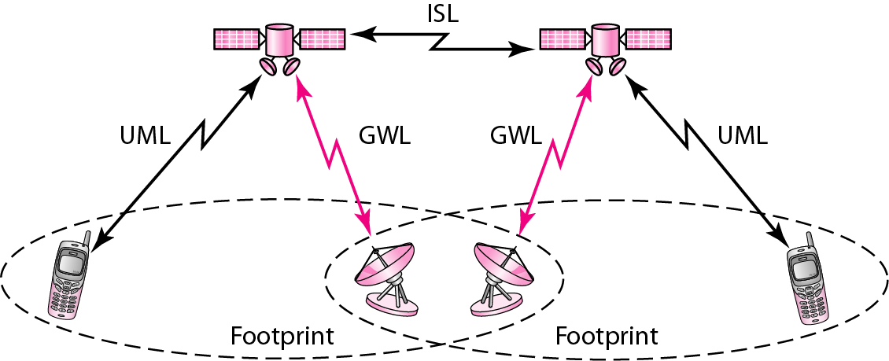
LEO satellite system

Slide 39
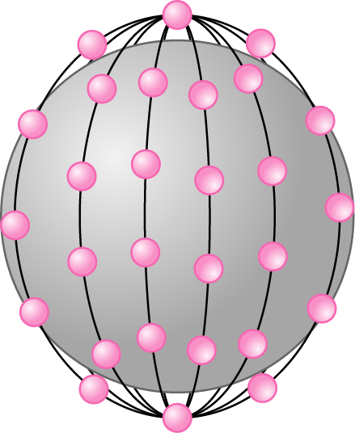
Iridium constellation

Slide 40
The Iridium system has 66 satellites in six LEO orbits, each at an
altitude of 750 km.

Slide 41
Iridium is designed to provide direct worldwide voice and data communication using
handheld terminals, a service similar to cellular telephony but on a global scale.

Slide 42
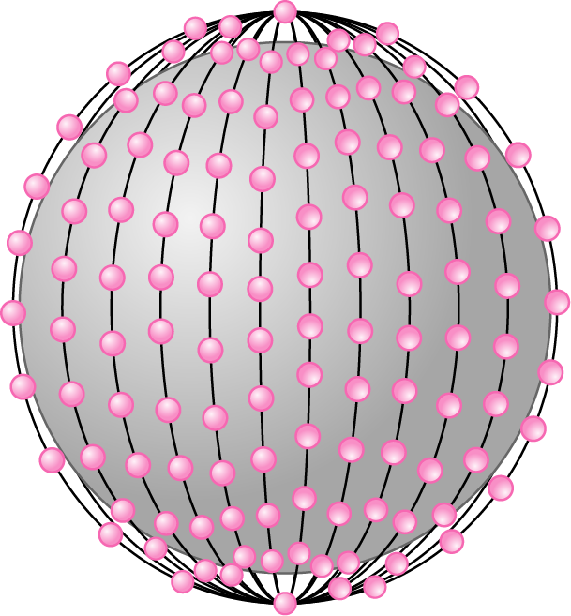
Teledesic

Slide 43
Teledesic has 288 satellites in 12 LEO orbits, each at an altitude of 1350 km.

