Slide 1
More Window
Controls

Slide 2
The Common Dialog Controls
OpenFileDialog
SaveFileDialog
ColorDialog
FontDialog
PrintDialog
The Rich TextBox Control

Slide 3
Common Dialog
Controls

Slide 4
There are some built-in dialog boxes that can be used in any application for prompting the user to choose filenames, font names and sizes, or colours to be used by the application.
The common dialogs are nothing more than dialog boxes, and they return a value indicating how they were closed.
To display a common dialog box from within your application, you must first add an instance of the appropriate control to your project.
To display a common dialog box from within your code, you simply call the control’s ShowDialog method, which is common for all dialog controls.
The code for invoking the Open Dialog box and retrieving the selected filename is as shown below
If OpenFileDlg1.ShowDialog=DialogResult.Ok Then
filename = OpenFileDlg1.FileName
End If

Slide 5
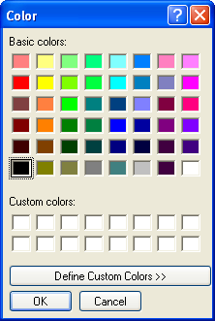
The Color Dialog Box

Slide 6
The Color Dialog Box
The code for invoking the Color Dialog box and reading the value of the selected colour is as shown below:
If ColorDialog1.ShowDialog=DialogResult.Ok Then
Me.BackColor = ColorDialog1.Color
End If
AllowFullOpen – This property enables the Define Custom Colors button on the Dialog box. Otherwise, this button is disabled.
ColorDialog1.AllowFullOpen = True
Color – If you set this property before opening the Color dialog box, the selected colour will appear on the control as the preselected colour.
ColorDialog1.Color = Color.Azure
AnyColor – This is a Boolean value property that determines whether the dialog box displays all available colors in the set of basic colours.

Slide 7
Custom Colors – This property indicates the set of custom colours that will be shown in the Color Dialog. The Color dialog box has a section called custom Colors, where you can display 16 additional custom colours.
The CustomColor property is an array of integers that represent colours. To display three custom colours in the lower section of the Color Dialog box, use a statement like the following:
Dim colors( ) As Integer = {222663, 35453, 7888}
ColorDialog1.CustomColors = colors
SolidColorOnly – Indicates whether the dialog box will restrict users to selecting solid colors only. This setting should be used with systems that can display only 256 colours.

Slide 8
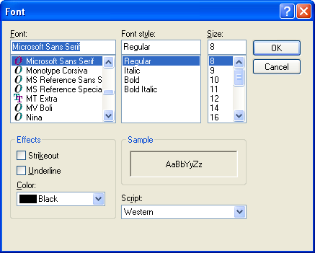
The Font Dialog Box

Slide 9
The Font Dialog Box
AllowSimulations – This property is a Boolean value that indicates whether the dialog box allows the display and selection of simulated fonts.
AllowVectorFonts – This property is a Boolean value that indicates whether the dialog box allows the display and selection of vector fonts.
AllowVerticalFonts – This property is a Boolean value that indicates whether the dialog box allows the display and selection of both horizontal and vertical fonts. Its default value is False.
FixedPitchOnly – This property is a Boolean value that indicates whether the dialog box allows only the selection of fixed-pitch fonts. Its default value is False.

Slide 10
The Font Dialog Box (…contd)
Font – This property is a Font object. Example:
If FontDialog1.ShowDialog = DialogResult.Ok Then
TextBox1.Font = FontDialog1.Font
End If
ShowColor – This property is a Boolean value that indicates whether the dialog box allows the user to select a colour for the font
Color – This property sets or returns the selected font colour. To select a colour for the selected font, the ShowColor property should be set to True.
TextBox1.ForeColor = FontDialog1.Color
ShowEffects - This property is a Boolean value that indicates whether the dialog box allows the user to specify special text effects, such as strikethrough and underline.

Slide 11
MaxSize, MinSize – These two properties are integers that determine the minimum and maximum point size the user can select.
AllowScriptChange – This property is a Boolean value that indicates whether the Script combo box will be displayed on the Font common dialog.
ScriptsOnly – (Check out)
ShowApply – (Check out) used to display the Apply button
FontMustExist – (Check out)

Slide 12
The OpenFile and SaveFile Dialog Controls
The following are the properties of the OpenFile dialog and SaveFile dialog controls:
AddExtension – This property is a Boolean value that determines whether the dialog box automatically adds an extension to a filename.
CheckFileExists - This property is a Boolean value that indicates whether the dialog box displays a warning if the user enters the name of a file that does not exist.
CheckPathExists - This property is a Boolean value that indicates whether the dialog box displays a warning if the user specifies a path that does not exist, as part of the user-supplied filename.
DefaultExtension – This property sets the default extension of the dialog box.
DereferenceLinks - This property indicates whether the dialog box returns the location of the file referenced by the shortcut or the location of the shortcut itself.
FileName – This property is the path of the file selected by the user on the control.

Slide 13
The OpenFile and SaveFile Dialog Controls
Filter – This property is used to specify the type(s) of files displayed on the dialog box.
FilterIndex – When you specify more than one filter for the Open dialog box, the filter specified first in the Filter property becomes the default.
InitialDirectory – This property sets the initial directory (folder) in which files are displayed
MultiSelect – This property is a Boolean value that indicates whether the user can select multiple files on the dialog box.
ReadOnlyChecked – This property is a Boolean value that indicates whether the read-only check box is initially selected when the dialog box first pop ups.
ShowReadOnly
RestoreDirectory
ValidateNames
FileNames

Slide 14
The OpenFile Dialog Box
Example:
OpenFileDialog1.DefaultExt = "TXT”
OpenFileDialog1.AddExtension = True
OpenFileDialog1.CheckFileExists = True
OpenFileDialog1.Multiselect =True
OpenFileDialog1.Filter = "Text Files|*.TXT|HTML Files|*.HTM|All Files|*.*"
OpenFileDialog1.FilterIndex = 1
OpenFileDialog1.ShowDialog()
If OpenFileDialog1.FileName = "" Then Exit Sub
Dim TReader As System.IO.StreamReader
System.IO.StreamReader(OpenFileDialog1.FileName)
Editor.Text = TReader.ReadToEnd
TReader.Close()

Slide 15
The Save As Dialog Box
Example:
SaveFileDialog1.DefaultExt = "TXT“
SaveFileDialog1.AddExtension = True
SaveFileDialog1.Filter = "Text Files|*.TXT|HTML Files|*.HTM|All Files|*.*"
SaveFileDialog1.FilterIndex = 1
SaveFileDialog1.ShowDialog()
If SaveFileDialog1.FileName = "" Then Exit Sub
Note: Go through Chapter 13 : For Opening and Saving a File

Slide 16
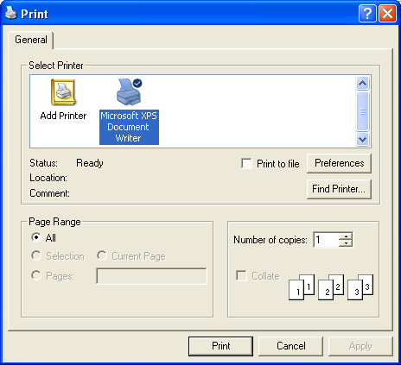
The Print Dialog Box
The following properties are Boolean values:
AllowPrintToFile – Controls whether the user will be given the option to print to a file.
AllowSelection – Determines whether the user is allowed to print the current slection of the document.
AllowSomePages – Determines whether the Pages option on the dialog box will be enabled.

Slide 17
The Print Dialog Box
PrintDialog1.AllowSomePages = True
PrintDialog1.AllowSelection = True
PrintDialog1.PrinterSettings = New System.Drawimg.Printing.PrinterSettings()
PrintDialog1..ShowDialog()
To retrieve the properties of the printout specified by the user on the dialog box, you must use the PrintSettings object. This object exposes many properties, such as FromPage, ToPage, PrinterName, etc. as given below:
PrintDialog1.PrinterSettings.FromPage
PrintDialog1.PrinterSettings.ToPage
PrintDialog1.PrinterSettings.Copies
PrintDialog1.PrinterSettings.PrinterName
PrintDialog1.PrinterSettings.PrintRange
PrintDialog1.PrinterSettings.LandscapeAngle

Slide 18
The Rich TextBox Control
The Rich TextBox is the core of a full-blown word processor.
It provides all the functionality of a textbox control; in addition, it gives one the capability to mix different fonts, sizes, and attributes.
It also gives a precise control over the margins of the text.
Also, images can be placed in the text on a Rich TextBox control
The fundamental property of the Rich TextBox control is its RTF (Rich Text Format) property.
It is similar to the Text property of the TextBox control. However, besides returning the text of the control it also returns the formatting information, like font size, style and colour.

Slide 19
The RTF Language
RTF (Rich Text Format) is a language similar to HTML (Hypertext Markup Language).
RTF uses simple commands to specify the formatting of a document. These commands, or tags, are ASCII strings, such as \par (to mark the beginning of the paragraph) and \b (to turn on the bold style). All formatting tags are prefixed with the backslash (\) symbol.

Slide 20
The Rich TextBox’s Properties
SelectedText – The Selected text. Example: Str = RichTextBox1.SelectedText
SelectedRTF – The RTF code of the selected text.
SlelectionStart – The position of the selected text’s first character.
SelectionLength – The length of the selected text.
SelectionFont – The font of the selected text.
SelectionColor – The colour of the selected text.
SelectionIndent, SelectionRightIndent, SelectionHangingIndent – The indentation of the selected text.
RightMargin – The distance of the text’s right margin from the left edge of the control
SelectionBullet – Whether the selected text is bulleted
BulletIndent – The amount of bullet indent for the selected text.

Slide 21
The Rich TextBox’s Methods
SaveFile – Saves the contents of the control to a disk file.
RichTextBox1.SaveFile(path, filetype)
LoadFile – Loads the control from a disk file
RichTextBox1.LoadFile(path, filetype)
Select– Selects a section of the text.
RichTextBox1.Select(start, length)
SelectAll - Selects the entire text.
RichTextBox1.SelectAll( )
CanUndo, CanRedo – Boolean value properties
Undo, Redo – To undo or redo an action.
Cut, Copy, Paste
RichTextBox1.Cut( )
Find – locates a string in the control’s text. Similar to InStr( ) function
RichTextBox1.Find(string)
RichTextBox1. Find(string, searchMode)

Slide 22
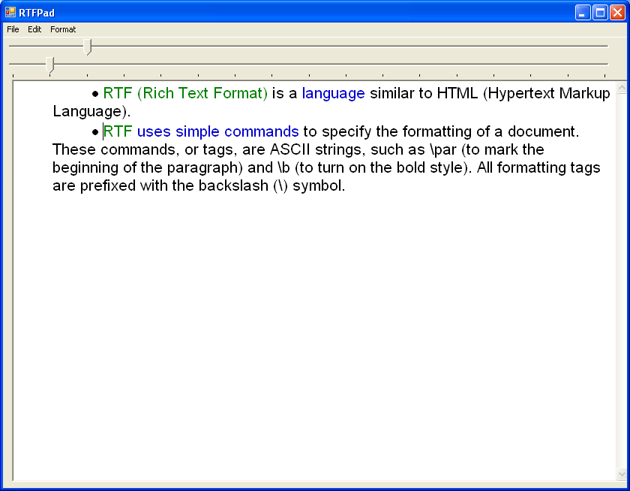

Slide 23
Menu Options for the RTF Project
File Edit Format
New
Open
Save
Save As
Exit
Undo
Redo
Cut
Copy
Paste
Select All
Find
Word Wrap
Bold
Regular
Italic
Underline
Upper Case
Lower Case
Font
Text Color
Page Color

