Slide 1
Basic Windows
Controls

Slide 2
The Text Box Control
The TextBox control is the primary mechanism for displaying and entering text and is one of the most common elements of the Windows user interface.
With the exception of graphics applications, the textbox control is the bread and butter of any Windows application.
The Textbox control can hold more than 2 billion characters, which is more than you care to read in a single session.

Slide 3
Basic Properties of the Text Box Control
Multiline, ScrollBars and WordWrap - By default, the Windows Forms TextBox control displays a single line of text and does not display scroll bars. If the text is longer than the available space, only part of the text is visible. You can change this default behavior by setting the Multiline, WordWrap, and ScrollBars properties to appropriate values.
MaxLength - Determines the maximum number of characters allowed in the text box. Its default value is 32,767 and its maximum capacity is 2 GB (For this, set this property to zero.
AcceptReturn – (Values: True / False) Determines how the control reacts to the Return (Enter) key. If its value is set to True, pressing Ctrl+ENTER keys in a multiline TextBox control, will activate the default button for the form.
AcceptTab - (Values: True / False) Determines how the control reacts to the Tab key. If its value is set to True, pressing Ctrl+Tab in a multiline TextBox control, will move to the next control in the form.

Slide 4
Text-Manipulation Properties
Text – The most important property of the TextBox control, which holds the control’s text.
ReadOnly – (value: True / False) Indicates whether the contents of the TextBox control can be changed.
Locked - (value: True / False) Locks the control at design time so that we cannot move or change its properties by mistake.
Lines – Lines is a string array where each element holds a line of text. The first line of the text is stored in the element Lines(0).
PasswordChar - Sets the character for masking characters of a password in a single-line TextBox control. Can set this value to asterisk (*).

Slide 5
Text-Selection Properties
SelectedText – Returns the selected text, enabling one to manipulate the current selection from within the code.
SelectionStart – Returns or sets the position of the first character of the selected text.
SelectionLength – Returns or sets the length of the selected text.
HideSelection – Used to keep text highlighted in a TextBox control while another form or a dialog box has the focus, such as a Find and Replace dialog box.
Text-Selection Methods
The TextBox control has two methods for selecting text – Select and SelectAll
Syntax: TextBox1.Select(start, length)
TextBox1.SelectAll( )

Slide 6
My.Computer.Clipboard Object
The Clipboard can be used to store data, such as text and images. Because the Clipboard is shared by all active processes, it can be used to transfer data between them. Items moved or copied to the Clipboard persist even after the application is shut down.
Data on the Clipboard can be in any data format, also called a Clipboard format.
The My.Computer.Clipboard object provides methods and properties that can be used to interact with the Clipboard, allowing the user to write data to or get data from the Clipboard, as well as to check whether data of a specified format exists on the Clipboard.
The Clipboard is a set of functions and messages that enable applications to transfer data. Because all applications have access to the Clipboard, data can be transferred easily between them.

Slide 7
To read text from the Clipboard and display it
The following code reads the text and displays it in a message box. There must be text stored on the Clipboard for the example to run correctly.
MsgBox(My.Computer.Clipboard.GetText())
To write text to the Clipboard
The following code writes the string "This is a test string" to the Clipboard.
My.Computer.Clipboard.SetText("This is a test string.")
To clear the Clipboard
Use the Clear method, as follows:
My.Computer.Clipboard.Clear()

Slide 8
Operations Available in the Edit Menu
The Cut, Copy and Paste Operations:
Private Sub EditCopy_Click(ByVal sender As System.Object, ByVal e As System.EventArgs) Handles EditCopy.Click
My.Computer.Clipboard.SetText(txtMain.SelectedText)
End Sub
Private Sub EditCut_Click(ByVal sender As System.Object, ByVal e As System.EventArgs) Handles EditCut.Click
My.Computer.Clipboard.SetText(txtMain.SelectedText)
txtMain.SelectedText = "“
End Sub
Private Sub EditPaste_Click(ByVal sender As System.Object, ByVal e As System.EventArgs) Handles EditPaste.Click
txtMain.SelectedText = My.Computer.Clipboard.GetText()
End Sub

Slide 9
The List Box,
CheckedListBox
and
ComboBox
Controls

Slide 10
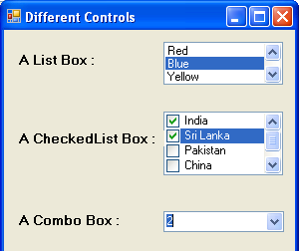
The ListBox, CheckedListBox and ComboBox controls present list of choices from which the user can select one or more.

Slide 11
Differences Among These Controls
The ListBox control occupies a user-specified amount of space on the form and is populated with a list of items. If the list of items is longer than one can fit on the control, a vertical scroll bar appears automatically.
The CheckedListBox control is a variation of a ListBox control. It displays a list of items, like the ListBox control, but also displays a check mark next to items in the list.
The ComboBox control also contains multiple items but typically occupies less space on the screen. The ComboBox control is an expandable ListBox control; the user can expand is to make a selection and collapse it after the selection is made.

Slide 12
Types of Combo Boxes
There are three types of ComboBox control –
DropDown
DropDownList, and,
Simple
Any of these types can be chosen with the help of the DropDownStyle property of the ComBox control.
Value Effect
DropDown (Default) It is a combination of a drop-down list and a text box. An item can be selected from the list or a new one can be typed in the text box.
DropDownList It is a drop-down list. An item can be selected from the list but a new one cannot be typed in the text box.
Simple It is a combination of a list and a text box that does not drop down. An item can be selected from the list or a new one can be typed in the text box.

Slide 13
Common Basic Properties of These Controls
IntegralHeight – This property is a Boolean value (True/False) that indicates whether the control’s height will be adjusted to avoid the partial display of the last item
Items – The Items property is a collection that holds the items on the control. We use the members of the Items collection to access the control’s items and to add or remove items. Each member of the Items collection is an object.
MultiColumn – A ListBox control can display its items in multiple columns, if you set its MultiColumn property to True.
SelectionMode – This property determines whether the user can select multiple items and which method will be used for multiple selections.
Sorted – If you want the items to be always sorted, set the control’s sorted property to True.

Slide 14
The Items Collection
Add – To add items to the list, we use the Items.Add method. The syntax of the Add method is
ListBox1.Items.Add(item)
The Add method appends new items to the end of the list, unless the Sorted property has been set to True.
Insert – To insert an item at a specific location, we use this method, whose syntax is:
ListBox1.Items.Insert(index, item)
where item is the object to be added and index is the location of the new item.
Clear – The Clear method removes all the items from the control. Its syntax is:
ListBox1.Items.Clear
Count – This is the number of items in the list.
ListBox1.Items.Count

Slide 15
Remove – To remove an item from the list, we can use this method, whose syntax is:
ListBox1.Items.Remove(index)
or, ListBox1.Items.Remove(item)
CopyTo – This method retrieves all the items from a ListBox control and stores them to the array passed to the method as argument. Its syntax is:
ListBox1.Items.CopyTo(arr, index)
where arr is the name of the array that will accept the items and index is the index of an element in the array where the first item will be stored.
Contains – This method accepts an object as argument and returns a True/False value indicating whether the collection contains this object or not.
Dim varItem as String
If Not ListBox1.Items.Contains(varItem) Then
ListBox1.Items.Add(varItem)
End If

Slide 16
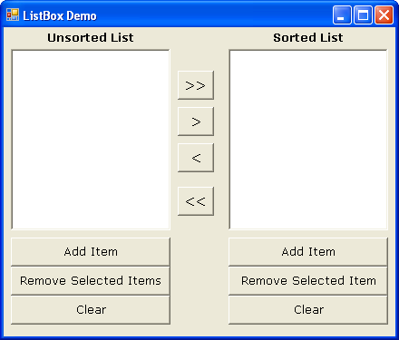

Slide 17
Program:
In the colour code that is used in resistors, the different colours have values as follows:
Black=0, Brown=1, Red=2, Orange=3, Yellow=4, Green=5, Blue=6, Violet=7, Gray=8 and White=9.
The value of the resistor is indicated by drawing three coloured bands round it. The first two bands indicate the first two digits in the numerical value of the resistance, while the third band is the decimal multiplier, i.e., it gives the number of zeroes after the two digits.
For example, if the bands have colours Green-Blue-Orange successively, then the numerical value is 56000.
Design a form with suitable controls and write appropriate event handlers to accept the colours from the user and print the equivalent numerical. Use combo boxes for choosing the various colour options.

Slide 18
The ScrollBar
and
TrackBar
Controls

Slide 19
The ScrollBar & TrackBar Controls
Both these controls let the user specify a magnitude by scrolling a selector between its minimum and maximum values.
The ScrollBar control should be used when the exact value is not as important as the value’s effect on another object or data element.
The Trackbar control has a fixed number of Tick marks, which the developer can label. The user can place the slider’s indicator to the desired value.

Slide 20
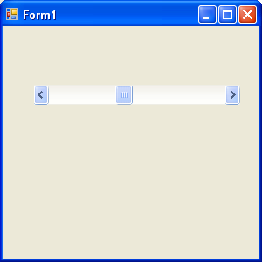
Note: The Minimum and Maximum properties are positive Integer values. If the range we need is 2.5 to 8.5, we can set the Minimum property to 25 and the Maximum property to 85, and then divide the control’s value by 10.
SmallChange
Value
SmallChange
LargeChange
The Basic Properties of a ScrollBar control are:
Minimum – The control’s minimum value (Default value is 0)
Maximum - The control’s maximum value (Default value is 100)
Value - The control’s current value, specified by the indicator’s position.
SmallChange – The amount by which the scroll box position changes when the user clicks a scroll arrow or presses an arrow key.
LargeChange – The amount by which the scroll box position changes when the user clicks in the scroll bar or presses the Page Up or Page Down key.

Slide 21
Changing the Value of a ScrollBar Control
The user can change the ScrollBar control’s value in three ways:
By clicking the two arrows at its ends
By clicking the area between the indicator and the arrows
By dragging the indicator with the mouse
You can monitor the changes on the scrollBar’s value from within your code with two events: ValueChanged and Scroll. Both the events are fired every time the indicator’s position is changed.
If you change the control’s value from within your code, then only the ValueChanged event will be fired.
The Scroll event can be fired in response to many different actions, such as scrolling of the indicator with the mouse or a click on one of the two buttons at the ends of the scrollbars.

Slide 22
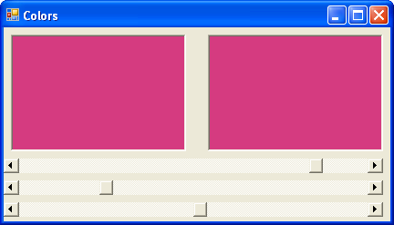

Slide 23
Program:
Using functions, write a program to calculate the simple interest accured on a given principal using the formula:
SI = (Principal x rate x Time) / 100
The user input and output thereof must be on different forms. The input form must have a textbox where the principal must be entered by the user, a scroll bar for the rate of interest, and a listbox from where the user can select the time (in years). Provision must also be kept for adding and removing items to and from the listbox.
On clicking a button, the function must calculate the SI and the result should be shown in the second form.

Slide 24
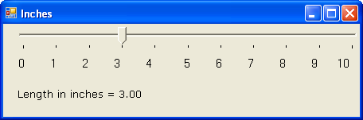
The TrackBar Control
The Basic Properties of a TrackBar control are:
Minimum – The control’s minimum value (Default value is 0)
Maximum – The control’s maximum value (Default value is 100)
Value – The control’s current value, specified by the indicator’s position.
SmallChange – The number of positions the slider moves in response to keyboard input.
LargeChange - The number of positions the slider moves in response to mouse clicks or the PAGE UP and PAGE DOWN keys.
TickFrequency –The number of positions between the tick marks.

