Slide 1
Building
Custom Window Controls

Slide 2
Custom Window Controls
In addition to a host of controls that come with VB.NET, you can also easily create your own custom controls.
There are three ways in which a custom control can be created:
Designing a new control that inherits an existing control and adds some extra functionality.
Designing a new control that combine multiple .NET controls. Such controls are called as compound controls.
Designing a user-drawn control which is an empty surface where the control’s interface is needed to be drawn.

Slide 3
Enhancing Existing Controls
The .NET Windows controls are quite functional, and you’ll be hard-pressed to come up with ideas to make them better.
However, its very likely that you may have to add some functionality that’s specific to an application.
For example, to add a functionality to a TextBox, we can change its background colour as soon as it loses focus.
Building Compound Controls
A compound control provides a visible interface that combines multiple Windows controls.
For example, if we need to combine two or more text boxes along with their corresponding labels, and treat it as one control, it will be considered as a compound control.

Slide 4
Steps For Building Compound Controls
Start with a new Windows Form Control Library project.
Place the appropriate controls required to use on the UserControl object to make it behave as a Custom Compound Control.
Get the coding written for the UserControl object.
Once done, build the control to create a DLL file.
Now start with a new Windows Application Project. Add, in the toolbox, choose the UserControl tool from the toolbox.
Add the tool in the form and carry out further steps to complete the program.

Slide 5
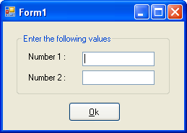
A Compound Control
Involving
Several Existing Controls
Public Class Form1
Dim ans As Integer
Private Sub Button1_Click(… …) Handles Button1.Click
ans = ctrl.number1 + ctrl.number2
MsgBox(ans)
End Sub
End Class

Slide 6
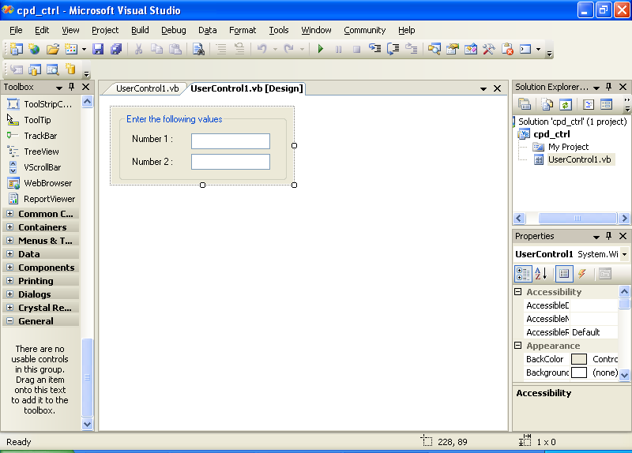
Designing The Compound Control

Slide 7
Public Class ctrl
Property number1() As Integer
Get
number1 = TextBox1.Text
End Get
Set(ByVal value As Integer)
TextBox1.Text = value
End Set
End Property
Property number2() As Integer
Get
number2 = TextBox2.Text
End Get
Set(ByVal value As Integer)
TextBox2.Text = value
End Set
End Property
End Class

Slide 8
Steps For Building An Existing Control With Further Capabilities
Public Class MyTextBox
Inherits TextBox
Private Sub MyTBox_Enter(ByVal sender As Object, ByVal e As System.EventArgs) Handles Me.Enter
Me.BackColor = Color.Crimson
End Sub
Private Sub MyTBox_Leave(ByVal sender As Object, ByVal e As System.EventArgs) Handles Me.Leave
Me.BackColor = Color.LightSkyBlue
End Sub
End Class

Slide 9
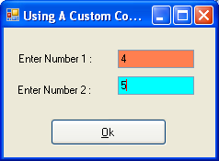
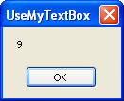
Using A
Custom Control
That Is Inherited
From A TextBox
Public Class Form1
Private Sub Button1_Click(… …) Handles Button1.Click
Dim n As Integer
n = Val(MyTextBox1.Text) + Val(MyTextBox2.Text)
MsgBox(n)
End Sub
End Class

Slide 10
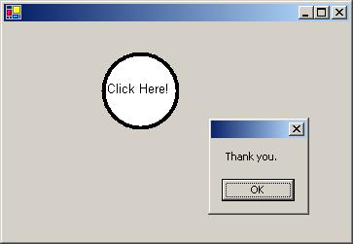
Steps For Building User Drawn Control
The UserControl class provides an empty control that can be used to create other controls. It is an indirect child of the Control class.
One important thing when developing a custom control is how we draw the user interface. Whatever shape our custom control has, we need to be aware that the control is repainted occasionally. Therefore, the user interface must be redrawn whenever your custom control is repainted.
Considering that the Control class' OnPaint method is called every time the control is repainted, overriding this method with a new OnPaint method that draws your custom control's user interface will ensure that your custom control has a permanent look.
Building The
RoundButton Control
Figure 1: The RoundButton control
embedded in a form.

Slide 11
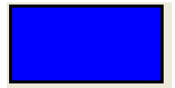
To Create A Rectangular Shaped Control
Public Class NewCtrl
Inherits UserControl
Protected Overrides Sub OnPaint(ByVal e As PaintEventArgs)
Dim graphics As Graphics = e.Graphics
'create pen for drawing the border of the rectangle
Dim blackPen As New Pen(Color.Black, 4)
graphics.DrawRectangle(blackPen, 5, 5, width-4, height-4)
'for filling up the interior of a rectangle with a colour
Dim myBrush As New SolidBrush(Color.Blue)
graphics.FillRectangle(myBrush, 7, 7, width-8, height-8)
End Sub
End Class

Slide 12
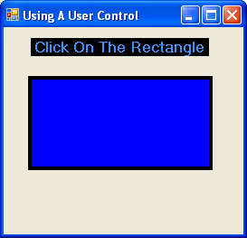
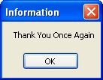
Designing The Form

Slide 13
Public Class frmCtrl
Private Sub NewCtrl1_Click(ByVal sender As Object, ByVal e As System.EventArgs) Handles NewCtrl1.Click
Static Dim ch As Boolean
If ch = False Then
NewCtrl1.Width = 100
NewCtrl1.Height = 50
NewCtrl1.Refresh()
MsgBox("Thank You", MsgBoxStyle.OkOnly, "Information")
Else
NewCtrl1.Width = 200
NewCtrl1.Height = 100
NewCtrl1.Refresh()
MsgBox("Thank You Once Again", MsgBoxStyle.OkOnly, "Information")
End If
ch = Not ch
End Sub
End Class

Slide 14
Using ActiveX Controls
ActiveX controls were the old Windows controls used with previous versions of VB. You can continue using ActiveX controls with the .NET projects as well.
To add an ActiveX control to the toolbox, we need to right-click the ToolBox and select ‘Choose Items…’ option. In the COM components tab, we can locate the ActiveX controls we want to add. Once selected, it appears in the list of controls that are available in the ToolBox.
By default, .NET does not know how to handle ActiveX controls. To use an ActiveX control in a .NET application, we must create a “wrapper” around the ActiveX control. The wrapper is a layer of code that allows .NET to communicate with the ActiveX control. .NET thinks it is talking to a .NET control, an the ActiveX control thinks its talking to a COM component. Hence, the wrapper acts as a translator that allows the two parties to communicate with one another, even though they don’t understand each other’s language. This is called a Runtime Callable Wrapper (RCW).

