Slide 1
DEBUGGING

Slide 2
Debugging
The act of hunting and eliminating errors in a program is called debugging.
Removing the bugs is called as debugging the program.
There are few weapons that can be used in the war against bugs –
Breakpoints,
Stepping through,
Local and Watch windows

Slide 3
Breakpoints
When we set a breakpoint in a program, we are telling the VB.NET to stop execution of the program when it reaches a certain line in the code.
Once stopped, we can examine the state of the program, including the values of the variables, the procedure stack, etc.
The value of the various variables can be seen in a tooltip by resting the mouse over the variable.
Once, the bug is found, to fix it is easy. We need to stop the program from running by selecting Stop Debugging from the Debug menu ( shortcut key is Shift + F5)

Slide 4
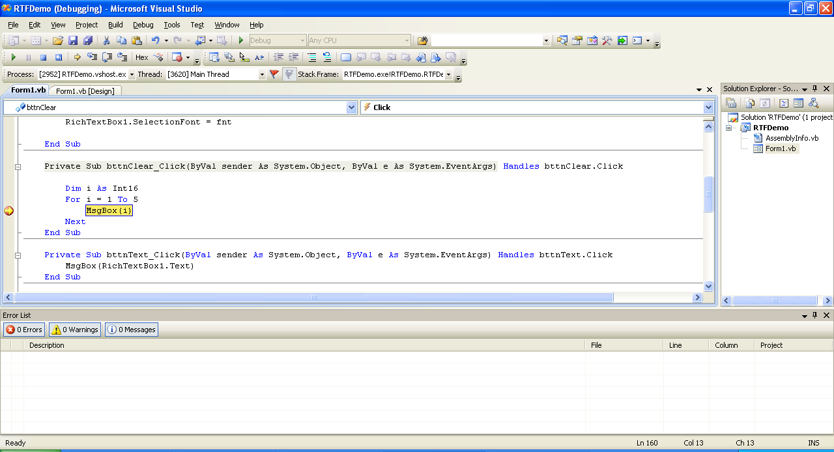
A Breakpoint Created

Slide 5
Stepping Through
Once a breakpoint is created, to make the program step through the current line of code, we need to press the F10 key.
Each time we press F10, one line of code gets executed, and the yellow highlight moves to the next line of code that is about to be executed.
The F11 key (Step Into Option) also steps through the code, but it will step into any procedure that are called. The F10 key (Step Over Option) steps over the procedure calls, running them all at once and returning back to the original spot.

Slide 6
The Local and Watch Windows
While still stopped in debug mode, we can select: Debug > Windows > Locals from the Debug menu.
This window shows the current value of all of the locally declared variables.
To get even more information, highlight a variable, right-click on it and select Add Watch from the Context menu. This will bring up the Watch window.
The Watch window is similar to the Locals window, but it allows one to look at the value of even complex expressions.

Slide 7
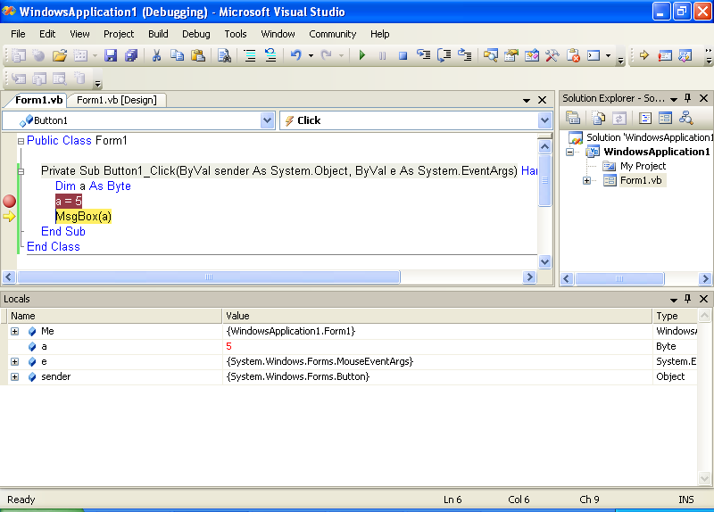
The Local Window

Slide 8
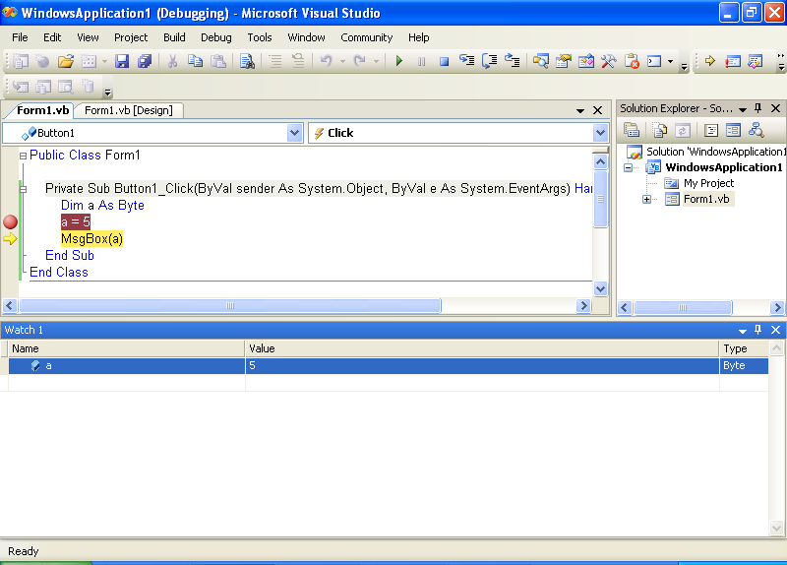
The Watch Window

Slide 9
Error Handling

Slide 10
Type of Errors
The errors caused by a computer program can be categorized into three major groups:
Design-time error
Run- time error
Logic error

Slide 11
Design-Time Error
A design-time error (or, syntax error) occurs when we write a piece of code that does not conform to the rules of the language in which we are writing.
Some syntax errors are simple typographical errors, where we have mistyped a keyword. Others are the result of missing items: undeclared variables, incorrect method call, etc.
A program having design-time errors cannot be compiled and run – we must locate the errors and correct them before continuing.
Any blue-coloured squiggly line represents a design-time error.
To design what the errors are, we need to locate the Task window in the IDE and bring it forward.

Slide 12
Run-Time Error
Run-time errors are harder to locate, because VB.NET does not provide any help in finding run-time errors at design-time.
These errors occur while a program is run.
Examples of run-time errors:
Dividing a number by zero.
Attempting to open a file that does not exist
Entering character data when number is expected.

Slide 13
Logic Error
Logic errors also occur at run-time, when a program does not do what the developer intended it to do.
For example, writing a loop which proceeds to infinity.
Some logic errors may not make not a program crash or produce any type of error message. They simply would not perform as intended.
However, some logic errors may make a program crash, at which point the line between a logic error and a runtime error becomes blurry.

Slide 14
Exceptions
A runtime error in VB.NET generates what is called as an exception. It is a response to the error condition that the program just generated.
Exception handling is an in-built mechanism in .NET framework to detect and handle run time errors. The .NET framework contains lots of standard exceptions.
It is displayed in a dialog box in the form of an exception message.
An error handler is a section of VB.NET code that allows one to detect exceptions and perform the necessary steps to recover from them.
An exception creates an instance of an object, and that object is a descendent of class Exception.

Slide 15
Handling An
Exception

Slide 16
Exception Handling
To handle an exception, we need to use the Try... ...Catch... ...End Try block. This block is a basic exception handler.
The Try...Catch...End Try command can be used as a control structure to handle errors, or exceptions, that might occur in our code at run time.
The Try...Catch...End Try structure begins with the TRY statement, which marks the beginning of the TRY block. In the TRY block, we can specify code that might produce errors at run time.
If our program completes the TRY block without generating an error or exception, then it skips the CATCH block.
Finally, it searches for the FINALLY block near the end of the structure, if it exists, and runs the corresponding statements.
If the FINALLY block does not exist, the program execution continues outside the structure at the first statement following the ENDTRY statement, which marks the end of the Try...Catch...Finally...End Try structure.

Slide 17
Private Sub Button1_click (………………) Handles Button1_click
Dim n as Byte
Try ' Statement which can cause an exception
n = text1.text
Catch ' Statements for handling the exception Msgbox(“Sorry – Enter a valid value”)
End Try
End Sub
If any incorrect input is given by the user (e.g. 32767), the error message in a message box is displayed.

Slide 18
Private Sub Button1_click (………………) Handles Button1_click
Dim n as Byte
Try
n = text1.text
Catch ex As Exception ‘Catching Any Exception
Msgbox(ex.Message)
End Try
End Sub
In this example, the exception generates an instance of the Exception class and places that instance in a variable ex.
If any incorrect input is given by the user, the exception message in a message box is displayed.
For example, if input taken is 32767, the exception message displayed is “Arithmetic operation resulted in an overflow”

Slide 19
Other Examples: Catching a Specific Exception
Dim a, b, c As Int16
Try
a = 32767
b = 1
c = a + b
Catch ex As System.ArithmeticException
MsgBox(“Error")
End Try
Dim a, c As Int16
Try
a = 3
c = a / 0
Catch ex As System.OverflowException
MsgBox("error")
End Try

Slide 20
Some Important System Exceptions
Some System Exceptions generated are:
System.OutOfMemoryException
System.NullReferenceException
System.InvalidCastException
System.ArrayTypeMismatchException
System.IndexOutOfRangeException
System.ArithmeticException
System.DevideByZeroException
System.OverFlowException

Slide 21
Summary
Try Statements
Optional. Statement(s) where an error can occur. Can be a compound statement.
Catch
Optional. Multiple Catch blocks permitted. If an exception occurs while processing the Try block, each Catch statement is examined in textual order to determine if it handles the exception, with exception representing the exception that has been thrown.
Finally
Optional. A Finally block is always executed when execution leaves any part of the Try statement.

Slide 22
Multiple Catch Blocks
Private Sub Button1_click (………………) Handles Button1_click
Dim n, ans As Byte
Try
n = Text1.Text
ans = 2 / n
Catch ex As System.OverflowException
MsgBox("Please Enter a Number other than Zero")
Catch ex As Exception
MsgBox(ex.Message)
End Try
End Sub
We can also write exception handlers that handle different classes of errors. In the above example, if the number 0 is taken as input, the overflow exception occurs and the error message displayed is “Please Enter a Number other than Zero". But, if we enter a string, the exception message shown is: “Conversion from string “as” to type ‘Byte’ is not valid”.

Slide 23
The Use of Finally Block
Private Sub Button1_Click(………………………… ) Handles Button1.Click
Dim n, ans As Byte
Try
n = Text1.Text
ans = 2 / n
MsgBox("Thank You")
Catch ex As System.OverflowException
MsgBox("Please Enter a Number other than Zero")
Catch ex As Exception
MsgBox(ex.Message)
End Try
End Sub
In the above example, if an error occurs, the message “Thank You” will not be displayed. If you want to show this message even if an error occurs, we can place it in the Finally block as shown next.

Slide 24
Private Sub Button1_Click(………………………… ) Handles Button1.Click
Dim n, ans As Byte
Try
n = Text1.Text
ans = 2 / n
Catch ex As System.OverflowException
MsgBox("Please Enter a Number other than Zero")
Catch ex As Exception
MsgBox(ex.Message)
Finally
MsgBox("Thank You")
End Try
End Sub

Slide 25
Throwing One’s Own Exception
We can even throw our own exceptions. The 'throw' keyword is used for this purpose.
For example, if age is taken as an input, an invalid value such as 1500 should generate an error.
The best way to handle this problem is by sending an exception. For this, an exception handler can be written on our own in the program code. This is referred to as “throwing an exception”.

Slide 26
An Example
Dim age As Integer
age = TextBox1.text
If age > 130 Then
Throw New Exception("Age cannot be greater than 130")
Else
MsgBox("Your age = " & age)
End If

Slide 27
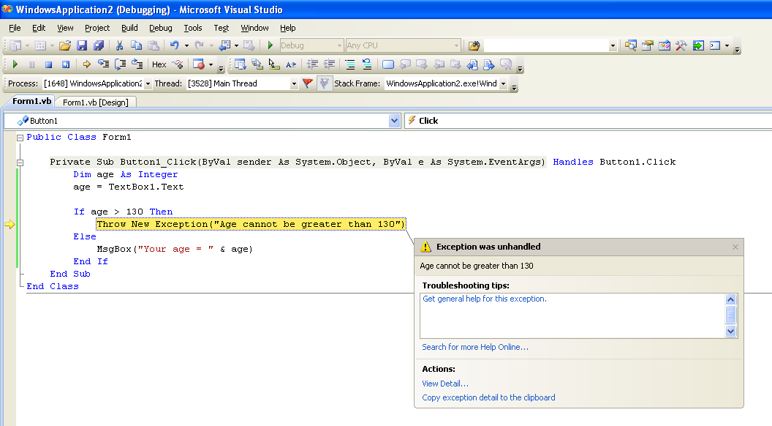
An Example

Slide 28
