Slide 1


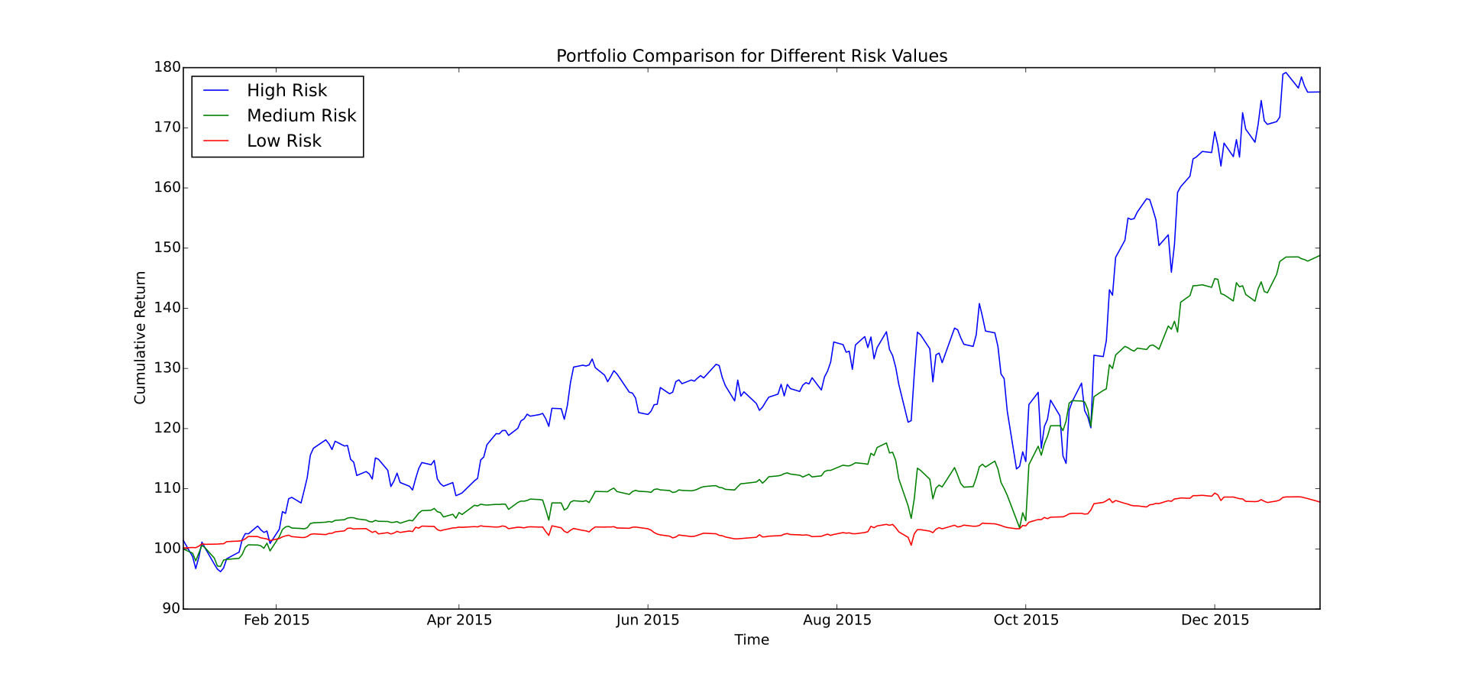


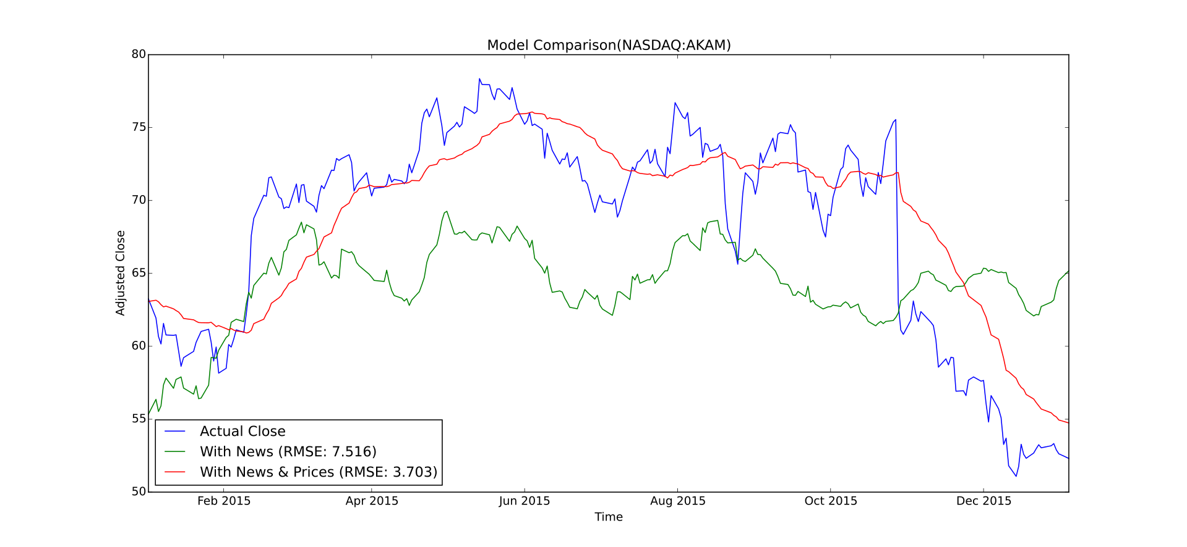






SmartStocks : Stock Price Prediction using Financial News
Jivjot Singh Bikramdeep Singh Manpreet Singh
Objectives
Methodology
Results
Understand relationship and predict the movement of stock prices in the market based on financial news
Create a portfolio for recommending best investment options to users
Create an interactive web and mobile application for the user and visualize the results
Data Cleaning
Converted raw news data from XML to JSON format
Feature
Extraction
Converted news data to word2vec feature vectors
Model
Training
Used linear regression to predict future stock prices and direction
Trained model using only the news data
Trained model using news and historical stock market data
Pruned HTML and CSS tags
Filtered out special characters such as foreign languages and symbols
Calculated stock price movement direction using historical data
Stock price window created in accordance with trading days
Removal of stopwords and punctuations
Portfolio
Creation
Created portfolio for recommending best stocks to the user
Portfolio takes into account risk factor and expected return
Recommending multiple stocks investment options to the user
Tools and Technologies
Visualizations of stock prices for different models
Interactive Stock prediction of top 100 traded companies listed on NASDAQ
SmartStocks web and mobile app portfolio where user can get recommendations for investment
Learnings
There is a direct relationship between financial news and stock prices
Some stock prices are more sensitive to news than others
Better results are achieved by combining historical stock prices with news data
Notes:
You can add your presentation notes here. This presentation template for research posters is fully editable so text, graphics and content can be updated to fit your own research needs.
Download more poster presentation templates from FPPT.com

