Slide 1
IST 565 FINAL PROJECT
Romill Shroff
Wei Mu
Aditya B Patnaik

Slide 2
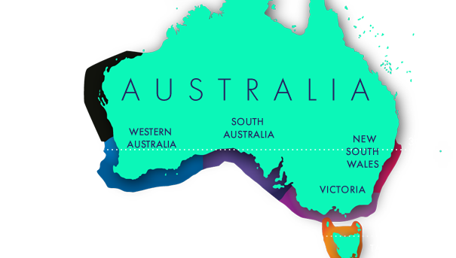
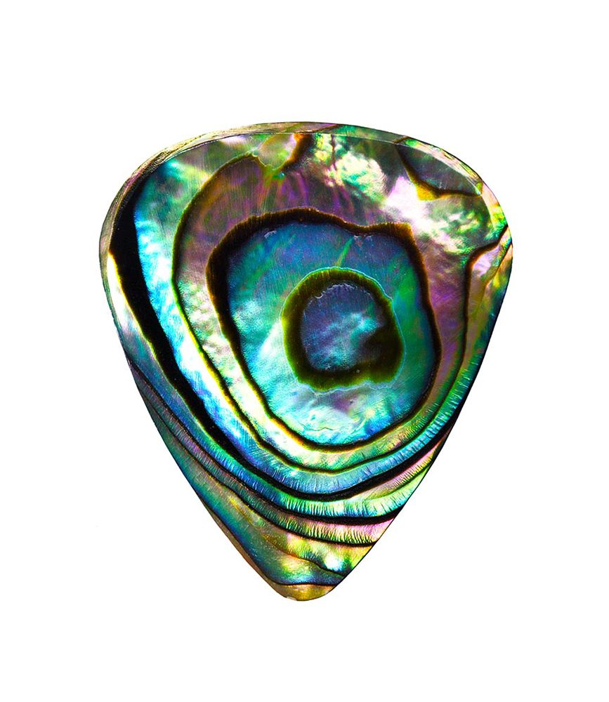
Goal: To predict the age of abalone (marine creature) based on its physical features

Slide 3
DATA SOURCE
UCI Machine Learning Repository. The dataset comes from an original study - "The Population Biology of Abalone (Haliotis species) in Tasmania. I. Blacklip Abalone (_H. rubra_) from the North Coast and Islands of Bass Strait", Sea Fisheries Division, Technical Report No. 48 (ISSN 1034-3288).

Slide 4
Metadata

Slide 5
STEPS OF OPERATION
Data preprocessing
Descriptive Analysis
Dividing dataset into training and testing
Fitting ML algorithms to the dataset
Compute accuracy
Compare algorithm performance

Slide 6
Data Preprocessing
No missing values
Scaled observations
Removing sex column
Discretizing the rings attribute into age with two levels- young and old

Slide 7
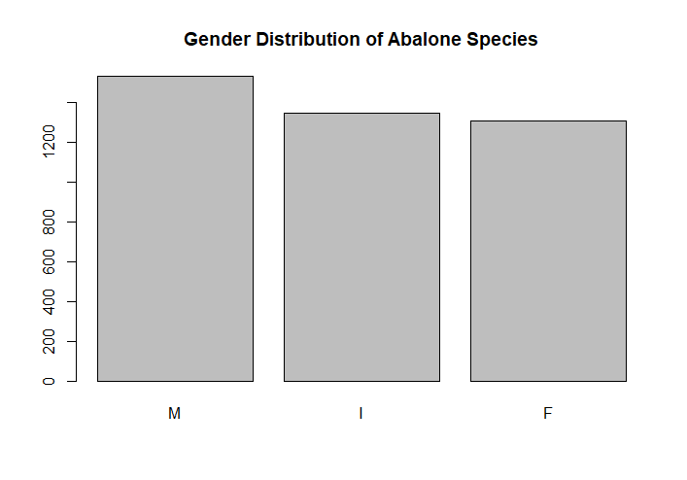
Gender Distribution

Slide 8
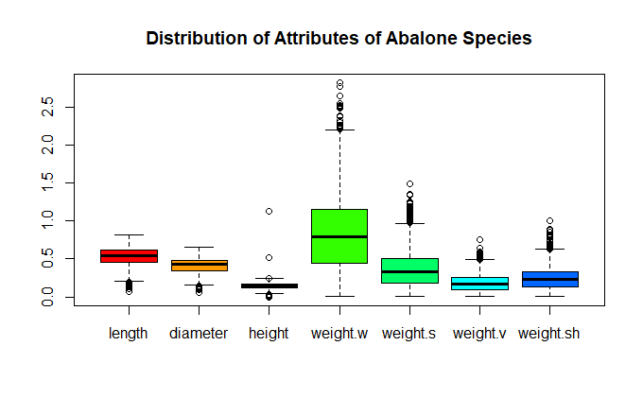
Box plot of attributes

Slide 9
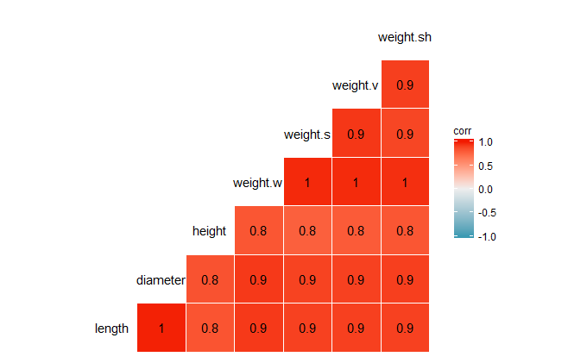
Correlation plot for attributes

Slide 10
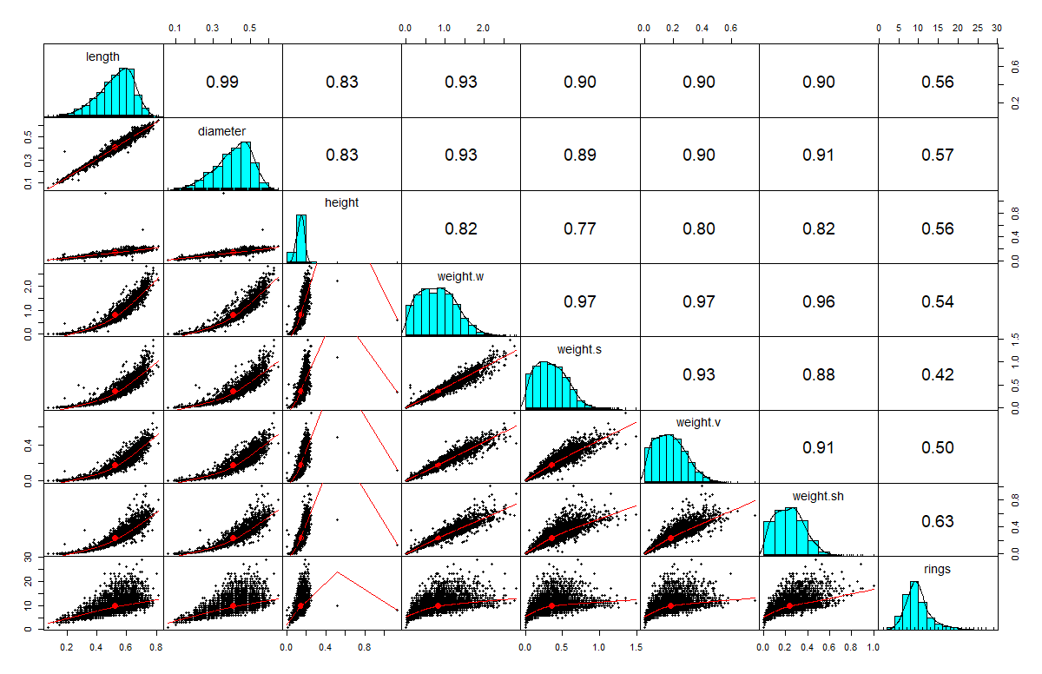
Distribution of attributes

Slide 11
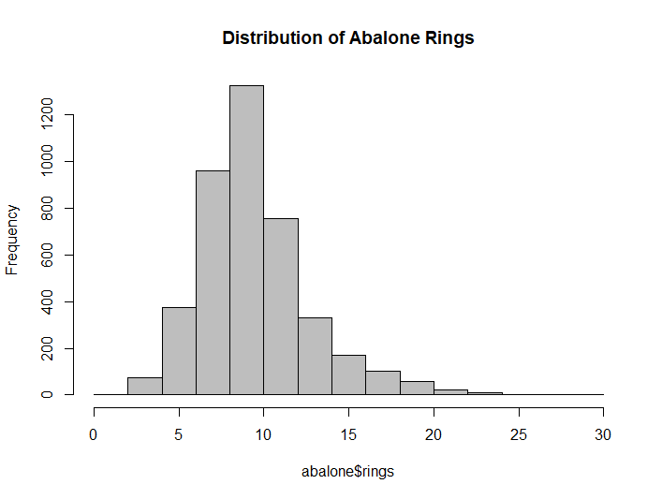
Histogram for abalone rings

Slide 12
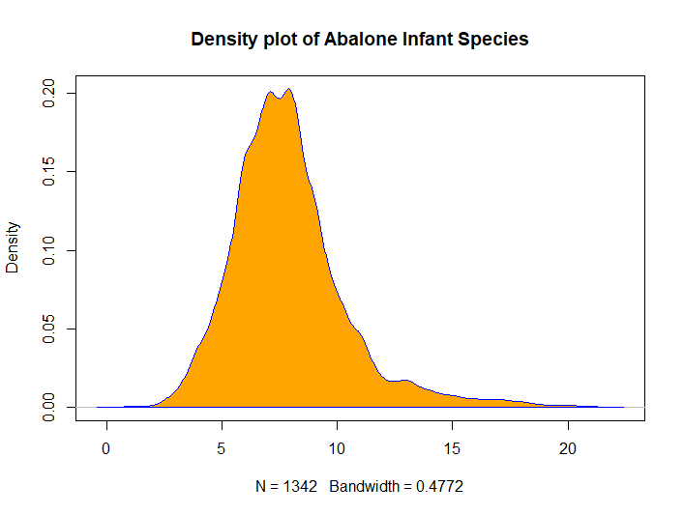
Abalone infant distribution

Slide 13
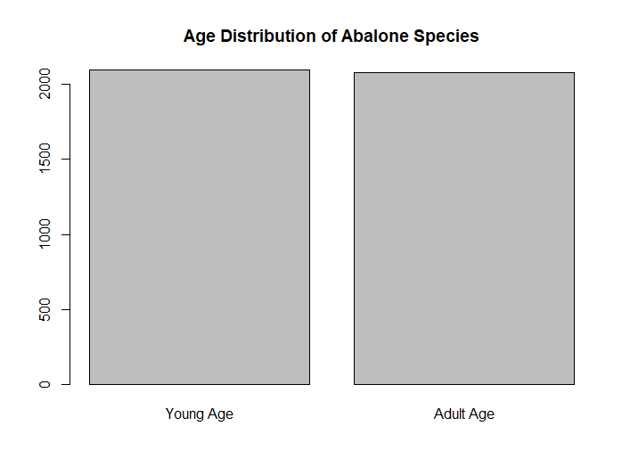
Class (label) distribution

Slide 14
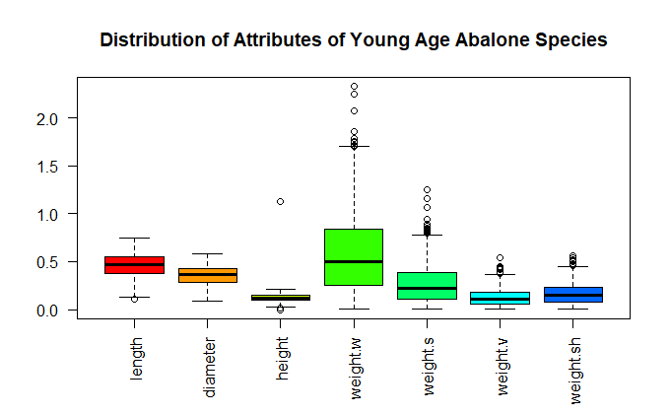
Distribution of attributes for young aged abalone

Slide 15
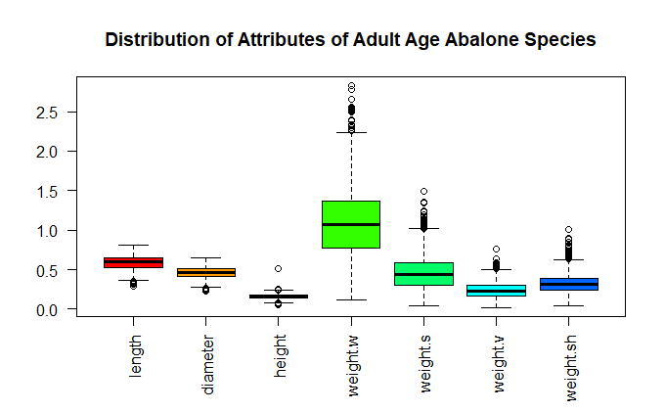
Distribution of attributes for adult aged abalone

Slide 16
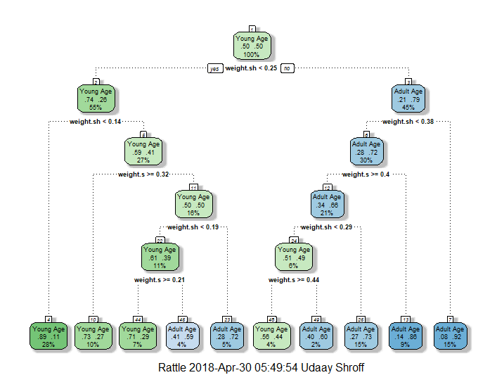
Decision Tree to Predict age

Slide 17
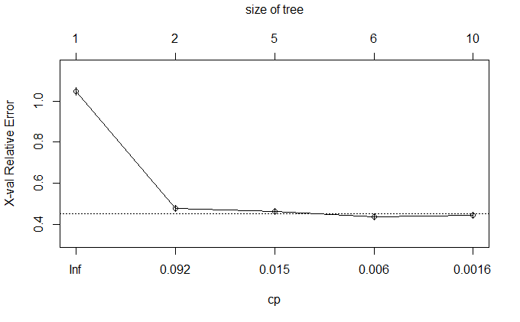
Cost of 0.092 minimizes error

Slide 18
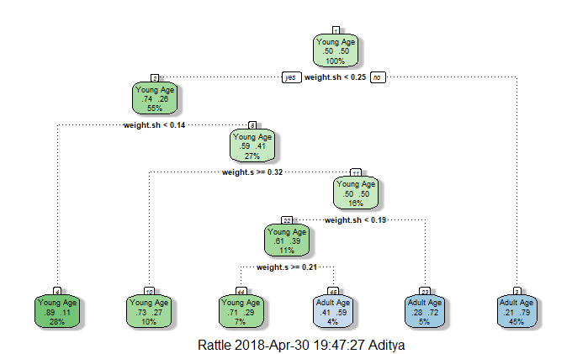
Pruned Decision Tree

Slide 19
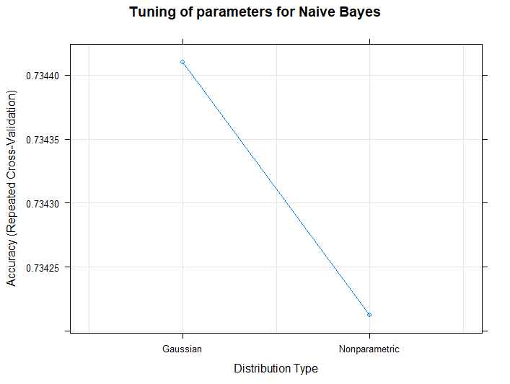
Accuracy for Gaussian vs Non parametric for Naïve Bayes

Slide 20
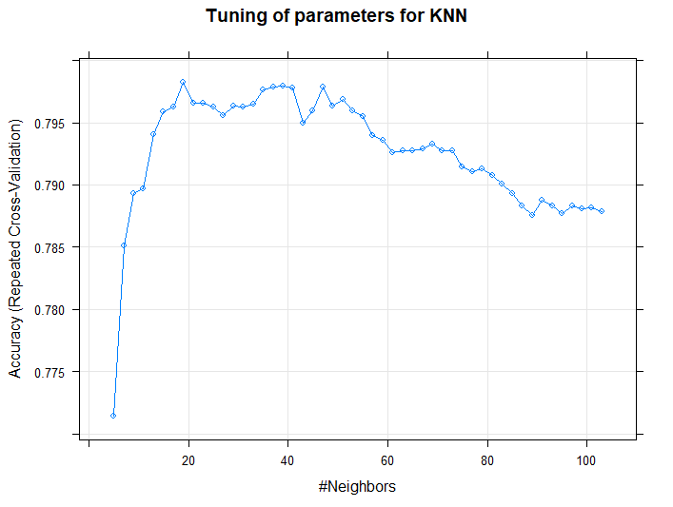
Determining number of neighbors for KNN

Slide 21
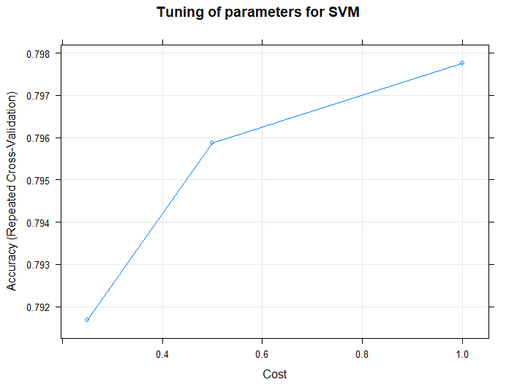
Determining optimal cost for SVM

Slide 22
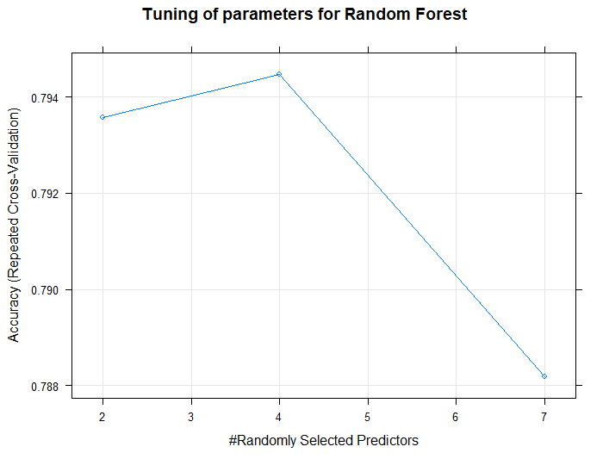
Finding optimal number of predictors for random forest

Slide 23
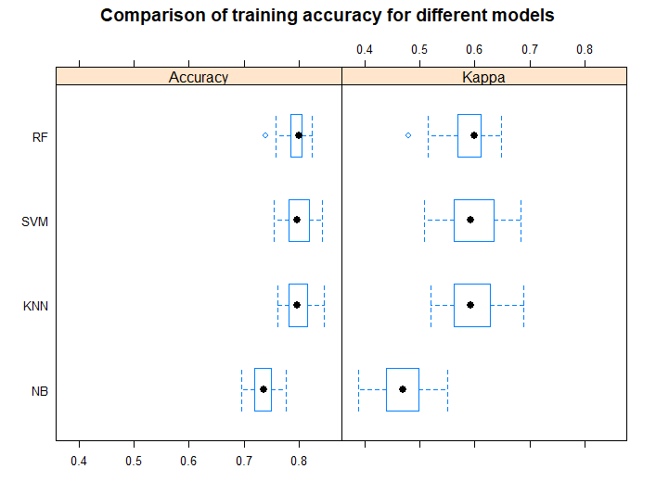
Algorithm performance on training data

Slide 24
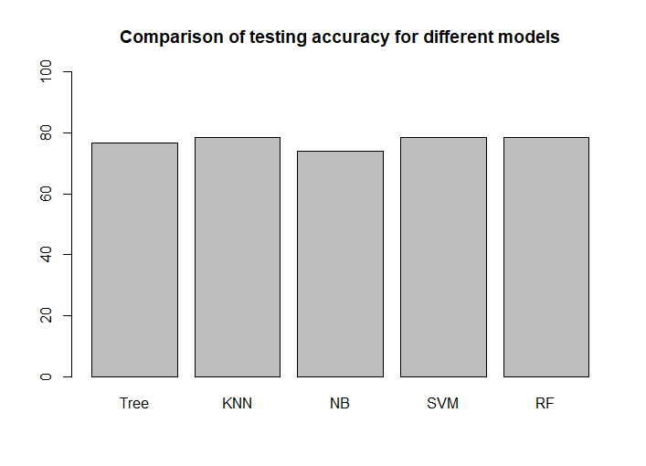
Algorithm performance on test data

