Slide 1
Environmental data on demand
ReportNet next challenge
Jan Bliki, Peter Kjeld
(Discussed with Bernt,Sheila,Tim)
Notes:
Bring ReportNet to the next level of reporting.
The idea of how reporting is performed is revolutionary in this demonstration.
It will require a very different look on reporting from existing data providers and data receivers.
What is important is that there is a believe that existing infrastructures could be converted failry easily and cost effective.
Existing flows can keep running until replaced or proven to function.

Slide 2
Some terms to understand
EEIS : Shared European Environment Information System. (Central hosting at EEA ,used by many)
ReportNet : Practical implementation of an information infrastructure through an application suite.
SEIS : Shared Environmental Information System. (National, Regional and International implementations.)
ReportNet : EEA’s implementation of SEIS?
Notes:
It’s important that we put the terms right as those terms will be used several times in the presentation. ReportNet is sometimes seen as EEA network of common tools and sometimes seen as the technological implementations. It’s important to understand that those are different. I therefore will use ReportNet for the technological implementations. ReportNet aim is going beyond the current existing tools EEA has to it’s community.

Slide 3
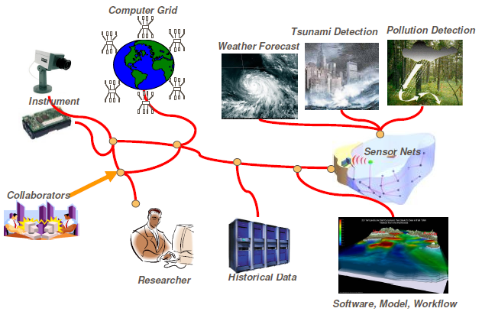
Modern networks
Source : http://www.buyya.com/papers/SensorWebChapter.pdf

Slide 4
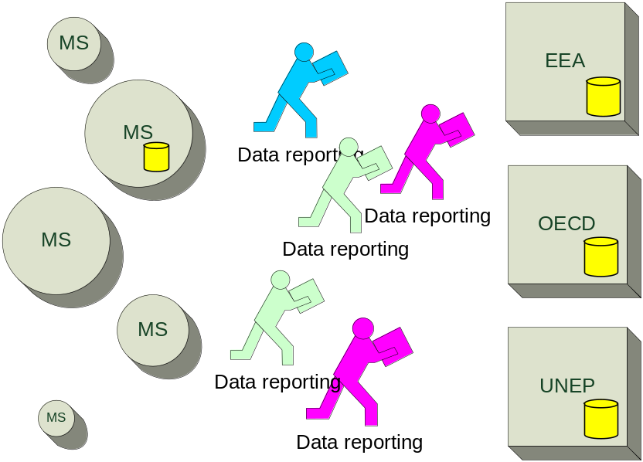
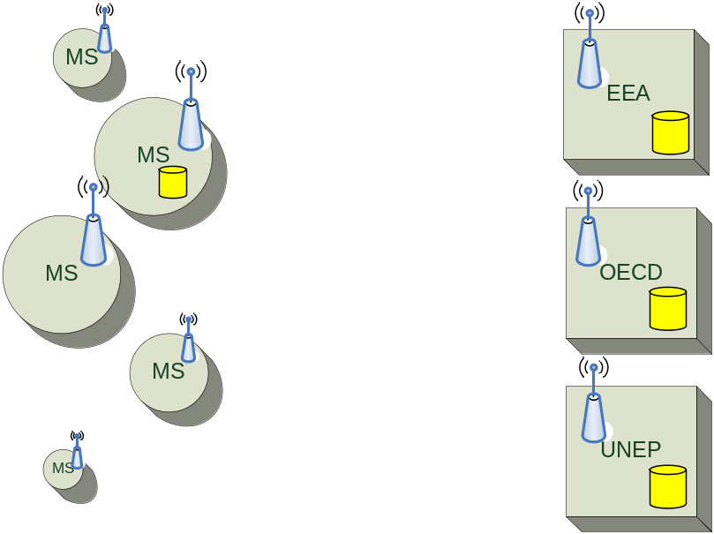

From Reporting to Online Services
The current data flows
Near real time Information Systems
Member states
Organisations
Member states
Organisations
Notes:
What we will learn is that ReportNet is developed to hold packages of data that are rather small and have a typical frequency of once a year. (See Technical paper 2002 Development of common tools and an information infrastructure for the shared European Environment Information System).
ReportNet has been successfull in sharing the same content packages for those organisations needing the same datasets aldo it has shown that it is difficult to harmonize all needs of all international organisations into one data package and make all use that same infrastructure.
ReportNet design is not supporting online services, large flows and has not the capacity needed to produce insitu monitoring services for GMES developments. ReportNet has also problems to streamlining the current reporting obligations that should remove redundancies and duplications. ReportNet has no tools for accomadating those streamlining. It is also not a technical problem.
Those are all demands that are growing in the last couple of years.
If we want to go beyond those limitations we need to step away from the ’packaging’-approach data providers need to produce for every singly receiver. However not ALL flows would be able to be moved what means that ReportNet infrastructure will be one of the infrastructures that should stay existing for ever.

Slide 5
What we NOT try to do
Not one solution for ALL flows.
To develop one central storage place.
Developing tools for others to use.
Use local sensors in the countries.
Push any software platform.
Not EEA only driven.
Notes:
It’s important that we put the terms right as those terms will be used several times in the presentation. ReportNet is sometimes seen as EEA network of common tools and sometimes seen as the technological implementations. It’s important to understand that those are different. I therefore will use ReportNet for the technological implementations. ReportNet aim is going beyond the current existing tools EEA has to it’s community.

Slide 6
What we try to do
Focus to our own need without limitation to be used or implemented by other.
One solution for near real time data flows.
One common communication concept for all thematic areas.
Level independent. (very detailed level to aggrigated level use the same methods)
Encurage industry support (Industry driven)

Slide 7
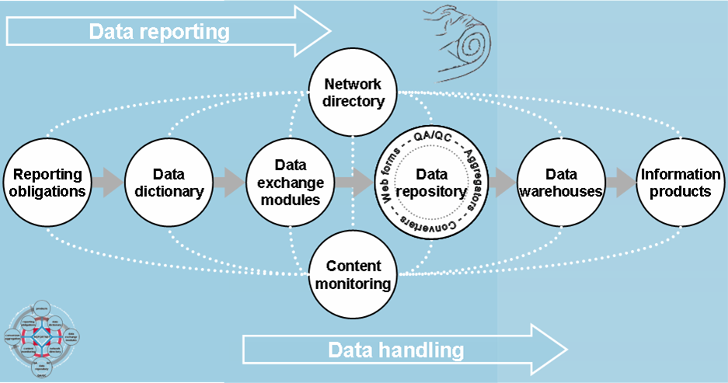

Reportnet 2009
Notes:
The first steps are taken, ReportNet (ReportNet infrastructure today) is packaging the results...
SWE implementation in this technology would be hard and wrong. But all other reporting elements could be

Slide 8
State of the art data package delivery system
Data receiver
Preparing an obligation
Data provider
Preparing package
Data receiver
Preparing EU dataset
?
+
+
=
Define data structure
Define agrigation level
Define method
Define formats
Define time coverage
Collect data
Aggrigate data
Re-structure to receiver needs
Add requested time coverage
Deliver dataset.
QA/QC result
Combine deliveries
EU QA/QC
Produce outputs
Harmonize
One to five years
Once a year
Six months
Notes:
Because of the long implementation time (2-5 years) international organisations have the tendency to do ”over shopping”, we only have one shot better ask as much we can.
Once the receiver has defined the rules, providers need to implement and adjust there systems to accomodate those requirements. Asking providers to produce receivers exact format is costly and slow.
Packaging on provider level is what we should try to avoid. EEA is calling this ’tightly coupled’ data flows.
Once all packages have been received, international levels are having the downting task to join those back together. Depending on the quality of the obligation this might be easy or difficult.
Quality asurance is at all levels and very complex to manage.

Slide 9
RDFa Primer

Slide 10
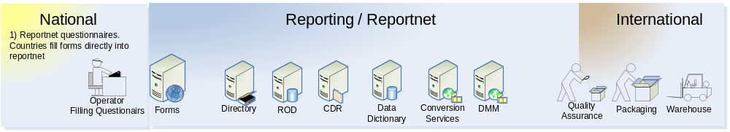
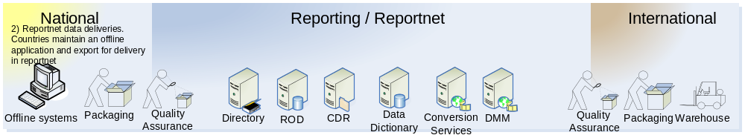
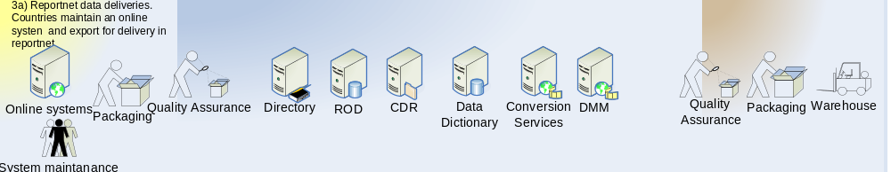
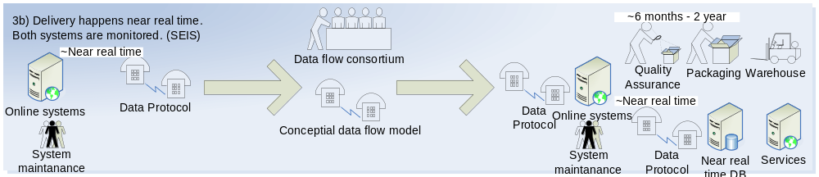
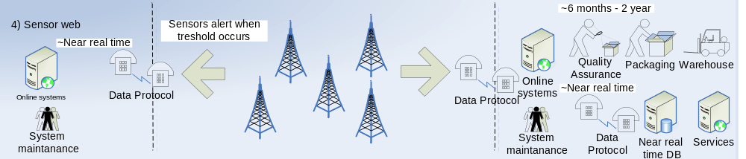
Evolution of EEA’s data/information flows
Questionairs
60%
Standalone systems
30%
10%
Near real time systems
Notes:
Legal transposition (Small, only once, ReportNet,ROD)
Details of Member States national laws enactine EU legislation
Practical compliance (Candidate aldo politics will need time to find ways of good control for possible mistakes)
Data on exceedances of environmental standards, limit values, national derogations,etc...
Environmental data (Big candidate,Also the heaviest one)
Data on environmental pressures and state of the environment
Decriptions of policy measures (Questionairs, keep reportnet)
Plans programmes and instruments put in place by Member states to comply with EU legislations.
Policy effects and effectiveness (Questionairs, keep reportnet, maybe outcomes of 3 might proof some effectivness)
The effect of these measures and the extend to witch they acheive their objectives

Slide 11
Our aims and gains
Faster delivery!
Easier to change!
Only what we need!
Cheaper!
More control by provider and receiver.
More receivers!
Reduce the reporting fatigue!

Slide 12

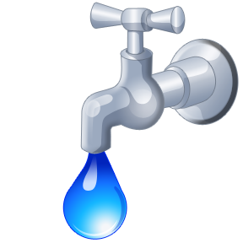


Sensor Web Enabled data flow
Data provider
Data receiver
Data receiver
Notes:
What we should learn here is that data packaging on a provider level is the real cost generator. It is also the cause of ’over shopping’ as the time to get everybody alligned is time consuming.
(What format to deliver in?, what structure?, where to store it?...)
We are basicaly to ”tightly coupled” when it comes to data providing.
Another appoach could be to remove the entire data packaging and generate tigny drops of information that could be captured by the receiver and build up into there own agreed data strucutre.
This would generate a ’loosely coupled’ relation as anybody would be able to receive the same drops in exactly the same format and process but could capture those into there own data structure the receiver can decide it’s own complexity depending in there needs required.

Slide 13
Sensor Web Enabled data flow
Single drop of information
One stream
of information
(NOx,Co2,Pm10)
Higest allowed detail
One place in space
One moment in time
Notes:
Imagine that data providers only focus on the absolute higest allowed detail of information.
That these data provider can decide at what level this information is channeld. (Examples: Directly from the station, QA/QC’s by the provider, pre-processed by the provider).
A Data provider can keep control of that information at any time by the possibility of re-sending detailed information at any time.
Image that Data receivers can decide what information is usefull to them and what they need at that moment in time.
Receivers can experiment with more/less detailed without the need of constandly asking data providers willingness to change.
Can provide results to data providers while negotiation process are ongoing.
We could achieve this when data can be flown in as single drops of information. This drop’s of information are compiled together to produce the desired packaging required on the receiver side. In order to make this work, drops of information need to be small and specifique. One drop might should only focus on one place and for one moment in time and for a small number of values. Those drops should contain all the nececary metadata to explain it’s original and content. The receivers can then recompile a desired package (result).
We call this ’loosely coupled’

Slide 14
Sensor Web Enabled data flow
Subscribing to a data provider
Grant access rights
To the receiver.
Define a
moment in time.
Define drops
of information to your
interest.
Notes:
The infrastructure to produce and receive these drops needs to be one single concept that can be used for any type of flow. A data provider should only have to grant access rights for a data receiver to one or more channels of data drops.
The receiver would then be able to login and configure the rules of what,when and under what conditions drops should be send to them.

Slide 15
Sensor Web Enabled data flow
Data receiver responsibility
Define a
data structure
Define
time coverage
Define methology
to agrigated data
Perform Quality Asurance

Slide 16


Sensor Web Enabled data flow
Data provider
Data receiver
Data receiver
Data receiver
Notes:
What we should learn here is that data packaging on a provider level is the real cost generator. It is also the cause of ’over shopping’ as the time to get everybody alligned is time consuming.
(What format to deliver in?, what structure?, where to store it?...)
We are basicaly to ”tightly coupled” when it comes to data providing.
Another appoach could be to remove the entire data packaging and generate tigny drops of information that could be captured by the receiver and build up into there own agreed data strucutre.
This would generate a ’loosely coupled’ relation as anybody would be able to receive the same drops in exactly the same format and process but could capture those into there own data structure the receiver can decide it’s own complexity depending in there needs required.

Slide 17






Using OGC
OGC Project
(Implementing SWE)
EEA
EPA
National
National
FP7-project

Slide 18
Interoperability pyramid
Applications
Receiver
respsonible
Select generic receiver(s)
(SWE enabled databases,
SWE enabled Object Oriented Systems)
Adopt generic services from Open Standards
(SWE-suite of OGC)
motivate
Industrie
Use Network infrastructure (Internet)
(TCP/IP)

Slide 19
Project goals
Near real time flow demonstration project.
Obstacle identification for redesign of existing near real time flows.
Establish of cooperation between national state authorities, and with departments inside the authorties.
Evaluate maturity of the technology
Engage the industry & Open Source comm.
Introduce SWE into existing infrastructures.
Security issues
Quality issues.

Slide 20
Open questions
How to sell this as a ReportNet solution?
How does Søren’s RDF story fits in to this?
SEIS , INSPIRE? How do we best map those two inside the paper?
How can we work with OGC resources?
  Who can take a lead on this?
Who should take the lead where?
  Political awareness ?
  EEA internal project steering?
  Technical followup OSE3.
  OGC and other international cooperation???
DC, How to fit data centres? If needed...

