Slide 1
PDC Final Project
April 20, 2025
Submitted To: Sir. Aadil ur rehman

Slide 2
Group Information
Muhammad Daniyal Aziz – 22i-0753
Muhammad Bilal Khawar – 22i-0786
Haleema Tahir Malik – 22i-0937

Slide 3
Report # 02
A parallel social behavior-based algorithm for the identification of influential users in a social network

Slide 4
Influence Maximization
Current social media networks have billions of nodes, each having its unique characteristics and influence.
Influence Maximisation is the process in which we extract k nodes that offer us the most interaction or product adoption.
In this report, we will look into a model called “PSAIIM” to calculate influence; it utilizes two variables:
User Interest
Dynamically Weighted Social Interactions
Influence Maximisation is used in fields like digital marketing, tracking news, political movements and epidemic outbreaks.

Slide 5
Problem at hand?
Each social media network consists of billions of nodes. If we compute the influence power of each node and its effects on neighboring nodes, it will take much computational power using traditional IM models.

Slide 6
Solution
taking advantage of parallelized architecture and algorithms that allow us to divide and conquer tasks.
Instead of computing whole networks, we divide the network into strongly knit communities.

Slide 7
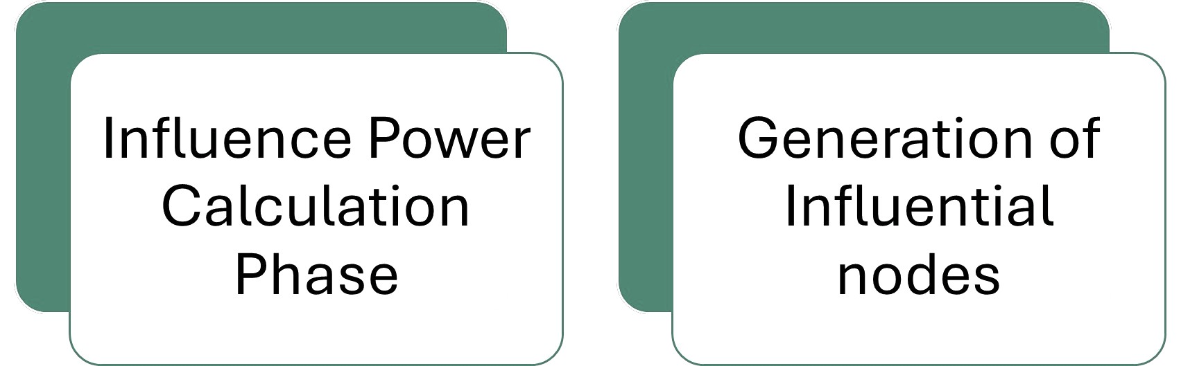
Let’s talk about PSAIIM

Slide 8
Key characteristics of PSAIIM
Social Behavior:
user interests + user interactive behavior
Influence-BFS Tree:
Only queue those nodes with higher influence power than the threshold power
Two-Criterion Model:
Semantics aware b/w nodes + structure of neighbor nodes

Slide 9
Key characteristics of PSAIIM
Parallelizing
Parallelize all communities on the same level
Graph Partitioning
Partition the graph into strongly connected communities and connected acyclic communities
Page Rank
Ranks nodes in a network based on the quantity and quality of their incoming links, measuring their relative importance.

Slide 10
Algorithms & Datasets
Algorithms Compared
Key comparisons include:
SAIM (serial version of their model)
Parallel (GPU-based from Xiao et al.)
FBI (interest-based PageRank)
LP (Monte Carlo + linear programming)
MLIM (likelihood-based)
Coreness (heuristic using k-shell)
Four real-world datasets:
Tencent Weibo – huge social network from China
Higgs Twitter – tweets around the Higgs boson discovery
Twitter – standard ego-Twitter dataset
p2p-Gnutella4 – peer-to-peer file-sharing network

Slide 11
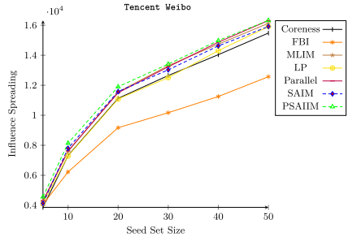
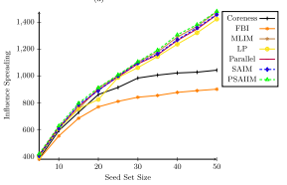
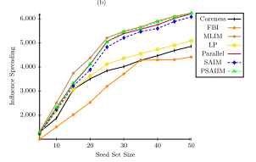
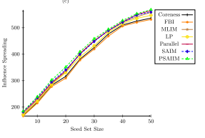
Influence Spread for each Algorithm

Slide 12
Influence Spread for each Algorithm
On Tencent Weibo: PSAIIM outperforms everyone, reaching 88% influence spread vs 86% (Parallel) and 76% (MLIM)
Generally outperforms others, especially on semantically rich datasets like Tencent and Higgs Twitter
Slightly worse on Twitter and p2p-Gnutella4 due to lack of semantic info (interests were random there)

Slide 13
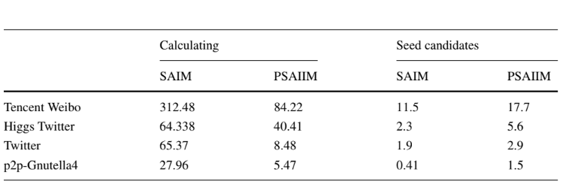
Time Taken

Slide 14
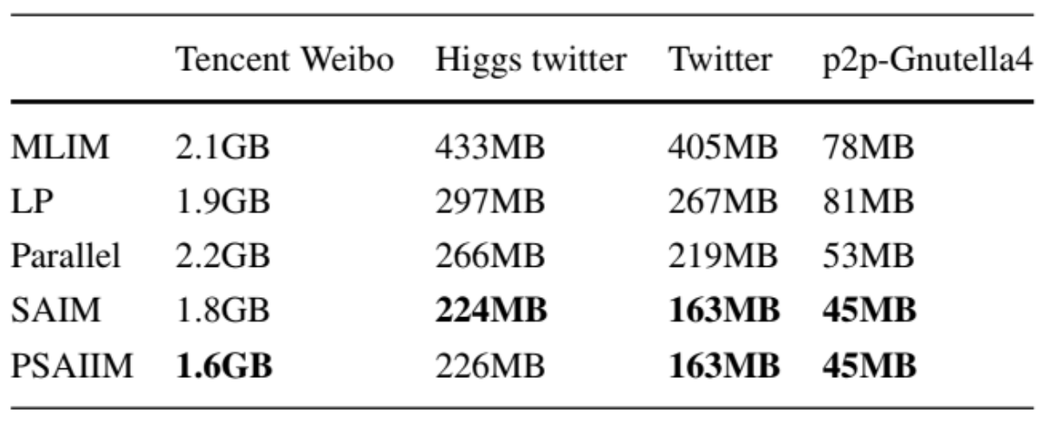
Memory Usage

Slide 15
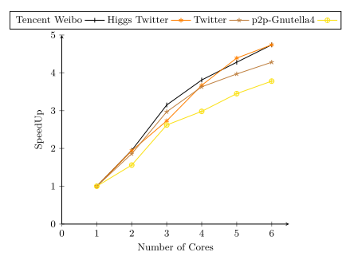
Speedup w.r.t Number of Cores

Slide 16
PSAIIM: A Parallel Framework for Influence Maximization
Two-stage parallel framework designed to address the influence maximization problem efficiently
Stage 1: Utilizes SCC-CAC partitioning to divide the graph into communities, prune less influential nodes, and select strong candidate nodes
Stage 2: Incorporates semantic social behavior through user interests and dynamically-weighted social actions
Introduces the concept of the Influence-BFS Tree to select seed nodes that ensure rapid information spread
Performance Evaluation: Demonstrates significant improvements in influence spread, runtime, and memory efficiency compared to state-of-the-art methods
Future Work:
Extend PSAIIM to dynamic networks with evolving communities and actions
Generalize the pruning framework for Group Influence Maximization (GIM) in large-scale social networks

Slide 17
OUR SOLUTION for “A parallel social behavior-based algorithm for the identification of influential users in a social network”

Slide 18
Step 1: Input and Graph Preparation
Dataset: Higgs Twitter Dataset from SNAP
Contains 4 types of user interaction graphs:
Follow Graph (social connections)
Retweet Graph (content propagation)
Mention Graph (engagement)
Reply Graph (conversations)
Each stored in a separate .edgelist file
We construct 4 separate graphs to capture interaction-specific influence dynamics

Slide 19
Step 2 – Graph Partitioning with METIS
Each interaction type (Follow, Retweet, Mention, Reply) creates a separate graph
METIS partitions each graph individually into k balanced subgraphs
Each partition reflects a community structure within that interaction type
Ensures minimal cross-partition edges and balanced workload per process
Output: mapping of each node to its partition for each graph type

Slide 20
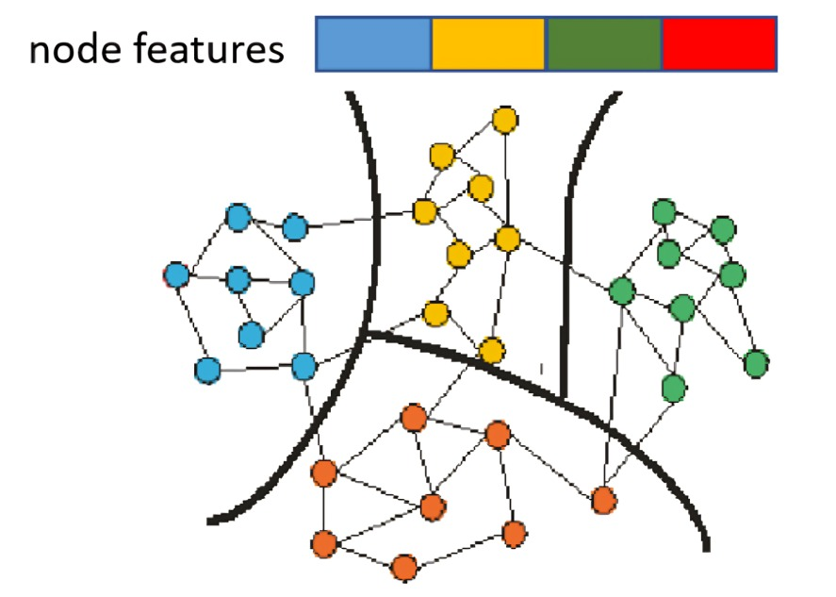
4 small graphs (one per interaction), each color-coded by partition

Slide 21
Step 3 – Distributing Work with MPI
Each MPI rank is assigned one or more partitions per graph
Each process:
Loads its subgraph for all interaction types
Computes influence scores separately for each graph
MPI enables distributed memory processing for large graphs
Each graph is treated independently across processes

Slide 22
Step 4 - Influence Scoring with OpenMP
Inside each MPI process:
Use OpenMP to compute influence scores in parallel per node
Run this in each graph layer separately
Influence Score = Σ (Interaction Weight × Jaccard Similarity with neighbors)
Jaccard Similarity = shared interests / union of interests
Final score can be combined from different graphs (weighted average or union)

Slide 23
Step 5 – Influence Tree & Seed Node Selection
Build BFS trees in each graph layer from top influencers
Option 1: Select top-k from each graph separately
Option 2: Merge all scores and trees for global selection
Filter overlapping trees to ensure maximum non-redundant spread
Final output: top-k users with highest aggregated reach

Slide 24
Step 6 – Final Aggregation (MPI Rank 0)
Each rank computes local top-k users for each graph
Sends them to Rank 0 via MPI.gather()
Rank 0:
Merges results across graphs
Applies weighted combination logic (e.g., 0.5×Retweet + 0.3×Mention)
Picks global top-k seed users

Slide 25
Step 7 – Testing & Visualization
Evaluated separately on:
Follow Graph
Retweet Graph
Mention Graph
Reply Graph
Metrics Analyzed:
Influence Spread (% nodes reached)
Execution Time (sequential vs MPI+OpenMP)
Speedup per graph type
Tools: Matplotlib (Python)

Slide 26
Step 8 - Our Hybrid Parallel Strategy (4 Graphs)
MPI: distributes partitions for each graph layer
OpenMP: scores nodes in parallel within each layer
We parallelized:
Across interaction types
Across nodes
Benefits:
Scalability even with multiple interaction dimensions
Efficient memory & computation per graph

Slide 27
Conclusion
Handled multi-layer influence modeling with 4 interaction graphs
Computed influence separately and/or combined via scores
Hybrid parallelism (MPI + OpenMP) gave strong scalability
Real-world data (Higgs Twitter) validated model performance

